Slide 1


Slide 2
Fabricatable machines
Open informal research project – anyone can use and contribute
Lives on github.com/Fabricatable-Machines

Slide 3
Goals
Enable people to make and play around with custom digital fabrication machines
Focus on making as many parts of a machine as possible

Slide 4
Whats is "Fabricatable"?
Accesable techniques
Simple and accesable BOM
Focus on DIY over sourcing parts
Complexity in CAD, simplicity in manufacturing and assembling
Open source (files and toolchain)

Slide 5
Fabricatable business
Gentleman agreements with royalties
Direct sales
https://www.patreon.com/jensdyvik

Slide 6
Lessons learned
DIY rails is mostly suitable for small light duty machines
Segmented rails are tricky
"CNC friendly rack and pinion" works well
Gearing is still needed for stiff machines
HPL sheets work well
Alu extrusions + FDM is more accesible than large format machining

Slide 7
Modules-Axes-Machines
https://github.com/fellesverkstedet/fabricatable-machines/wiki/Modules

Slide 8
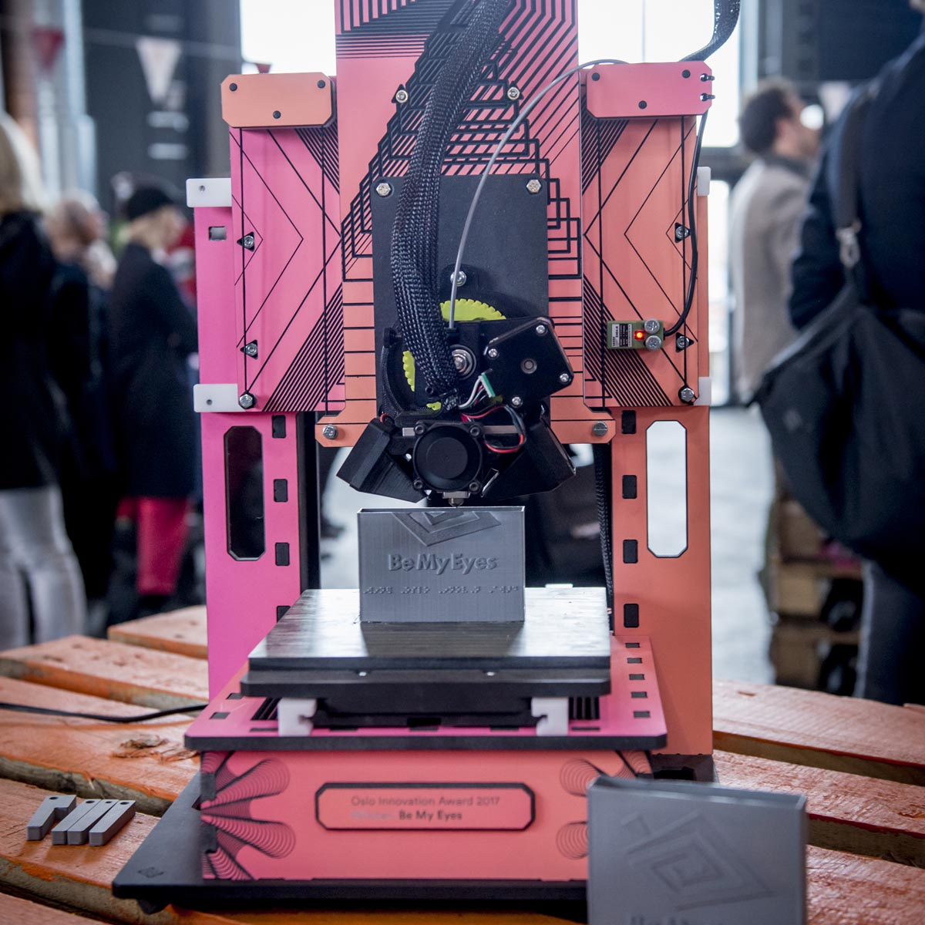
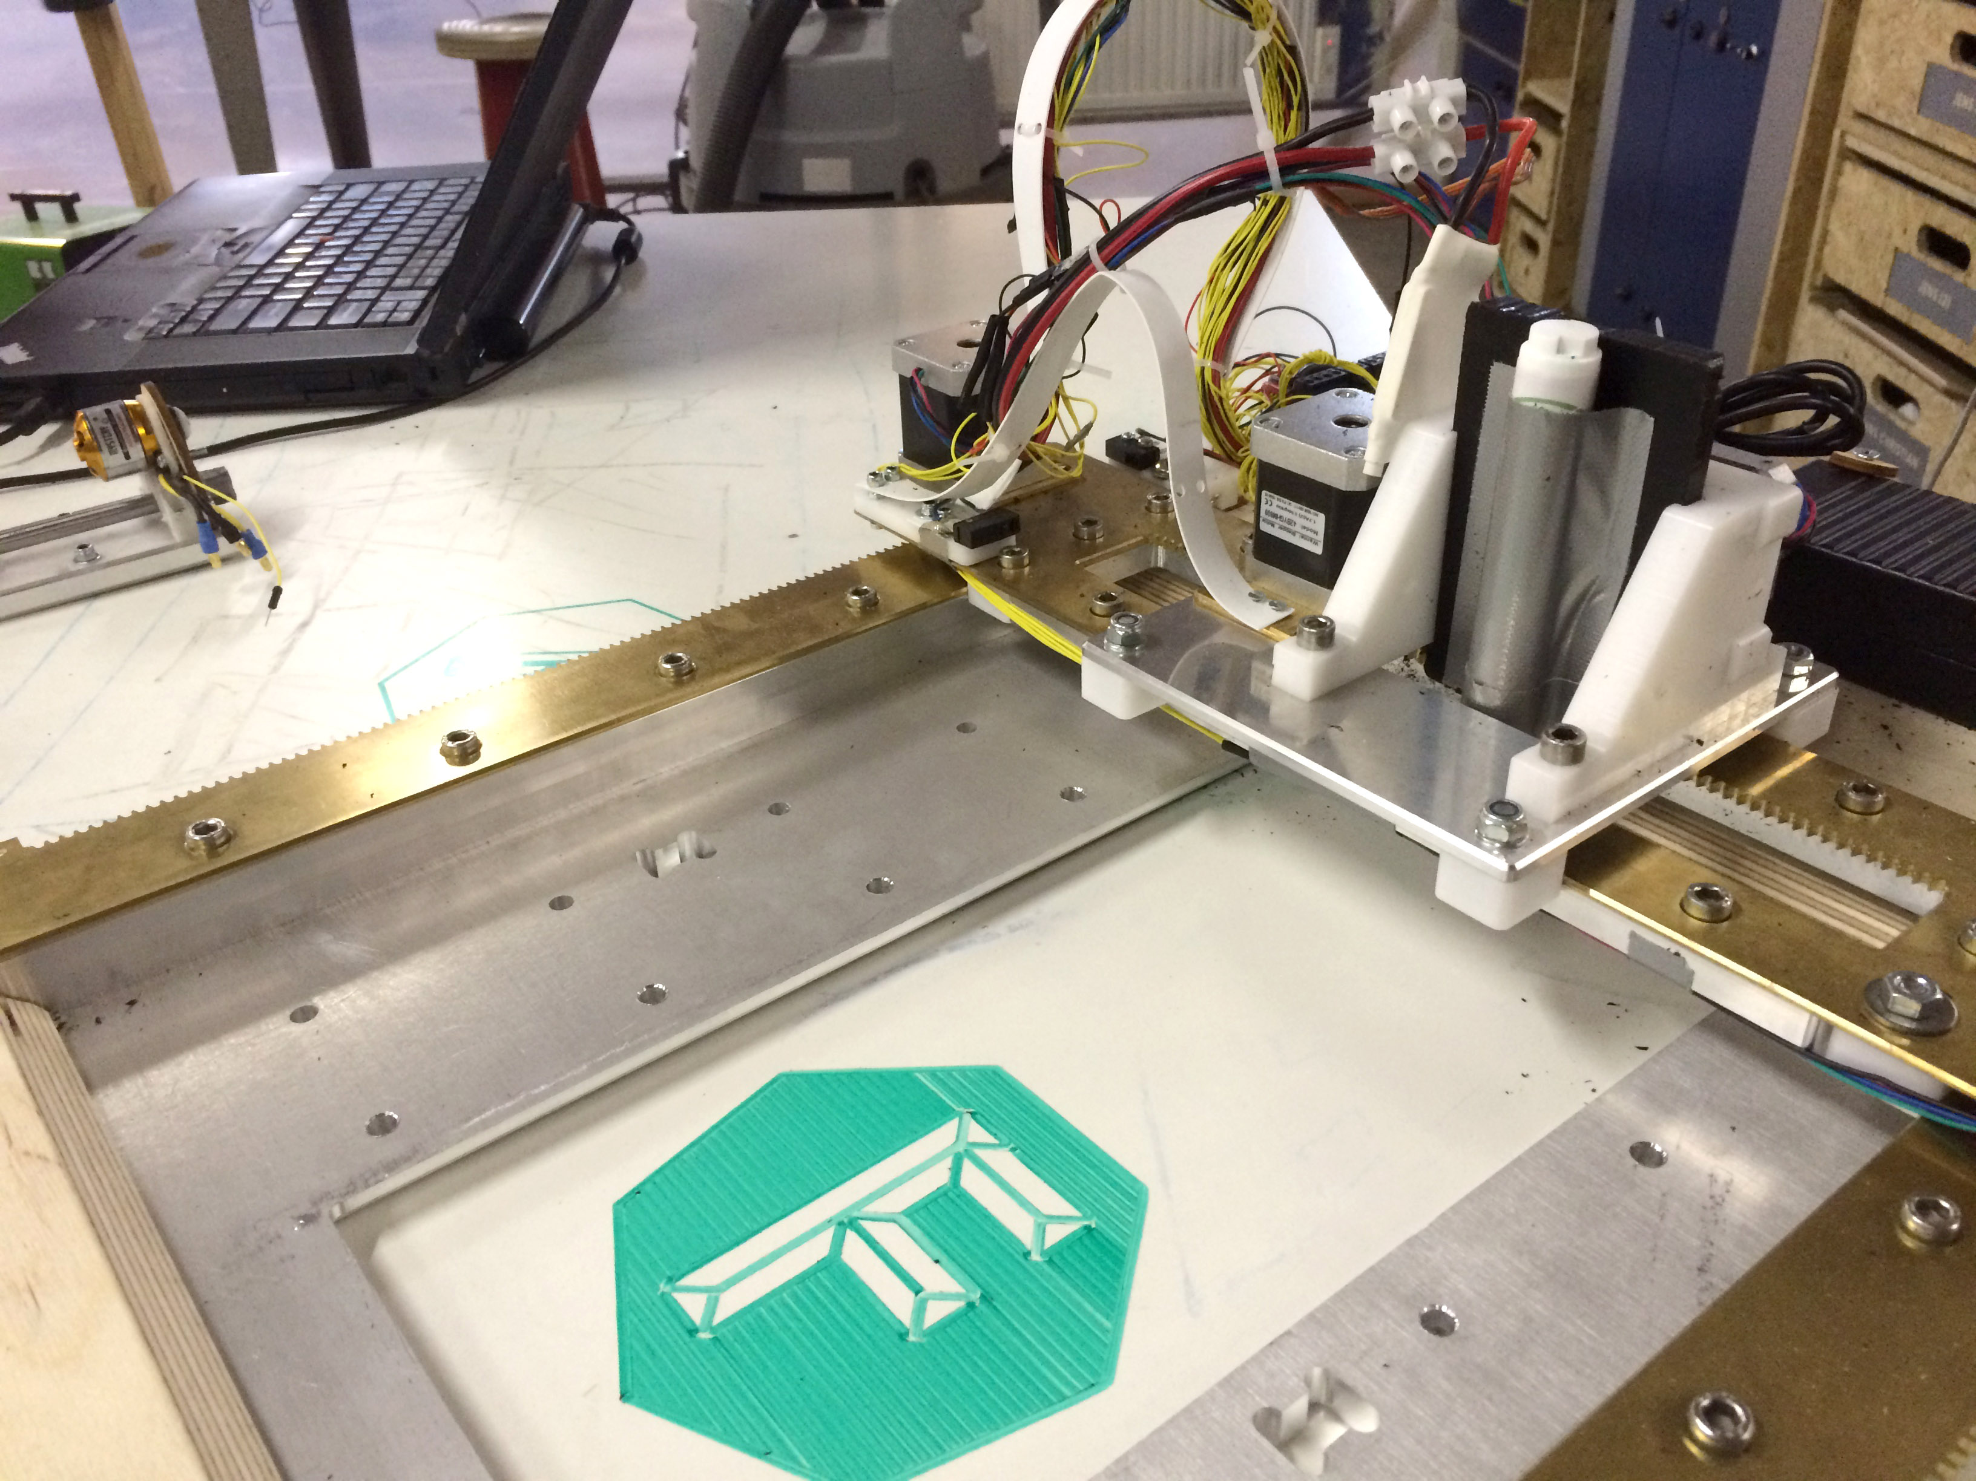
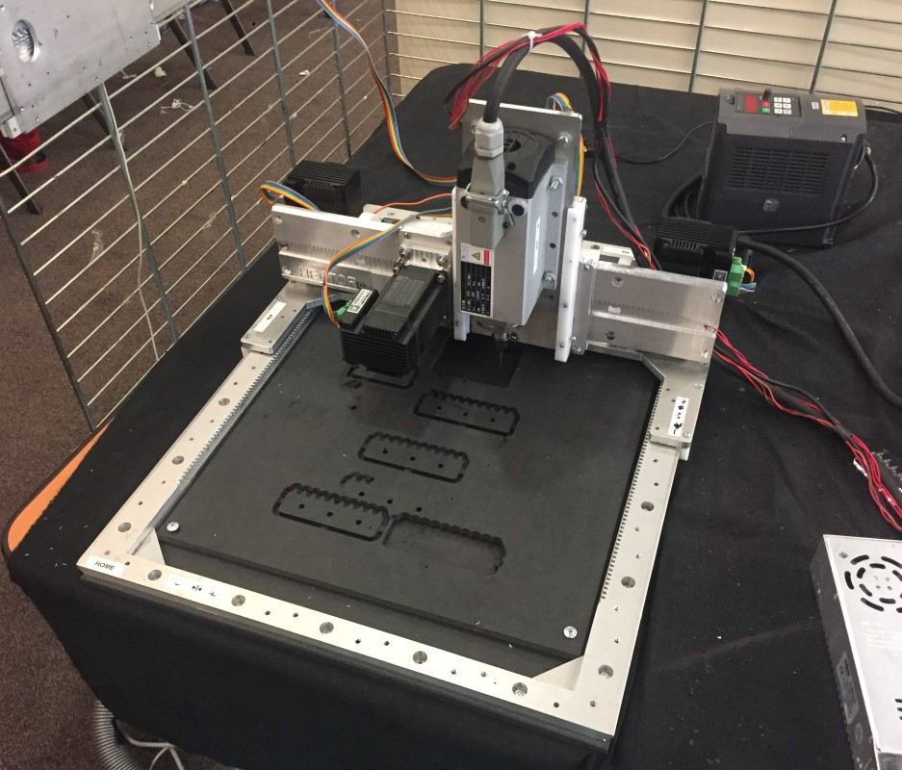
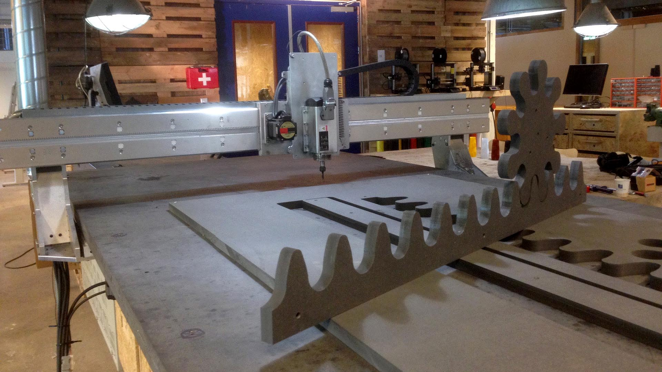
Favourite machines

Slide 9
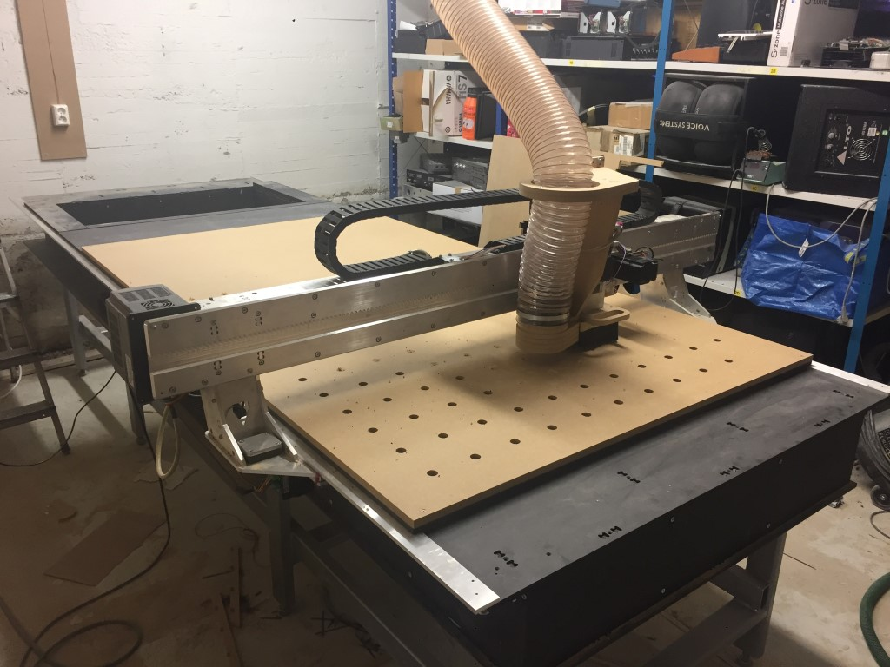
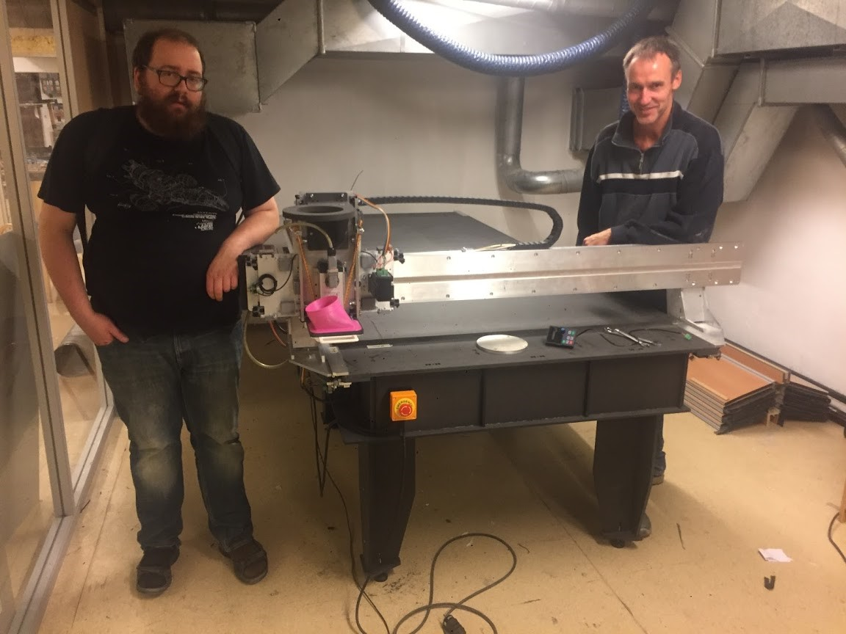
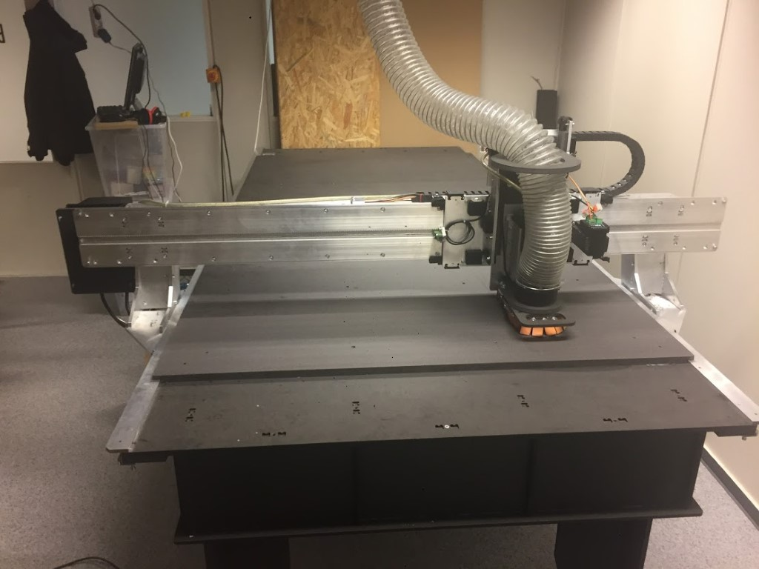
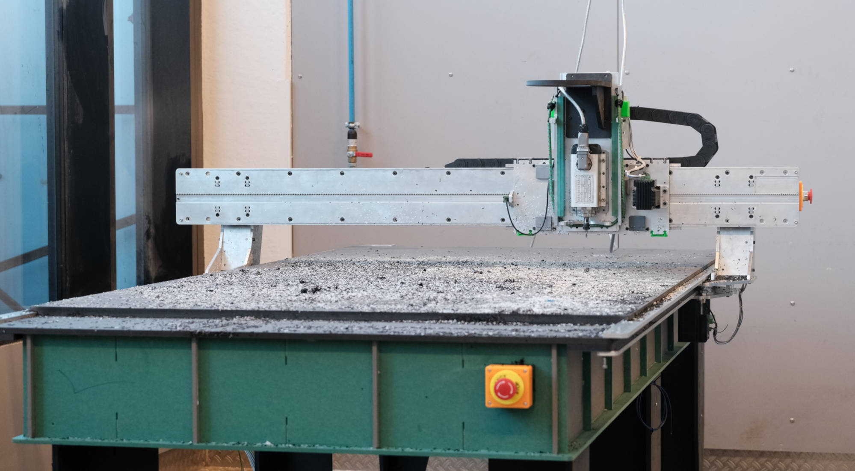
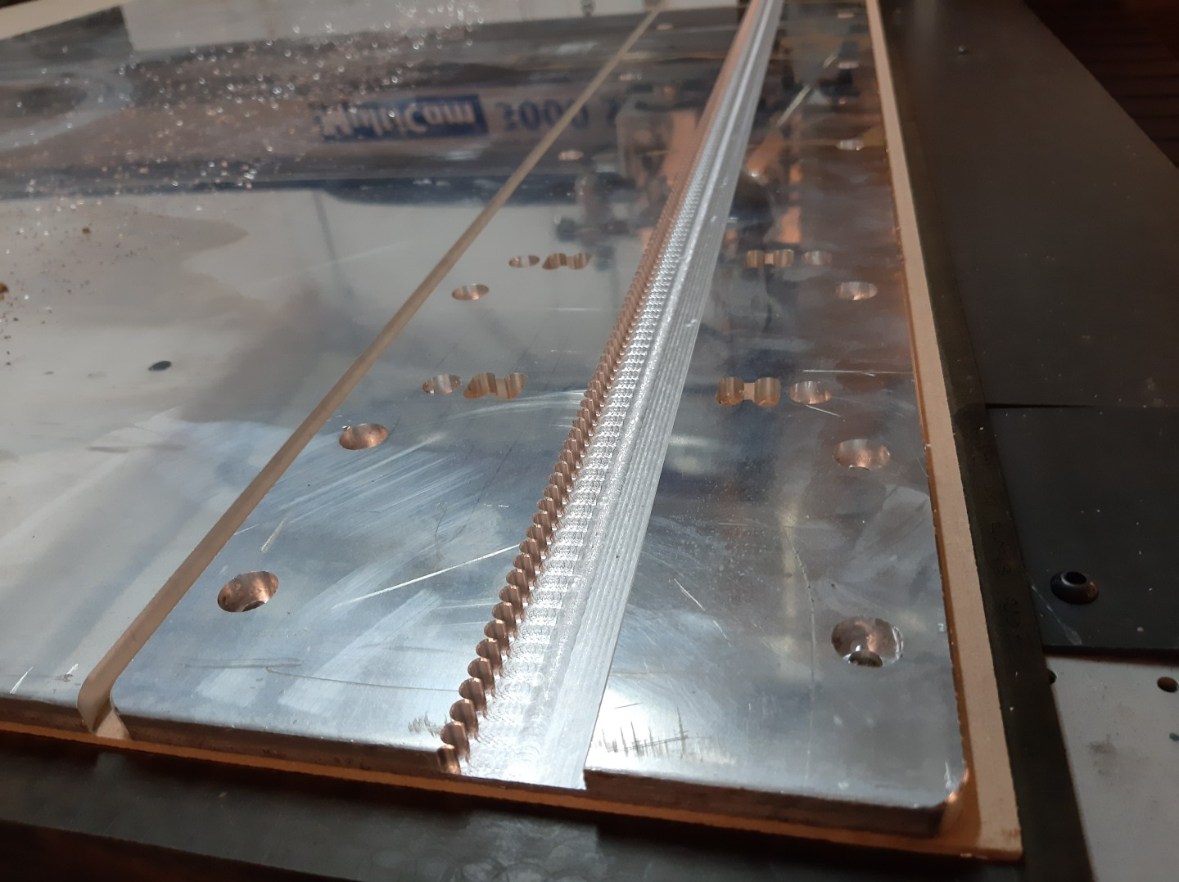
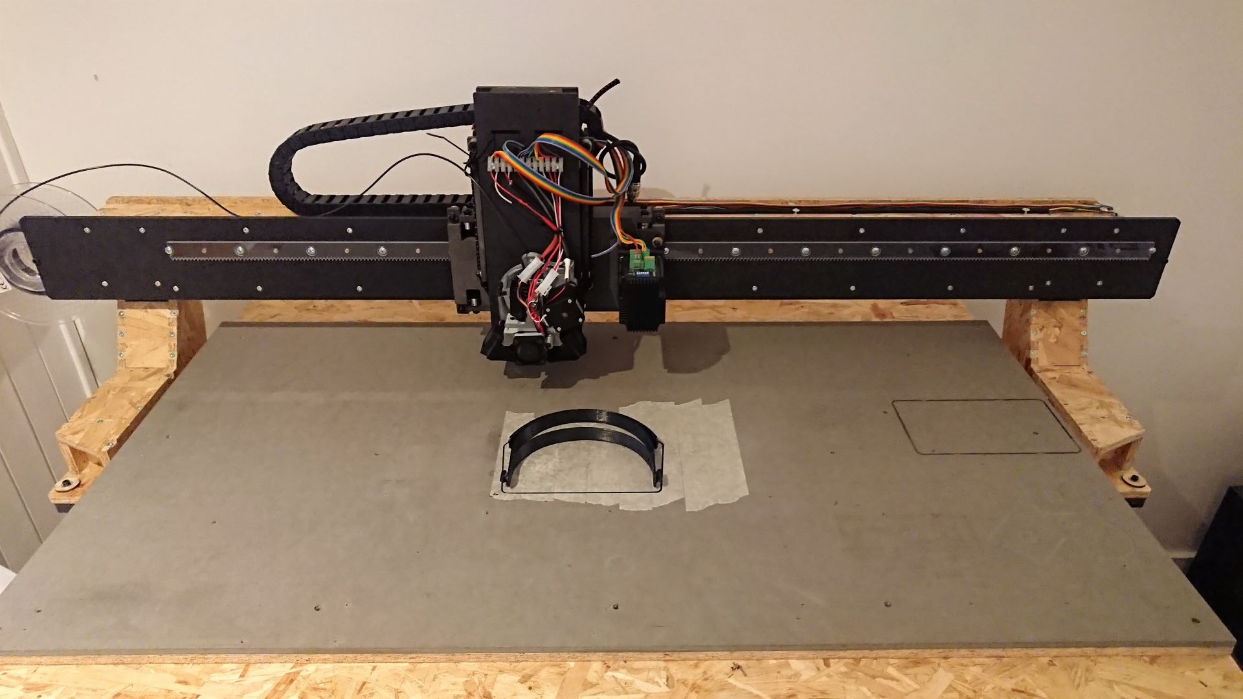
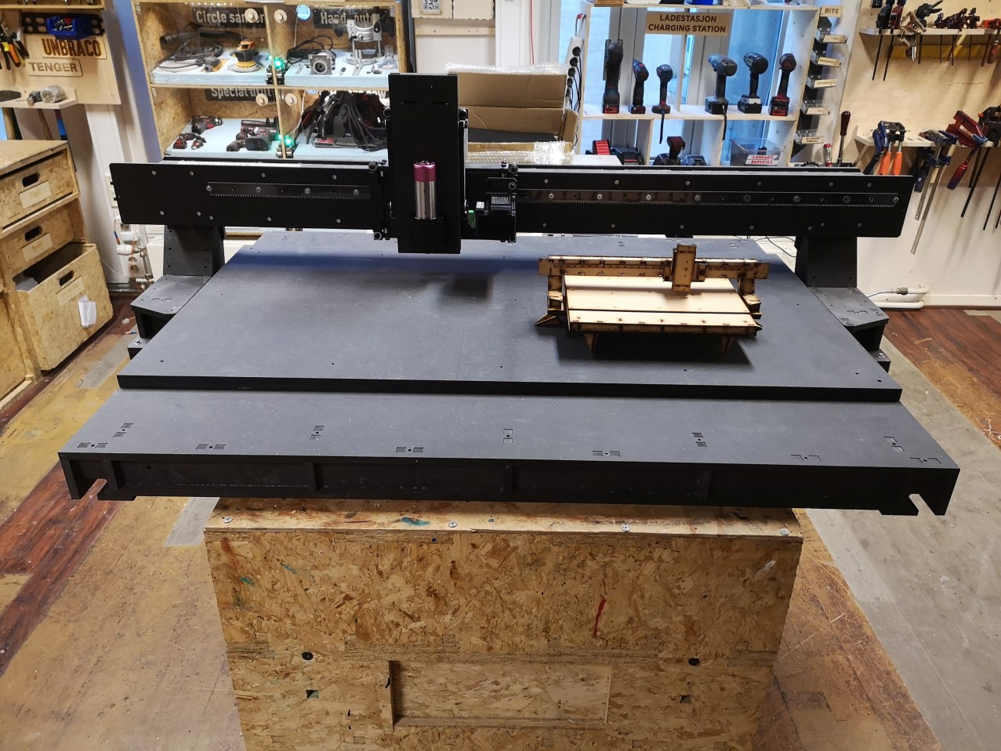
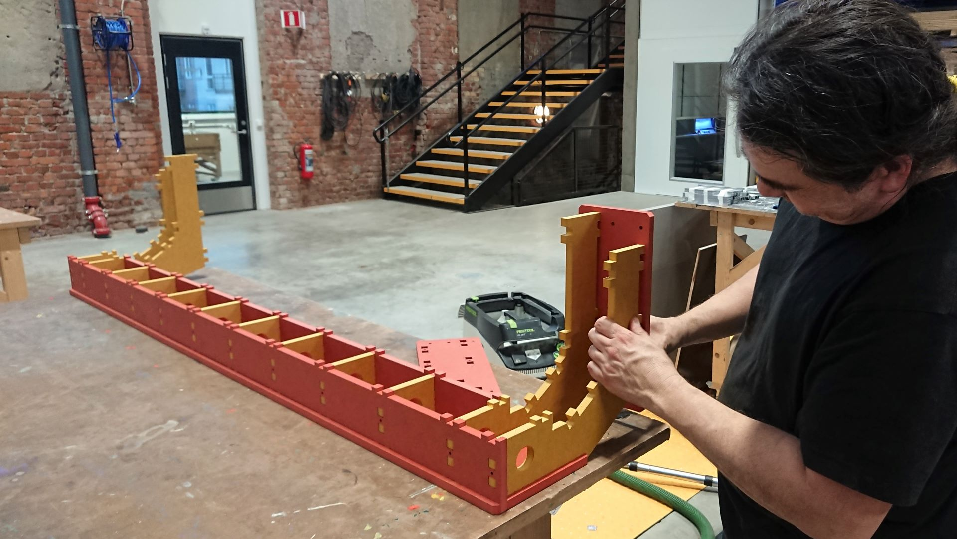
Humphrey1’s in the wild

Slide 10
Humphrey2
https://github.com/Fabricatable-Machines/Humphrey2

Slide 11
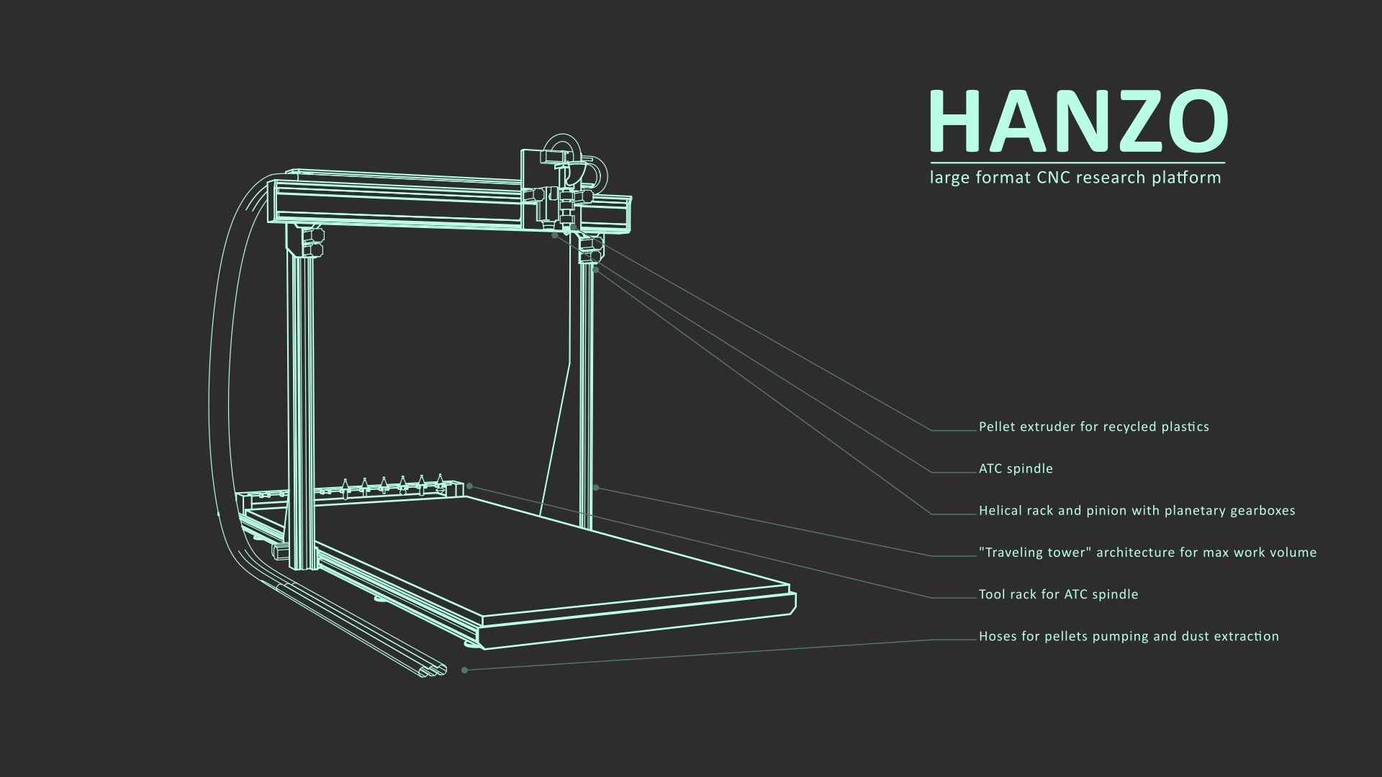
Hanzo
https://github.com/Fabricatable-Machines/Hanzo

Slide 12
Contact
jens@dyvikdesign.com

