Slide 1



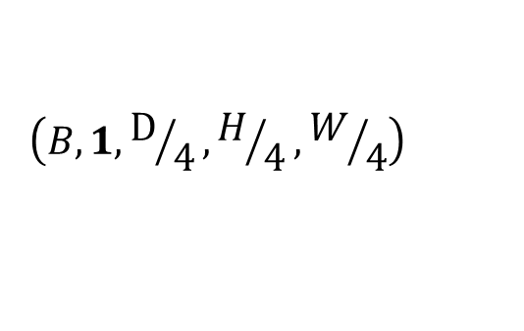
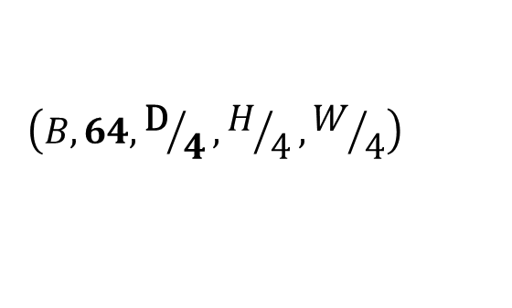
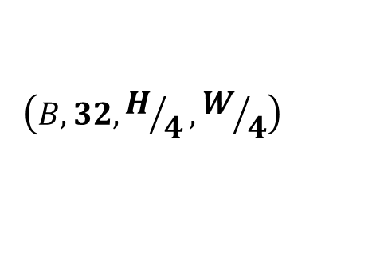


$$\left(B, 3, H, W\right)$$
$$\left(B, 32, H/4,W/4\right)$$
$$\left(B, 1, H, W\right)$$
$$\left(B, 64,{\text{D}}/4,H/4,W/4\right)$$
$$\left(B, 1,{\text{D}}/4,H/4,W/4\right)$$
CNN
Left Camera
Regressor
3D CNN
Shared
cat
Left Disparity Map
CNN
Right Camera
Feature Extraction
Joint Processing
Disparity Regression

Slide 2
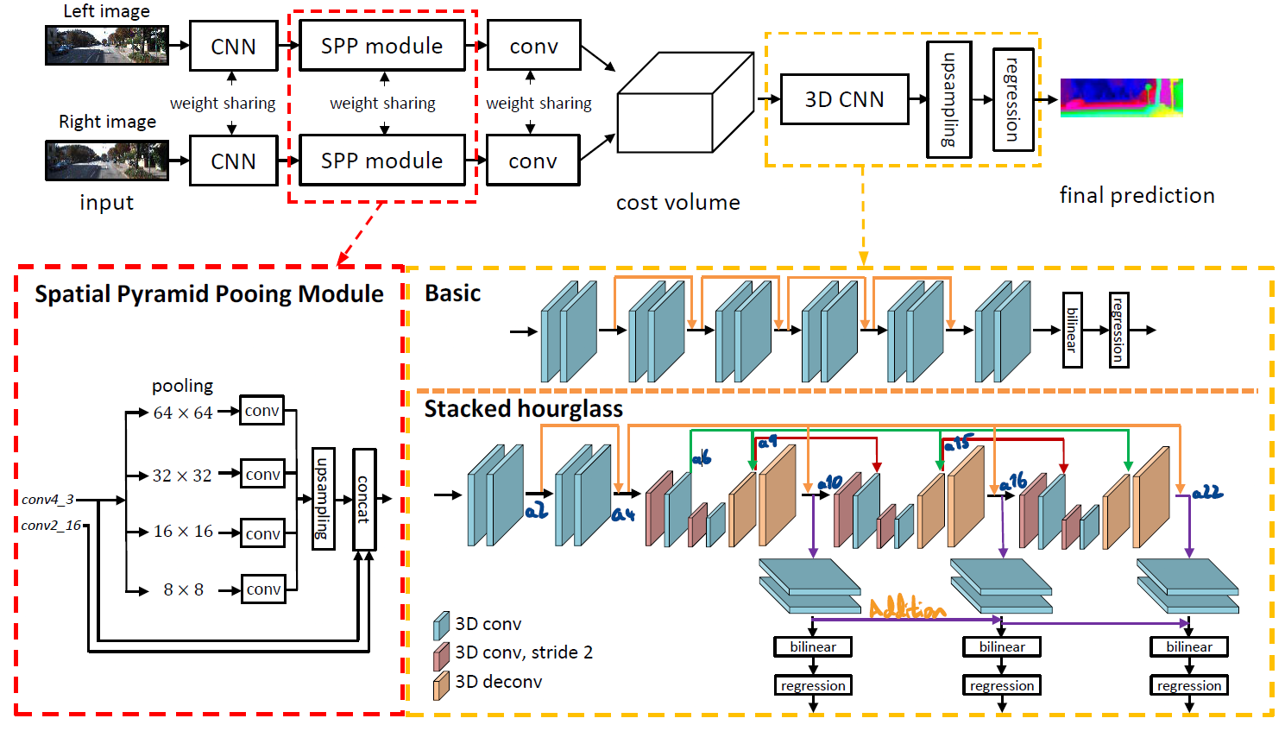
UniBonn-Blue 004F9F = 0, 79, 159
UniBonn-Yellow F4B400 = 244, 180, 0 (lighter shades: FFDE85, FFD35C)
Legend:
3D conv
3D conv, stride 2
3D deconv
+
+

Slide 3
Legend:
3D conv
3D conv, stride 2
3D deconv
+
+
Regressor

Slide 4
+
+

Slide 5
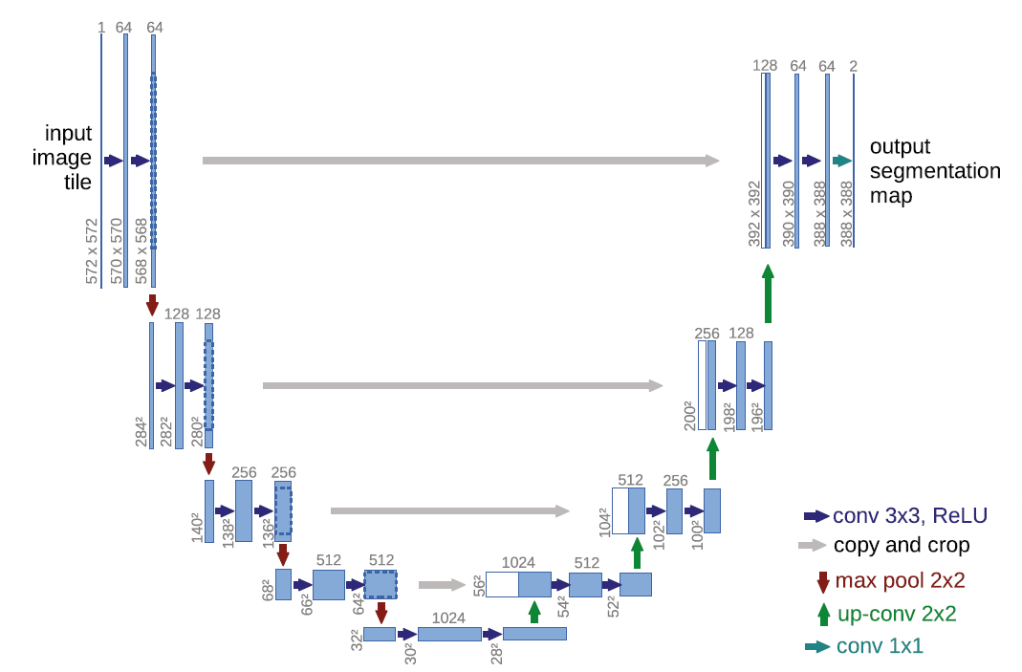


































$$1$$
$$64$$
$$2$$
$${572}^{2}$$
$${570}^{2}$$
$${568}^{2}$$
$${392}^{2}$$
$${390}^{2}$$
$${388}^{2}$$
$${388}^{2}$$
$$128$$
$${284}^{2}$$
$${282}^{2}$$
$${280}^{2}$$
$${200}^{2}$$
$${198}^{2}$$
$${196}^{2}$$
$$256$$
Conv 3x3, ReLU
Copy & Crop
Max Pool 2x2
Up-Conv 2x2
$${140}^{2}$$
$${138}^{2}$$
$${136}^{2}$$
$${104}^{2}$$
$${102}^{2}$$
$${100}^{2}$$
$$512$$
$${68}^{2}$$
$${66}^{2}$$
$${64}^{2}$$
$${56}^{2}$$
$${54}^{2}$$
$${52}^{2}$$
$$1024$$
$${32}^{2}$$
$${30}^{2}$$
$${28}^{2}$$

Slide 6
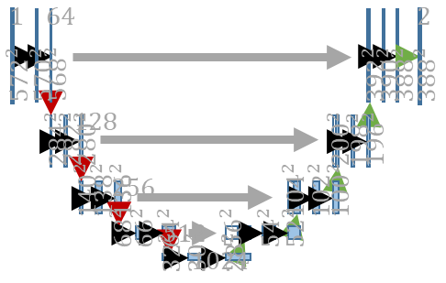
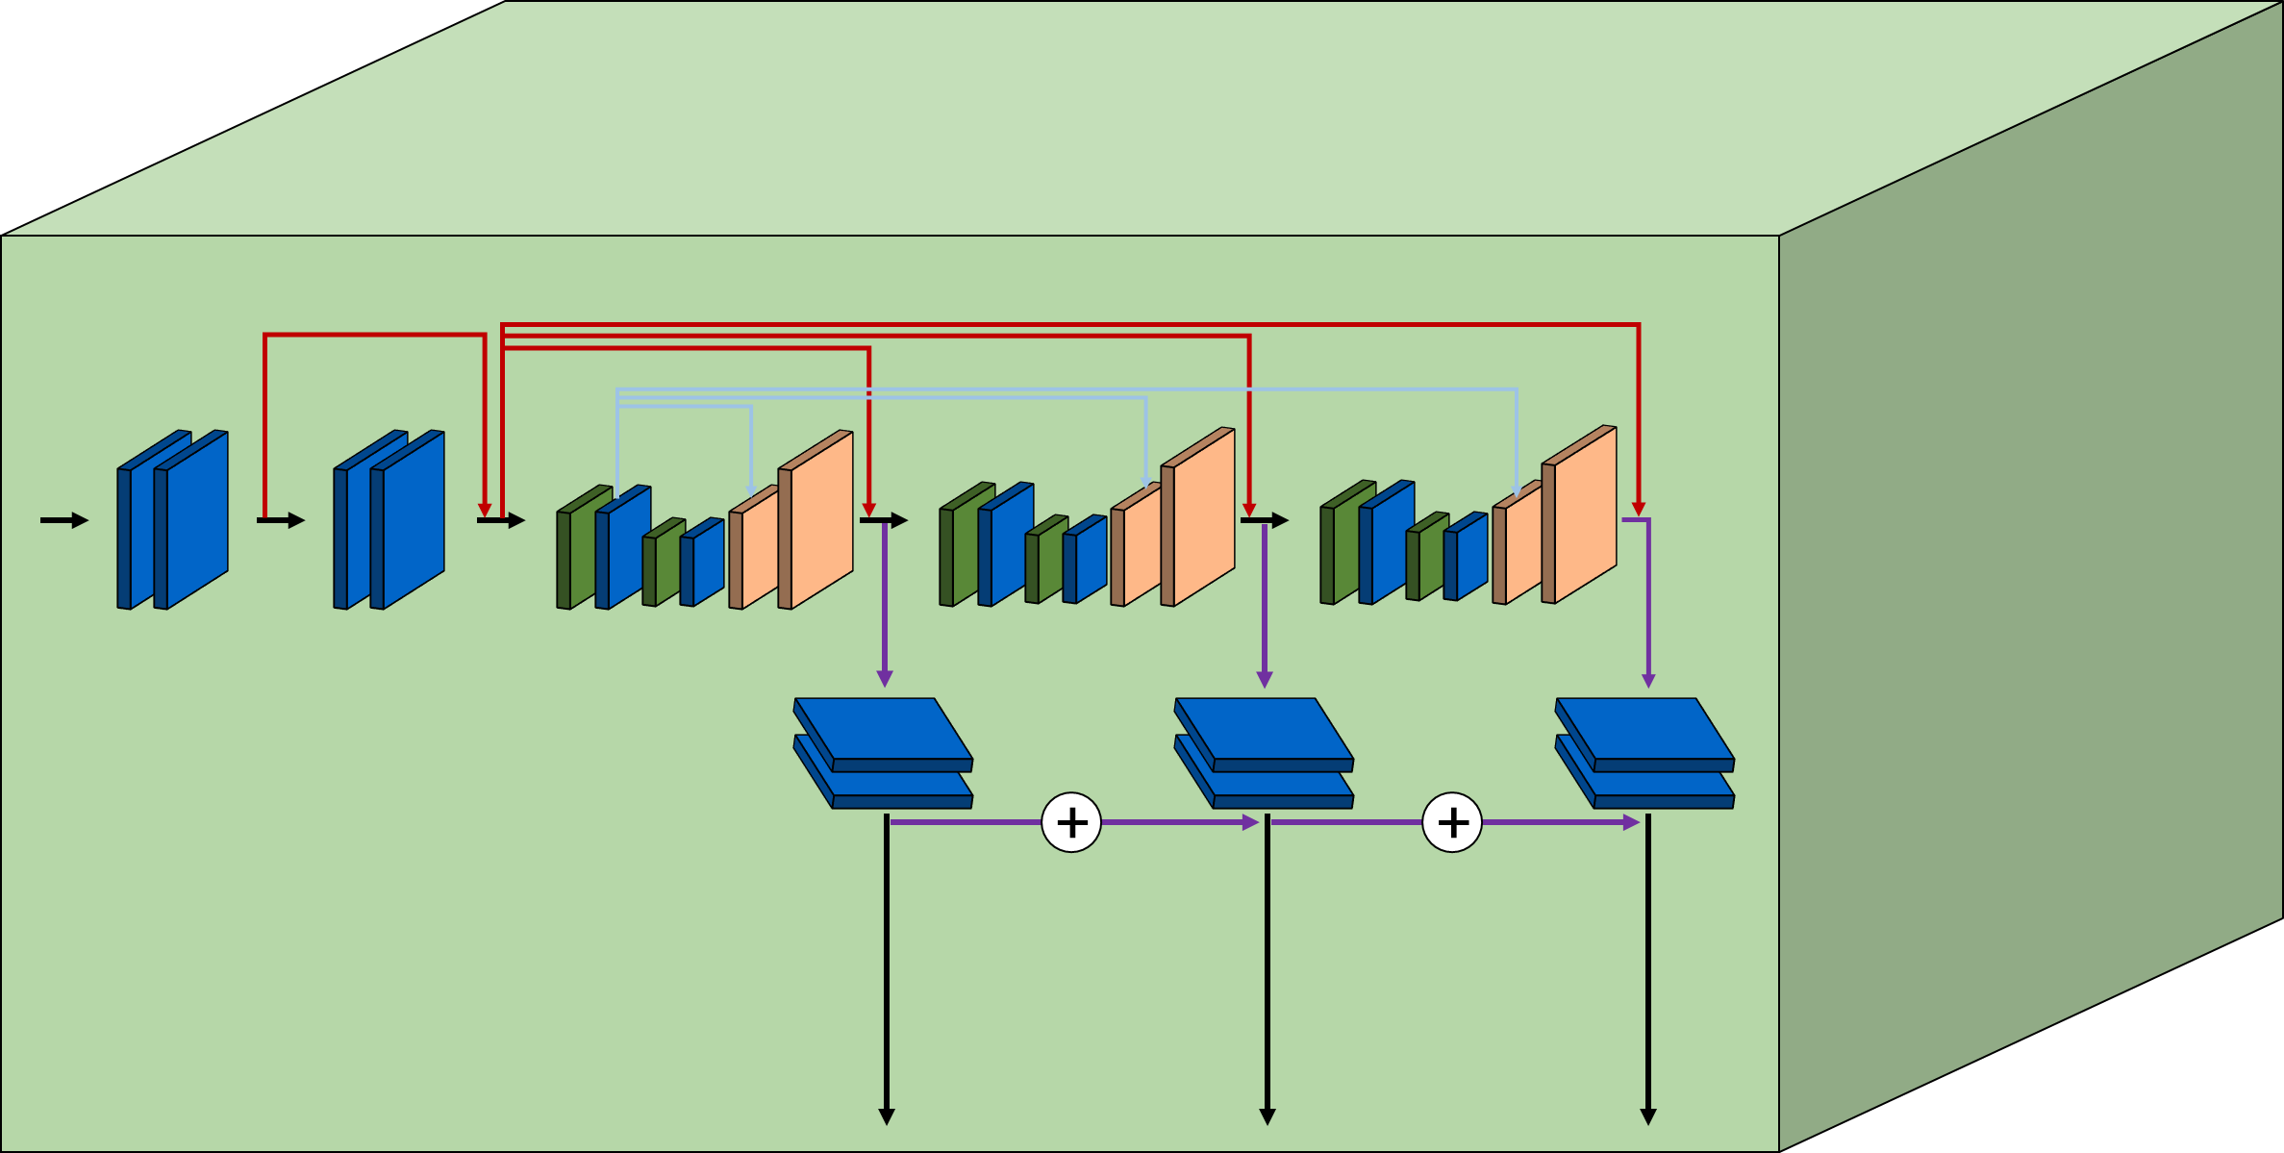


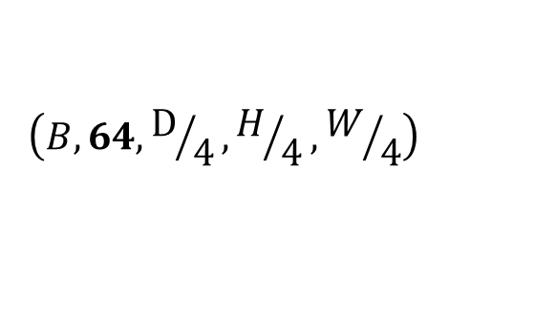
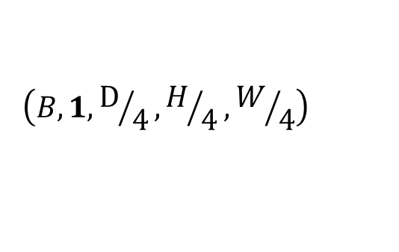
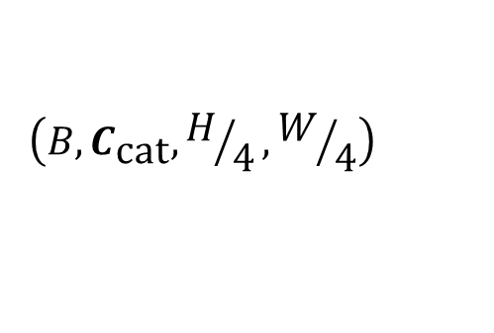
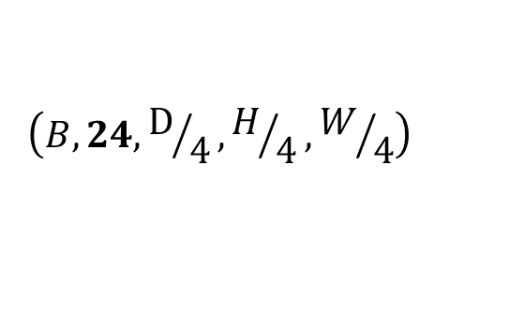
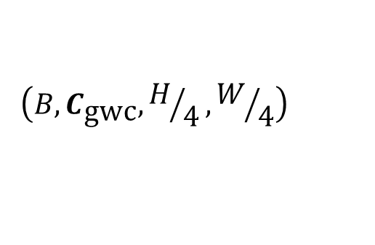
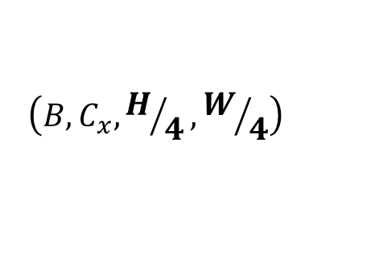
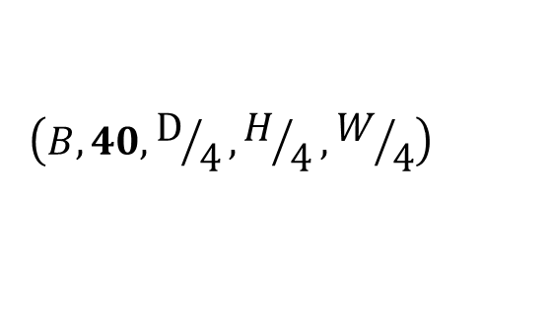
$$\left(B,C_{\text{gwc}}, H/4,W/4\right)$$
$$\left(B, 3, H, W\right)$$
$$\left(B, C_{x}, H/4,W/4\right)$$
$$\left(B,C_{\text{cat}}, H/4,W/4\right)$$
$$\left(B, 1, H, W\right)$$
gwc
$$\left(B, 1,{\text{D}}/4,H/4,W/4\right)$$
$$\left(B, 24,{\text{D}}/4,H/4,W/4\right)$$
$$\left(B, 40,{\text{D}}/4,H/4,W/4\right)$$
$$\left(B, 64,{\text{D}}/4,H/4,W/4\right)$$
Left Camera
cat
Regressor
gwc
Shared
cat
Left Disparity Map
gwc
Right Camera
cat
Feature Extraction
Joint Processing
Disparity Regression

