Slide 1
Regression

Slide 2

Linear Regression for continuous outcomes
#
= $β$ + ($β$*temperature) + ($β$*day) + ($β$*price) + error
Some linear combination of temperature values, day of the week dummy variables and price estimate the number of cones that will sell.
Notes:
What should we expect the beta signs to be? Whats the relationship the information has with ice cream sales?
Temp goes up? Sales go up. Temp goes down? Sales go down. Positive relationship
Price goes up? Sales go down. Price goes down? Sales go up. Negative relationship

Slide 3

The linear combination equation captures information
outcome
coefficients
constant
error (noise)
predictors

Slide 4
#
= $6$ + 0.$25$*temperature + $3$*satudray_dummy + -0.5*price
Beta-Naught | Temperature | Satuday_dummy | Price | Best Fit Prediction
6 | 0.25 * 80 degrees | 3 * 1 | -0.5 * 5 | 26.5
6 | 0.25 * 88 | 3 * 0 | -0.5 * 2 | 27

Slide 5
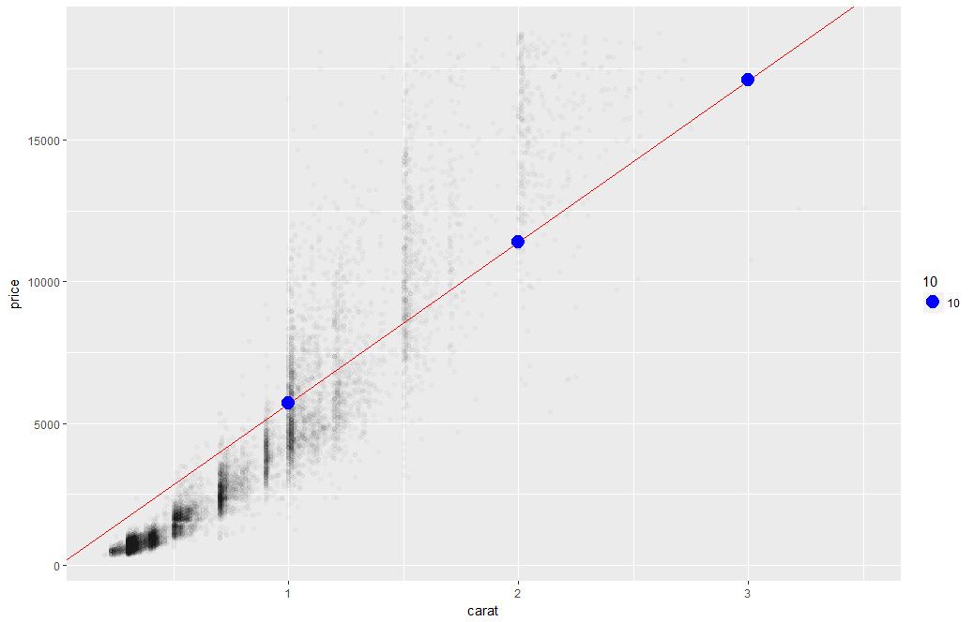
What’s really going on?
Errors between a prediction and actual.
Notice some are negative and some are positive

Slide 6
So what is really going on?
The algorithm is optimizing the inputs and weights (beta’s) to minimize the sum of squared errors.
This is called “ordinary least squares (OLS).

Slide 7
Let’s Practice
Open C_Regression.R

Slide 8
Predictive Modeling
Goal: predict target values in other data where we have predictor values, but not target values
Classic data mining context
Model Goal: Optimize predictive accuracy
Train model on training data
Assess performance on validation (hold-out) data
Explaining role of predictors is not primary purpose (but useful)

Slide 9
Let’s practice.
Open D_oldCar.R
Price in Euros
Tires binary 0/1 are new tires on car
Age in months as of 8/04
KM (kilometers)
Fuel Type (diesel, petrol, CNG)
HP (horsepower)
Metallic color (1=yes, 0=no)
Automatic transmission (1=yes, 0=no)
CC (cylinder volume)
Doors
Quarterly_Tax (road tax)
Weight (in kg)
Using the preprocessing and partitioning code in your toolbox, create a linear model of Toyota prices.

Slide 10
Regression is susceptible to multi-colinearity
Math
The presence of two or more predictor variables sharing the same linear relationship with the outcome variable.
Don’t shock the cat by having multi-collinearity.
In other words
Two+ informative features are measuring essentially the same thing.
Example
When predicting ice cream sales you include Fahrenheit and Celsius temperatures as two separate informative features.

Slide 11

Regression is susceptible to multi-colinearity
What happens with multi-collinearity?
The effect is exaggerated e.g. double counted.
The good news
The problem is so prevalent/impactful that R’s linear regression function handles it.
Other algorithms are not affected by double counting
Best Practice
Even though R removes it, do not rely on the function. Understanding the data you put in will avoid “garbage in, garbage out” scenarios.
Make happy cats by
knowing your data.

Slide 12
Back to R, script D!

Slide 13
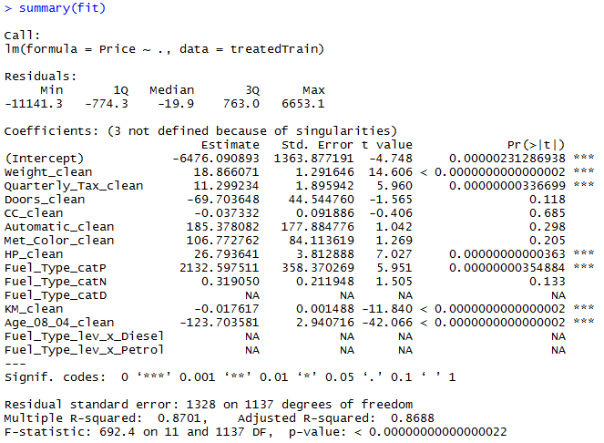
The Summary of the Fit

Slide 14
The Summary of the Fit
Auto ID of multi colinearity

Slide 15
The Summary of the Fit
Another name for errors.
Summary stats for the errors.

Slide 16
The Summary of the Fit
Treated Variable Names i.e. informative features

Slide 17
The Summary of the Fit
Coefficients or Beta values

Slide 18
The Summary of the Fit
The average amount that the coefficients vary from the actual average value of our response variable.
Notes:
We’d ideally want a lower number relative to its coefficients. In other words, the lower the better since it measures how much we can trust the coefficient relationship. If the std error is more than the coefficient you can’t really trust the coefficient since it could be positive or negative…the model couldn’t figure it out.

Slide 19
The Summary of the Fit
The coefficient t-value is a measure of how many standard deviations our coefficient estimate is far away from 0. In another way, values away from 0 indicate a real relationship
Notes:
T-VALUE We want it to be far away from zero as this would indicate we could reject the null hypothesis - that is, we could declare a relationship between weight and price exist. According to T, We are less confident about cylinder displacement (cc) and price’s relationship. The signal of price isn’t really in the variable “cc” and is likely captured in weight and hp.

Slide 20
The Summary of the Fit
P-Values
The probability of seeing a value larger than the t value.
Small p-values mean its less likely due to chance.

Slide 21
The Summary of the Fit
P-Values
In stats p <0.05 is good but in business I have seen p<0.2.
It’s a good idea to rebuild a model without variables that do not meet the cutoff.

Slide 22
Back to the script D

Slide 23
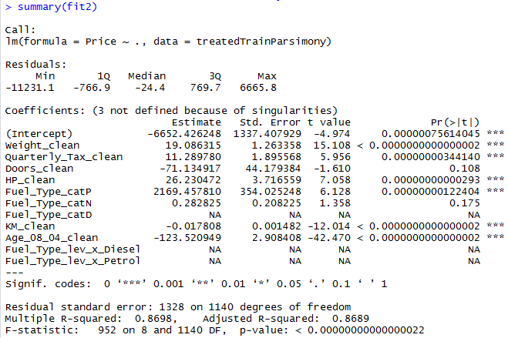
Parsimonious Model
Parsimony or compactness is desirable in models. The more features in a model, the more complexity we introduce, data integrity, data interactions, time to score and time to predict are all impacted.
Notes:
We could drop yet another engineered variable but let’s continue. P =.175

Slide 24
Parsimonious Model
R-Sq: how much of the variation are the model is fitting. R-Sq measures the linear relationship between Price & features It always lies between 0 and 1
Notes:
We could drop yet another engineered variable but let’s continue.

Slide 25

Compare the two models
fit1
fit2
It can be said that both models explain ~87% of the variation in car prices. Dropping the variables improved accuracy and reinforces the fact that the variables didn’t add value.

Slide 26
Evaluating a Prediction Model
RMSE- Root Mean Squared Error
MAPE- Mean Absolute Percentage Error
y
y-hat
Actual Values | Predicted/Forecasted
10 | 6
12 | 8
20 | 18
36 | 20
Besides P-Values which is a variable level KPI, and adjusted R-Sq there are two popular KPI for evaluating continuous model predictions.

Slide 27
RMSE
RMSE- Root Mean Squared Error
y
y-hat
ERROR
ERROR-SQ
Actual Values | Predicted/Forecasted | Errors | Squared Errors
10 | 16 | -6 | 36
12 | 8 | 4 | 16
20 | 17 | 3 | 9
36 | 34 | 2 | 4
Mean
36+16+9+4
4
To manually calculate RMSE, work the acronym backwards.

Slide 28

RMSE
RMSE- Root Mean Squared Error
Actual Values | Predicted/Forecasted | Errors | Squared Errors
10 | 16 | -6 | 36
12 | 8 | 4 | 16
20 | 17 | 3 | 9
36 | 34 | 2 | 4
Mean
Square Root
36+16+9+4
$$\sqrt{16.25}$$
4
=4.03
In the same units being measured, tells you +/- the prediction error.

Slide 29
MAPE
MAPE- Mean Absolute Percentage Error
Actual Values | Predicted/Forecasted | Errors | Absolute | As % of Forecast
10 | 16 | -6 | 6 | =6/16 or 37%
12 | 8 | 4 | 4 | =4/8 or 50%
20 | 17 | 3 | 3 | =3/17 or 17%
36 | 34 | 2 | 2 | =2/34 or 5%
Mean of Percentages
37%+50%+17%+5%
4
=27.7%
Instead of squaring error, take the absolute error. Then divide that by the forecast value. Lastly calculate a mean average of all the percentage errors.

Slide 30

Back to script D
How good is Dale’s model?
Notes:
For the predict warning about rank deficient matrices:
Rank of the matrix is reduced since it throws out multi-collinear variables. Often can be safely ignored.

Slide 31


Your Data Mining Toolbox
Previous Lessons
Some R Programming
Knowledge of Data Preparation
Exploratory Data Analysis
Basic Visualization
After today
You can predict continuous business outcomes using linear regression
Regression is an initial starting algorithm. It puts you on a path to more complex machine learning but more importantly you can start to frame business problems in terms algorithms can understand.

