Slide 1
Equities

Slide 2
Agenda
Topic I
Obtaining Stock Data & Basic Visualization What is the financial market? Types of investing strategies. What is an API? API access to stock data in R Manipulate a time series object TTR_A.R
2

Slide 3
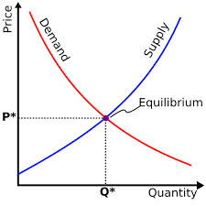
What is a Market?
Traditional Markets
Stock Markets
Bond Markets
Housing/Mortgages
Commodities – gold/silver etc
Crop Futures – corn/soybean
Consumer Credit
…
A market is one of the many varieties of systems, institutions, procedures, social relations and infrastructures whereby parties engage in exchange. Traditional markets are often regulated, have defined trading norms/rules, and have been in existence for some time.
3

Slide 4

Securities Trading can be distilled into 4 categories
Belief Based Investing
The intrinsic value of a company is appealing regardless of market & financial factors. As a result, intrinsic value changes trigger buy/sell action.
I like Wonder bread, so I bought stock in Flower Foods (FLO) since they make it.
https://www.steadygo.digital/blog/terrible-stock-photos/
4
Notes:
I like Netflix movies so I bought Netflix.
I don’t agree with tobacco sales so I avoid those stocks.
Warren Buffet “Buy companies you understand”

Slide 5

Securities Trading can be distilled into 4 categories
Financial Fundamentals Investing
Traditional financial performance indicators trigger an action regardless of sector, or company product.
Monsanto (MON) makes genetically modified food, I don’t care if it is safe. I bought the stock because the EPS is good.
5
Notes:
Reviewing an annual report and pouring over cash flow, revenue growth, expenditures like R/D all count as fundamental investing

Slide 6

Securities Trading can be distilled into 4 categories
Technical Trading
Trade based on “indications”. Uses non-financial mathematical indicators to quantify risk/reward, or trigger buy/sell
“Algorithmic Trading” – using algorithms to identify an equity action
Momentum – Recognize prices moving up/down at thresholds to trigger action
“Charting” – Visual chart patterns trigger actions (crossovers, head & shoulders)
The MACD crossover pattern for Smith & Wesson (AOBC) is positive so now is a good time to buy.
6
Notes:
Reviewing an annual report and pouring over cash flow, revenue growth, expenditures like R/D all count as fundamental investing

Slide 7
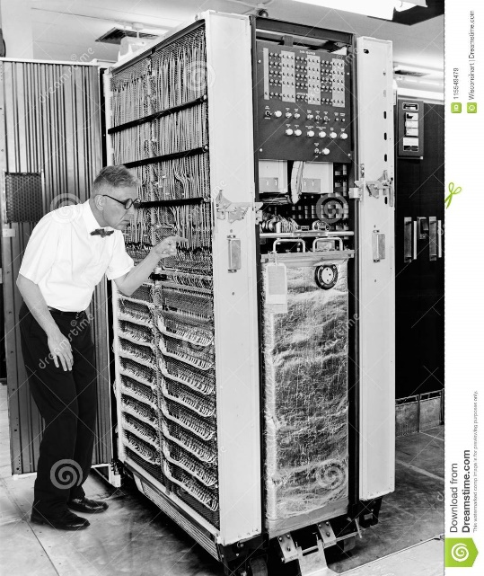

Securities Trading can be distilled into 4 categories
High Frequency Trading
Extremely technical trading executed without a human that can trigger thousands of actions measured in nano-seconds. “scalping” small profits thousands of times per minute.
1001100100…
*Although HFT uses algorithms:
>There is no human in the loop
>Primary profits derive from market making
7
Notes:
$460M

Slide 8

Speaking of Knight Cap
What happened to them?
Notes:
$460M

Slide 9
Keep in mind for trading…
In the short term the market is a NEGATIVE sum transaction. Market “makers” make money on the transactions. Retail investors pay a commission/fee for the trade, some financial information or for their account.
Be careful & be sure to test your methods!
Notes:
$460M

Slide 10
What type?
The Stochastic Momentum Indicator (SMI), a formula for measuring momentum, crossed over to positive territory. I think I will buy Google (Alphabet).
Belief Based – some intrinsic value of the company is appealing and triggers a buy/selling action.
Fundamental Trading - traditional financial indicator triggers an action regardless of sector, or company product.
Technical Trading – trade based on “indications” or “algo trading”
High Frequency Trading – “scalping” small profits repeatedly
10

Slide 11
What type?
Our PhD physicist wrote an algorithm that trades apple stock 10,000 per minute.
Belief Based – some intrinsic value of the company is appealing and triggers a buy/selling action.
Fundamental Trading - traditional financial indicator triggers an action regardless of sector, or company product.
Technical Trading – trade based on “indications” or “algo trading”
High Frequency Trading – “scalping” small profits repeatedly
11

Slide 12
What type?
I won’t buy firearm companies.
Belief Based – some intrinsic value of the company is appealing and triggers a buy/selling action.
Fundamental Trading - traditional financial indicator triggers an action regardless of sector, or company product.
Technical Trading – trade based on “indications” or “algo trading”
High Frequency Trading – “scalping” small profits repeatedly
12

Slide 13
What type?
In our workshop we modeled the probability of risk using a decision tree and it looks like buying a consumer loan is a good investment.
Belief Based – some intrinsic value of the company is appealing and triggers a buy/selling action.
Fundamental Trading - traditional financial indicator triggers an action regardless of sector, or company product.
Technical Trading – trade based on “indications” or “algo trading”
High Frequency Trading – “scalping” small profits repeatedly
13

Slide 14
What type?
Google’s quarterly ad revenue is improving, so I am going to buy some shares.
Belief Based – some intrinsic value of the company is appealing and triggers a buy/selling action.
Fundamental Trading - traditional financial indicator triggers an action regardless of sector, or company product.
Technical Trading – trade based on “indications” or “algo trading”
High Frequency Trading – “scalping” small profits repeatedly
14

Slide 15
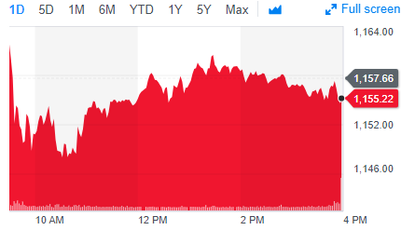
Stock Prices represent a time series
PRICE or Volume
TIME
Stock price of US Steel
15

Slide 16
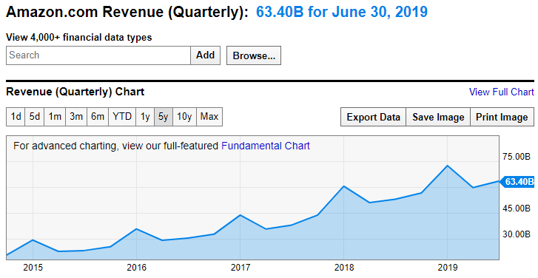
Not all times series can be forecasted
Qrtly Revenue
TIME
https://ycharts.com/companies/AMZN/revenues
This time series has a trend and seasonality so a traditional forecasting method like Holt Winters could be used.
16

Slide 17
Stock Prices represent a time series
Random Walk
VS.
Predictable Patterns (non-stock)
From a forecasting perspective stock prices are often considered a “random walk” meaning traditional econometric forecasting techniques do not apply.
17

Slide 18
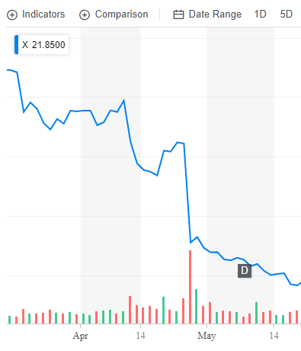
Why can’t you forecast the time series?
Daily Chart
U.S. Steel
Q1 Jan/Feb/Mar plus ~30 days for reporting
4/25/17 Close : $31
4/26/17 Close: $22
4/26/17 Volume spike
18

Slide 19
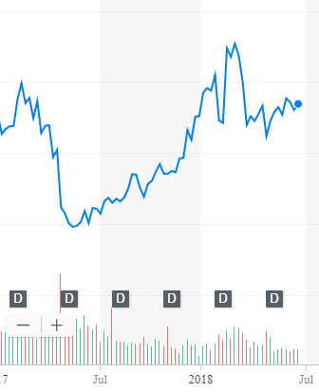
What other forces can impact US Steel?
Weekly Chart
U.S. Steel
4/25/17 Close : $31
4/26/17 Close: $22
4/26/17 Volume spike
5/15/17: ~$20
2/26/18: ~$45
Missed Qrtly Earnings
19

Slide 20
What other forces can impact US Steel?
Weekly Chart
U.S. Steel
4/25/17 Close : $31
4/26/17 Close: $22
4/26/17 Volume spike
5/15/17: ~$20
2/26/18: ~$45
4/16/18: ~$36
6/16/18: ~36
Missed Qrtly Earnings
Steel tariffs
20

Slide 21
What other forces can impact US Steel?
Weekly Chart
U.S. Steel
4/25/17 Close : $31
4/26/17 Close: $22
4/26/17 Volume spike
5/15/17: ~ $20
2/26/18: ~ $45
4/16/18: ~ $36
6/16/18: ~ $36
Missed Qrtly Earnings
Steel tariffs
Retaliatory Auto tariffs
21

Slide 22
So forecasting (pattern recognition) methods won’t work.
Weekly Chart
U.S. Steel
Missed quarterly earnings (self inflicted)
Steel Tariffs (political/macro)
Auto Tariffs (out of sector performance)
External factors remove pattern recognition that econometric forecasts seek.
22

Slide 23
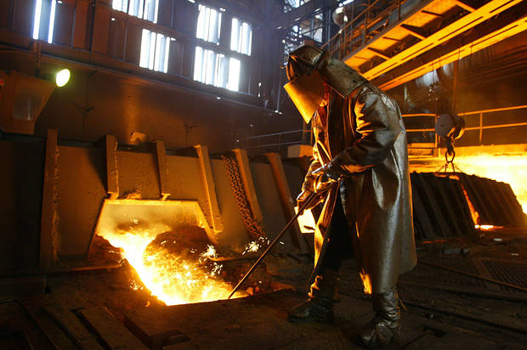


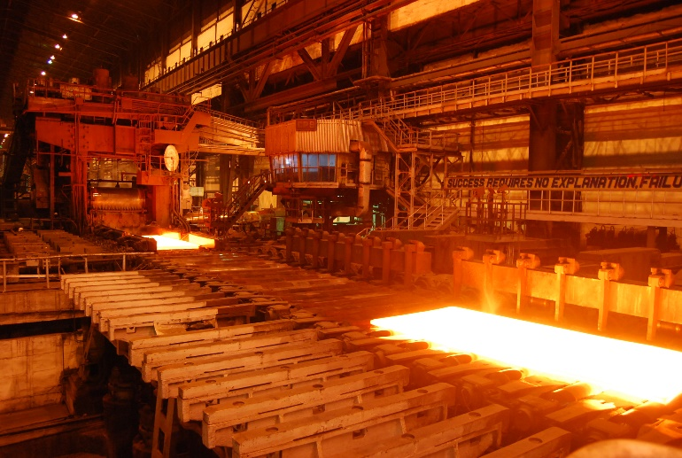
Meanwhile, US Steel was... producing steel.
A belief investor would not have bought or sold.
23

Slide 24
Meanwhile, US Steel was... producing steel.
A fundamental investor would have sold after the quarterly earnings report waiting for another financial indicator to buy again (next quarter).
24

Slide 25
Meanwhile, US Steel was... producing steel.
A technical investor may have gotten out after the price drop but back in as positive moment based on steel tariffs occurred only to sell again after the momentum faded based on automotive tariffs
25

Slide 26
Meanwhile, US Steel was... producing steel.
An HFT would have been in and out many times per second and minute making money no matter the direction, they work only with speed as an advantage.

Slide 27
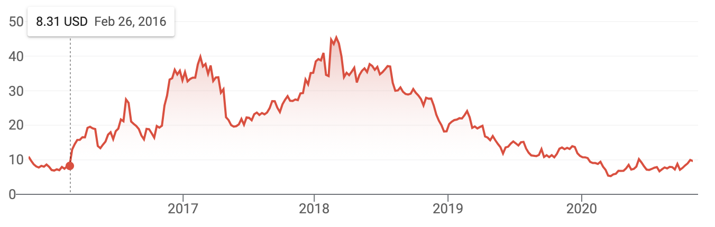
US Steel Update: Pandemic Fearful Economic Panic & Uncertainty
Steel Tariff & Trade War as discussed.
US Steel Update: Declining Impact of Trade War & Expected “Soft Landing” Recession
Pandemic Dip and Uncertainty

Slide 28
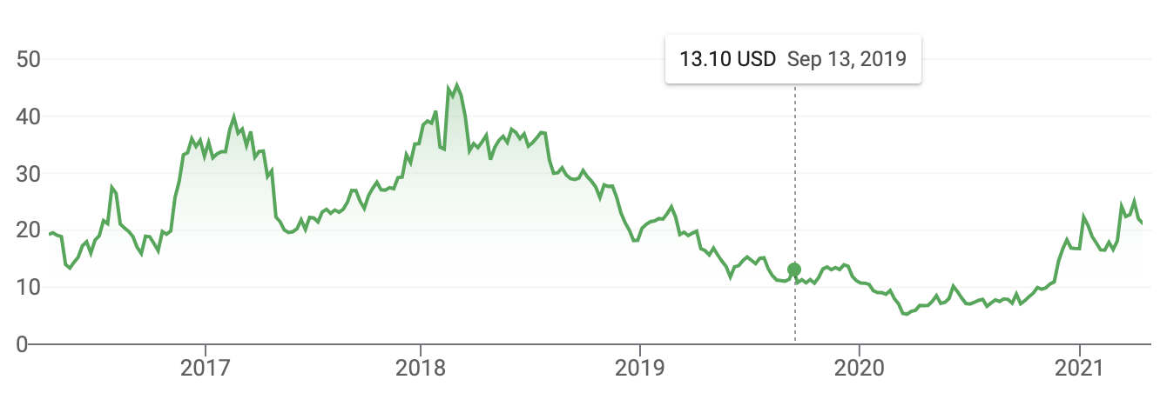
Looks like a positive momentum? Improving US economy, infrastructure bill

Slide 29
What is an example of a stock that has been impacted by macroeconomic forces?

Slide 30
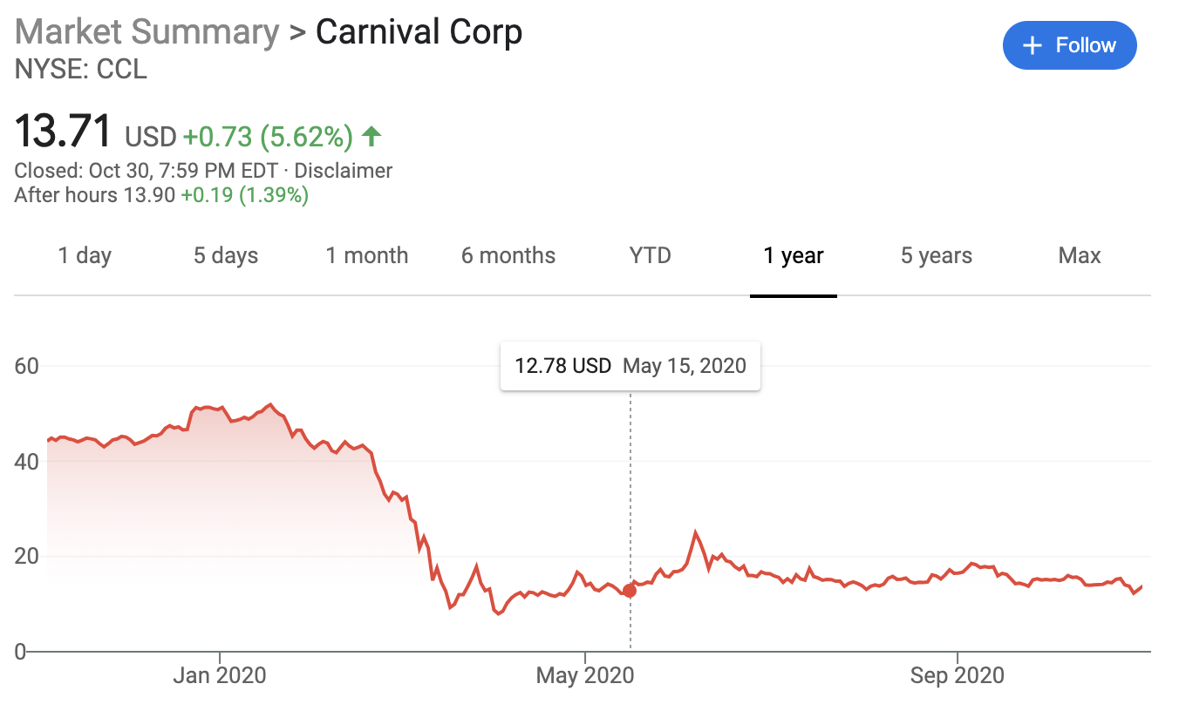
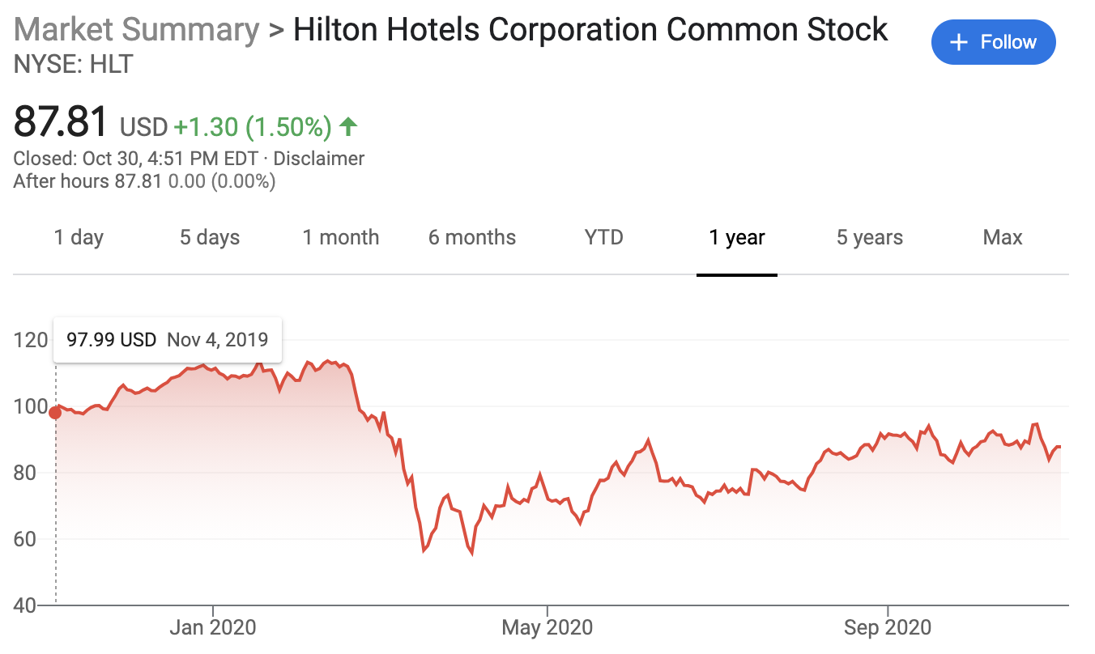
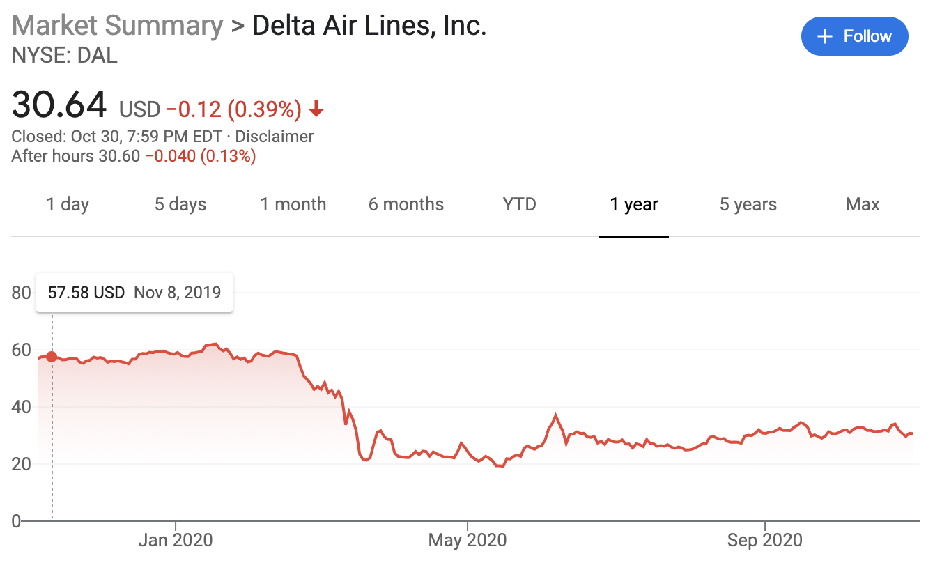
What is an example of a stock that has been impacted by external forces?

Slide 31
Agenda
Topic I
Obtaining Stock Data & Basic Visualization What is the financial market? Types of investing strategies. What is an API? API access to stock data in R Manipulate a time series object TTR_A.R
31

Slide 32



R has many API related libraries.
Quantmod handles the request & organizing data to a time series object.
Rather than code requests & parse responses ourselves we use the quantmod package.

Slide 33
Agenda
Topic I
Obtaining Stock Data & Basic Visualization What is the financial market? Types of investing strategies. What is an API? API access to stock data in R Manipulate a time series object TTR_A.R
33

Slide 34
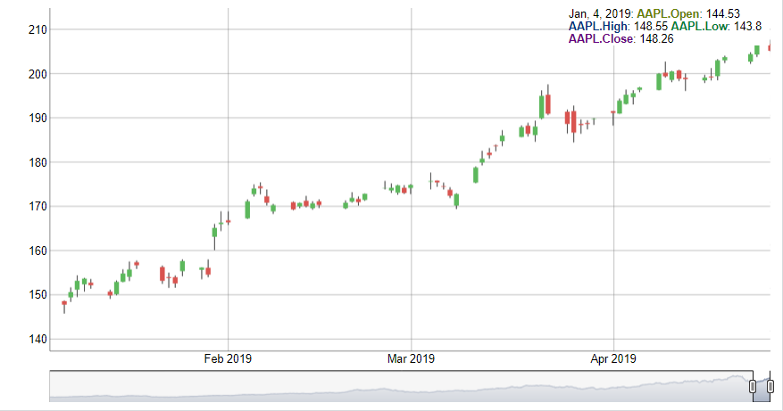
Interpreting a Candlestick Chart
Down Day
Up Day
High Price
High Price
Opening Price
Closing Price
Closing Price
Opening Price
Low Price
Low Price

Slide 35
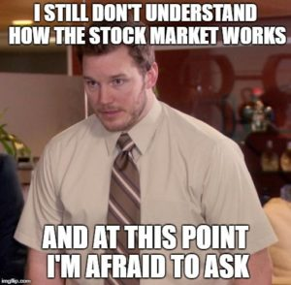
Let’s Practice! Open TTR_A.R
Learning Objective:
Get real stock data
Subset an xts object
Plot the time series dynamically
35

Slide 36
Agenda
Topic II
Creating the first indicator Explain what a technical trading rule/indicator is Learn what a lagged simple moving is Calculate & Visualize 3 SMAs to understand the “smoothing” effect on time series data TTR_B.R
36

Slide 37
Technical traders use “indicators” to trigger actions.
1. Indicator:
If the daily Boris Johnson quotes of “economic recovery” is greater than 5,
then buy (or hold) WLTW (Willis Towers Watson) the next day.
2. Back-testing:
In the last 180 days, this indicator has yielded a 6% return [fictitious]
3. In Production:
Set up a script to monitor Boris’ “economic recovery” quotes and buy if the number is greater than 5.
4. Execution:
In any given day that has quotes > 5 buy WLTW otherwise have no position.
5. Continual Monitor:
If you are in WLTW and quotes is < 5, then sell and vice versa.

Slide 38
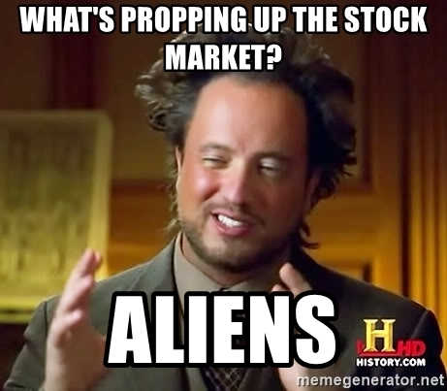
Technical Trading Assumptions
“what” > “why”
Price action > reasons for move (non-explanatory)
Technical traders don’t necessarily care why a price changes.
38

Slide 39
Technical Trading Assumptions
“what” > “why”
Price action > reasons for move (non-explanatory)
Known information is already reflected in the price.
Technical traders believe tradeable information is immediately embedded in the price (not worth the effort to “scalp” i.e. trade based on speed, acting on info before others ).
39

Slide 40
Technical Trading Assumptions
“what” > “why”
Price action > reasons for move (non-explanatory)
Known information is already reflected in the price.
Buyers & sellers trade based on emotion.
Fear & greed are powerful forces
Technical traders realize that some amount of trades occur due to emotion. Technical traders are unemotional when trading thereby exploiting the emotional traders.
40

Slide 41
Technical Trading Assumptions
“what” > “why”
Price action > reasons for move (non-explanatory)
Known information is already reflected in the price.
Buyers & sellers trade based on emotion.
Fear & greed are powerful forces
Markets fluctuate.
For technical traders to be successful, there needs to be pricing volatility.
41

Slide 42
Let’s zoom into Technical Trading Rules (TTR)
Our learning goal is to use and understand some of the common technical indicators which affect you as a saver, pension holder, stock trader etc.
Further research is needed to be successful.
Our learning goal is NOT to make you a trader or convince you that you are now qualified to be a technical trader.
42

Slide 43
Agenda
Topic II
Creating the first indicator Explain what a technical trading rule/indicator is Learn what a lagged simple moving is Calculate & Visualize 3 SMAs to understand the “smoothing” effect on time series data TTR_B.R
43

Slide 44
In addition to quantmod we will use TTR (technical trading rules)
library(TTR)
SMA() #simple moving average
MACD() #moving avg convergence/divergence
RSI() #Relative Strength Index
For expediency we will cover simple indicators but there are many more and you could even develop your own.
44

Slide 45

What is a moving average?
vec[1:15]
[1,] -11.070657
[2,] 3.774292
[3,] 11.844412
[4,] -22.456977
[5,] 5.291247
[6,] 6.060559
[7,] -4.747400
[8,] -4.466319
[9,] -4.644520
[10,] -7.900378
[11,] -3.771927
[12,] -8.983864
[13,] -6.762539
[14,] 1.644588
[15,] 10.594941
A smoothing technique reducing noise in a data series. Takes the average over “n” number of periods.
45

Slide 46

What is a moving average?
vec[1:15]
TTR::SMA(vec[1:15], n=5)
[1,] -11.070657
[2,] 3.774292
[3,] 11.844412
[4,] -22.456977
[5,] 5.291247
[6,] 6.060559
[7,] -4.747400
[8,] -4.466319
[9,] -4.644520
[10,] -7.900378
[11,] -3.771927
[12,] -8.983864
[13,] -6.762539
[14,] 1.644588
[15,] 10.594941
[1,] NA
[2,] NA
[3,] NA
[4,] NA
[5,] -2.5235367
[6,] 0.9027066
[7,] -0.8016318
[8,] -4.0637779
[9,] -0.5012865
[10,] -3.1396115
[11,] -5.1061087
[12,] -5.9534017
[13,] -6.4126457
[14,] -5.1548241
[15,] -1.4557603
A smoothing technique reducing noise in a data series. Takes the average over “n” number of periods.
46

Slide 47

So how does SMA become an Indicator?
Red Card! We need to lag the trading rule to ensure the signal is realistic. Calculations are not real time, but at the day’s close so you need to adjust the results to emulate a real scenario.
47

Slide 48
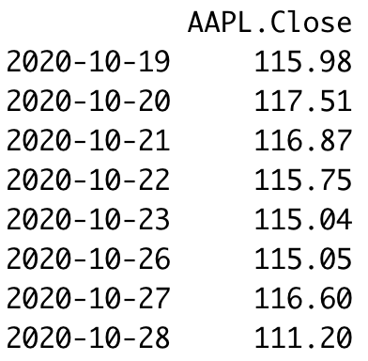
Why Lag? Version 1
Our Indicator:
“Buy if the previous day closing price was >$115 & sell if <$115
End of Closing Oct 19: Buy when the market opens Oct 20
End of Closing Oct 26, 27: Hold because the price is >115. You even hold Oct 28 all day because the indication is closing day price. At the end of Oct 28, the indication triggers at $111. You sell on Oct 29.
Because there is a lag for acting on the trigger, you move all data down by one period.
48

Slide 49
Why Lag? Version 2
Day 1 you have a closing price at 4:00pm EST
Day 2 you have a closing price at 4:00pm EST
Day 3 you have a closing price at 4:00pm EST
Day 4 you have a closing price at 4:00pm EST
Day 5 you have a closing price at 4:00pm EST
Day 6 at 9:30AM is the earliest you could trade using the 5 day MA.
As a result you have to move the results of the calculation ”down” 1 day because that is when you would have it for use (day6)
Now you have 5 complete data points to calculate the moving average.
*setting aside futures/after hours

Slide 50
Agenda
Topic II
Creating the first indicator Explain what a technical trading rule/indicator is Learn what a lagged simple moving is Calculate & Visualize 3 SMAs to understand the “smoothing” effect on time series data TTR_B.R
50

Slide 51
Open TTR_B.R
Learning Objective:
Get real stock data
Subset an xts object
Create three simple moving averages and plot to see the smoothing effect
51

Slide 52
Agenda
Topic III
Applying the SMA Indicator 50 & 200 day as a trading indicator Calculate the investment return with SMAs “death” and “golden” cross pattern Explain what a back-test is for evaluating an indicator Visualize the historical performance using a back-test TTR_C.R Q&A Break (5 minutes)
52

Slide 53
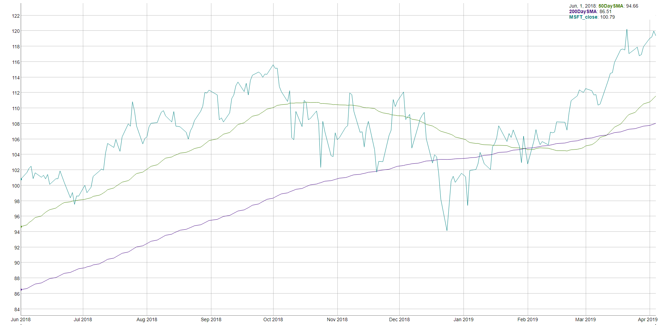
How does SMA become an indicator? MSFT 50 & 200 day SMA
“Golden Cross”
“Death Cross”

Slide 54
How does SMA become an indicator? MSFT 50 & 200 day SMA
“Golden Cross”
“Death Cross”
200 day: 9.5 months of trading
50 day: ~2.4 months of trading
Indicator Information
If the 50day average is > than the 200day then money is moving into the stock. Converse is True.

Slide 55
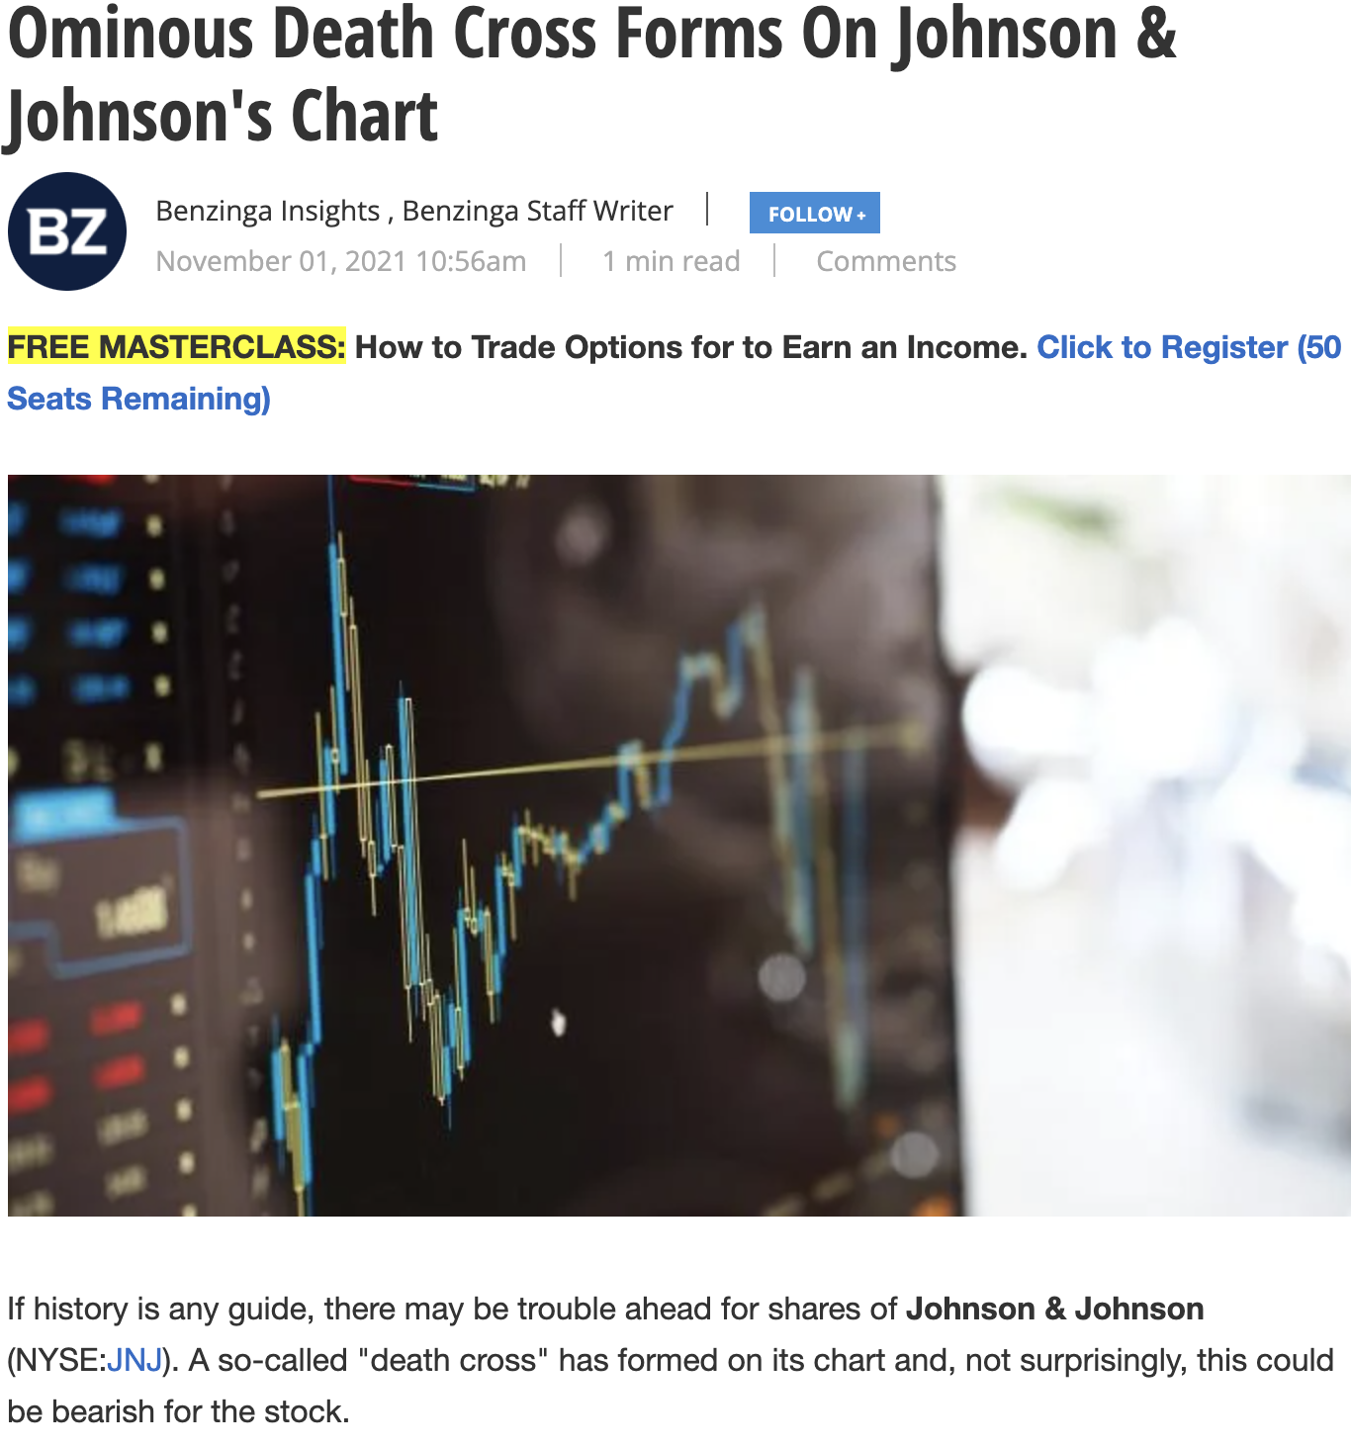
Do people really use SMA?
https://www.benzinga.com/markets/21/11/23791953/ominous-death-cross-forms-on-johnson-johnsons-chart

Slide 56
Agenda
Topic III
Applying the SMA Indicator 50 & 200 day as a trading indicator Calculate the investment return with SMAs “death” and “golden” cross pattern Explain what a back-test is for evaluating an indicator Visualize the historical performance using a back-test TTR_C.R Q&A Break (5 minutes)
56

Slide 57
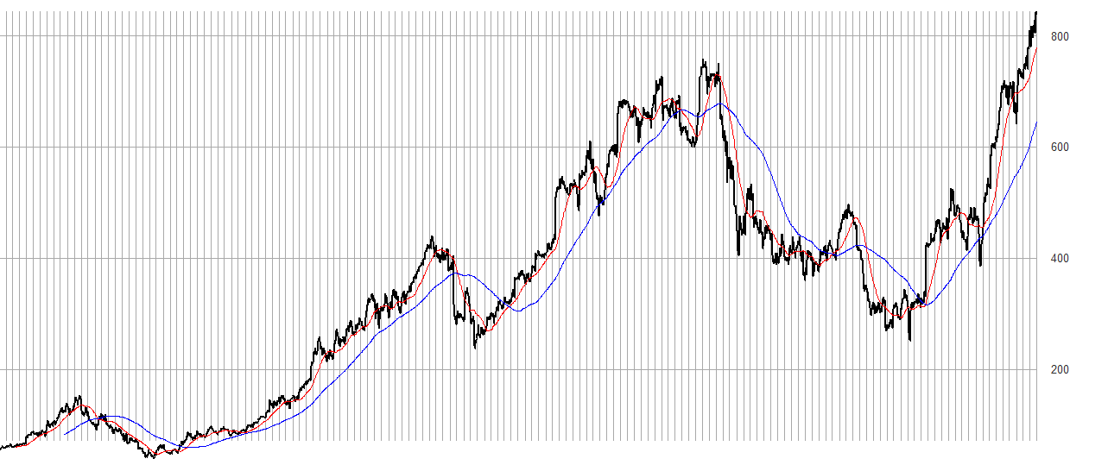
Once you have an indicator you must test it.
An investor can “backtest” the strategy to find an acceptable “n” in case 50/200 doesn’t work. Once the best “n” is found, an investor can look for “crosses” to indicate buy/sell.

Slide 58
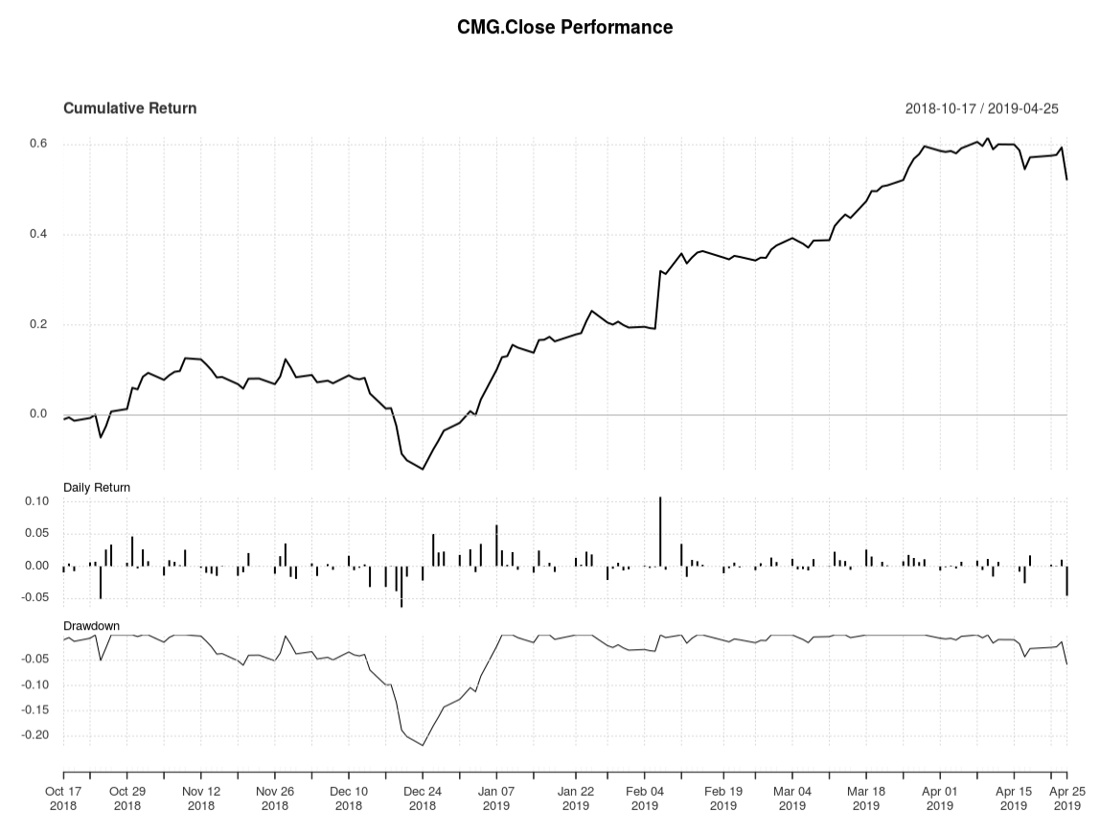
Interpreting the Rate of Change (ROC)
Total Cumulative Return using the rule.
Day to Day Return
Important if rule is sub one day periodicity.
Peak to trough % change, used to understand volatility.
SMA as an Indicator for CMG as shown in a performance chart.
58
Notes:
Peak to trough analysis is a measure of volatility and often used in intraday. A good resource is http://www.pring.com/articles/article7.htm

Slide 59
Agenda
Topic III
Applying the SMA Indicator 50 & 200 day as a trading indicator Calculate the investment return with SMAs “death” and “golden” cross pattern Explain what a back-test is for evaluating an indicator Visualize the historical performance using a back-test TTR_C.R Q&A Break (5 minutes)
59

Slide 60

Open TTR_C_50Day_200Day_SMA.R
Learning Objective:
Get real stock data
Subset an xts object
Calculate SMA 50 & 200
Create a trading indicator (rule)
Lag the Rule
Back-test the lagged rule to see cumulative returns
Switch a single character in the rule & back-test again to see the impact like Knight Capital
60

Slide 61
Agenda
Topic III
Applying the SMA Indicator 50 & 200 day as a trading indicator Calculate the investment return with SMAs “death” and “golden” cross pattern Explain what a back-test is for evaluating an indicator Visualize the historical performance using a back-test TTR_C.R Q&A Break (5 minutes)
61

Slide 62
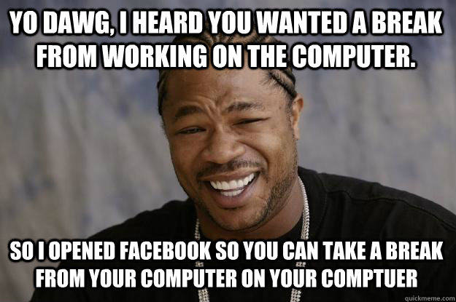
Break!

Slide 63
Agenda
Topic IV
Creating the MACD Indicator Walk through the moving avg convergence divergence indicator Manually calculate a standard moving average Apply the MACD signal as an indicator Visualize the stock & MACD in a dynamic plot TTR_D.R Debrief on MACD visuals & back-test Q&A
63

Slide 64
Moving Average Convergence Divergence
By measuring the moving average of two moving averages with different time frames, an investor hopes to capture when momentum is building or receding.

Slide 65

Moving Average Convergence Divergence
Money is moving into a stock…let’s jump on the upswing!
Money is moving away from a stock…let’s sell!

Slide 66
Moving Average Convergence Divergence
Instead of SMA’s “n”:
nFast(12) – the smaller window to measure (12 periods)
nSlow(26)- the longer window to measure (26 periods)
nSig(9)- the number of periods used to measure the avg difference “signal”
66

Slide 67
Moving Average Convergence Divergence
Instead of SMA’s “n”:
nFast(12) – the smaller window to measure (12 periods)
nSlow(26)- the longer window to measure (26 periods)
nSig(9)- the number of periods used to measure the avg difference “signal”
Calculate the 12 (nFast) day & 26 (nSlow) day moving averages.
Calculate the difference between averages from the previous step
Calculate the 9 day Moving Avg (nSig) of the previous step
67

Slide 68
Moving Average Convergence Divergence
Instead of SMA’s “n”:
nFast(12) – the smaller window to measure (12 periods)
nSlow(26)- the longer window to measure (26 periods)
nSig(9)- the number of periods used to measure the avg difference “signal”
Calculate the 12 (nFast) day & 26 (nSlow) day moving averages.
Calculate the difference between averages from #1 (in R it’s the MACD column)
Calculate the 9 day Moving Avg (nSig) of #2
When MACD output of #2 > Signal, the price is accelerating, positive momentum/money is coming to the equity which represents a buying opportunity. Converse is true.
68

Slide 69
Agenda
Topic IV
Creating the MACD Indicator Walk through the moving avg convergence divergence indicator Manually calculate a standard moving average Apply the MACD signal as an indicator Visualize the stock & MACD in a dynamic plot TTR_D.R Debrief on MACD visuals & back-test Q&A
69

Slide 70
Open TTR_D.R
Learning Objective:
Get real stock data
Subset an xts object
Calculate MACD
Plot a dynamic graph of the closing & MACD indicator
Visually inspect the results of buy/sell actions
Calculate cumulative return for the indicator
70

Slide 71
Agenda
Topic IV
Creating the MACD Indicator Walk through the moving avg convergence divergence indicator Manually calculate a standard moving average Apply the MACD signal as an indicator Visualize the stock & MACD in a dynamic plot TTR_D.R Debrief on MACD visuals & back-test Q&A
71

Slide 72
As a momentum indicator…
MACD captures when the market is moving positively or negatively towards an equity. When emotional sentiment is positive or negative.
MACD does not “Buy Low & Sell High” It’s buy high and sell higher!
MACD will not identify the market low point or high point exactly. So the returns will never be 100% of the possibility.

Slide 73
Agenda
Topic V
Creating & Applying the RSI Indicator Learn what a relative strength indicator is Interpret RSI as an indication Construction & visualization of RSI in dynamic plot with TTR_E.R
73

Slide 74
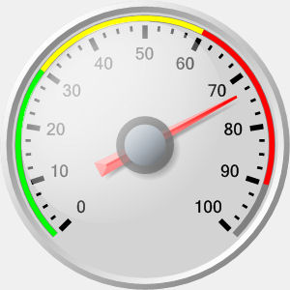
Relative Strength Index (RSI)
Momentum Oscillator
Index between 0-100
Compares average gains and losses in 14 day periods (“n”)
Usually interpreted as an overbought/oversold (over 70 / below 30)
* Usually uses EMA but we will do SMA.
74

Slide 75
Creates a control chart.
overbought
70
Sell
RSI
Hold
30
Buy
oversold
TIME
When the RSI dips below a threshold (30) the stock is considered “oversold” meaning the market has overreacted indicating a buying opportunity. RSI greater than 70 indicates the market is over buying the stock so it may be good to exit your position.
75

Slide 76
First the Relative Strength
RS = Avg Gain / Avg Loss
Avg Gain = For “up” days, total number of points up / number of “up” days (14 trading days)
Avg Loss = For “down” days, total number of points down/ number of “down” days (14 trading days)
76

Slide 77
Calculating the RSI
RSI = 100 - (100 / 1+RS)
Where RS:
RS = Avg Gain / Avg Loss
Avg Gain = For “up” days, total number of points up / number of “up” days (14 trading days)
Avg Loss = For “down” days, total number of points down/ number of “down” days (14 trading days)
77

Slide 78
Neutral RS
Avg Gain = 10 of the last 14 days, the stock went up 10 points,
10 points UP / 10 UP days = 1
RS = Avg Gain / Avg Loss
Avg Loss = 4 of the last 14 days, the stock went down 4 points,
4 points DOWN / 4 DOWN days = 1
RS = (10/10)/ (4/4)
RS = 1

Slide 79
Neutral RSI
RS = 1
RSI = 100 - (100 / 1+RS)
RSI = 100 - (100 / 1+1)
100 – (100/2)
100 – 50
50 (neutral)

Slide 80
Overbought RS
Avg Gain = 10 of the last 14 days, the stock went up 100 points,
100 points UP / 10 UP days = 10
RS = Avg Gain / Avg Loss
Avg Loss = 4 of the last 14 days, the stock went down 4 points,
4 points DOWN / 4 DOWN days = 1
RS = (100/10)/ (4/4)
RS = 10

Slide 81
Overbought RSI
RS = 10
RSI = 100 - (100 / 1+RS)
RSI = 100 - (100 / 1+10)
100 – (100/11)
100 – 9.09
90.9 (overbought)

Slide 82
Oversold RS
Avg Gain = 10 of the last 14 days, the stock went up 5 points,
5 points UP / 10 UP days = .5
RS = Avg Gain / Avg Loss
Avg Loss = 4 of the last 14 days, the stock went down 40 points,
40 points DOWN / 4 DOWN days = 10
RS = (5/10)/ (40/10)
RS = 0.5/4
RS = .125

Slide 83
Oversold RSI
RS = .125
RSI = 100 - (100 / 1+RS)
RSI = 100 - (100 / 1+.125)
100 – (100/1.125)
100 – 88.8
11 (oversold)

Slide 84
Open TTR_E.R
Learning Objective:
Get real stock data
Calculate RSI
Plot a dynamic graph of the closing & RSI indicator
Visually inspect the results of buy/sell actions
84

