Slide 1
3DConvAD
Milestone 2: Reproducibility
AUTHORS
Ambra Urso
Francesco Peragine
Valerio Longo

Slide 2
Data Version Control: Remote setup
Online data storage setup using a Network Attached Storage (NAS)
Access through SFTP (Secure File Transfer Protocol) protected via username and password
--local command options used to locally setup credentials in a config.local file that is ignored by git
$ dvc remote add -d thuls ssh://<external_ip>/3DConvAD
$ dvc remote modify --local thuls password <password>
$ dvc remote modify --local thuls user <username>

Slide 3
Data Version Control: Start tracking data
Source csv files added to DVC
Raw images source files moved to a data/external folder to keep a coherent structure
Preprocessing pipeline coded into make_dataset.py
Preprocessing pipeline is included into the DVC thanks to the DVC run command
$ dvc add data/raw/clinical-data.csv
$ dvc add data/raw/mri-session.csv
$ dvc run -n make-dataset\
–d data/raw/clinical-data.csv \
–d data/raw/mri-session.csv
–d data/external/OASIS3_MRI_SESSIONS/ \
–d data/external/OASIS3_MRI_FREESURFER/ \
–d src/data/make_dataset.py \
–o data/processed/clinical-mri.csv \
–o data/processed/clinical-mri-full.csv \
–o data/processed/data/ \
python src/data/make_dataset.py <args>

Slide 4
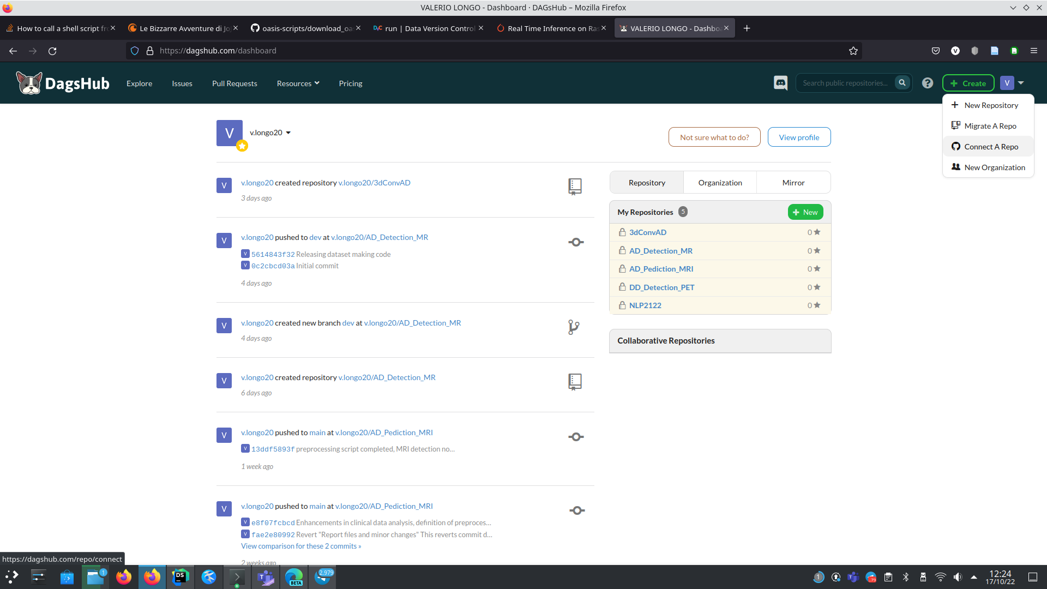
Experiment tracking: MLflow
Experiment and model tracking achieved by means of the MLflow integration provided by DagsHUB
GithHub project connected to DagsHUB
As a side effect we can also have a pretty view of the data pipeline

Slide 5
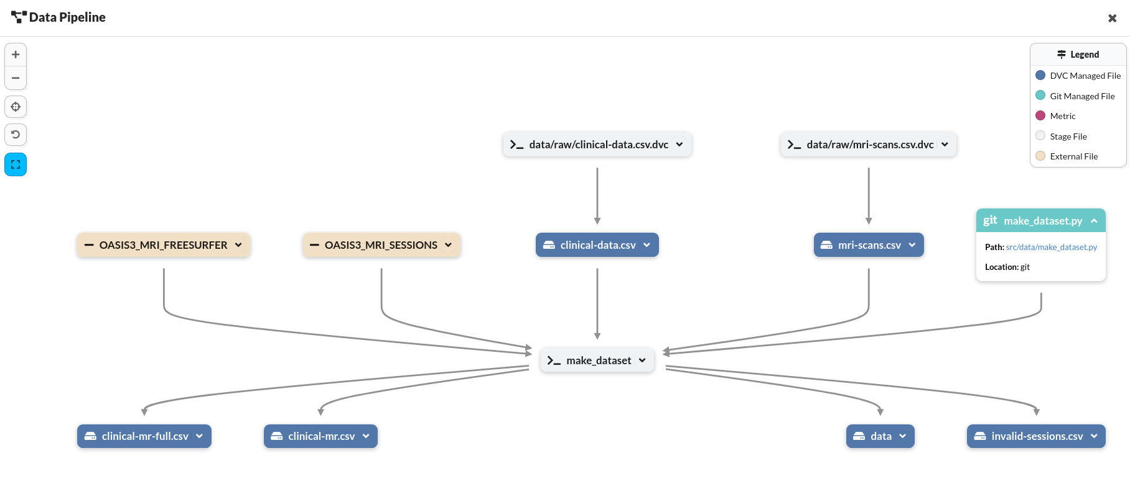
DagsHUB: Data pipeline view

Slide 6
DagsHUB: MLflow Model registry
The trained models are stored on MLflow as artifacts
Hence we can use MLflow registry

Slide 7
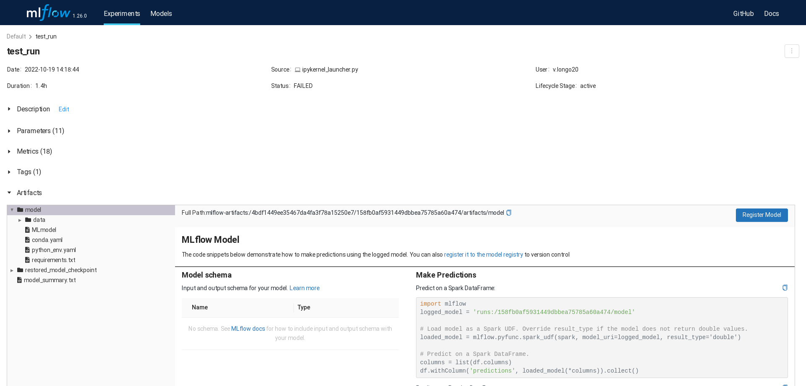
DagsHUB: MLflow Model registry

Slide 8
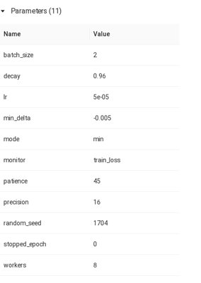
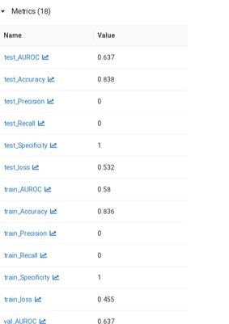
DagsHUB: MLflow Model registry

Slide 9
Thanks for the attention

