Slide 1
3DConvAD
Milestone 3: Quality Assurance
AUTHORS
Ambra Urso
Francesco Peragine
Valerio Longo

Slide 2
Agenda
What is QA
Static Analysis
Modules
Notebooks
Unit Testing
Pytest
Behavioral Testing
Minimum functionality
Invariance
Data Testing
Great Expectations

Slide 3
What is QA
What is expected
Formal specs
Activities
Static analysis
Reviews
Dynamic testing

Slide 4
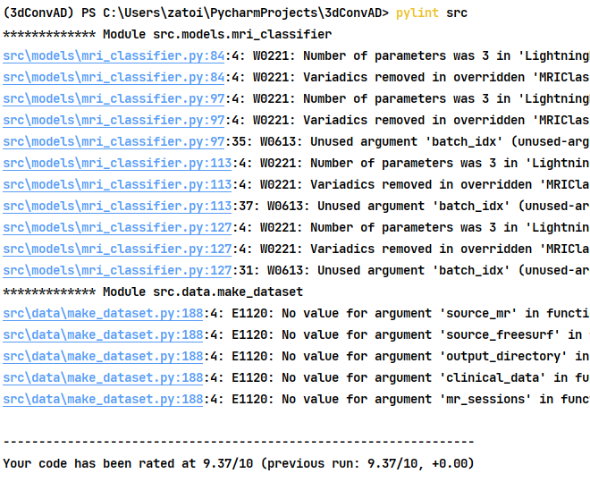
Static analysis: Modules
Pylint linting
Initial score: 5,47/10
Final score: 9,37/10
Modified configuration file:
good variables added (x, y)
Ignored torch module
Why not 10/10:
Torch lightning
Click

Slide 5
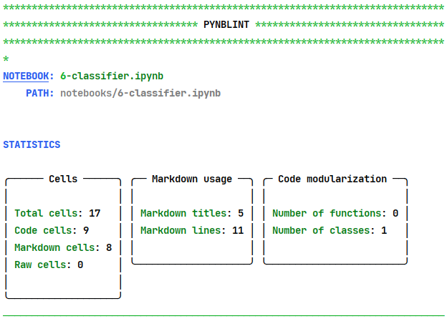
Static analysis: Notebook
Pynblint linting
Added Markdown cells
Moved all import cells to the top
Added conclusions

Slide 6
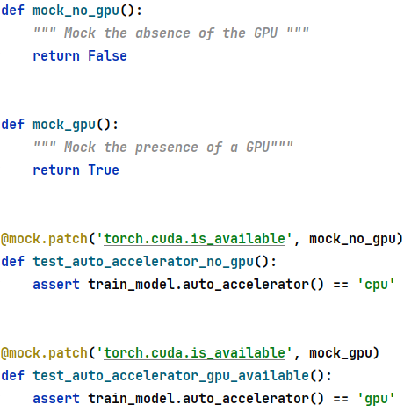
Unit Testing
Migration from unittest to pytest
Custom marks:
require_data
require_raw
require_model
Unittest mock support
Simulate availability GPU
Images are generated using tested code -> correct images

Slide 7
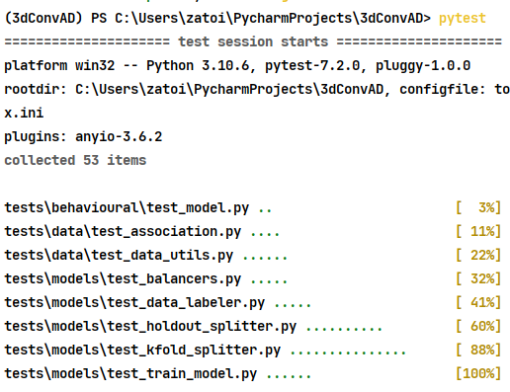
Behavioral Testing
Pytest assertions
Minimum functionality
Severe AD subject -> correctly identified
Invariance test
Rotation
Prediction (non rotated) ≈ prediction (rotated)

Slide 8




Data Testing: Great Expectations
Great Expectations pipeline
Setup
Connecting the Data
Datasources: Raw and Processed
Create Expectations
Suites: clinical-data , clinical-map , clinical-mr, clinical-mr-full, mri-scans, subjects
Validate Data
Checkpoints: run suites vs data

Slide 9
Data Testing: Great Expectations
2 Datasources to track raw and processed data
Tracked all .csv files (immutable)
Controls on unique indentifiers / null values
Tracked and pushed GE notebooks
Collaborative editing
Check diagnosis coverage in set from json dictionary
expect_column_values_to_be_in_set (col_name, <values>)

Slide 10
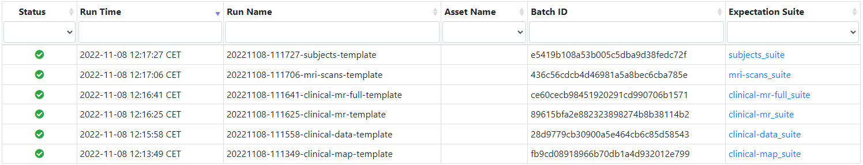
Data Testing: Great Expectations
Results:

Slide 11
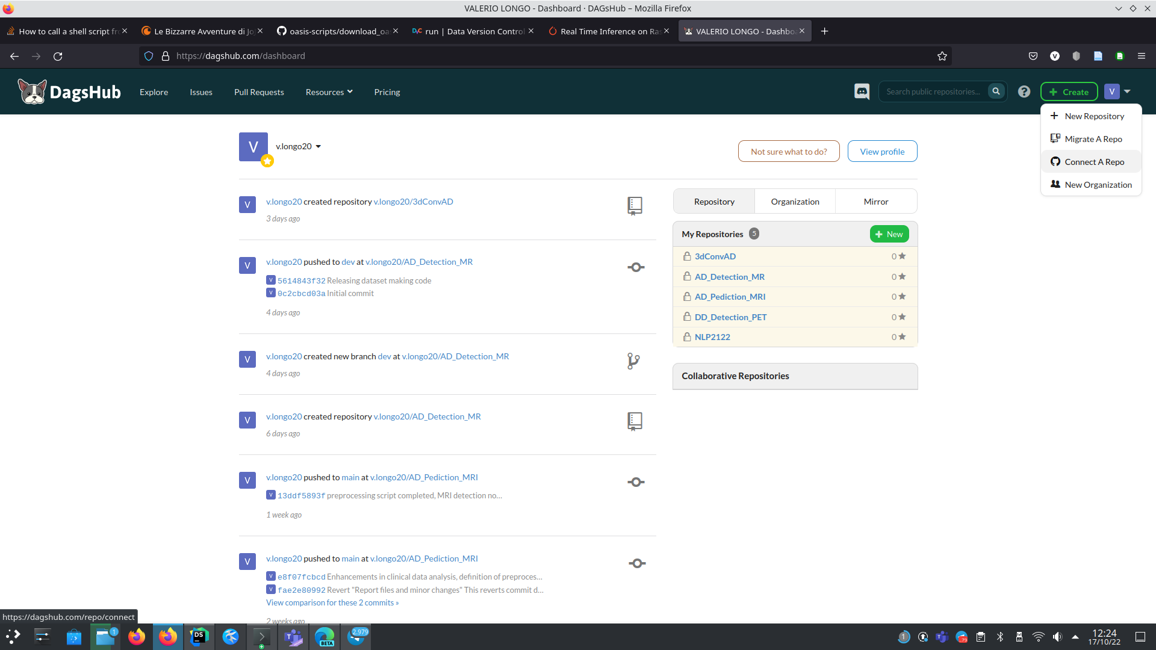
Thanks for your attention

