Slide 1
3DConvAD
Milestone 4: API
AUTHORS
Ambra Urso
Francesco Peragine
Valerio Longo

Slide 2
Agenda
Initial REST endpoints
Input constraints
Prediction time problem
Final REST endpoints
Testing

Slide 3
Initial endpoints
# HATEOAS sample response
{
message: "read the docs!",
docs_url: "https://docs.doc/docs"
}
Endpoints
Root --> GET ("/")
Prediction
Make prediction --> POST("/predict")
Results
Processed file --> GET("/files/processed/<file_id>")
Integrated gradients --> GET("/files/attribution/<file_id>")
Hypermedia as the Engine of Application State (HATEOAS):
Constraint of REST architecture
Entry points return response with references to additional resources
Robustness to changes
Roy T. Fielding 20 Oct 2008 - REST APIs must be hypertext-driven

Slide 4
Input constraints
Domain specific file formats
Input requirements
Fixed size
Clear brain volume
File sources alternatives
Brain volume extracted by hand
Raw MRI scan with additional mask
Encoded with pydantic validators
@pydantic.validator("brainscan")
# Validation on the specified field
def mime_type(cls, value)
def raw_type
def prep_type
...
@pydantic.root_validator
# Validation on all class fields
def cross_dependency(cls, values)
HINT: pylint warnings on "cls" parameter are handled by the pylint-pydantic plugin

Slide 5
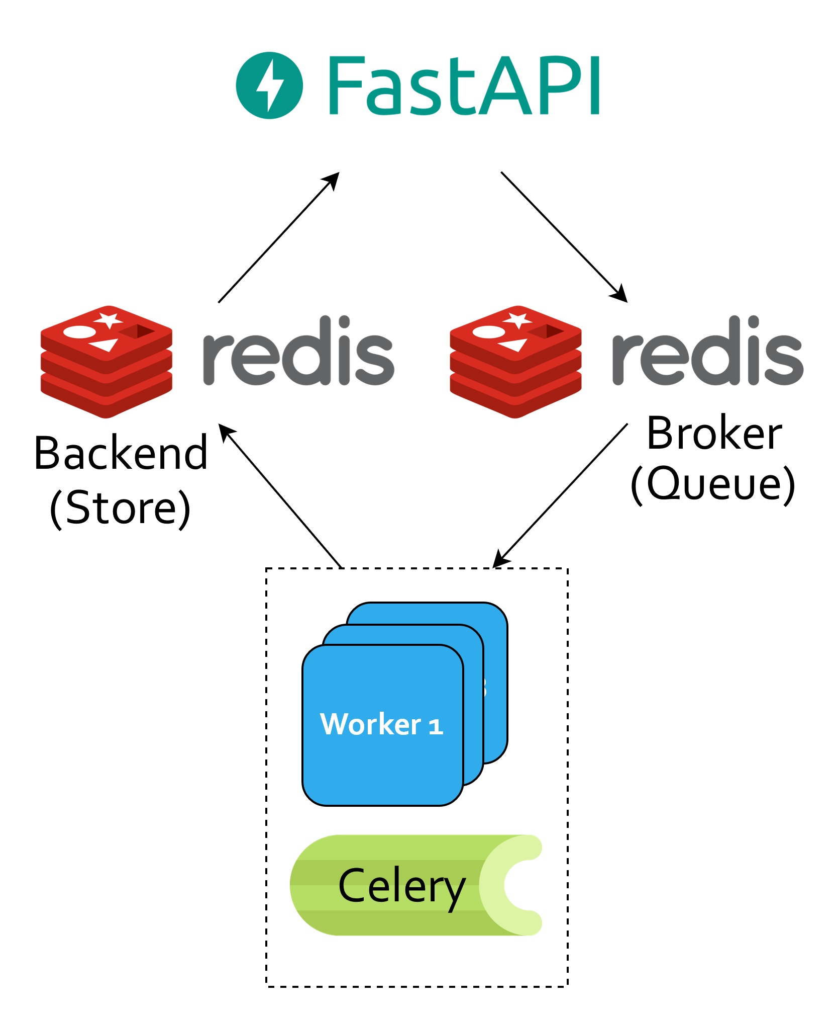
Prediction time problem /1
Problems:
Input pre-processing
Slow integrated gradient computation
Solution:
Decouple prediction request from actual computations
Tools:
Celery
Distributed task queue
Redis
Message broker
Data store

Slide 6
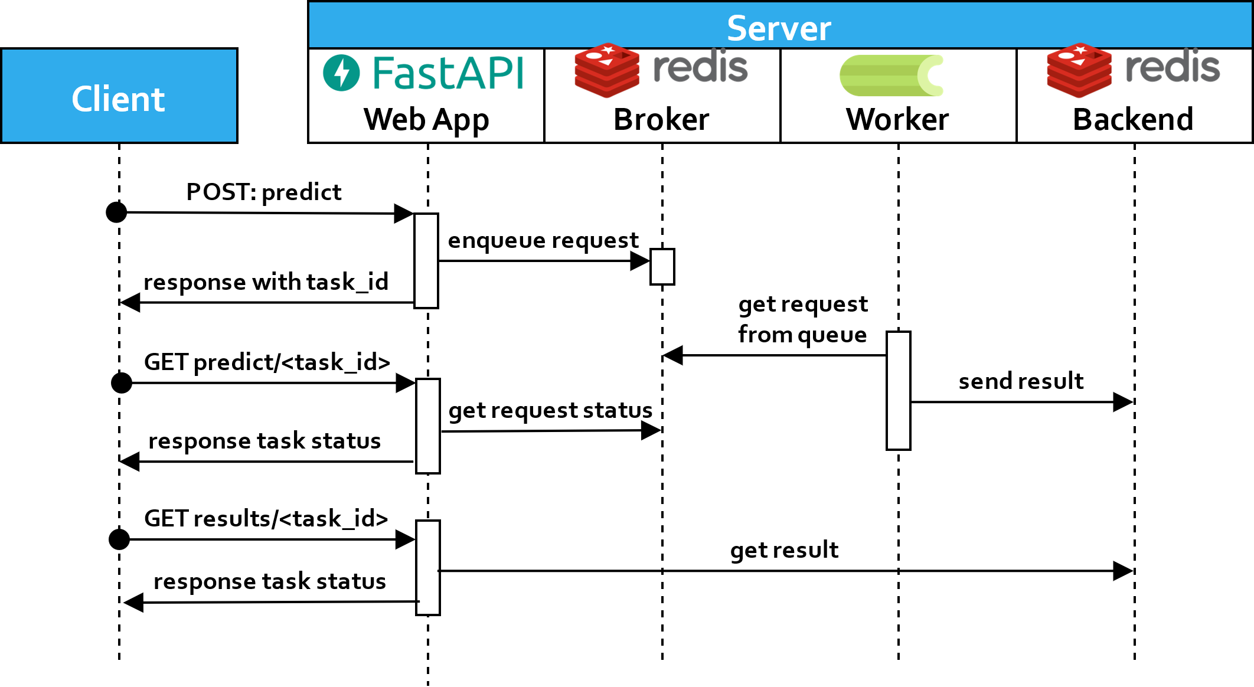
Prediction time problem /2
Pipeline sequence diagram

Slide 7
Final endpoints
Root endpoint --> GET ("/")
Model prediction
Make prediction --> POST("/predict")
Prediction status --> POST("/predict/<task_id>")
Results
Prediction results --> GET("/results/<task_id>")
Processed file --> GET("/results/<task_id>/files/processed")
Integrated gradients --> GET("/results/<task_id>/files/attribution")

Slide 8
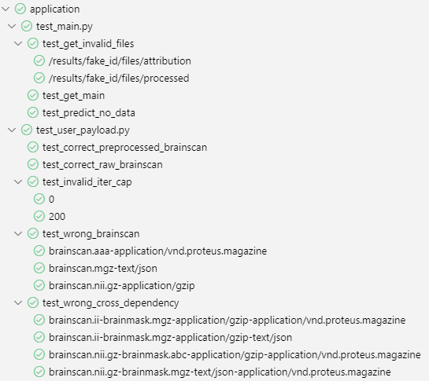
Testing /1
Pylint 10/10
Unit testing
API: Pytest + starlette client
Pydantic validators: pytest
Integration tests
Postman test suite

Slide 9
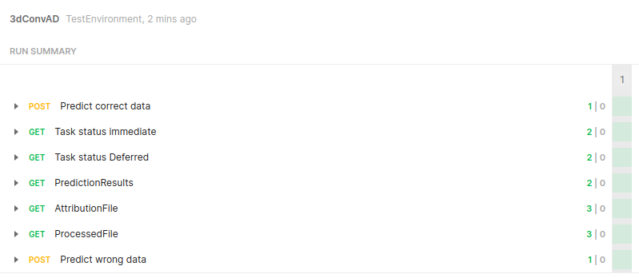
Testing /2
Postman subsequent HTTP requests

Slide 10
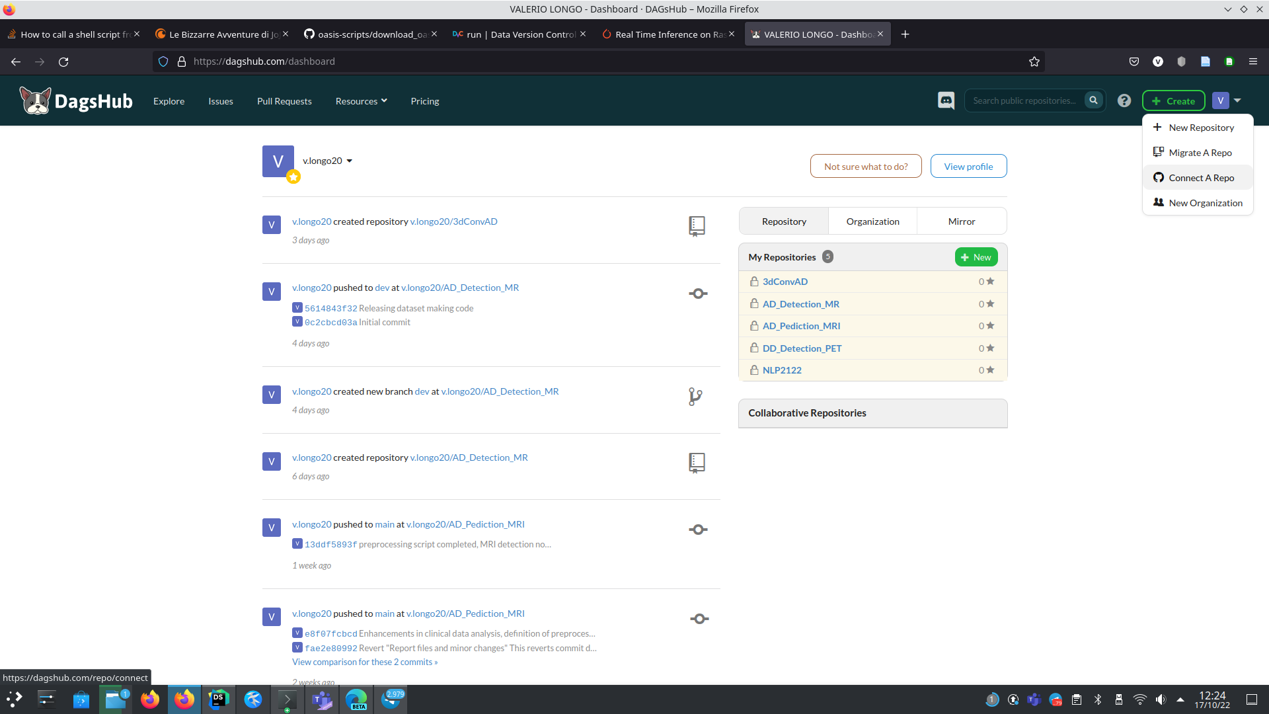
Thanks for your attention

