Slide 1
3DConvAD
Milestone 5: Deployment, CI/CD
AUTHORS
Ambra Urso
Francesco Peragine
Valerio Longo

Slide 2
Agenda
Architecture
Hosting
Speedup inference
Containerization
CI/CD

Slide 3
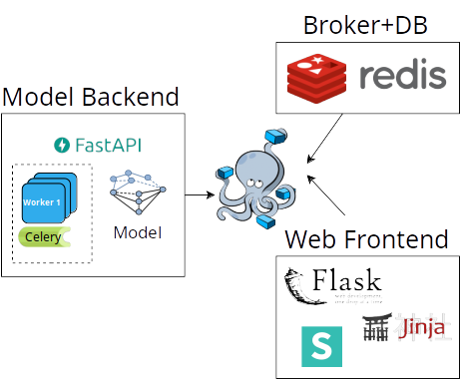
Architecture
Microservices
Frontend web based
Backend (Model)
Minimal requirements
Model Backend
FastAPI
Celery
Web frontend
Flask
Redis
Backend
Message broker

Slide 4


Hosting server
Rasperry Pi 4
ARM64 Architecture
4 GB RAM
64 GB HDD
Need for lightness
Rewritten model code to avoid unnecessary computation
Rewritten input processing
Removed intra-project dependencies
Containers accessible via apache2 reverse proxy

Slide 5
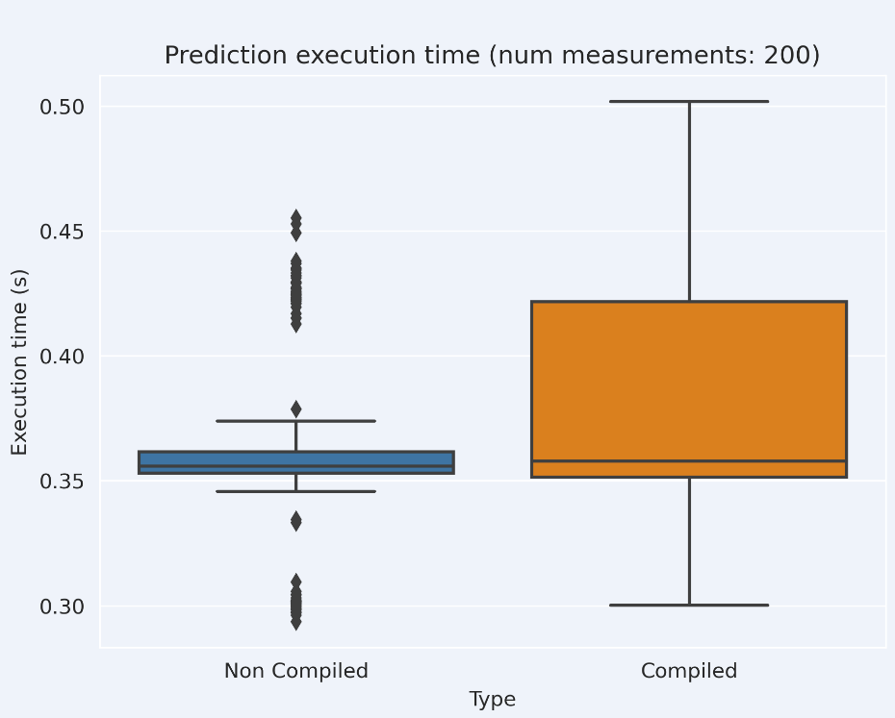
Speedup inference

Slide 6
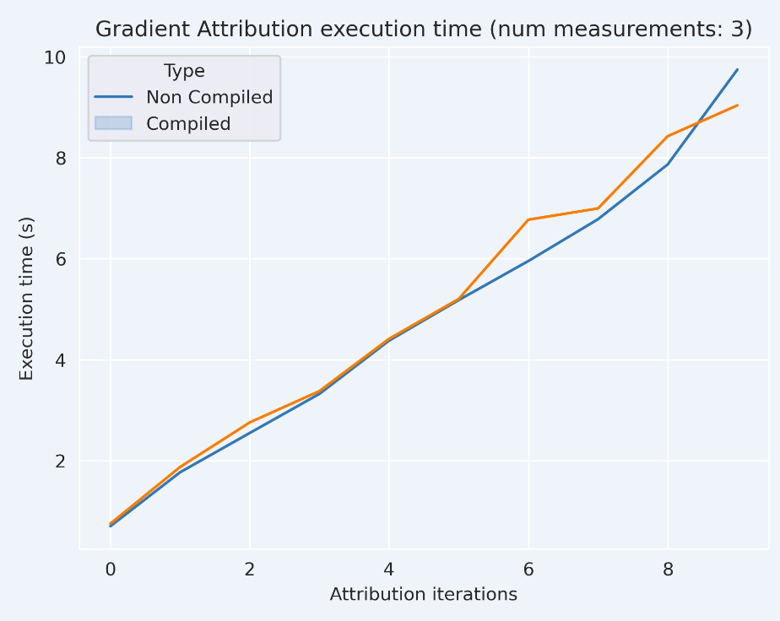
Speedup inference

Slide 7
CI/CD - Overview
Caching
Github runtime limit reached!
Self-hosted runners
Linux
MacOS
Windows
~800 workflow runs

Slide 8
CI/CD - Continuous Integration
Caching
Scheduling
Critical issue check
Mark stale issues and PR
on Push
Linting/Unmarked tests
on Push/Pull Request/Release
Marked tests
Workflow_dispatch
Workflow_call

Slide 9
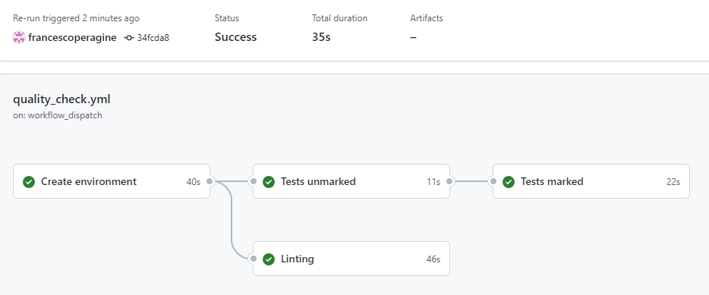
CI/CD - Continuous Integration

Slide 10
CI/CD - Continuous Deployment
Deployment workflows
Docker container build and push
Deploy to server

Slide 11
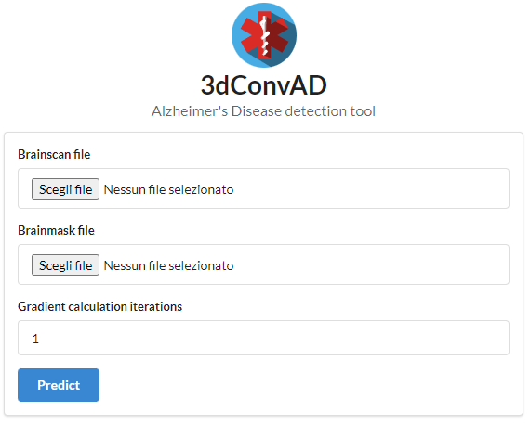
Containers: Overview
Model backend
Based on python slim
Depends on Redis
Automatically download trained model from MLflow
Web frontend
Based on python alpine
Docker-compose for orchestration
http://3dconvad.trendatre3.duckdns.org/

Slide 12
Docker build
Model container needs secrets for model download
FROM python:3.10.8-slim WORKDIR /app COPY requirements.txt /app RUN pip3 install torch --extra-index-url https://download.pytorch.org/whl/cpu ... COPY . /app RUN --mount=type=secret,id=ML_FLOW_USERNAME \ --mount=type=secret,id=ML_FLOW_PASSWORD \ export MLFLOW_TRACKING_USERNAME=$(cat /run/secrets/ML_FLOW_USERNAME) && \ export MLFLOW_TRACKING_PASSWORD=$(cat /run/secrets/ML_FLOW_PASSWORD) && \ python download_model.py ... CMD ["bash", "starter_script.sh"]

Slide 13
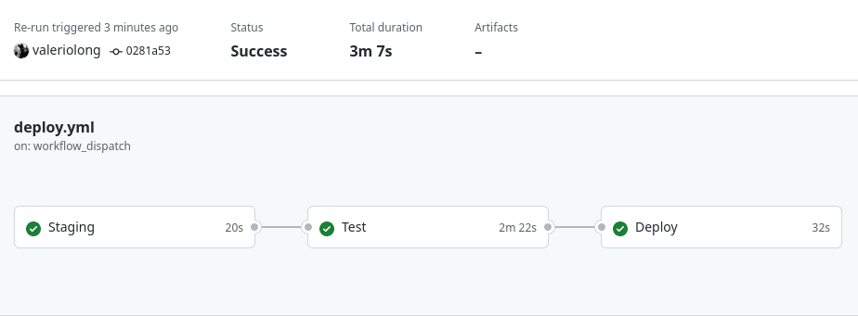
Deploy
Deployment split into three phases
Run services on staging server
Automatic testing on staging
Run services on deploy server

Slide 14
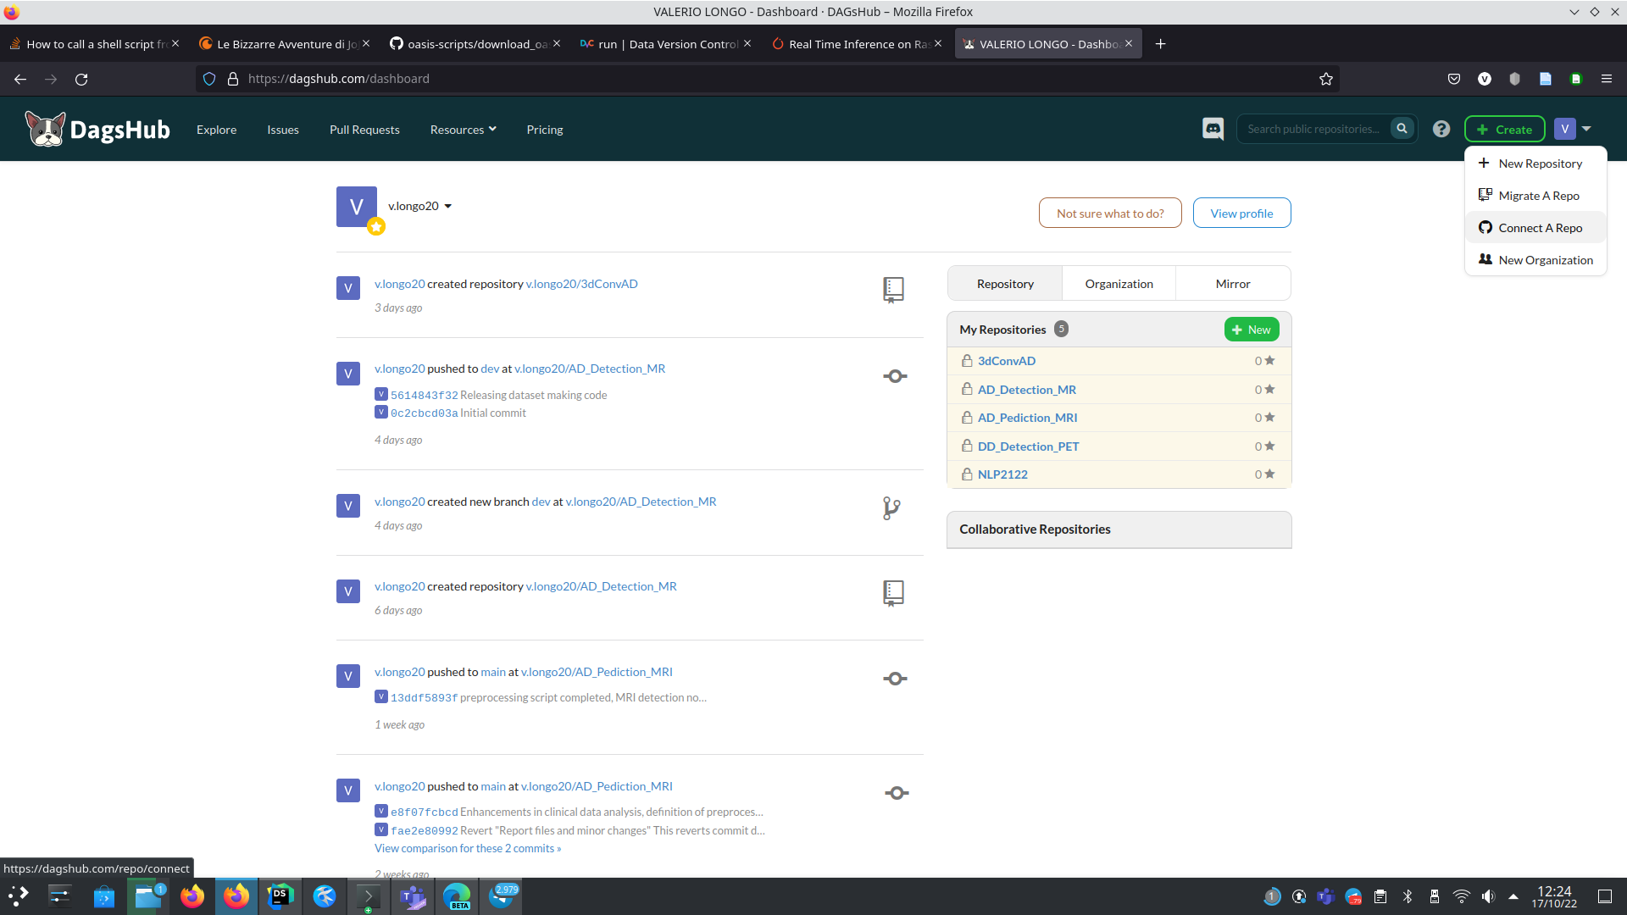
Thanks for your attention

