Slide 1
3DConvAD
Milestone 6: Monitoring
AUTHORS
Ambra Urso
Francesco Peragine
Valerio Longo

Slide 2
Agenda
System architecture
Drift detection
Alibi Detect
Platform monitoring
Better Uptime
Stress tests
Locust
Resources’ monitoring
Prometheus, Grafana

Slide 3
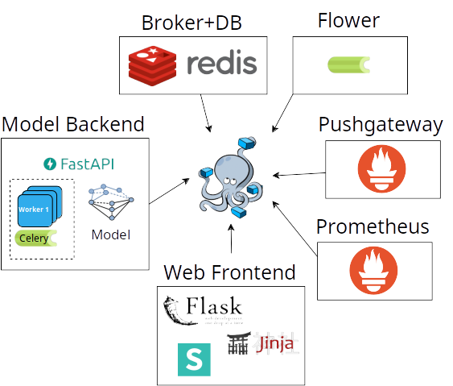
System architecture
Microservice architecture
Web front-end
Model back-end
Redis
Prometheus
Prometheus pushgateway
Flower/Celery
Asynchronous processing
Hosted on Raspberry Pi 4

Slide 4

Drift detection
Feature store implementation
Saves processed MRI, prediction results and features extracted from convolutional layers.
Files named with the corresponding timestamp
Online drift detection with Maximum Mean Discrepancy (MMD)
Drift detection:
Growing window
Fixed time window (1 hour)

Slide 5
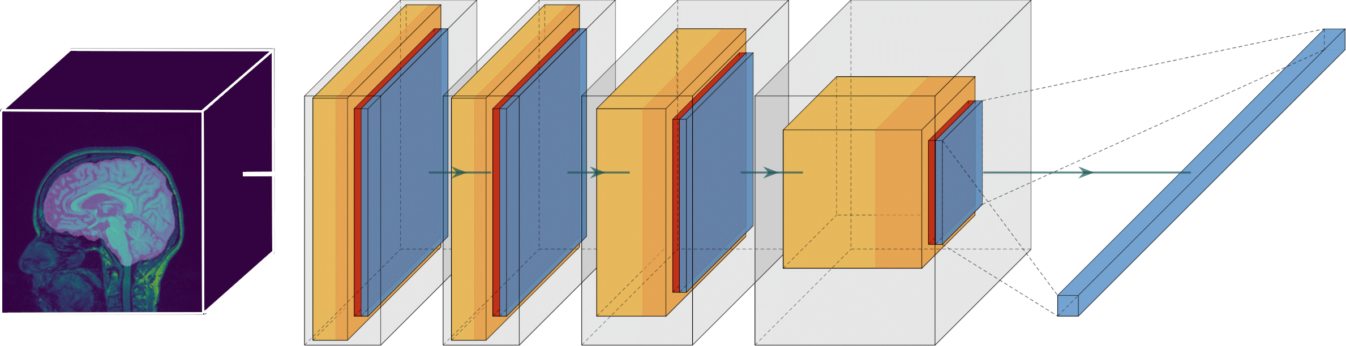
Drift detection
Model assumed to be well trained
Features extracted from CNN are general
Can be used for anomalous data and hence for drift detection
Reference features: Feature extracted from training set

Slide 6
Drift detection
Celery task scheduled every 10 minutes (for testing purposes)
Drift information metrics exposed through Prometheus Pushgateway
Prometheus Pushgateway provides metrics from batch jobs
self.registry = CollectorRegistry()
self.drift_info = Info("drift_fixed", "Drift status fixed window (last hour)", registry=self.registry, namespace="driftdetector")
…
result = self.detector.predict(x=x)
self.drift_info.info(result)
push_to_gateway('gateway:9091', job='drift_detect', registry=self.registry)

Slide 7
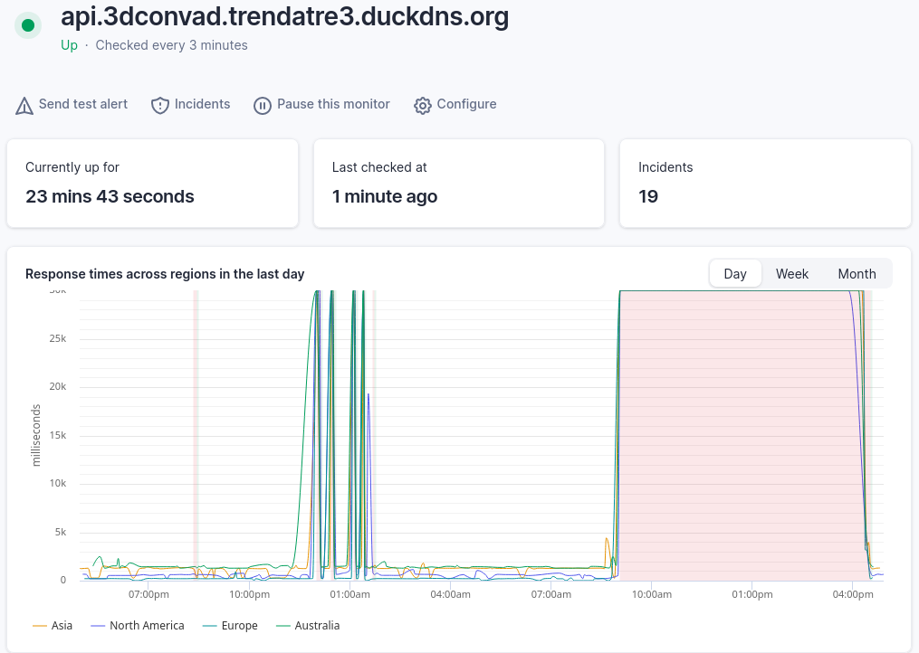
Platform monitoring: Better Uptime
Private server
Availability monitored
Beware the spam!

Slide 8
Stress Tests: Locust
User prototypes
StandardUser, CompulsiveUser
SequentialTaskSet
Sanity check - Exception handling
/predict – Keeps task_id for next steps
/predict/{task_id}
/results/{task_id}

Slide 9
Stress Tests: Locust
Double Wave test
Two peaks at different loads (60 and 30 users)
Time limit 600s (10m)
Step Load test
Two users increase at each step
Time limit 600s (10m)
Spawn Rate 1 user

Slide 10
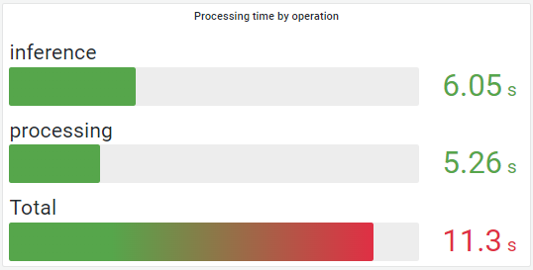
Stress Tests: Locust
Findings
Unacceptable preprocessing time (avg. 1 minute)
Heavily optimized
Checks added to avoid unnecessary computations
Less nibabel dependant
Numpy library

Slide 11
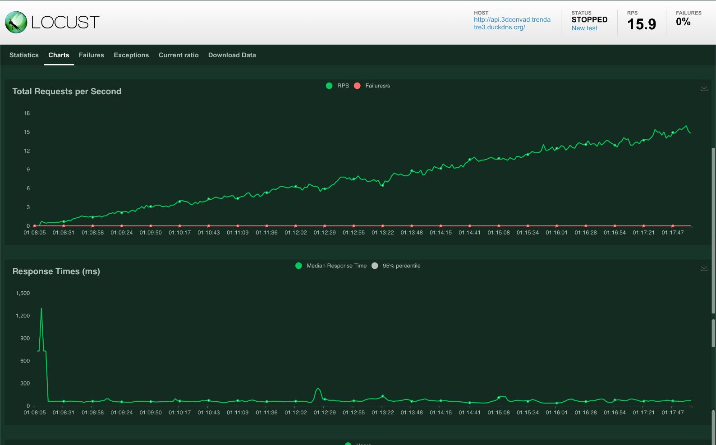
Stress Tests: Locust
Results – Step Load

Slide 12
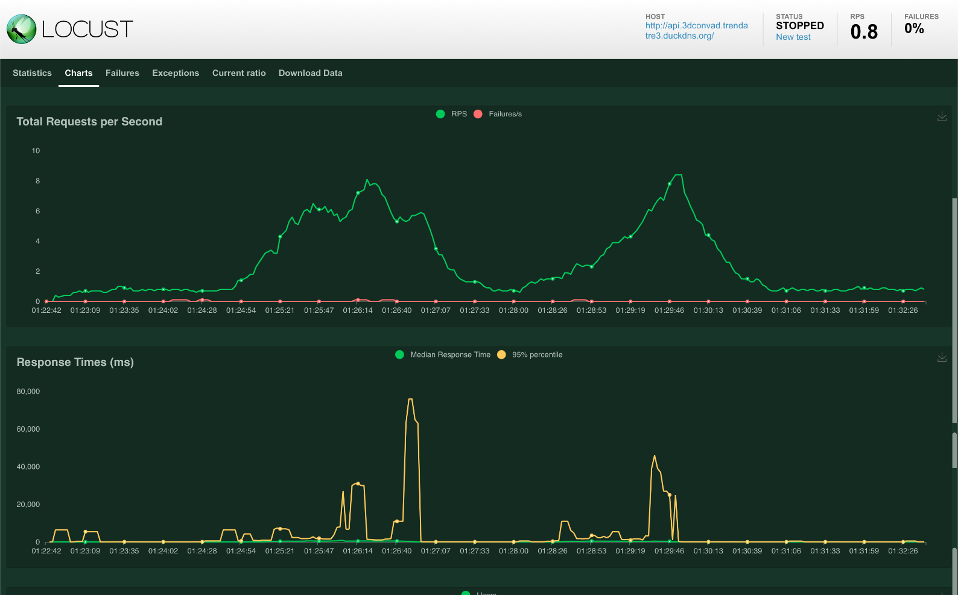
Stress Tests: Locust
Results – Double Wave

Slide 13
Monitoring resources
Prometheus FastAPI Instrumentator
Modified version that allows reading from the response body*
Celery tasks monitored by Flower (online_workers, prefetch_time, …)
Data drift metrics pushed to Prometheus Pushgateway
* Prometheus fastapi instrumentator PR-203

Slide 14
Monitoring resources: Custom metrics
Counters
user_agents_total: label mechanism used to track browsers
predicted_class: «positive/negative» labels
Summary
processing_seconds: «processing/inference» labels
attribution_iterations, payload_bytes
Info
drift, drift_fixed

Slide 15
Monitoring resources: Alert rules
Celery workers’ alerts
Worker offline
FailureRateTooHigh (> 1%)
PrefetchTimeTooHigh (> 5s)
Written in prometheus-alerts.yml
Loaded from configuration file
Alert manager not set due to the limited computational resources

Slide 16
Monitoring resources
Dashboards
HTTP: total requests, duration, avg. time by endpoint, request by methods, …
Backend: worker status, n. tasks currently executed, avg. task runtime, …
Drift Detector: MMD distance, MMD results
Node Exporter: CPU, Mem, Disk, network traffic, …
One playlist to watch them all.
*prometheuus-fastapi-instrumentator/pr-203

Slide 17
Thanks for your attention

