Slide 1
3DConvAD
Milestone X: _______________
AUTHORS
Ambra Urso
Francesco Peragine
Valerio Longo

Slide 2
Agenda
Arg1
Arg2
Arg2.1

Slide 3
TITLE
arg1
Arg1.1
arg1.1.1

Slide 4
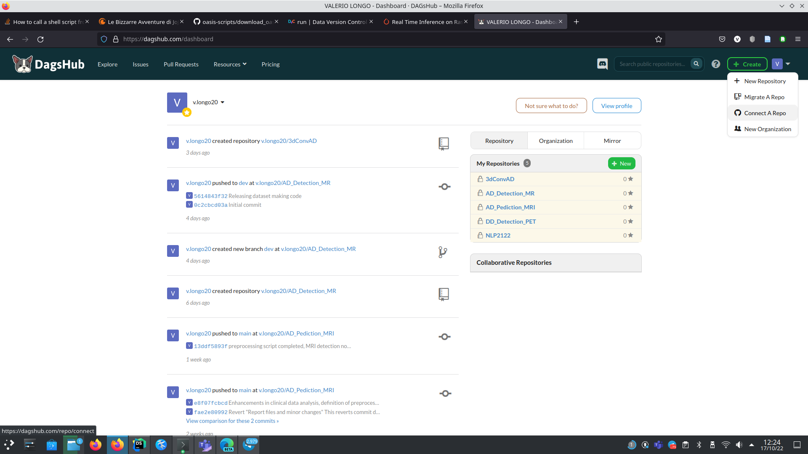
Thanks for your attention

