Slide 1
Customer Premise Equipment Management API Proposal

Slide 2


High-Level Overview
Customer Premises Equipment (CPE), refers to telecommunications and information technology equipment located at the customer's site, specifically associated with their account and address:
Wi-Fi routers
Modems
Set top boxes
The CPE Management APIs enhance functionality for value added resellers and vendors in the short-term rental sector, offering features such as:
Manage SSID
Reboot equipment

Slide 3
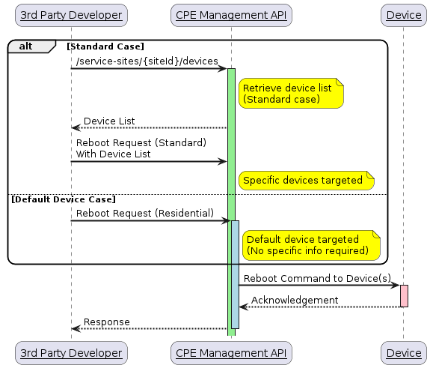
Example Flow
Standard CASE/DEFAULT DEVICE CASE - REBOOT DEVICE
Service Site
A distinct service owner location, as interpreted by the network operator, with one or more devices. A service site typically has a one-to-one relationship with the mailing address of the location.
Device
A network operator supplied network access device that supports isolated networks.

