Slide 1

2026 / 2
Reinventing Accessibility

Slide 2








































INCLUSIVE DESIGN & ACCESSIBILITY TEAM
30+
Accessibility Specialists
ROME
MILAN
TURIN
Notes:
Within Accenture Song's Inclusive Design team & Accessibility team, we work every day to build robust solutions for accessibility for our clients.

Slide 3





+
+
A suite of tools to manage and monitor digital accessibility, powered by a robust agentic AI engine.
Copyright © 2024 Accenture. All rights reserved.
3

Slide 4

+
+
A single solution to manage accessibility
EFFICIENCY
EMPOWERMENT
OPTIMIZATION
Thanks to GenAI, operational effort required to manage and monitor websites can be significantly reduced.
Built to scale accessibility beyond specialist teams, the suite enables wider organisational adoption.
The solution is designed to streamline accessibility operations and ensure compliance with AgID requirements
Copyright © 2024 Accenture. All rights reserved.
4

Slide 5

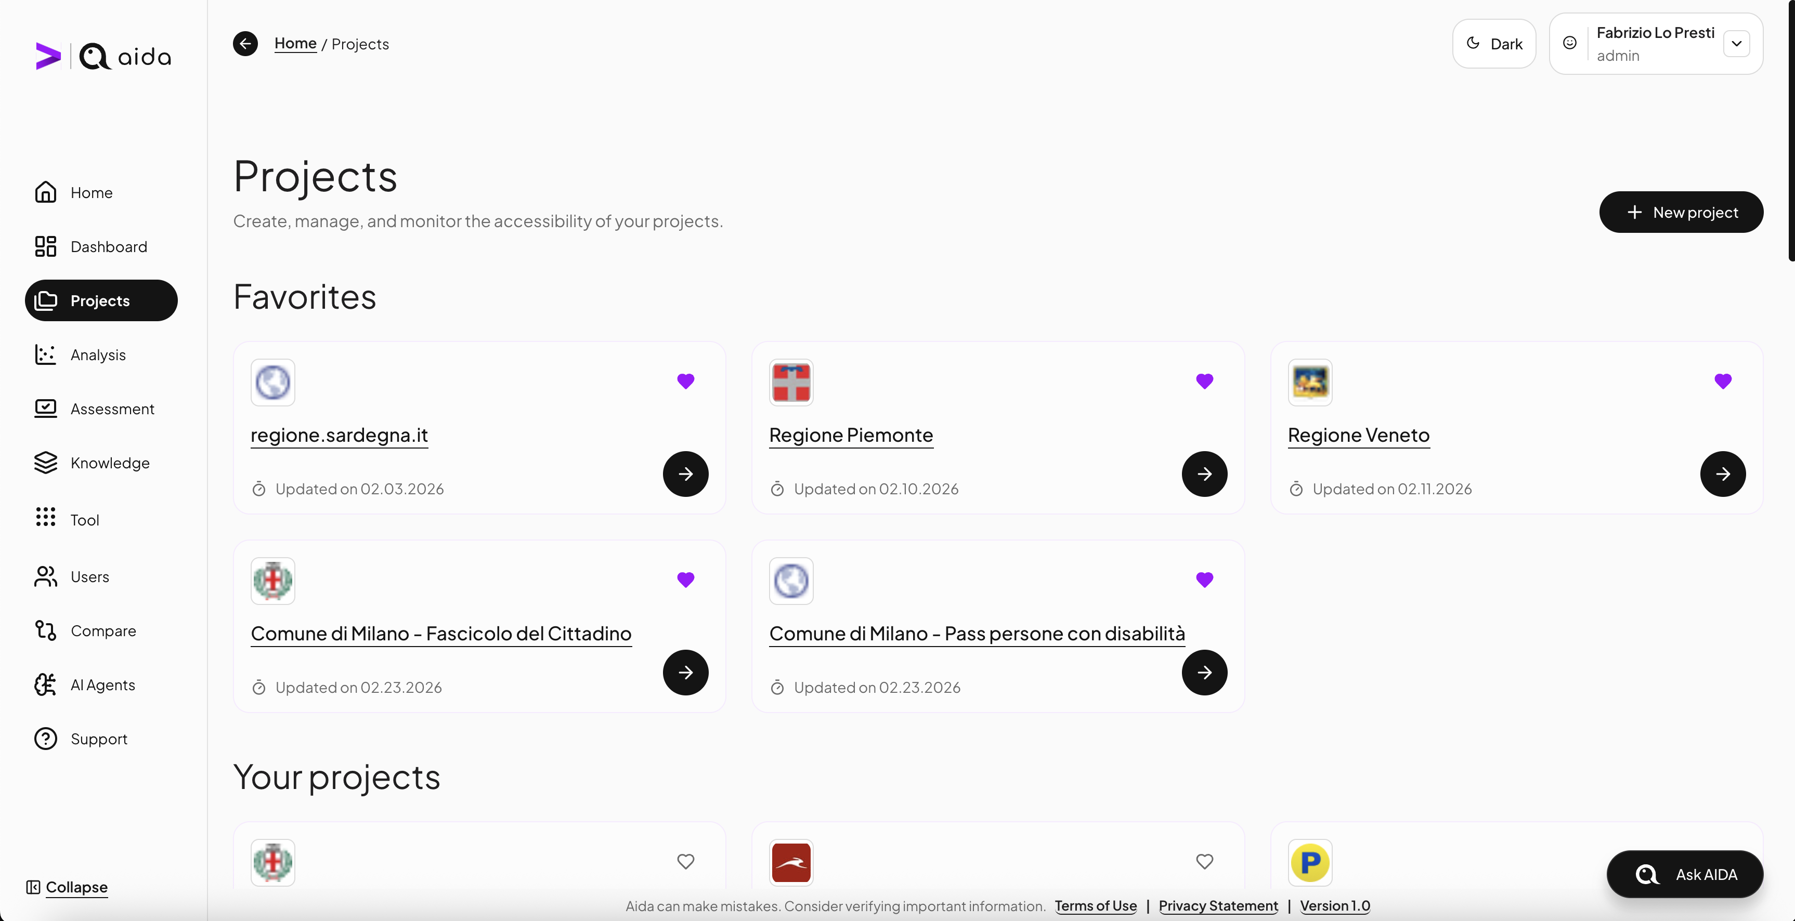
01
GenAI accessibility suite
Analizza tramite AI aree critiche e l'identifica azioni correttive.
+
Compila automaticamente la dichiarazione di accessibilità AgID.
Diagnosi veloci e confrontabili nel tempo.
Utilizzabile da utenti non esperti in temi di accessibilità.

Slide 6
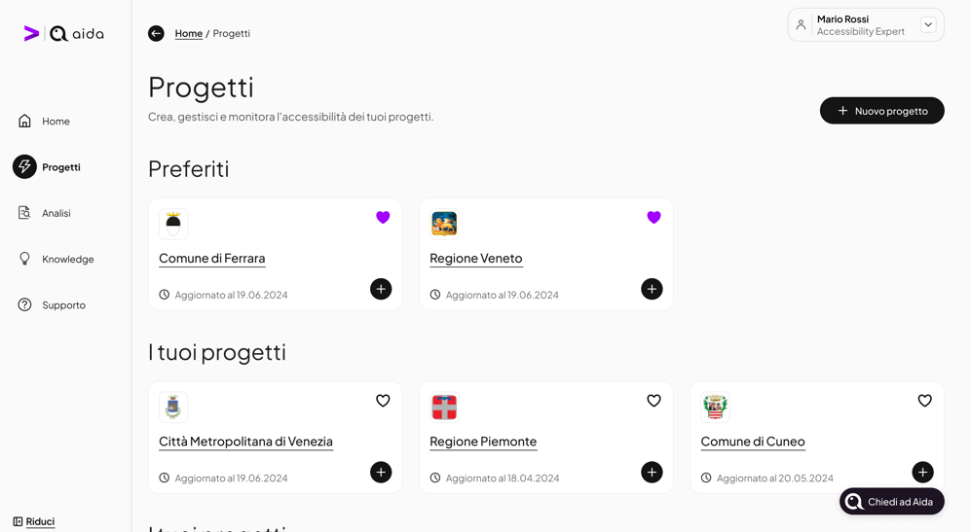
01
GenAI accessibility suite
+
Accelerates the detection and resolution of accessibility issues.
Uses AI to identify critical areas and recommend corrective actions.
Automatically generates the AgID accessibility statement.
Fast diagnostics, comparable over time.
Enables organization-wide adoption beyond specialist team.

Slide 7
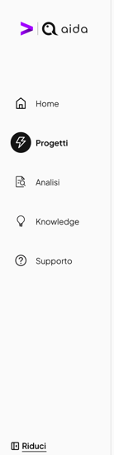
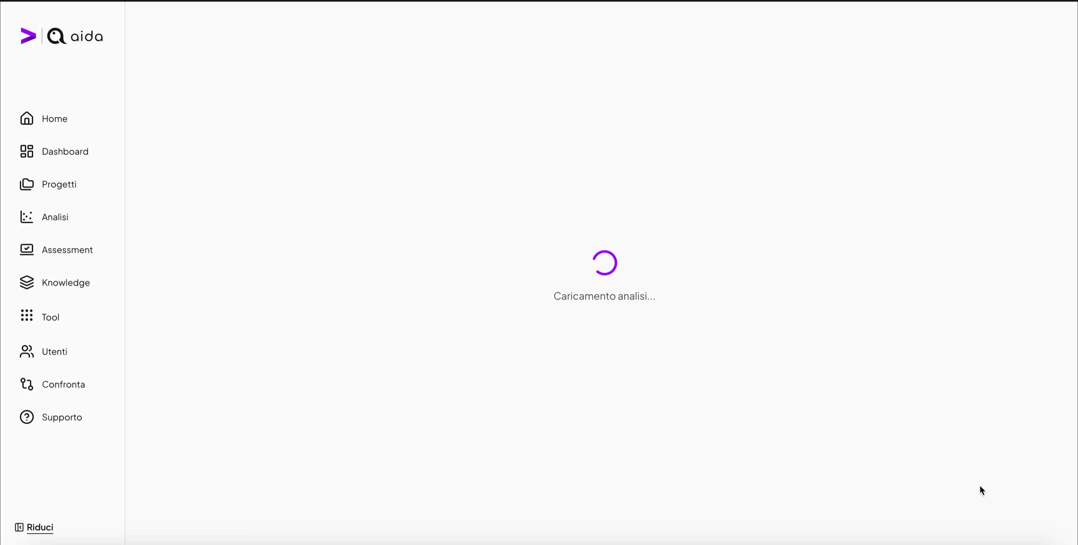
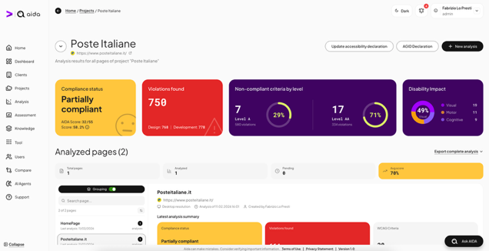
01
GenAI accessibility suite
+
Accelerates the detection and resolution of accessibility issues.
Uses AI to identify critical areas and recommend corrective actions.
Automatically generates compliance accessibility statements*.
Fast diagnostics, comparable over time.
Enables organization-wide adoption beyond specialist team.
*where required by laws.

Slide 8

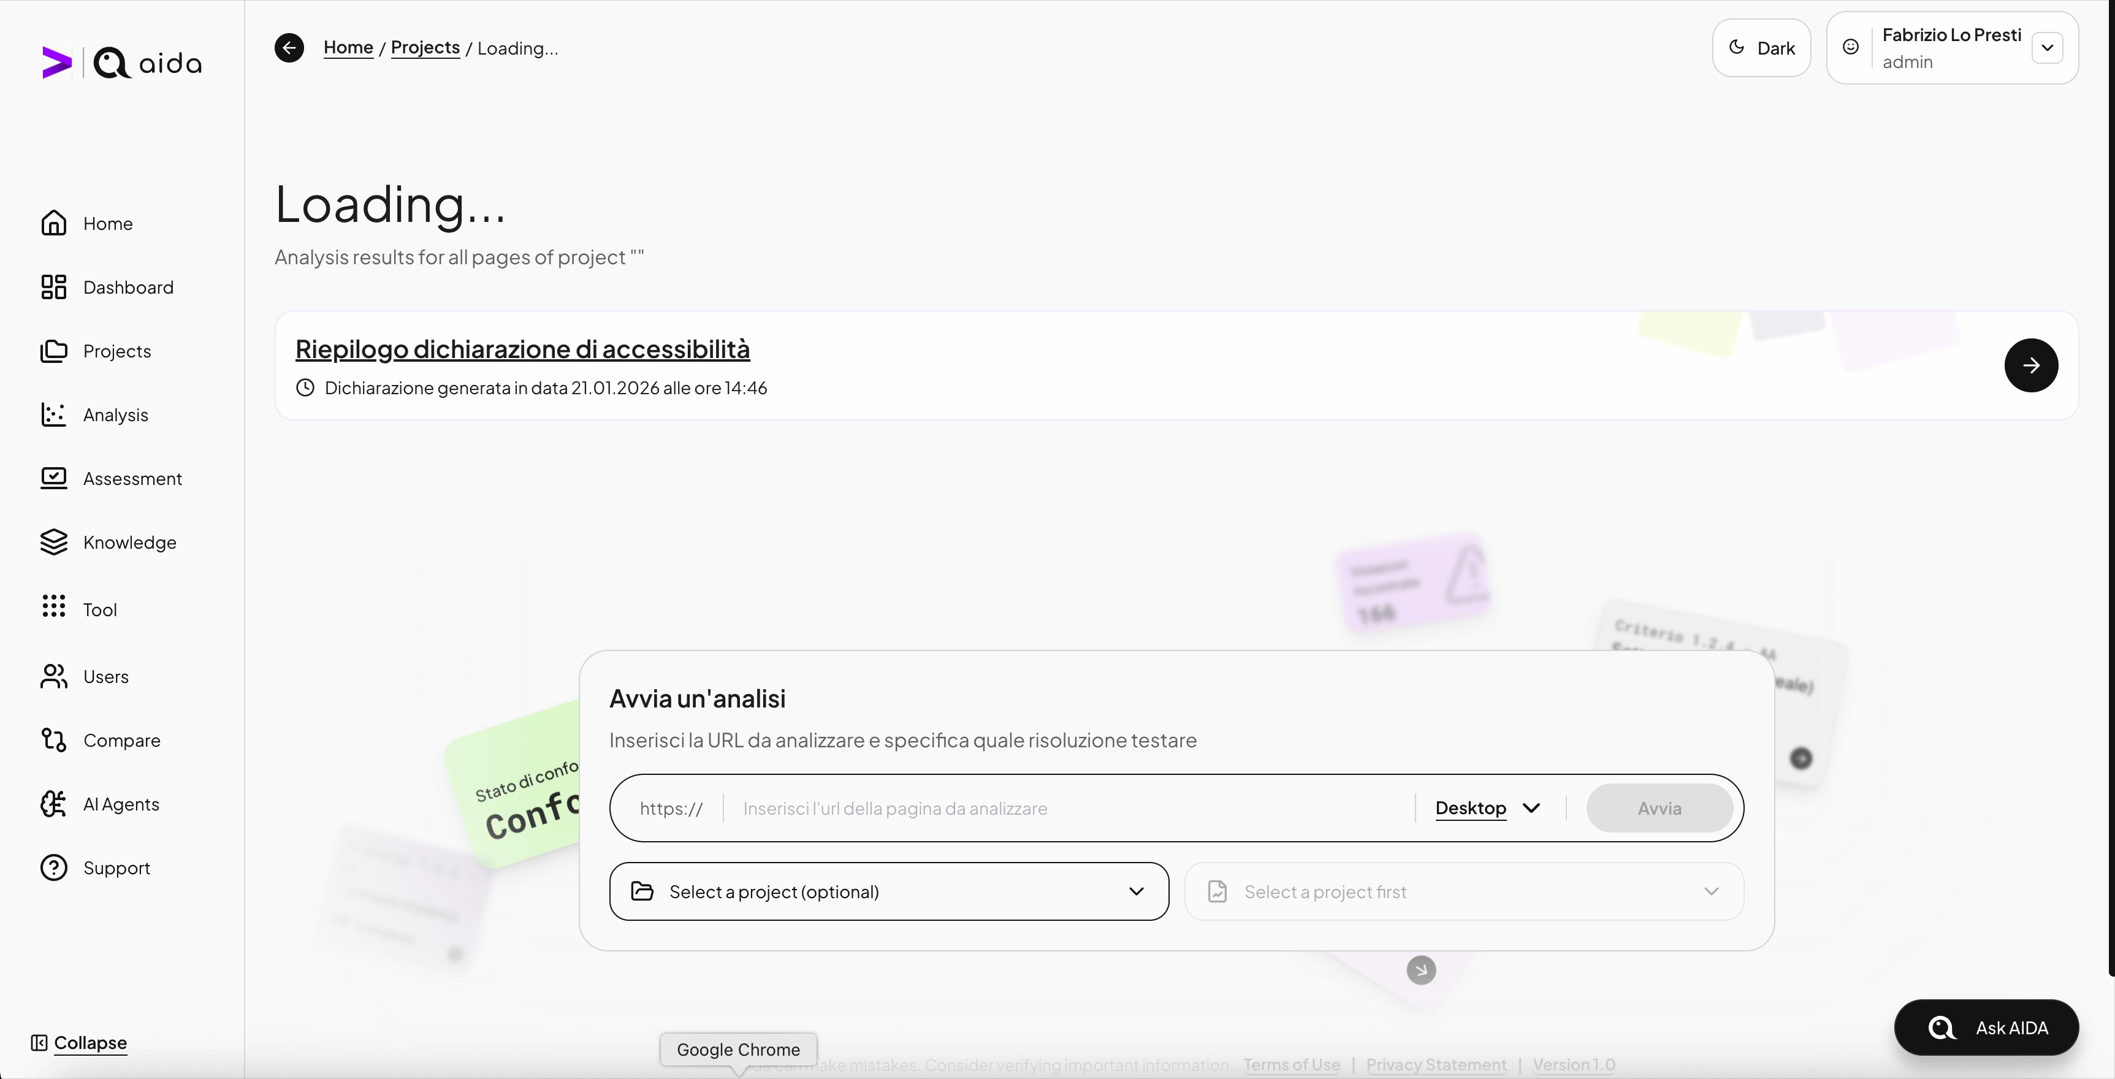
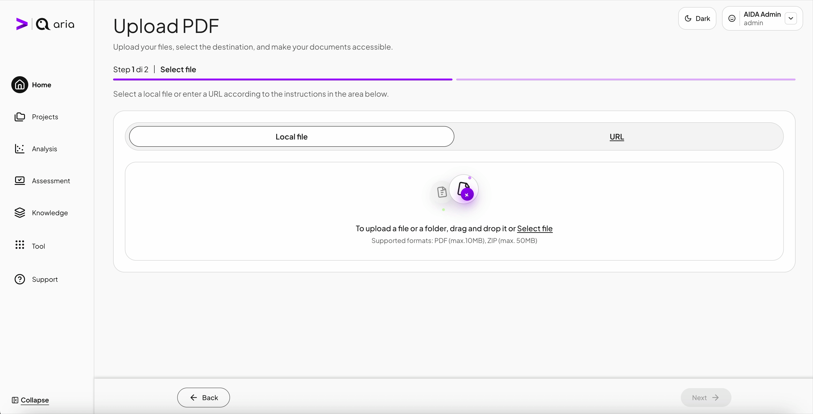
01
GenAI accessibility suite

Slide 9
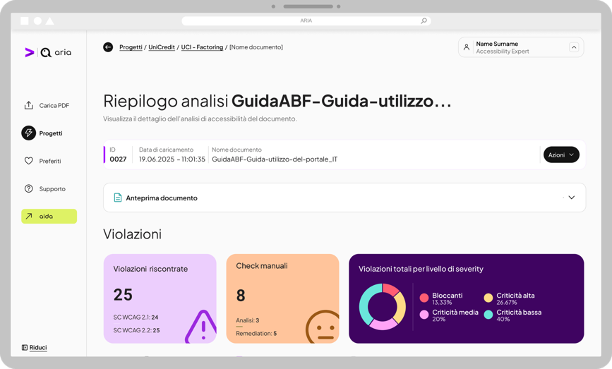
01
GenAI accessibility suite
The solution for making non-web documentation (PDFs) compliant
Bulk and rapid scanning of non-web documents (PDF).
Automated document compliance remediation.
📑 Scannerizzazione massiva e rapida di documenti non–web (PDF).
🏛️ Messa a norma automatica dei documenti.
👩‍💻 Possibilità di trasformare i documenti PDF in pagine HTML editabili.
Ability to convert PDF documents into editable HTML pages.

Slide 10
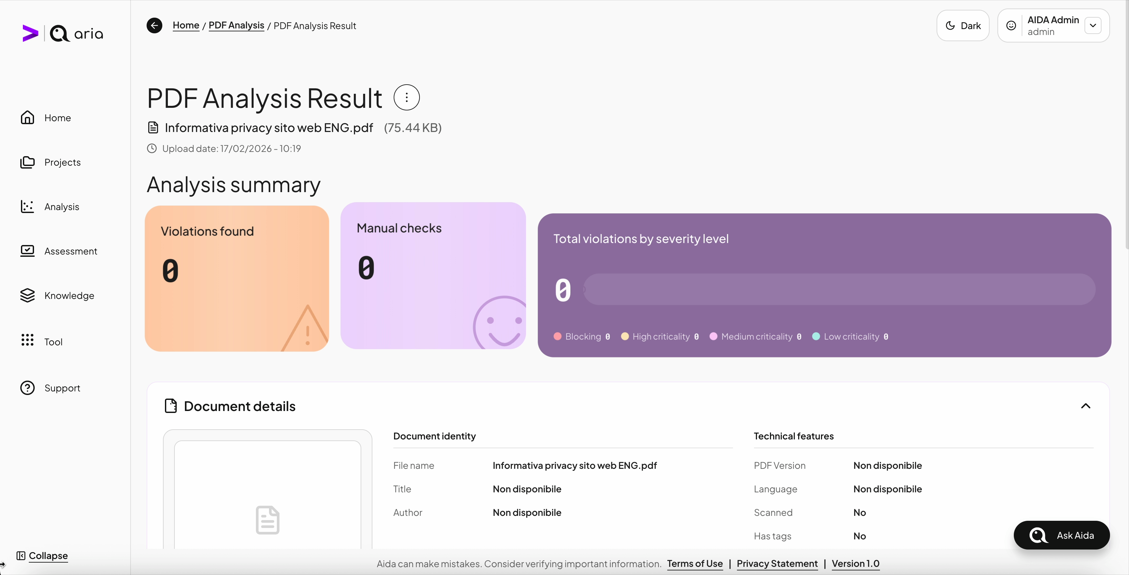
MIGLIORARE L’IMPATTO GRAFICO
01
GenAI accessibility suite
The solution for making non-web documentation (PDFs) compliant
Bulk and rapid scanning of non-web documents (PDF).
Automated document compliance remediation.
📑 Scannerizzazione massiva e rapida di documenti non–web (PDF).
🏛️ Messa a norma automatica dei documenti.
👩‍💻 Possibilità di trasformare i documenti PDF in pagine HTML editabili.
Ability to convert PDF documents into editable HTML pages.

Slide 11
01
GenAI accessibility suite
AIDA is trained on our team’s expertis and hands-on experience, built over years of fieldwork.
AI-powered testing
Compliance score (%)
Conversational AI assistant
Suggested code fixes |  | (text-based guides)
Support for EAA and AgID🇮🇹 compliance requirements
Remediation integrata nel workflow
✦
✦
✦
✦

Slide 12
01
GenAI accessibility suite
Future outlook
Technical Scalability
Expansion of AIDA’s skills
Certifications
E-commerce Conversion Rate Optimization Assessment
ISO 9001 Quality
ISO 27001 Data Security
Brand Guidelines Assessment and Communication
ISO 27701 Privacy

Slide 13















Storie di successo raccontate dai risultati: numeri concreti e azioni mirate che hanno reso i progetti realmente accessibili.
Our Clients

Slide 14

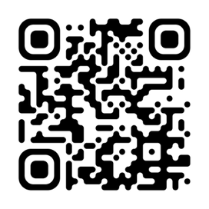
Contacts
Fabrizio Lo Presti
Experience Director
Accenture SONG
Design & Digital Products

Slide 15
Thank You.
Notes:
Dove gli altri vedono ostacoli, noi costruiamo accessibilità

