Slide 1


Offline2Online RL

Slide 2
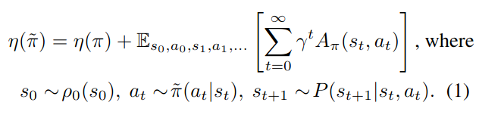
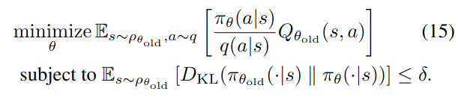

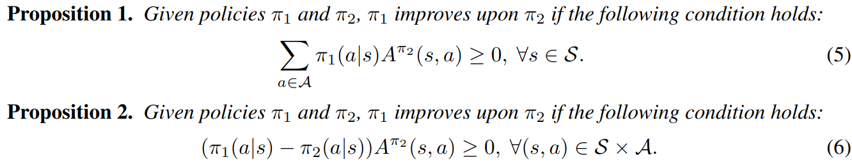
TRPO/PPO/HPO
TRPO:
PPO:
HPO:
Online Policy improvement gurantee

Slide 3
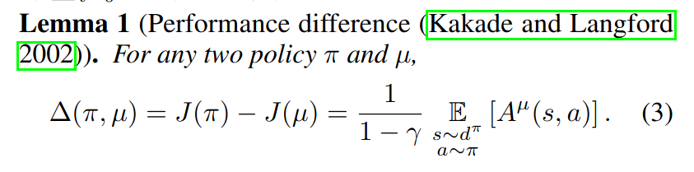
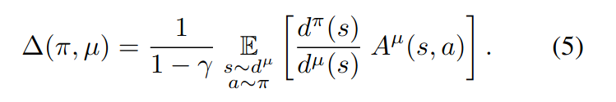

SBAC
Offline Policy improvement gurantee

Slide 4
Offline2Online
Offline Policy improvement gurantee
Online Policy improvement gurantee

Slide 5


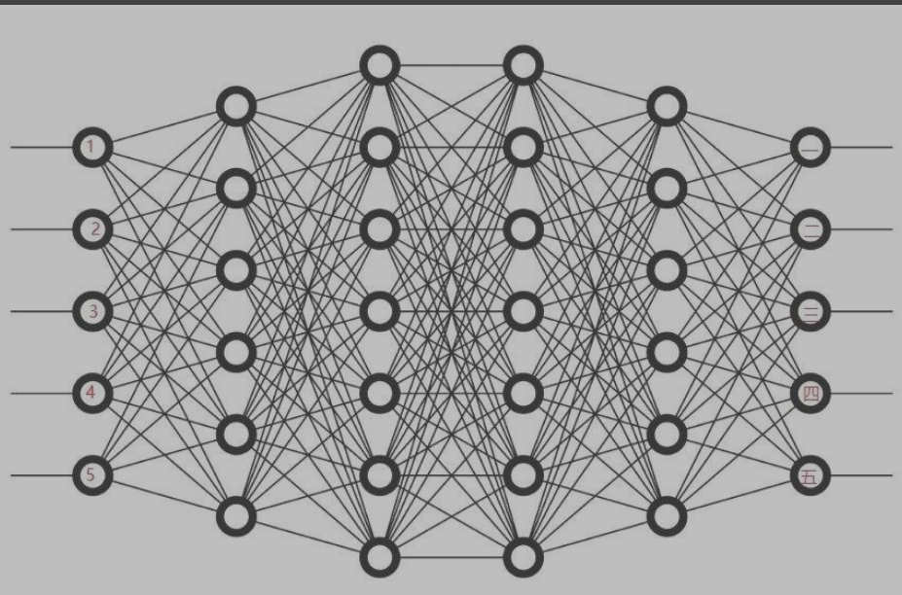






Offline2Online: Offline
Dataset
BC
Dataset

Slide 6
Offline2Online: Offline2Online
PPO
TRPO
HPO
...
Dataset
BC
BC
Dataset

Slide 7

Offline2Online: Online2Offline
PPO
TRPO
HPO
...
Dataset
BC
BC
Dataset

Slide 8
Offline2Online: Online2Offline
PPO
TRPO
HPO
...
Dataset
BC
BC
Dataset

Slide 9


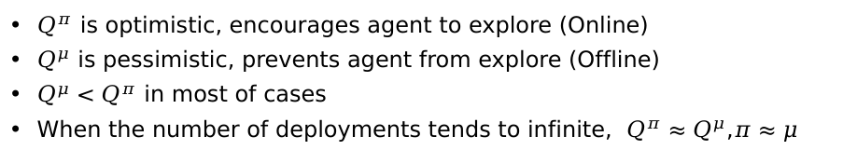
Insight
Offline Policy improvement gurantee
Online Policy improvement gurantee

Slide 10

Offline2Online: Online2Offline
HPO:
Full-life policy improvement gurantee:
Best policy improvement gurantee

