Slide 1

TECHNICAL SEMINAR PRESENTATION-2025
Summer Internship Evaluation
Parala Maharaja Engineering College
Presented by: Mr.Bighna Raj Bhattamishra
Regd.No. 2301109379
Under the guidance of
Dr. Dinesh Kumar Dash Sir
and Mrs. Shankhamitra Sunani Ma’am
Mr.Bighna Raj Bhattamishra (Regd.No. 2301109379)
[‹1›]

Slide 2


Introduction to My Journey
My internship at CODSOFT was a transformative experience in virtual web development.The company specializes in innovative web solutions, offering a dynamic environment to apply and expand my skills.
I chose web development for its blend of creativity and problem-solving, a field where I can build tangible products that impact users directly.
Parala Maharaja Engineering College
The opportunity came to my attention through numerous posts on LinkedIn where I observed several of my peers enrolling in the CodSoft internship program. Intrigued by the prospect, I decided to seize the opportunity and enrolled in the web development internship.
The internship spanned one month, packed with intensive learning and hands-on experience.
Mr.Bighna Raj Bhattamishra (Regd.No. 2301109379)
[‹2›]

Slide 3

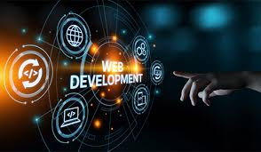
What is Web Development?
Web development is a multidisciplinary field involving the design, creation, and maintenance of websites and web applications. It ranges from building static, content-based pages to developing complex, interactive platforms such as enterprise-level applications, social networking systems, and e-commerce solutions. The discipline integrates user interface design, server-side programming, database management, and modern frameworks to deliver efficient, scalable, and user-centric digital experiences.
Parala Maharaja Engineering College
Web development comprises three primary components:-
  Frontend (Client-side): What users see (HTML, CSS, JavaScript).
  Backend (Server-side): Logic, databases, and server handling (e.g., Node.js, Python).
  Full Stack: Combines both frontend and backend.
Mr.Bighna Raj Bhattamishra (Regd.No. 2301109379)
[‹3›]

Slide 4
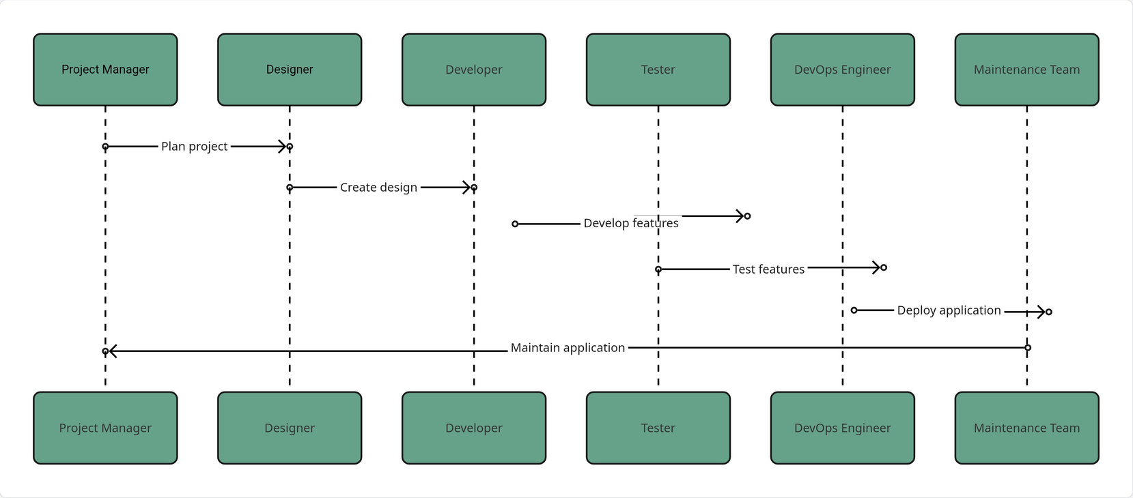
Basic Workflow in Web Development
Parala Maharaja Engineering College
Mr.Bighna Raj Bhattamishra (Regd.No. 2301109379)
[‹4›]

Slide 5
About Frontend Web Development?
The frontend development constitutes the client-facing layer of a website or web application—essentially, the interface through which users interact directly. It encompasses all visual and interactive components rendered within the user’s browser, including layout structures, aesthetic design, and dynamic features. The primary objective of frontend development is to deliver a visually engaging, intuitive, and responsive user experience.
Key aspects include:
  User Interface (UI) Design: Emphasizes the creation of visually coherent and aesthetically refined interfaces through the thoughtful application of layout, color schemes, typography, and interactive elements.
  Responsiveness: Ensures seamless adaptability across a wide range of devices and screen sizes, maintaining consistent usability and visual integrity on desktops, tablets, and smartphones.
  Interactivity: Implements dynamic and user-driven functionalities—such as forms, buttons, animations, and real-time content updates—that foster user engagement and improve usability.
  Cross-Browser Compatibility: Guarantees uniform functionality and performance across all major web browsers, including Chrome, Firefox, Safari, and Edge, thereby enhancing accessibility and user reach.
Parala Maharaja Engineering College
Mr.Bighna Raj Bhattamishra (Regd.No. 2301109379)
[‹5›]

Slide 6
About Backend Web Development?
The Backend development pertains to the server-side architecture of a web application—the critical infrastructure that operates behind the scenes to process requests, manage data, and execute business logic. While the frontend delivers the user interface, the backend ensures that the application functions efficiently, securely, and reliably by enabling communication between the user interface and the server, database, and other systems.
Basic Backend Architecture
Parala Maharaja Engineering College
In essence, backend development is foundational to the performance, scalability, and reliability of web applications, ensuring that the user-facing components are powered by a secure and efficient underlying system.
Mr.Bighna Raj Bhattamishra (Regd.No. 2301109379)
[‹6›]

Slide 7
Internship Objectives
Before commencing the internship, I took deliberate time to establish a comprehensive set of well-defined objectives that would serve as the foundation for my entire learning journey. These goals were not created arbitrarily but were carefully aligned with both my academic background and long-term professional aspirations. By doing so, I intended to create a strategic framework that would guide every stage of the internship, from initial observation and skill acquisition to active participation and performance evaluation. Setting these objectives allowed me to maintain clarity of purpose, measure progress effectively, and ensure that each task I undertook contributed meaningfully to my overall development. This preparatory step transformed the internship from a routine academic requirement into a focused, goal-oriented, and outcome-driven experience, enabling me to approach every challenge with intention, discipline, and a sense of direction.
Parala Maharaja Engineering College
Enhance Front-end & Back-end Skills
Learn Industry-Standard Frameworks
Gain Real-World Project Exposure
To master modern frameworks and build robust, scalable applications.
To gain proficiency in popular libraries and tools used in the professional settings.
To work on live mini projects, understanding the full development lifecycle.
Mr.Bighna Raj Bhattamishra (Regd.No. 2301109379)
[‹7›]

Slide 8




My Developer Toolkit: Tools & Technologies
During my internship, I worked extensively with a wide range of tools, frameworks, and technologies that define modern web development. This hands-on experience deepened my practical understanding of both frontend and backend processes—from creating responsive user interfaces with HTML, CSS, and JavaScript frameworks to managing servers, databases, and deployment. I also became proficient with version control tools like Git and learned to write optimized, scalable code. Overall, this exposure enhanced my technical skills, problem-solving ability, and professional coding discipline while strengthening my grasp of the complete web development lifecycle.
Front-end Essentials
Frameworks & Libraries
Parala Maharaja Engineering College
HTML, CSS, JavaScript: The foundational languages for web interface design.
React/Angular: Building dynamic, single-page applications efficiently.
Back-end & Databases
Version Control
Node.js & MongoDB: Powering server-side logic and data management.
Git/GitHub: Collaborative coding and managing project history.
Mr.Bighna Raj Bhattamishra (Regd.No. 2301109379)
[‹8›]

Slide 9
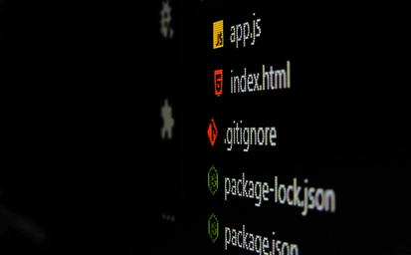
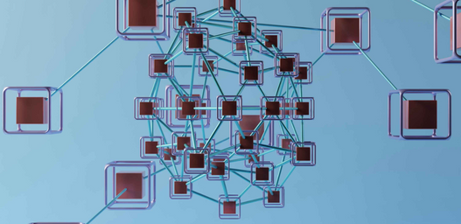
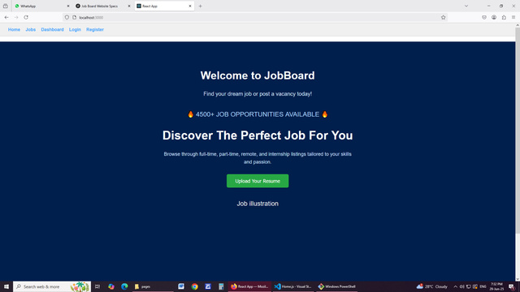
Tangible Achievements: Projects & Tasks
During my internship, I developed several focused mini projects that transformed theoretical understanding into practical, real-world execution. These projects deepened my technical expertise across both frontend and backend domains while simultaneously enhancing my analytical thinking, problem-solving ability, and professional discipline. Through this applied experience, I refined my capacity to design, build, and optimize solutions with precision, translating conceptual knowledge into tangible developmental impact.
Parala Maharaja Engineering College
JobBoard – Explore, Filter, and Apply for Jobs
JazzQuizMaker – Create & Take Quizzes Easily
A modern, responsive job board platform where users can browse listings, filter jobs by category, upload resumes, and apply instantly. Also includes full backend integration with MongoDB.
An intuitive full-stack quiz web app with authentication, dynamic quiz creation, result calculation, and protected routes — made with React and Express.
Mr.Bighna Raj Bhattamishra (Regd.No. 2301109379)
[‹9›]

Slide 10
About my Projects
Project 1: JazzQuizMaker – Create & Take Quizzes Easily
  Description: It is a full-stack, MERN (MongoDB, Express.js, React.js, Node.js) web application that enables users to create, take, and manage quizzes effortlessly. The platform supports secure authentication, allowing users to maintain personal profiles and track their progress. Users can dynamically design quizzes with multiple question types, and the app automatically calculates results upon completion. Protected routes ensure data privacy and access control, while a responsive interface provides a seamless user experience across devices. This project highlights the integration of frontend and backend technologies, showcasing practical skills in authentication, dynamic content management, and real-time result processing within a structured, interactive learning environment.
  Tech Stack:
    Frontend – React.js, HTML/CSS
    Backend – Node.js, Express.js
    Database – MongoDB (Mongoose)
    Auth – JWT login/signup
    Tools – Axios, CORS, Postman
  Key Features:
    JWT-secured login/register
    Auth-gated quiz creation
    Live quiz result summary
    Component reuse & modular UI
    Complete backend–frontend API integration
Parala Maharaja Engineering College
Mr.Bighna Raj Bhattamishra (Regd.No. 2301109379)
[‹10›]

Slide 11
More About JazzQuizmaker
Frontend (React.js, HTML/CSS): Modular React components deliver reusable, maintainable, and responsive interfaces, including quiz forms, dashboards, and results pages. HTML/CSS ensures a polished, user-friendly design across devices.
Backend (Node.js, Express.js, JWT): Express handles API routing and server logic, while JWT-based authentication secures login, registration, and access to protected routes, maintaining user privacy and data integrity.
Database (MongoDB, Mongoose): MongoDB stores user profiles, quizzes, questions, and results, supporting flexible schema design and efficient data retrieval for dynamic quiz content.
Key Features:
  JWT-secured login/register with protected dashboards
  Dynamic quiz creation and management
  Real-time quiz participation and instant result calculation
  Component-based, modular UI for maintainability
  Seamless frontend-backend integration with Axios
Development Tools: Postman, CORS, and Axios ensure reliable API communication and professional workflow management.
Parala Maharaja Engineering College
Mr.Bighna Raj Bhattamishra (Regd.No. 2301109379)
[‹11›]

Slide 12
About my Projects
Project 2: JobBoard – Explore, Filter, and Apply for Jobs
  Description: It is an interactive web application designed to simplify the job search process by allowing users to explore, filter, and apply for jobs seamlessly. The platform features dynamic search and advanced filtering options, enabling users to find relevant job listings based on location, role, and experience. Built with a responsive frontend and a robust backend, JobBoard integrates real-time data management, secure user authentication, and application tracking. This project not only demonstrates practical implementation of web development concepts but also enhances user experience through intuitive navigation and efficient job-matching functionality, making job hunting streamlined and accessible. Includes backend integration with MongoDB.
  Tech Stack:
    Frontend – React.js, CSS
    Backend – Node.js, Express.js
    Database – MongoDB (Mongoose)
    Extras – Multer, Axios, CORS, JWT Auth
  Key Features:
    Resume upload (PDF, DOC)
    Job filter by type, keyword, location
    Dynamic job detail pages
    Job posting via protected dashboard
    Mobile-friendly UI
Parala Maharaja Engineering College
Mr.Bighna Raj Bhattamishra (Regd.No. 2301109379)
[‹12›]

Slide 13
More About JobBoard
Frontend Architecture
  Developed using React for modular and reusable UI components.
  React Router DOM enables smooth, client-side navigation without page reloads.
  Axios manages secure communication between frontend and backend APIs.
  Implements a deep-blue, responsive theme ensuring consistent usability across all devices.
Backend Architecture
  Built on Node.js and Express.js for efficient, event-driven API handling.
  Manages routing, middleware, and request-response operations.
  Multer facilitates secure uploads of PDF, DOC, and DOCX files.
  JWT-based authentication secures user sessions and dashboard access.
Database Integration
  Utilizes MongoDB as a NoSQL database for dynamic data storage.
  MongoDB Compass supports data visualization and efficient query management.
Key Features
  Authentication: Secure user registration, login, and logout.
  Job Listings: Comprehensive details including company, type, and deadlines.
  Search and Filter: Keyword, location, and category-based filtering.
  Resume Upload: Instant validation and response for file submissions.
Core Components and Tools
  Frontend Components: Home.js, Jobs.js, JobDetails.js, Dashboard.js, Login.js, Register.js.
  Backend APIs: CRUD operations and file uploads (e.g., /api/resume/upload).
Development Tools: Postman for testing, Git Bash for version control, and MongoDB Compass for database management.
Parala Maharaja Engineering College
Mr.Bighna Raj Bhattamishra (Regd.No. 2301109379)
[‹13›]

Slide 14
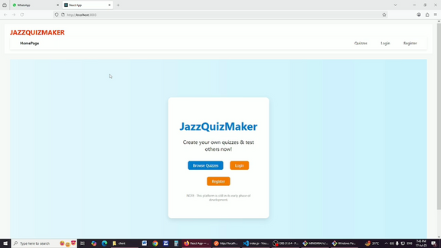
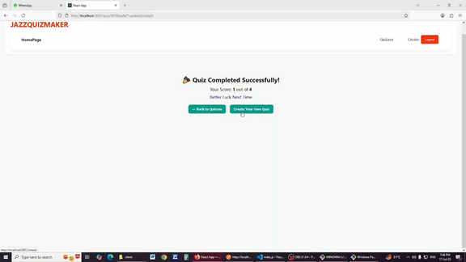
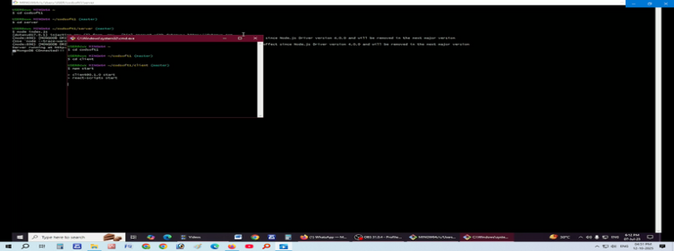
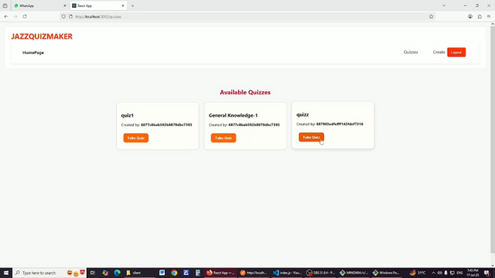
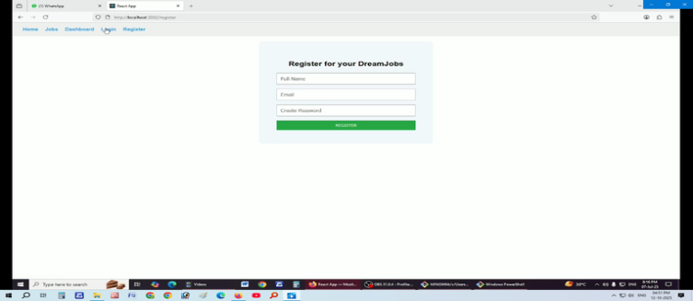
About my Projects
A Comprehensive Showcase of the Application’s Frontend Design and Interactive Features
Project 1: JazzQuizMaker – Create & Take Quizzes Easily
Project 2: JobBoard – Explore, Filter, and Apply for Jobs
Parala Maharaja Engineering College
Mr.Bighna Raj Bhattamishra (Regd.No. 2301109379)
[‹14›]

Slide 15
Overcoming Obstacles: Challenges & Solutions
Every challenge was an opportunity to innovate and strengthen my problem-solving abilities. During the internship and project development, I faced multifaceted technical and conceptual challenges. Each obstacle was approached strategically through research, iterative experimentation, and application of best practices. This methodical problem, solving not only resolved immediate issues but also sharpened my technical acumen, honed critical thinking, and cultivated resilience, transforming challenges into profound learning experiences and strengthening my capacity to deliver efficient, robust, and scalable solutions.
1
2
3
Parala Maharaja Engineering College
Virtual Communication
Complex Error Handling
Meeting Deadlines
Problem: Ensuring clear and timely communication in a remote team.
Problem: Debugging intricate system errors in unfamiliar codebases.
Problem: Balancing multiple tasks under tight project deadlines.
Solution: Actively participated in regular seminars, utilized project management tools, and communicated with designated mentor.
Solution: Prioritized tasks effectively, broke down large goals into smaller manageable steps, and communicated progress proactively.
Solution: Employed systematic logging, unit testing, and sought mentor guidance when necessary.
Mr.Bighna Raj Bhattamishra (Regd.No. 2301109379)
[‹15›]

Slide 16




Growth Trajectory: My Key Learning Outcomes
This internship acted as a transformative catalyst, significantly enhancing both my technical expertise and professional competencies. Immersed in real-world projects, I bridged theoretical knowledge with practical application, gaining mastery over modern web development practices, software design, and project workflows. Beyond technical skills, the experience honed critical thinking, problem-solving, time management, and effective communication, enabling me to approach challenges methodically and deliver precise solutions. Over the course of the internship, I achieved key learning outcomes that strengthened my technical acumen while cultivating the professional sophistication required to excel in collaborative, fast-paced, and results-driven environments.
Technical Acumen
Refined Debugging Skills
Parala Maharaja Engineering College
Mastered new frameworks like React, Node and adopted clean coding standards.
Proficiently used developer tools to diagnose and fix complex issues.
Effective Time Management
Virtual Teamwork & Communication
Successfully managed multiple tasks and deadlines in a virtual setting.
Collaborated seamlessly with remote colleagues, enhancing project delivery.
Mr.Bighna Raj Bhattamishra (Regd.No. 2301109379)
[‹16›]

Slide 17

Looking Forward: Shaping My Future
This internship enhanced my full-stack web development skills using the MERN stack. I built dynamic UIs with React, developed backend APIs with Node.js/Express, and managed MongoDB databases with Mongoose..
I implemented JWT auth, handled file uploads, resolved CORS/routing issues, and gained hands-on experience with tools like Postman, MongoDB Compass, Git, sharpening my skills in RESTful API design, debugging, and end-to-end web development.
Parala Maharaja Engineering College
I intend to further refine my expertise in serverless architectures while advancing the integration of machine learning into web applications. Focusing on scalable, efficient, and responsive systems, I aim to leverage serverless frameworks to streamline infrastructure management. Simultaneously, incorporating intelligent, data-driven functionalities—such as predictive analytics and personalized recommendations—will enhance application sophistication and user experience. This dual pursuit positions me at the forefront of contemporary web development, equipping me to design innovative, high-performance solutions that address complex, real-world challenges with technical precision and strategic foresight.
My goal is to contribute to innovative projects that leverage technology to create meaningful impact and foster positive user experiences.
Mr.Bighna Raj Bhattamishra (Regd.No. 2301109379)
[‹17›]

Slide 18
REFERENCES
  Introduction to Web Development, Springer.com
  CodSoft Work Experience For Web Development Internship, GeeksforGeeks
  IBM Skillbuild, Web Development Fundamentals
  Welling, L., & Thomson, L. (2017). PHP and MySQL Web Development (5th ed.). Addison-Wesley.
  Duckett, J. (2014). HTML & CSS: Design and Build Websites. Wiley.
  Duckett, J. (2014). JavaScript and JQuery: Interactive Front-End Web Development. Wiley.
  Flanagan, D. (2020). JavaScript: The Definitive Guide (7th ed.). O’Reilly Media.
Parala Maharaja Engineering College
  My GitHub Repository
Mr.Bighna Raj Bhattamishra (Regd.No. 2301109379)
[‹18›]

Slide 19
TECHNICAL SEMINAR PRESENTATION-2025
THANK YOU
Parala Maharaja Engineering College
Mr.Bighna Raj Bhattamishra (Regd.No. 2301109379)
[‹19›]

