Slide 1
Development Of Split Ergonomic Keyboard To Prevent Wrist Fatigue And RSI
Supervisor-
Dr. T. Mita Kumari

Slide 2
Members
Mr. Subham Choudhary- 2301109431
Mr. Bighna Raj Bhattamishra- 2301109379
Mr. Ella Jayakishan- 2301109389
Mr. Mihir Panda- 2301109402
Mr. Adarsh swarup maharana- 2421109136
Ms. Monalisha Panda- 2421109138
Ms. Muskan Patro- 2301109403
Ms. Payal Maharana- 2301109407

Slide 3
Agenda
INTRODUCTION
PRODUCT DESCRIPTION
FEATURS
CARPAL TUNNEL SYNDROM
RSI SYNDROME
RISK OF CTS
NUMBER OF DIGITAL USER
MARKET COMPARISON
CHALLANGES WE FACED
FUTURE IMPROVEMENT
CONCLUSION

Slide 4
INTRODUCTION
Problem Statement
The Issue: Traditional flat keyboards cause ulnar deviation and pressure on the median nerve.
Health Risk: Prolonged use leads to Carpal Tunnel Syndrome (CTS) and Repetitive Strain Injury (RSI).
The Solution: A split, concave ergonomic keyboard designed to align with natural human biomechanics.
Key Objectives: Improve typing comfort, reduce finger travel distance, and provide a fully wireless experience.

Slide 5
PRODUCT DESCRIPTION
What is an Ergonomic Keyboard?
An ergonomic keyboard is a specially designed keyboard that reduces strain on your hands, wrists, and arms while typing.
Unlike traditional flat keyboards, it is shaped to match the natural posture of your body, helping prevent issues like RSI (Repetitive Strain Injury) and carpal tunnel syndrome.

Slide 6
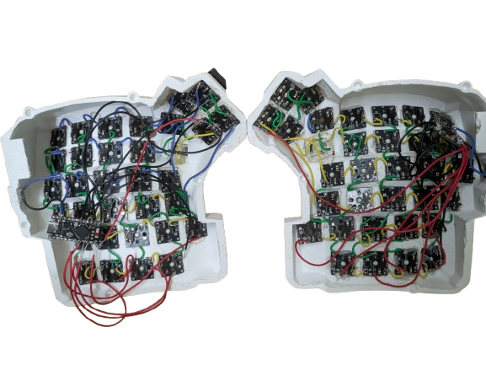
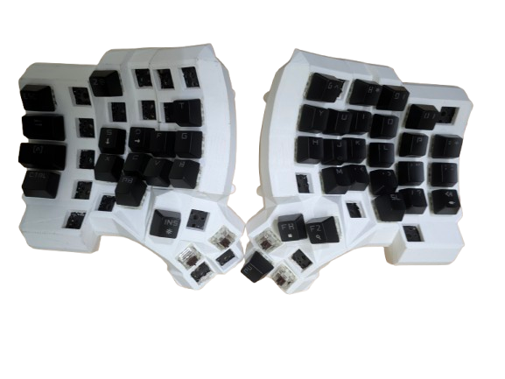
PRODUCT DESCRIPTION

Slide 7
STANDARD VS ERGONOMIC KEYBAORD
Feature | Standard Keyboard | Ergonomic Keyboard
Design | Flat, straight layout | Curved, split, or angled layout
Hand Position | Forces hands close together | Keeps hands in natural position
Wrist Angle | Bent (unnatural) | Neutral (straight)
Comfort | Less comfortable for long use | More comfortable for long typing
Health Impact | Can cause strain & RSI | Reduces strain and fatigue
Productivity | Normal | Often improves with comfort
Learning Curve | Easy (familiar) | Takes time to adjust
Cost | Cheap | Expensive
Portability | Compact & easy to carry | Bulky in some cases

Slide 8
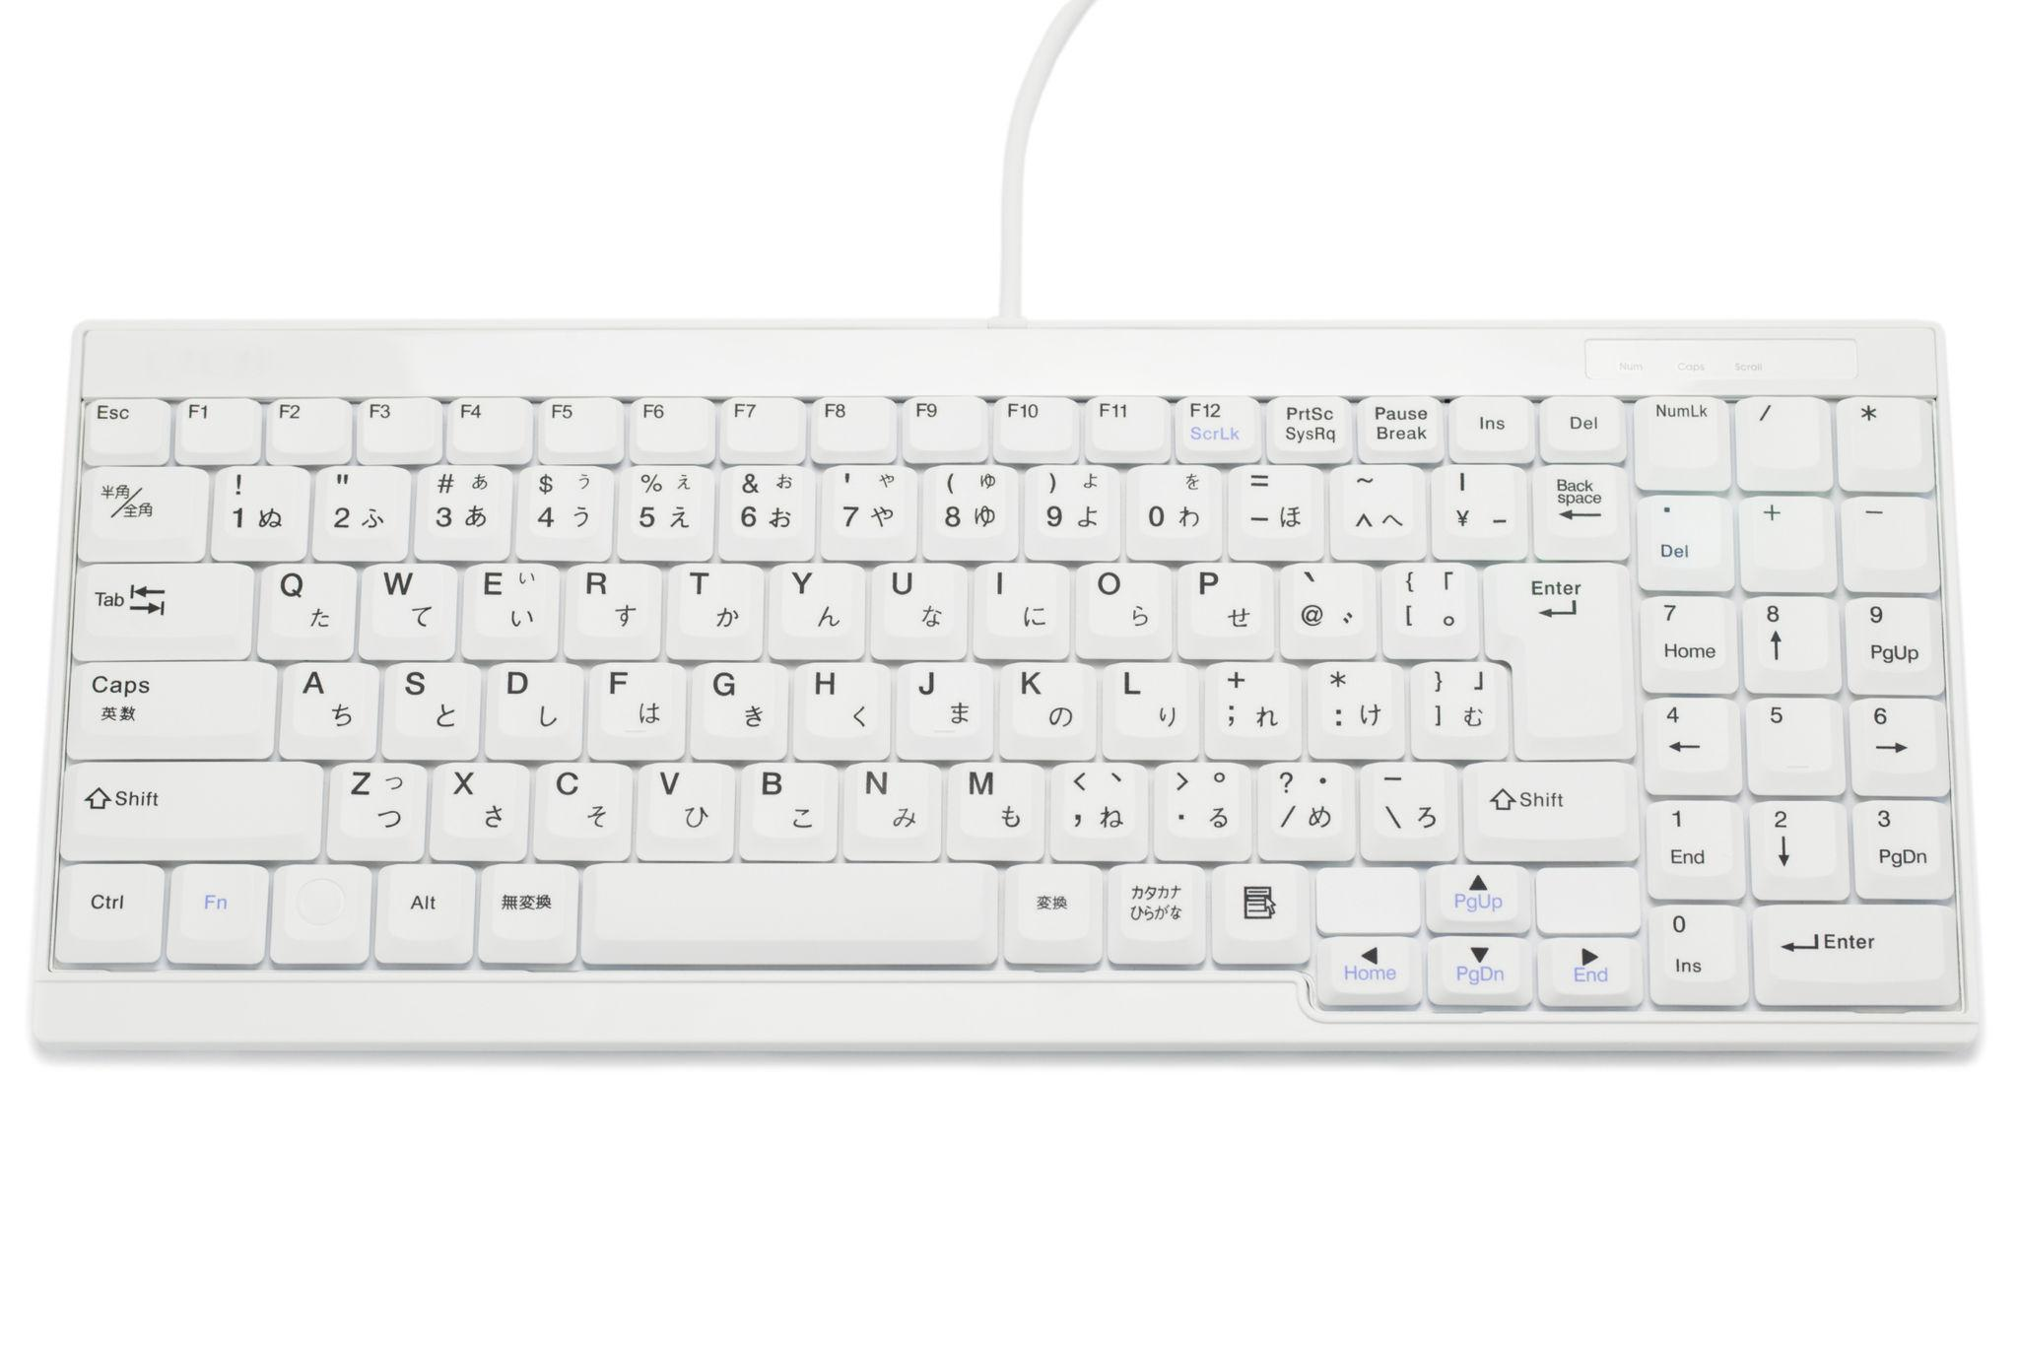
STANDRED KEYBOARD
ERGONOMIC KEYBOARD

Slide 9
FEATURES
Mechanical & Ergonomic Design
Split Architecture: Two independent halves allow users to adjust for shoulder width, preventing strain.
Concave Key-Well: A 3D-curved layout (55 mm radius) follows the natural arc of finger movement.
Tactile Switches: Outemu Brown mechanical switches provide physical feedback to prevent "bottoming out".
Custom Enclosure: 3D-printed using PLA material with a 0.15 mm layer height for structural durability.

Slide 10
FEATURES
Hardware & Connectivity
Main Controller: Pro Micro nRF52840 (64 MHz ARM Cortex-M4) manages scanning and wireless stacks.
Wireless Protocol: Bluetooth 5.0 (BLE) ensures low-latency communication with the host and between halves.
Anti-Ghosting: 6 X 6 matrix with 1N4148 diodes allows for N-key rollover (detecting multiple simultaneous presses).
Maintainability: hot-swap sockets allow users to replace switches without soldering.

Slide 11
FEATURES
Firmware & Software Architecture
RTOS Integration: Built on the Zephyr Real-Time Operating System for deterministic task scheduling.
ZMK Framework: Leverages the ZMK framework for advanced features like layered keymaps and Bluetooth profile switching.
Layered Logic: Three primary layers (Base, Lower, Raise) maximize the utility of 66 physical keys.
Cloud Build Pipeline: Firmware is compiled via GitHub Actions, ensuring a reproducible and accessible build environment.

Slide 12
FEATURES
Power Management & Validation
Battery System: Each half uses an independent 500 mAh Li-ion battery.
Charging: Integrated USB-C charging with an onboard LiPo charge circuit.
Smart Sleep States:
  Active: Full speed scanning for responsiveness.
  Idle: Reduced scanning rate after 30 seconds.
  Deep Sleep: Consumes only 2-5 uA after 15 minutes of inactivity
Performance: Validated 10-week battery life per charge with a 7.5 ms connection interval for zero perceptible lag.

Slide 13
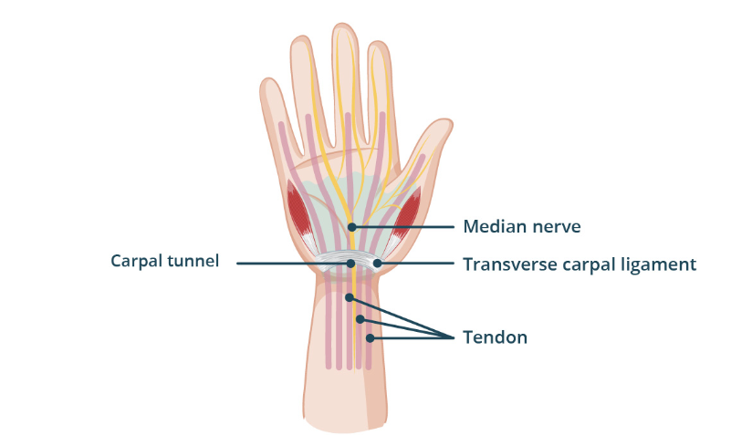
Carpal tunnel syndrome (CTS)
Standard keyboards often force users into unnatural wrist and hand positions. Prolonged usage can lead to discomfort and repetitive strain injuries such as Carpal Tunnel Syndrome (CTS).
CTS occurs due to pressure on the median nerve in the wrist, resulting in pain, numbness, and reduced hand functionality. With the increasing reliance on computers, there is a growing need for ergonomic input devices that minimize physical strain.

Slide 14
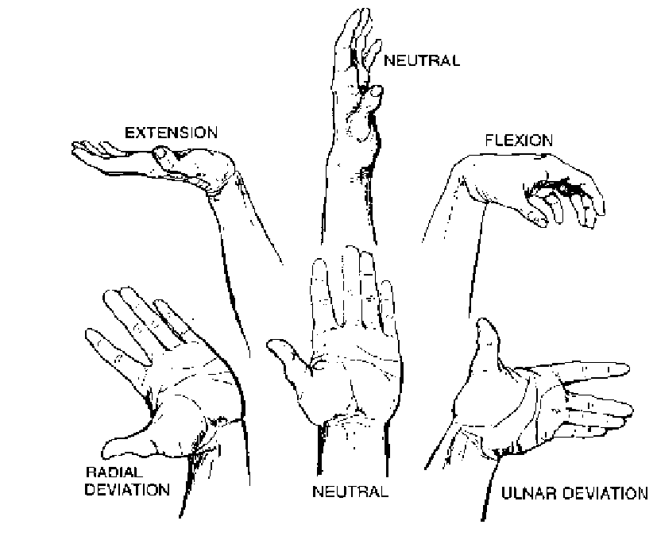
RSI syndrome
Such stress problems are often casually grouped together under the various ‘portmanteau’ terms of Repetitive Strain Injuries (RSI’s) or Work-Related Upper Limb Disorders (WRULD’s), amongst others. Although not medically diagnostic, such terms are widely used to cover more precise musculoskeletal or nerve related injuries which may be caused or triggered by rapid, low-force actions.

Slide 15
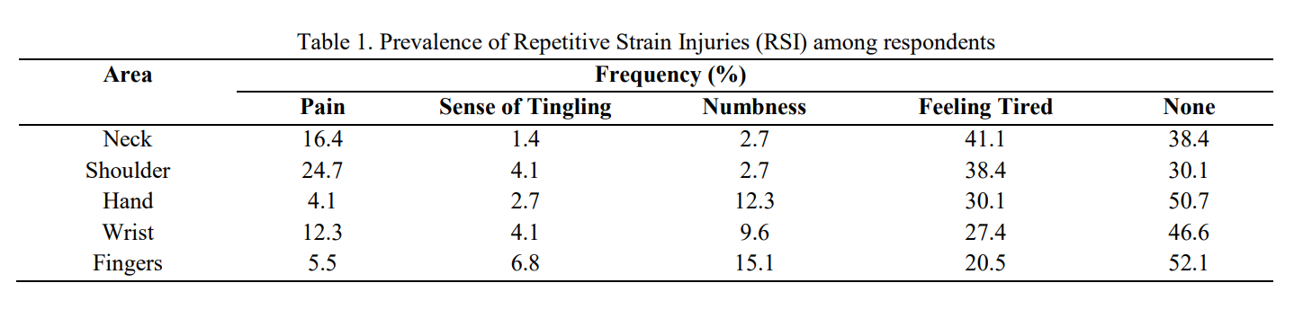
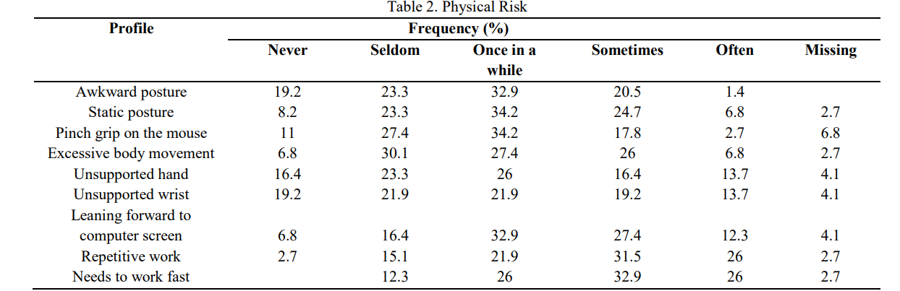
RSI syndrome

Slide 16
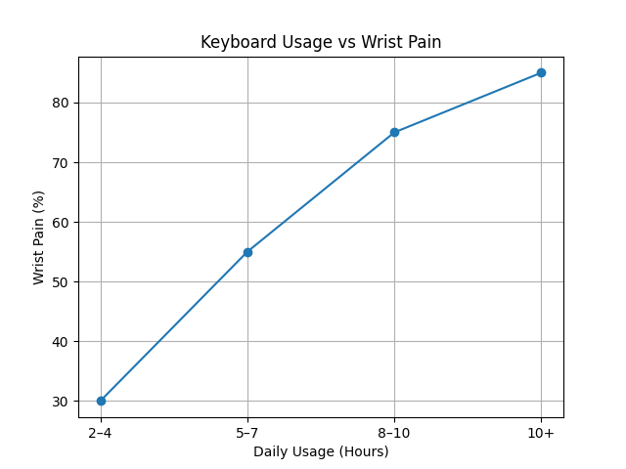

Slide 17
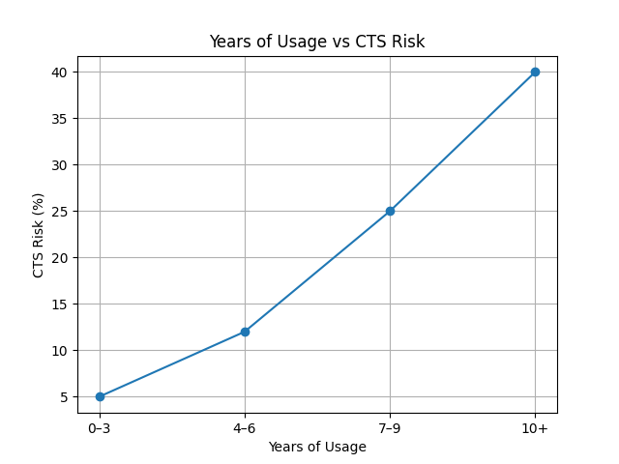

Slide 20
Challenges Faced
One of the major challenges was the firmware setup using ZMK. Configuring Bluetooth communication, keymaps, and split functionality required extensive testing and debugging. However, overcoming this challenge significantly enhanced our technical expertise.

Slide 21
Future Improvements
Additional hardware features supported by ZMK can be incorporated to enhance usability. For instance, OLED displays can be integrated using ZMK’s display subsystem
Introduce adjustable tenting angles
Enhance portability and design aesthetics.

Slide 22
Conclusion
This project successfully demonstrates the design and implementation of a split ergonomic concave keyboard aimed at reducing strain associated with prolonged typing. The system combines mechanical design, embedded firmware, and wireless communication into a cohesive and functional solution.

Slide 23
REFERENCE
[1] ZMK Firmware Project, "ZMK Documentation," zmk.dev, 2024. [Online]. Available: https://zmk.dev/docs
[2] ] Zephyr Project, “Pro Micro nRF52840 Board Documentation,” 2024. [Online]. Available: https://docs.zephyrproject.org/latest/boards/others/promicro_nrf52840/doc/index.ht ml
[3] Zephyr Project, "Zephyr RTOS Documentation," docs.zephyrproject.org, 2024. [Online]. Available: https://docs.zephyrproject.org
[4] TurkeyBoards, “QMK and ZMK Firmware Options,” 2024. [Online]. Available: https://docs.turkeyboards.com/turkeyboards-docs/buyers-guide/qmk-and-zmkfirmware-options
[5] A. C. Antona, C. Stephanidis, and J. Clarkson, “Ergonomic Evaluation of Alternative Keyboard Designs,” Proc. Int. Conf. Engineering and Product Design Education, 2015. [Online]. Available: https://researchportal.northumbria.ac.uk/ws/portalfiles/portal/3037317/Ergo_keyboa rds.pdf
[6] StatPearls Publishing, “Carpal Tunnel Syndrome,” StatPearls, 2024. [Online]. Available: https://www.ncbi.nlm.nih.gov/books/NBK448179/

Slide 24
THANKYOU

