Slide 1
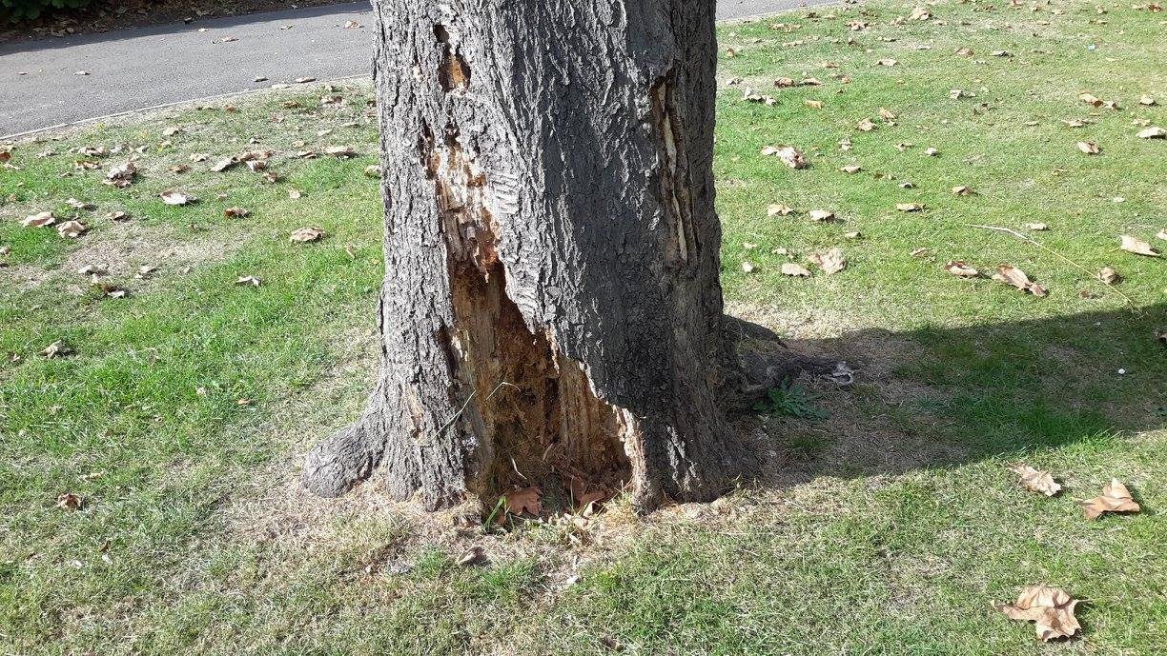
HUMENS CUTTING ME DOWN!
Deforestation has many negative effects on the environment. The most dramatic impact is a loss of habitat for millions of species. Seventy percent of Earth's landanimals and plants live in forests, and many cannot survive the deforestation that destroys their homes.

Slide 2
