Slide 1
Uniform Connectedness
The principle of uniform connectedness is the strongest of the Gestalt Principles concerned with relatedness. It refers to the fact that elements that are connected by uniform visual properties are perceived as being more related than elements that are not connected. As with the principle of proximity, uniform connectedness causes us to perceive groups or chunks rather than unrelated, individual things.
In practice, uniform connectedness is quite simple: draw a box around a group of elements and you’ve indicated that they’re related. Alternately, you can draw connecting lines (or arrows or some other tangible connecting reference) from one element to the next for the same effect.

Slide 2
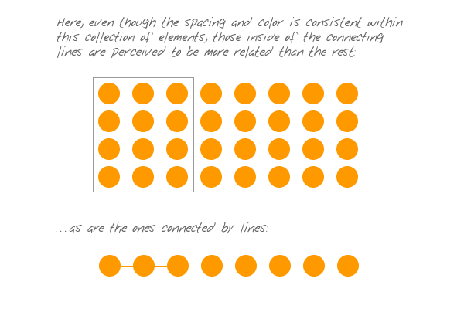
Example:

Slide 3
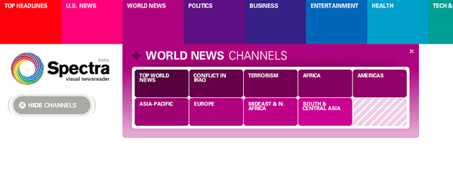
In web design, it is common to employ uniform connectedness to show context. Tabbed navigation is a prime example of this principle. When you have two visually and proximally distinct elements (navigation link – and – page copy), the easiest way to show related context is to enclose disparate elements, like this:

Slide 4
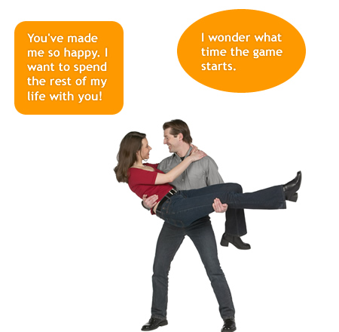
Here’s an example showing the efficacy of connecting lines …and the problems encountered when they’re not used:
This image doesn’t make much sense. What’s missing is the essential element that exploits uniform connectedness.

Slide 5
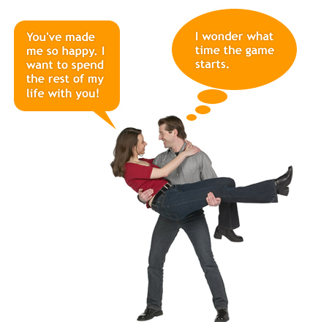
As for this image, Here we have clear context and have associated the woman with what we now perceive as something she is saying. The speech bubble works not because of graphic or cultural convention, but because of how it is consistent with uniform connectedness.

