Slide 1

CANOPY
Brand kit for agents
Privacy-centric browser · Android & Linux · Folio Calm Sage

Slide 2
POSITION
A quiet place on the open web.
What it is
What it feels like
What it is not
Canopy is a privacy-centric browser for Android and Linux. It covers the reader — trackers stay outside the canopy.
Calm, literate, protective. More forest study than operations center. Adult software, not a mascot or a threat poster.
Not a VPN billboard, not a crypto wallet, not neon-hacker chrome, not military cosplay.
Tagline · Browse under cover.
Alts: “Privacy that grows with you.” “Cover for what you read.” “What you read stays under the canopy.”
CANOPY · BRAND KIT · FOR AGENTS
02

Slide 3

METAPHOR
Canopy + guardian + private knowledge
01
Canopy
Living cover. Shade, growth, an umbrella of leaves. The product name is the metaphor — not a decoration.
02
Guardian
Faceted helmet or shield. Protection without aggression. Armor is geometric, never skulls or weapons.
03
Private knowledge
The book and the locked cubes. Reading is the act. Data stays sealed. Use this pair only in narrative art.
CANOPY · BRAND KIT · FOR AGENTS
03

Slide 4


LOGO SYSTEM
One idea, four resolutions
Glyph
App icon
Primary mark
Narrative emblem
Three leaves on a shield. Favicon and 16–64 px.
Radiating leaves over a shield. Launcher 192–512.
Helmet with living canopy. Marketing, splash.
Knight, book, locked cubes. Campaigns only.

Slide 5
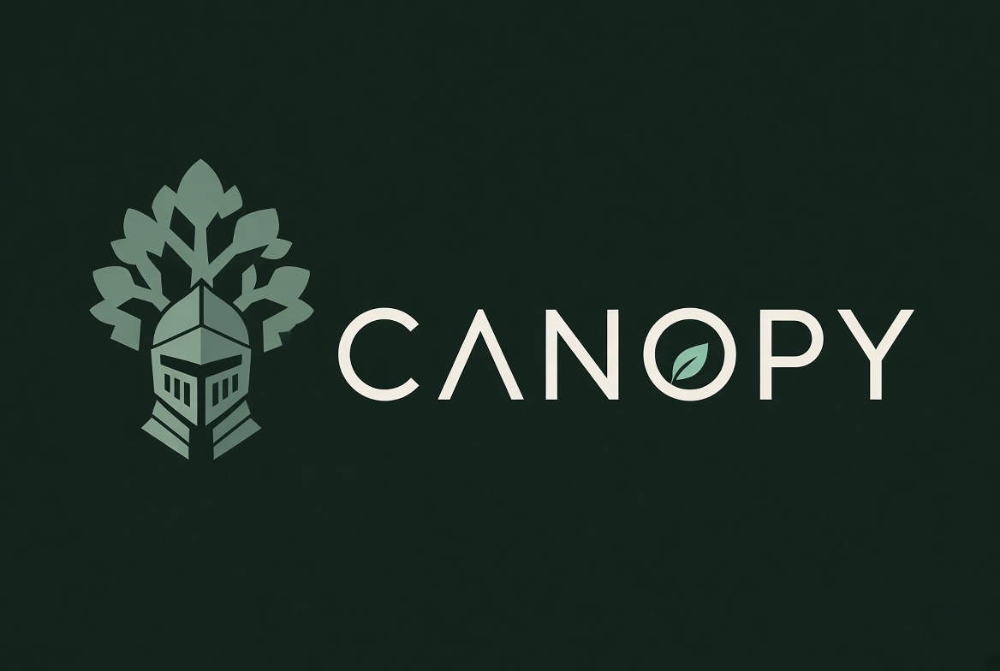
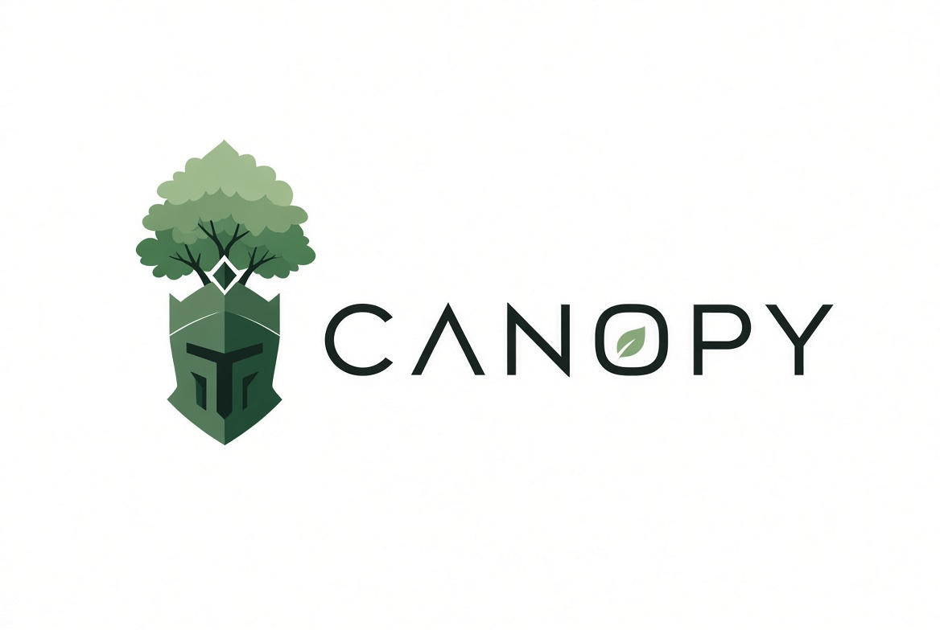
LOCKUPS
Wordmark sits to the right of the mark

Slide 6
COLOR · FOLIO CALM SAGE
Do not invent extra greens or cyans.
Primary
Sage seed
Sage light
Container
Clay
#496556
#6B8E7D
#98B4A4
#2F483D
#D4B197
Slate
Paper
Pine
Cream text
#A6B7C6
#F7F9F7
#181C1A
#E0E3DF

Slide 7
TYPE & VOICE
Exo 2 for display. Figtree for UI.
Typography
Voice
CANOPY
Calm. Precise. Protective.
Unflashy. Literate.
Display · Exo 2 Semibold, tracking +80–120
Wordmark is all caps. Headlines are sentence case.
Say
“Trackers stay outside the canopy.”
“Shields up. Trackers out.”
Body and UI — Figtree
16/24 body. 13/18 labels. Medium for actions.
Fallbacks: Source Sans 3, Inter.
Mono for URLs and logs: JetBrains Mono.
Do not say
“UNLEASH MILITARY-GRADE ANONYMITY.”
Fear copy, leet-speak, Web3 hype.
Never bake a tagline into the wordmark.
CANOPY · BRAND KIT · FOR AGENTS
07

Slide 8
USAGE
Keep the canopy intact
Do
Don’t
Use only Folio Calm Sage hexes.
Match mark to size: glyph under 64px.
Default UI to pine + cream text.
Give the mark a leaf-height of clear space.
Keep clay as a single warm note.
Ship the same brand on Android and Linux.
Do not ship the source teal/cyan art.
Do not put the writing knight in a toolbar.
Do not stretch, bevel, or glossy-shadow.
Do not add slogans inside the mark.
Do not use skulls, rifles, or hoodie-hackers.
Do not recolor leaves gold, neon, or RGB.
CANOPY · BRAND KIT · FOR AGENTS
08

Slide 9
PRODUCT UI
Quiet chrome. One accent at a time.
Surfaces
canopy://new-tab
Shields up
Address bar on container. Page on pine or paper.
New tab
Tabs
What you read stays under the canopy.
Hairline outline. Active tab gets a sage-light pip.
Search
Private session
Blocked 14
Empty states
Primary button
Secure state
Use the glyph. Never the writing knight.
Continue privately
Sage-light pip on container.
Not a red recording dot.
Warnings use clay + plain words.
Adaptive icon
Fill primary · label cream
Sage glyph on pine. Do not let OEM tint the mark.

Slide 10
FOR AGENTS
Read AGENT_BRAND.md first.
AGENT_BRAND.md
Voice, logo roles, UI rules, copy patterns.
tokens/tokens.json
Machine-readable colors, type, logo system.
tokens/tokens.css
CSS custom properties for product UI.
logos/*.svg
Glyph, app icon, wordmark, dark lockup.
logos/*.jpg
Rendered marks, lockups, narrative emblem.

