Slide 1



Notes:
Hello, I'm Lee Sang Yoon, the presenter of the off-source project

Slide 2








- Building Database
- Connecting to server
- Manage server codes (Node JS)
- Front-end sub-role
- Most features, including CRUD
- Created schedule screen
- Created category pages
- Created presentation
- Collected image materials
- Login / Membership screen production
- Created main menu screen
- Created presentation
- Database design
- Making membership algorithm
- Member management
- Created image material
Notes:
Let me introduce my team members
Lee Sang-yoon made DB and Back end, Yoo Hwan and Song Joo-han made Front End, and Jung Ji-geun made Back End

Slide 3


Project introduction
Project Content
How it works
Notes:
For the next table of contents, 1. Project introduction , 2 project content 3 project implementation status

Slide 4






Notes:
As for the project introduction, I will explain the background of the topic development, differentiation, development schedule

Slide 5


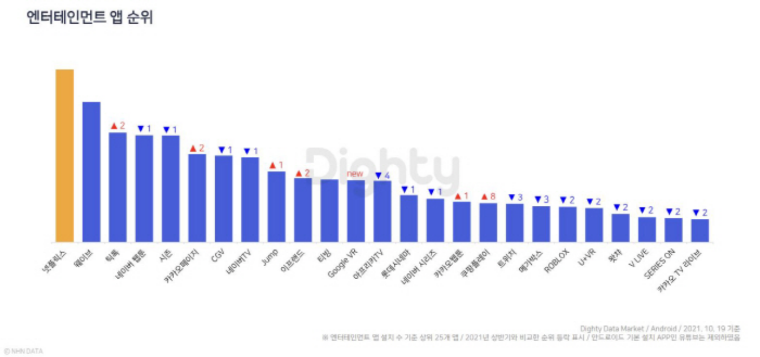




Notes:
There are many entertainment apps on the market, but they are limited to movies and dramas.
we decided to create a variety of active entertainment programs, including board games and room escape, because we knew that there were no programs to book them as they developed and diversified day by day. In addition, we want to create a mutual aid structure that can help promote facilities by promoting them at the same time as well as booking functions.

Slide 6
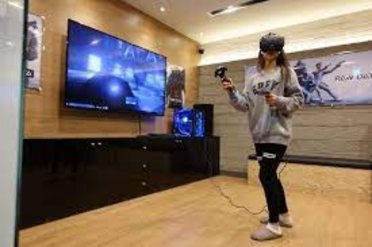
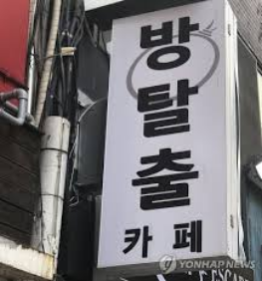



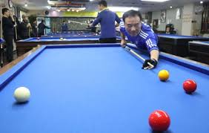

Notes:
Let me tell you about the difference between the apps on the market and ours.
Providing clients with the convenience of using the Join us app at home, on the go, or at any time of the day or night, as well as the online integrated entertainment booking software should be convenient for both customers and businesses

Slide 7

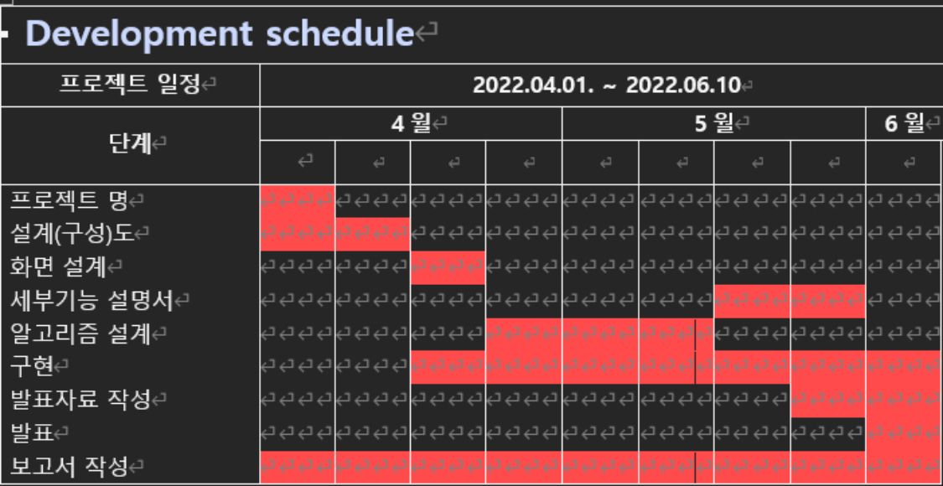



Slide 8




- Tools we used
Notes:
Next, I will talk about the project contents. I will explain AI technology elements, system structure, and key functions in order

Slide 9





Tools we used
Notes:
The artificial intelligence technology elements used are Mongo Db, Android Studio, and Java

Slide 10
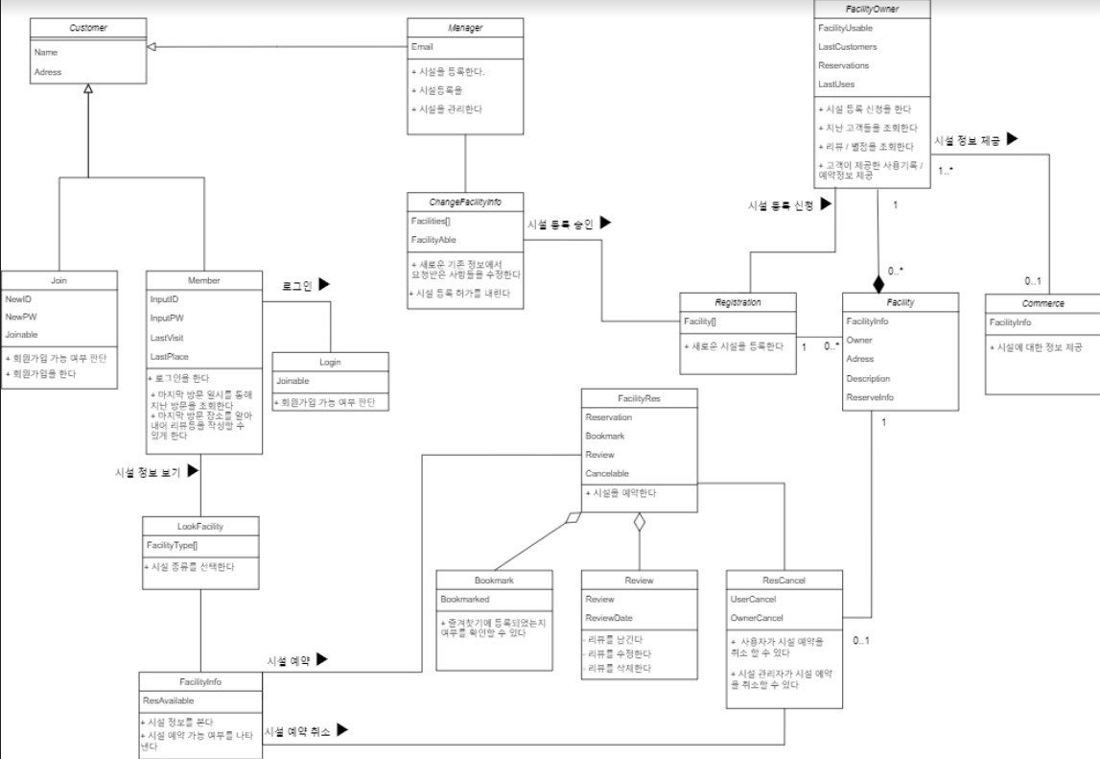


Slide 11
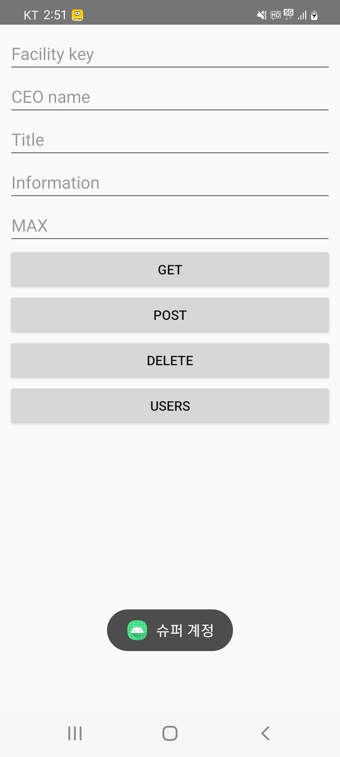
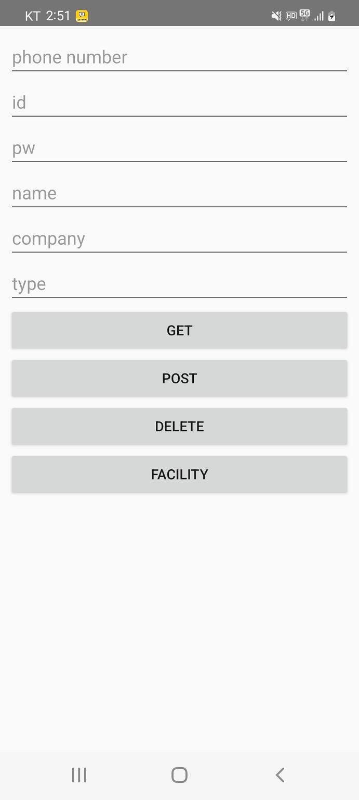

Super ID

Slide 12
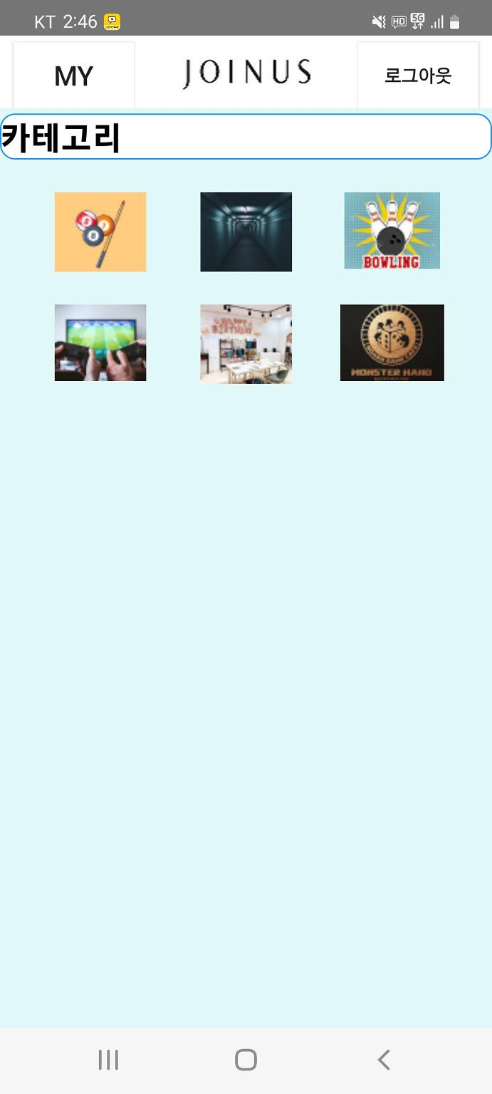
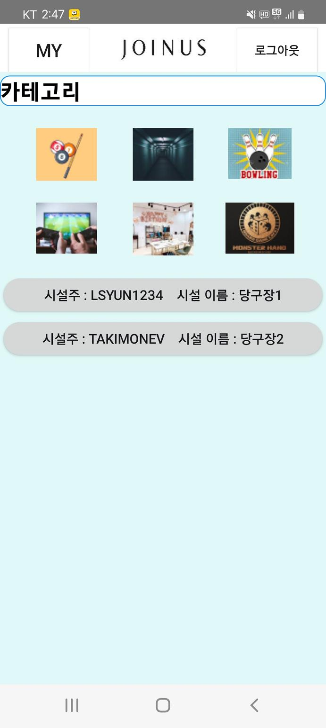
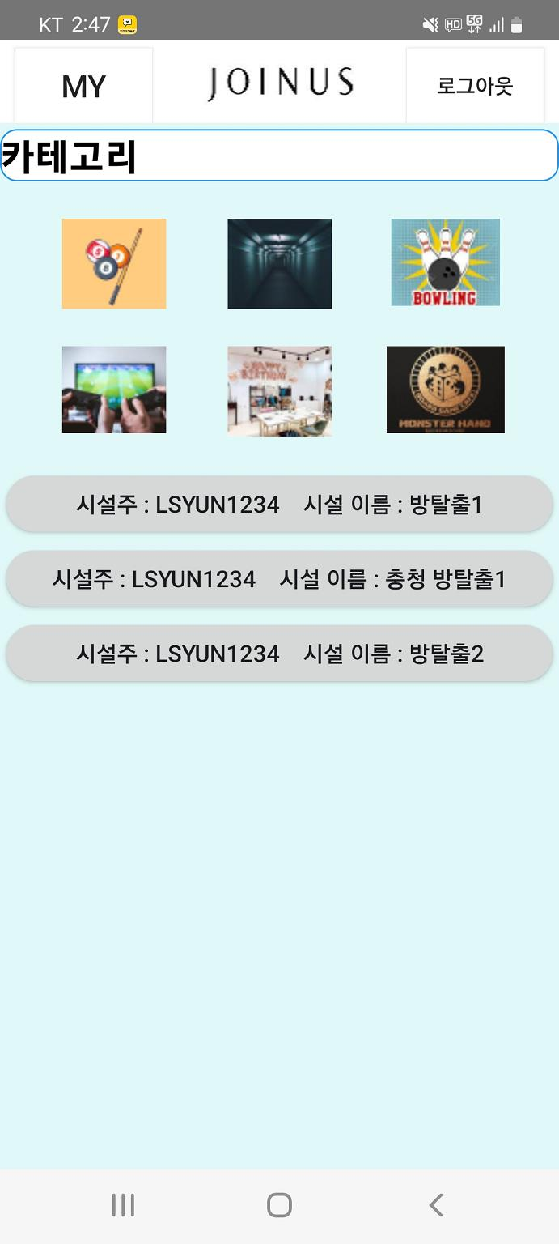
Main page

Slide 13
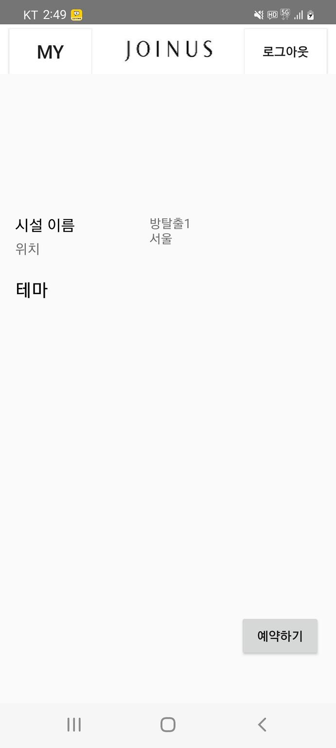
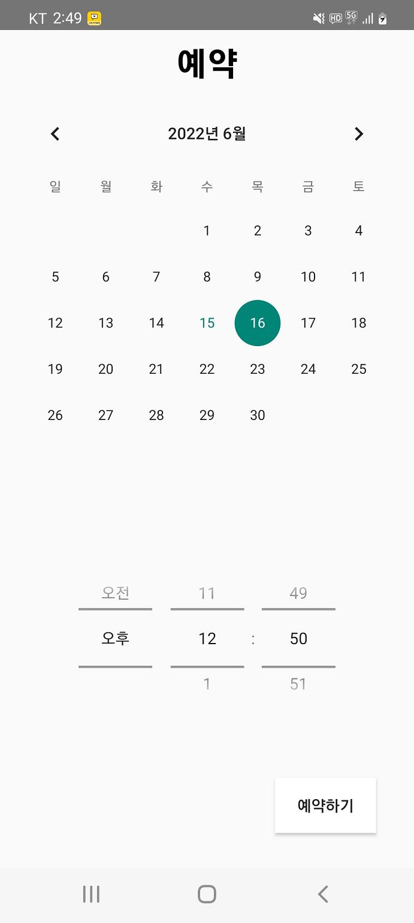
Reservation page

Slide 14
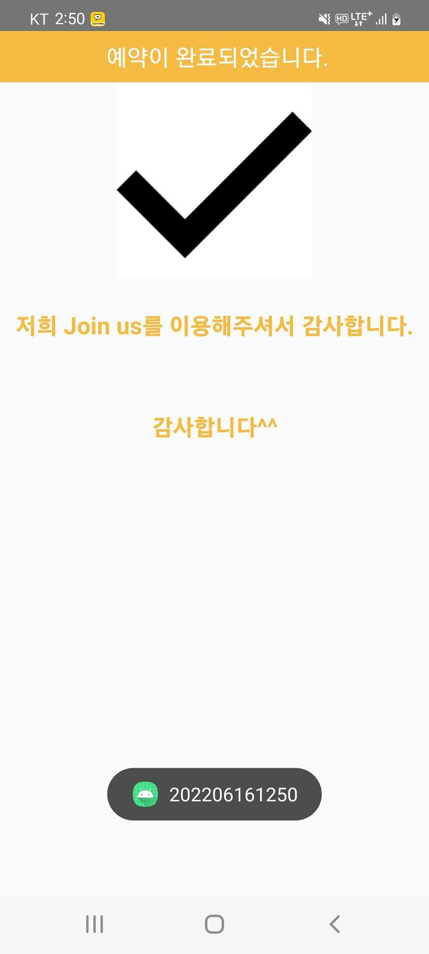
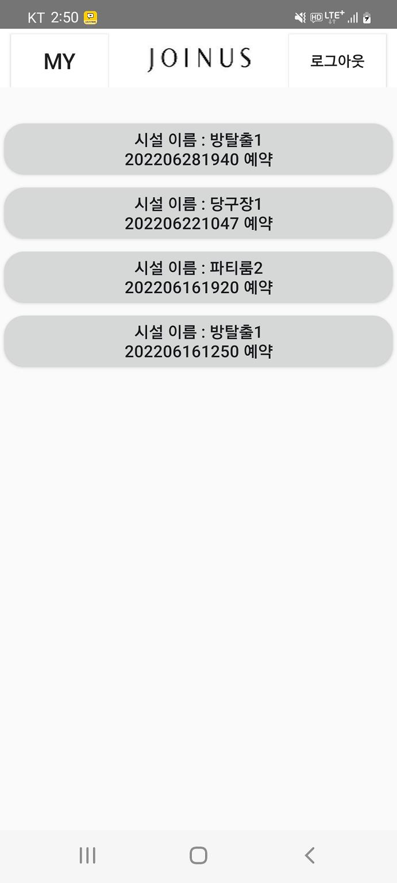
Confirm pages

Slide 15

How it works
- HTTP communication
- Used algorithm
- Demo movie

Slide 16

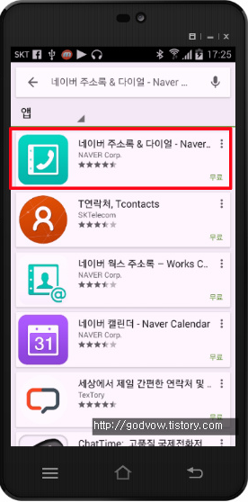

Security problem
HTTP communication
Can’t access directly to server database

Slide 17
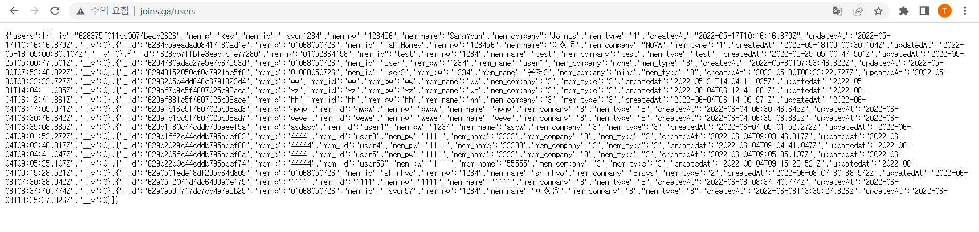
Alternative way
http://www.joins.ga/users
http://www.joins.ga/facility
http://www.joins.ga/review
OO 방탈출카페
시설정보
예약하기
Informatiom
HTTP communication
Get JSON data from server and change it to string

Slide 18
Before talk about algorithm...
Many people will know what we have learned from the book, so we will explain mainly difficult tools or self-made algorithms.
Used algorithm

Slide 19


Slide 20
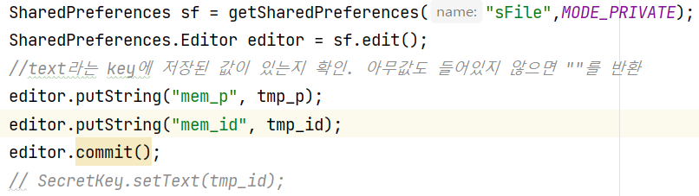
SharedPreferences
kind of cookie data
Used algorithm
input what you want to send

Slide 21
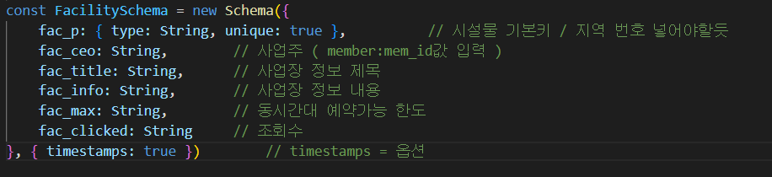
Mistake...
we missed region information and facility type
Used algorithm

Slide 22
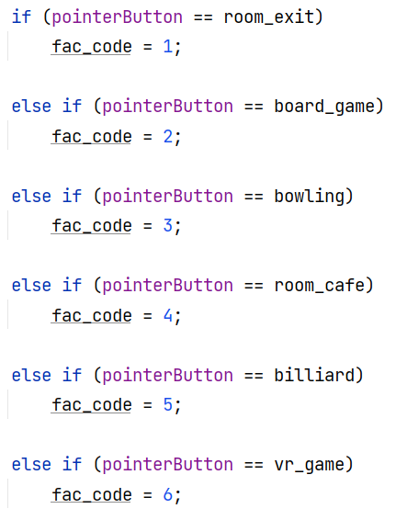
How we solved problem
key / 1000 -> region number
key % 1000 / 100 -> facility type
ex) 1001 -> 서울(1), 방탈출(0), 1st facility(01)
Used algorithm

Slide 23
Demo
https://youtu.be/919SaMd9QWM
Demo movie

Slide 24










Notes:
Thank you for listening to the end of the presentation

