Slide 1

-1-
Defective Analysis Report
□ Field Defective
□ 0Km Defective
□ In House Defect
Symptom [Rear camera not work]
Part Number : RH00488A01
Alpine Model : G11 Honda Model

Slide 2
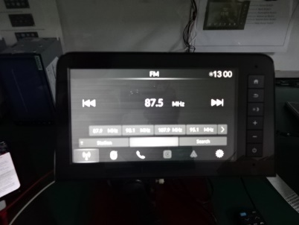
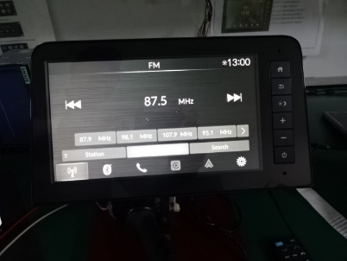
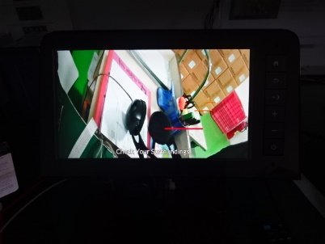
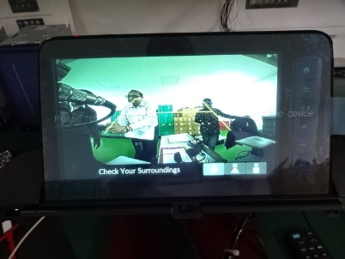
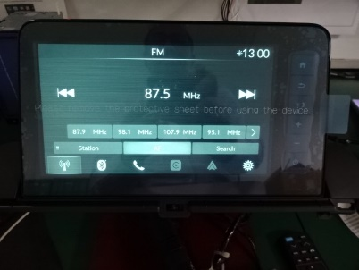
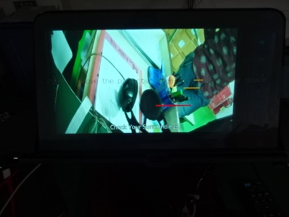
-2-
Detail picture part
Unit turning on and displaying animation video.
Sound is coming from speaker and other functions are working ok.
Hard key and touch is working ok.
Rear camera mode is not activating.
Rear camera :- NG
NG unit’s details
LW camera :- OK
Rear camera :-OK
OK unit’s details
LW camera :- OK
Result :- The unit is rejected due to the Rear camera mode is not activating.
Please note that we have checked both the units in same jig.

Slide 3
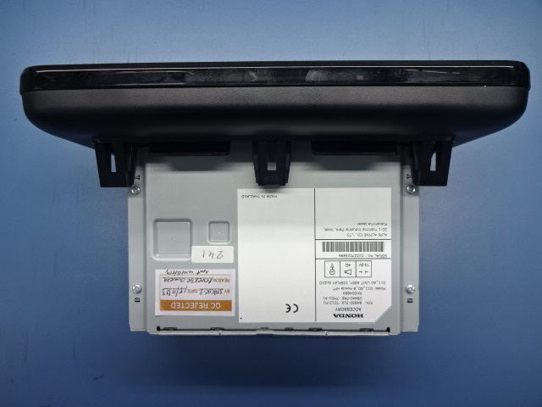
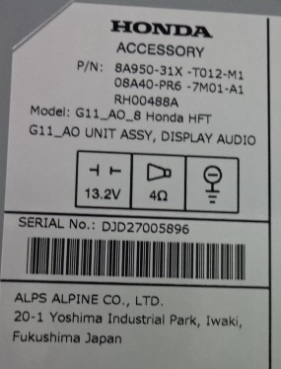
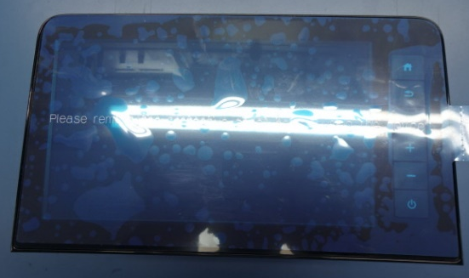
-2-
Detail History Product.
Rear camera mode is not activating.
Unit turn on and displaying the animation video and sound coming from speaker
but the activation of the rear camera mode is not occurring.
Serial : DJD27005896

Slide 4
①-1 Situation
-3-
Timeline status product NG
Rear camera not work
2023.Nov.16
AATH inform to AOTH
2023.Sep.02
AOTH Production
Wo-216002 1,080 pcs.
Occurrence
A1XC
開発開始
Operator change
Set Assembly #2,#3
Set Assembly #1
Touch up
Manual insert
Not control one cycle step
Brightness adjustment
Auto #1 – Auto #4
OP#1 – OP#2
Appearance check
200% Check
No item check Rear camera

Slide 5
6. Product History
History in Production
History of Serial no. DJD27005896 |  |  |  |  | 4M Change
Items. | WO# | Lot Size | Date | Predict time produced defect | Material | Method | Machine | Man
History in Production | 216002 | 1080 | 01-Sep’23 | Night Shift | No change | No change | No change | Change Operator touch up not work
.
Remark :
Process Touch up operator no working and sub-lead working for
Operator MT

Slide 6
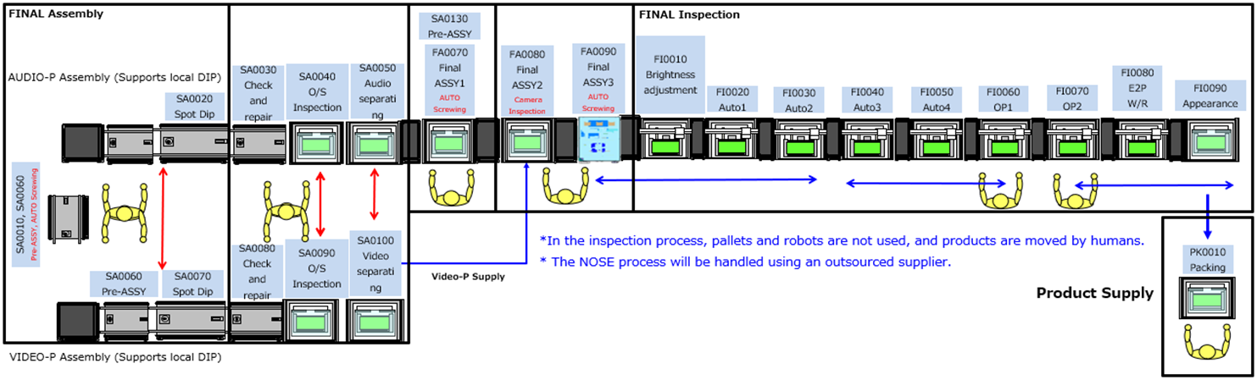
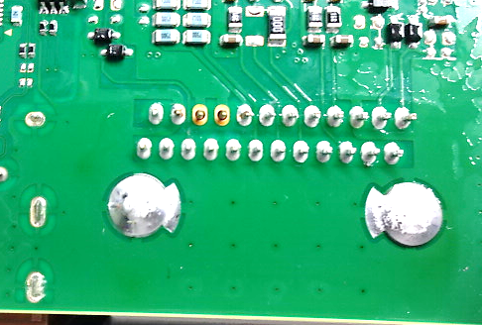
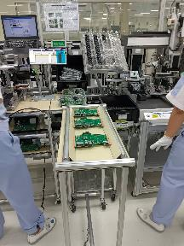
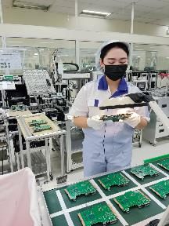
Detail problem
6
Where | Touch up problem
How/Problem | Process Touch up operator no working sub-lead working
Picture (Evidence) Cause
Cause : Skip touch up process
Regarding Sub-lead touch up and have other job after sport dip process inform to operator manual insert separate PWB after spot dip because of sub-lead have line call about center PCB → Operator Manual insert
Keep PCB wrong magazine
Skipp touch up
Action | - Stop WIP after spot dip change to one by one ( One cycle step ) - Add inspection at set assembly #1 after cutting confirm solder touch up - Special list for touch up process and buffer in case operator not work for touch up process | Mr.Mongkol / Prod CA | Due date: 20 Nov-23

Slide 7
Detail problem
7
Where | OP#2 process
How/Problem | Process operator combine process and working not one cycle step
Picture (Evidence) Cause
Cause : Operator OP#1 process and appearance process working OP#2 together not finish step process of OP#2 → 2 person / 1 process forget step work
Action | Review process set line balance 1.) Working one cycle step 2.) Setting operator each process review OPS 3.) Training operator about this problem | Mr.Mongkol / Prod CA | Due date: 20 Nov-23

Slide 8
8
Customer Claim
Before Current
7 Person
After
8 Person
Function check
Telephone check
Note : Improve line balance

Slide 9
9
Daily of production 20-Nov-23 (Line G11 Model)
Items. | Problems | Root Cause | Action
Line Call | PWB Video No Solder PWB Audio Red Solder | Solid Flux nozzle (หัว Flux ตัน) | Cleaning flux nozzle
Defect in line | Operator found nose assembly from MCT deform (RH00485A01) 10 In FG Stock 330 pcs | (Inform to MCT ) | 1. Night shift production confirm 100% 2. IQC check 100% nose assembly
4M Change control | No | No | No
Touch up manual Video CB3000 Audio IC1400 | BR Solder 4 pcs BR Solder 12 pcs |  | Re Touch up

Slide 10
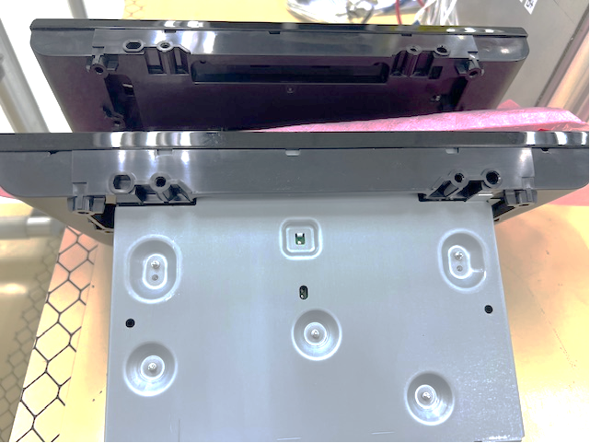
10
Daily of production 20-Nov-23 (Line G11 Model)

Slide 11



