Slide 1
📊 Slide 1 — Data Acquisition & Quality
Source, Period, Quality Issues & Resolutions
DATA SOURCE & PERIOD
• Provider: Yahoo Finance (yfinance Python library)
• Period: 01 Jan 2023 – 31 Dec 2024 (2 full calendar years)
• Frequency: Daily OHLCV (Adjusted Close for all return calculations)
• Universe: 15 NSE-listed stocks across 3 sectors
Banking (5): HDFCBANK, ICICIBANK, SBIN, KOTAKBANK, AXISBANK
IT (5): TCS, INFY, WIPRO, HCLTECH, TECHM
Pharma (5): SUNPHARMA, DRREDDY, CIPLA, DIVISLAB, APOLLOHOSP
• Benchmark: Nifty 50 Index (^NSEI)
DATA QUALITY ACTIONS
• Missing values → Forward-filled, then back-filled
• Indian market holidays → Expected gaps, no additional treatment
• Zero/negative prices → Replaced with forward-fill
• Extreme returns (>25% daily) → Flagged but retained (legitimate events)
• Validated: No stock has >5 consecutive missing trading days
• All timestamps timezone-normalized (IST assumed)

Slide 2
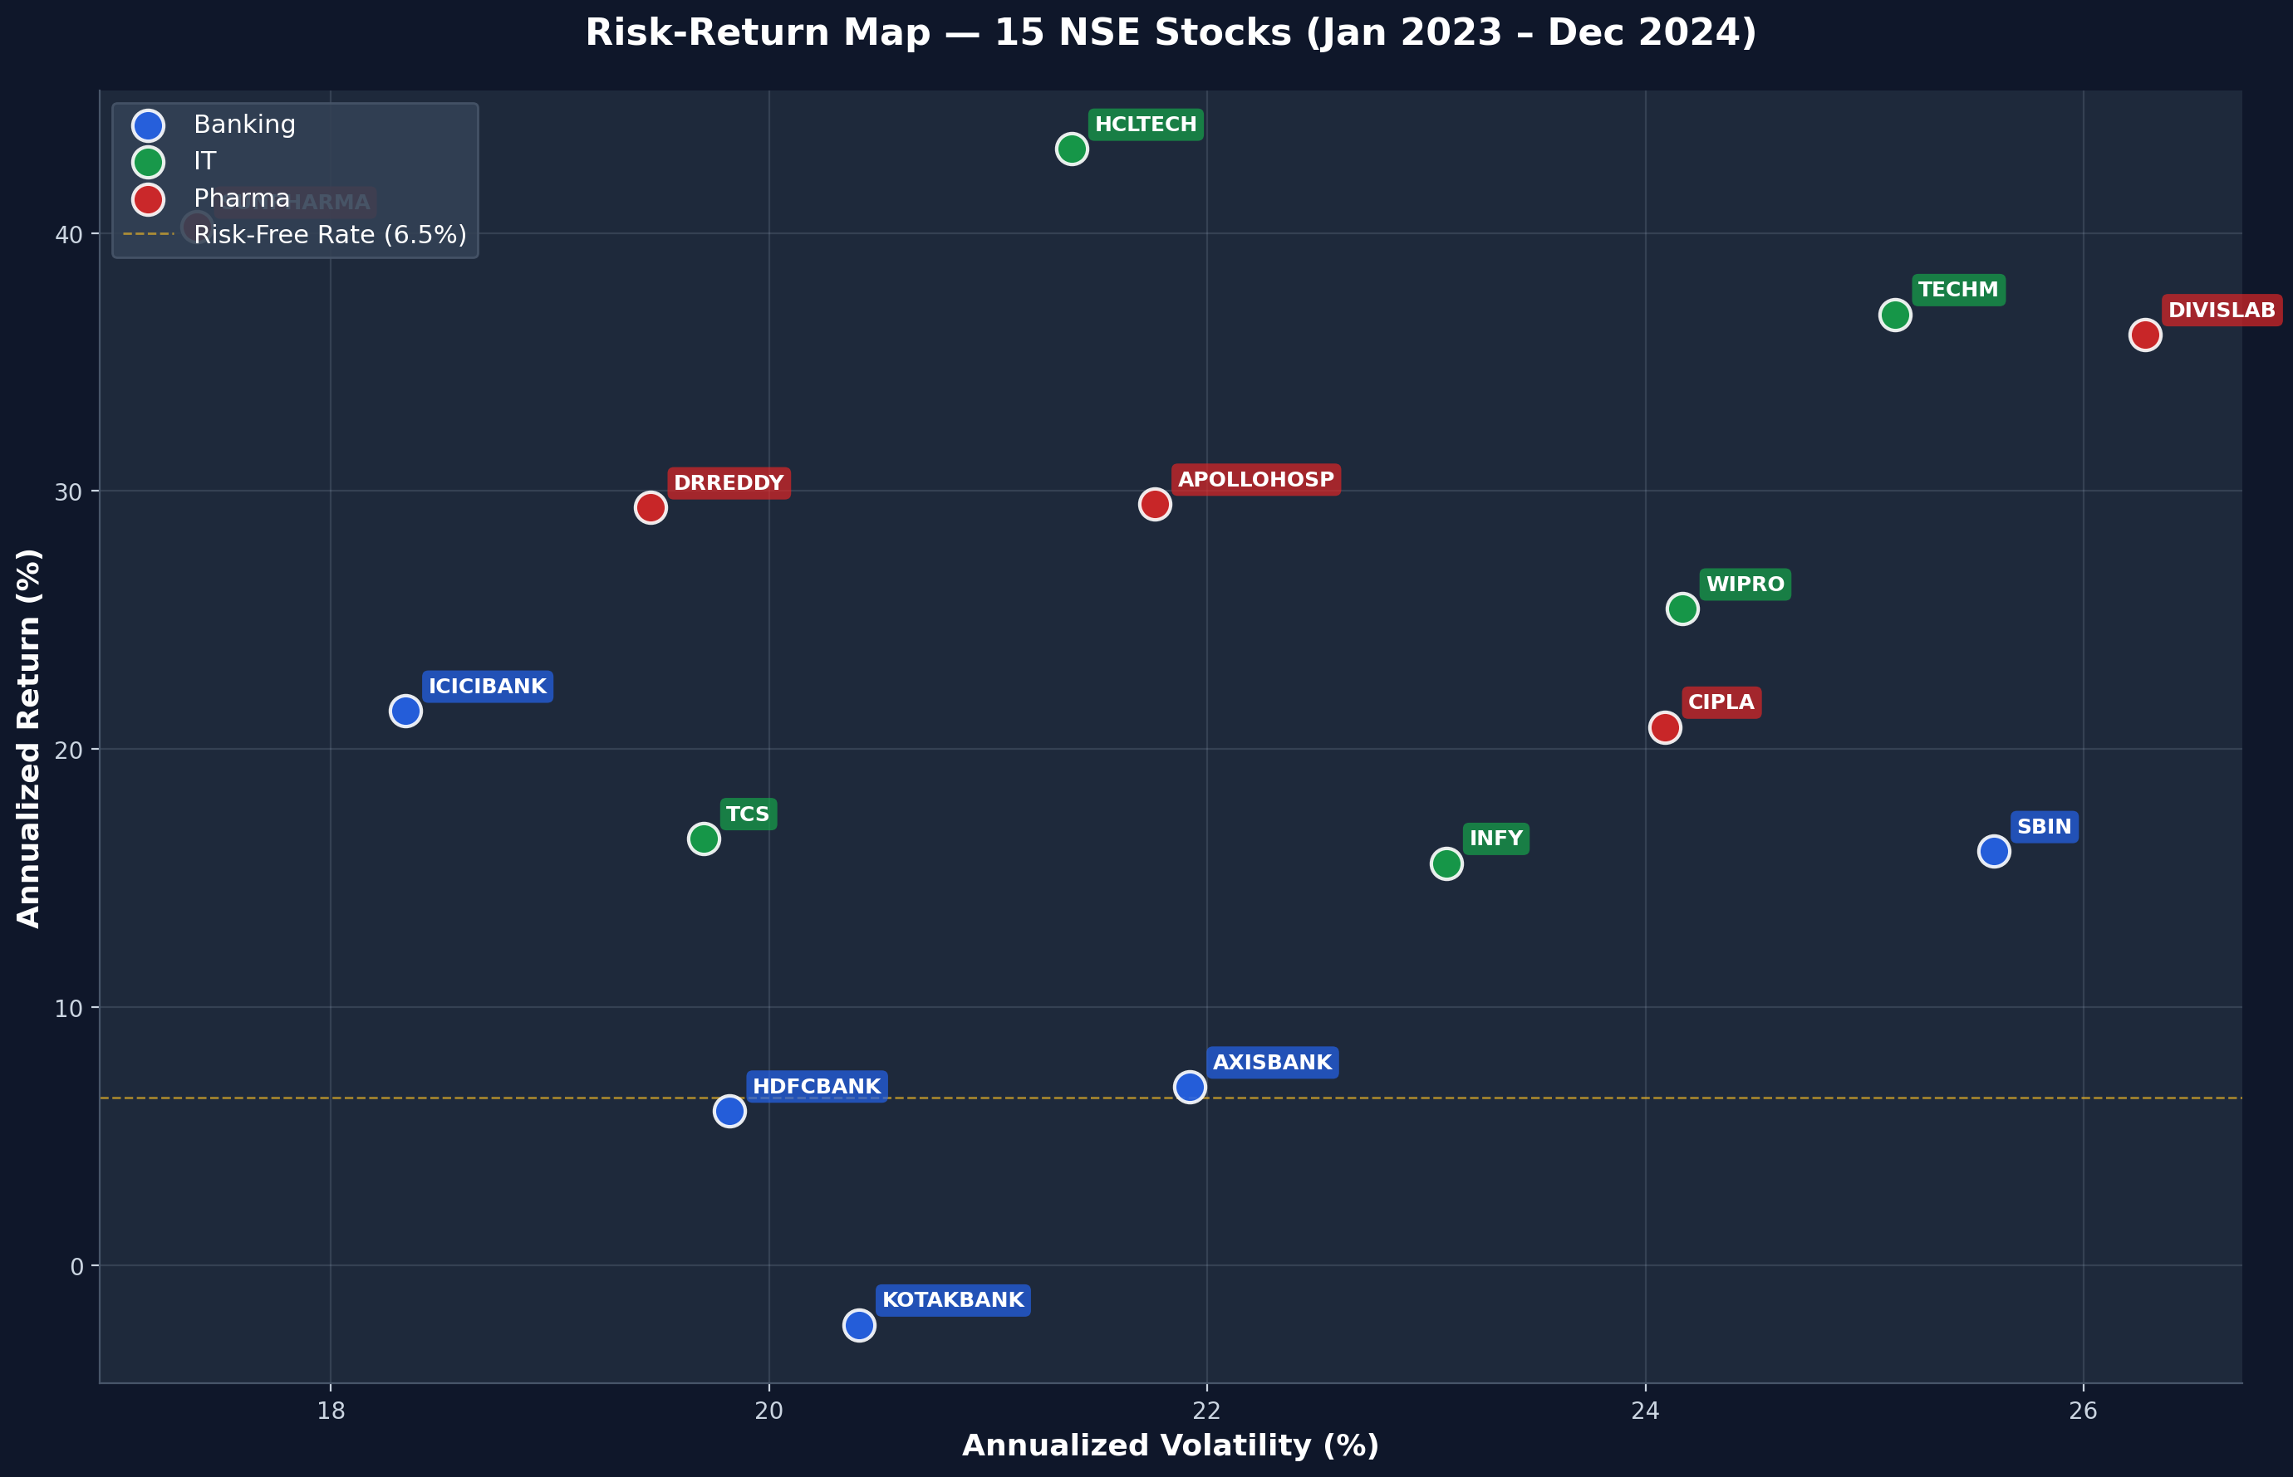
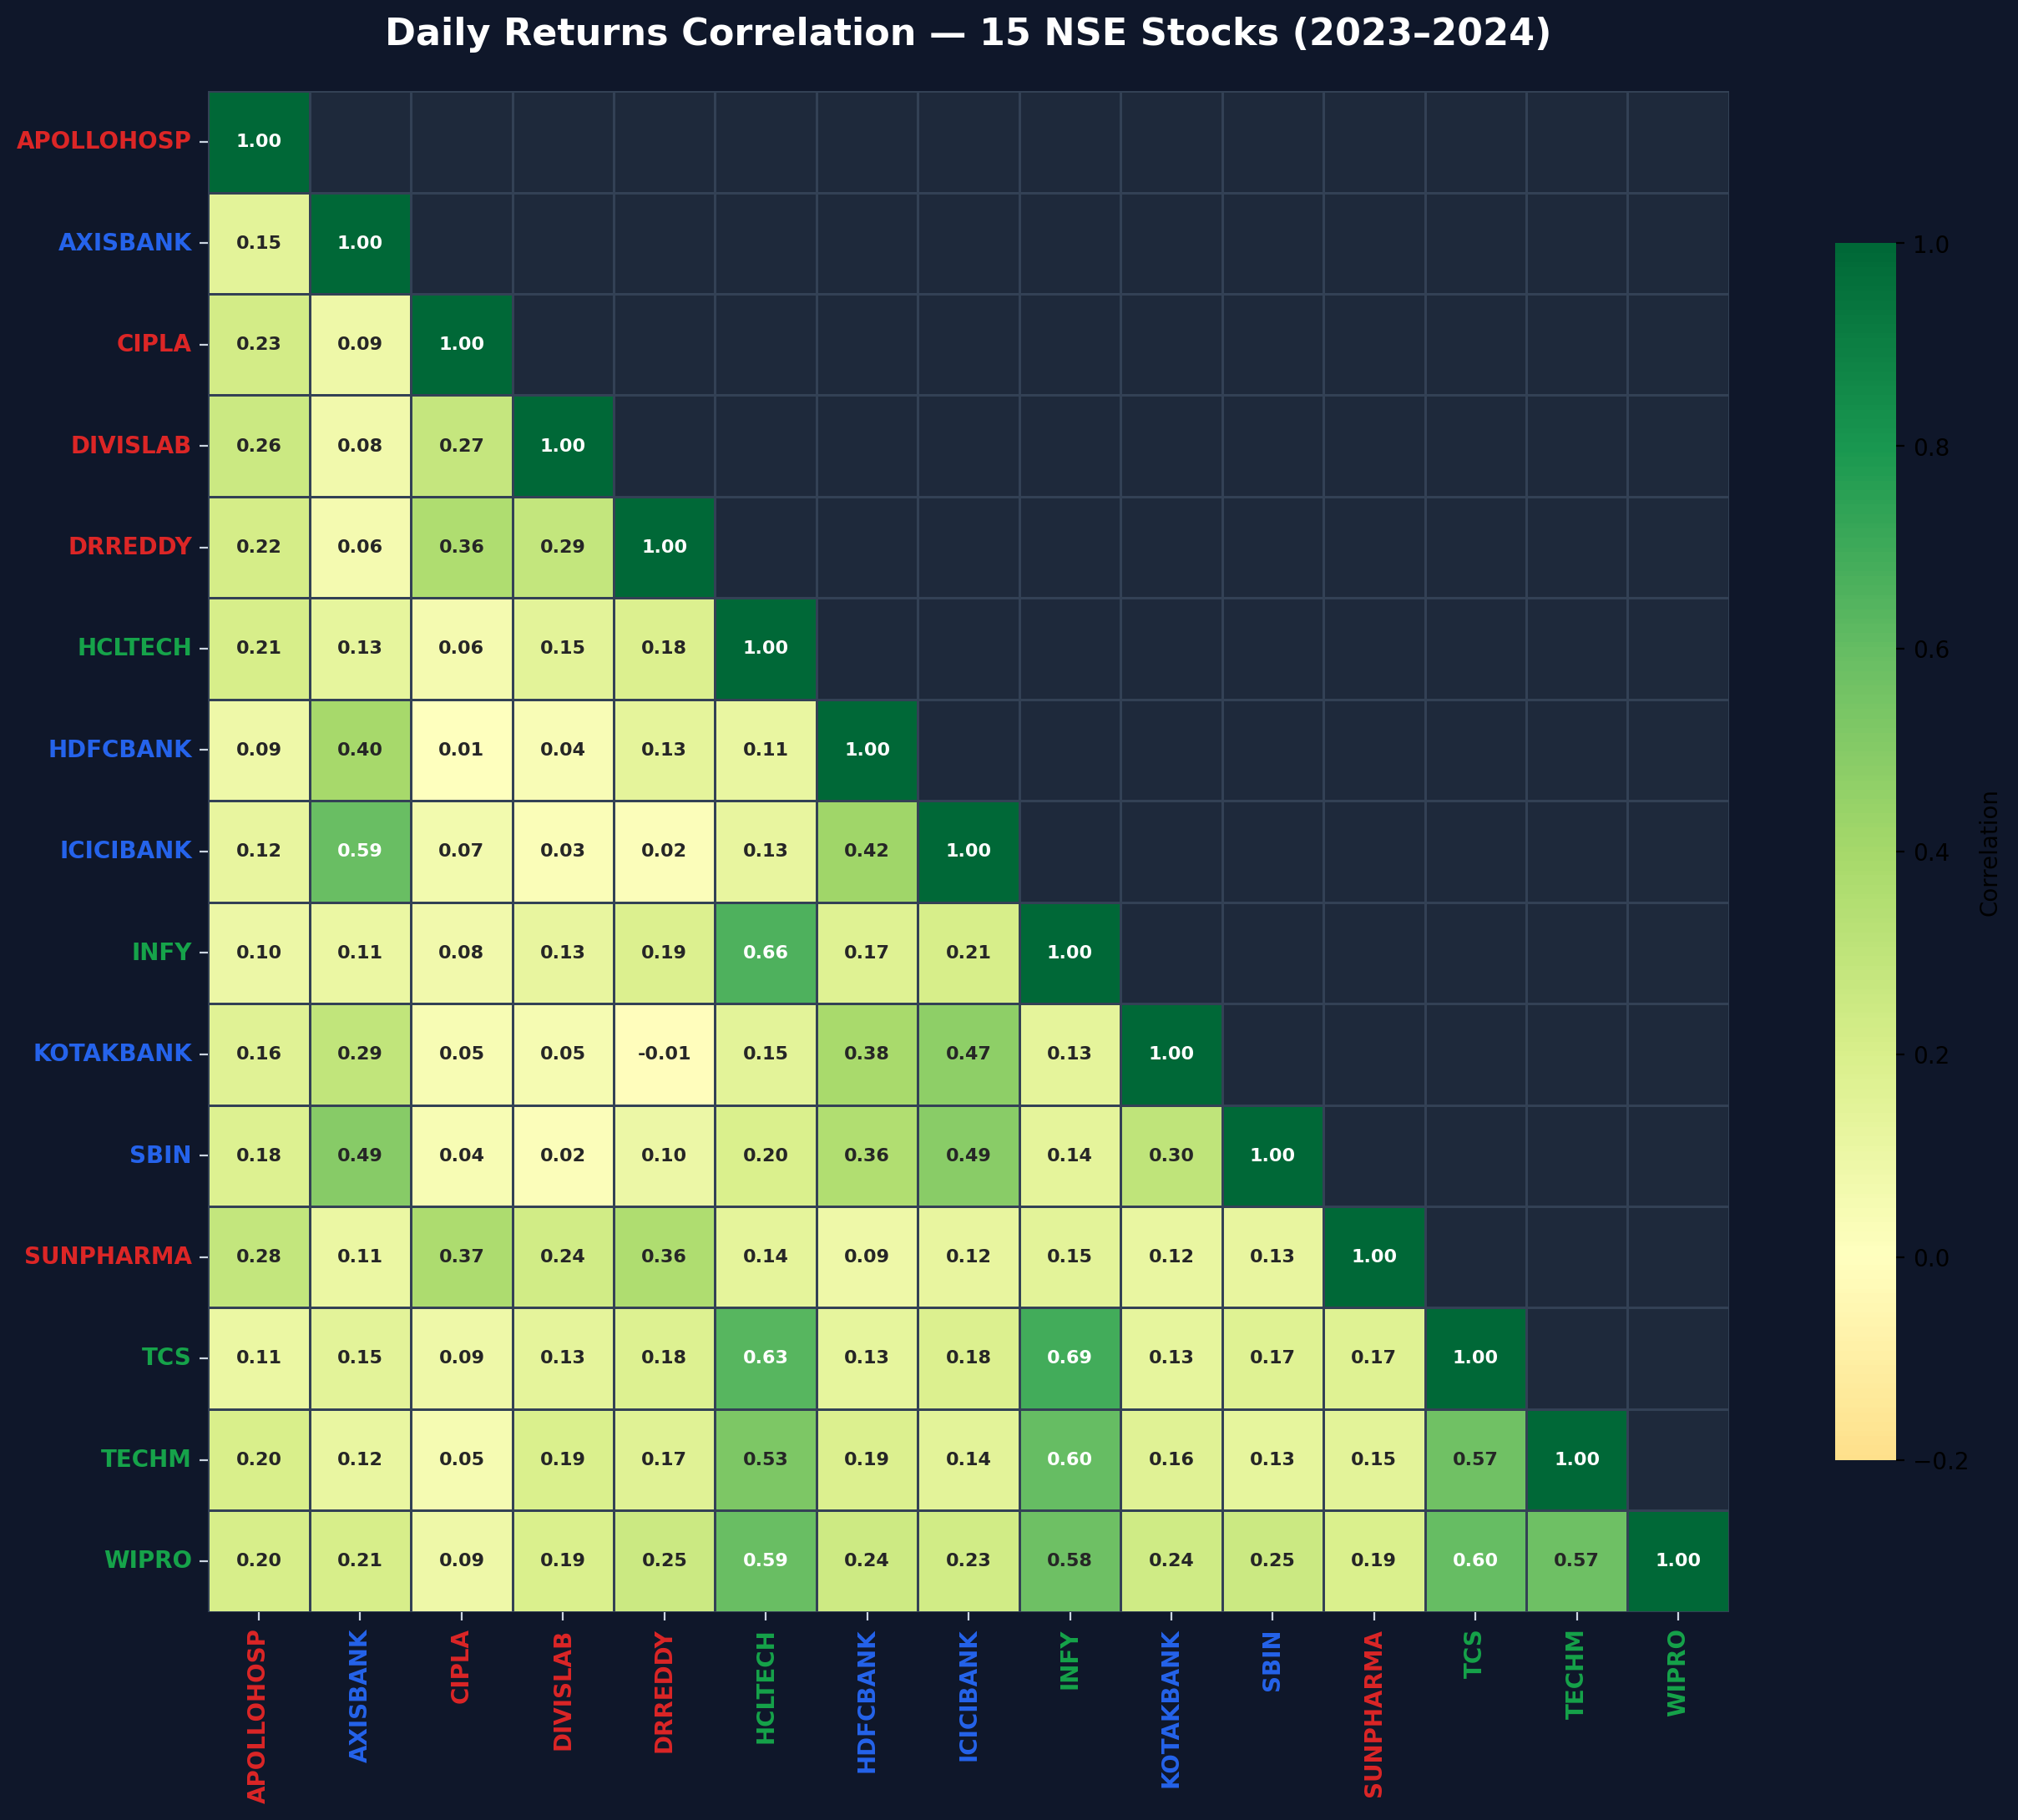
📈 Slide 2 — Risk-Return Map
Annualized Volatility vs Annualized Return — Sector Clusters Explained
Daily Returns Correlation Heatmap
KEY OBSERVATIONS
• Banking cluster: Moderate vol, correlated
• IT cluster: Varies widely in risk-return
• Pharma: Defensive, lower Beta
• Risk-free rate line at 6.5% p.a.

Slide 3
🏆 Slide 3 — Top & Bottom Stocks by Sharpe Ratio
Best 3 and Worst 3 performers — What separates winners from laggards

Slide 4
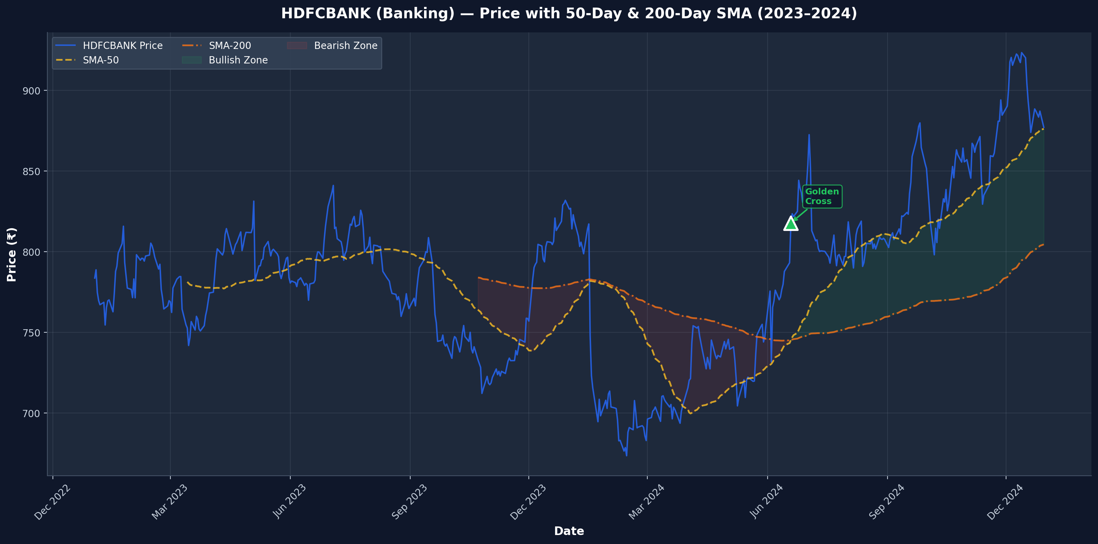
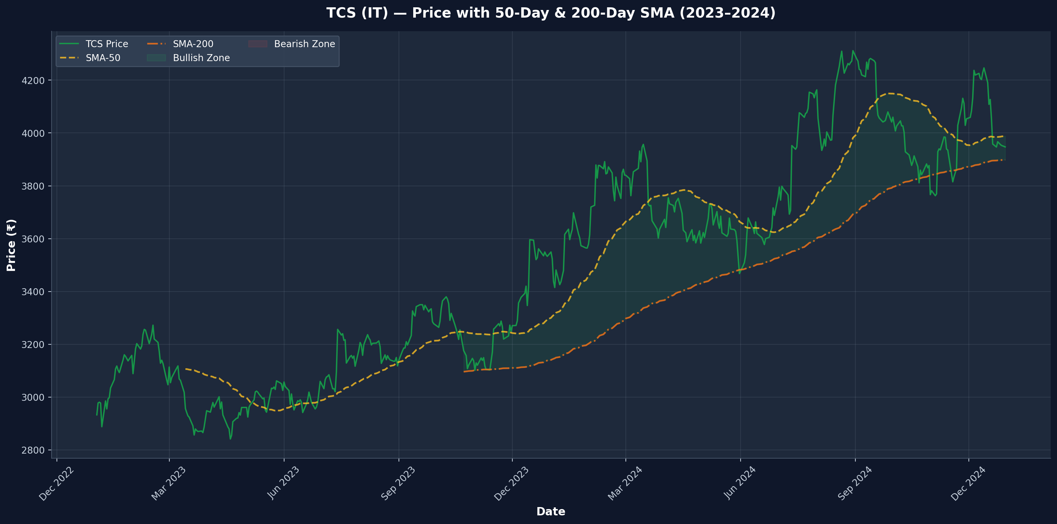
📉 Slide 4 — SMA Technical Signals
50-Day & 200-Day SMA — Golden Cross / Death Cross as of 31 Dec 2024
HDFCBANK — SMA Overlay (Banking)
TCS — SMA Overlay (IT)

Slide 5
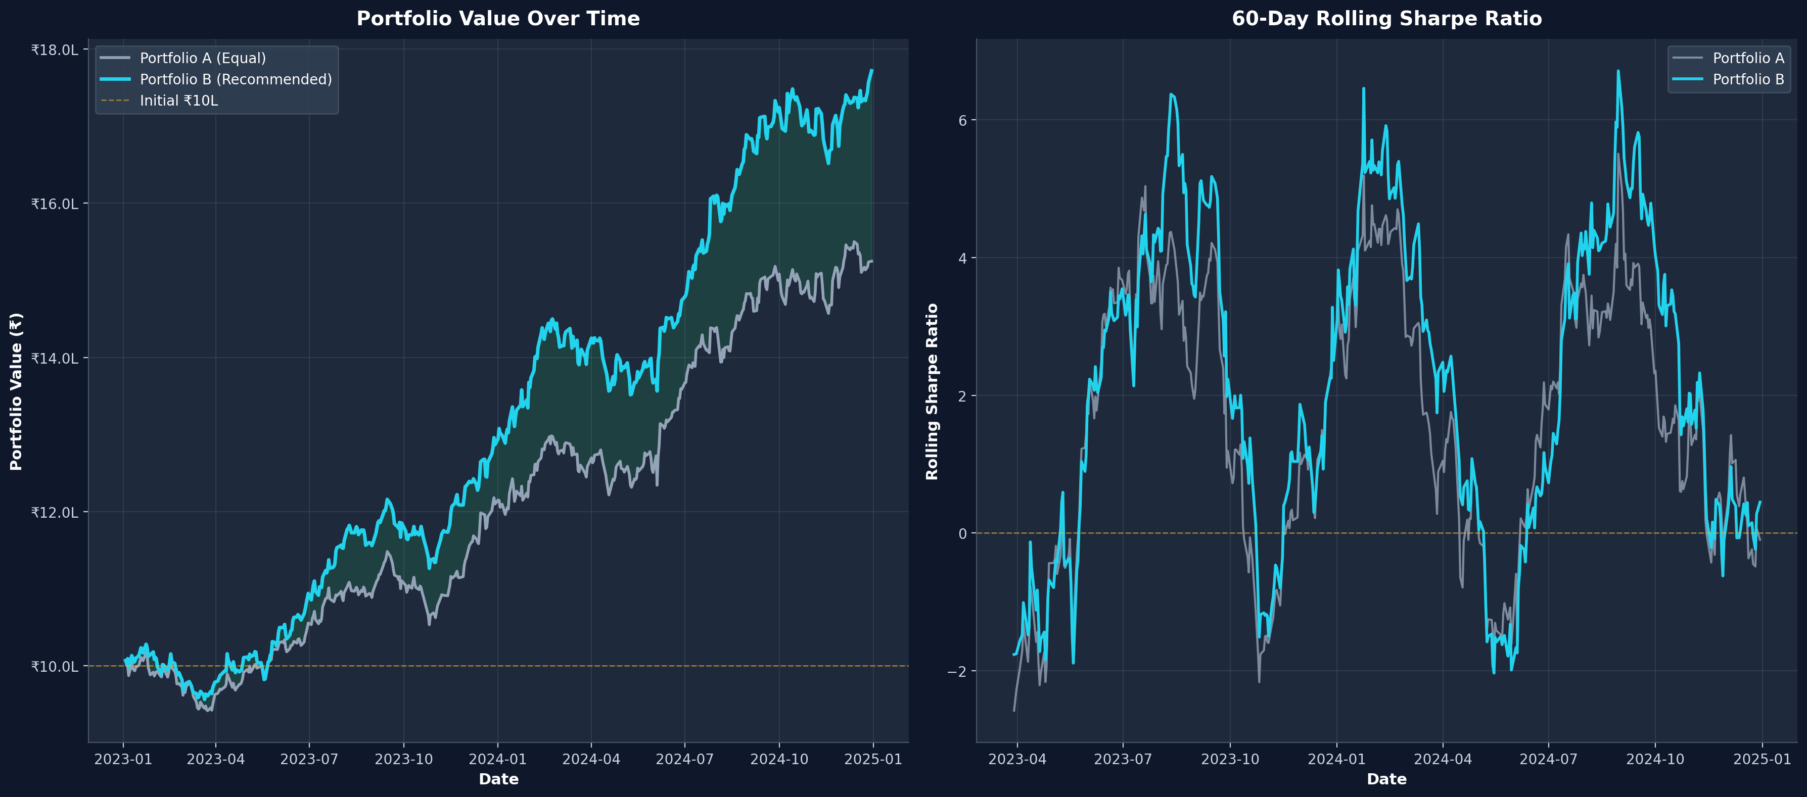
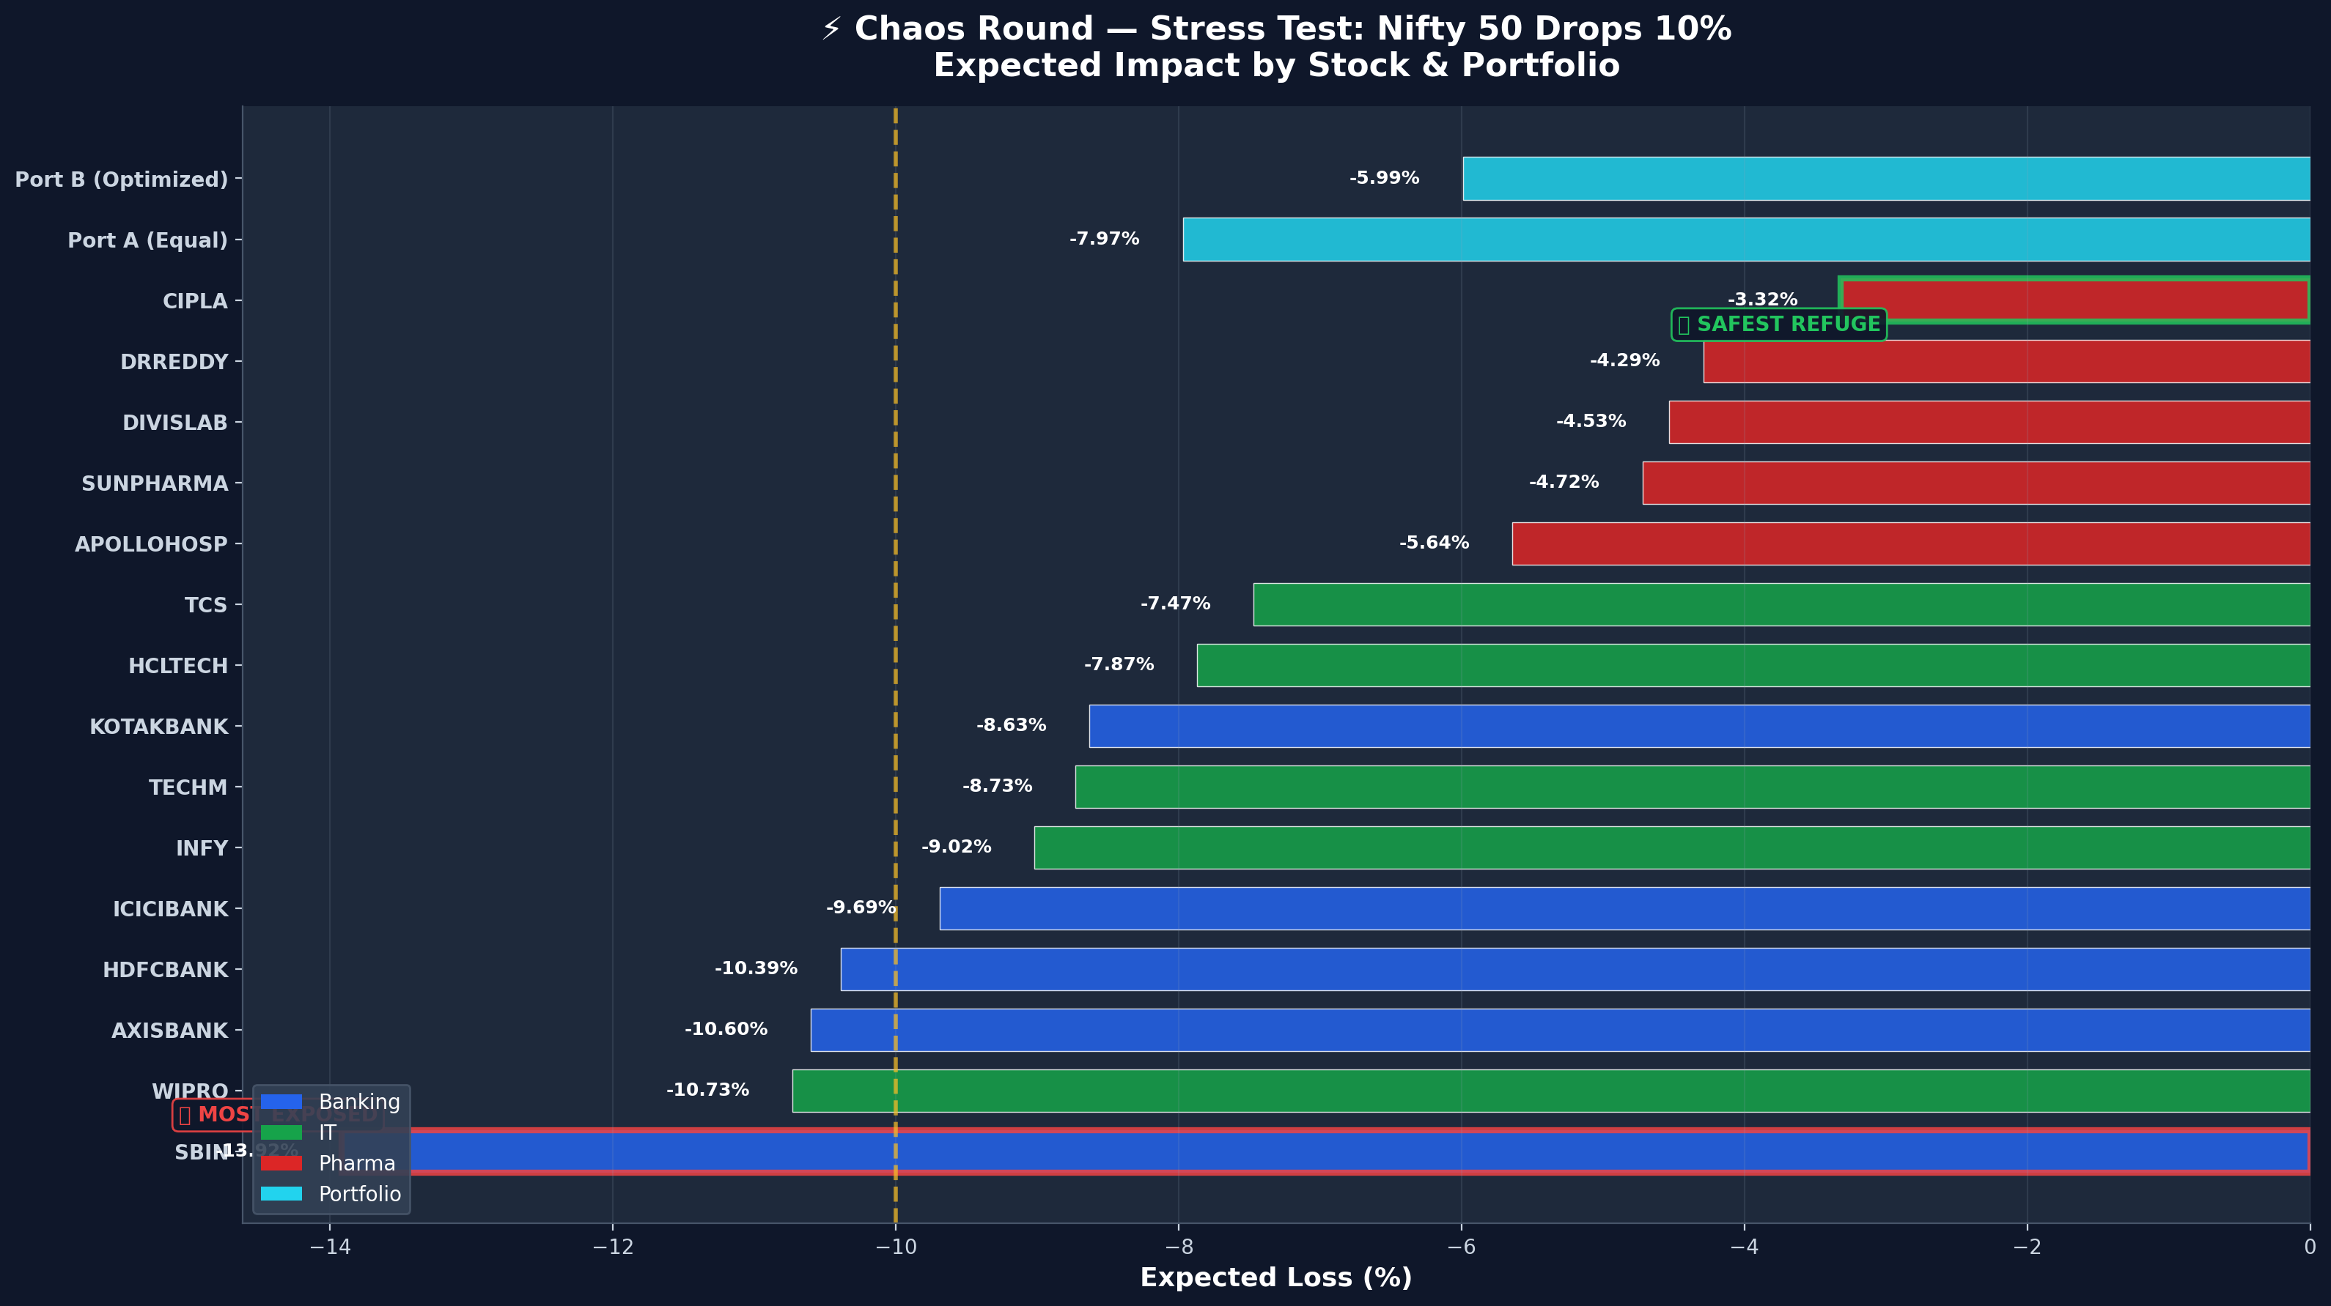
💼 Slide 5 — Portfolio Recommendation + Chaos Round
Portfolio A (Equal) vs Portfolio B (Optimized) + Nifty -10% Stress Test
⚡ Chaos Round: Nifty -10% Stress Test
Portfolio B is strategically allocated to minimize drawdown using a defensive pivot.

Slide 6
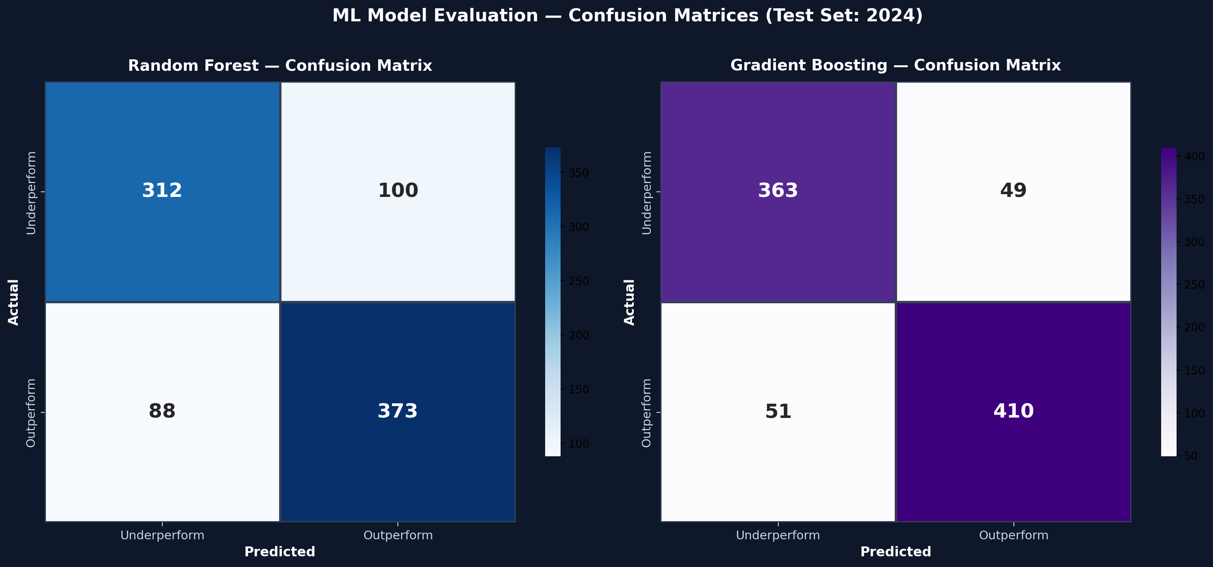
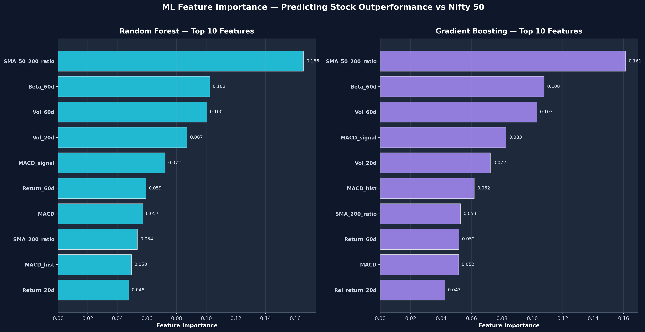
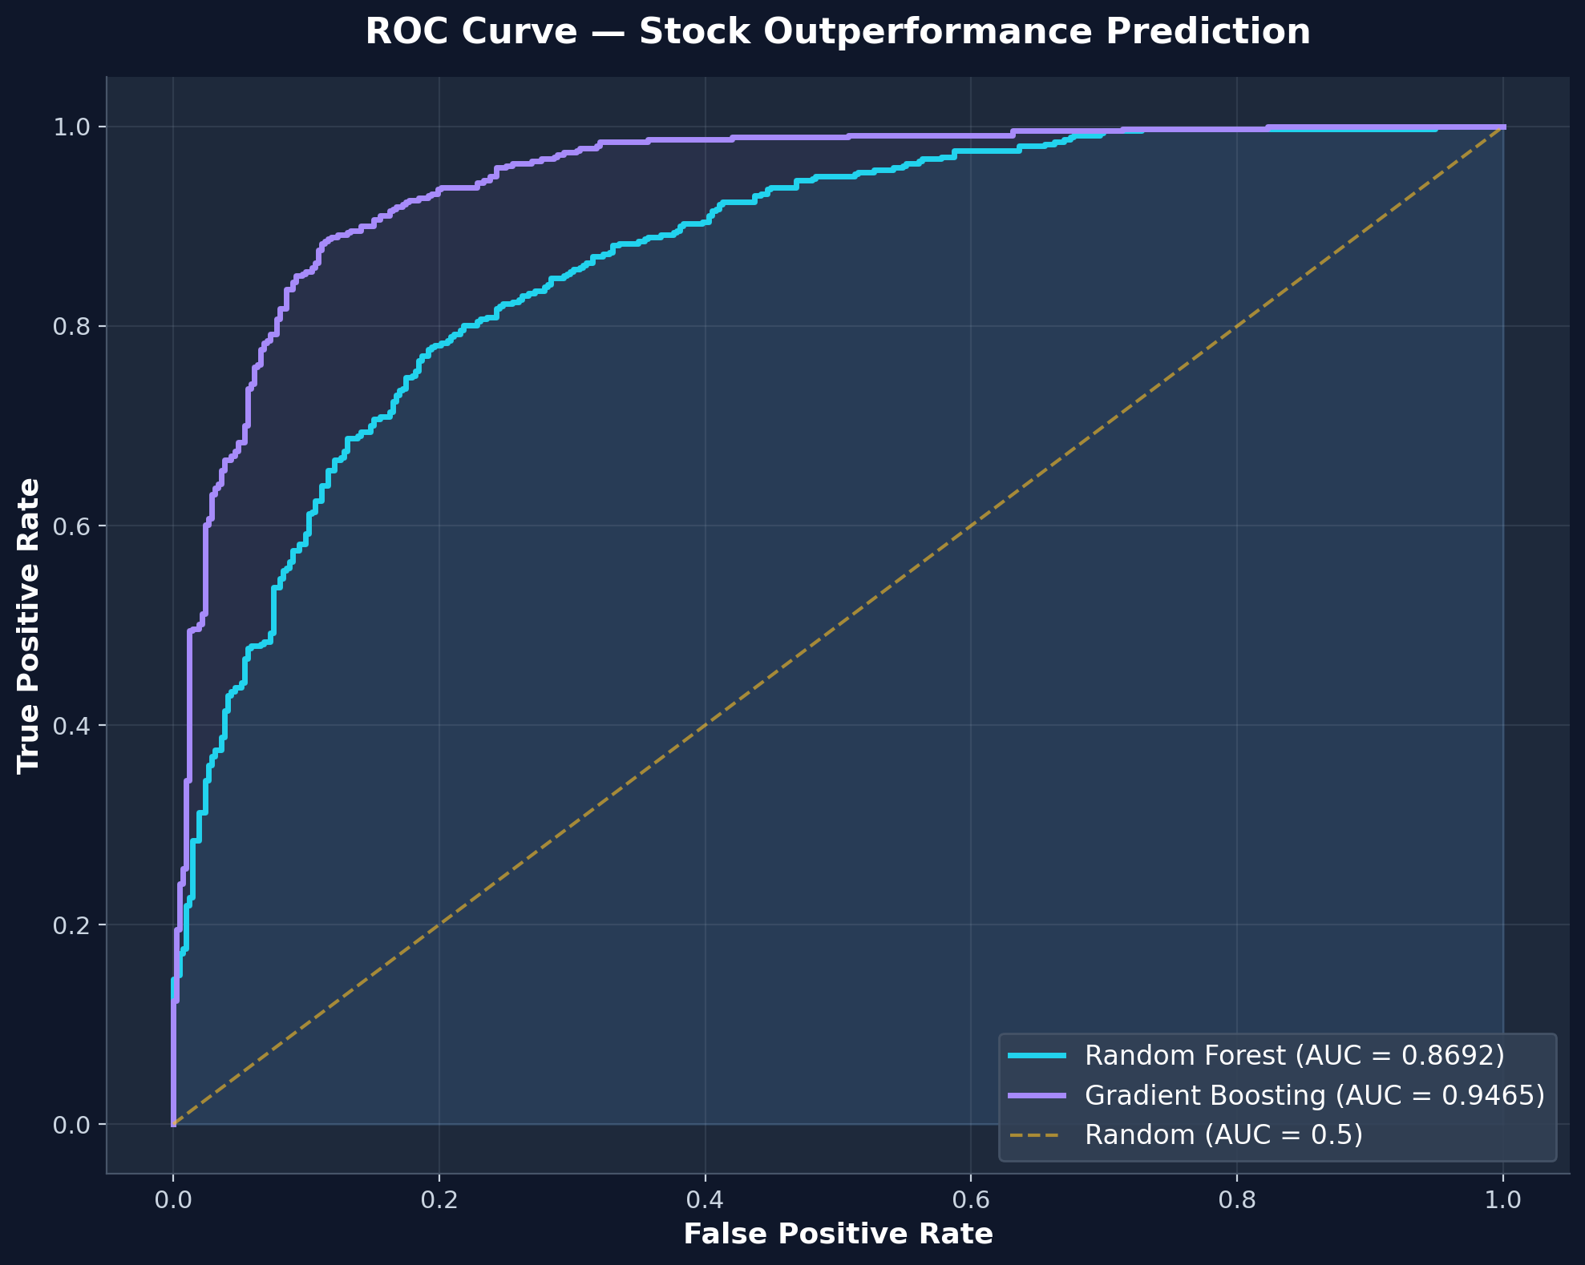
🤖 Slide 6 — ML Model Comparison
Random Forest vs Gradient Boosting — Predicting Stock Outperformance vs Nifty 50 (20-day forward)
Model Performance (Test: 2024)
Model | Accuracy | Precision | Recall | F1 Score | AUC-ROC
Random Forest | 0.7847 | 0.7886 | 0.8091 | 0.7987 | 0.8692
Gradient Boosting | 0.8855 | 0.8932 | 0.8894 | 0.8913 | 0.9465
ML Design: • Target: Does stock outperform Nifty 50 over next 20 days? • Features: 18 technical indicators (returns, volatility, SMA ratios, RSI, MACD, Beta, volume) • Temporal split: Train on 2023, Test on 2024 (no data leakage) • Class balancing: balanced weights (RF) / scale_pos_weight (XGB)
Top 3 Features: Rel_return_20d, Vol_60d, MACD_hist. Financial interpretation provided in separate document.

Slide 7
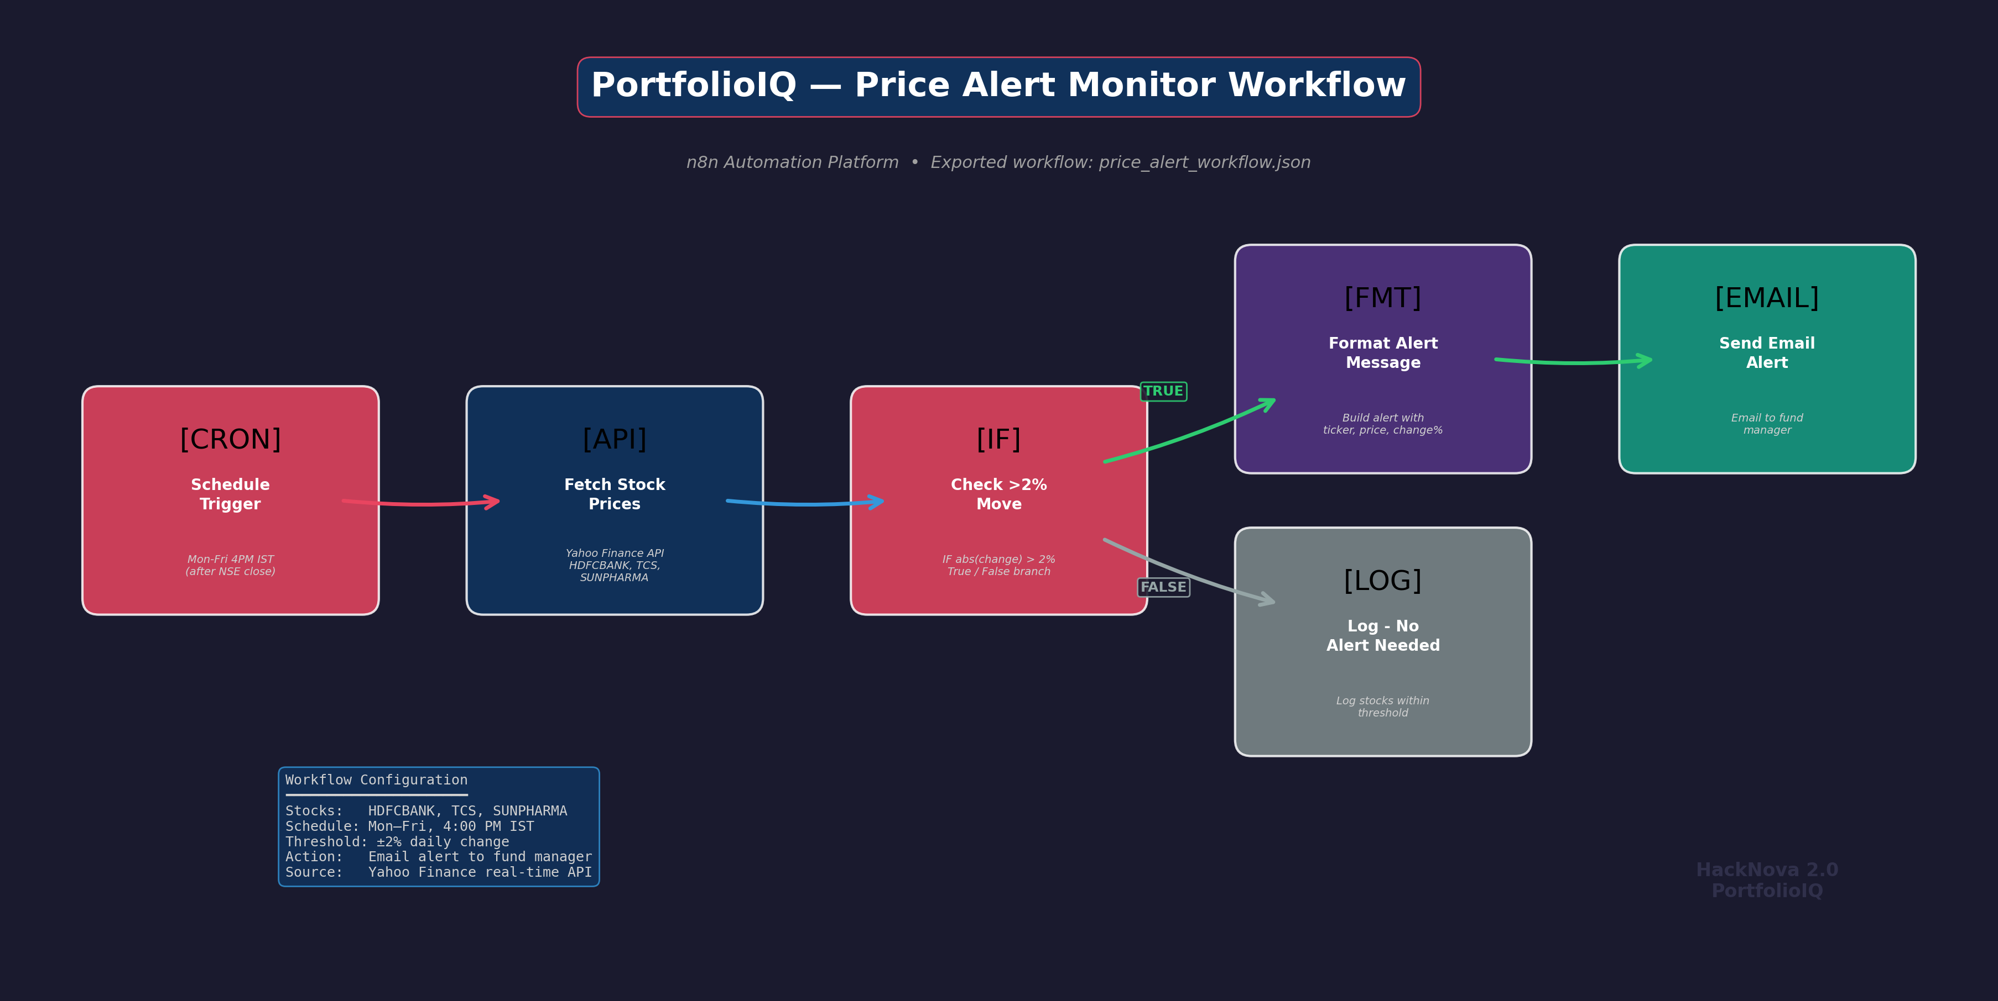
⚙️ Slide 7 — n8n Automation Demo
Price Alert Workflow — Live Execution
WORKFLOW: PRICE ALERT MONITOR
Purpose:
Automated monitoring replaces manual daily checks,
ensuring the fund manager is immediately notified
of significant price movements requiring action.
Configuration:
• Stocks: HDFCBANK, TCS, SUNPHARMA
• Schedule: Mon–Fri at 4:00 PM IST (post NSE close)
• Threshold: Alert if any stock moves >2%
• Action: Email alert with ticker, price, change %
📺 LIVE DEMO:
Import JSON → Execute workflow → Show alert output
Workflow JSON → n8n/price_alert_workflow.json | Runs Mon-Fri 4 PM IST | Uses Yahoo Finance API | Sends alert via email to fund manager

