Slide 1
📊 Slide 1 — Data Acquisition & Quality
Source, Period, Quality Issues & Resolutions
DATA SOURCE & PERIOD
• Provider: Yahoo Finance (yfinance Python library)
• Period: 01 Jan 2023 – 31 Dec 2024 (2 full calendar years)
• Frequency: Daily OHLCV (Adjusted Close for all return calculations)
• Universe: 15 NSE-listed stocks across 3 sectors
Banking (5): HDFCBANK, ICICIBANK, SBIN, KOTAKBANK, AXISBANK
IT (5): TCS, INFY, WIPRO, HCLTECH, TECHM
Pharma (5): SUNPHARMA, DRREDDY, CIPLA, DIVISLAB, APOLLOHOSP
• Benchmark: Nifty 50 Index (^NSEI)
DATA QUALITY ACTIONS
• Missing values → Forward-filled, then back-filled
• Indian market holidays → Expected gaps, no additional treatment
• Zero/negative prices → Replaced with forward-fill
• Extreme returns (>25% daily) → Flagged but retained (legitimate events)
• Validated: No stock has >5 consecutive missing trading days
• All timestamps timezone-normalized (IST assumed)

Slide 2
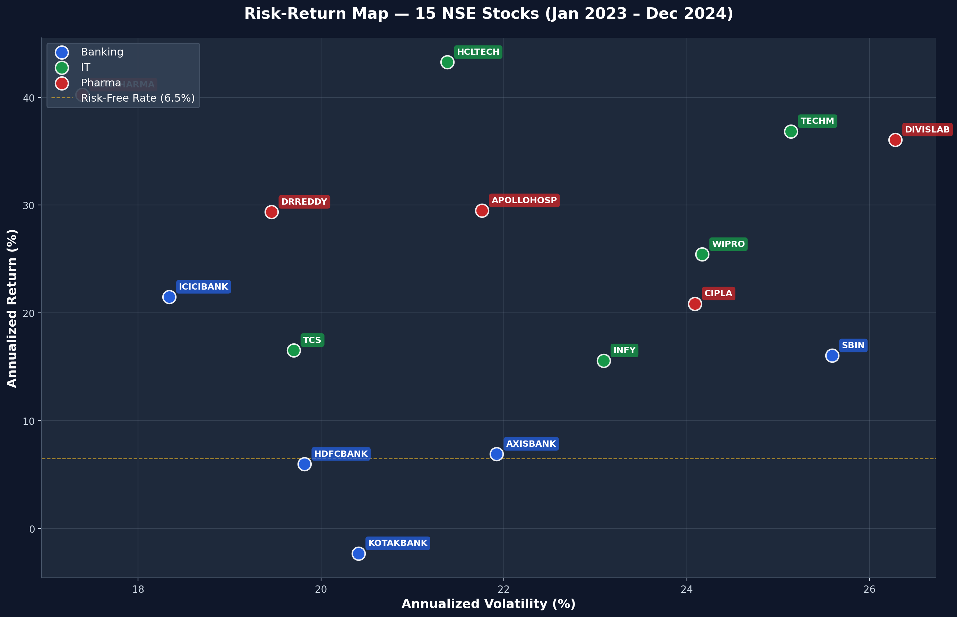
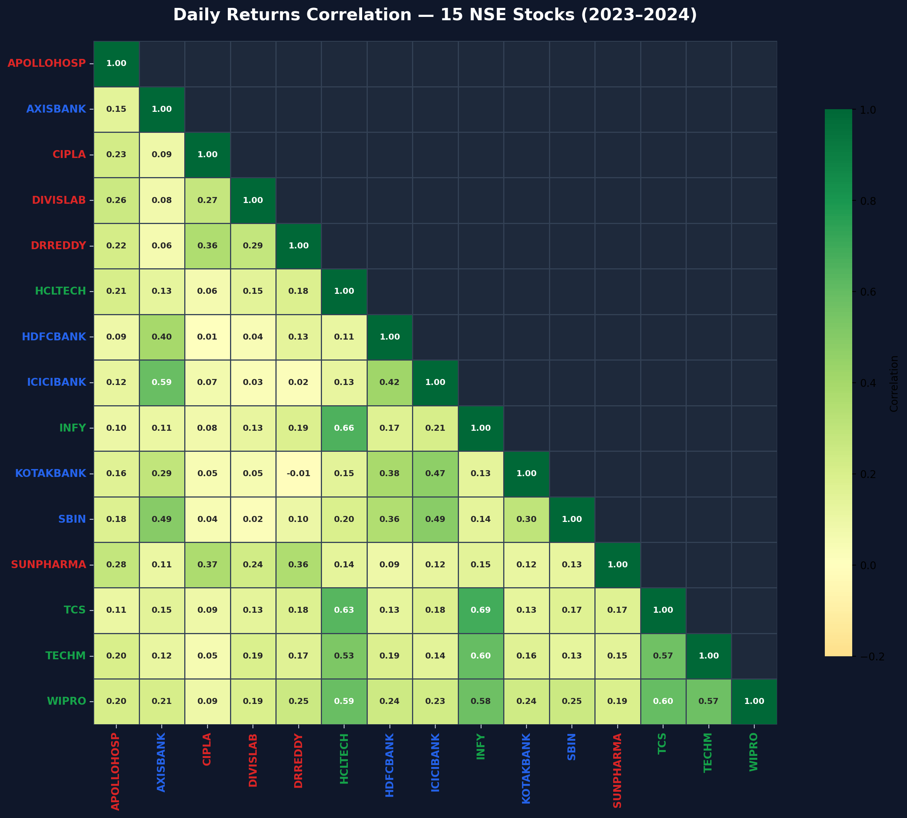
📈 Slide 2 — Risk-Return Map
Annualized Volatility vs Annualized Return — Sector Clusters Explained
Daily Returns Correlation Heatmap
KEY OBSERVATIONS
• Banking cluster: Moderate vol, correlated
• IT cluster: Varies widely in risk-return
• Pharma: Defensive, lower Beta
• Risk-free rate line at 6.5% p.a.

Slide 3
🏆 Slide 3 — Top & Bottom Stocks by Sharpe Ratio
Best 3 and Worst 3 performers — What separates winners from laggards
🟢 TOP 3 (Highest Sharpe Ratio)
Ticker | Sector | Annualized Return (%) | Annualized Volatility (%) | Sharpe Ratio | Beta vs Nifty 50 | Maximum Drawdown (%)
SUNPHARMA | Pharma | 40.24 | 17.39 | 1.9399 | 0.4725 | -12.24
HCLTECH | IT | 43.26 | 21.38 | 1.719 | 0.7871 | -21.66
TECHM | IT | 36.85 | 25.14 | 1.2074 | 0.8729 | -16.22
🔴 BOTTOM 3 (Lowest Sharpe Ratio)
Ticker | Sector | Annualized Return (%) | Annualized Volatility (%) | Sharpe Ratio | Beta vs Nifty 50 | Maximum Drawdown (%)
AXISBANK | Banking | 6.91 | 21.92 | 0.0185 | 1.0601 | -18.78
HDFCBANK | Banking | 5.98 | 19.82 | -0.0265 | 1.0391 | -19.91
KOTAKBANK | Banking | -2.31 | 20.41 | -0.4318 | 0.8634 | -23.15
📊 Sector Averages
Sector | Avg Sharpe Ratio | Avg Beta | Portfolio A Exposure (%) | Portfolio B Exposure (%)
Banking | 0.15 | 1.0647 | 33.3 | 5.7
IT | 0.9227 | 0.8763 | 33.3 | 27.7
Pharma | 1.1786 | 0.4501 | 33.3 | 66.6

Slide 4
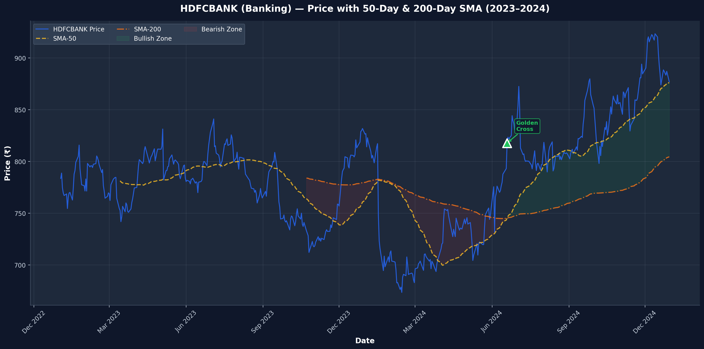
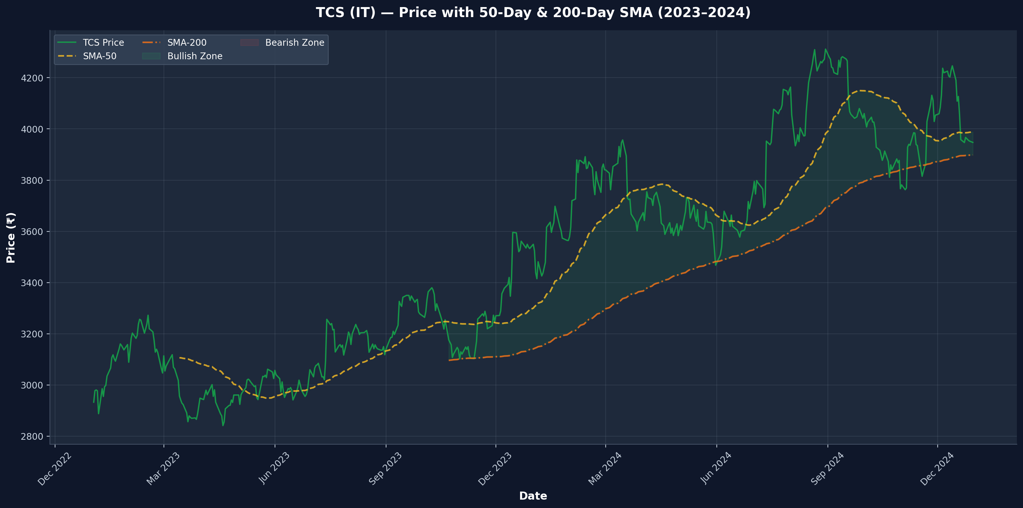
📉 Slide 4 — SMA Technical Signals
50-Day & 200-Day SMA — Golden Cross / Death Cross as of 31 Dec 2024
Ticker | Sector | SMA-50 | SMA-200 | Signal | Last Crossover Date
APOLLOHOSP | Pharma | 7050.71 | 6559.55 | Golden Cross | nan
AXISBANK | Banking | 1144.55 | 1160.8 | Death Cross | 2024-12-12
CIPLA | Pharma | 1487.43 | 1492.87 | Death Cross | 2024-12-24
DIVISLAB | Pharma | 5901.81 | 4838.6 | Golden Cross | 2024-05-16
DRREDDY | Pharma | 1263.89 | 1267.88 | Death Cross | 2024-12-13
HCLTECH | IT | 1792.28 | 1558.68 | Golden Cross | 2024-07-22
HDFCBANK | Banking | 876.15 | 804.55 | Golden Cross | 2024-06-19
ICICIBANK | Banking | 1282.17 | 1188.17 | Golden Cross | nan
INFY | IT | 1825.72 | 1648.63 | Golden Cross | 2024-07-12
KOTAKBANK | Banking | 352.1 | 353.36 | Death Cross | 2024-12-26
SBIN | Banking | 812.27 | 795.13 | Golden Cross | nan
SUNPHARMA | Pharma | 1789.64 | 1661.11 | Golden Cross | nan
TCS | IT | 3988.23 | 3898.45 | Golden Cross | nan
TECHM | IT | 1665.61 | 1439.69 | Golden Cross | nan
WIPRO | IT | 271.8 | 244.06 | Golden Cross | nan
HDFCBANK — SMA Overlay (Banking)
TCS — SMA Overlay (IT)

Slide 5
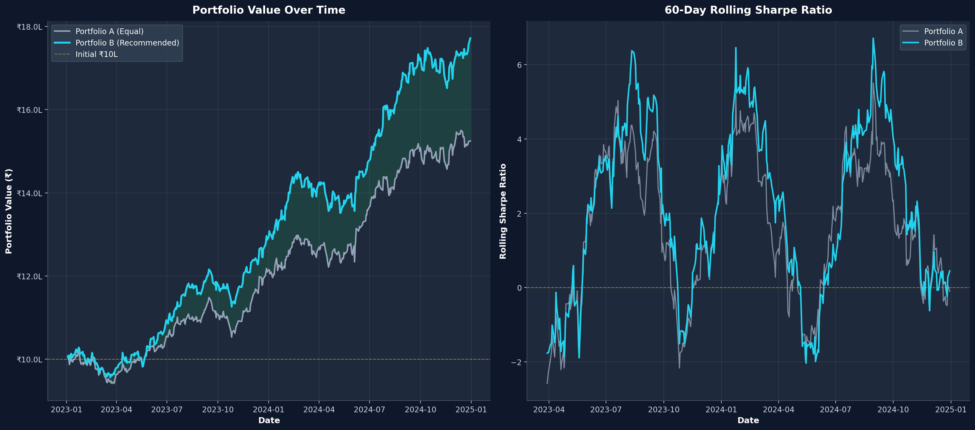
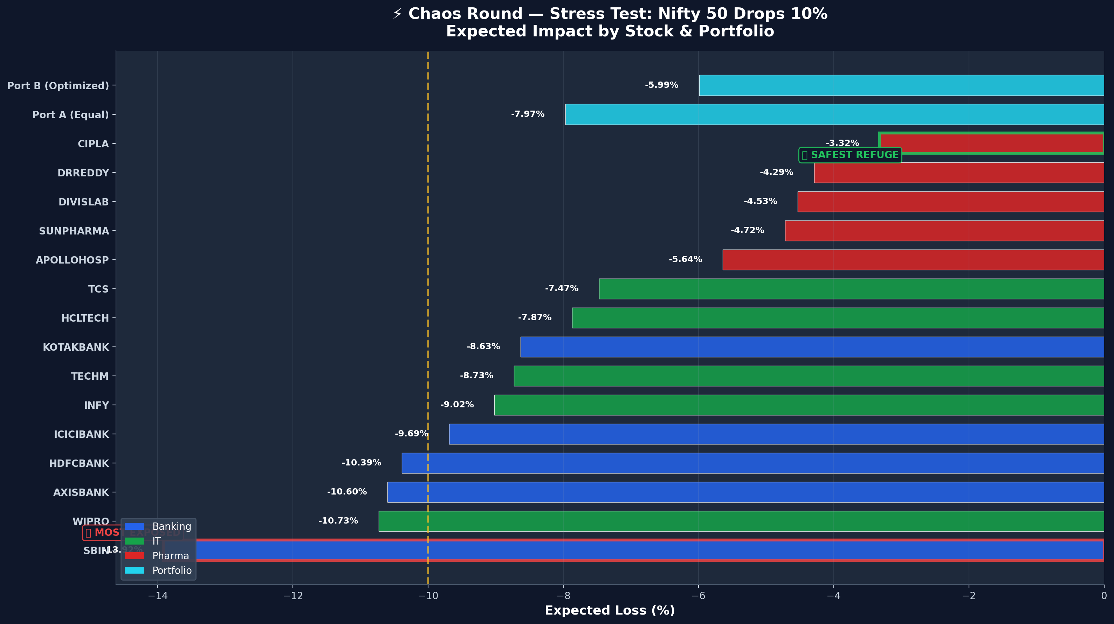
💼 Slide 5 — Portfolio Recommendation + Chaos Round
Portfolio A (Equal) vs Portfolio B (Optimized) + Nifty -10% Stress Test
Portfolio Comparison
Metric | Portfolio A (Equal Weight) | Portfolio B (Recommended)
Annualized Return (%) | 24.28 | 34.29
Annualized Volatility (%) | 11.43 | 12.1
Sharpe Ratio | 1.5564 | 2.2956
Banking Exposure (%) | 33.3 | 5.7
IT Exposure (%) | 33.3 | 27.7
Pharma Exposure (%) | 33.3 | 66.6
⚡ Chaos Round: Nifty -10% Stress Test
Ticker | Sector | Beta | Expected Loss (%)
PORTFOLIO A | Portfolio | - | -7.97
PORTFOLIO B | Portfolio | - | -5.99
MOST EXPOSED | Banking | 1.3916 | -13.92
SAFEST REFUGE | Pharma | 0.3322 | -3.32

Slide 6
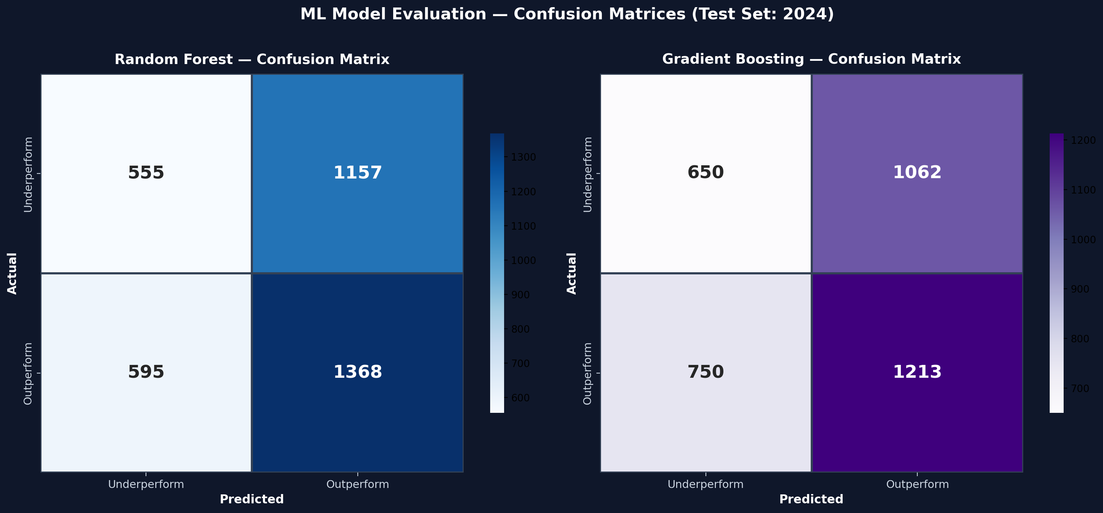
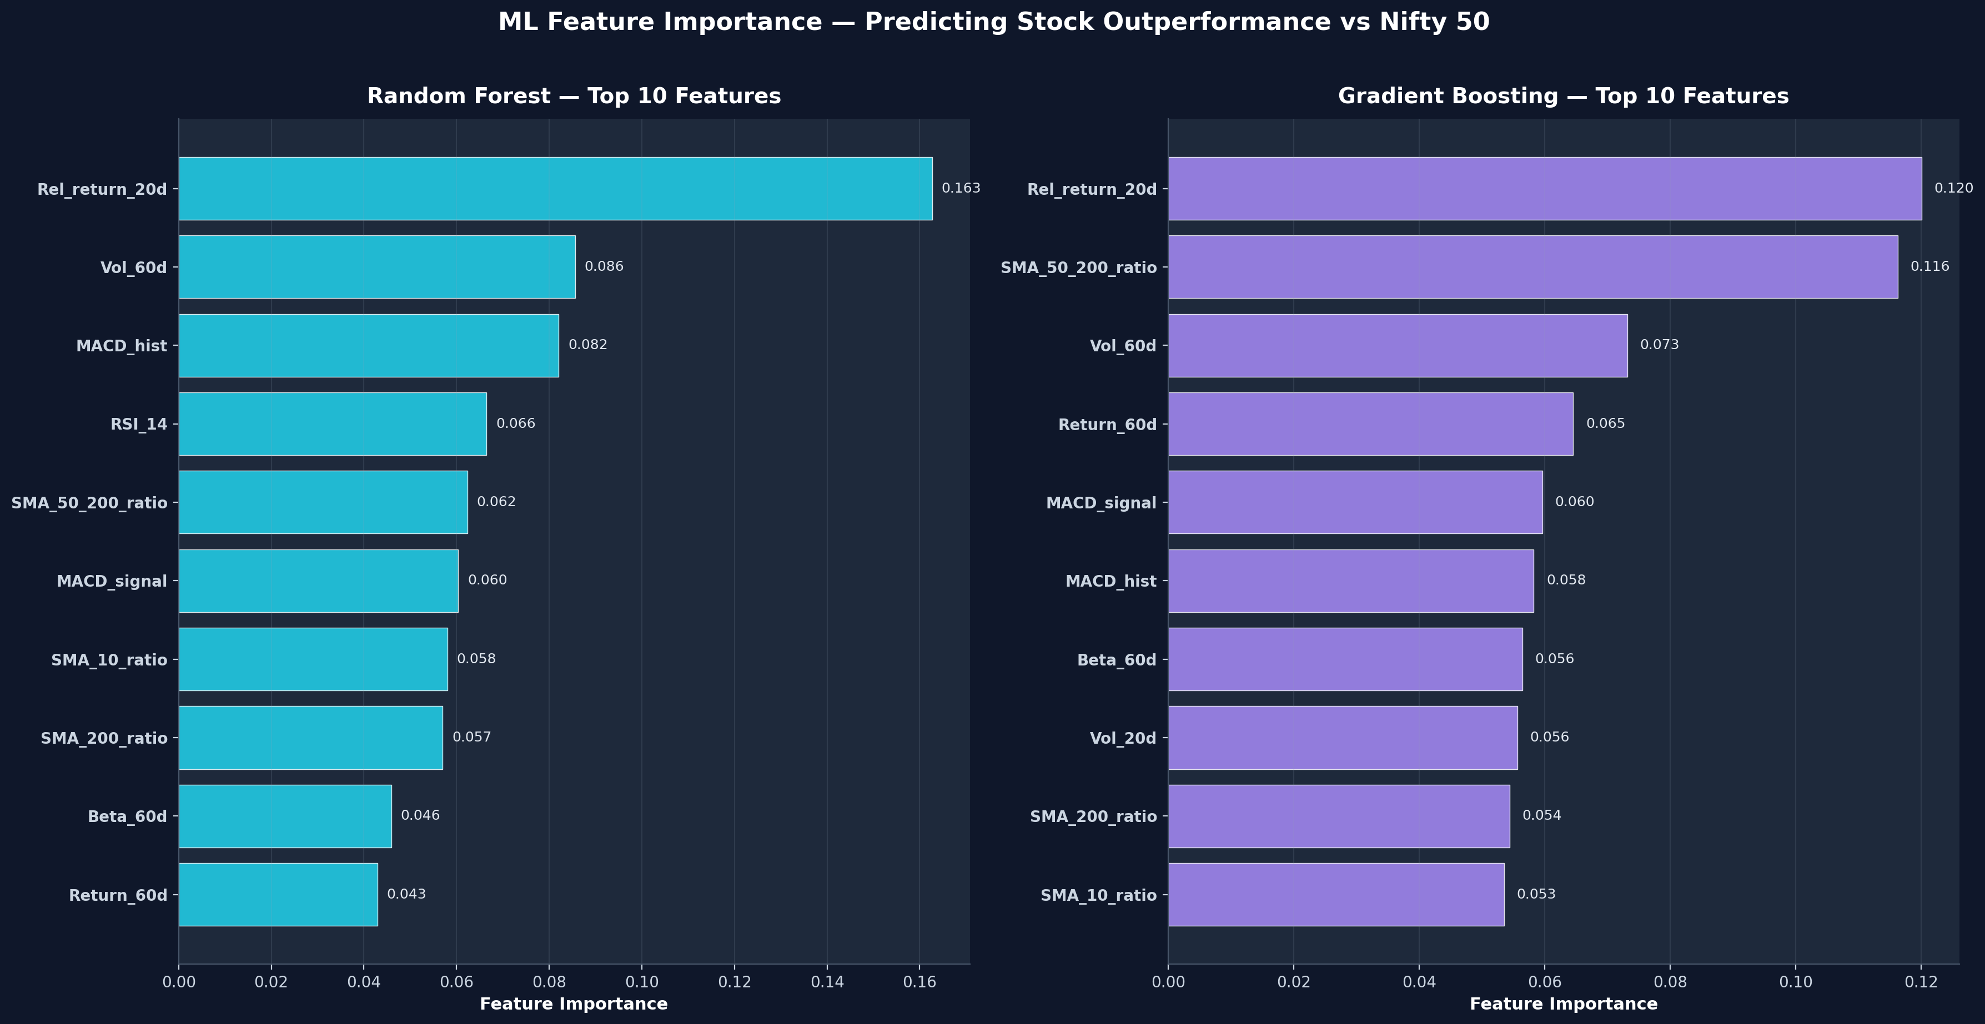
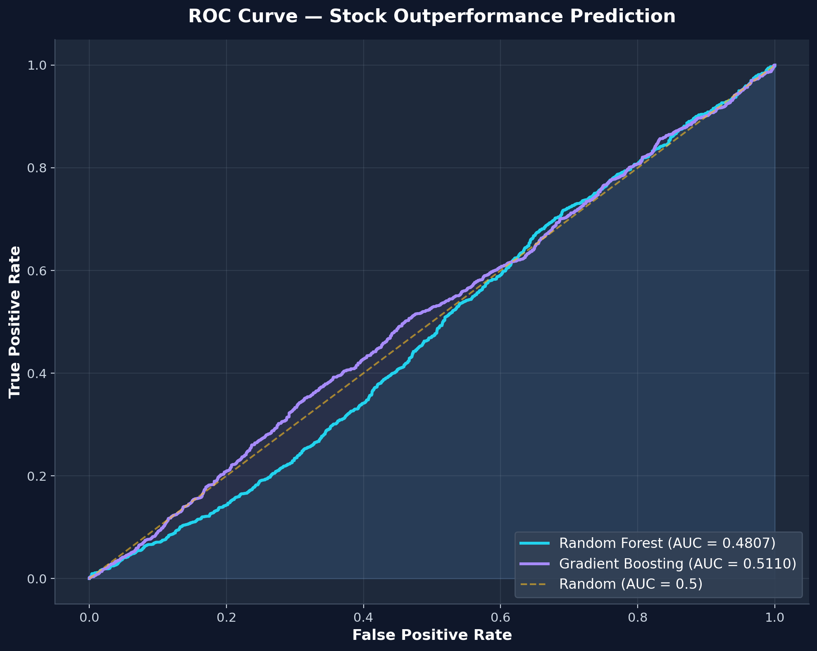
🤖 Slide 6 — ML Model Comparison
Random Forest vs Gradient Boosting — Predicting Stock Outperformance vs Nifty 50 (20-day forward)
Model Performance (Test: 2024)
Model | Accuracy | Precision | Recall | F1 Score | AUC-ROC
Random Forest | 0.5233 | 0.5418 | 0.6969 | 0.6096 | 0.4807
Gradient Boosting | 0.5069 | 0.5332 | 0.6179 | 0.5724 | 0.511
ML Design: • Target: Does stock outperform Nifty 50 over next 20 days? • Features: 18 technical indicators (returns, volatility, SMA ratios, RSI, MACD, Beta, volume) • Temporal split: Train on 2023, Test on 2024 (no data leakage) • Class balancing: balanced weights (RF) / scale_pos_weight (XGB)

Slide 7
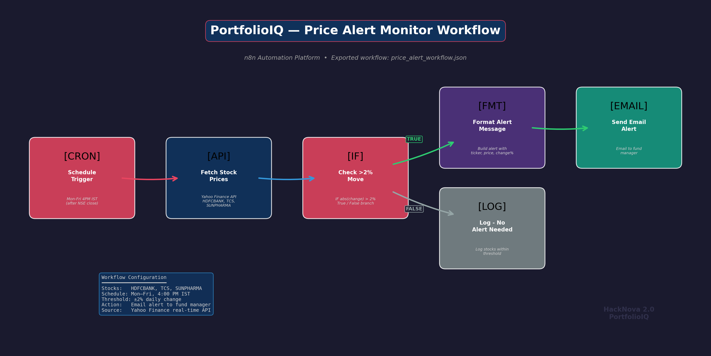
⚙️ Slide 7 — n8n Automation Demo
Price Alert Workflow — Live Execution
WORKFLOW: PRICE ALERT MONITOR
Purpose:
Automated monitoring replaces manual daily checks,
ensuring the fund manager is immediately notified
of significant price movements requiring action.
Configuration:
• Stocks: HDFCBANK, TCS, SUNPHARMA
• Schedule: Mon–Fri at 4:00 PM IST (post NSE close)
• Threshold: Alert if any stock moves >2%
• Action: Email alert with ticker, price, change %
📺 LIVE DEMO:
Import JSON → Execute workflow → Show alert output
Workflow JSON → n8n/price_alert_workflow.json | Runs Mon-Fri 4 PM IST | Uses Yahoo Finance API | Sends alert via email to fund manager

