Slide 1
Activities in Libraries
City of Madrid
Javier García Menéndez
Francisco José de la Higuera
Guillermo Paredes López
Jorge Forcada Sanz
Adrian Gil Lobete
Group 08

Slide 2
App requirements
¿What activities I can find in this library? …
¿What is the library where I can take part of this activities ? …

Slide 3
Datasets
Libraries in Madrid
Activities in Libraries in Madrid
Licenses: Allows the commercial and non-commercial use of the data

Slide 4
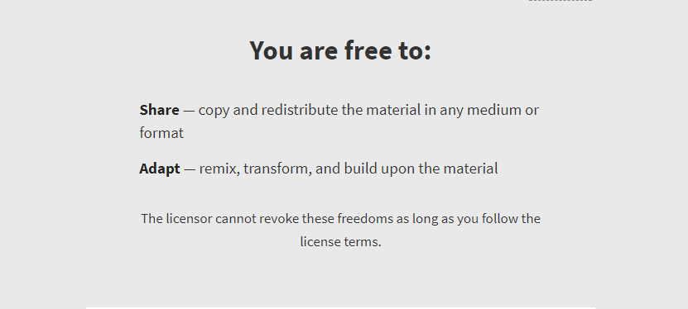
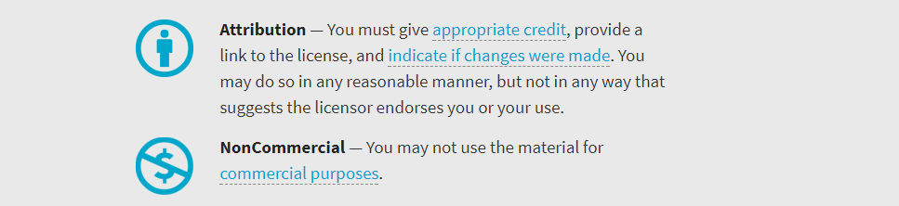
Our License
CC-BY-NC

Slide 5
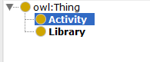
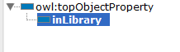
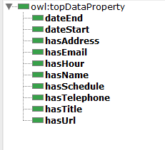
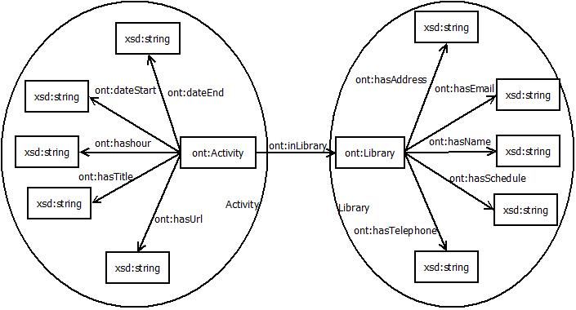
Our Ontology

Slide 6
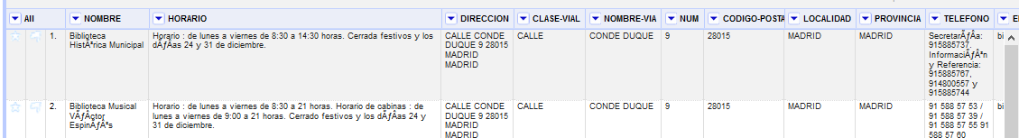
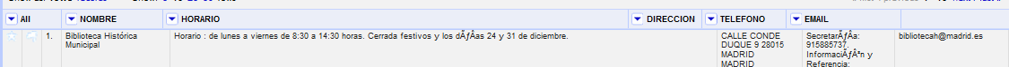
CSV transformation
1º
2º
Adaptation of wrong characters

Slide 7
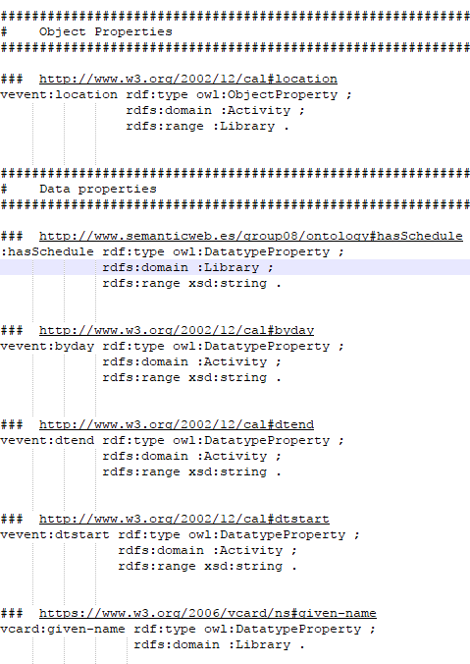
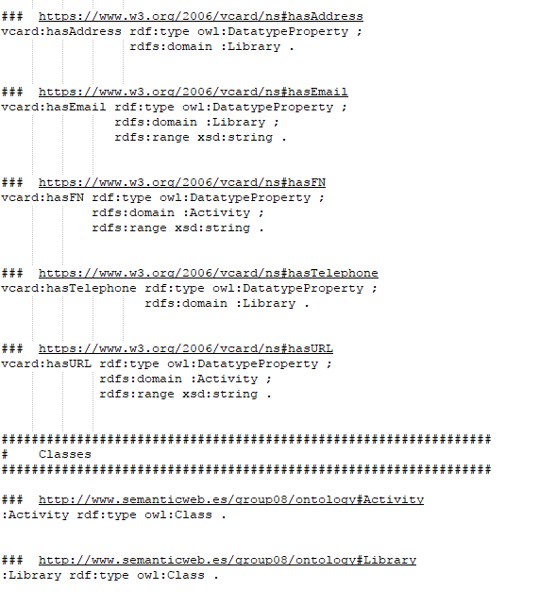
Ontology Reuse

Slide 8
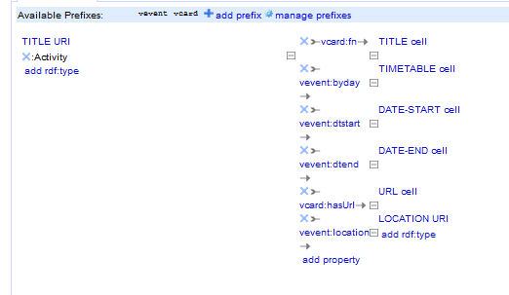
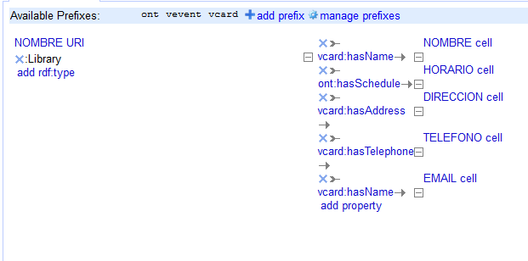
Ontology Reuse - RDF creation

Slide 9
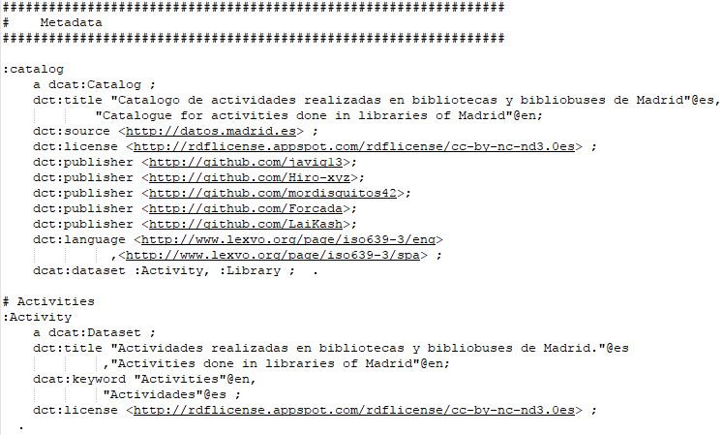
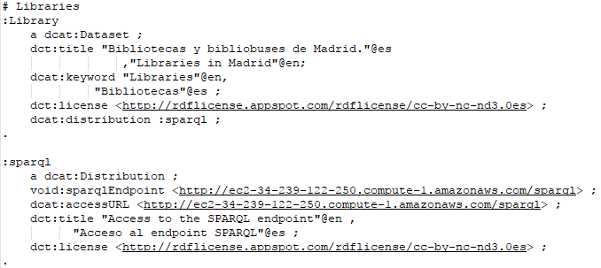
Ontology Publishing - Metadata

Slide 10
Data Linking
No columns of our data could be linked

Slide 11
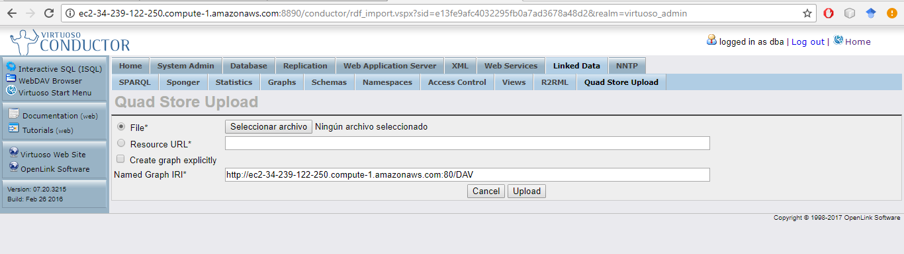
AWS & Virtuoso
http://ec2-34-239-122-250.compute-1.amazonaws.com/sparql

Slide 12
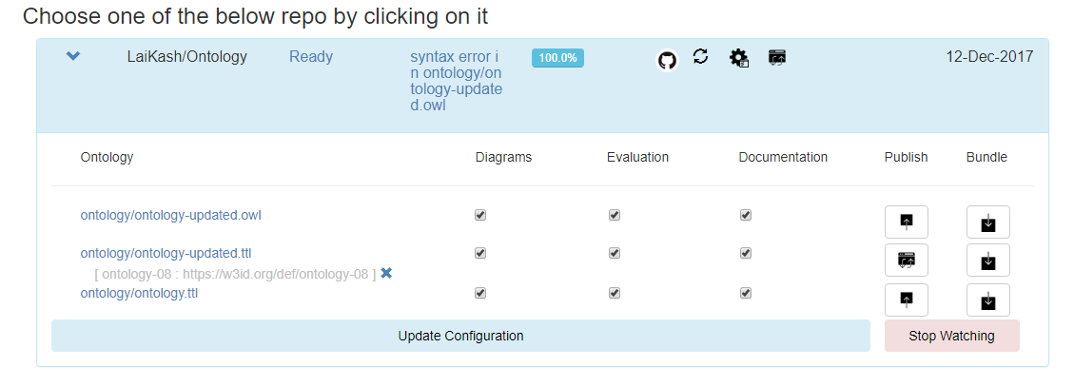
Ontoology
http://ontoology.linkeddata.es/publish/ontology-08/index-en.html

Slide 13
DEMO

Slide 14
