Slide 1

Open Data and Knowledge Graphs Presentation
UPM – 2021/2022
Jenifer Tabita Ciuciu-Kiss
Daniel García Cebrián
Fernando Madrazo Bringas
David Cabornero Pascual
Santiago Monteso Fernández
(Group 42)
Notes:
Santi

Slide 2
Contents
Introduction and Dataset
Ontology, resource naming strategy
Data cleaning - OpenRefine
Mapping
SPARQL queries
Data linking
Shacl
Application
Conclusions
/13
Notes:
Santi

Slide 3
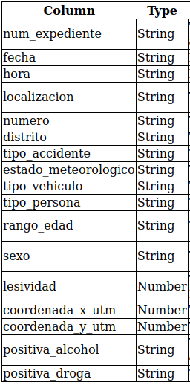
Introduction and Dataset
From: https://datos.madrid.es
Bicycle accidents (2019-2020-2021)
The purpose is to identify conflictive areas or identify street or places problematic.
Also using this information it is possible to perform some demographic analysis and study correlations.
This table is the original one before Data Cleaning.
/13
Notes:
Santi

Slide 4
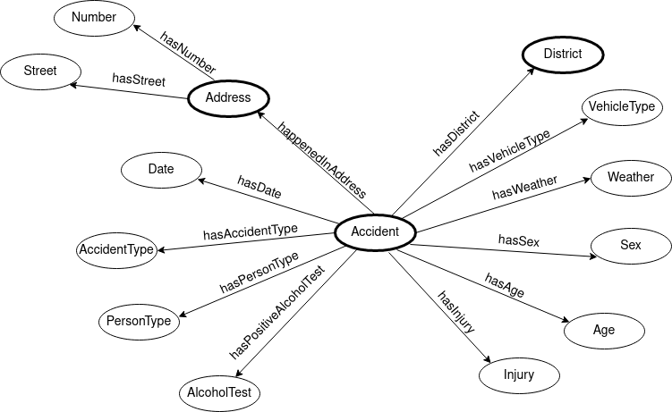
Ontology, resource naming strategy
Domain: http://bicycleaccidents.org/
Ontologycal terms: http://bicycleaccidents.org/ontology#
Individuals path: http://bicycleaccidents.org/resource/
It was not possible to include a class “Person” (not unique identifier)
/13
Notes:
Santi

Slide 5
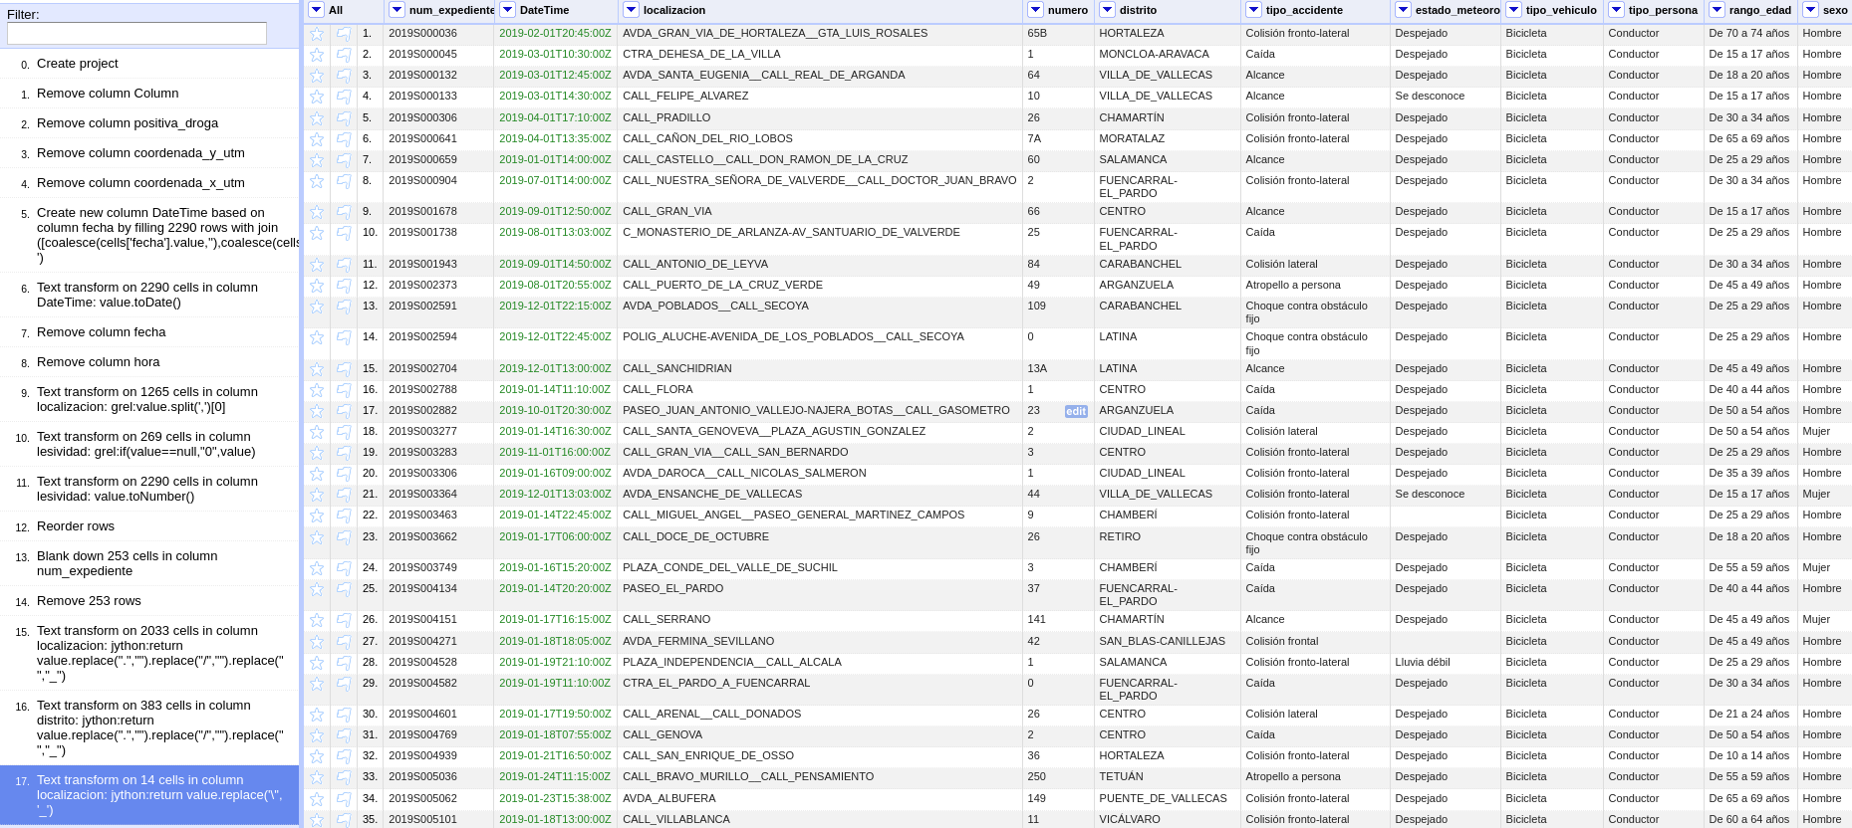
Data cleaning - OpenRefine
/13
Notes:
Dani
Of course, before we could use any of this data we had to clean it and format it. We did so using OpenRefine.
We first removed columns with unimportant or missing data, and also removed samples that were not complete and formatted the date into a standard datetime format.
After that, we had to separate the number from the street, as they were in the same column and tried to format the adress and district columns. As they came, those 2 columns had lots of spaces, dots and slashes among some other errors so we had to clean and replace them columns so that they were usable as resource identifiers in an RDF, as well as replacing special characters that were generating some encoding errors.
We also duplicated the street name column and replaced abbreviations with full expressions for the latter use in the data linking process.

Slide 6
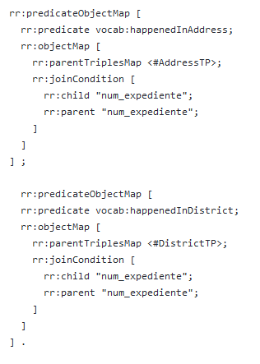
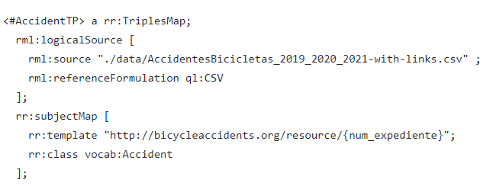
Mapping
RMLMapper by RMLio
Follows the resource naming strategy
/13
Notes:
Dani
Once we had a read- to-use csv file, we created an rml mapping for it with 3 triples map bc we have 3 classes and 2 join conditions on the accident ID to map them.
For this step we used a Docker image of RMLMapper bc we were having some kind of error on the join process with Helios materializer.

Slide 7
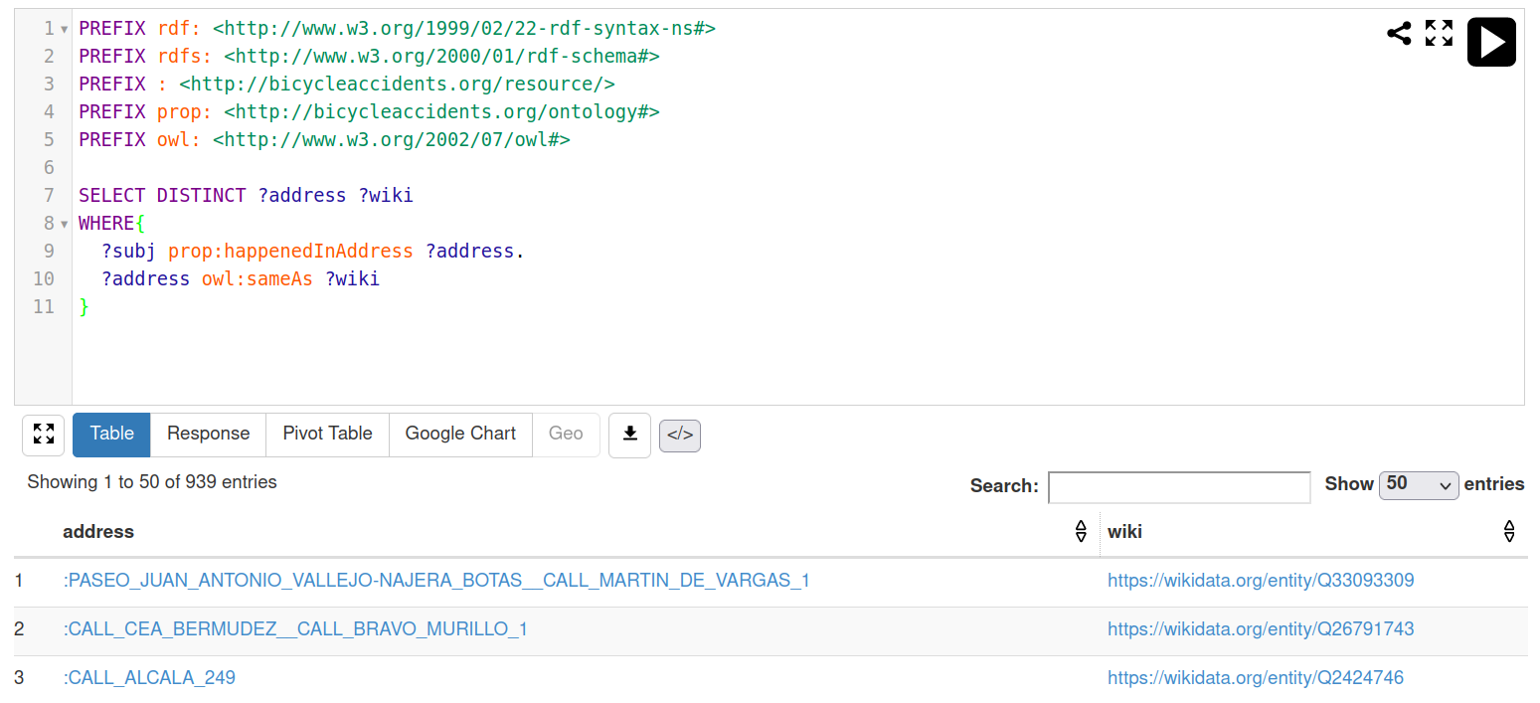
SPARQL queries
/13
Notes:
Fernando

Slide 8
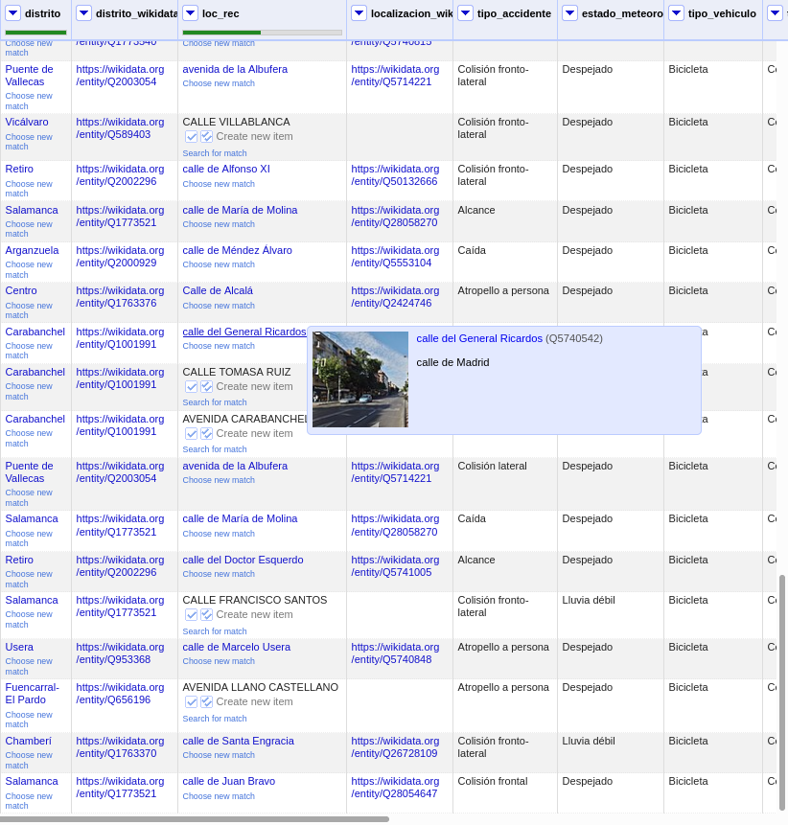
Data linking
Link district and street to Wikidata
using the spanish data API.
Reconciling the district was
straightforward but the streets took
some manual work.
/13
Notes:
Fernando

Slide 9
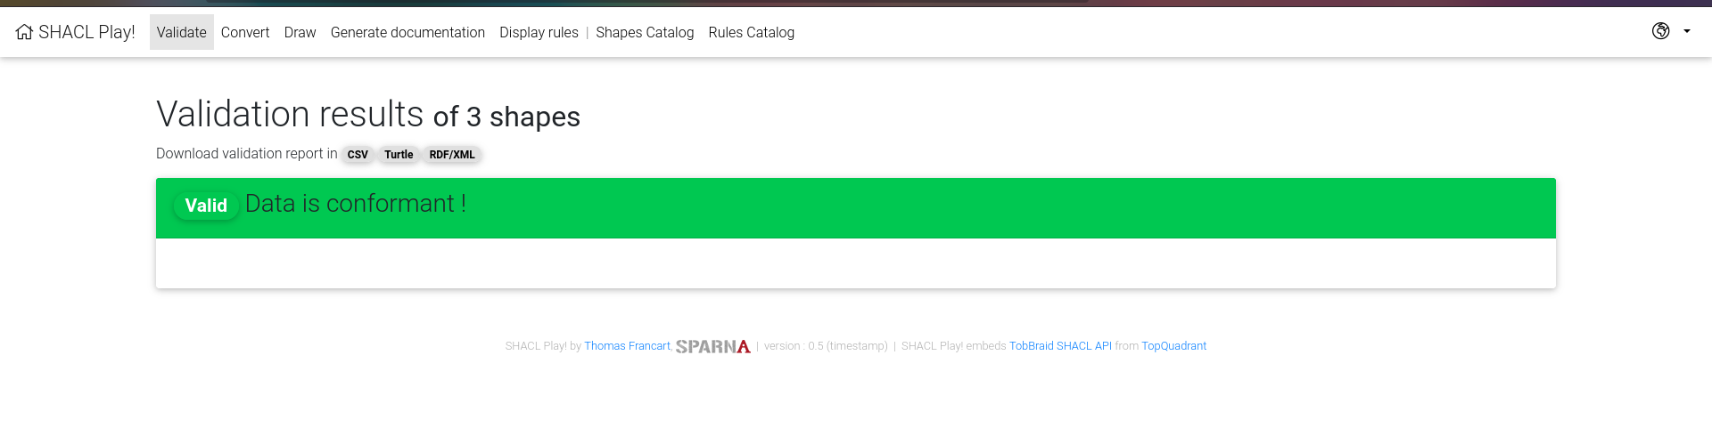
Shacl
The Data Graph has been checked and validated against the Shapes Graph in order to see how this technology works (July 2017 - https://www.w3.org/TR/shacl-af/).
Notes:
Jeni

Slide 10
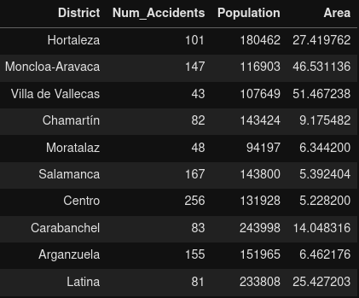
Let’s see it in practice!
Using reconciliated districts, we can obtain information from Wikidata.
Probably we could obtain more data from another sources
Some frequency tables have been drawn to see some statistical info.
/13
Notes:
Jeni

Slide 11
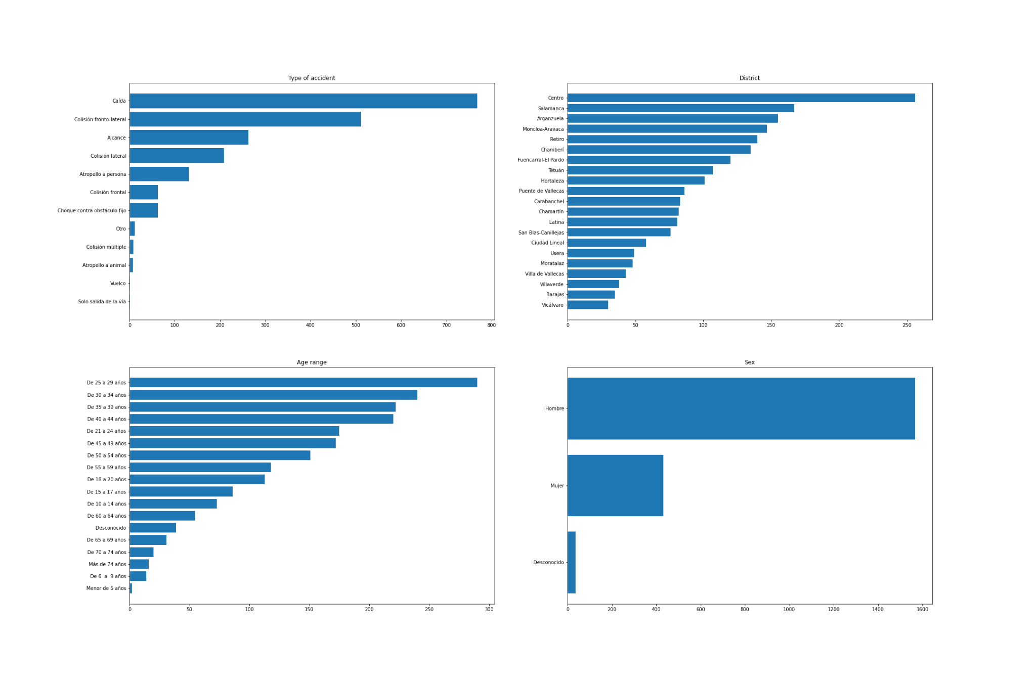
/13
Notes:
David

Slide 12
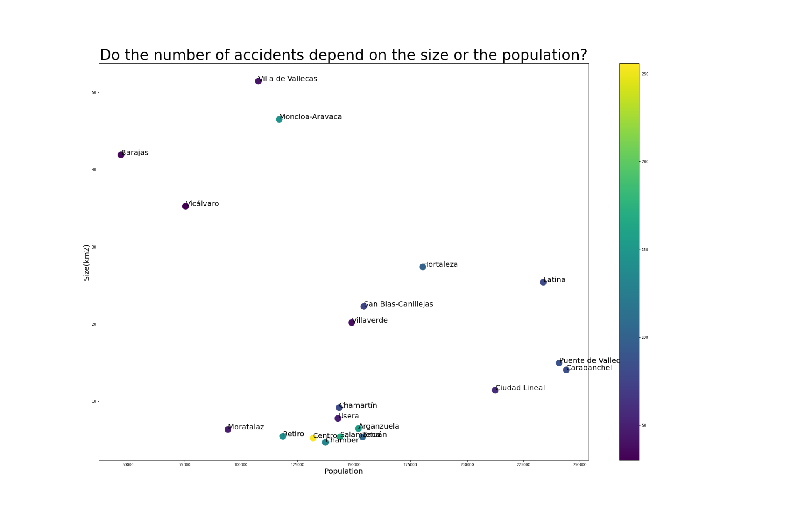
/13
Notes:
David

Slide 13
Conclusions
Dataset with bike accidents of Madrid in 2019-2021
Written by multiple sources (problems of heterogeneity)
Streets and Districts were linked
Population and Area of districts extracted from Wikidata
The Center district has been found to be the one with more accidents
/13
Notes:
David

Slide 14
Thank you for your attention!
Notes:
Buenas gracias y muchas tardes

