Slide 1


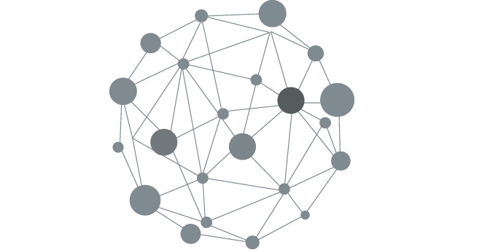
Events in Madrid
A linked data based web application
Open Data and Knowledge Graphs
MSc. Data Science
ETSIINF, UPM

Slide 2
Alvaro Ramirez Sixtos
Carlos Morote García
David Lorenzo Alfaro
Hasan Remzi Yahya
Raúl González Duarte
Group 12
MSc. Data Science
ETSIINF, UPM

Slide 3



Dataset
Open data portal of the Madrid City Council
Date of release → 29/03/2017
30 attributes
Título (Title)
Fecha (Date)
Urls
Content-url
url-actividad
url-instalacion

Slide 4

Dataset - preprocessing
Several transformations were performed
Time and hour format changed
18:00 → 18:00:00

Slide 5
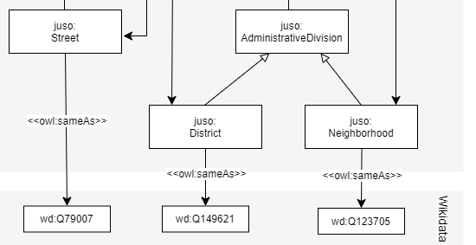
Dataset - preprocessing
Several transformations were performed
Time and hour format changed
18:00 → 18:00:00
Reconciliation
Street
Distrito (District)
Barrio (Neighbourhood)

Slide 6
Resource Naming Strategy
Domain
https://data.eventsinmadrid.org/
Ontology
ontology#
Class
[className]
Property
[propertyName]
Data
resource/
Individual
[className]/identifier
Hash URIs for ontological terms, slash URIs for individuals

Slide 7

Ontology at a high level

Slide 8
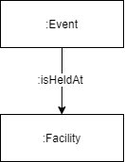
Ontology at a high level

Slide 9
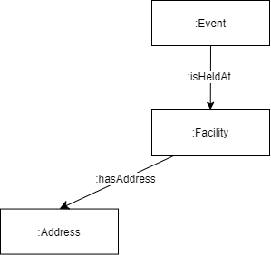
Ontology at a high level

Slide 10
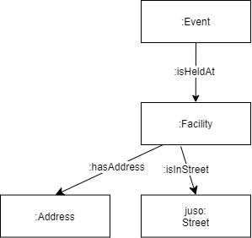
Ontology at a high level

Slide 11
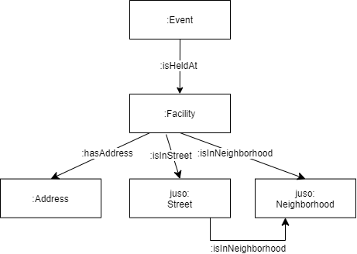
Ontology at a high level

Slide 12
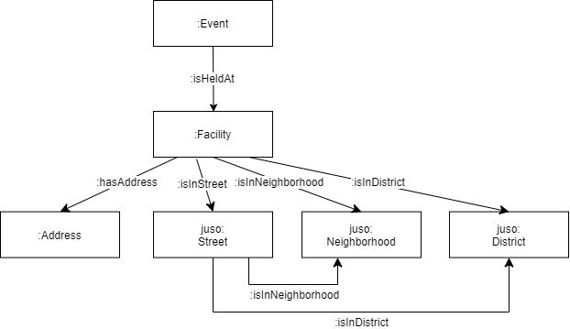
Ontology at a high level

Slide 13
Ontology at a high level
Redundant connections allow for better maintenance

Slide 14
Ontology
Add object and data properties
Add domain and ranges
Reuse definitions from existing ontologies

Slide 15


Ontology
Add object and data properties
Add domain and ranges
Reuse definitions from existing ontologies
R4SC

Slide 16

Ontology
Based on well-known ontologies:
schema
vcard
wsg84_pos
juso
Data properties excluded from the graph:
rdfs:label
rdfs:comment

Slide 17


RDF Generation
RML
YARRRML
We chose RML.io’s rml mapper due to its high performance

Slide 18
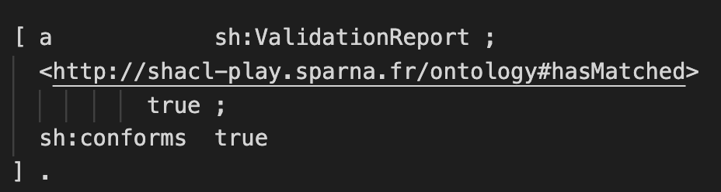
Knowledge Graph Quality
Generated RDF conforms with the SHACL shapes.

Slide 19








Web Application
wikidata - endpoint
Events in Madrid
Events in madrid- endpoint

Slide 20
Web application - Demo

Slide 21
Events in Madrid
A linked data based web application
Open Data and Knowledge Graphs
MSc. Data Science
ETSIINF, UPM

