Slide 1
Semantic web Project
Group 1, 2023 - 2024

Slide 2
Index
Introduction
CSV
Ontology
Mappings
App

Slide 3

Introduction
Dataset must have information about resident’s parking spots
See the parkigs available

Slide 4
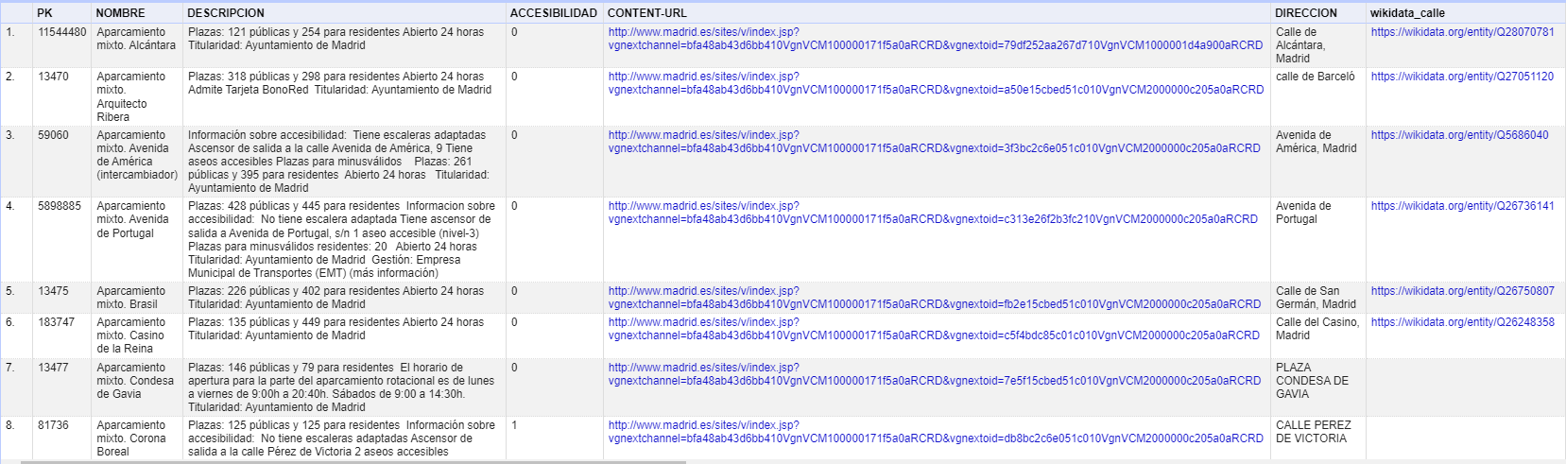
csv

Slide 5
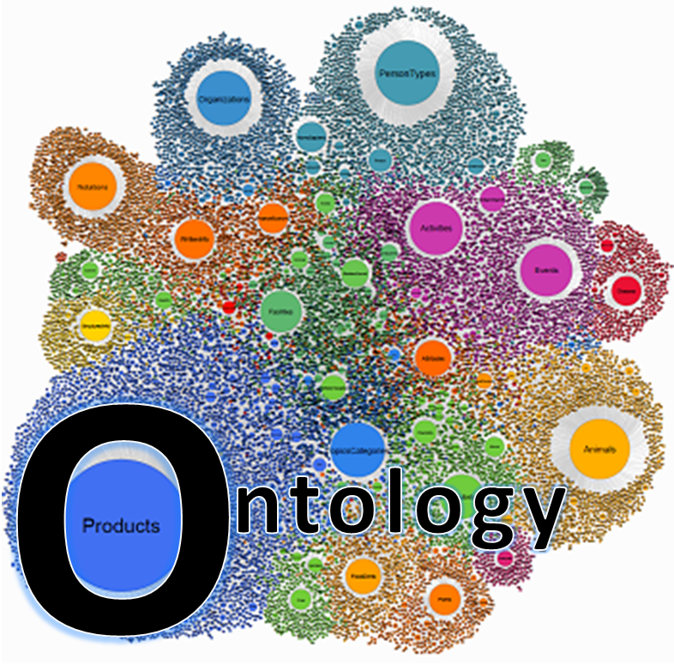
ontology
Classes:
Parking Spot
Location
Adress
Contact

Slide 6
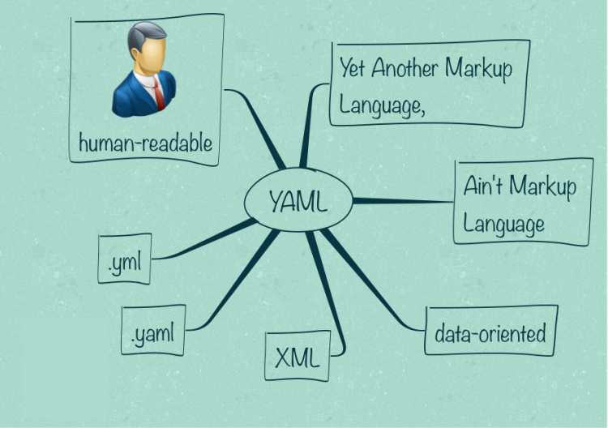
mappings
Mappings
Mapping rules

Slide 7
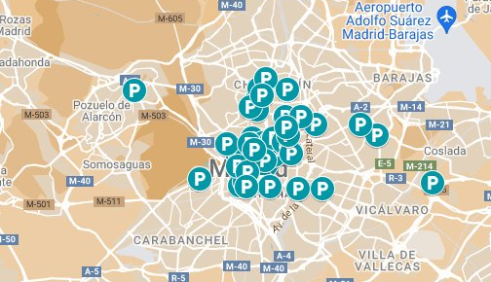
app

