Slide 1
Semantic Web, Linked Data and Knowledge Graphs
Group o2
Darío puras perales
Alberto Galeano Díaz
Juan miguel rodríguez santos
CELIA JIAORONG HIRT QUIROGA
STEFANI DAWN SCOTT PERNIA

Slide 2
The project
Stage 1
Data selection and analysis
Stage 2
Data cleaning and transformation
Stage 3
Data transformation to RDF
Stage 4
Linking data
Stage 5
Publishing data

Slide 3
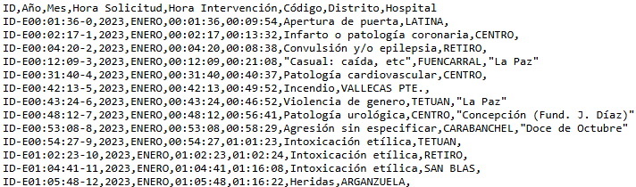
Stage 1: Project csv
SAMUR activations in Madrid for 2023
The dataset satisfies the requirements R1, R2, R3, R4, R5 and R6.
Dataset structure: ID, Year, Month, Request Time, Intervention Time, Type of Emergency, District and Hospital.

Slide 4

Stage 2: openrefine
Delete empty property rows (except Hospital)
Normalise months (gMonth)
Add an ID per activation
Add wikidata links

Slide 5
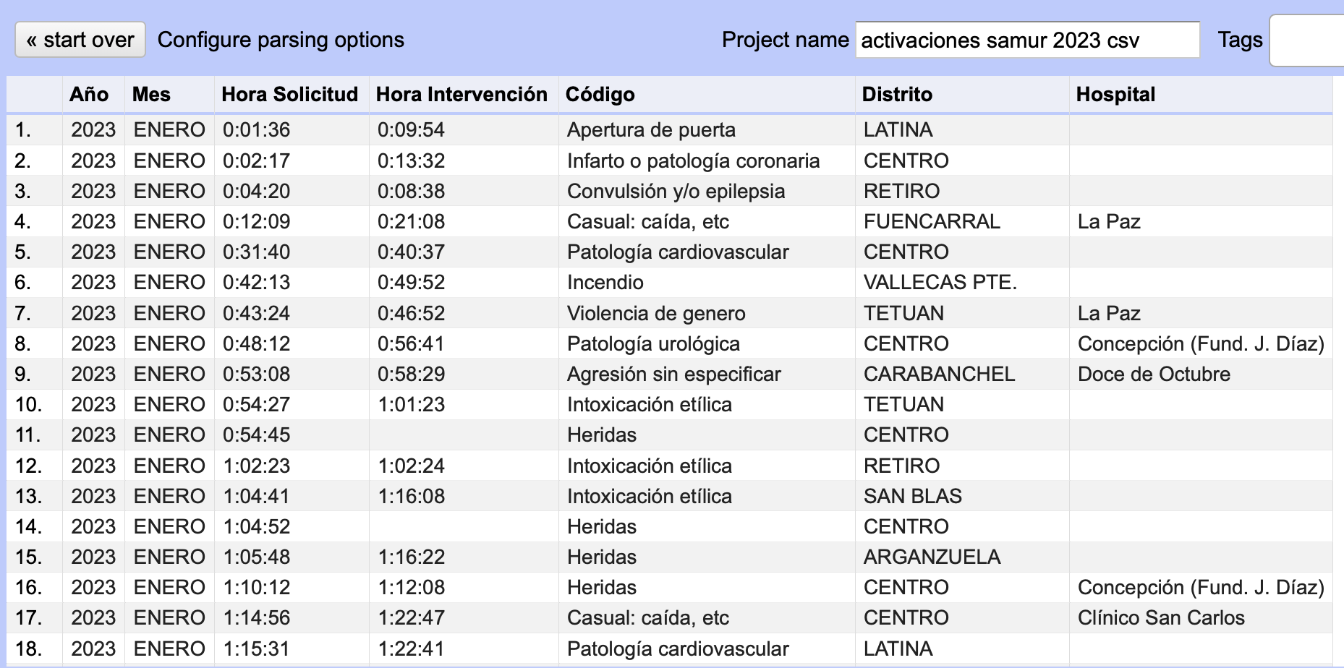

Slide 6
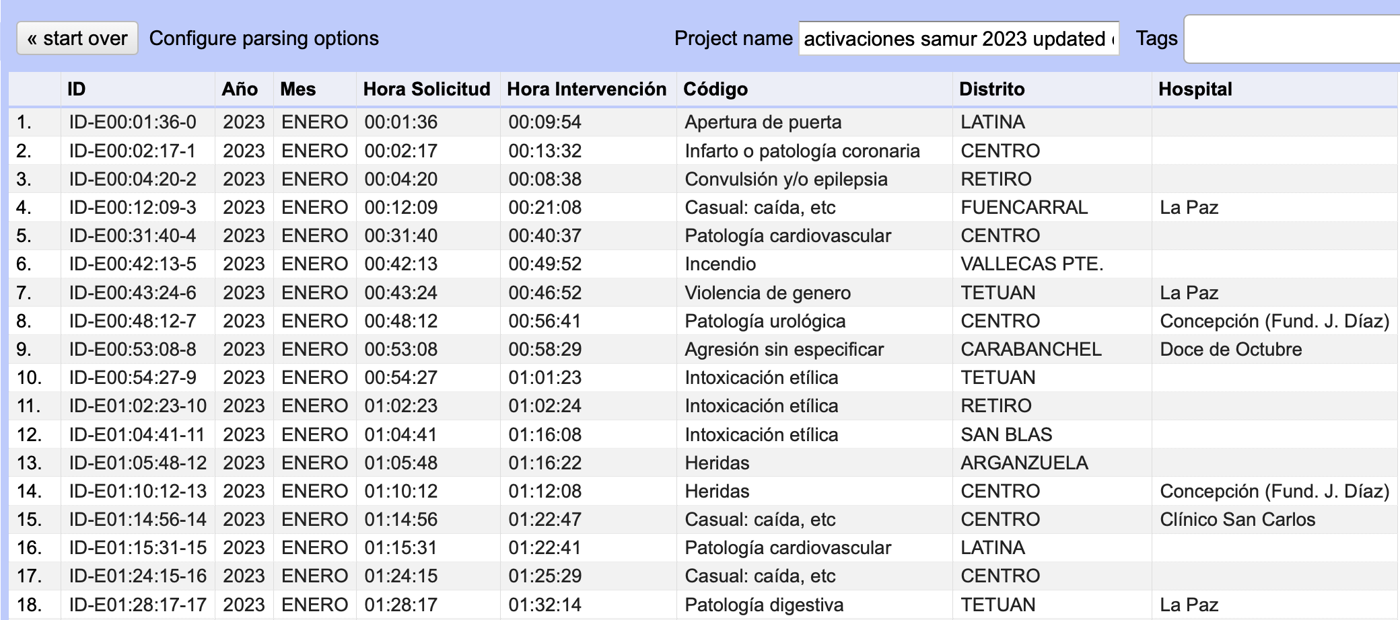

Slide 7
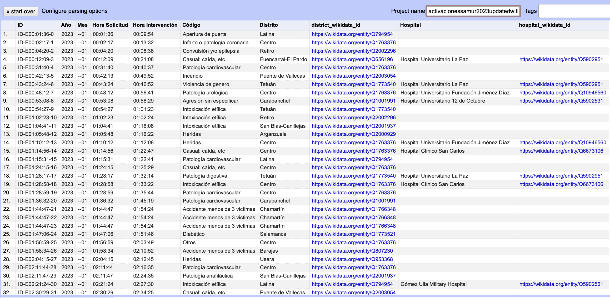

Slide 8

Stage 3: rdf
RML Mapper
NT and TTL
SPARQL

Slide 9
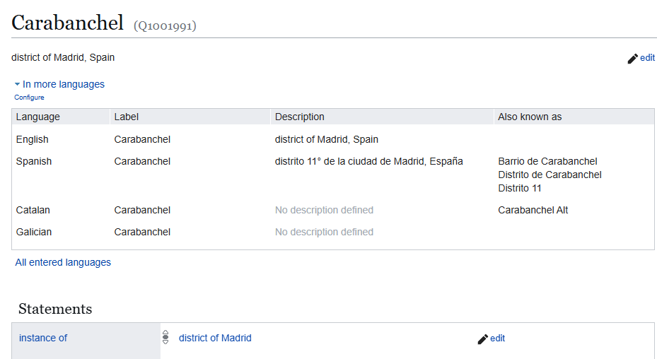
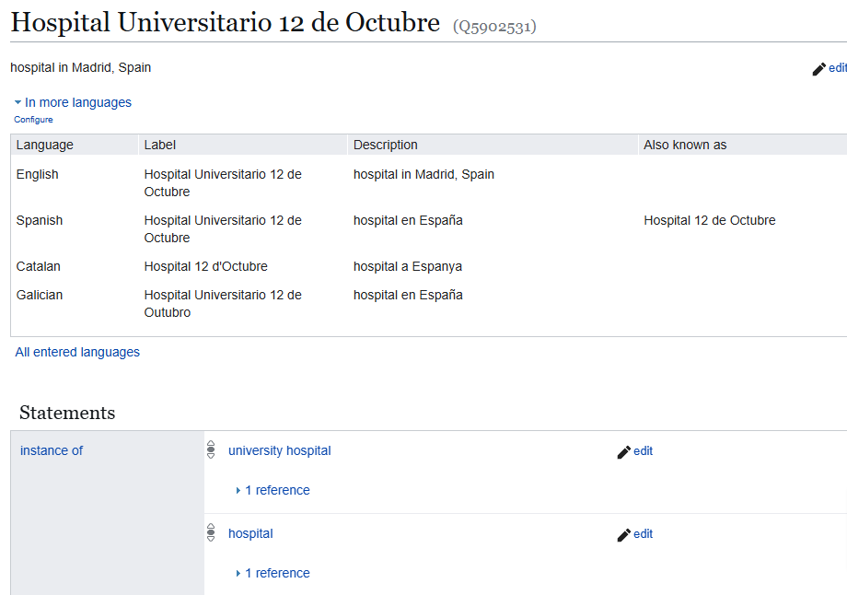
Stage 4: Linking

Slide 10





Stage 5: publishing
Next.js (TypeScript)
rdflib -> Apache Jena Fuseki
SPARQL queries
DATASET (.ttl)

Slide 11
THANKS

