Slide 1
Sender Name
Sender Project
Receiver Name
Receiver Project
Preview Form
Attach E-way Bill
Send Form
Your Items
Selected Items
Choose Items | Category | Name | Make | Model | ID
 | Electronics | Bipod Controller Holder | Trimble | R6 | MA1323A
 | Electronics | DGPS Receiver | Trimble | 58002007 | 6152x00853
 | DGPS Equipment | DGPS Battery | Trimble | TDC6002 | 6152x00853
 | DGPS Equipment | DGPS Controller | Trimble | TDC6002 | TE30A1500F02
 | Drone Equipment | Tribrach | Trimble | R10/R12 | 24701215062539C
 | Drone Equipment | Tribrach | Trimble | R10/R12 | BM2131D
 | Extras | Bag | Trimble | 1.2 | BM213104C
 | Extras | Pencil | Trimble | 1.4 | PP421248A

Slide 2
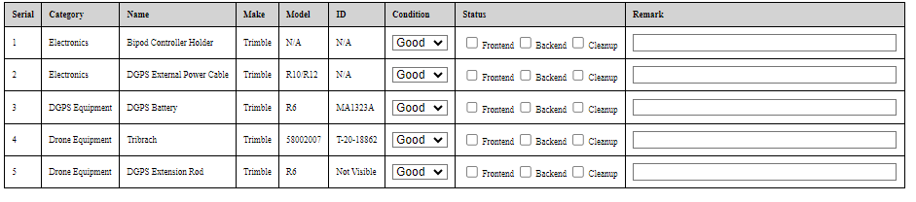
Sender Name
Sender Project
Receiver Name
Receiver Project
Preview Form
Send Form
Your Items
Selected Items

Slide 3
Approve Sender Form
Receiver Form
Approve Receiver Form
Eway-bill No :
Send By :
Send Approval By
Receive By :
Receive Approval By :
Origin of Site :
Destination Site :
No of Items :
Current Stage in :
Send Date :
Send Approval Date:
Receive Date :
Receive Approval Date :
Categories:
DGPS
UAV
Miscellaneous

Slide 4
Approve Sender Form
Receiver Form
Approve Receiver Form
Eway-bill No :
Send By :
Send Approval By
Receive By :
Receive Approval By :
Origin of Site :
Destination Site :
Enter Eway Bill Number :

Slide 5

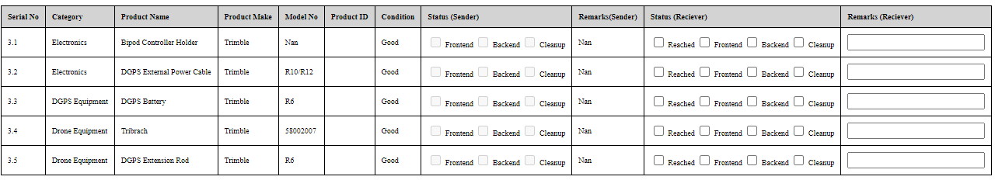
Approve Sender Form
Receiver Form
Approve Receiver Form
Eway-bill No :
Send By :
Send Approval By
Receive By :
Receive Approval By :
Origin of Site :
Destination Site :

Slide 6

Approve Sender Form
Receiver Form
Approve Receiver Form
Eway-bill No :
Send By :
Send Approval By
Receive By :
Receive Approval By :
Origin of Site :
Destination Site :

Slide 7
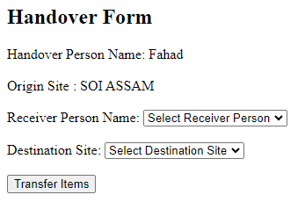

Approve Sender Form
Receiver Form
Approve Receiver Form
Status

Slide 8
Approve Sender Form
Receiver Form
Approve Receiver Form

Slide 9
Company Inventory
My Personal Inventory
More Details
Search
More Details
Previous Project
Previous Owner
Send Date :
Send Approval Date:
Receive Date :
Receive Approval Date :
Form No
Eway Bill No
Serial | Category | Name | Make | Model | ID | Current Owner | Current Project | Condition
 | Electronics | Bipod Controller Holder | Trimble | R6 | MA1323A
 | Electronics | DGPS Receiver | Trimble | 58002007 | 6152x00853
 | DGPS Equipment | DGPS Battery | Trimble | TDC6002 | 6152x00853
 | DGPS Equipment | DGPS Controller | Trimble | TDC6002 | TE30A1500F02
 | Drone Equipment | Tribrach | Trimble | R10/R12 | 24701215062539C
 | Drone Equipment | Tribrach | Trimble | R10/R12 | BM2131D
 | Extras | Bag | Trimble | 1.2 | BM213104C
 | Extras | Pencil | Trimble | 1.4 | PP421248A

Slide 10
Company Inventory
My Personal Inventory
More Details
Search
Serial | Category | Name | Make | Model | ID | Condition
 | Electronics | Bipod Controller Holder | Trimble | R6 | MA1323A
 | Electronics | DGPS Receiver | Trimble | 58002007 | 6152x00853
 | DGPS Equipment | DGPS Battery | Trimble | TDC6002 | 6152x00853
 | DGPS Equipment | DGPS Controller | Trimble | TDC6002 | TE30A1500F02
 | Drone Equipment | Tribrach | Trimble | R10/R12 | 24701215062539C
 | Drone Equipment | Tribrach | Trimble | R10/R12 | BM2131D
 | Extras | Bag | Trimble | 1.2 | BM213104C
 | Extras | Pencil | Trimble | 1.4 | PP421248A

Slide 11
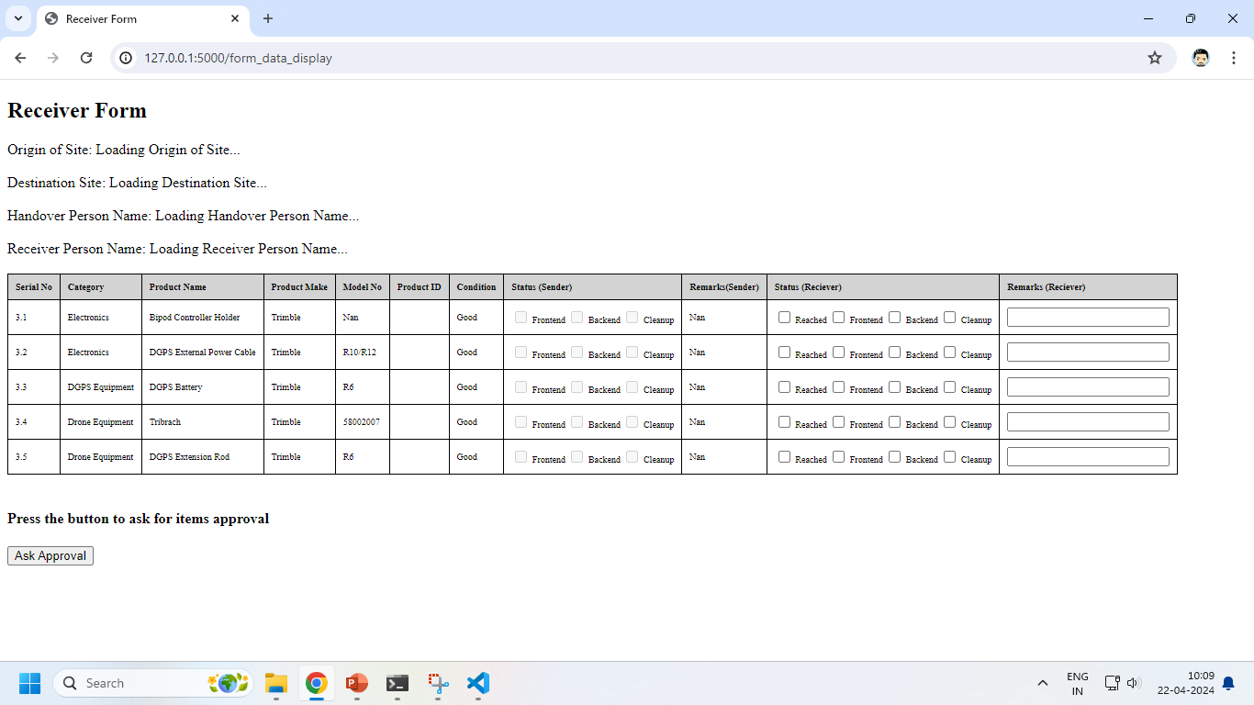
Sender Name
Umar
Sender Project
Receiver Name
Receiver Project
SOI Assam
Zafar
SOI Karnataka
Attach Eway Bill

