Slide 1
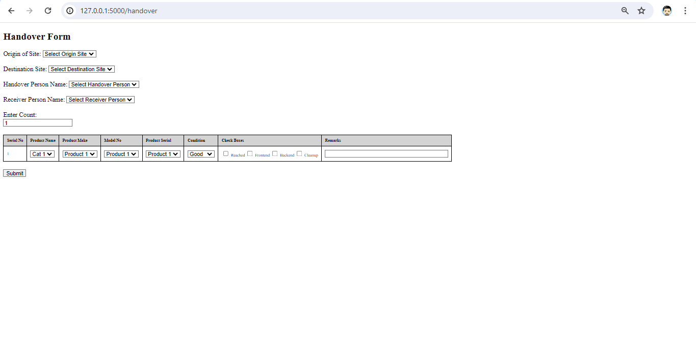
Electronics
Electronics
DGPS Equipments
Drone Equipment

