Slide 1


Student Internship Application
Ayleen Roque
Vasil Ivanov III
Justin Williams
Maria Paula Serpa

Slide 2

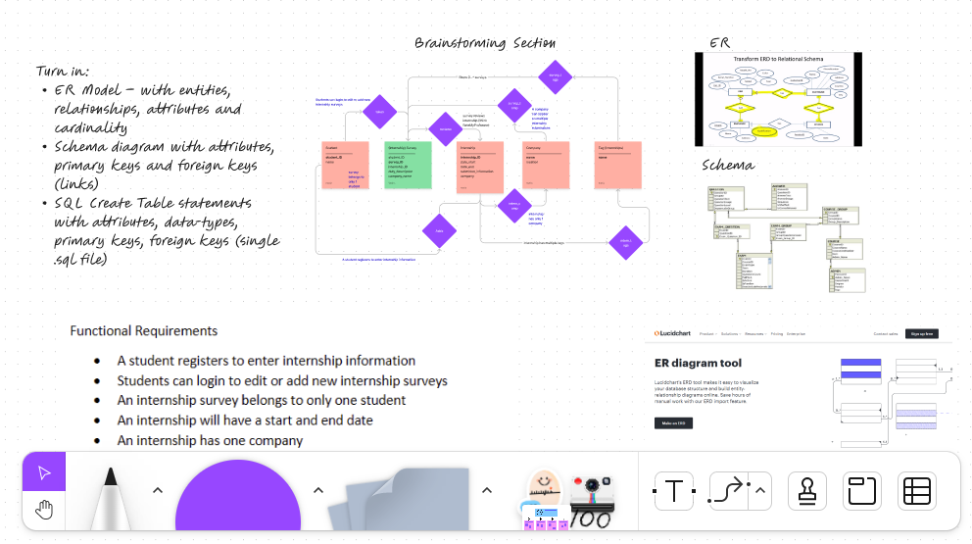

Project
Strategies

Slide 3



Project
Strategies

Slide 4
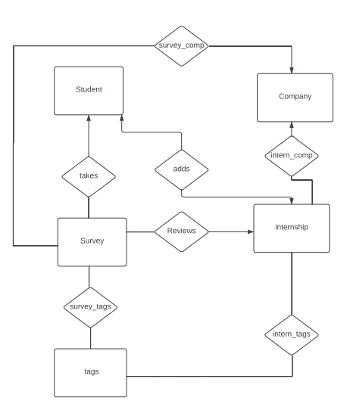
ER Model

Slide 5
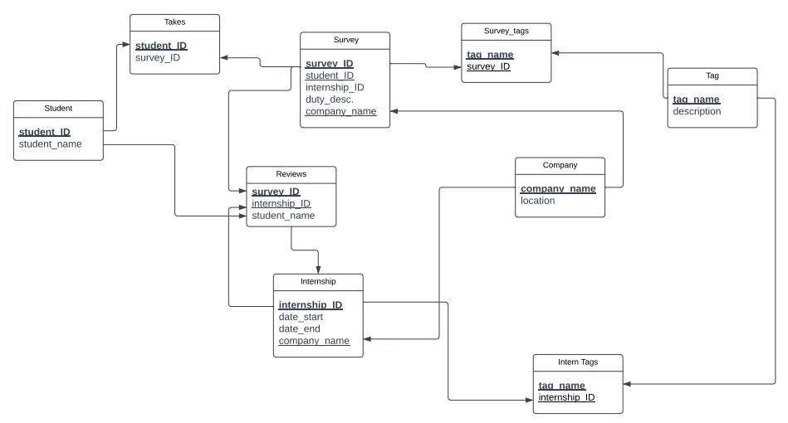
Schema
Diagram

Slide 6
Schema
Diagram

Slide 7
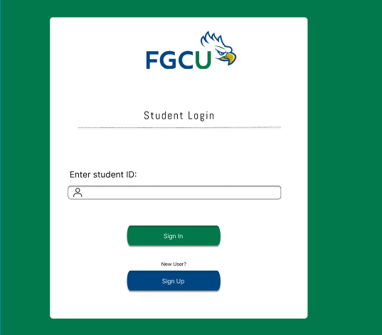
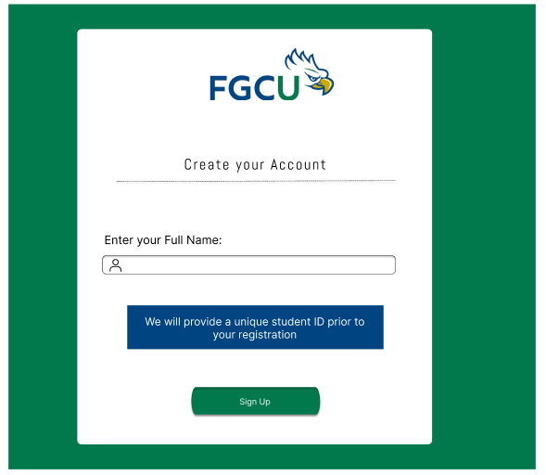
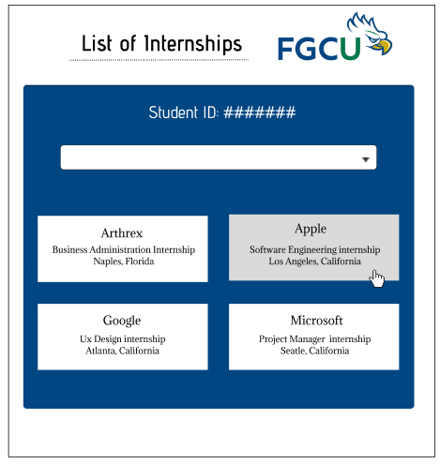
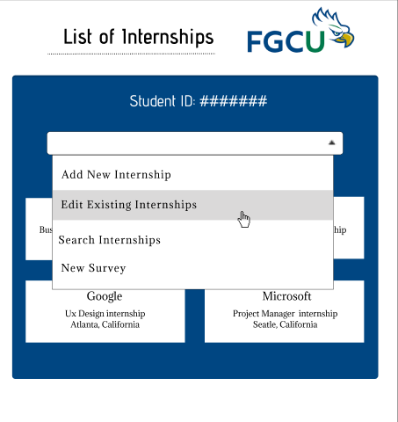
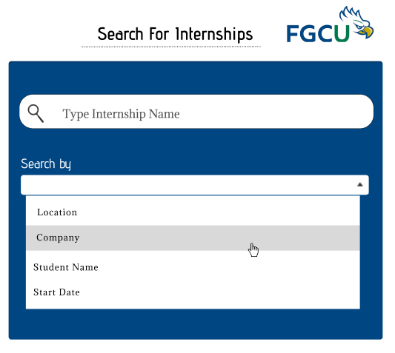
Prototypes

Slide 8
Prototypes

Slide 9
Prototypes

Slide 10
Prototypes

Slide 11
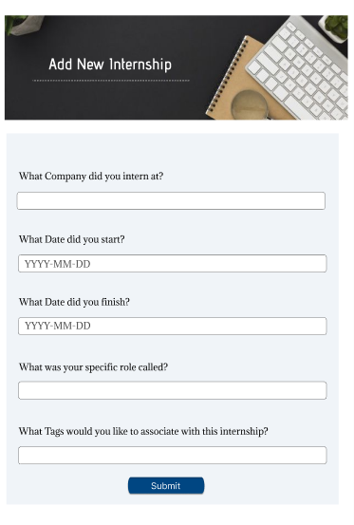
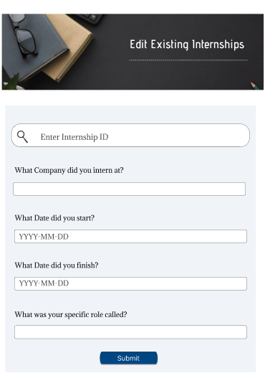
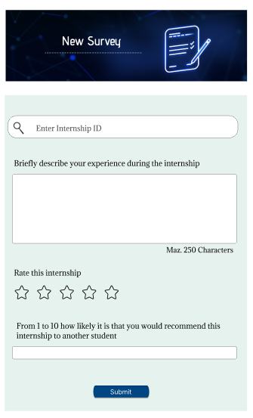
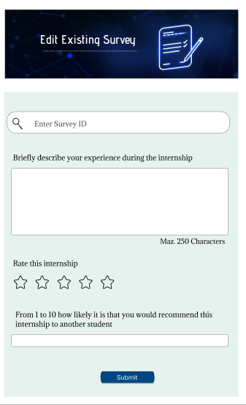
More
Prototypes

Slide 12
Prototypes

Slide 13
Prototypes

