Slide 1
ALGORITMA
Muhammad Fadhlan Putranto

Slide 2
Encrypt Image
RC4
Permutation Block
Embeding
Histogram Shiffting
Embeding

Slide 3

Encrypt Image
1

Slide 4
Encrypt Image
Algoritma encrypt
input (key)
input(img)
addPadding(img)
initialitationArray(key)
keySchedulingAlgorithm
pseudorandom(img)
permutation(img)
closePadding(img)
insert key and padding to metadata image

Slide 5
RC4
Algoritma pseudoRandom
i = 0
j = 0
For n = 0 to nBlok do
i = (j + 1) mod 256
j = (j + S[i]) mod 256
Swap (S[i],S[j])
key = S[(S[i] + S[j]) mod 256]
xorBlok(img, key, n);
{endFor}
{end}
Algoritma initialitationSArray
For i = 0 to 255 do
S[i] = i
K[i] = key[ i mod lengthKey]
{endFor}
{end}
Algoritma keySchedulingAlgorithm
j = 0;
For i = 0 to 255 do
j = (j + S[i] + K[i]) mod 256
Swap (S[i] and S[j] )
{endFor}
{end}

Slide 6
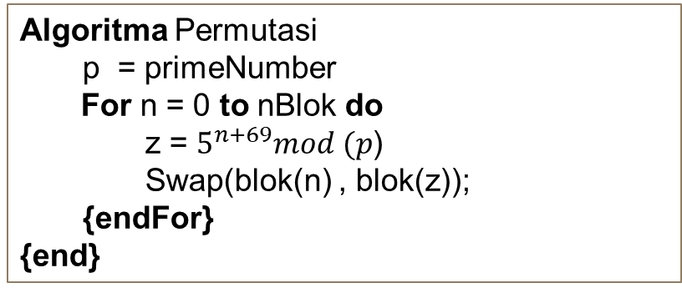
Permutation
Algoritma Permutasi
p = primeNumber
For n = 0 to nBlok do z = $5^{n+69}mod (p$)
Swap(blok(n) , blok(z));
{endFor}
{end}

Slide 7
Embeding Message
2

Slide 8
Encrypt Image
Algoritma embeding
input (message)
input(img)
addPadding(img)
histoShifting(img)
Embeding(img,message)
closePadding(img)
insert map L and padding to metadata image

Slide 9
Histogram Shifting
Algoritma histoShifting
For y = 0 to imegH do
For x = 0 to imageW do
If valuePixel = 0 then
insert “1” to List L
valuePixel = valuePixel + 1 // change value pixel at cordinat (x,y)
else If valuePixel = 255 Then
insert “1” to List L
ValuePixel = valuePixel – 1 // change value pixel at cordinat (x,y)
else if valuePixel = 1 or valPixel = 254 Then
insert “0” to List L
{endIf}
{endFor}
{endFor}
{end}

Slide 10
Embeding Message
Algoritma Embeding
int m = 0;
For n = 0 to nBlok do
For y = 0 to 3 do
For x = 0 to 3 do
cenX = defBlok[n].m
cenY = cefBlok[n].n
If( not (x = 0 and y = 0)) then
diff = valuePixel(cenX + x, cenY + y) - valuePixel(cenX, cenY)
If (diff < -1 ) then
valPixel = valPixel -1
else If (diff = -1 ) then
valPixel = valPixel - binMessage[m]
increment m
else If (diff = 0 ) then
valPixel = valPixel + binMessage[m]
increment m
else If (diff > 0 ) then
valPixel = valPixel -1
{endIf}
{endIf} {endFor}
{endFor}
{endFor}
{end}

Slide 11
Decrypt Image
1

Slide 12
Decrypt Image
Algoritma decrypt
input(img)
key = get key from metadata
addPadding(img)
permutation(img)
initialitationArray(key)
keySchedulingAlgorithm
pseudorandom(img)
closePadding(img)
insert key and padding to metadata image

Slide 13
Extraction Message
2

Slide 14
Extraction Image
Algoritma Extraction
input(img)
addPadding(img)
mapL = get L map from metadata
Extract(img,message)
histoShiftingEx(img,mapL)
closePadding(img)
insert padding to metadata image

Slide 15
Histogram Shifting
Algoritma histoShiftingEx
n = 0
For y = 0 to imegH do
For x = 0 to imageW do
If valuePixel = 254 and mapL[n] = “1” then
valuePixel = 255 // change value pixel at cordinat (x,y)
increment n
else If valuePixel = 1 and mapL[n] = “1” Then
valuePixel = 0 // change value pixel at cordinat (x,y)
increment n
else if valuePixel = 1 or valPixel = 254 Then
increment n
{endIf}
{endFor}
{endFor}
{end}

Slide 16
Extrct Message
Algoritma extract
message = “”
For n = 0 to nBlok do
For y = 0 to 3 do
For x = 0 to 3 do
cenX = defBlok[n].m
cenY = cefBlok[n].n
If( not (x = 0 and y = 0)) then
diff = valuePixel(cenX + x, cenY + y) - valuePixel(cenX, cenY)
If (diff = -1 or diff = 0 ) then
message = message + “0”
else If (diff = 1 or diff = 2 ) then
message = message + “0”
{endIf}
If (diff > 0 ) then
valPixel = valPixel – 1
increment m
else If (diff < -1 ) then
valPixel = valPixel + 1
{endIf}
{endIf}
{endFor}
{endFor}
{endFor}
{end}

