Slide 1
FROM EVALUATION RESEARCH TO A LOCAL WORKFLOW
LLM Comparison Lab
Same questions. Two provider routes. Inspectable evidence.
A bounded implementation inspired by Chang et al. (2024)
No overall winner claim
2026-10-21 • Research-project presentation
01
Notes:
This presentation explains how a small local application turns a limited part of evaluation research into a workflow that can be inspected. The comparison gives two exact provider routes the same selected questions. It records inputs, attempts, outputs, checks, and omissions. It does not claim a general ranking of models. I will distinguish synthetic demonstration evidence from the one narrow live smoke run throughout.
Sources: sources/ai_project.md; README.md; docs/METHODOLOGY.md; Chang et al. (2024), DOI 10.1145/3641289.

Slide 2
LLM COMPARISON LAB
The research problem
A fluent response alone does not show whether a comparison is fair.
• Prompts, provider routes and timing can change the result.
• Missing answers and scorer limitations change the denominator.
• A small convenience sample cannot support a population ranking.
Research question How can a small two-route comparison be reproducible and interpretable?
2026-10-21 • Research-project presentation
02
Notes:
Chang and colleagues describe evaluation as a choice of tasks, data, and methods. Our problem is narrower: a beginner can see two polished answers but may miss route effects, failures, and weak scoring rules. The project asks how to make a modest comparison traceable enough to interpret honestly. Reproducibility here means freezing the planned inputs and keeping logs. Hosted provider behavior may still change later.
Sources: sources/ai_project.md; docs/METHODOLOGY.md; Chang et al. (2024).

Slide 3
PRIMARY SURVEY FRAMEWORK
WHAT, WHERE and HOW
WHAT
WHERE
HOW
Tasks and risks
Questions and provenance
Protocol and assessment
Local task types only
Authored/imported items
Checks, review, analysis
Chang et al. (2024) → one bounded local adaptation
Original diagram; no ACM figure reproduced.
2026-10-21 • Research-project presentation
03
Notes:
The primary survey organizes evaluation around what we evaluate, where we evaluate it, and how we assess it. What includes tasks and potential risks. Where concerns the data or benchmark setting. How covers protocols, metrics, and human or automatic judgments. The boxes are an original diagram of that organizing idea. Our lab operationalizes a bounded subset through local question metadata, two-route execution, task-specific checks, and review. It does not implement the survey as a whole.
Sources: sources/ai_project.md, sections 3–5; docs/RESEARCH_FOR_ARENA.md; DOI 10.1145/3641289. Diagram text equivalent: three groups named What, Where, How, each with one survey meaning and one local mapping.

Slide 4
LLM COMPARISON LAB
From papers to local features
Source
Local use
Status and limit
R0 Chang
What / where / how scope
Motivation; limited subset
R1 HELM
Separate quality, coverage and failures
Motivation; no HELM scenarios
R2 IFEval
Declared deterministic instruction checks
Adaptation; no official IFEval score
R3 Dror
Paired family resampling
Motivation; local bootstrap policy
R4 Zheng
Blinded A/B human review
Adaptation; no MT-Bench or AI judge
2026-10-21 • Research-project presentation
04
Notes:
This map separates what inspired the project from what it actually implemented. Chang gives the organizing frame. HELM motivates reporting several dimensions rather than collapsing them. IFEval inspires bounded checks on declared constraints. Dror motivates inference that respects the sampling unit, but our exact bootstrap rules are project choices. Zheng informs blinded pairwise review and a discussion of judge bias. None of these rows asserts replication of a published benchmark or transfer of its results.
Sources: docs/METHODOLOGY.md; docs/RESEARCH_FOR_ARENA.md; backend/app/evaluation/scoring.py; backend/app/services/analysis.py; frontend/src/HumanReview.tsx.

Slide 5
LLM COMPARISON LAB
System architecture
React guided UI
Questions, routes, review
FastAPI
Validation, catalogs, exports
SQLite
Frozen design, dataset, jobs, attempts
Durable worker
Provider adapter and retry policy
Scoring + saved analysis
Task metrics, paired family snapshot
2026-10-21 • Research-project presentation
05
Notes:
The frontend guides selection and displays results. FastAPI validates imports, experiment designs, route readiness, and export requests. SQLite persists dataset versions, frozen configurations, generation jobs, attempts, scores, and analyses. A separate worker dispatches through exact provider adapters, including OpenRouter and OpenCode Zen as distinct routes. Scoring and analysis stay local. The architecture diagram reads from top to bottom as the user and data path, ending in results, review, and exports.
Sources: frontend/src/Experiments.tsx; backend/app/api; backend/app/services/experiments.py; backend/app/worker/runner.py; backend/app/services/analysis_store.py. Diagram text equivalent: five editable rows tracing UI to API to database to worker to scoring and saved analysis.

Slide 6
LLM COMPARISON LAB
WHERE: questions with provenance
Built-in sample
• 30 original authored items; quick start selects up to 10.
• Category-balanced selection uses a local seed.
Imported data
• CSV or JSONL validation preserves source, license, split and family.
• Canonical hashes protect version identity; declared review is not independent review.
2026-10-21 • Research-project presentation
06
Notes:
The current application ships a newly authored 30-item convenience dataset, with a small category-balanced selection for a first comparison. These questions are demonstrations rather than an established benchmark. Imports accept CSV or JSONL and validate versioned metadata such as source, license, split, family, and variant. Hashes help identify the saved content. The older prototype benchmark file is separate from the current application. The five-family instruction-following draft is development material and has not become a held-out study.
Sources: README.md; docs/METHODOLOGY.md; backend/app/services/datasets.py; backend/app/api/datasets.py.

Slide 7
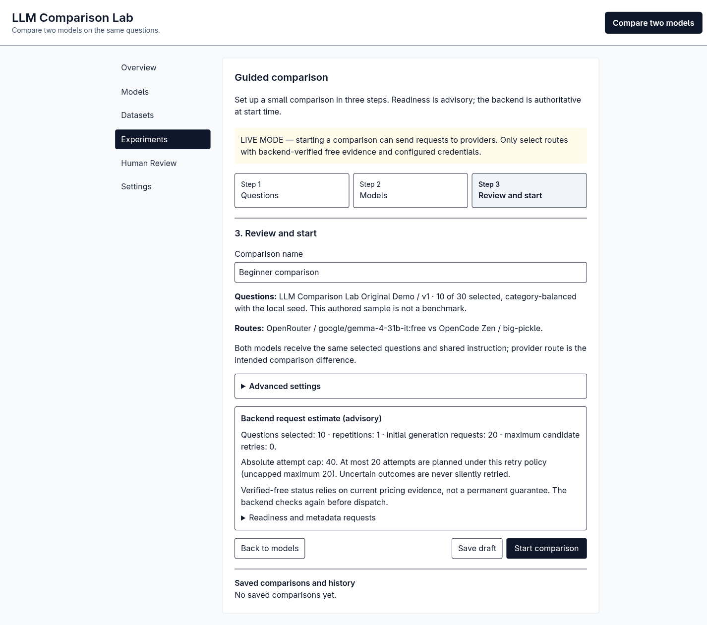
LLM COMPARISON LAB
HOW: a fair planned comparison
• Both routes receive the same selected questions and instruction.
• The design freezes exact route identity and request settings.
• Review estimates show initial requests, retries and attempt cap.
A local sampling seed cannot make hosted output deterministic.
LIVE REVIEW SCREEN • no dispatch shown
2026-10-21 • Research-project presentation
07
Notes:
The review screen shows a planned 10-question, two-route comparison before the Start action. Both model slots receive the same selected questions and shared instruction. The saved design identifies exact providers and model routes, plus repetitions and request limits. For the pictured settings, the interface estimated 20 initial generation requests, but this screenshot does not prove any request was sent. The local seed controls question selection and order, not remote model determinism. Provider and time effects remain confounds.
Sources: docs/BEGINNER_COMPARISON.md; docs/VERIFICATION.md; frontend/src/Experiments.tsx; backend/app/services/experiments.py. Screenshot text equivalent: review page listing ten selected questions, two routes, 20 initial requests, retry estimate, and an unclicked Start button.

Slide 8
LLM COMPARISON LAB
Provider and price safeguards
• Credentials stay on the server; a configured key is not proof of authentication.
• The backend requires current exact-route zero-price evidence.
• Expired, unknown, paid or unsupported routes fail closed.
• No silent route substitution; Zen quota remains unknown.
Observation: Zen evidence rechecked 2026-10-21; local expiry 2026-10-22 00:00 UTC.
2026-10-21 • Research-project presentation
08
Notes:
The application applies a free-only policy at the backend, not just in the selector. It needs current, explicit zero-price evidence for the exact route and blocks unknown or stale cases. The official OpenCode Console table was rechecked on 21 October 2026, but the local evidence window expires on 22 October at midnight UTC. That expiry is a local safety rule, not a provider guarantee. Existing credentials and catalog discovery do not demonstrate authenticated generation. Zen quota is undocumented in the local evidence.
Sources: docs/PROVIDER_CONFIGURATION.md; docs/VERIFICATION.md; backend/app/services/providers.py; backend/app/services/access.py.

Slide 9
LLM COMPARISON LAB
Execution survives interruptions
1
2
3
4
Queued
Attempt
Response
Recovery
Frozen plan
Durable record
Saved or failed
Pause or retry policy
Unknown remote outcomes require acknowledgement before retry.
2026-10-21 • Research-project presentation
09
Notes:
Starting a saved design creates durable jobs and attempt records. The worker can resume remaining work after a pause rather than silently restarting the whole comparison. It uses an absolute attempt cap and a bounded retry policy. A rate limit can pause execution. If the process loses contact after dispatch, the remote outcome may be unknown and a retry could duplicate provider work. The application requires acknowledgement for that uncertainty. These stages describe implemented behavior, not a fabricated live success sequence.
Sources: backend/app/worker/runner.py; docs/BEGINNER_COMPARISON.md; docs/VERIFICATION.md. Diagram text equivalent: queued frozen plan, durable attempt, saved response or failure, then recovery under pause or retry policy.

Slide 10
LLM COMPARISON LAB
HOW: automatic checks
• Task scorers cover declared exact, numeric, JSON and constraint rules.
• Instruction checks keep each pass or failure and scorer version.
• Pooled check accuracy differs from all-check prompt success.
• Missing answers are separate from incorrect answers; truncated answers are unscored.
Coverage, quality, latency and usage stay separate.
2026-10-21 • Research-project presentation
10
Notes:
Automatic scoring follows each item’s declared task and rule. Exact matching, numeric parsing, JSON structure, and verifiable instruction constraints can be checked locally. The instruction checker reports both passed checks over declared checks and whether every check on a prompt passed; these denominators can differ. Malformed completed answers may fail a declared rule, while missing and truncated responses retain their own status. Overlap or formatting checks do not establish truth. The bounded instruction checks are inspired by IFEval, not official IFEval scoring.
Sources: backend/app/evaluation/scoring.py; docs/METHODOLOGY.md; frontend/src/ResultsPanel.tsx; Zhou et al. (2023), arXiv:2311.07911v1.

Slide 11
LLM COMPARISON LAB
Paired analysis respects question families
Independent unit
Question family, with repeats and variants kept together
• Include only families complete for both model slots.
• Report slot 2 minus slot 1; average within family, then across families.
• 10,000 paired bootstrap draws; withhold 95% interval below 10 families.
Convenience sampling and selective missingness still limit inference.
2026-10-21 • Research-project presentation
11
Notes:
Repeating the same question does not create a new independent observation. The analysis groups planned responses by question family and includes a family only when both selected slots have the required scores. It averages repeats and variants inside each family, then weights complete families equally. A local paired bootstrap uses ten thousand draws. The software withholds a 95 percent interval with fewer than ten complete families and flags identical family differences as degenerate. Dror motivates matching inference to the design; these exact policies are ours.
Sources: backend/app/services/analysis.py; backend/app/services/analysis_store.py; docs/METHODOLOGY.md; Dror et al. (2018), ACL P18-1128.

Slide 12
LLM COMPARISON LAB
Human review now; AI judge later
Current app
• Identity-redacted A/B assignments and pairwise choices.
• Local evaluator labels do not verify independent raters.
Optional design only
• Separate credentials and consent; both answer orders; rubric and bias checks.
No AI judge has been implemented.
2026-10-21 • Research-project presentation
12
Notes:
The current app hides model identities in review assignments, records randomized A/B mappings privately, and accepts A, B, tie, or cannot-judge votes. A local label is not proof that distinct independent people reviewed the responses. The optional AI judge is a separate design document. It would need opt-in, separate provider credentials and costs, both answer orders, a declared rubric, and protection against instructions embedded in candidate answers. The Zheng paper informs bias discussion, not a claim that this app runs Arena or MT-Bench.
Sources: frontend/src/HumanReview.tsx; backend/app/services/review.py; docs/METHODOLOGY.md; docs/AI_JUDGE_DESIGN.md; Zheng et al. (2023), arXiv:2306.05685v4.

Slide 13
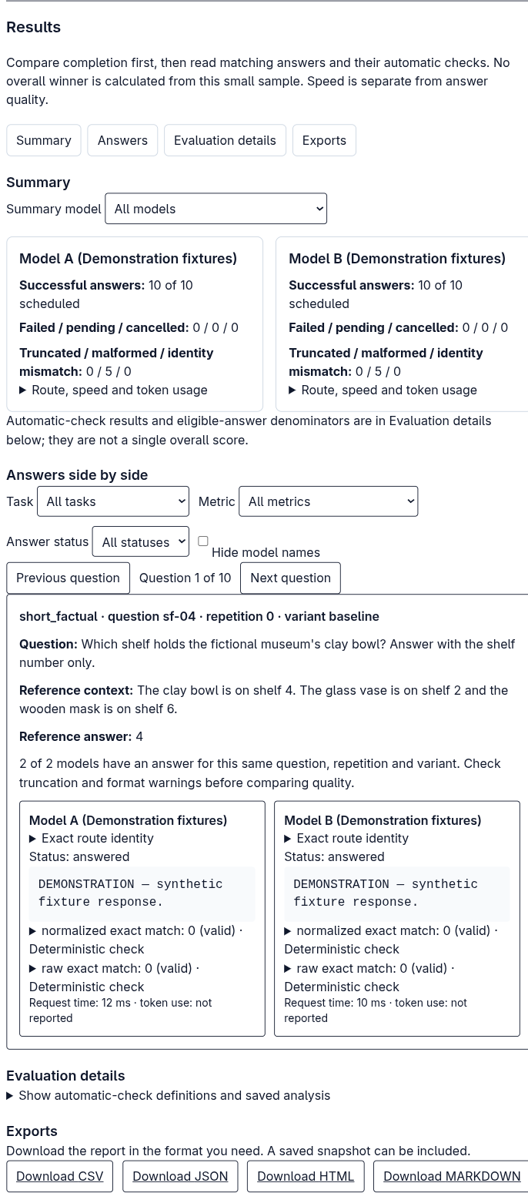
LLM COMPARISON LAB
Results evidence: synthetic demonstration
SYNTHETIC DEMONSTRATION
• The screen proves the result workflow and exports operate with fixtures.
• It does not measure provider quality or establish a winner.
• The separate 20/20 live smoke used 10 convenience items and two OpenRouter routes.
Screenshot: fixture responses, not live model data
2026-10-21 • Research-project presentation
13
Notes:
This screenshot is permanently labeled as a synthetic demonstration. The two fixture routes show how users inspect completion, matching answers, automatic checks, and export links. Their responses are synthetic and cannot support a model-quality conclusion. A separate earlier live smoke produced twenty responses across ten original questions and two OpenRouter routes. It is a narrow convenience run with its own database and record, not a benchmark or a winner claim. The live selection screenshot elsewhere only demonstrated catalog selectability.
Sources: docs/screenshots/results-desktop.png; docs/VERIFICATION.md; AGENTS.md; docs/METHODOLOGY.md. Screenshot text equivalent: two demonstration fixture panels, ten of ten responses each, side-by-side synthetic answers, evaluation details, and export buttons.

Slide 14
LLM COMPARISON LAB
Limits of the evidence
• Small authored samples; no independently reviewed held-out study.
• Routes, models, prices and hosted behavior can change.
• Scorer proxies cannot establish broad factuality or human preference.
• No fairness, calibration, agent, multimodal or official benchmark suite.
• The app is local and single-user; it does not collect public keys.
Frozen inputs and logs support audit; they do not freeze providers.
2026-10-21 • Research-project presentation
14
Notes:
The main limitation is scope. The built-in questions are small, authored examples, and the separate instruction draft has no independent review. Provider routes, availability, and pricing can shift after observation. Automatic checks evaluate declared narrow properties; they cannot establish broad factual accuracy or answer usefulness. This version has no fairness or calibration study, agent or multimodal evaluation, or official benchmark suite. Keeping inputs and attempt logs helps audit a run, but it cannot make a changing hosted model reproduce the same text later.
Sources: README.md; docs/METHODOLOGY.md; docs/PROVIDER_CONFIGURATION.md; sources/ai_project.md.

Slide 15
LLM COMPARISON LAB
What the lab contributes
01
Choose questions with provenance
02
Freeze two exact routes and request limits
03
Inspect progress and paired answers
04
Export results and review evidence
Next study: larger held-out set, precommitted design, balanced runs, independent review.
2026-10-21 • Research-project presentation
15
Notes:
The practical contribution is a traceable sequence from question selection to exact route choice, request review, durable progress, results, human review, and export. For a live demonstration, stop on the review screen before Start. A real study would require a larger independently reviewed held-out question set, a precommitted protocol, repeated balanced runs, permission to use the selected providers, and substantive human assessment. The present work shows a defensible workflow rather than a general model ranking.
Sources: frontend/src/Experiments.tsx; frontend/src/ResultsPanel.tsx; docs/BEGINNER_COMPARISON.md; docs/METHODOLOGY.md.

Slide 16
LLM COMPARISON LAB
References: five core sources
PRIMARY Chang et al. (2024). A Survey on Evaluation of Large Language Models. ACM TIST 15(3), Article 39.
https://doi.org/10.1145/3641289
Liang et al. (2023). Holistic Evaluation of Language Models. TMLR.
https://arxiv.org/abs/2211.09110v2
Zhou, Lu, Mishra, Brahma, Basu, Luan, Zhou & Hou (2023). Instruction-Following Evaluation for Large Language Models.
https://arxiv.org/abs/2311.07911v1
Dror, Baumer, Shlomov & Reichart (2018). The Hitchhiker’s Guide to Testing Statistical Significance in NLP. ACL.
https://aclanthology.org/P18-1128/
Zheng et al. (2023). Judging LLM-as-a-Judge with MT-Bench and Chatbot Arena. NeurIPS.
https://arxiv.org/abs/2306.05685v4
2026-10-21 • Research-project presentation
16
Notes:
These are the five sources used to frame or motivate local features. The primary source is Chang and colleagues’ 2024 ACM survey. HELM motivates multidimensional transparent reporting. The instruction-following paper is first-authored by Jeffrey Zhou, with Le Hou last in the arXiv author list; the earlier prompt reversed that attribution. Dror and colleagues motivate design-matched inference, and Zheng and colleagues inform review and judge-bias discussion. Hyperlinks point to publisher, ACL, or arXiv records.
Sources: sources/ai_project.md; docs/RESEARCH_FOR_ARENA.md; primary DOI; four linked publisher/arXiv records.

Slide 17
NOT METHODS IMPLEMENTED
Additional contextual reading
Cao et al. (2025). Toward Generalizable Evaluation in the LLM Era: A Survey Beyond Benchmarks.
https://arxiv.org/abs/2504.18838
Mohammadi, Li, Lo & Yip (2025). Evaluation and Benchmarking of LLM Agents: A Survey.
https://arxiv.org/abs/2507.21504
Ni et al. (2025). A Survey on Large Language Model Benchmarks.
https://arxiv.org/abs/2508.15361
These surveys provide context for future work. The lab does not run their suites or evaluate agents.
2026-10-21 • Research-project presentation
17
Notes:
The project overview names these three later surveys as context. Their titles and leading authors were checked against their arXiv records. They are not direct implemented methods in this local application. The agent survey concerns systems with tool use and extended interactions, which this lab does not evaluate. The benchmark survey catalogs many external suites that were not run here. These sources indicate possible future directions while keeping the eight-paper bibliography honest about what actually shaped the app.
Sources: project_overview.md; arXiv:2504.18838; arXiv:2507.21504; arXiv:2508.15361.

