Slide 1

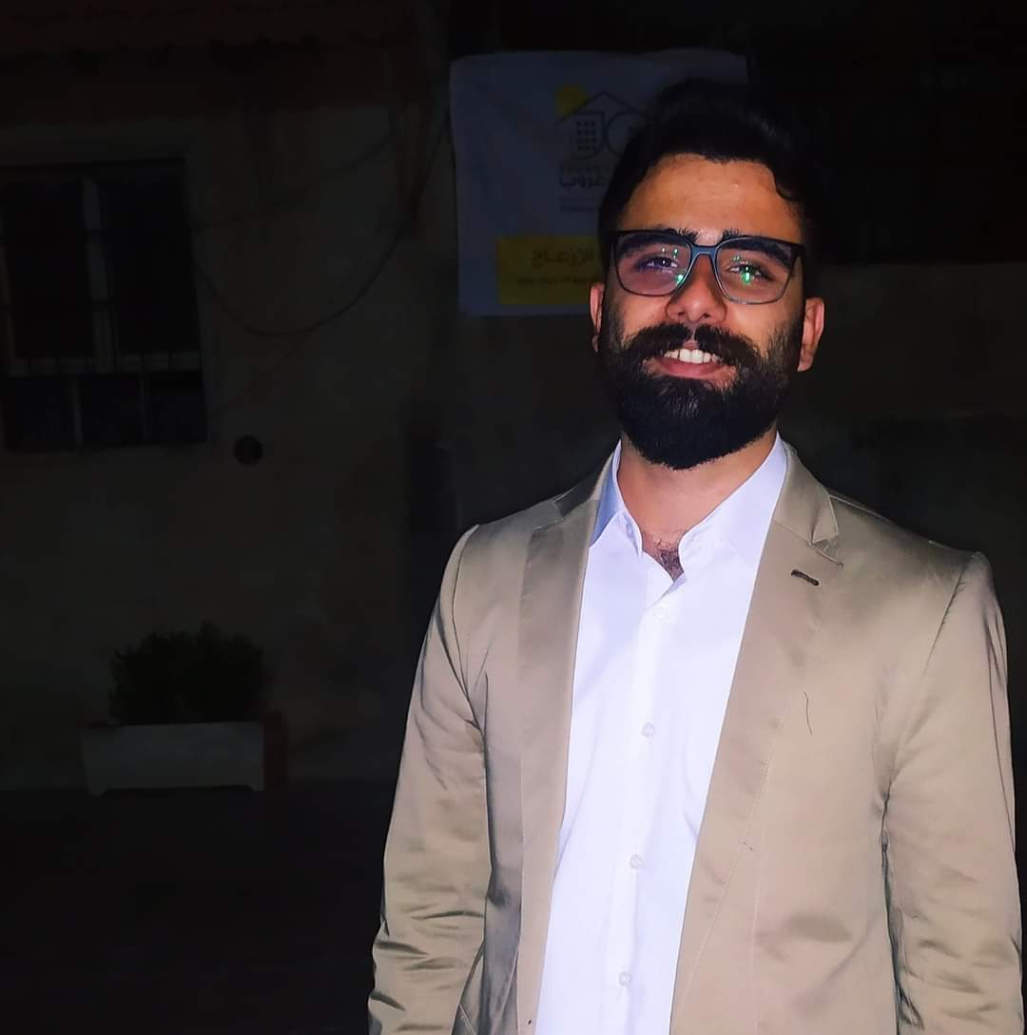
















Objective
FADI BARHOUM
WEB DEVELOPER
Seeking a position as a web developer where I can apply my master’s in Web Science with my four years experience and using my ability to solve problems in difficult situations.
Education
SYRIAN VIRTUAL UNIVERSITY Master in Web Science | 2018 - NOW
DAMASCUS UNIVERSITY Information Technology - Software Engineering | 2012 – 2018
Work Experience
Freelancer Web Developer Develop websites using frameworks | 2018 - NOW
Charitable Society for Sustainable Development Software Developer Develop all kinds of software the charity need Suggest technical solutions to make work more manageable Creating software documentation Software security Send monthly report | 2019 - NOW
Masar Syria Web Developer Meeting with customers To make an agreement about functional requirements Built database depends on functional requirements Develop Web User Interface design (UI) Creating software documentation Develop websites using HTML, CSS, JS Develop server-side using PHP | 2021 - 2022
07/06/1993
Male
+963 930 781 446
fadi.barhoum.fb@gmail.com
SKILLS
Laravel, WordPress, PHP, HTML, CSS, MSOffice
Java Script, SQL
CodeIgniter, jQuery
Activates
LANGUAGES
THE SACRED HEARTS SOCIETY Volunteer Volunteer team coordinator assistant | 2019 - NOW
GOPA-DERD Volunteer ORV Team | 2019 - 2022
Charitable Society for Sustainable Development Volunteer Planning for new projects Needs survey Follow up and evaluate | 2016 - 2019
Arabic
English
CERTIFICATE
+15 Certificate at humanitarian field
English
Beneficiaries Database Management
Time Management
Entrepreneurial Skills & Business Management
Mobile Maintenance
Note: please click on pictures to open websites.

