Slide 1

DATA ANALYTICS
CUSTOMER INSIGHTS
Customer Shopping Behavior Analysis
Analyzing 3,900 purchases across product categories to uncover spending patterns, customer segments, product preferences, and subscription behavior — guiding strategic business decisions.
M Fadil Ahmed
Data Science Student

Slide 2

Dataset Summary
The dataset contains 3,900 rows and 18 columns capturing the full shopping journey — from customer demographics to purchase details and behavioral signals.
Demographics: Age, Gender, Location, Subscription Status
Purchase Details: Item, Category, Amount, Season, Size, Color
Shopping Behavior: Discount, Promo Code, Previous Purchases, Frequency, Review Rating, Shipping Type
37 missing values found in the Review Rating column — imputed using median rating per product category.
3,900
18
Total Purchases
Data Columns
$59.76
3.75
Avg Purchase (USD)
Avg Review Rating

Slide 3




Exploratory Data Analysis in Python
Careful data preparation set the tone for the entire analysis. By thoroughly loading, validating, and cleaning the dataset before any modeling or visualization, we built a dependable foundation for uncovering insights that were both accurate and decision-ready.
Load Data
Clean Data
Engineer Features
Integrate
We standardized column names to snake_case to make the dataset easier to read, easier to reference in code, and less prone to errors during analysis. We also removed the redundant promo_code_used field after confirming it duplicated discount_applied. This prevented duplicated signals from distorting the results, reduced unnecessary clutter, and strengthened the overall integrity of the dataset for downstream analysis.

Slide 4
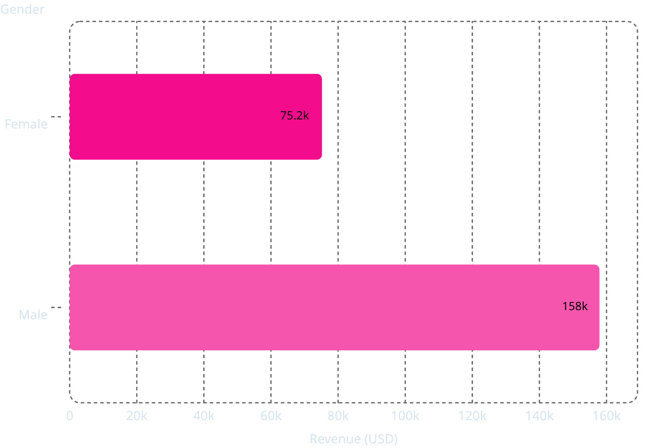
Revenue by Gender
Male customers generated $157,890 in total revenue — more than double the $75,191 contributed by female shoppers.
This significant gap highlights a male-dominated customer base and points toward gender-targeted growth opportunities.

Slide 5

Top Products & Discount Patterns
Top 5 by Rating
Most Discount-Dependent
Gloves — 3.86
Sandals — 3.84
Boots — 3.82
Hat — 3.80
Skirt — 3.78
Hat — 50.0%
Sneakers — 49.7%
Coat — 49.1%
Sweater — 48.2%
Pants — 47.4%

Slide 6
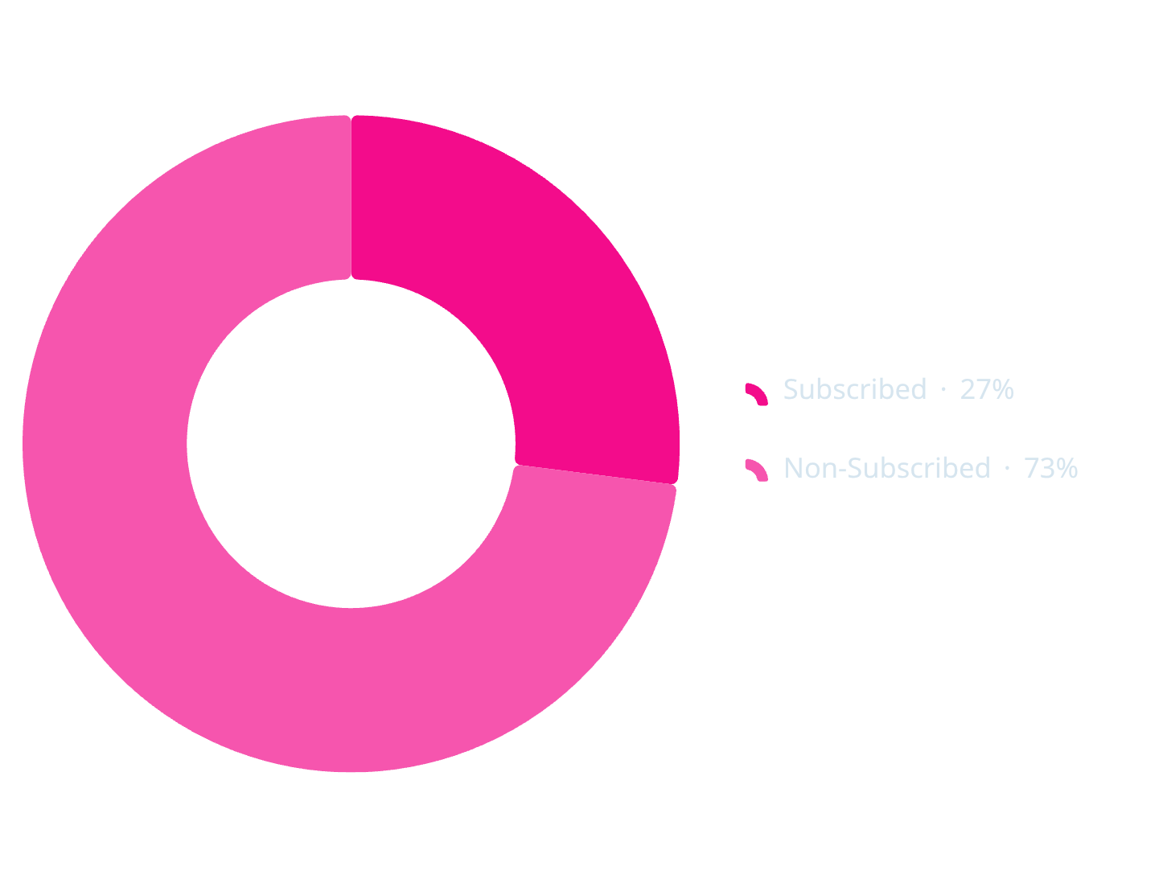
Subscribers vs. Non-Subscribers
Only 27% of customers are subscribers, yet average spend is nearly identical across both groups — $59.49 vs. $59.87.
Non-subscribers drove $170,436 in total revenue compared to $62,645 from subscribers, suggesting a large untapped base for conversion.

Slide 7
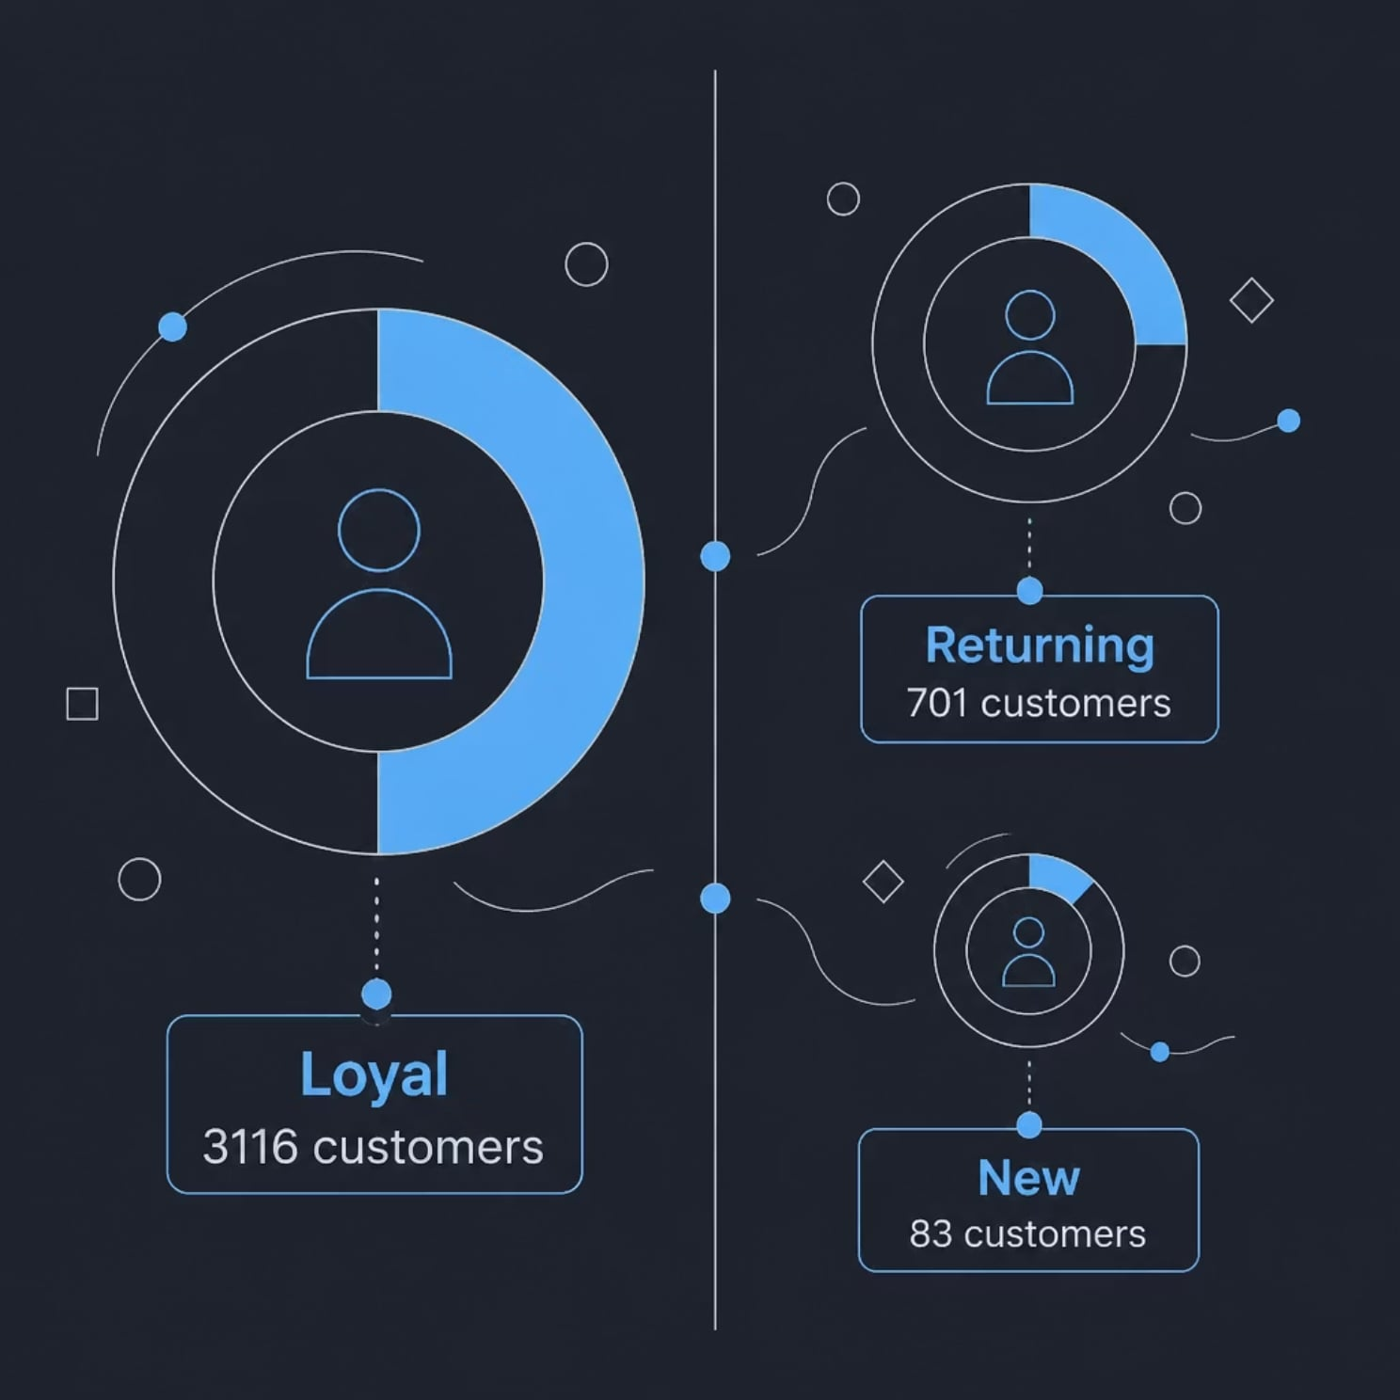
Customer Segmentation
By grouping customers into Loyal, Returning, and New segments, we uncover the engine of retention, repeat purchase behavior, and future expansion. This view highlights where the business already has a strong foundation — and where targeted engagement can unlock the next wave of growth.
Loyal
Returning
New
3,116 customers
701 customers
83 customers

Slide 8
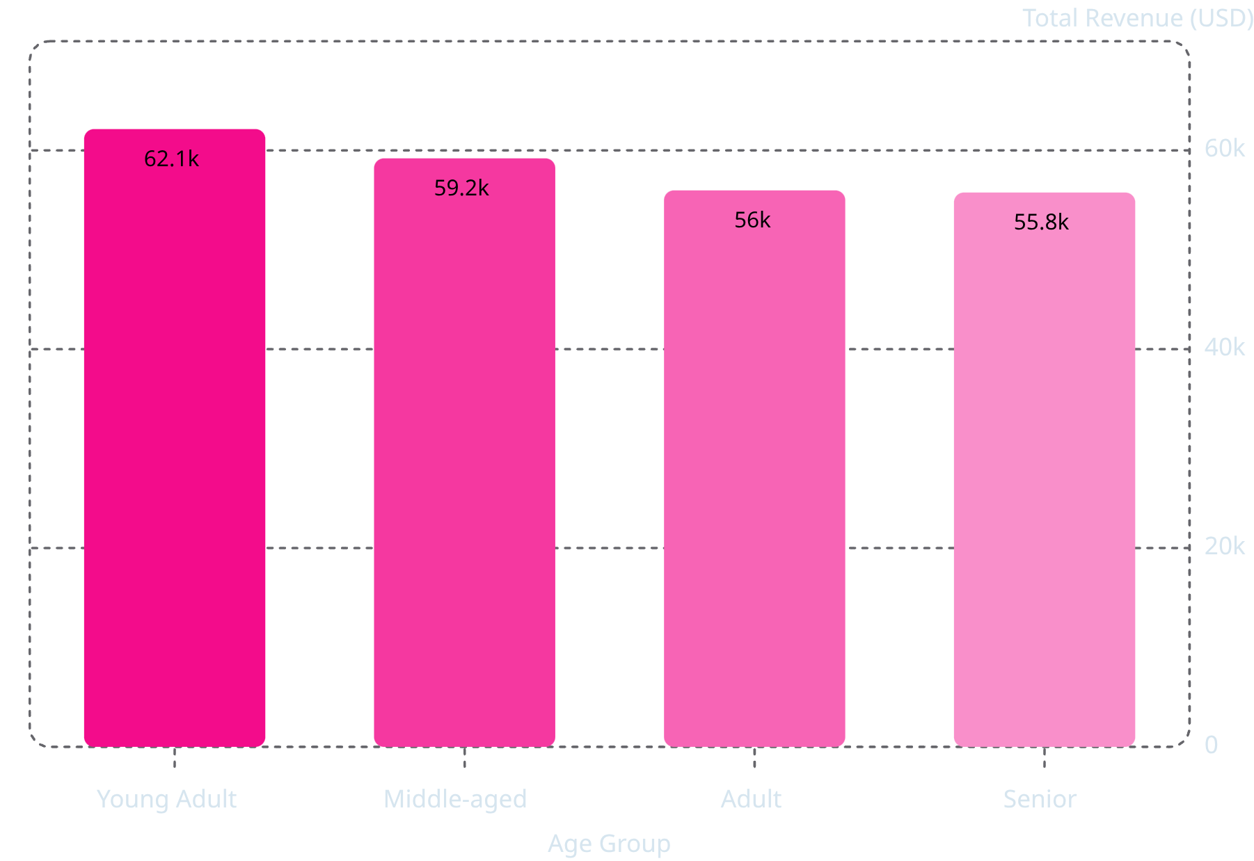
Revenue by Age Group
Young Adults lead revenue contribution at $62,143, followed closely by Middle-aged shoppers at $59,197.
Seniors contribute the least at $55,763, but the gap across all groups is relatively narrow — indicating broad appeal across age demographics.

Slide 9
Interactive Power BI Dashboard
The final dashboard consolidates every insight into a single interactive view with filters for Subscription Status, Gender, Category, and Shipping Type — featuring KPI cards, a subscription donut chart, and bar charts for revenue and sales breakdowns.

Slide 10

Business Recommendations
Boost Subscriptions
Loyalty Programs
Review Discount Policy
Promote exclusive benefits to convert the 73% non-subscriber base.
Reward repeat buyers to move them into the Loyal segment.
Balance sales boosts with margin control on discount-dependent products.
Product Positioning
Targeted Marketing
Highlight top-rated and best-selling products in marketing campaigns.
Focus on high-revenue age groups and express-shipping users.

Slide 11
Thank You for Your Time
Analysis and Presentation by M Fadil Ahmed
We trust these insights into customer shopping behavior will empower your strategic decisions and drive significant growth.

