Slide 1
CUSTOMER CHURNS IN BANKS
Causes, Impacts, and Solutions
Tools Used:- Ms Excel
Presented by: Falguni Fadnis
Submitted to: Jayesh Patil Sir

Slide 2
Objectives of study
Understand customer churn
Finding out causes
Analyze impact on banks
Suggest strategies to reduce customer churn

Slide 3
What is Customer Churn?
Customer churn is the number of existing customers lost, for any reason at all, over a given period of time. It provides companies(in our case the bank doing analysis) with an understanding of customer satisfaction and customer loyalty, and can identify potential changes in its bottom line.
Types of Churn:-
Voluntary: Customer chooses to leave
Reasons:- Dissatisfaction, better offers
Involuntary: Bank initiates closure(customer consent mandatory)
Reasons:- Regulatory policies, Fraud transactions etc.

Slide 4
Causes of Customer Churn
Poor customer service
High fees or charges on ATM ,credit card , text messages etc.
Lack of personalization eg. Internet Banking,chatbots etc.
Better competitor offers
Tech issues eg. Application failure etc.

Slide 5
Studying Customer Behavior Trends
Younger customers prefer digital-first banks
Retention is higher with personalized service
60% customers switch for better tech experience

Slide 6
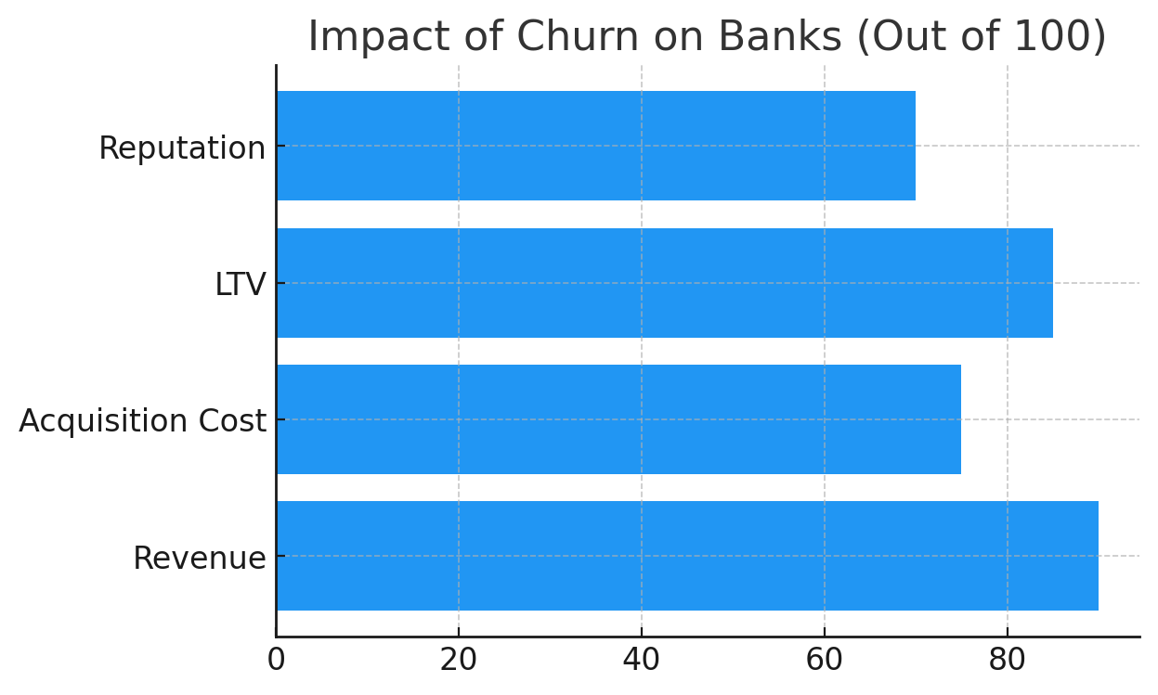
Impact on Banks
Loss of revenue
Increased acquisition cost
Damage to brand reputation
Reduced lifetime value (LTV) of customers

Slide 7
Case Study: XYZ Bank
XYZ Bank having branches across France, Germany & Spain has faced an annual customer churn .
Implemented a churn analysis using transaction data provided.
Analysis proceeds as follows:

Slide 8
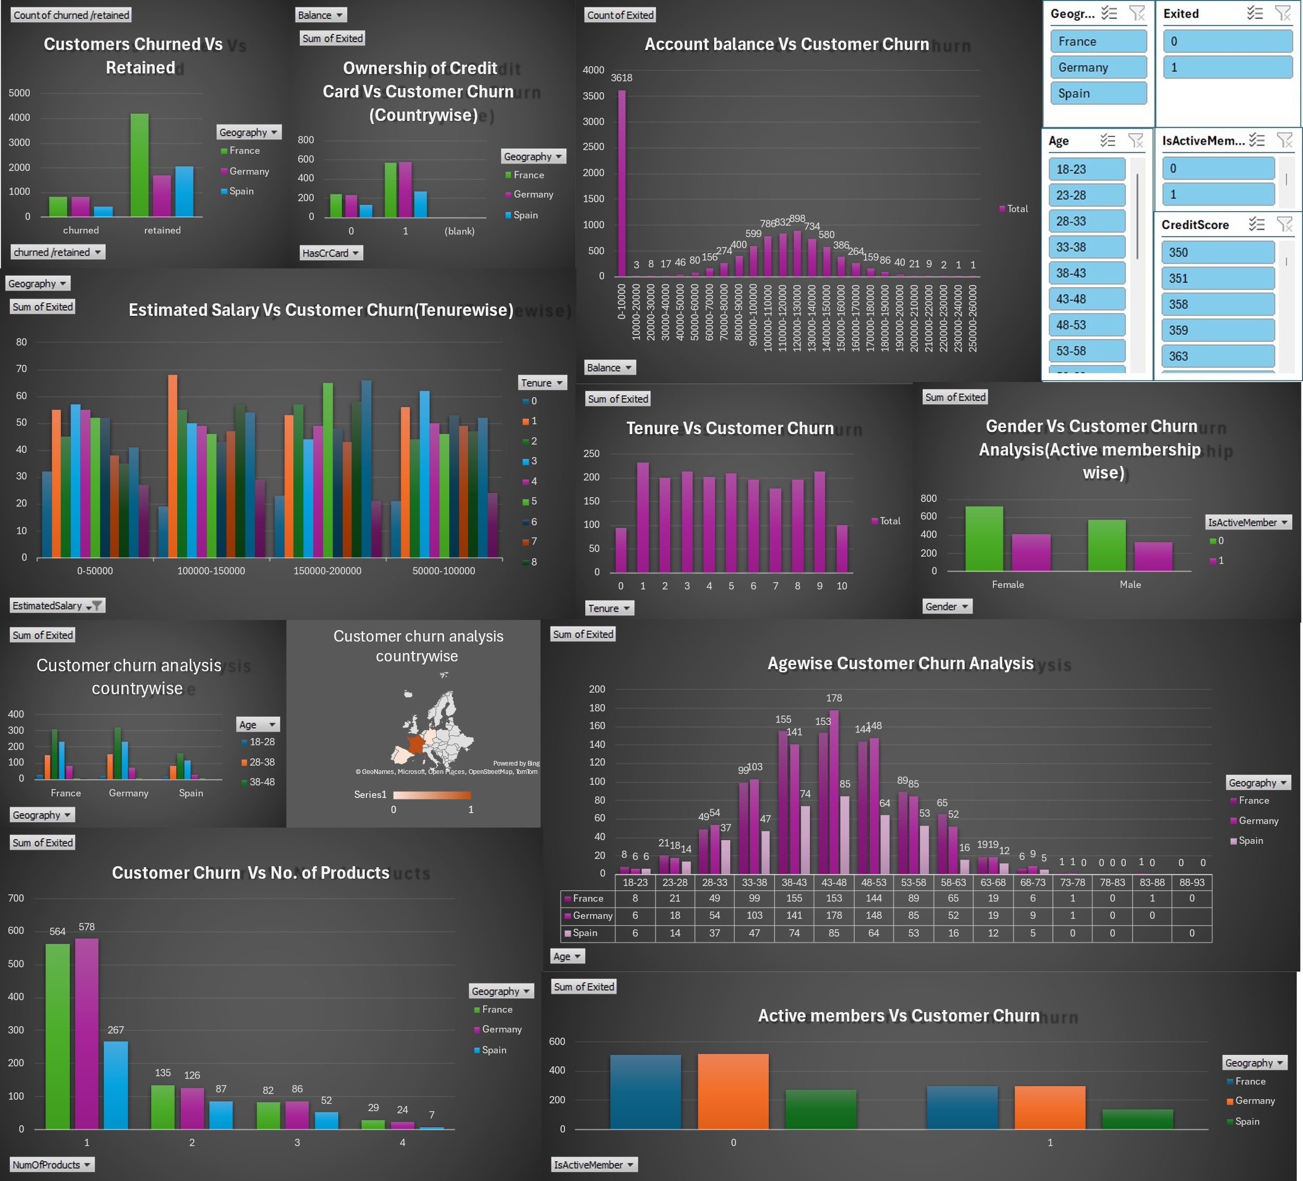
Analysis Dashboard

Slide 9

Churn Prediction & ANALYSIS
Problem Statement -1
To find out the ratio of churned vs retained customers
Count of churned /retained | Country
Churned/Retained | France | Germany | Spain | Grand Total
churned | 810 | 814 | 413 | 2037
retained | 4203 | 1696 | 2064 | 7963
Grand Total | 5013 | 2510 | 2477 | 10000
$$Ratio =\frac{Customers Churned}{Customers Retained}$$
$Ratio =\frac{2037}{7963}$= 0.255

Slide 10
Churn Prediction & ANALYSIS
Problem Statement -2
To find out the tenure durations who have observed least churn?
Tenure | Sum of Exited
0 | 95
1 | 232
2 | 201
3 | 213
4 | 203
5 | 209
6 | 196
7 | 177
8 | 197
9 | 213
10 | 101
Grand Total | 2037
Ans: 0 & 10
i.e. the newest and the oldest customers

Slide 11
Churn Prediction & ANALYSIS
Problem Statement -3
To find out the country observing highest churn ? Also find the age group having maximum churn in the same.
Sum of Exited | Age group
Country | 18-28 | 28-38 | 38-48 | 48-58 | 58-68 | 68-78 | 78-88 | 88-98 | Grand Total
France | 29 | 148 | 308 | 233 | 84 | 7 | 1 | 0 | 810
Germany | 24 | 157 | 319 | 233 | 71 | 10 | 0 |  | 814
Spain | 20 | 84 | 159 | 117 | 28 | 5 | 0 | 0 | 413
Grand Total | 73 | 389 | 786 | 583 | 183 | 22 | 1 | 0 | 2037
Ans: Germany(38-48)

Slide 12

Churn Prediction & ANALYSIS
Problem Statement -4
To find out the ratio of active member churns to dormant account churns are higher in female customers or for male customers?
Sum of Exited | Is active member
Gender | 0 | 1 | Grand Total
Female | 725 | 414 | 1139
Male | 577 | 321 | 898
Grand Total | 1302 | 735 | 2037
0- Not an active member
1- Active member
$For Females :414/725$ =0.57
$For Males :321/577$ =0.55

Slide 13
Churn Prediction & ANALYSIS
Problem Statement -5
To find out the age group observing maximum number of customer churns in each country?
Ans: Age-group 43-48

Slide 14
Churn Prediction & ANALYSIS
Problem Statement -6
To find out whether the bank is able to retain the customers having more number of products or not?
Sum of Exited | Country
No. of products owned | France | Germany | Spain | Grand Total
1 | 564 | 578 | 267 | 1409
2 | 135 | 126 | 87 | 348
3 | 82 | 86 | 52 | 220
4 | 29 | 24 | 7 | 60
Grand Total | 810 | 814 | 413 | 2037
Ans: Yes, Churn observed is higher for customers having lesser products.

Slide 15
Churn Prediction & ANALYSIS
Problem Statement -7
To find out the ratio of active and inactive members whom the bank has lost.
Sum of Exited | Age Group
Is Active member | France | Germany | Spain | Grand Total
0 | 512 | 518 | 272 | 1302
1 | 298 | 296 | 141 | 735
Grand Total | 810 | 814 | 413 | 2037
Is Active/Inactive | France | Germany | Spain | Grand Total
0(Inactive) | 512 | 518 | 272 | 1302
1(Active) | 298 | 296 | 141 | 735
Ratio (Active/Inactive) | 0.5820313 | 0.57143 | 0.52 | 0.564516129
Ans: Total Ratio:-0.56

Slide 16
Churn Prediction & ANALYSIS
Problem Statement -8
To find out salary bar which has observed highest churn.
Ans: Highest churn observed is for the customers having salary bar 150000-200000 having a tenure of 6 years.

Slide 17
Strategies to Reduce Churn
Personalization & support
Use customer data to tailor services
Example: 1)Recommended financial products based on history.
2)Priority support
3) Fee waivers
Loyalty rewards: Coupons etc.
Improved digital services: Faster issue resolution improves
  Retention Eg. Improved Mobile apps, AI bots, real-time support.

Slide 18
Conclusion
Churn is costly but predictable.
Data-driven strategies help retention.
Focus on customer experience is key.

Slide 19
THANK YOU

