Slide 1
DELIVERY APP ANALYSIS

Slide 2
Introduction
This presentation provides an overview of Zomato's sales performance, covering revenue, top-performing restaurants, popular cuisines, and customer engagement insights.
A detailed analysis is being done using My SQL queries including joins , subqueries and aggregate functions.

Slide 3
Sales Overview
Total Sales: ₹12 Cr
Orders Placed: 1.2M
Average Order Value: ₹500
Revenue Growth: 15% YoY

Slide 4
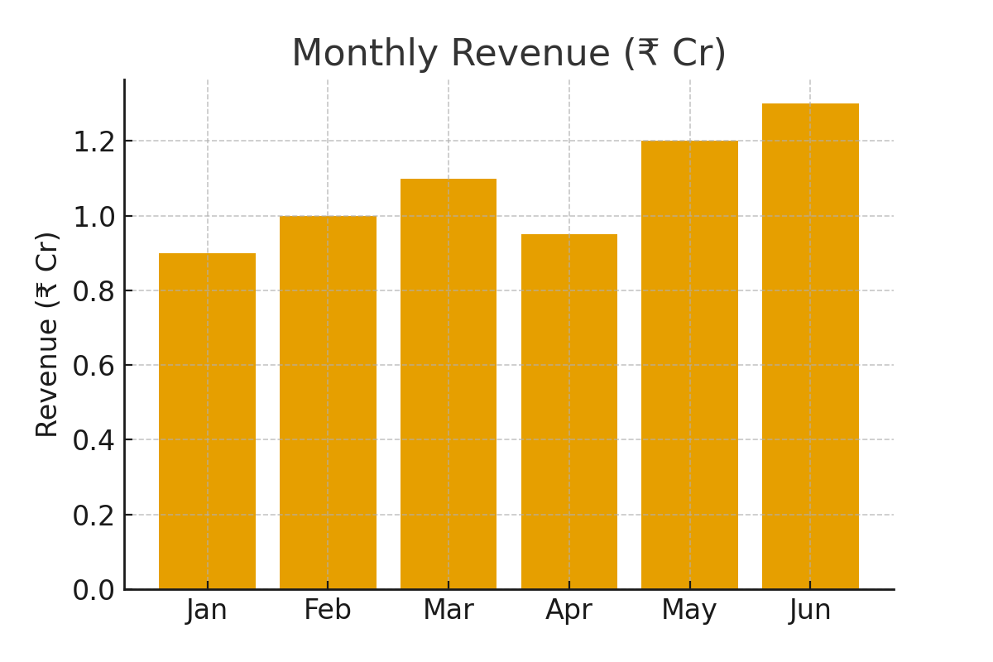
Monthly Revenue

Slide 5
Top Performing Restaurants
1. Biryani House - ₹2.1 Cr
2. Pizza Palace - ₹1.8 Cr
3. Spice Hub - ₹1.5 Cr
4. Café Delight - ₹1.3 Cr
5. Burger World - ₹1.1 Cr

Slide 6
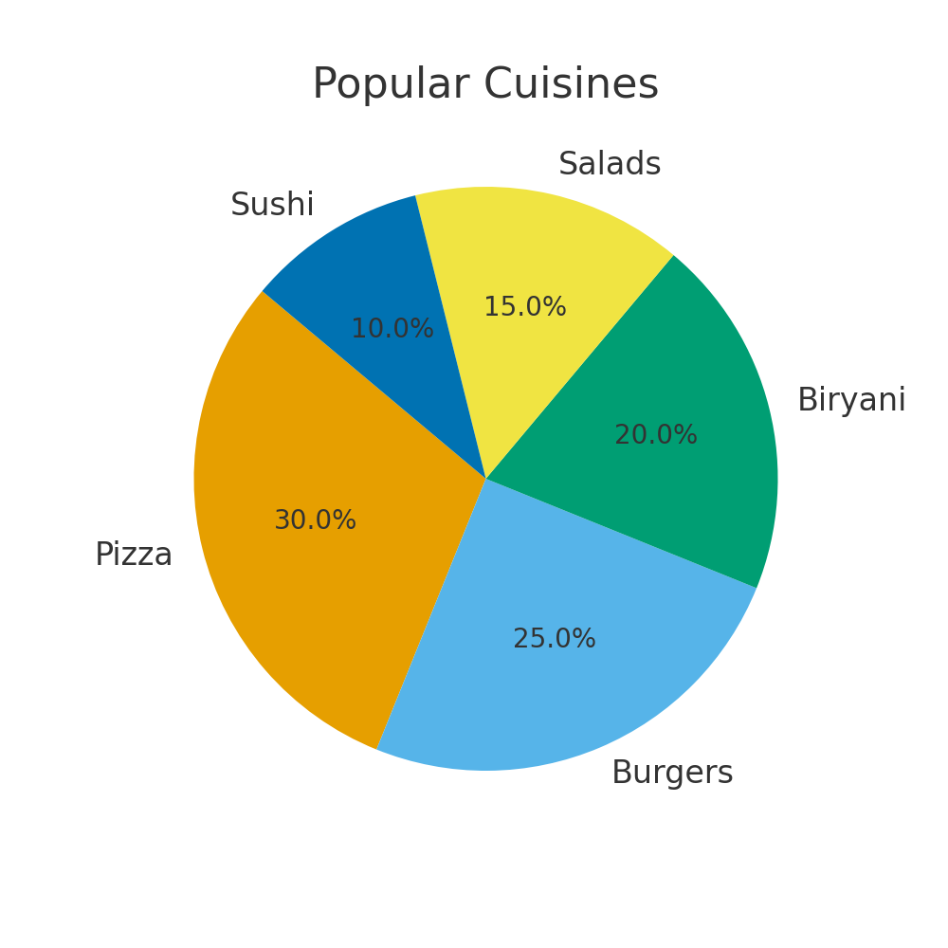
Popular Cuisines
🍕 Pizza - 30%
🍔 Burgers - 25%
🍛 Biryani - 20%
🥗 Salads - 15%
🍣 Sushi - 10%

Slide 7
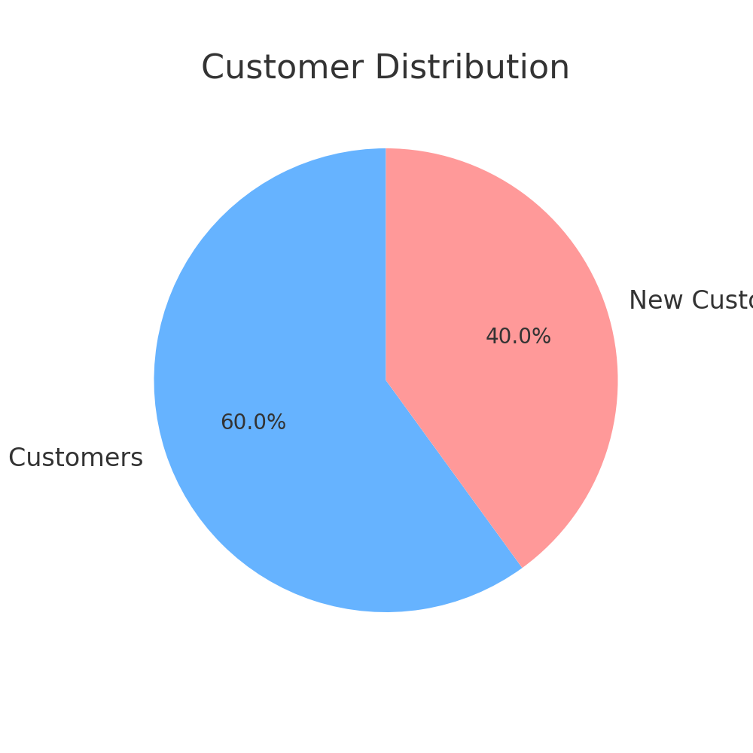
Customer Insights
Repeat Customers: 60%
New Customers: 40%
Highest Orders by Age Group: 25-34 years
Peak Ordering Time:
7 PM - 10 PM

Slide 8
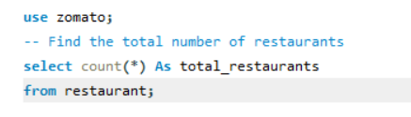
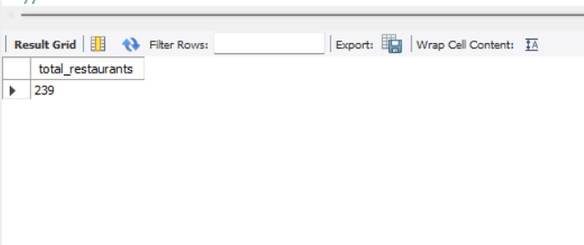
1. Find the total number of restaurants

Slide 9
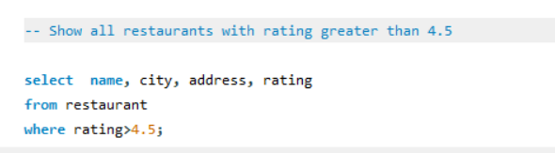
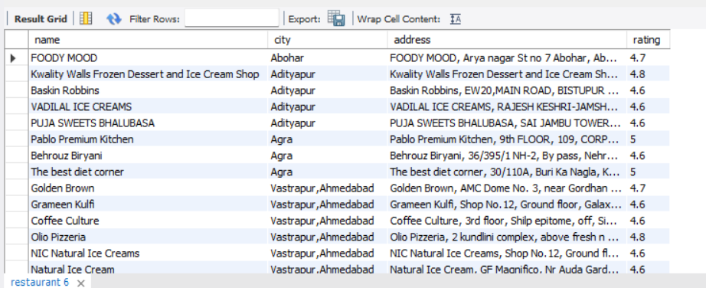
2. Show all restaurants with rating greater than 4.5

Slide 10
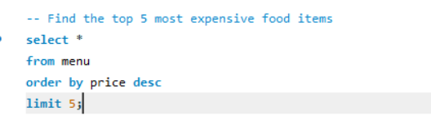
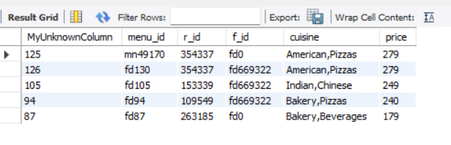
3. Find the top 5 most expensive food items

Slide 11
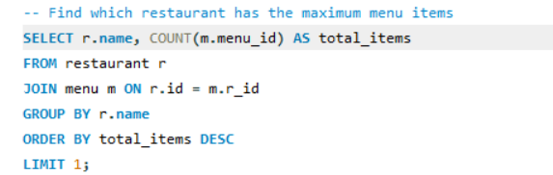
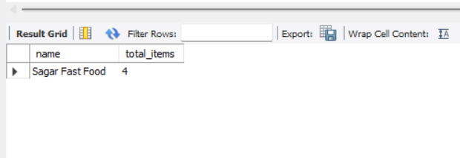
4. Find which restaurant has the maximum menu items

Slide 12
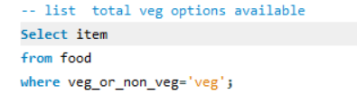
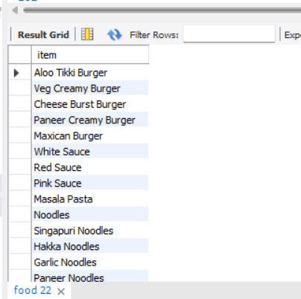
5. list total veg options available

Slide 13
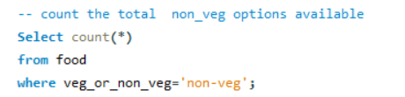
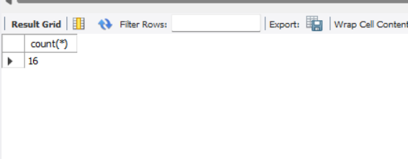
6. count total non-veg options available

Slide 14
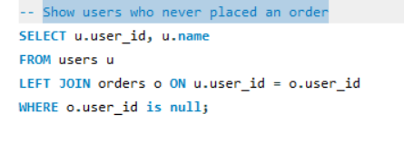
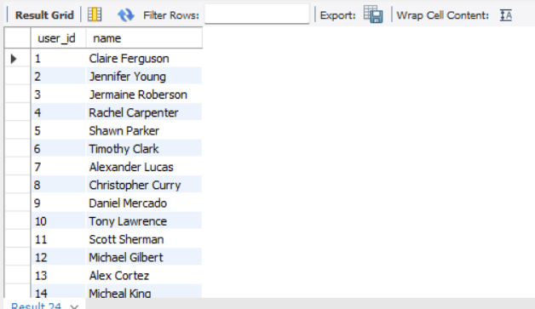
7. Show users who never placed an order

Slide 15
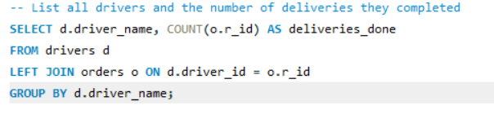
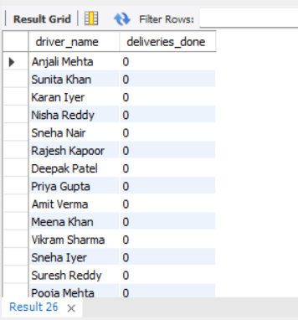
8. List all drivers and the number of deliveries they completed

Slide 16
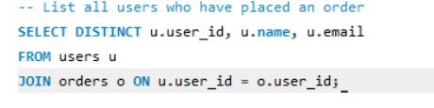
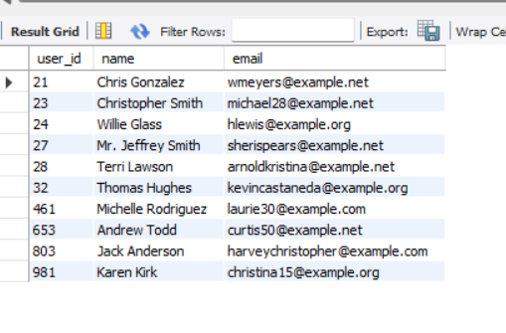
9. List all users who have placed an order

Slide 17
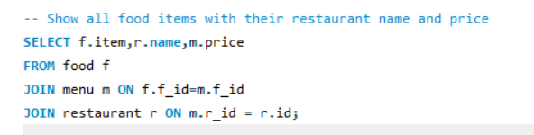
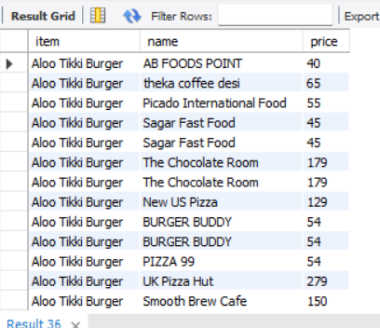
10. Show all food items with their restaurant name and price

Slide 18
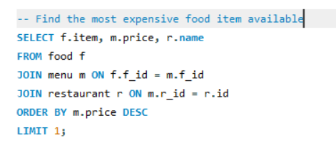
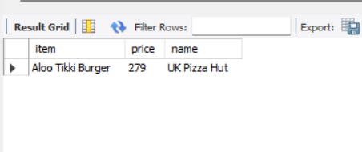
11. Find the most expensive food item available

Slide 19
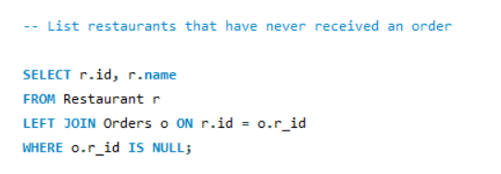
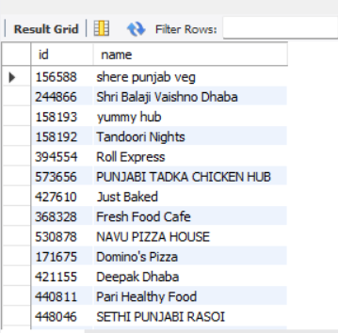
12. List restaurants that have never received an order

Slide 20
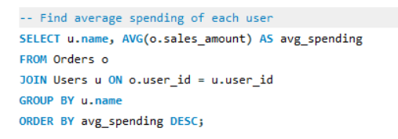
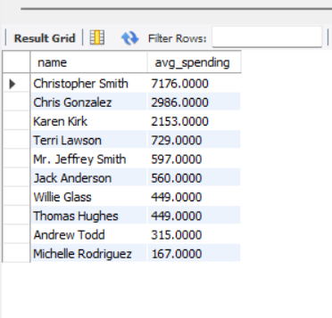
13. Find average spending of each user

Slide 21
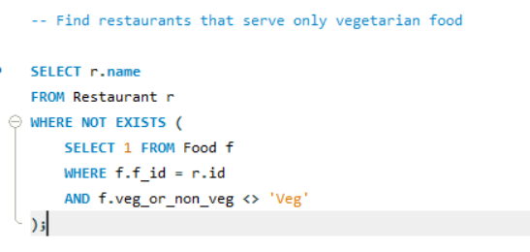
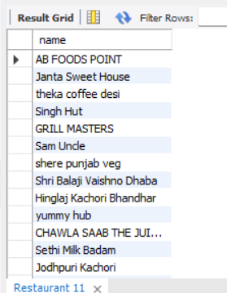
14. Find restaurants that serve only vegetarian food

Slide 22
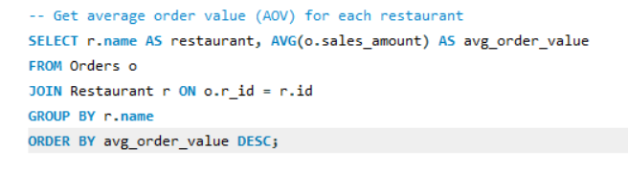
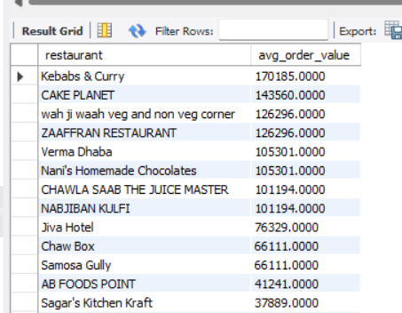
15. Get average order value (AOV) for each restaurant

Slide 23
Conclusion
Zomato analysis through SQL leads to detailed information regarding all the aspects such as top restaurants, most ordered food,least ordered items etc. Conclusions can be made accordingly about the business.

Slide 24
THANK YOU

