Slide 1
📈
StockVision
Stock Market Analysis System
Framework
Data Source
Charts
Language
Streamlit
Yahoo Finance
Plotly
Python
Canadian International College | Dr. Khalaf | Team of 4

Slide 2
Agenda
01
Project Overview & Objectives
02
System Architecture
03
Tools & Technologies
04
Team Roles & Responsibilities
05
System Diagrams (DFD, Use Case, Sequence, ER)
06
Features & Demo
07
Testing Results
08
Conclusion

Slide 3
Project Overview
What is StockVision?
Search
4
StockVision is a Streamlit web application that enables users to search, analyze, and visualize stock market data in real-time using the Yahoo Finance API.
Any Stock Symbol
Chart Types
Understand stock market data collection
Build interactive web application
Visualize price trends with charts
6
MA7/20/50
+ VWAP
Provide financial indicators to users
Handle errors gracefully
Time Periods
Indicators

Slide 4
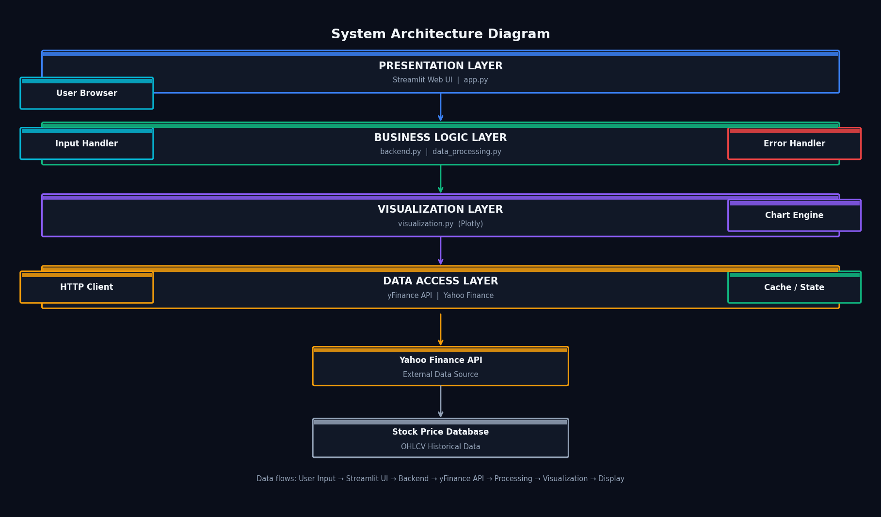
System Architecture

Slide 5
Tools & Technologies
🌐
Streamlit
🐍
Python 3.10+
📊
yFinance
Web UI Framework
Server-side rendering
Core Language
Object-oriented design
Yahoo Finance API
OHLCV + Company Info
🐼
Pandas / NumPy
📈
Plotly
🔧
Git / GitHub
Data Processing
DataFrame operations
Interactive Charts
Line, Candlestick, Bar
Version Control
Team collaboration

Slide 6
Team Roles & Responsibilities
Member 1
Member 2
Member 3
Member 4
Backend Dev
Data Analyst
Visualization
UI / QA / Docs
backend.py
data_processing.py
visualization.py
app.py
yFinance API integration
Pandas data cleaning
Plotly chart creation
Streamlit UI layout
Symbol validation
OHLCV extraction
Line + Candlestick
Session state mgmt
Error handling
MA / VWAP computation
Volume bar chart
Testing all scenarios
Data fetching
Daily change calc
MA overlays
Docs + Presentation

Slide 7
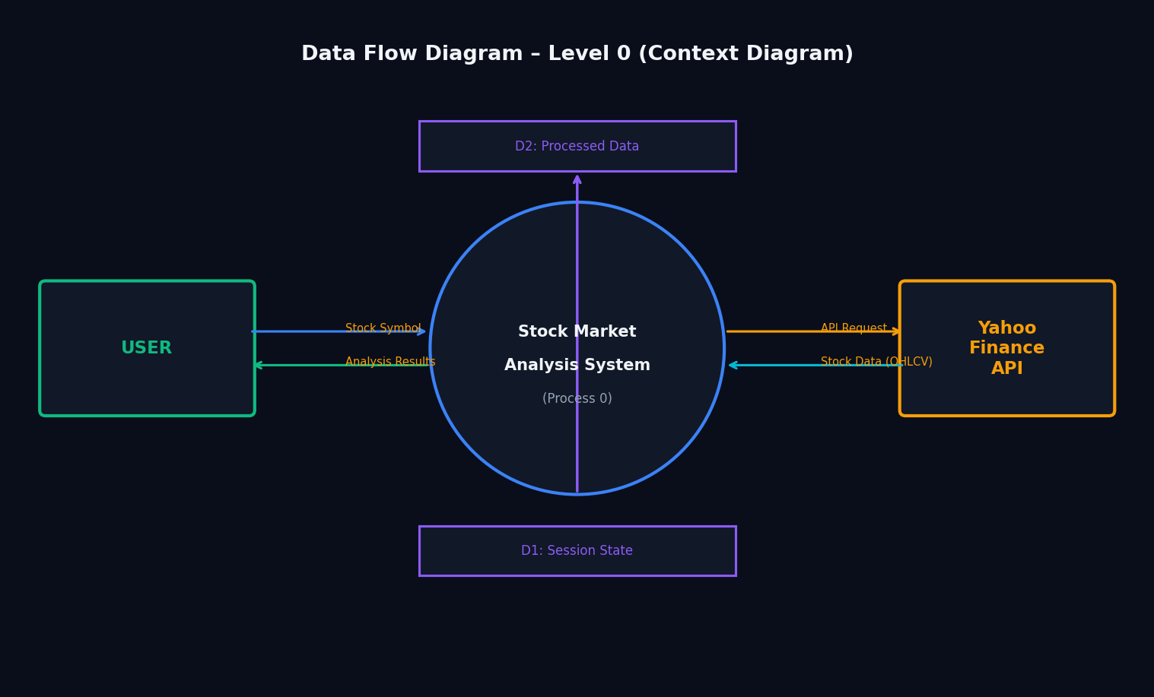
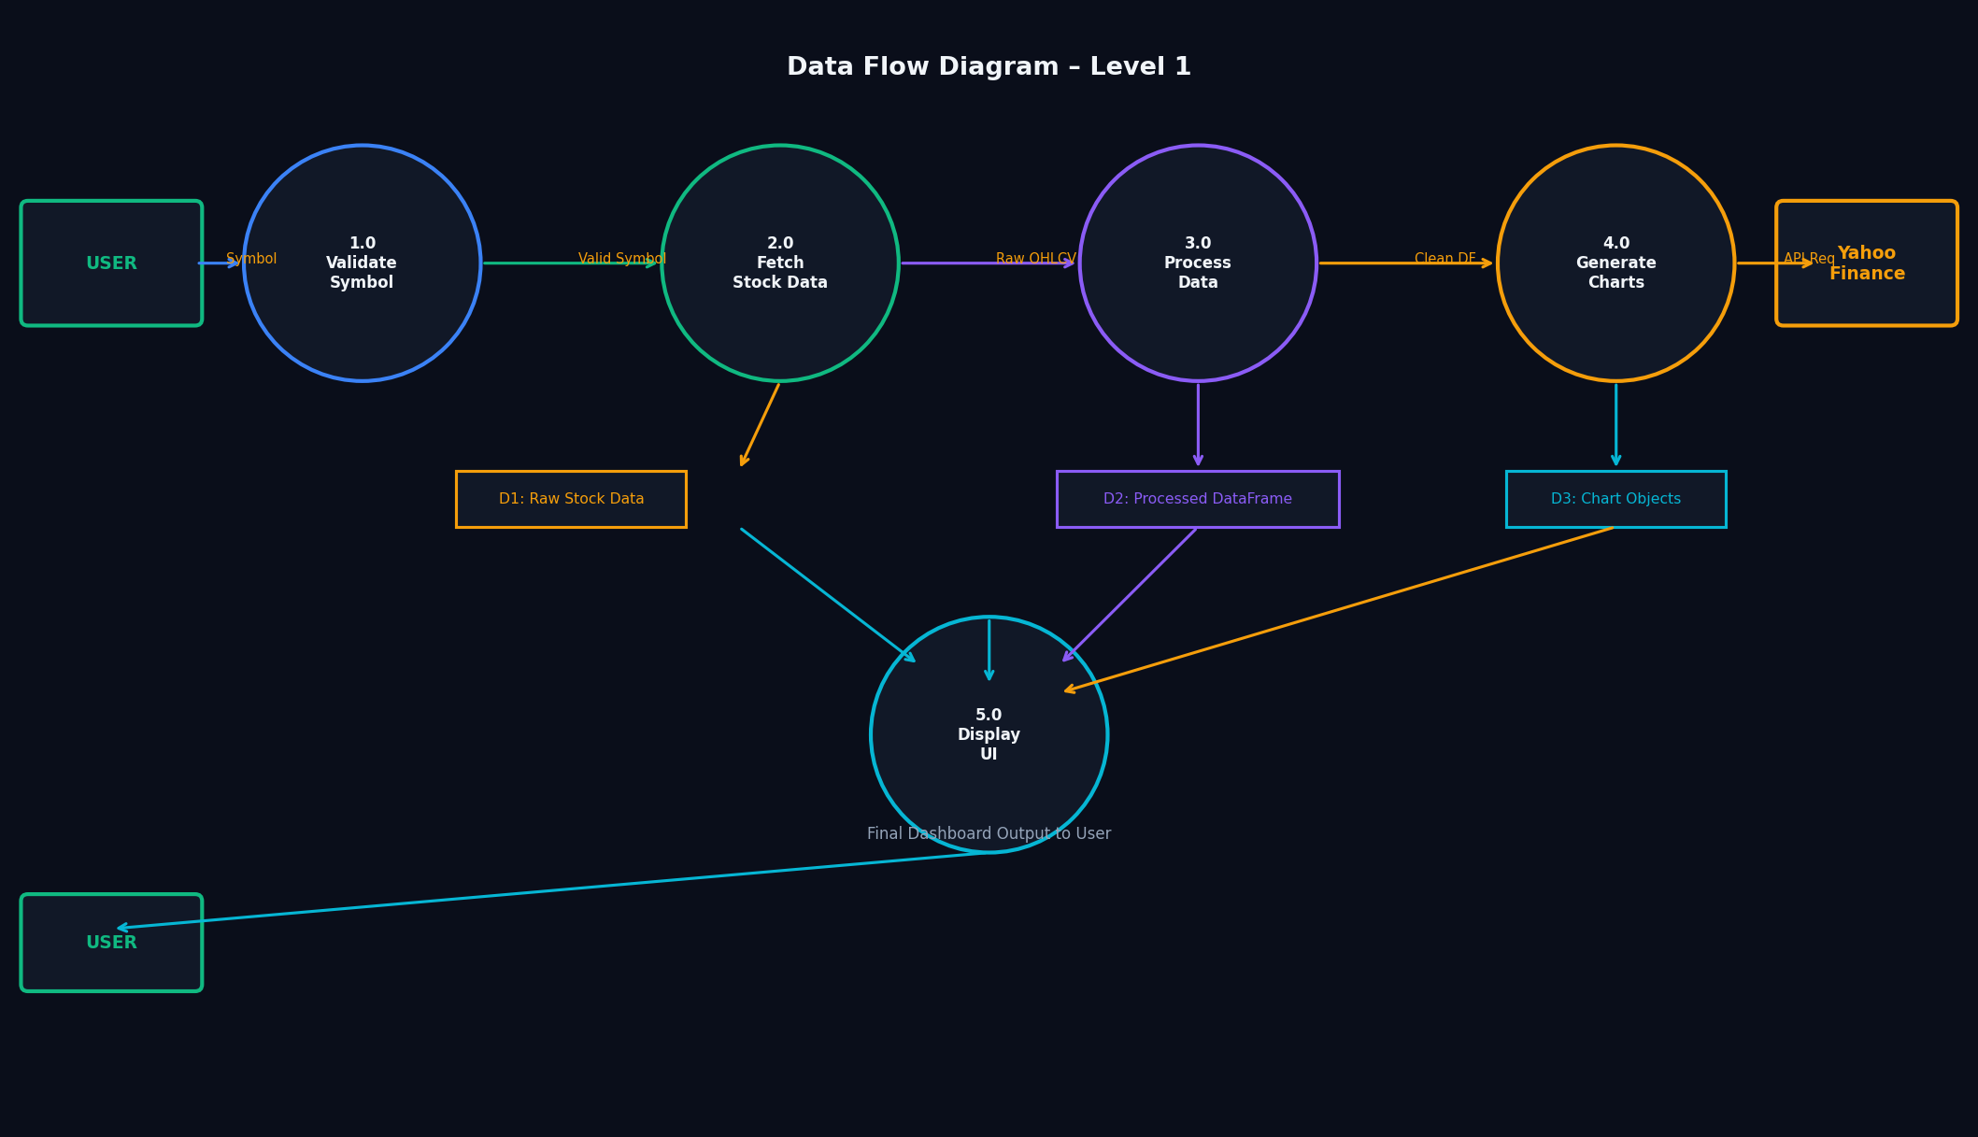
Data Flow Diagrams
Level 0 – Context
Level 1 – Internal Processes
The system receives a Stock Symbol from the User, requests data from Yahoo Finance, processes it through validation → fetch → clean → visualize, and returns a complete dashboard.

Slide 8
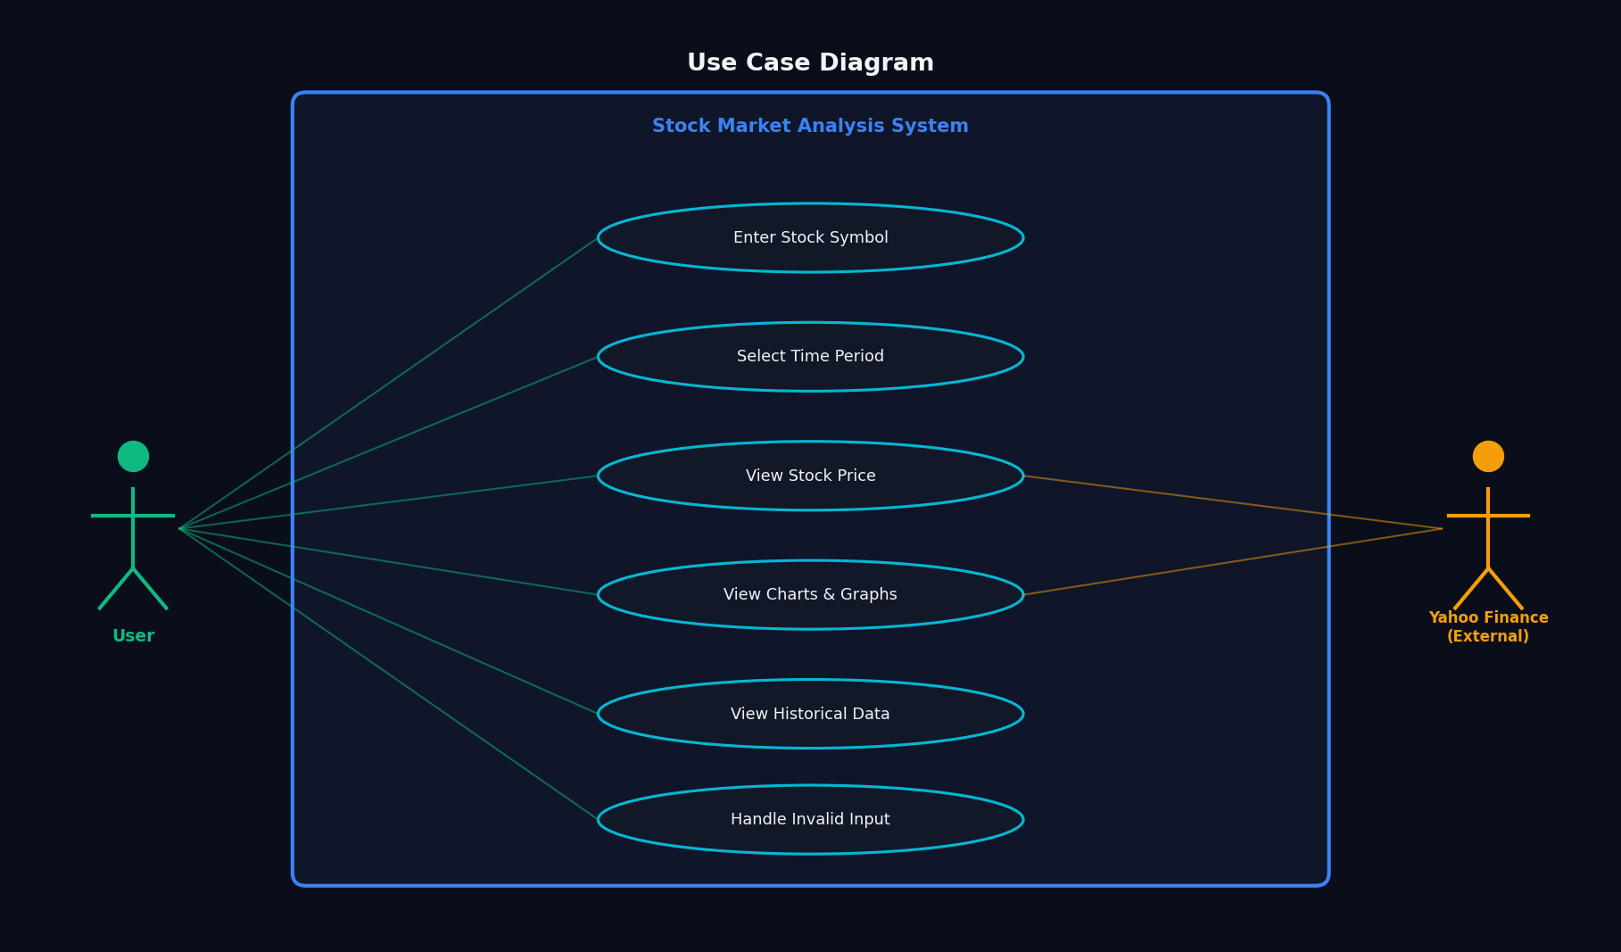
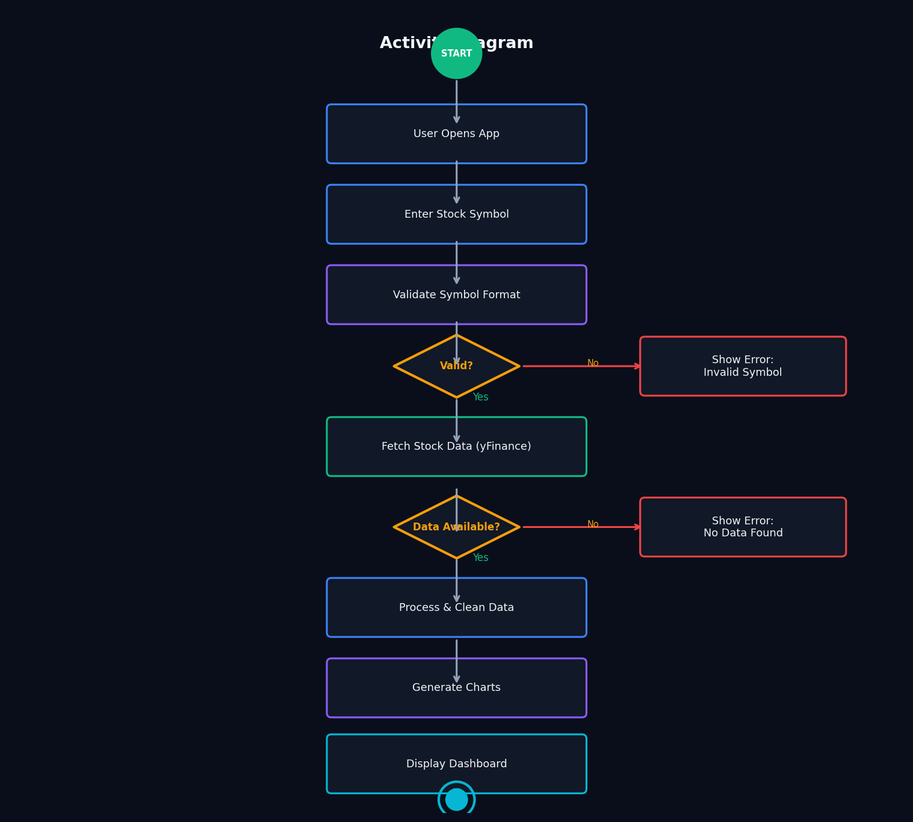
Use Case & Activity Diagrams
Use Case Diagram
Activity Diagram

Slide 9
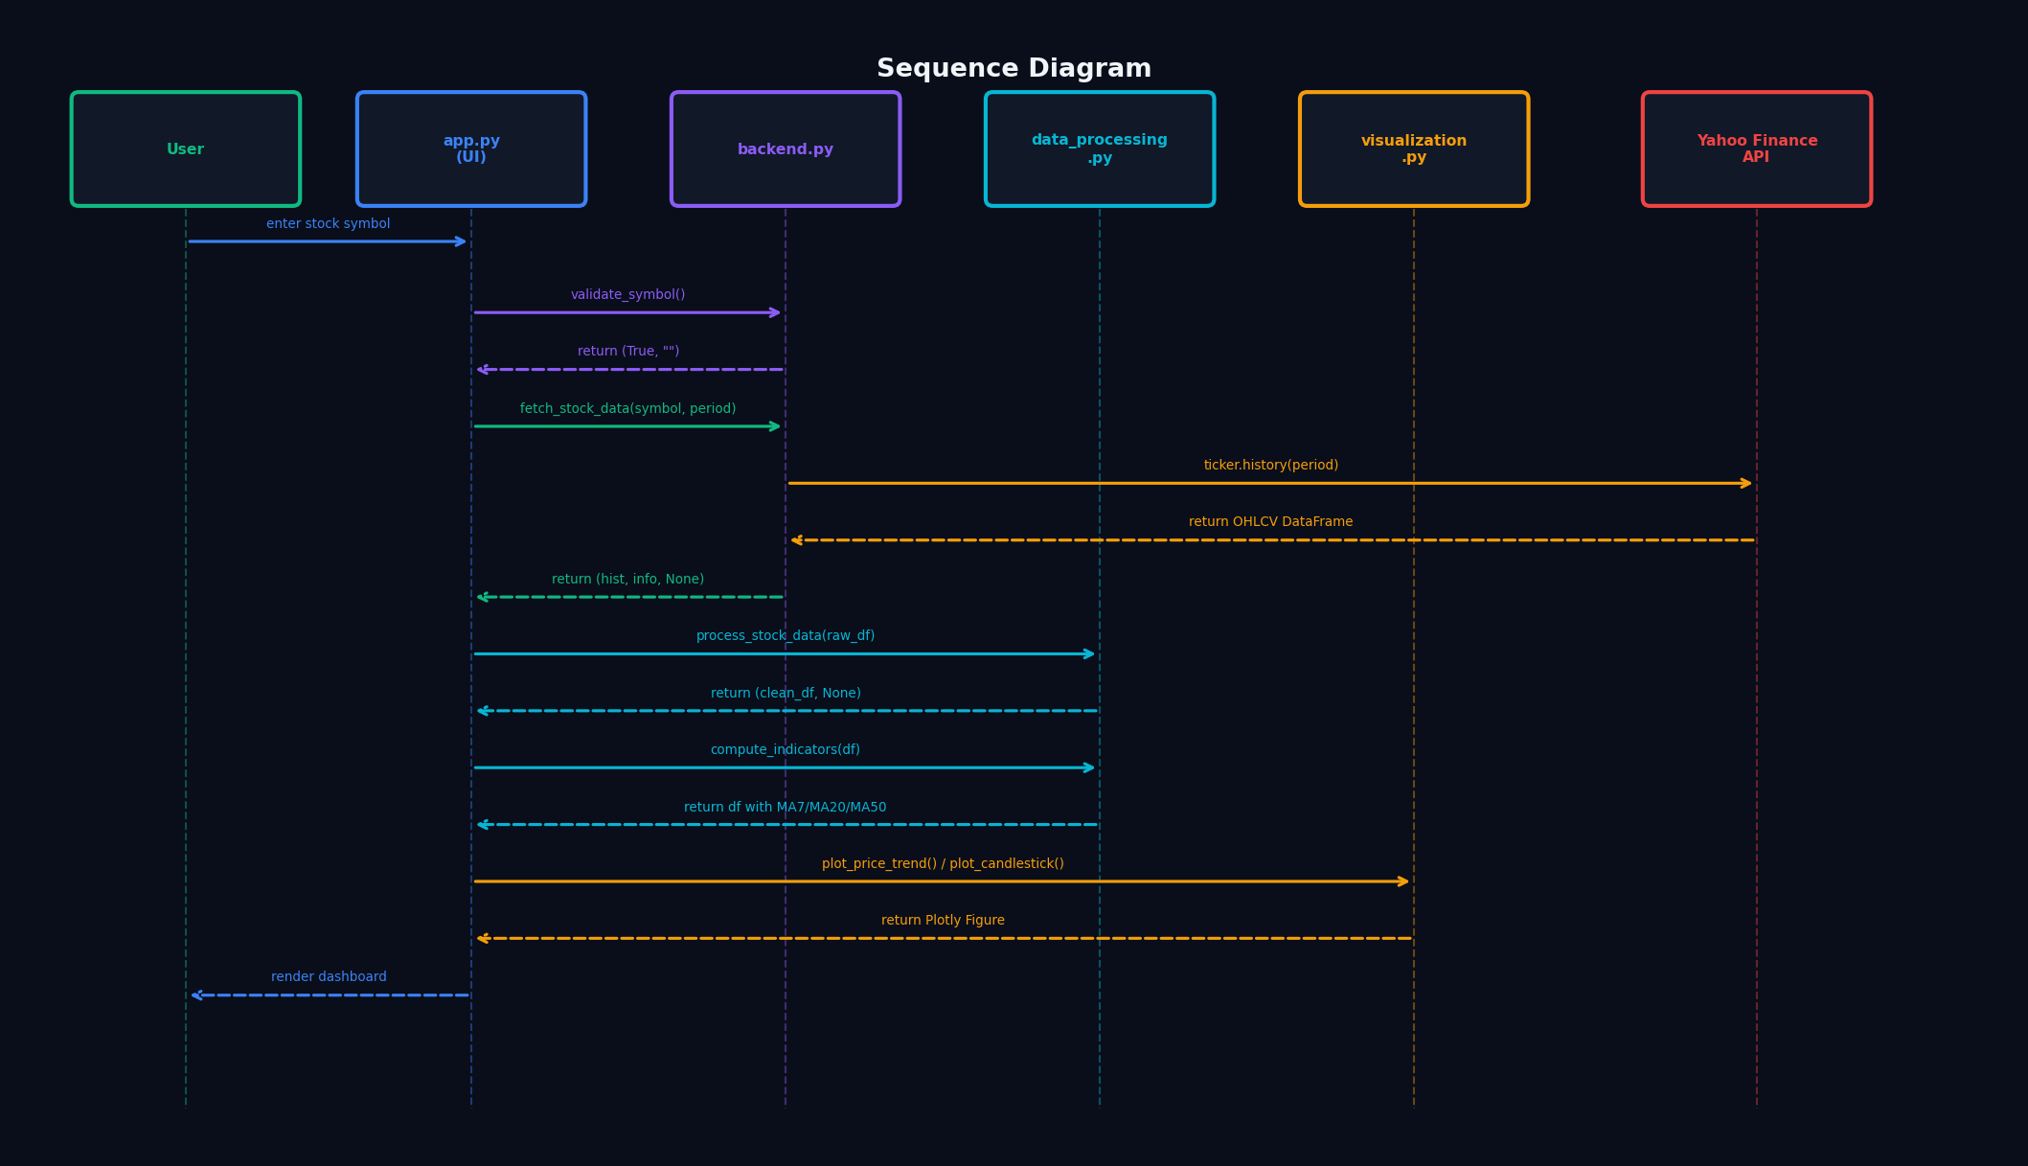
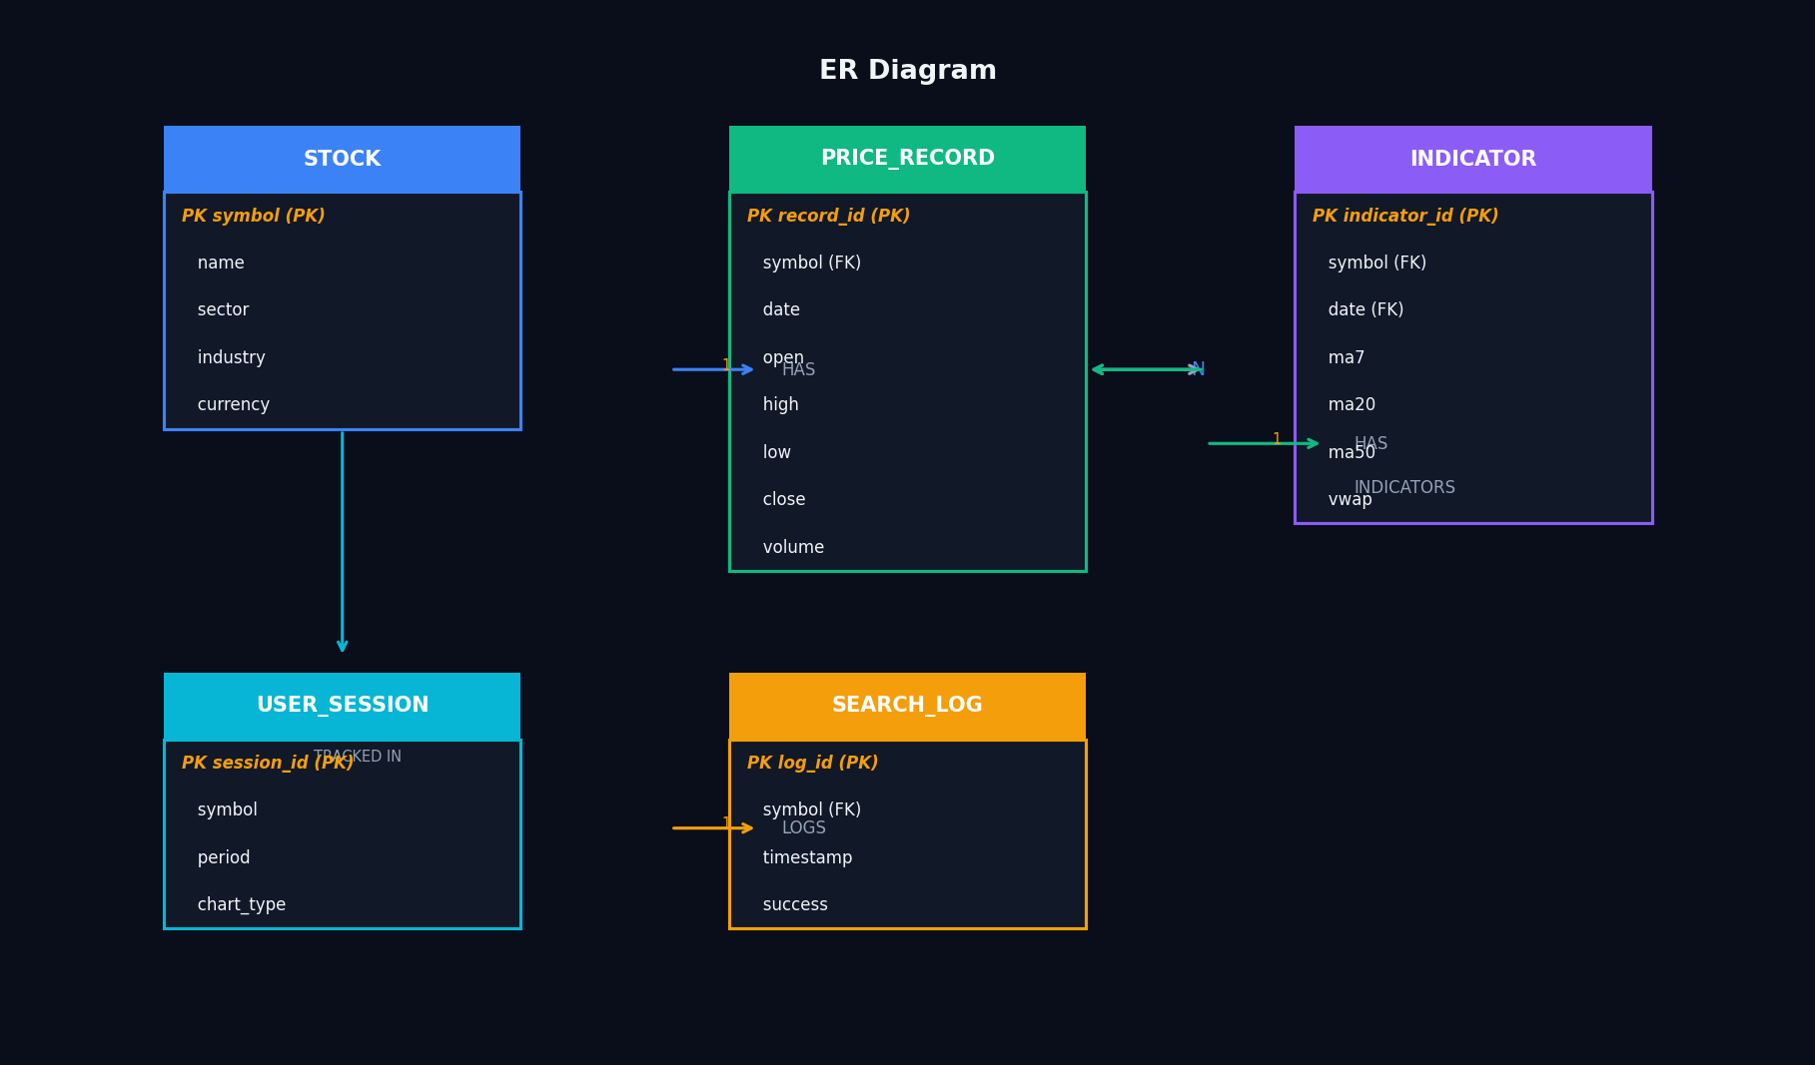
Sequence & ER Diagrams
Sequence Diagram
ER Diagram
The Sequence Diagram shows time-ordered calls between all 5 modules. The ER Diagram models 5 logical entities: STOCK, PRICE_RECORD, INDICATOR, USER_SESSION, and SEARCH_LOG.

Slide 10
Key Features
📡
Real-Time Data
📊
Interactive Charts
Fetches live and historical OHLCV data from Yahoo Finance for any valid ticker.
Line chart with gradient fill or full Candlestick (OHLC) via Plotly.
📉
Moving Averages
🔊
Volume Analysis
MA7, MA20, MA50 overlaid on price chart. VWAP computed per session.
Green/red bar chart shows trading volume direction per session.
⚡
Quick Search
🛡️
Error Handling
8 popular ticker shortcuts (AAPL, TSLA, NVDA…) for instant access.
Regex validation + API error catching with descriptive user messages.

Slide 11
Testing Results
14
14
0
100%
Total Test Cases
Tests Passed
Tests Failed
Pass Rate
Test Case | Input | Expected | Result
Valid Symbol (AAPL) | AAPL | Full dashboard renders | ✅ PASS
Invalid Format | 12345 | Format error message | ✅ PASS
Empty Input | (empty) | Required field error | ✅ PASS
Unknown Symbol | XXXXX | No data error message | ✅ PASS
Candlestick Chart | GOOGL | OHLC candles render | ✅ PASS
All Time Periods | MSFT | 7d→2y all work | ✅ PASS

Slide 12
📈
Conclusion
✅
All functional requirements met
✅
Real-time data via yFinance API
✅
Clean modular code architecture
✅
Interactive Plotly visualizations
✅
100% test pass rate (14/14 cases)
»
Foundation for RSI, MACD, ML prediction
Thank You | StockVision – Stock Market Analysis System | Dr. Khalaf

