Slide 1
Information system project for
*University housing database*

Slide 2
Overview:
-The University Accommodations (cities) one of the important care that the University provides the students .

Slide 3
- So, our project is to create a Database for such Accommodations to help university have clear data about students , employees , buildings etc.

Slide 4
-For example :
* We are going to create a Database For assuit university accommodation .
* It has 6 buildings for girls and 8 buildings for men and each building has a capacity of about 800 students in addition to the luxury building .

Slide 5
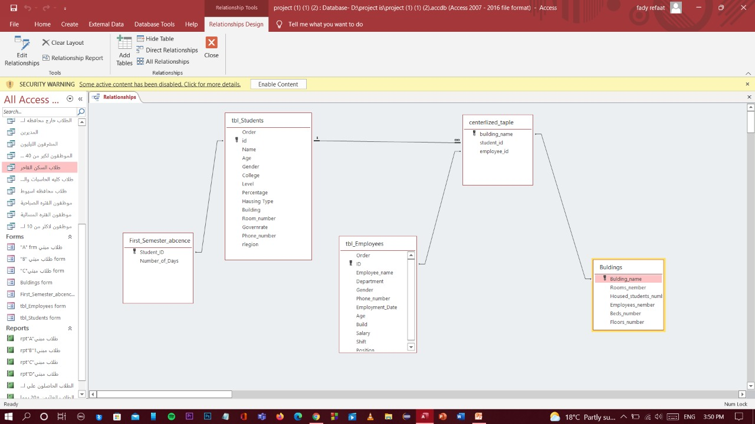
-We have the ERD for the database as shown in figure :

Slide 6
-Our Database consists of:
First , Tables :
* The students table which has a number of attributes such as : id, Name , age ,Gender , college ,level, percentage , housing type , building , room number and governorate .

Slide 7
* The Employee table which has : id , Employee name , department , gender , phone number , Employee date ,age , build ,salary , shift and position .

Slide 8
* The first semester absence table which shows the number of absence days the student has , and it has two attributes : Student id and the number of absence days .

Slide 9
* The Buildings table which has the following fields : building name , room number , housed students number , Employee number , bed number and floor number .

Slide 10
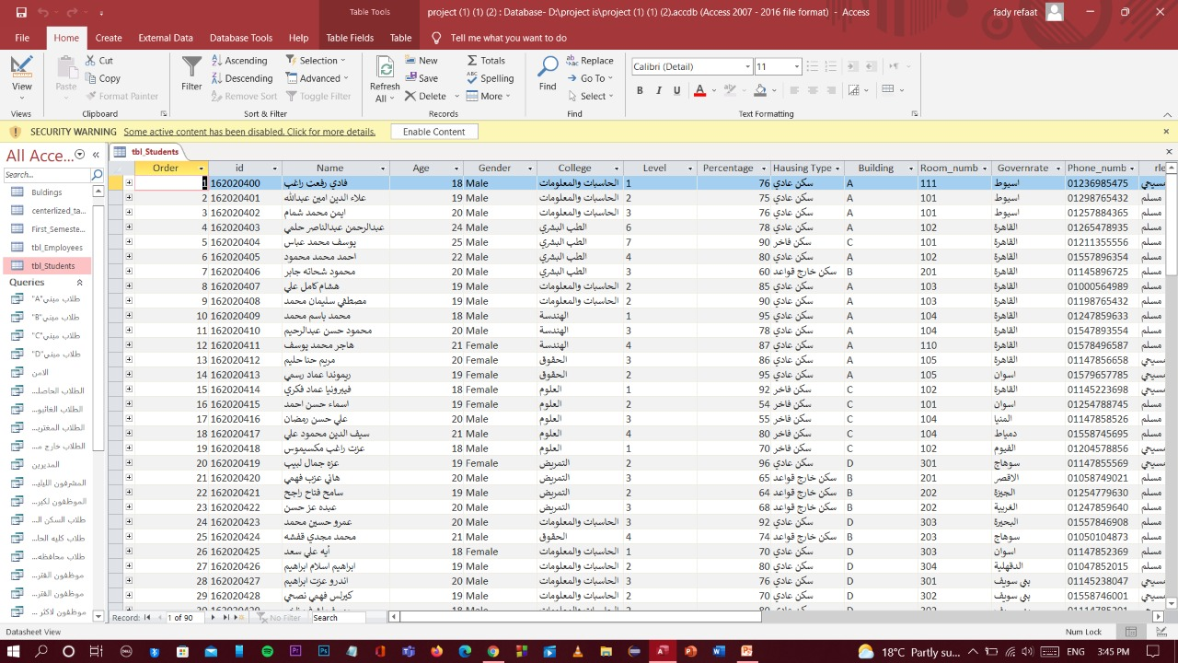
Example For tables :
Students table :

Slide 11
-Second , Queries :
-in this query , We took in consideration the update , delete and criteria (text , date\time and numbers) .

Slide 12
For example :-
* we have a Query which shows us the students with excellent grade and students from another countries in addition to students in the luxury housing .

Slide 13
* a Query shows the employees above 40 years old , employees of the morning and evening period and employees of more than 10 years etc. .

Slide 14
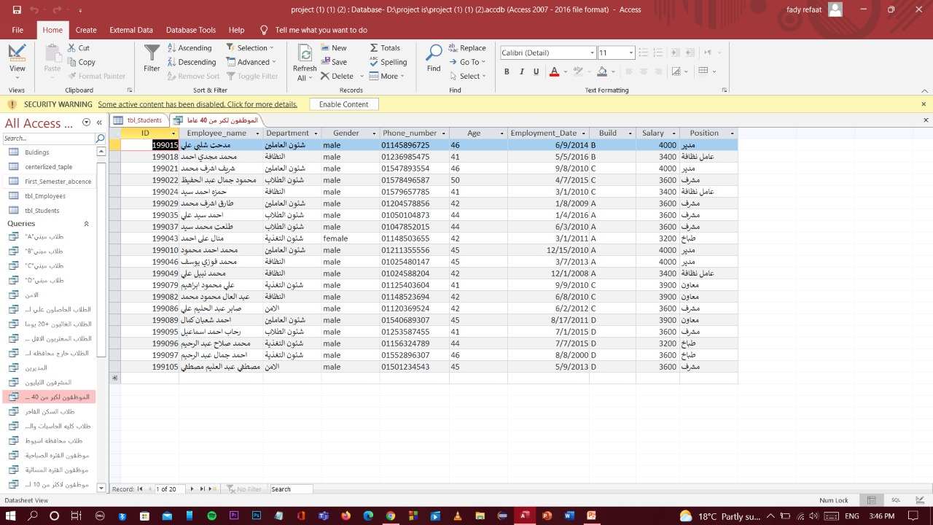
-Query for employees of above 40 years old :

Slide 15
-Third , Reports :
* We have reports such as : reports for students of building “A” and building “B” and a report for students who with excellent grade and others .

Slide 16
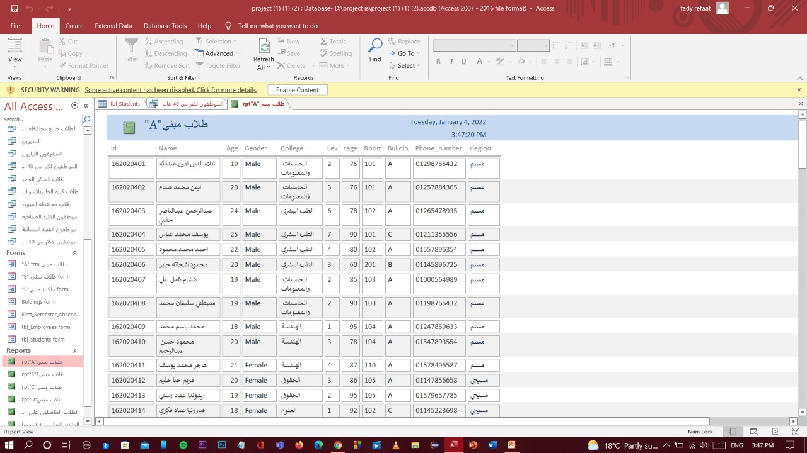
-Report for building “A” Students :

Slide 17
-Fourth , forms :
* We have many forms like employees form , form for students , building form , building “A” , “B” and “C” students form for each building , and a form for the first semester absence and these forms facilitates showing and entering data .

Slide 18
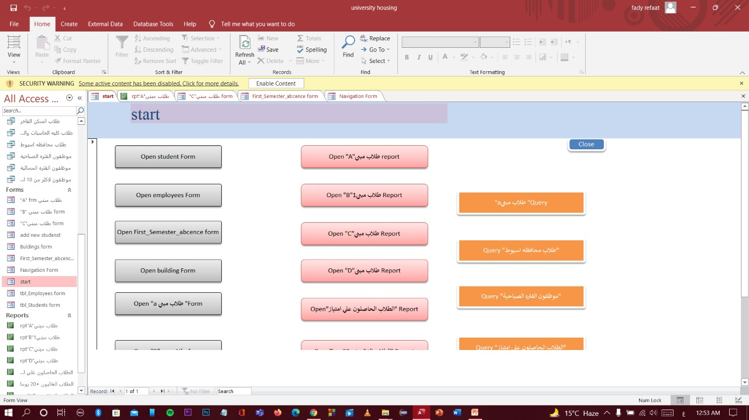
-Start Form :

Slide 19
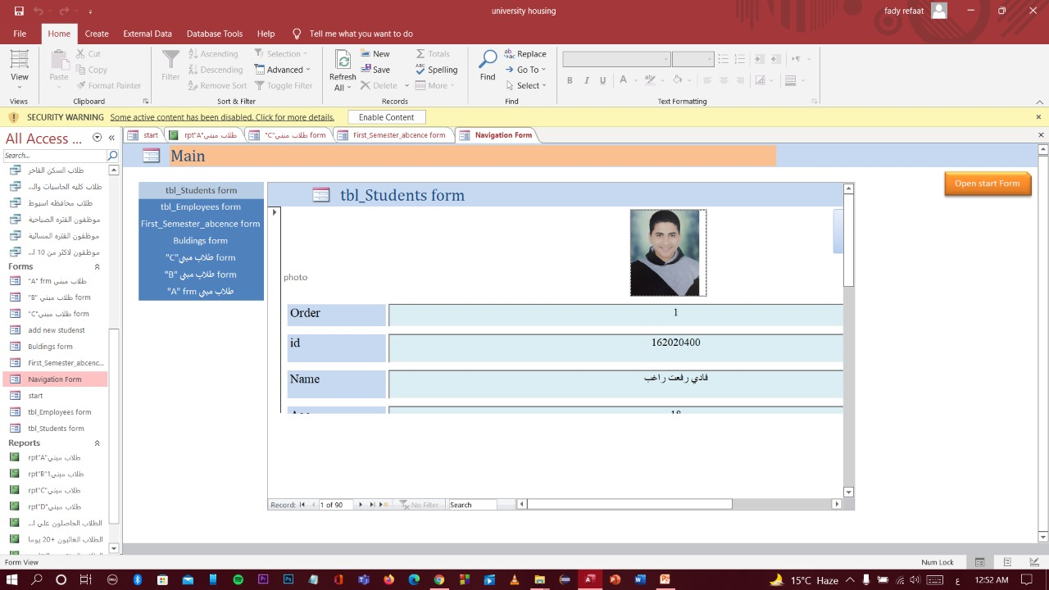
- Navigation form :

Slide 20
Github link here
https://github.com/Fady511/IS-Project

