Slide 1
Project management
Guider Application

Slide 2
Project defines
In this presentation we will define each of the following:
1- Application description
2-How we can use the application
3-Application design
4-Application advantages
5-Application disadvantages
6-Application summary

Slide 3
Application description
Our Application is designed to guide people with destinations and emergency situations as each of the following:
. Where ever the user be the second he will open Guider the app will
automatically show him the facilities and services he may need .
When someone have an accident on his way and need nearest hospital our application have a protocol with special button to call fast the ambulance and it will be the nearest to him .

Slide 4
How we can use the application
The app is easy to install as any app by installing it from App store and Google play .
At the first time the app will guide you how to use the app and it will be in menu (guide) that will show you again application use .

Slide 5
Application advantages
The Application is designed for guide person to his destination in best time and accuracy.
If person lost his destination he can use the app instead of GPS cause GPS have many errors and don’t always update the way .
Not as GPS. Accuracy in our app is more than GPS cause it always show the perfect way to our destination .
The application will have special service for urgent cases
Easy to use for all age groups .

Slide 6
Application disadvantages
It depends on internet so you cant use the application without internet
The application is simple but some people can’t use technology until now.
The project is simple but some people cant use technology until now .

Slide 7
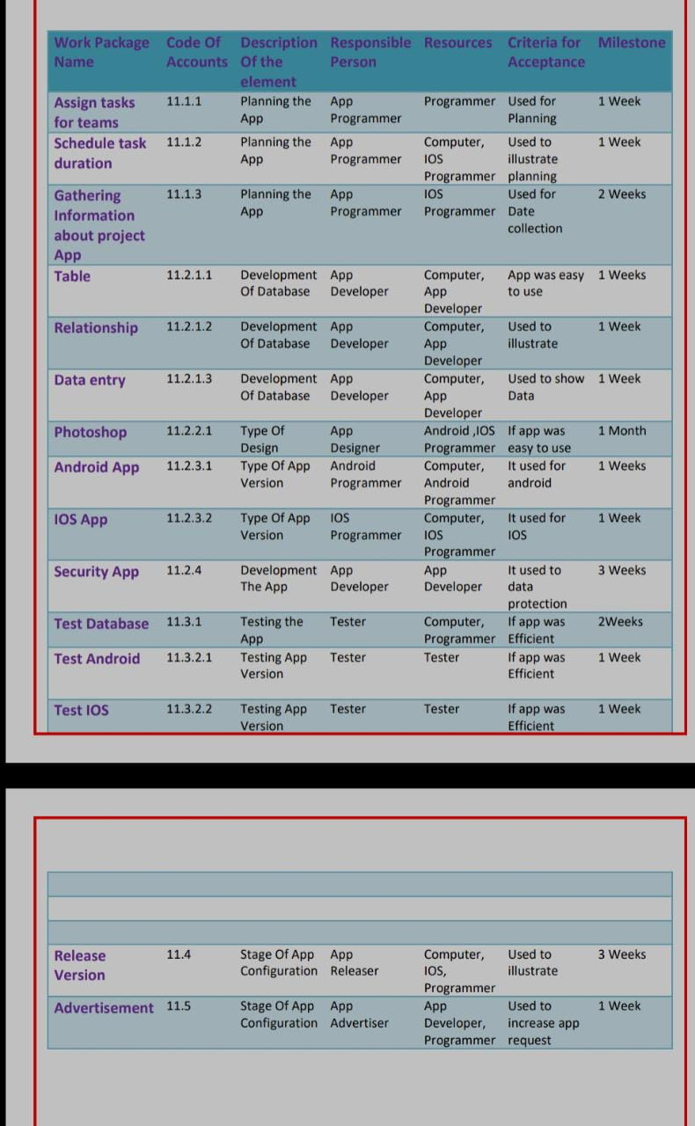
WPS dictionary

Slide 8
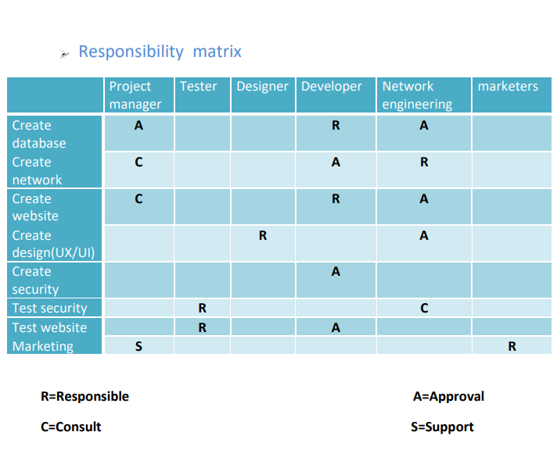
Responsibility matrix

Slide 9
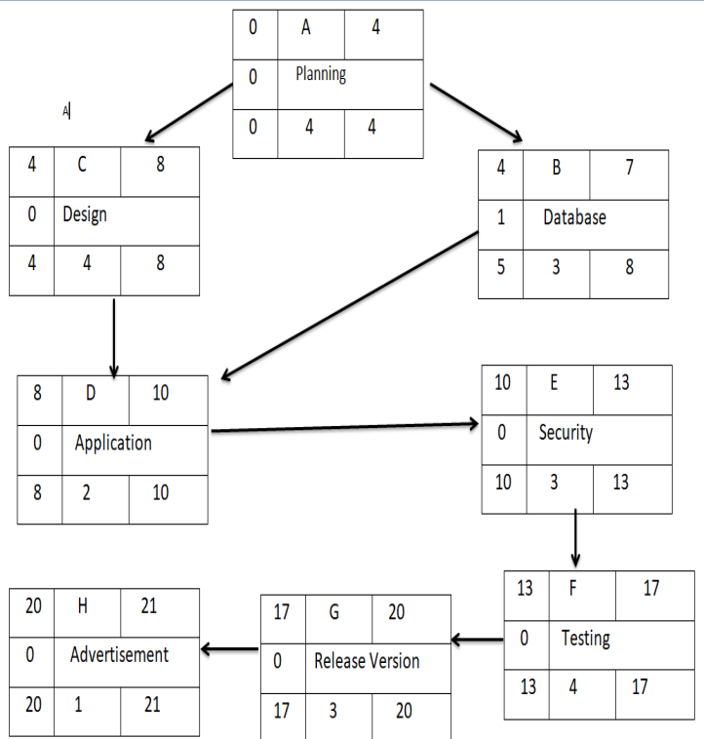
Project network

Slide 10
Our project network has many tasks like
Planing
Design
DataBase
Application
Security
Testing
Advertisement
Rehearse vision one

Slide 11
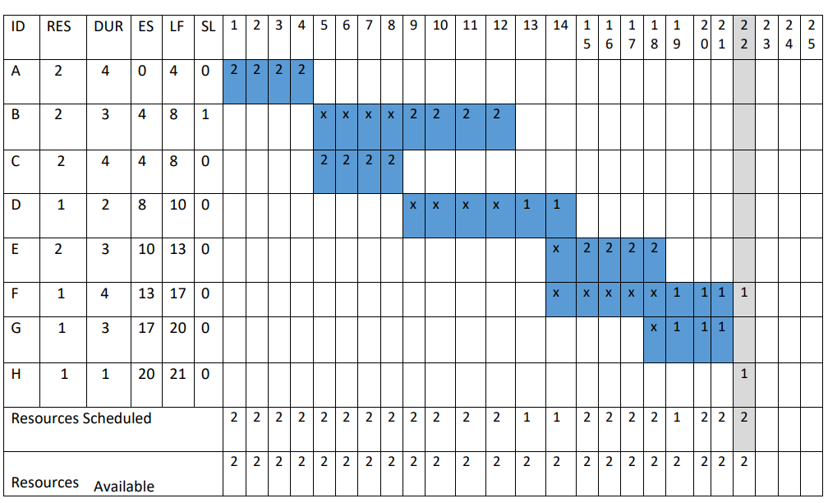
Recourses schedule

Slide 12
In these resources, a database shift occurs from the period 4 to 8 to the period 8 to 12, the shift occurs in application from the period from 8 to 10 to the period from 12 to 14, the shift occurs in security from the period 10 to 13 to the period 14 to 18, and the shifting occurs from A period from 13 to 17 to a period from 18 to 22 and this leads to a delay in the project, as it used to end after 21 weeks and now it will end after 22 weeks, i.e. a full week delay

Slide 13
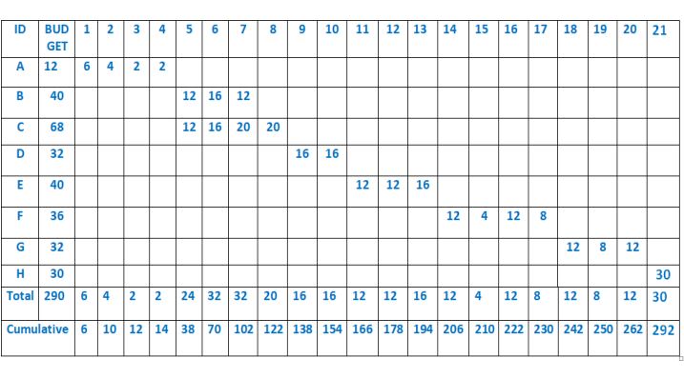
Budget schedule

Slide 14
The budget according to our plan was 250000 $
But the actual budget the project took is 292000$

Slide 15
Thank you

Slide 16
By :
Alaa-Eldeen Amin
Ghada Ragab Ali
Fady Refaat Ragheb,
Omar Ahmed Omar
Ghada Fares Abdulla
Omar Mahmoud Abd Elsalam

