Slide 1
AWS Rekognition
By Fady Adel
ALX1_AIS1_S1e
Student ID : 21051908
Instructor : Khadija

Slide 2
Amazon Rekognition Overview:
Amazon Rekognition is a powerful image and video analysis service provided by AWS. It uses deep learning algorithms to detect objects, people, text, and activities in images and videos. With features like facial recognition, object detection, and scene analysis, Rekognition helps businesses automate content moderation, secure environments, analyze visual media, and enable biometric access control. By leveraging the scalability and flexibility of AWS, it can process vast amounts of visual data efficiently and is widely used across industries like security, healthcare, retail, and more.

Slide 3
Library Imports
import boto3
import numpy as np
from PIL import Image, ImageDraw, ImageColor, ImageOps
Libraries Used:
boto3: AWS SDK for Python.
numpy: Numerical library for array and matrix manipulation.
PIL (Pillow): For image processing.
Key Functions:
Image: Open and manipulate images/ImageDraw: Draw shapes on images/ImageColor: Manage color definitions/ImageOps: Perform image operations.

Slide 4
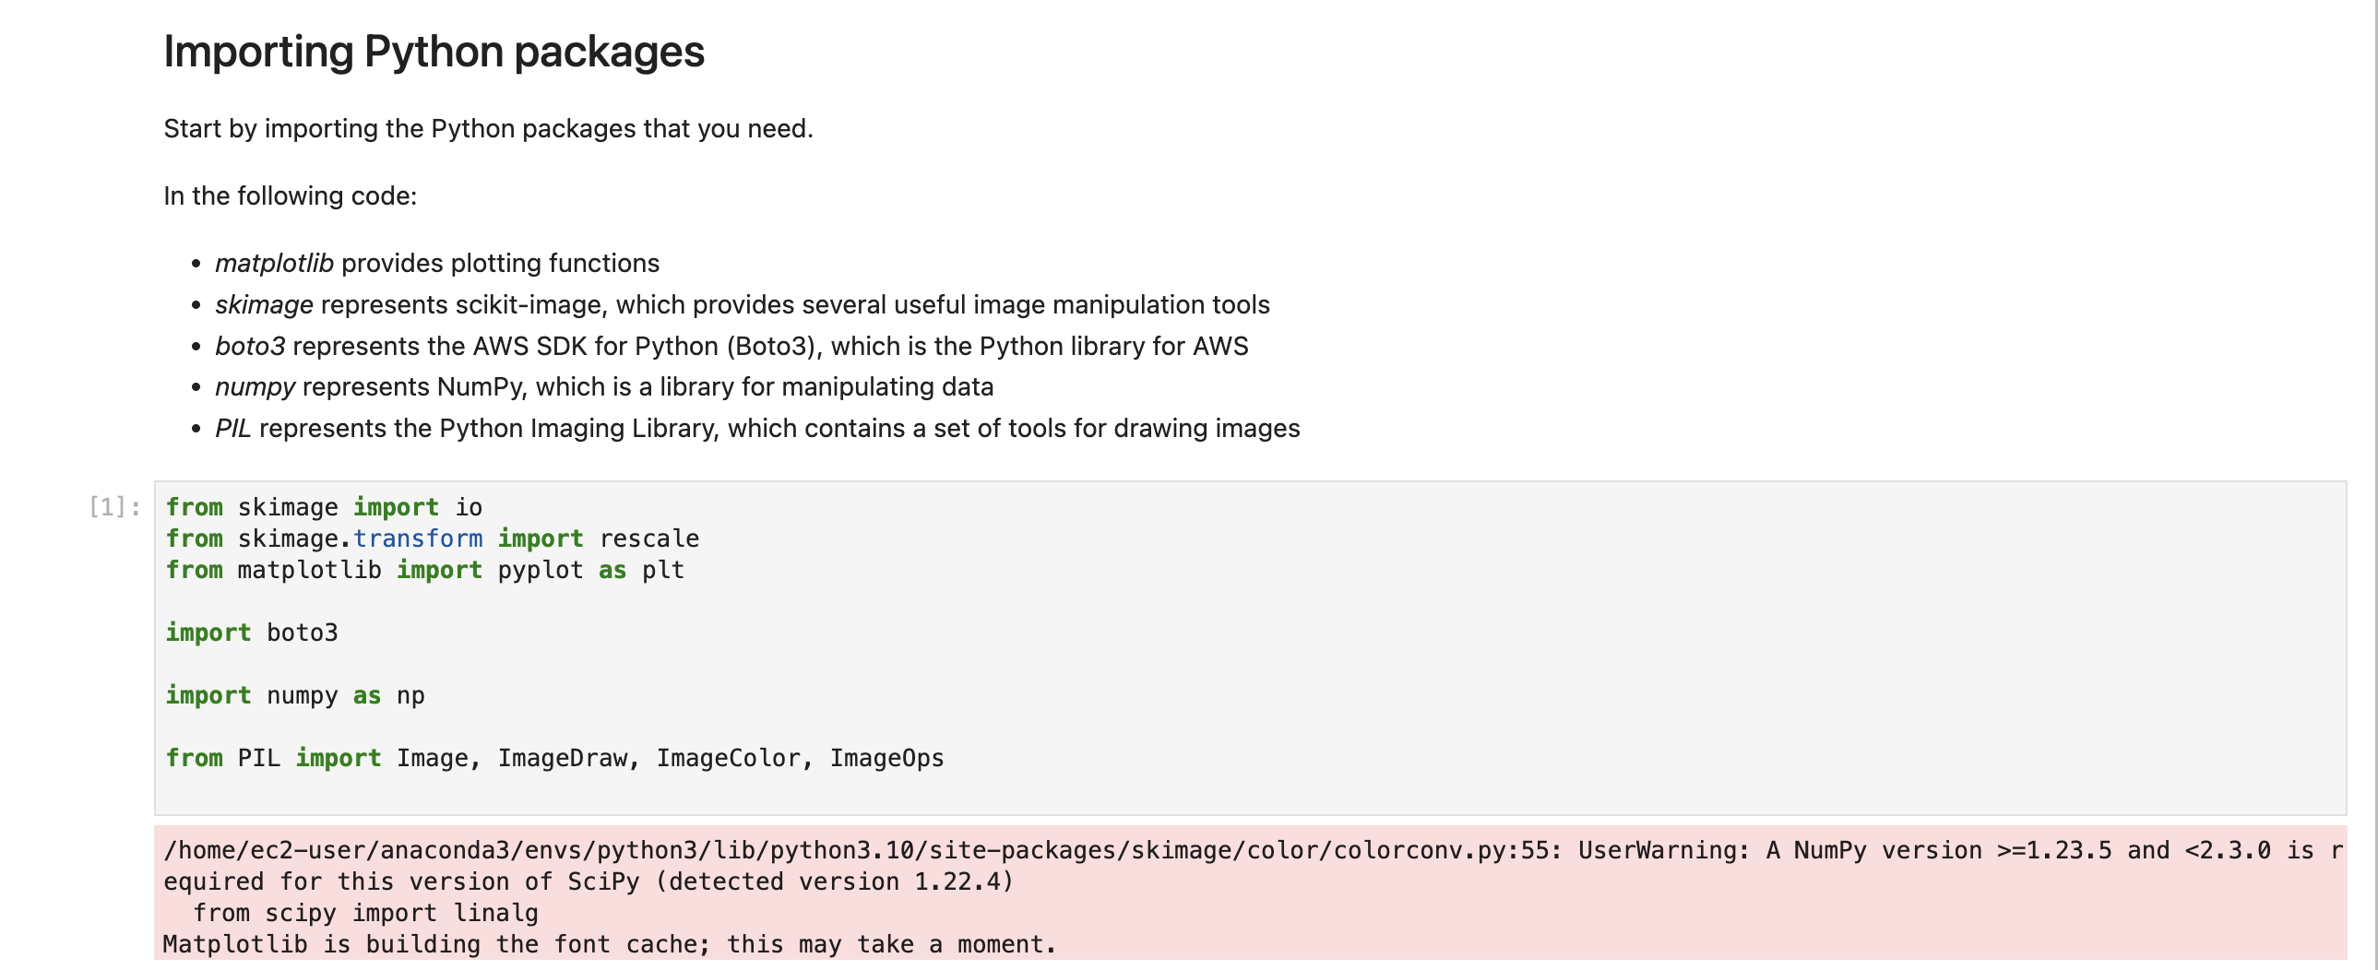

Slide 5
Setting Up the Rekognition Client
client = boto3.client('rekognition’)
collection_id = 'Collection’
Description:
Initializes a client to interact with the AWS Rekognition service.
Sets a variable collection_id to identify the face collection.

Slide 6
Creating a Face Collection
response = client.create_collection(CollectionId=collection_id)
Description:
Creates a new face collection in Rekognition to store facial data.
The response includes the collection's ARN and status code for success verification.

Slide 7
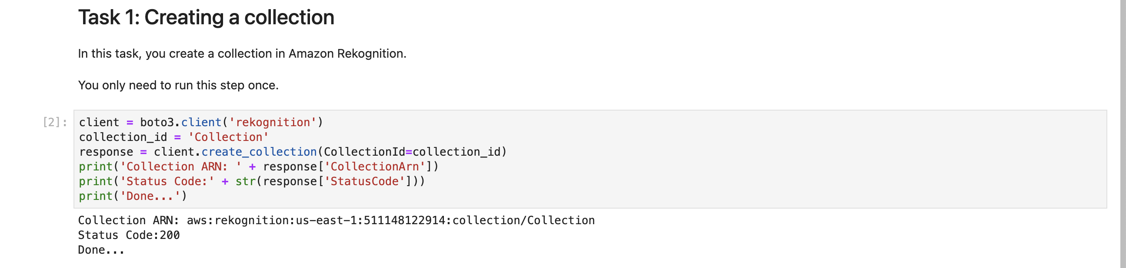

Slide 8
Uploading and Displaying an Image
filename = "mum.jpg"
faceimage = io.imread(filename)
plt.imshow(faceimage)
Description:
Loads the specified image file into a variable.
Displays the image using Matplotlib for visual confirmation before processing.

Slide 9
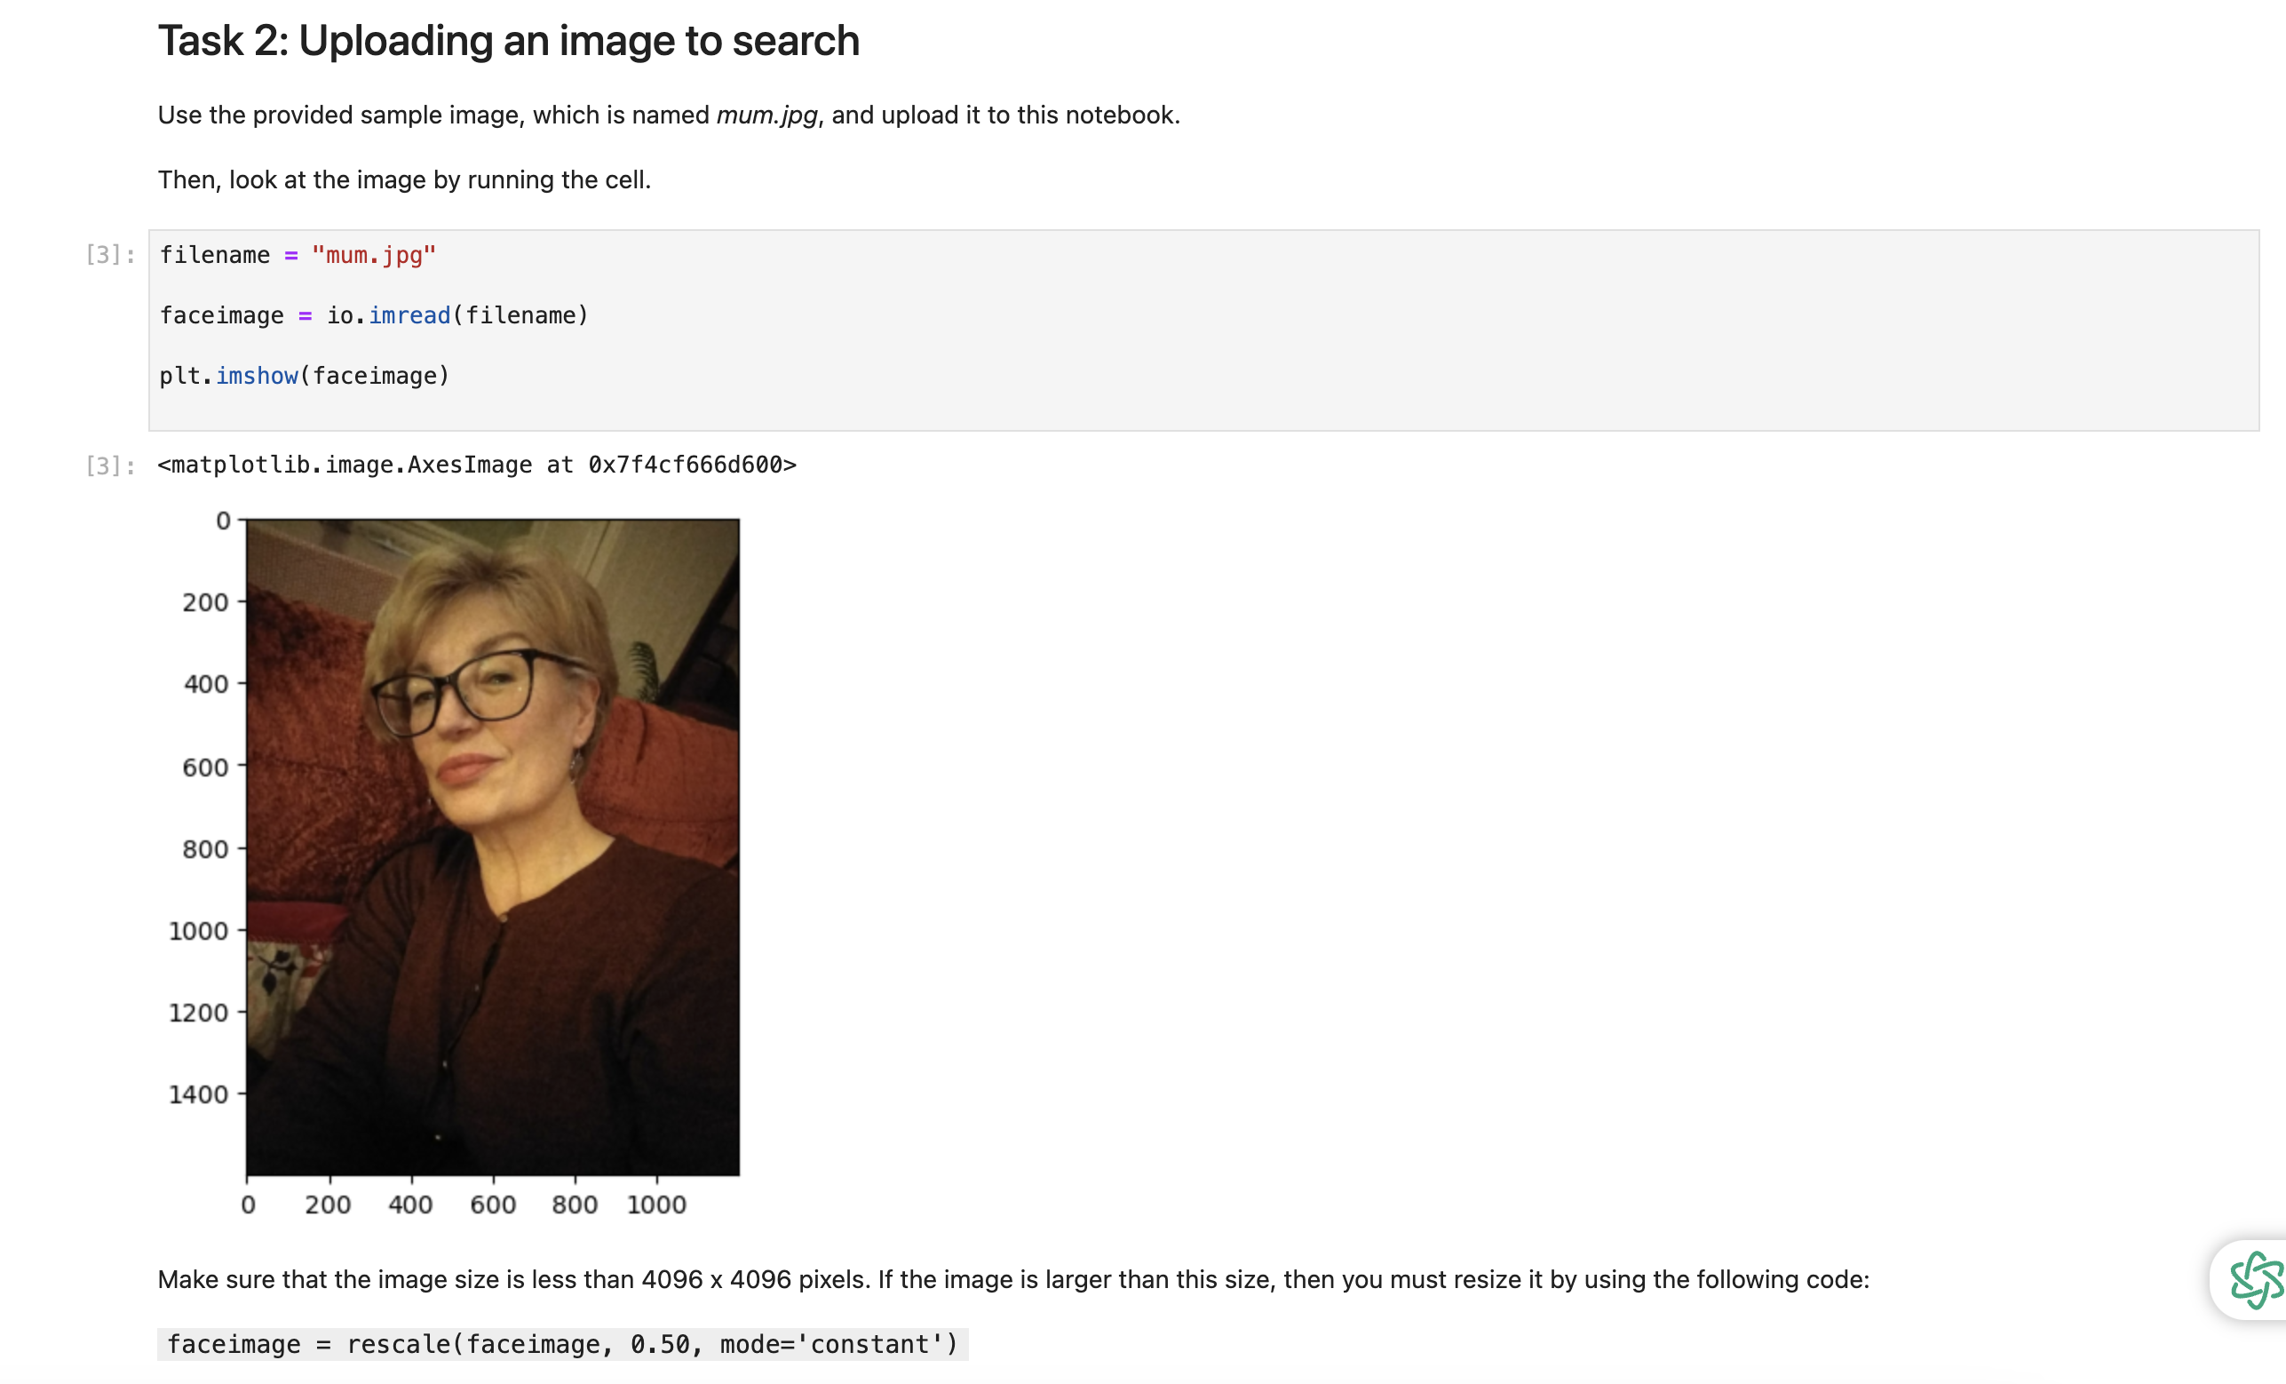

Slide 10
Indexing Faces in the Image Collection
response = client.index_faces(CollectionId=collection_id, Image={'Bytes': faceimage_bytes}, ExternalImageId="mum.jpg")
Description:
Sends the image data to Rekognition to identify and index faces.
Stores facial features in the collection for future reference.

Slide 11
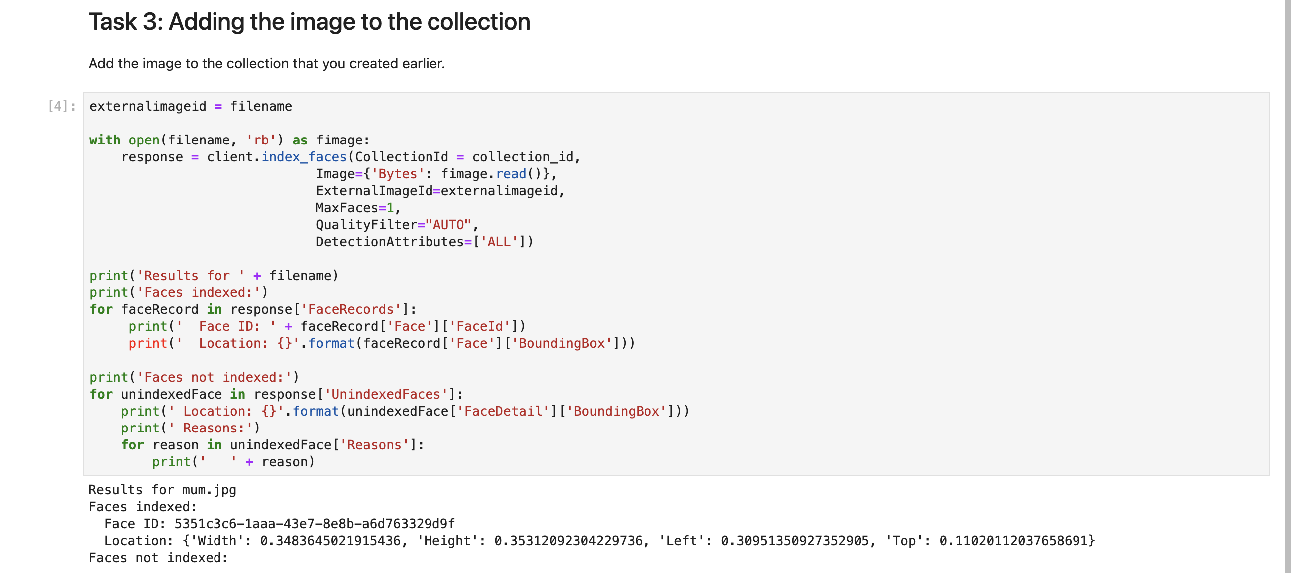

Slide 12
Listing Faces in the Collection
response = client.list_faces(CollectionId=collection_id, MaxResults=2)
Description:
Retrieves and lists up faces stored in the specified collection.
Displays unique Face IDs and confidence scores for each detected face.

Slide 13
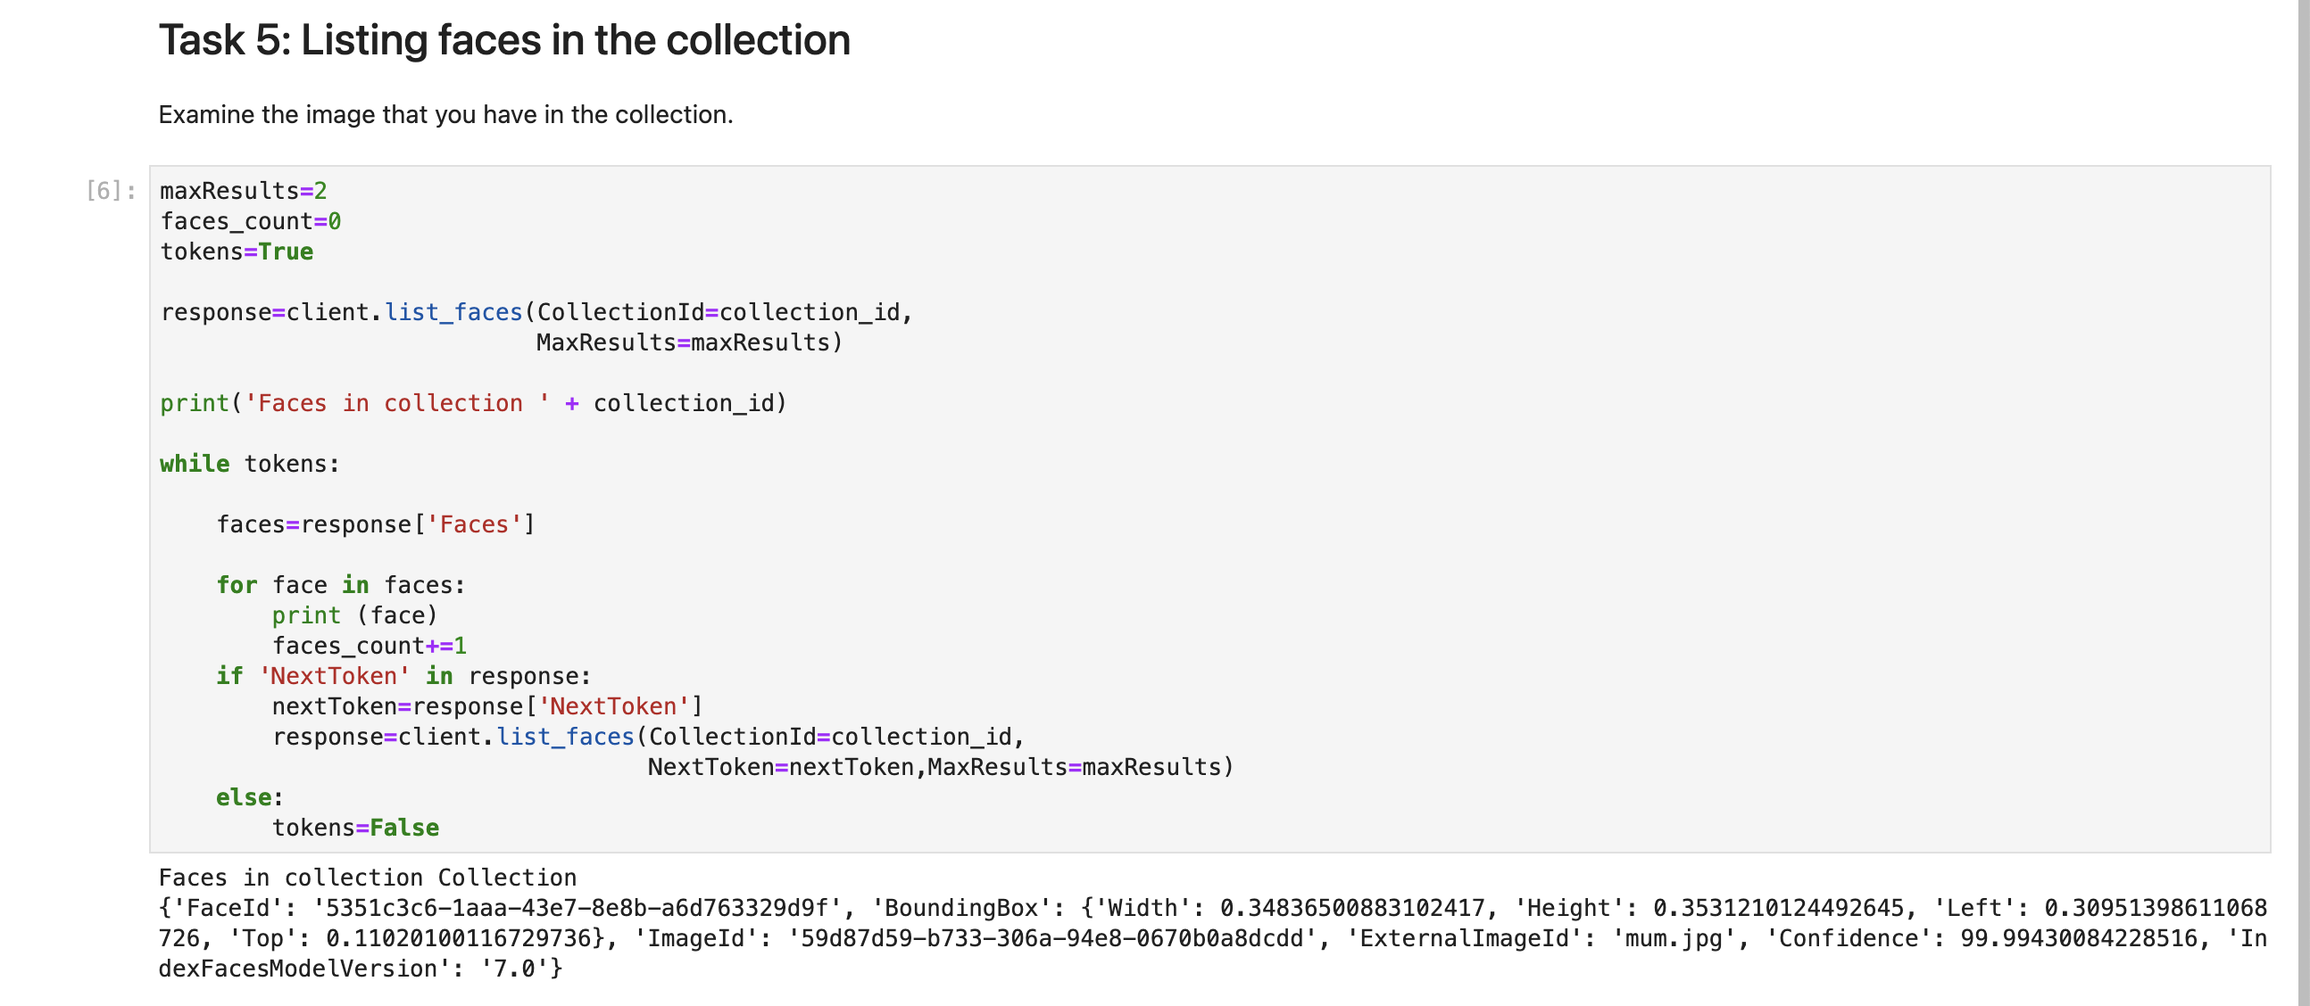

Slide 14
Searching for Matching Faces in a New Image
response = client.search_faces_by_image(CollectionId=collection_id, Image={'Bytes': target_bytes}, MaxFaces=2, FaceMatchThreshold=70)
Description:
Compares a new image against faces in the collection to find matches.
Limits results to the best match with a confidence threshold of 70%.

Slide 15
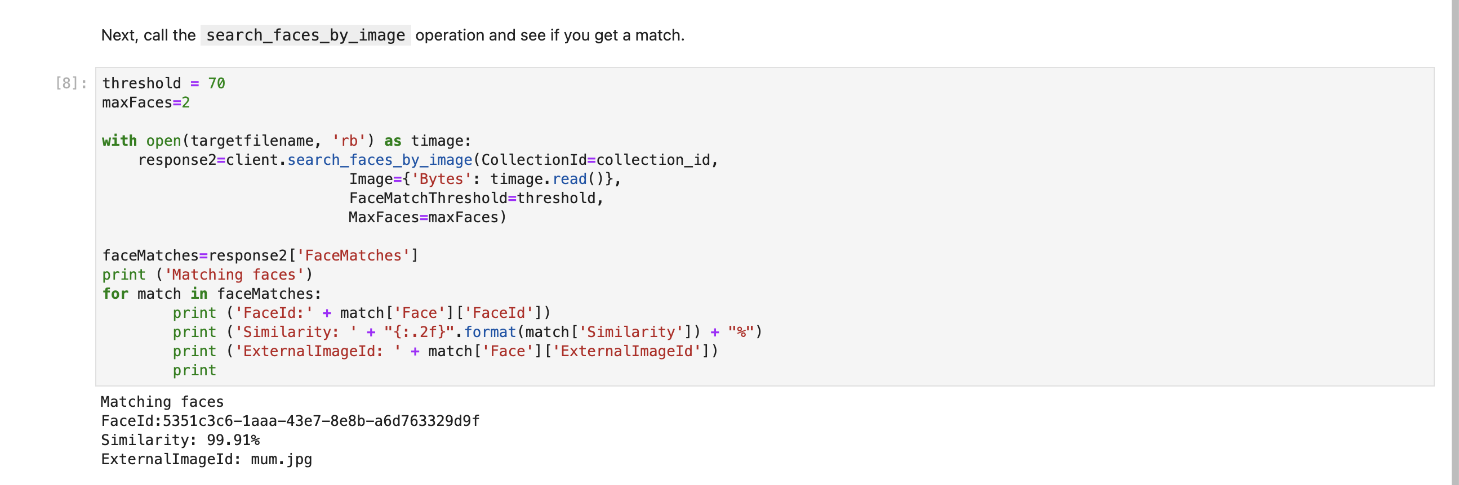

Slide 16
Bounding Box Drawing on Matching Faces
for match in response['FaceMatches']:
box = match['Face']['BoundingBox']
draw.rectangle([left, top, right, bottom], outline=”green")
Description:
Iterates through matched faces and retrieves their bounding box coordinates.
Draws green rectangles around the detected faces in the image for visualization.

Slide 17
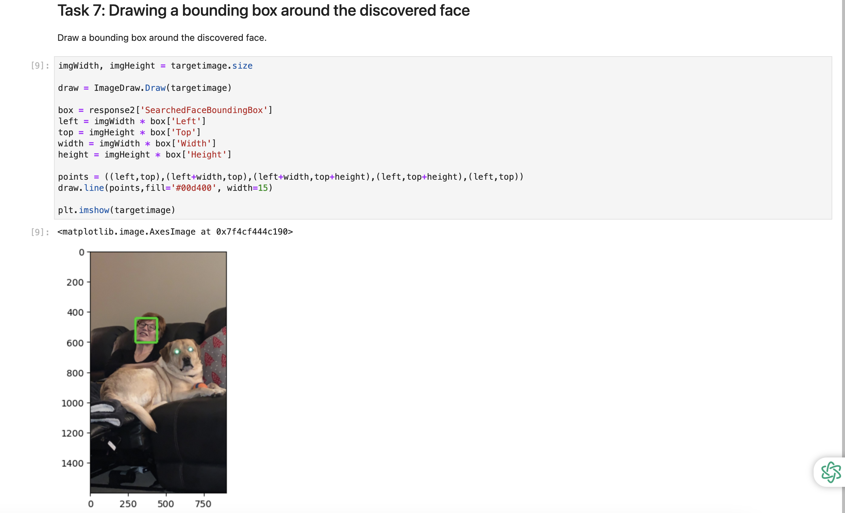

Slide 18
Deleting the Collection
response = client.delete_collection(CollectionId=collection_id)
Description:
Removes the specified face collection from Rekognition to free up resources.
The status code indicates whether the deletion was successful.

Slide 19
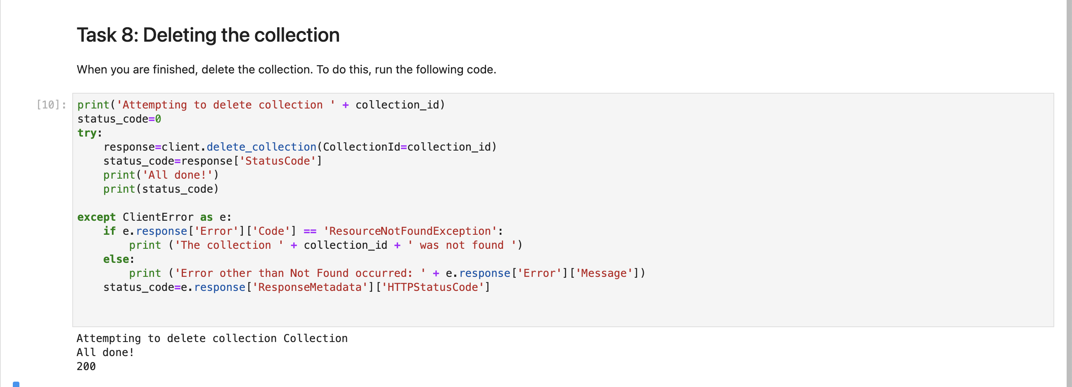

Slide 20
Final Notes
Workflow Overview:
The script covers collection creation, face indexing, searching, bounding box drawing, and deletion.
Applications:
Applicable in security systems, photo management, and any face recognition tasks.

Slide 21
Applications and Implications of Facial Recognition Technology

Slide 22
Security and Surveillance
Access Control:
Utilizes facial recognition for biometric authentication, granting access to secure areas based on verified identities.
Crime Prevention:
Scans CCTV footage in real-time to identify individuals of interest, enhancing security in public spaces.
Fraud Detection:
Authenticates users in financial transactions to prevent identity theft and fraud.

Slide 23
Identity Verification
Online Platforms:
Integrates facial recognition for user verification during account setup and high-risk transactions, adding security.
E-Passports:
Streamlines immigration checks at airports by matching traveler faces against passport photos for automated control.

Slide 24
Law Enforcement
Criminal Investigation:
Aids in tracking and identifying individuals by searching large databases and analyzing CCTV footage.
Search for Missing Persons:
Compares recent footage with existing databases to locate missing individuals effectively.

Slide 25
Retail and Marketing
Customer Experience:
Personalizes shopping by recognizing customers and suggesting products based on their history.
VIP Customer Service:
Enhances experiences for returning customers in high-end venues by providing personalized greetings and services.
Targeted Advertising:
Utilizes demographic analysis to display customized advertisements through digital kiosks.

Slide 26
Healthcare
Patient Identification:
Reduces misidentification errors in hospitals, ensuring accurate patient identification during treatments.
Medical Records:
Allows biometric access to medical histories, especially in settings with limited documentation.
Monitoring and Diagnostics:
Explores facial analysis for detecting medical conditions through facial expressions.

Slide 27
Employee Time Tracking
Workplace Attendance:
Automates attendance tracking by scanning employee faces as they enter or exit the workplace.
Remote Work Verification:
Confirms the identity of remote workers accessing secure systems to ensure authorized usage.

Slide 28
Education
Classroom Attendance:
Automates attendance recording in schools, improving efficiency in tracking student presence.
Campus Security:
Enhances safety by monitoring who enters campuses and identifying unauthorized individuals.

Slide 29
Event Management
Crowd Monitoring:
Monitors attendees at large events to prevent unauthorized access and ensure safety.
Ticketless Entry:
Utilizes facial recognition as a “ticket” for seamless entry, eliminating physical or digital tickets.

Slide 30
Smart Homes and IoT Devices
Home Security:
Integrates with smart home systems to recognize family and known guests for automatic entry.
Personalized Home Experiences:
Adapts recommendations based on recognized users for a tailored entertainment experience.

Slide 31
Automotive
Driver Monitoring:
Detects driver drowsiness or distraction, alerting them to enhance road safety.
Car Access:
Unlocks vehicles through facial recognition, ensuring that only authorized drivers can operate the car.

Slide 32
Entertainment and Social Media
Photo Tagging:
Automates tagging in social media, simplifying content sharing for users.
Interactive Gaming:
Personalizes gaming experiences by mirroring players’ faces in avatars.

Slide 33
Personalized Marketing and Analytics
Customer Insights:
Analyzes demographics and emotional responses to optimize marketing strategies and customer service.
Loyalty Programs:
Identifies repeat customers for personalized rewards, replacing traditional loyalty cards.

Slide 34
THANK YOU

