Slide 1


PLATFORM FOR MONITORING INFANT BEHAVIOR AND MATERNAL GUIDNEC
UNDER THE SUPERVISION OF
Dr. Shima Mahmoud
Dr. Ebtesam El-Hossiny

Slide 2






TEAMWORK
Abdelrhman Tarek
Fady Ezzat
Shahd fouad
Ghada Hamada
Nada Sobhy
Fatma Mohamed

Slide 3


AGENDA
Introduction
Problem Statement , Aim & Objectives
System Analysis
Main Use Cases
Tools & Technologies
Web , Mobile , AI , Database & Backend
Conclusion
Future Work

Slide 4


PROBLEM STATEMENT
First-time mothers face emotional, psychological, and practical challenge.
Difficulty interpreting infant behavior — especially crying.
Lack of immediate, reliable parenting guidance.
Limited access to affordable baby products.
Inadequate social and emotional support systems.
Existing solutions are fragmented and lack integration.
No single platform combines AI tools, community support and practical resources for mothers.

Slide 5
OBJECTIVES
AI-based baby cry analyzer.
Marketplace for second-hand baby items.
Real-time community chat.
Daily tips and structured parenting articles.
Secure login with token-based authentication and email verification for password recovery.
Web/mobile deployment using React and Flutter.
Backend with ASP.NET Core, SQL Server, Monster API.
OUR AIM
To support new mothers through an intelligent, secure, and integrated mobile and web application.

Slide 6

SYSTEM ANALYSIS
Main Use Cases

Slide 7
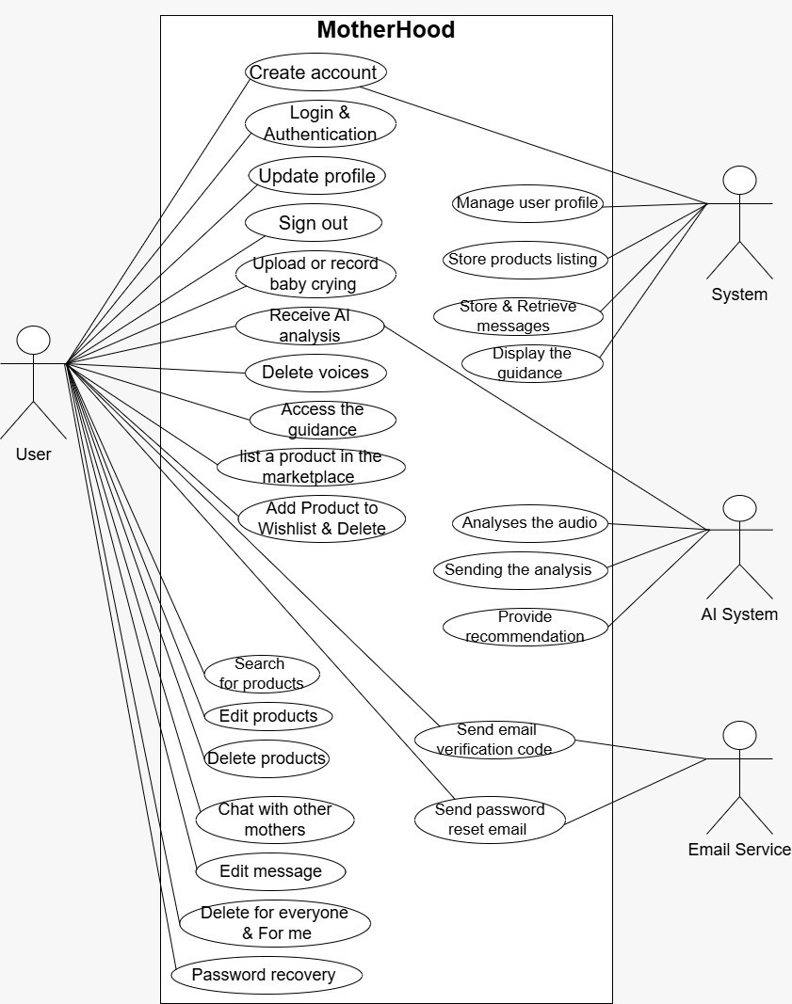

Slide 8

TOOLS & TECHNOLOGIS
Web Application
Mobile Application
Artificial Intelligence
Database
Backend

Slide 9

WEB APPLICATION

Slide 10
WEB APPLICATION
Framework
Head Tag Management
Project Setup
ReactJS
React Helmet Async
Vite
Styling
Routing
Data Fetching
Animation
Tailwind
React Router DOM
React Query
Framer Motion

Slide 11
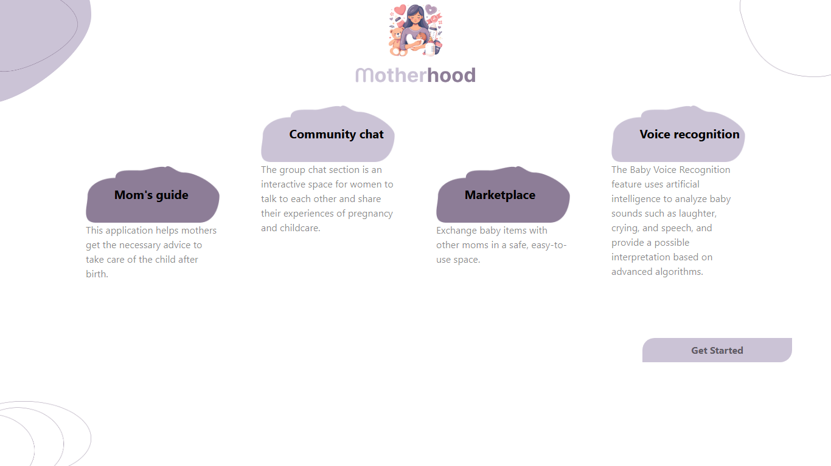

Slide 12
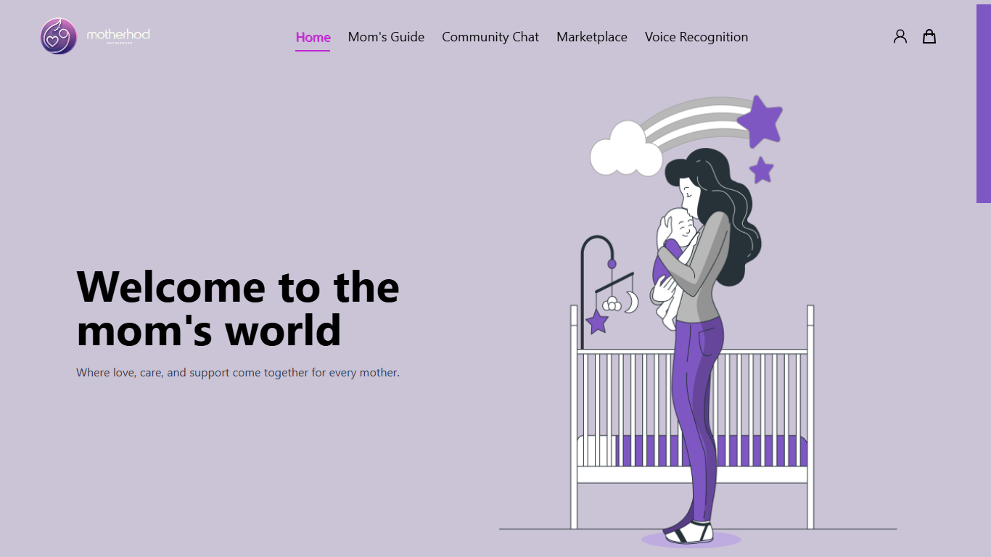

Slide 13
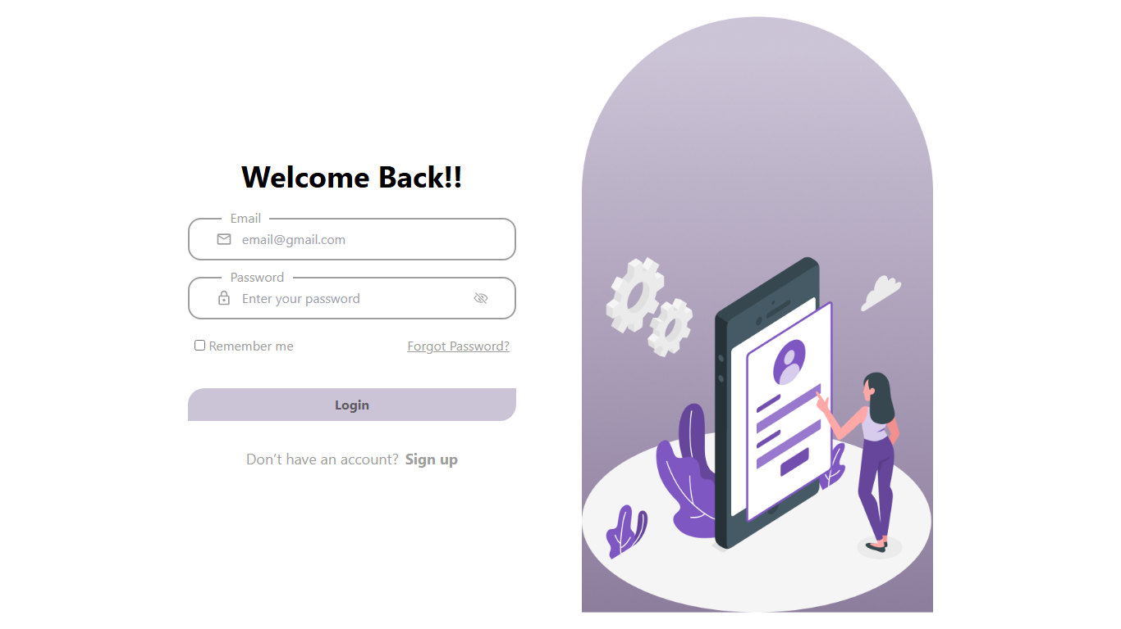

Slide 14
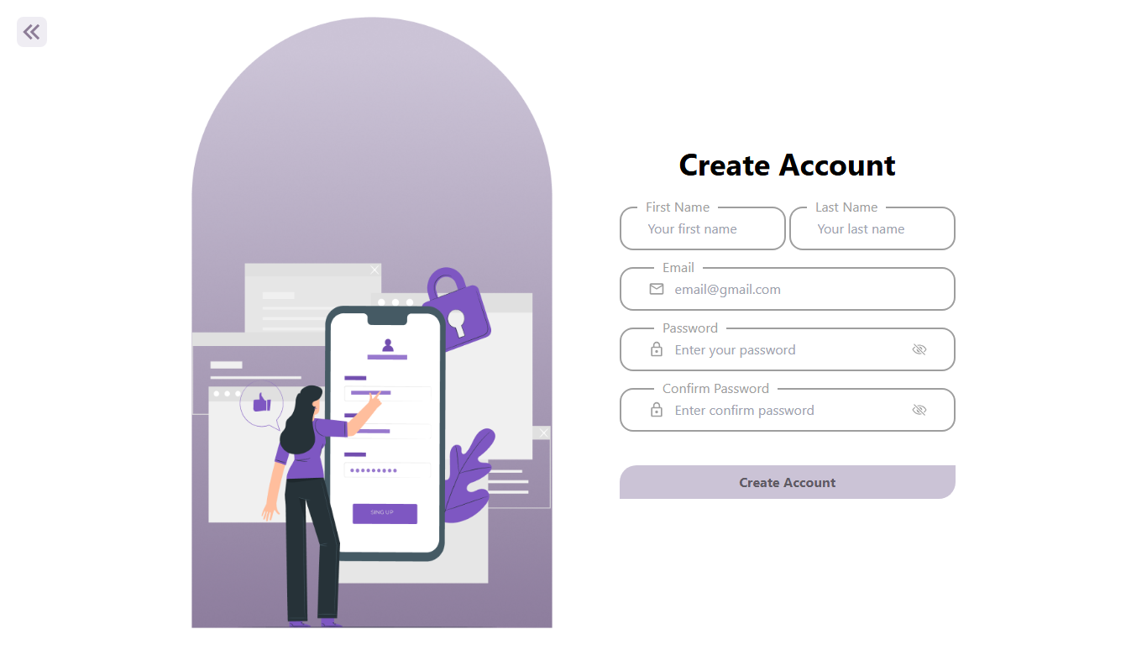

Slide 16
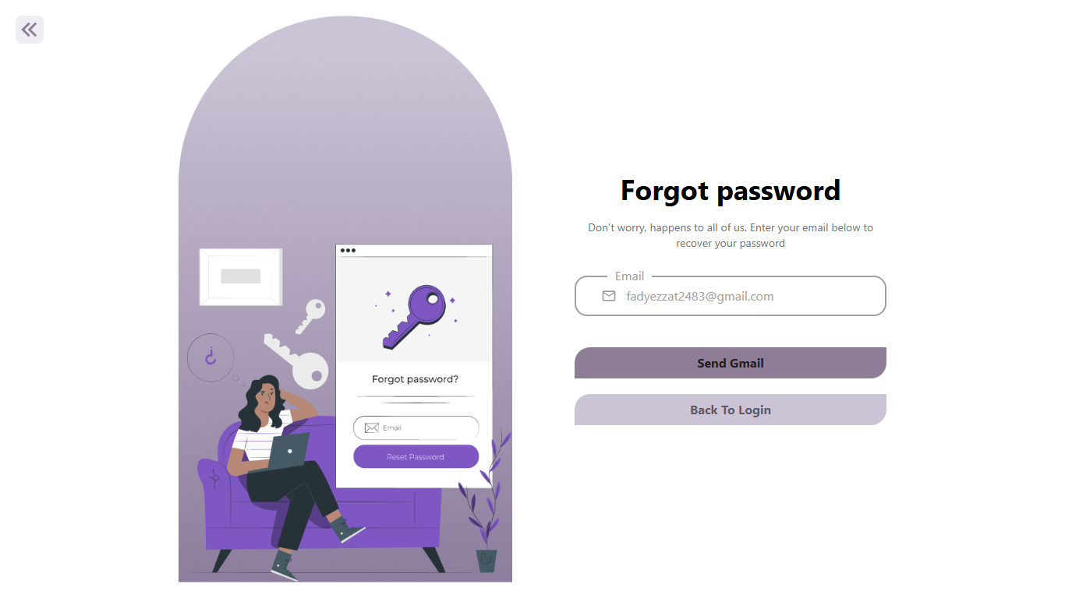

Slide 17
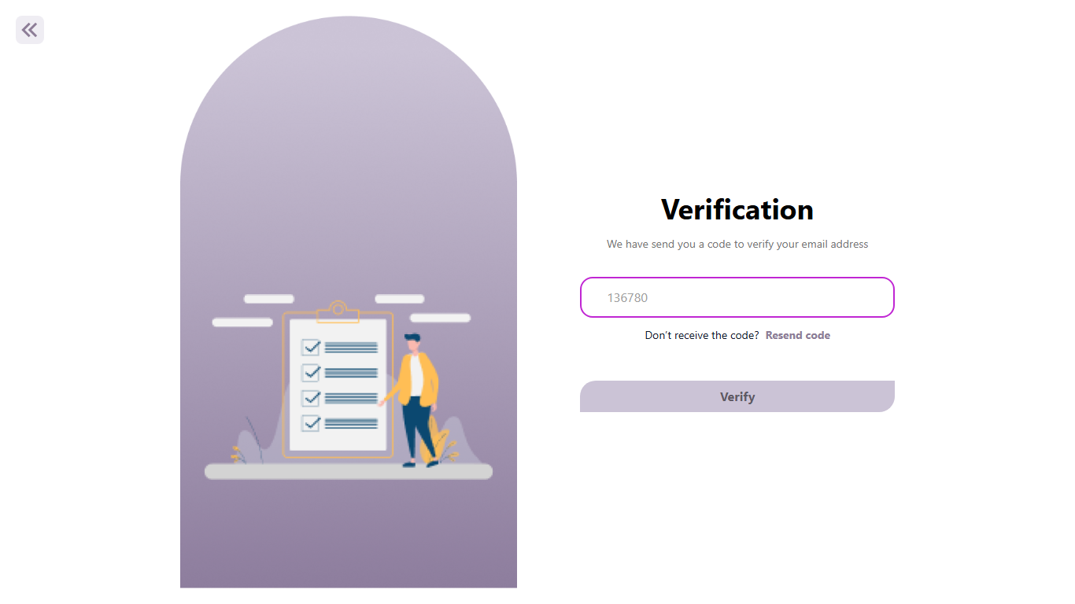

Slide 18
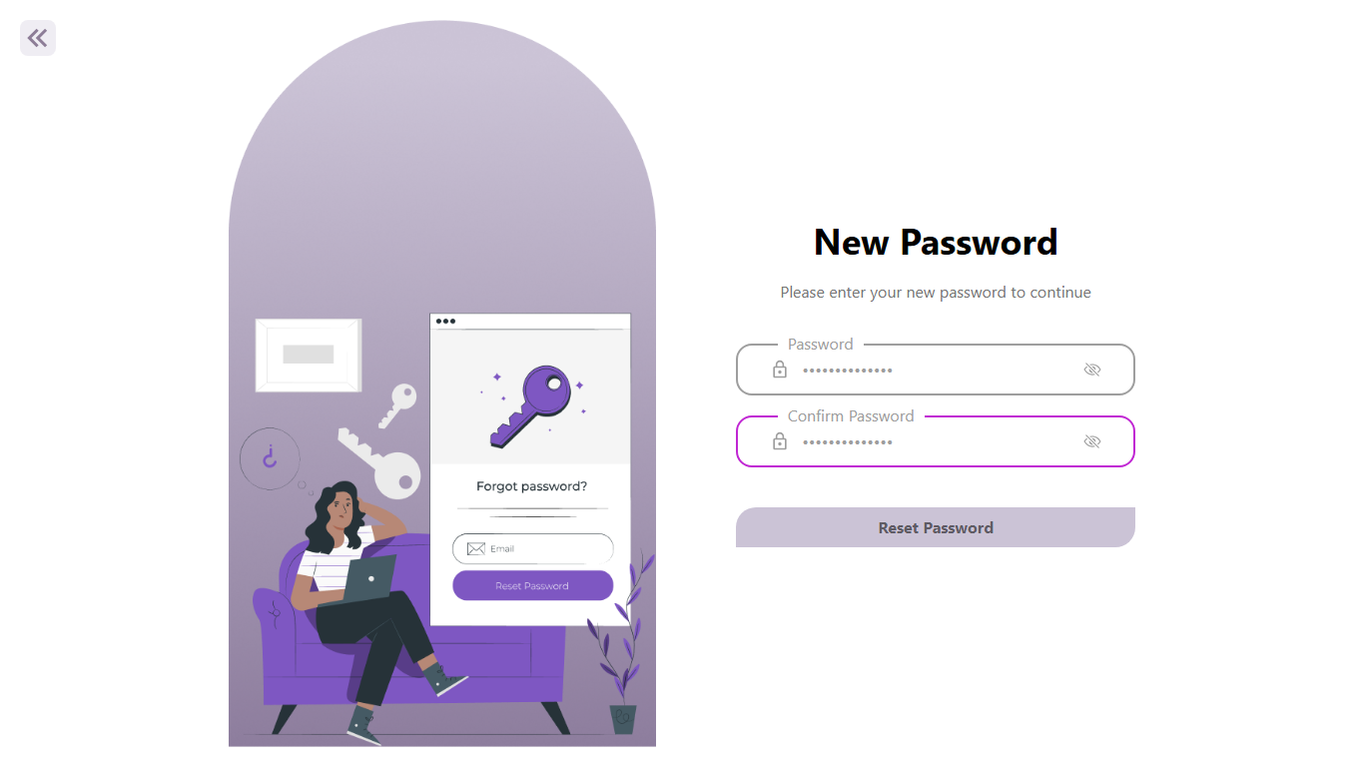

Slide 19
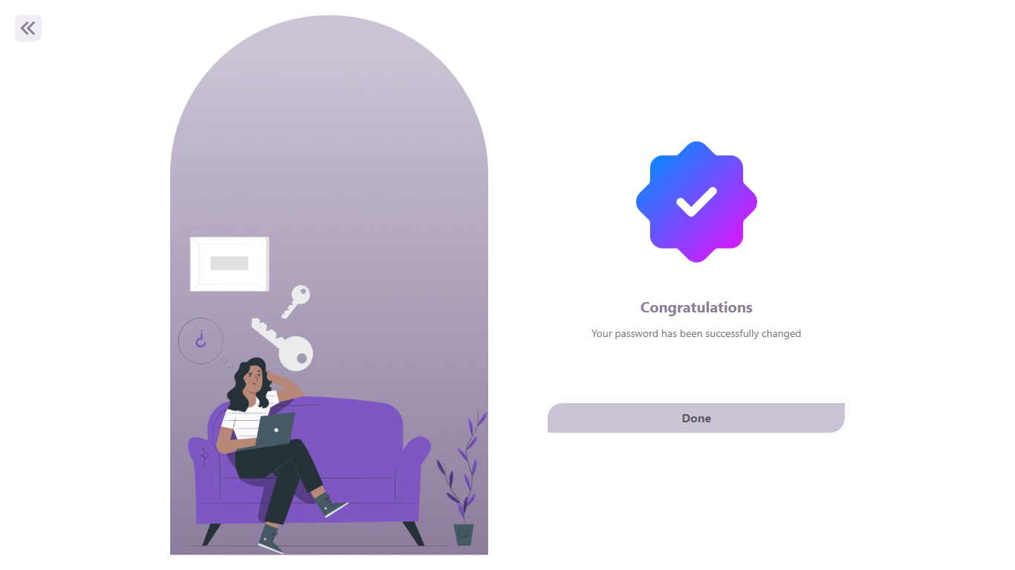

Slide 22
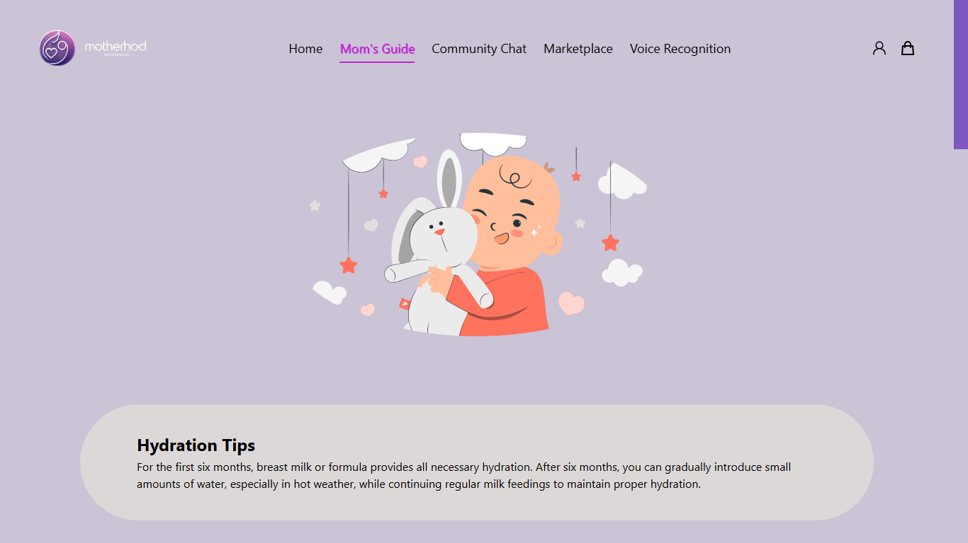

Slide 23
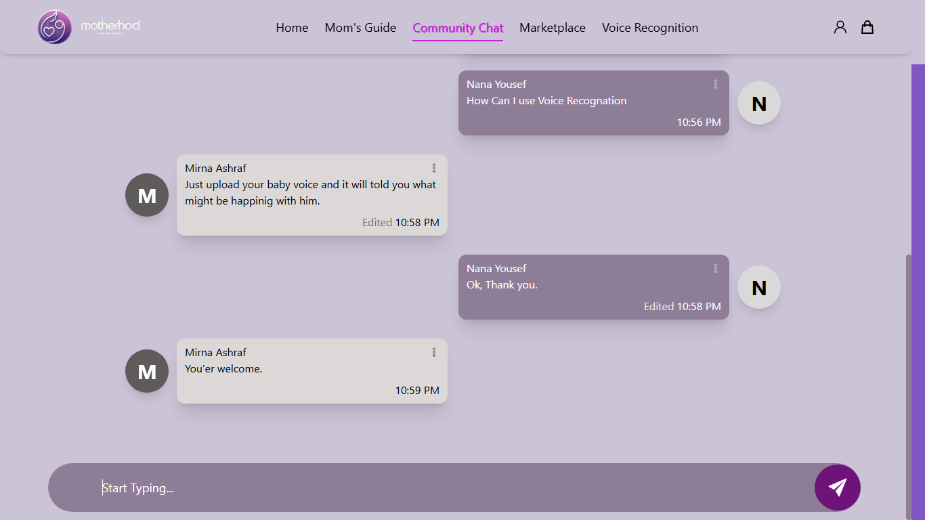

Slide 24
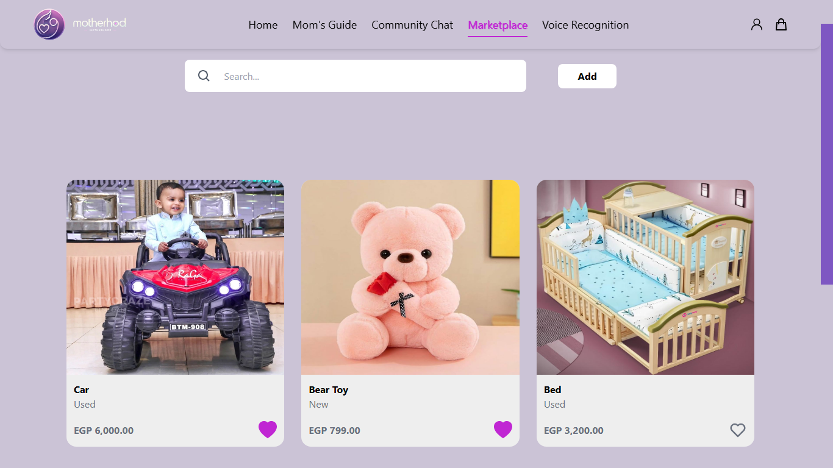

Slide 25
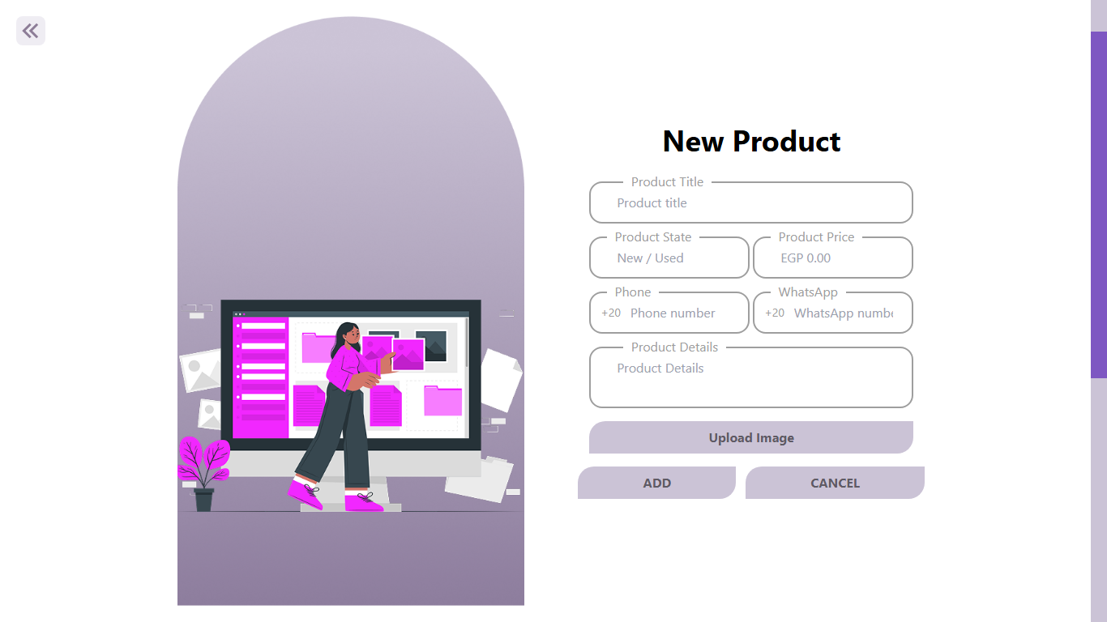

Slide 27
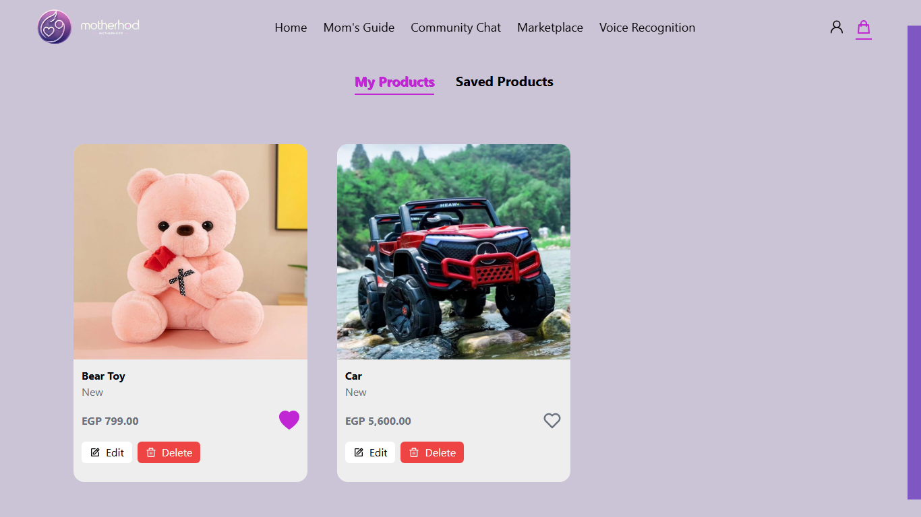

Slide 28
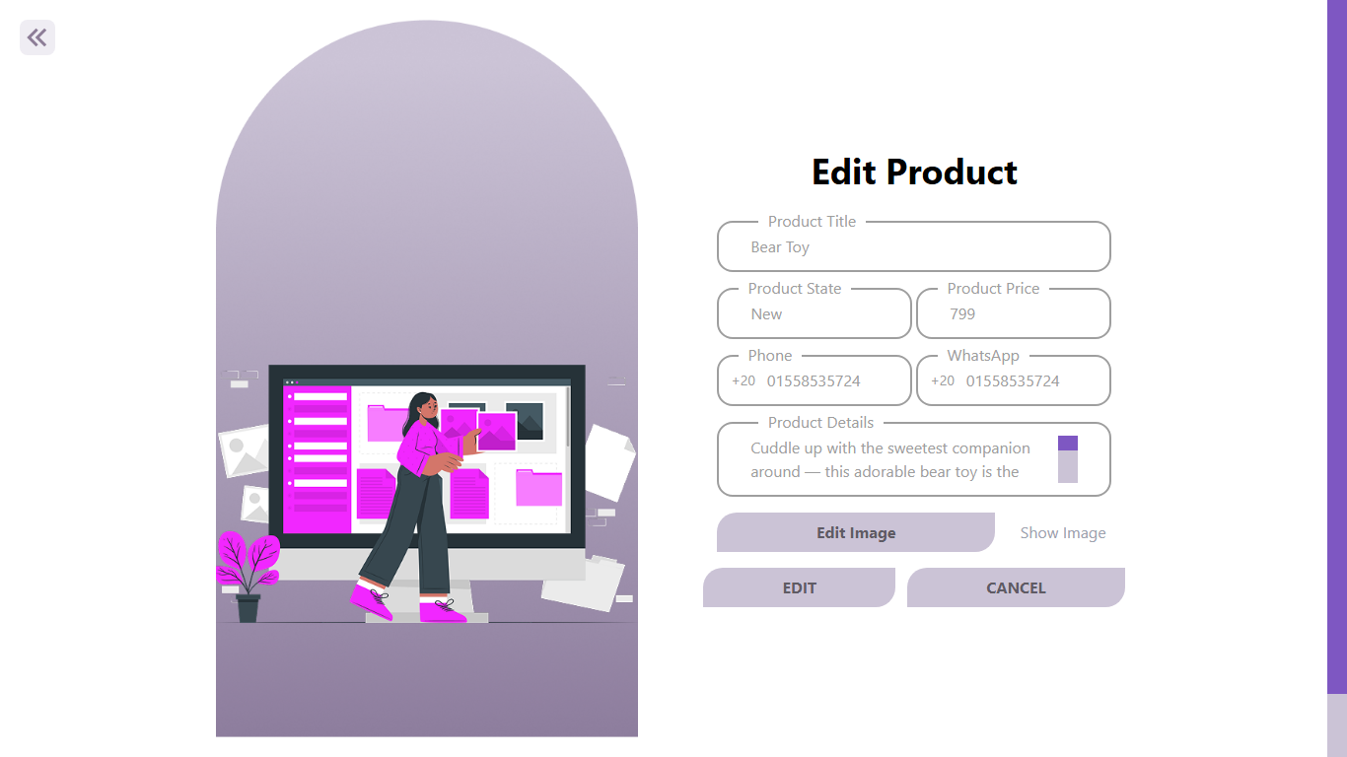

Slide 30
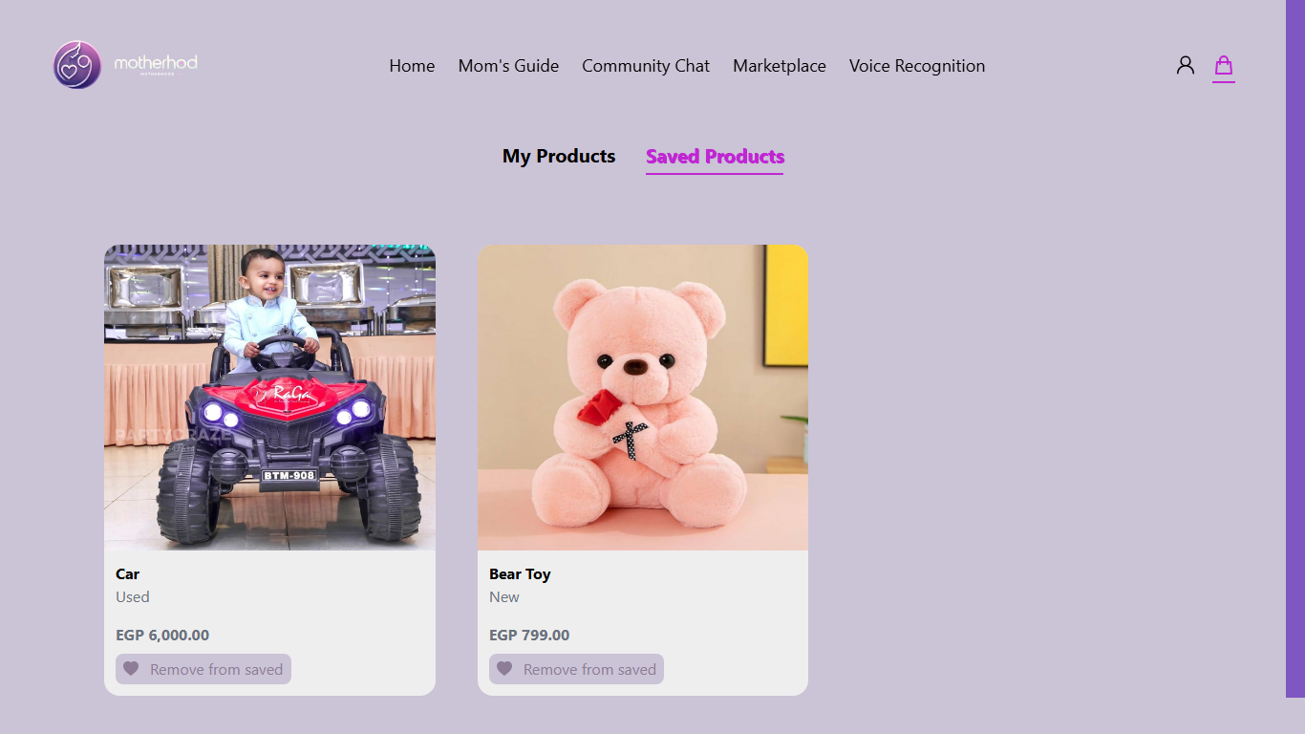

Slide 31
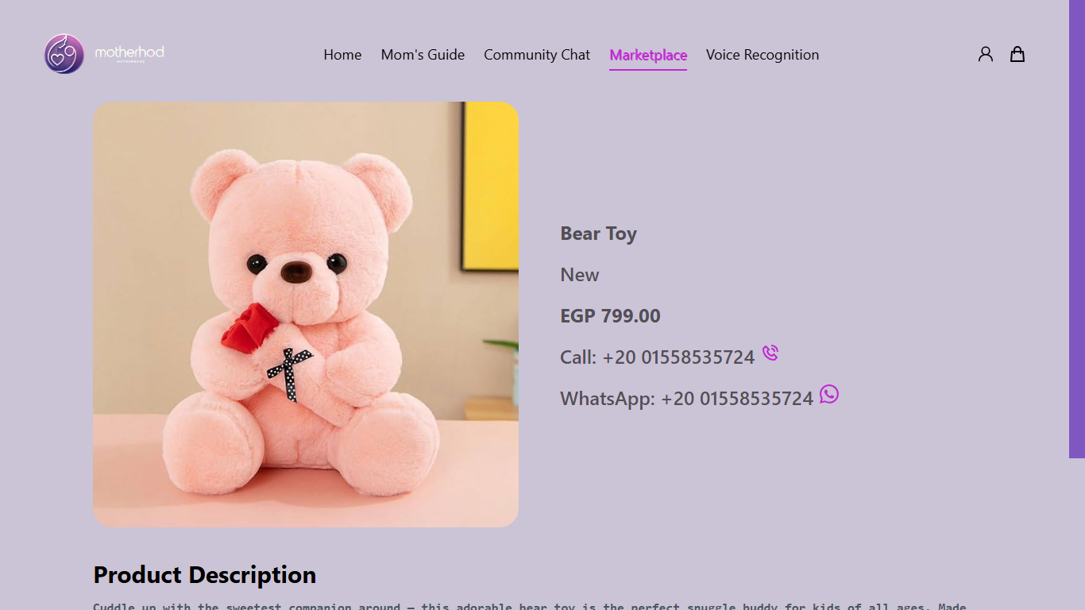

Slide 32
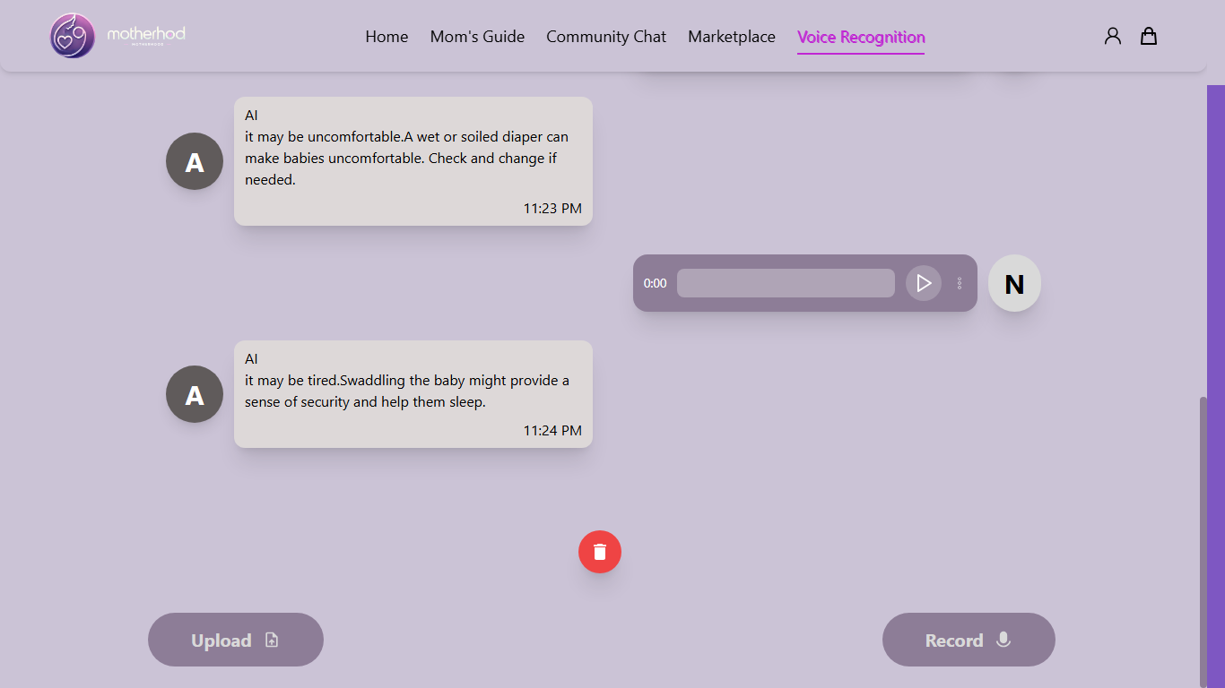

Slide 33
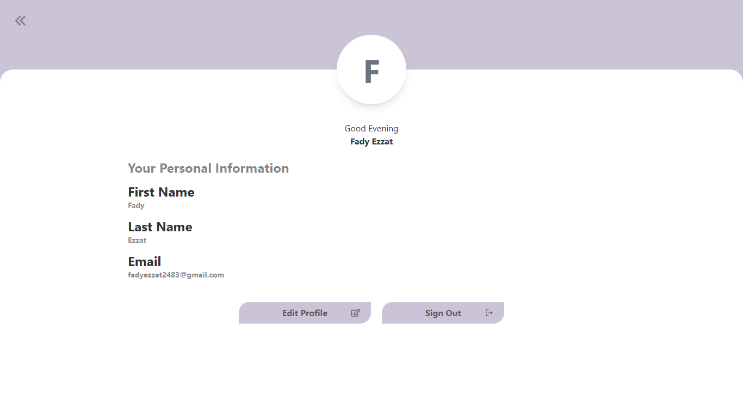

Slide 34
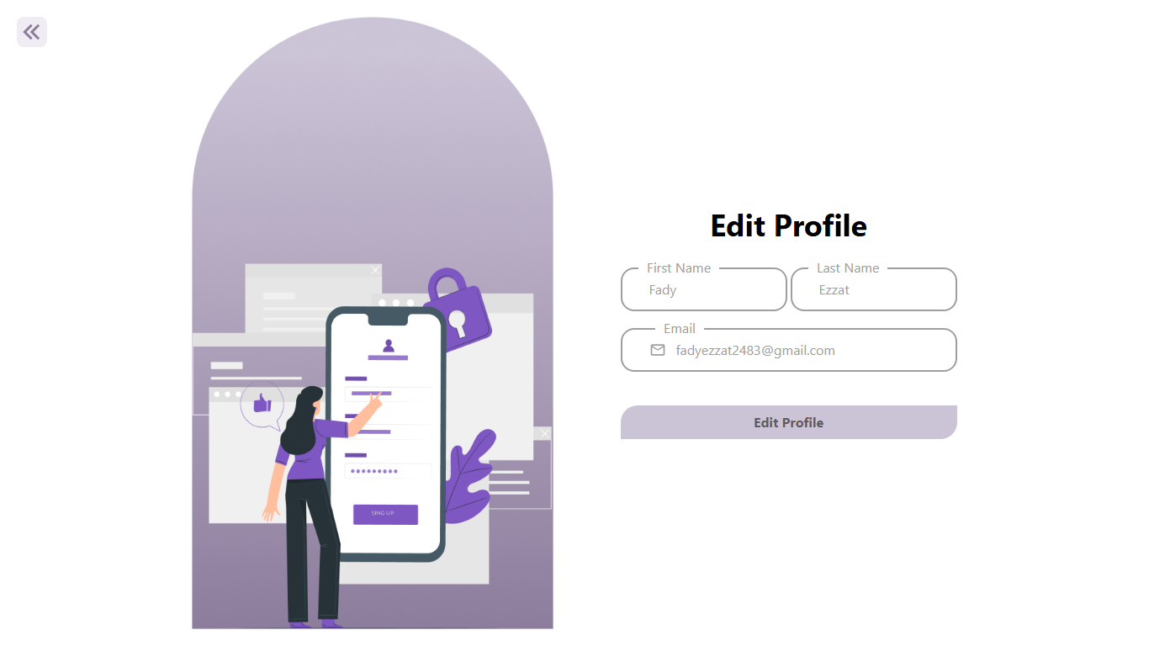

Slide 37

MOBILE APPLICATION
Framework : Flutter
Cross-platform for iOS and Android
Attractive & responsive UI
Fast development with Hot Reload

Slide 38
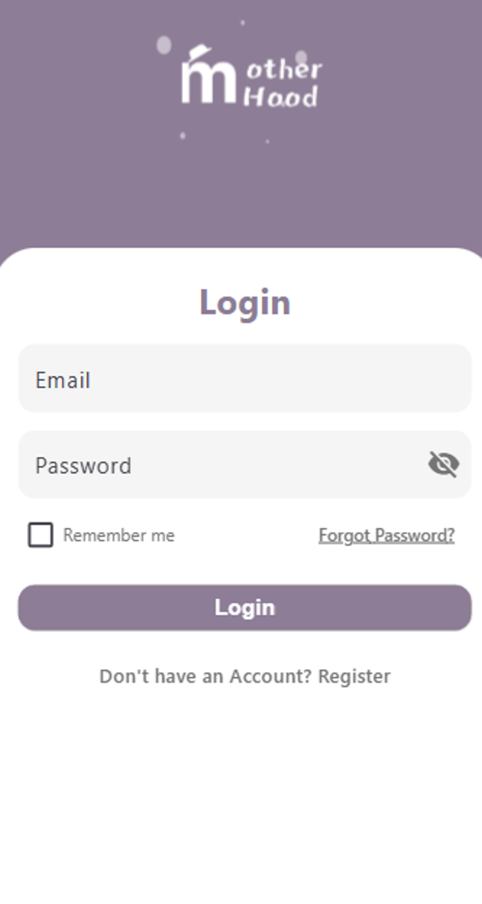
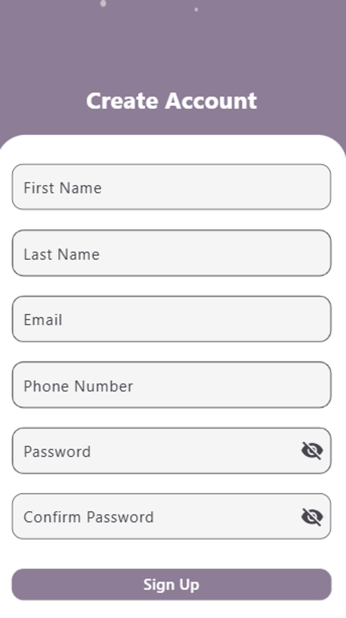


Slide 39
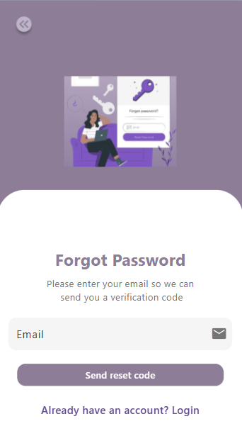
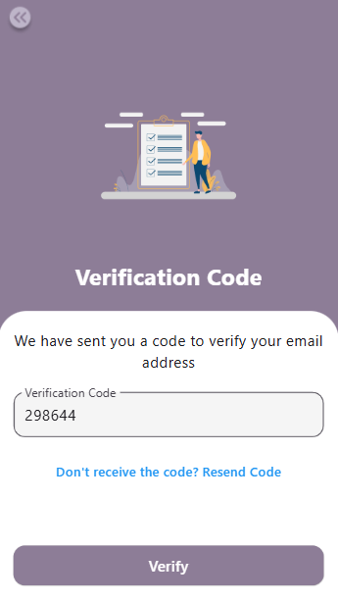
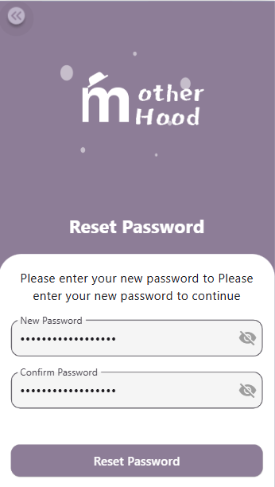

Slide 40
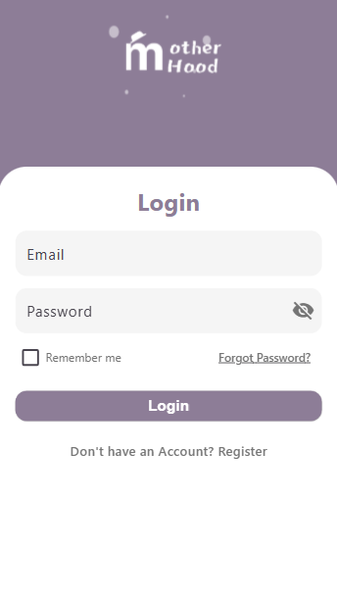
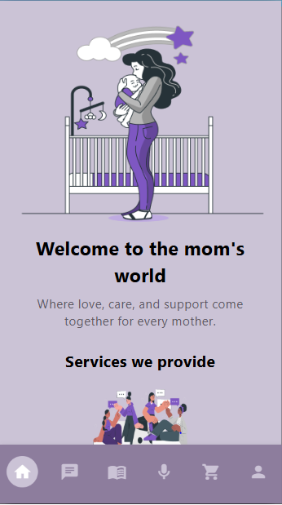
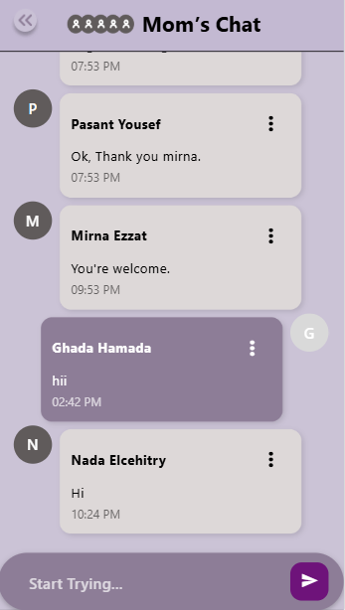

Slide 41
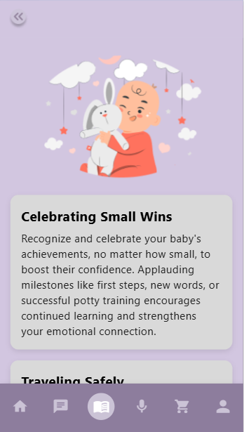
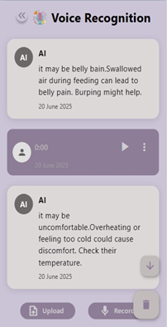
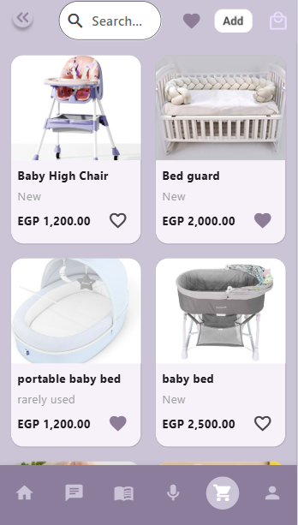

Slide 42
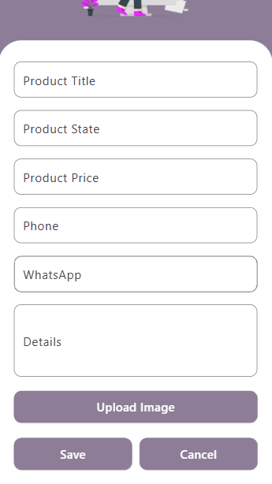
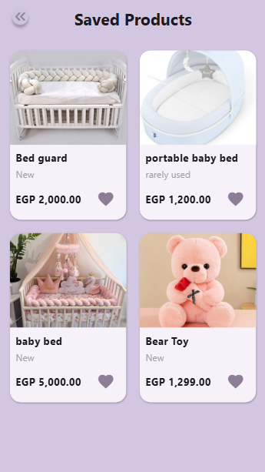

Slide 43
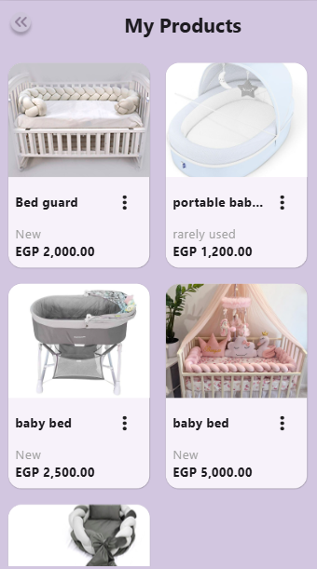
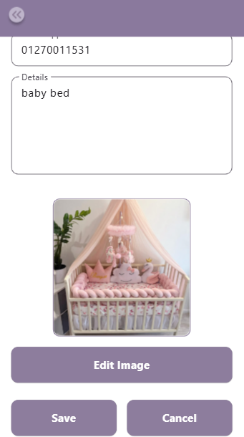
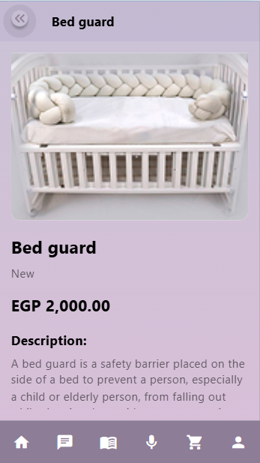

Slide 44
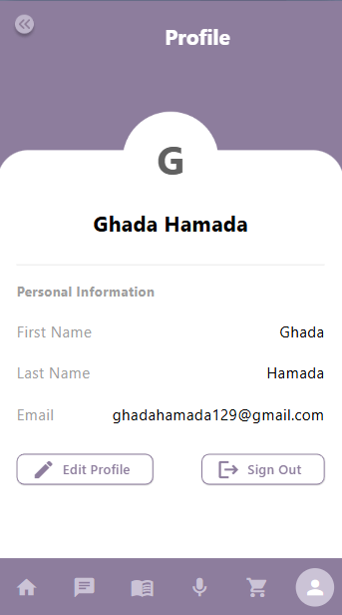
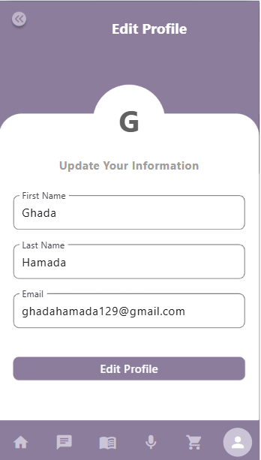

Slide 45

ARTIFICIAL INTELLIGENCE

Slide 46
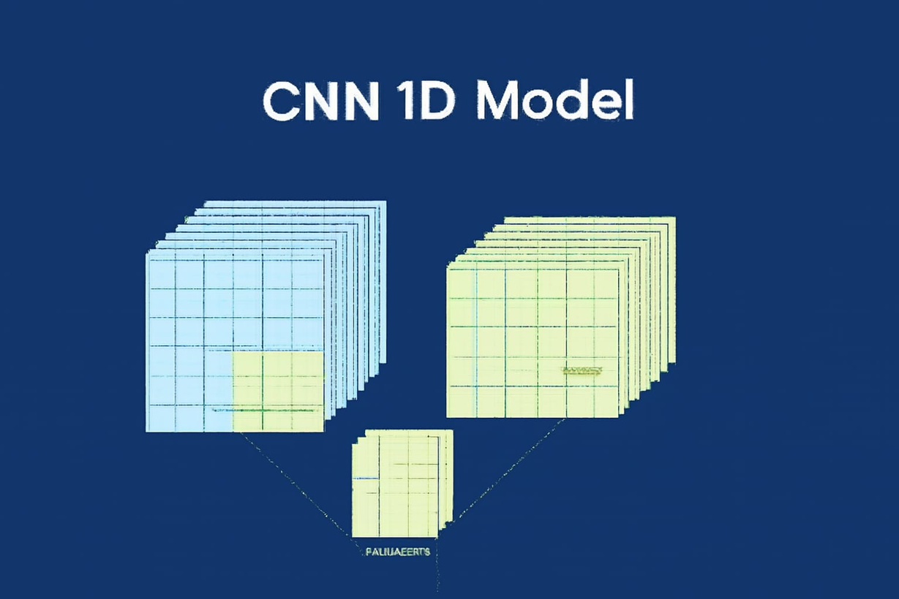
AI Model – CNN 1D for Audio Classification
I used the CNN 1D Model, which was trained on recordings of infant cries, to determine the baby's condition and help mothers understand how to handle their baby based on the sounds the baby makes.
The dataset consists of 500 infant cry recordings and is balanced. It is consists of 5 classes :
Discomfort
Hungry
Tired
Belly pain
Burbing

Slide 47
🟠 First Try
"In the first try, the dataset was unbalanced and consisted of a total of 457 recordings with 5 classes. Out of those, 382 recordings belonged to the 'Hungry' class. This created an unfair situation for the other classes, As a result, the model became overfitted to the 'Hungry' class.

Slide 48
🟠 Second Try
I collected the dataset from different resources and made it balanced, but I discovered that the sounds in all categories were very similar. Result ,the model got misclassified between classes.

Slide 49
🟠 Final Try
. I used the SMOTE technique to add synthetic samples for unbalanced classes
✅ Ensured sound variation between all classes .
✅ Dataset became balanced .
✅ The model achieved 97% acc on the test data.
✅ This the best result i have achieved .

Slide 50
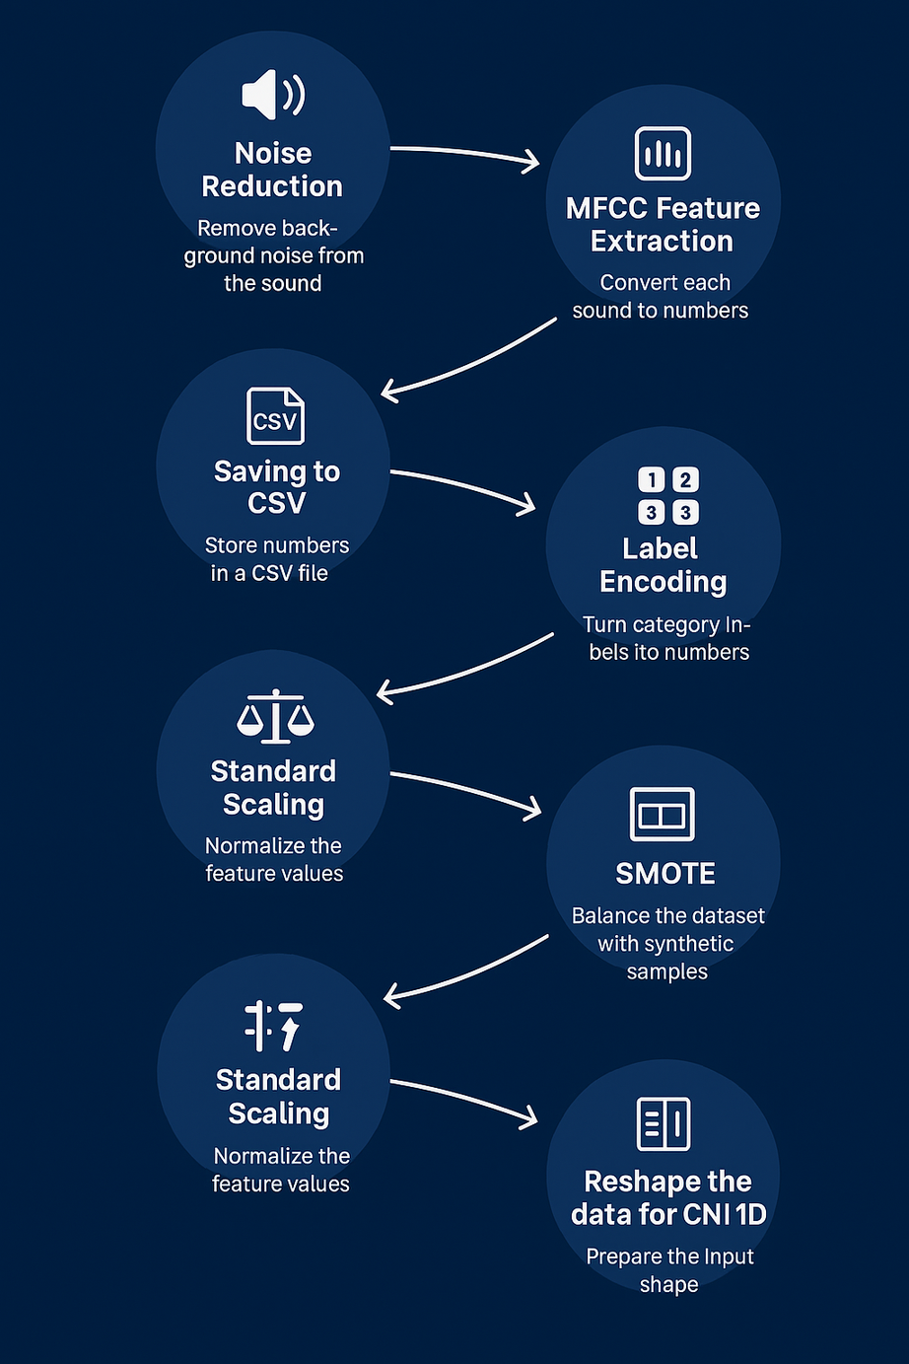
The proccessing Steps of Data

Slide 51
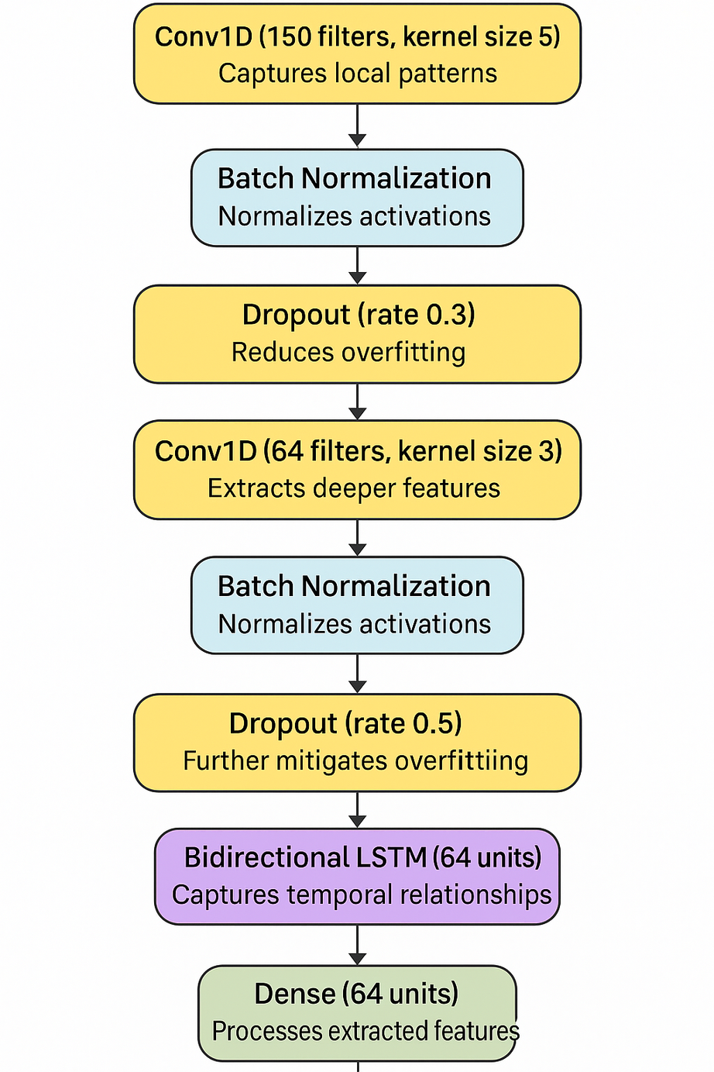
Architecture of the model

Slide 52
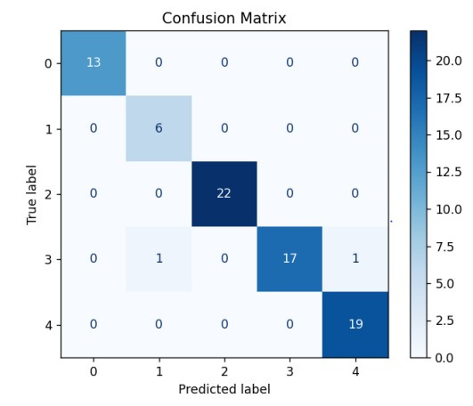
Confusion Matrix

Slide 53
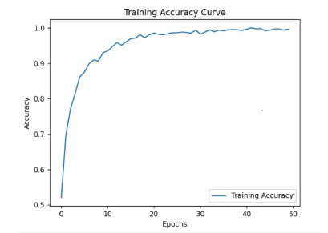
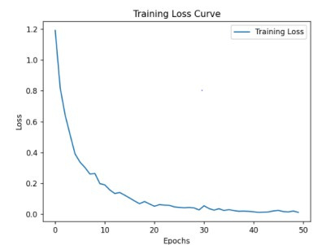
Training acc and training loss
The model achieved 98% acc on the Training data

Slide 54

DATABASE
ERD

Slide 55
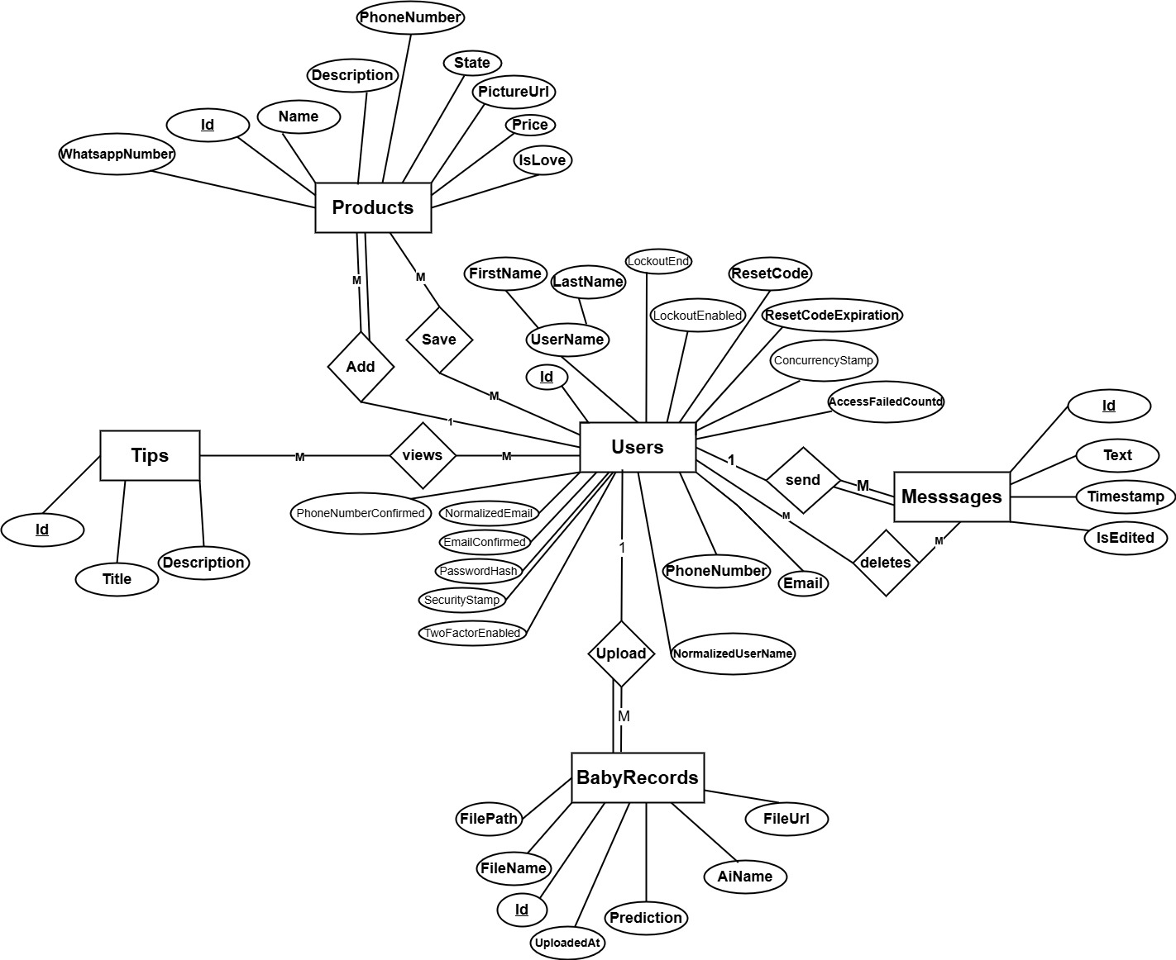

Slide 56

BACKEND

Slide 57

BACKEND
Asp .Net Core
Frameworks
Flask

Slide 58





AI Analysis Flow
Backend API
Receives the uploaded audio and sends it to the Flask server.
SQL Server
Stores the prediction result in the database.
1
2
3
4
5
Mobile or Web App
User uploads or records a baby cry audio file.
Flask Server
Preprocesses the audio, runs the AI model to classify the cry, and returns the prediction result to the backend.
Mobile or Web App
Displays the prediction result to the user.

Slide 59

01
JWT
Security & Authorization
02
SMTP

Slide 60
AUTHENTICATION FLOW
BACKEND API
Manages incoming requests and validates the provided data.
Generates a JWT token or sends a password reset email when necessary.
Dispatches a password reset email with a token upon request.
SQL SERVER
Stores or checks user info, and generates reset tokens if needed.
1
2
3
4
MOBILE OR WEB APP
Users can log in, sign up, or request a password reset.
MOBILE OR WEB APP
Displays success or error messages to the user.

Slide 61
MARKETPLACE FLOW
BACKEND API
Handles product listing, filtering, and cart/favorite actions.
Sends and receives product-related data.
SQL SERVER
Stores product info, user preferences, and cart data.
Returns relevant data based on user actions.
1
2
3
4
MOBILE OR WEB APP
User Adds , Edits ,Delets and Searches for baby products.
Can add items to cart or mark as favorite.
MOBILE OR WEB APP
Displays products, cart contents, and user actions.

Slide 62


TESTING
For testing and validating our API endpoints, we used Swagger
UI for real-time, interactive testing during development.
We also used Postman to manually send requests, check responses, and ensure the backend handled all use cases properly.

Slide 63
CONCLUSION
Our project aims to support new mothers by using AI to detect baby cries and provide helpful insights.
We wanted to build something meaningful — not just an academic success, but a real solution that can grow and benefit society.
This was both a challenge and a chance to apply what we’ve learned and create something we’re proud of.

Slide 64
Connect the chat with a child doctor
01
02
Enhance the model
Future work
Expand the Marketplace with Online Payment Options
03
04
Multi-language Support

Slide 65
THANK YOU!
Now it's time to explore the project's technical overview

