Slide 1
Camouflage-Resistant Graph Fraud Detection
A three-pillar framework: graph structure, a learned filtering policy, and language-model signal
Fady Tarek · German University in Cairo
In one sentence
Attach this framework to a graph fraud detector you already have, and that detector gets significantly better — demonstrated on two backbones and two datasets.

Slide 2
The problem
Why fraud detection on graphs is hard
Fraud is relational — so graphs are natural. But fraudsters know that.
▸ Fraudsters operate in groups, share targets, reuse patterns. A graph neural network can read both the behaviour and the connections.
▸ So fraudsters camouflage in two ways: they edit their own profile to look ordinary, and they connect to honest accounts.
▸ A network that averages over a fraudster's neighbours then averages in a crowd of innocents — and the fraud signal disappears.
▸ Benchmark: YelpChi — 45,954 reviews, 14.5% fraudulent, 32 behavioural features, three kinds of connection.
Background | 2 / 13

Slide 3
What already existed
CARE-GNN, and the two gaps it leaves
Its good idea
Do not compare neighbours by their raw features — faking features is exactly what camouflage IS. Instead rank them by predicted fraud likelihood and keep the closest ones.
▸ GAP 1 — one global threshold per relation, identical for all 45,954 nodes, set by a crude bandit. A heavily camouflaged node and a clean one are filtered the same way.
▸ GAP 2 — it only ever sees the graph. It never reads a single word of the review text, even though the text is right there.
Those two gaps are the second and third pillars.
Background | 3 / 13

Slide 4
The framework
Three pillars, one joint objective
STRUCTURAL
Multi-relation GNN
(CARE-GNN backbone,
kept as-is)
ADAPTIVE (CAPN)
An actor–critic policy replaces the bandit.
Outputs a threshold per NODE, per relation.
SEMANTIC
A language model scores each review on six
fraud-relevant text dimensions.
▸ The mechanism worth knowing: one learned number θ does two jobs — it sets how many neighbours survive the filter, AND its per-relation average becomes that relation's weight in the final blend. The aggregation adapts node by node.
▸ The language model runs ONCE, offline, cached. The training loop never calls it — so there is no added cost per epoch and no API dependency at train time.
Method | 4 / 13

Slide 5
How it was evaluated
The part reviewers praised
▸ Five seeds used for development. Then TWENTY fresh seeds, never touched during tuning, for every headline claim.
▸ Every baseline re-run in-house at the identical split — never quoted from its source paper. On this benchmark the amount of training data dominates the score, so cross-paper numbers are not like-for-like.
▸ Later: ten INDEPENDENT data splits, because repeated seeds on one split only measure initialisation noise, not generalisation.
▸ Re-implementations validated against published numbers before being trusted.
Why this mattered
Split-to-split variance turned out to be 2.4–2.8× larger than seed-to-seed variance. Reporting only seeds would have measured the smaller component and called it generalisation.
Method | 5 / 13

Slide 6
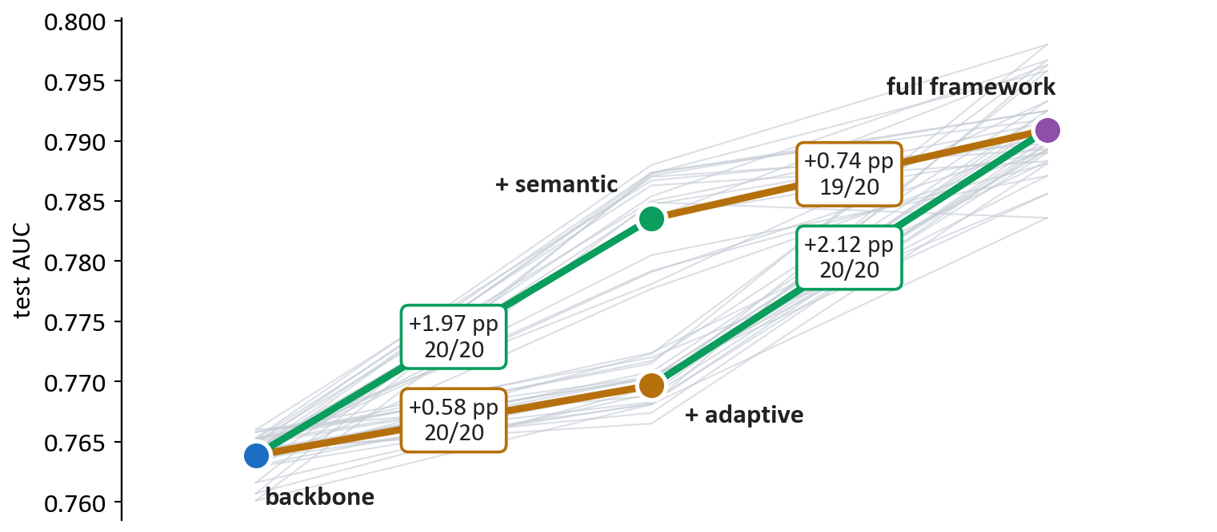
Main result
Each pillar measured separately, 20 held-out seeds
backbone 0.7639 → full framework 0.7909 (+2.70 pp AUC, +5.11 pp average precision)
Results | 6 / 13

Slide 7
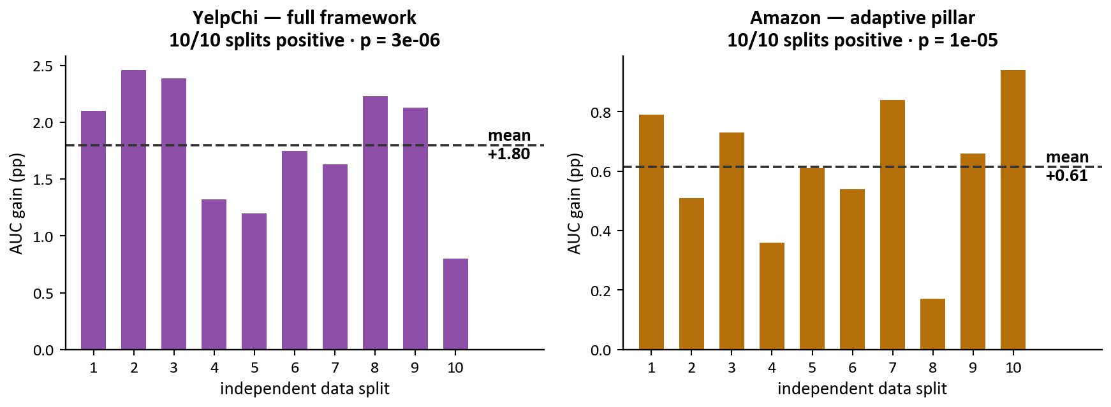
Does it survive different data?
Ten independent splits per dataset
Positive on every single split, on both datasets. This is the evidence that supports a generalisation claim — repeated seeds on one split do not.
Results | 7 / 13

Slide 8
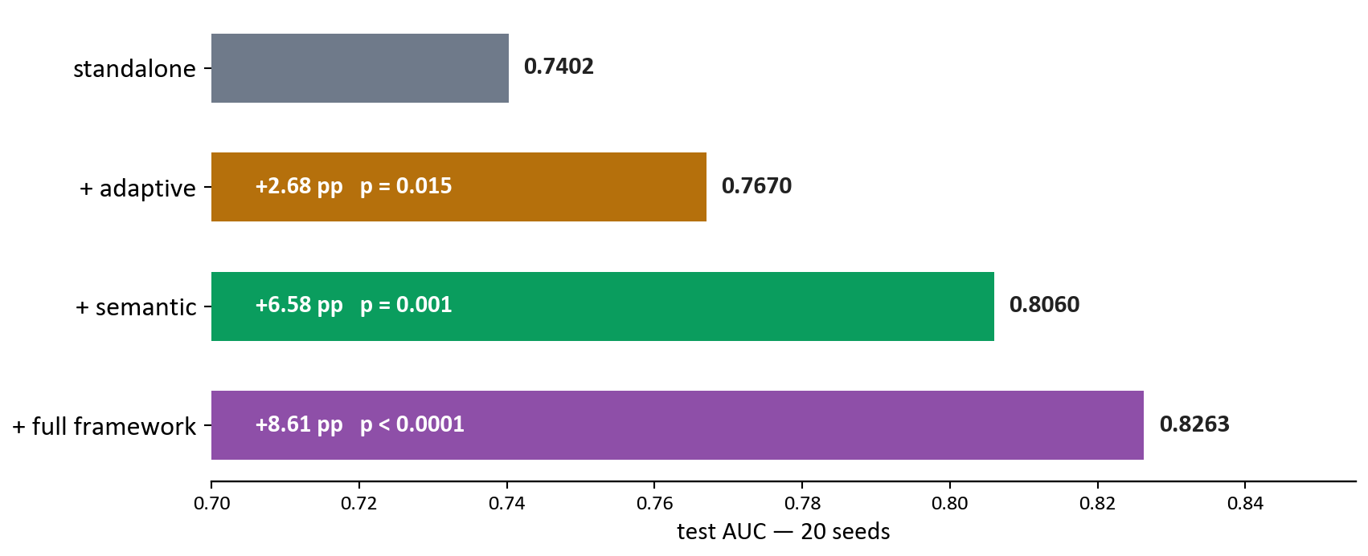
Attached to a backbone it was not built for
GraphConsis — a different architecture, 20 seeds
The complete framework, moved unchanged onto a second backbone: +8.61 pp, p < 0.0001. This is the wrapper claim.
Results | 8 / 13

Slide 9
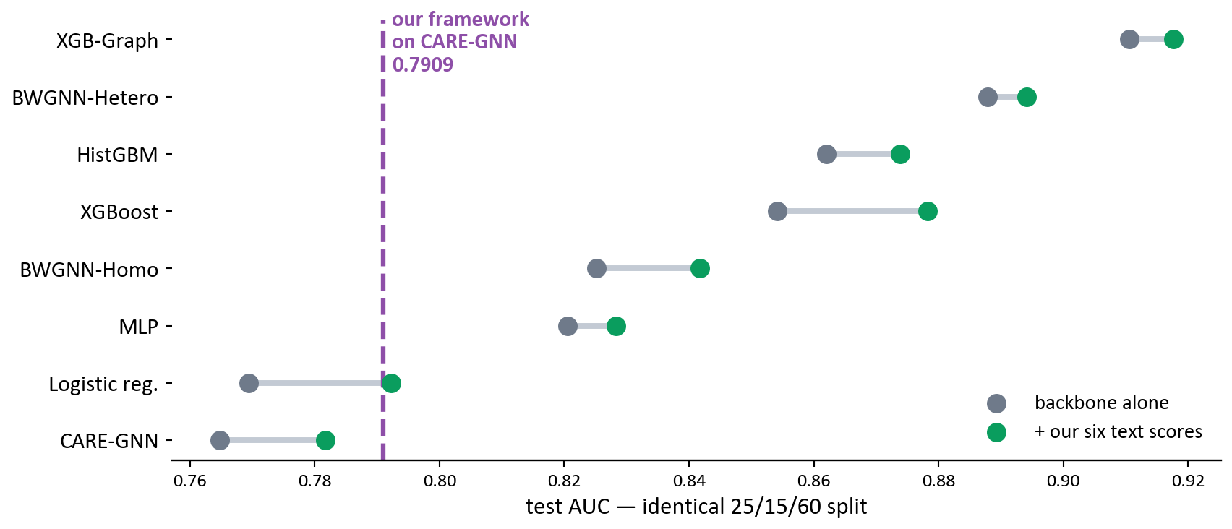
The text signal travels on its own
Six scores added to eight unrelated models
Significant on 7 of 8 — including the method that currently leads this benchmark. Note our own framework (dashed) is NOT the strongest absolute model: the claim is improvement over a base, not best-on-benchmark.
Results | 9 / 13

Slide 10
The findings I did not expect
All three are negative results
1 · My own design was sabotaging itself
I initialised the policy from LLM-derived priors to give it a head start. It was SUPPRESSING the policy (−0.71 pp). Removing it turned a null (+0.19 pp, p = 0.10) into +0.58 pp on 20/20 seeds.
2 · The language model is not necessary
A free deterministic scorer computing the same six quantities is statistically indistinguishable from Claude on EVERY graph backbone. The contribution is which six things you measure, not who measures them — and a practitioner needs no API at all.
3 · The pillars add, they do not synergise
+0.58 and +1.96 sum to +2.54; together they give +2.70. The interaction is +0.16 pp against 0.43 pp of noise. The 2025 wave of LLM-enhanced detectors assumes integration is where the value is. Nobody tested it. It is not.
Findings | 10 / 13

Slide 11
External review
Five blind reviewers + a devil's advocate
Verdict: major revision. No reviewer questioned the integrity of the work.
▸ Their strongest criticism was fair: our framework reaches 0.79 AUC while a gradient-boosted tree in our own comparison table reaches 0.92.
▸ The answer is the wrapper framing — it is not a competitor to that tree, it is an upgrade for graph detectors. Judged on base vs base-plus-wrapper, and that is +8.61 pp on a backbone we did not design it for.
▸ Our novelty claim survived their independent literature search: nothing combines a GNN, an RL filtering policy, and LLM signal.
And I corrected myself
Three published numbers were wrong because five seeds was too few on a high-variance backbone. I found all three and fixed them. They moved the same way — the paper had been claiming slightly more than it could support.
Status | 11 / 13

Slide 12
Where it stands
Established
• Both pillars significant, 20 held-out seeds
• Positive on 10/10 independent splits
• Replicated on a second dataset
• Transfers to a second backbone (+8.61 pp)
• Text signal lifts 7 of 8 other models
Open
• Not competitive on absolute accuracy
• No operating-point evidence yet
• Semantic pillar needs review text,
so Amazon is partial
• Paper needs restructuring + reformatting
Experiments are essentially done. Roughly 1–2 weeks of writing to a submittable draft.
Status | 12 / 13

Slide 13
What I need from you
▸ VENUE — PAKDD 2027 closes 20 November (three weeks, tight but reachable); ECML-PKDD 2027 closes around July and is the better fit, because negative results have a home there and Eindhoven is far cheaper to reach than New Zealand; IEEE ICAISET in Cairo closes 10 January, is hybrid, and needs no travel.
▸ A third backbone (PC-GNN) was insurance in case GraphConsis failed. It did not — so I would skip it unless you disagree.
▸ The paper is in the wrong template for every one of those venues, and all the conference options are double-blind. That conversion is unavoidable, so the venue decision should come first.
My recommendation
Target ECML-PKDD, keep Cairo as a floor. The extra months let me add operating-point evidence, which was the one reviewer gap I have not closed.
Decision | 13 / 13

