Slide 1
A Unified GNN + RL + LLM Framework
for Graph-Based Fraud Detection
Extending CARE-GNN with Learned Policy and LLM Reasoning
Fady Hassanein
Master's Thesis

Slide 2
Outline
1. Motivation and problem
2. Literature review
3. The unified framework
4. Datasets
5. Methodology: GNN pillar
6. Methodology: RL pillar
7. Methodology: LLM pillar
8. Unified training
9. Results
10. Conclusion
Outline | 2 / 27

Slide 3
Why Graph-Based Fraud Detection?
Fraud on review platforms is a multi-billion-dollar problem, and fraudsters rarely act alone. Their social and behavioural structure is exactly the kind of signal graph-based methods are designed to exploit.
Online fraud is expensive and networked.
▸ Fake reviews on Amazon and Yelp distort consumer decisions and merchant revenue.
▸ Fraudsters don't act alone — they form rings: coordinated users, burst-posted reviews, shared IP ranges, identical text templates.
▸ A single-user classifier misses the network evidence.
Graph Neural Networks (GNNs)
Exploit this structure by propagating information across user/review relationships, so a node is classified using evidence from its neighbours as well as its own features.
Motivation | 3 / 27

Slide 4
The Camouflage Problem
Even a well-designed GNN can be defeated by fraudsters who deliberately manipulate their features and their connections to blend in with legitimate users. Any serious fraud-detection GNN must model both forms of camouflage.
Fraudsters actively evade detection in two ways:
Feature camouflage
Fraudsters mimic legitimate users: normal ratings, plausible review length, boilerplate sentiment.
Relation camouflage
Fraudsters form ties to benign users to dilute the suspicious signal in neighbourhood aggregation.
A naive GNN aggregates all neighbours and inherits both attacks.
Research Question
Can we build a GNN that filters neighbours adaptively, incorporates semantic reasoning, and remains interpretable — without sacrificing scalability or reproducibility?
Motivation | 4 / 27

Slide 5
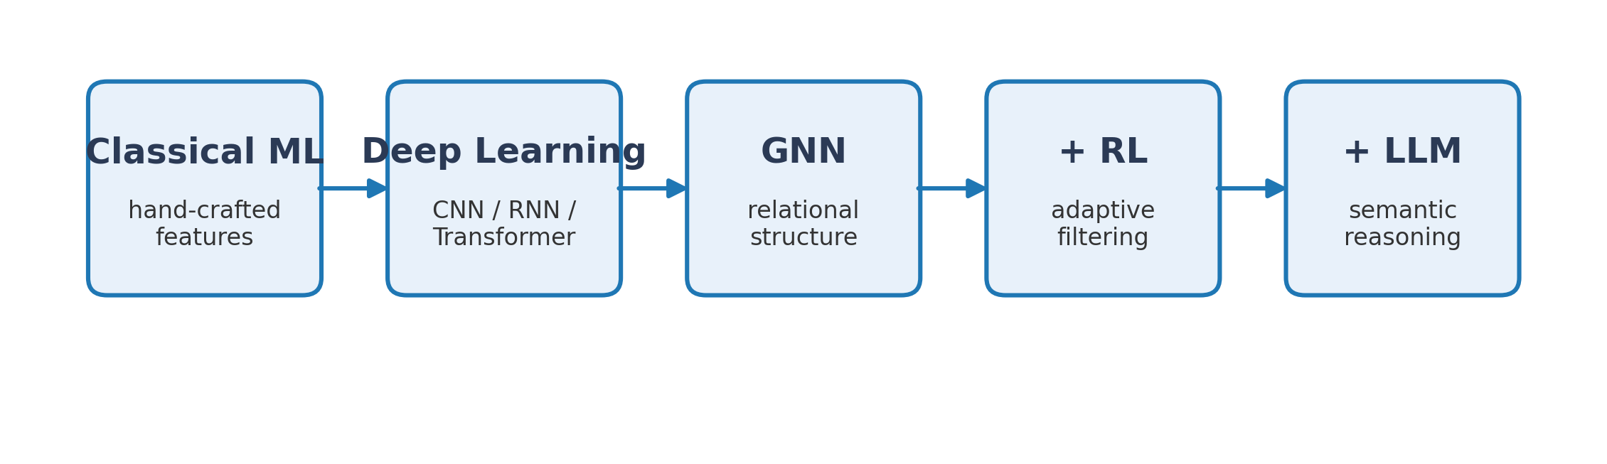
Progression of Fraud-Detection Methods
Fraud detection has evolved through five major waves, each fixing a specific limitation of the previous one. This thesis sits at the rightmost position — combining all the advances of prior generations.
▸ Classical ML: effective baselines, but ignore relational topology.
▸ Deep learning: stronger features, but nodes treated independently.
▸ GNNs: end-to-end relational learning (GCN, GraphSAGE, GAT, …).
▸ GNN + RL: CARE-GNN (Dou et al. 2020) adds a bandit-based neighbour filter.
▸ GNN + LLM: FLAG (Yang et al. 2025) uses text for neighbour sampling.
Literature Review | 5 / 27

Slide 6
Research Gap
Each wave above fixed one problem but introduced another. Crucially, no prior work combines structural (GNN), adaptive (RL), and semantic (LLM) reasoning in a single framework — that unfilled slot is the space this thesis occupies.
No existing work unifies all three components:
▸ Existing RL + GNN frameworks (CARE-GNN, RioGNN) use simple heuristic bandits with no semantic state.
▸ Existing LLM + GNN work (FLAG) augments features or sampling but does not use a learned RL policy for dynamic weighting.
This thesis
A unified GNN + RL + LLM framework that combines:
▸ A multi-relation GNN backbone (CARE-GNN).
▸ A learned actor–critic RL policy for per-node filtering.
▸ LLM-derived signals injected into both the policy state and the node features.
Literature Review | 6 / 27

Slide 7
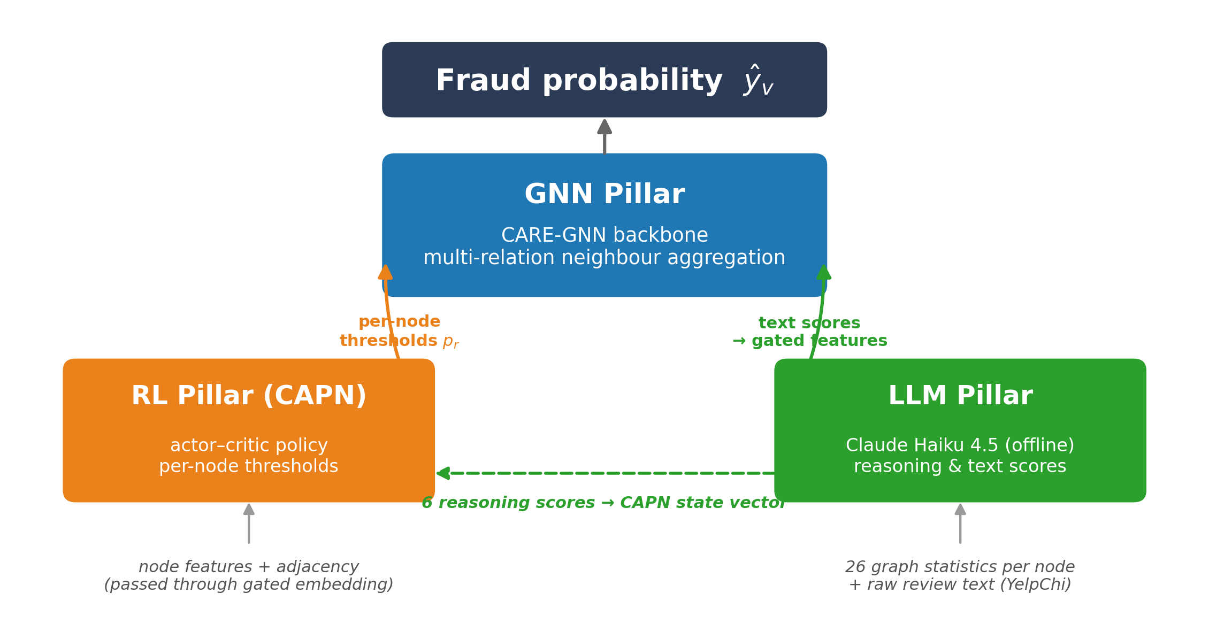
Three-Pillar Architecture
The framework is built from three independent pillars that plug into each other through well-defined interfaces. Read bottom-up: raw inputs enter the LLM and RL pillars, which feed their outputs into the GNN pillar, which produces the final fraud probability.
Unified Framework | 7 / 27

Slide 8
Design Principle: Additive, Attributable Pillars
Splitting the framework into three pillars is not just a conceptual choice — it is an engineering decision that lets us measure each pillar's contribution separately, swap pillars without refactoring, and reproduce every result from a single command.
Every design choice preserves two interoperability constraints:
▸ Each pillar enters the framework at a well-defined interface (feature space, policy state, or threshold variable).
▸ Enabling or disabling a pillar leaves the other two's code unchanged.
Why this matters
▸ The three-pillar ablation in Chapter 4 measures each pillar's contribution cleanly (no confounding).
▸ Reproducibility: each pillar toggle corresponds to a single command-line flag.
▸ Extensibility: new LLMs or alternative policies slot in without refactoring the backbone.
Unified Framework | 8 / 27

Slide 9
Benchmark Datasets
We evaluate on two complementary benchmarks. Amazon tests whether each pillar adds value when per-node features already carry most of the signal; YelpChi tests whether the same three pillars combine to beat CARE-GNN when features are weak and the graph carries the signal.
Property | Amazon | YelpChi
Nodes (total / labelled) | 11,944 / 8,639 | 45,954 / 45,954
Features | 25 raw | 32 pre-normalised
Fraud rate (labelled) | 9.50 % | 14.53 %
Relations | UPU, USU, UVU | RUR, RTR, RSR
Max |r| feature | 0.654 (feat. 19) | 0.235 (feat. 5)
Strongest relation | UVU (18.3 / 3.0 %) | RUR (92.5 / 0.4 %)
Review text available? | No | Yes
▸ Amazon: strong features, modest homophily — features already solve most of the problem, so pillar gains are small.
▸ YelpChi: weak features; RUR's near-perfect label homophily is the main signal, but RTR / RSR are noisy.
▸ All statistics recomputed from the release used in this thesis (verification scripts in the repo).
Datasets | 9 / 27

Slide 10
GNN Backbone: CARE-GNN
Our backbone is CARE-GNN (Dou et al. 2020) — a multi-relation GNN specifically designed for fraud detection. Its key idea: rank every neighbour by label agreement before aggregating, so camouflaged edges can be filtered out.
Single-layer, multi-relation GNN with label-aware filtering:
1. Label predictor S(v) = MLP(xᵥ) ∈ ℝ² produces per-node class logits.
2. Pairwise distance D(v, v′) = | S(v)[0] − S(v′)[0] | ranks neighbours by label agreement.
3. Filter: retain the top-pᵣ fraction by distance in each relation r.
4. Intra-relation aggregation: mean of retained neighbours.
5. Inter-relation aggregation: hᵥ = ReLU( W·hᵥ + Σᵣ pᵣ · W·h_{𝒩(v)}^(r) ).
What we keep vs replace
Replace: step 1 linear predictor → two-layer MLP (CAPN); step 3 bandit → actor–critic policy. Keep: steps 2, 4, 5 unchanged — this is what lets the LLM and RL pillars plug in without breaking the backbone.
GNN Pillar | 10 / 27

Slide 11
From Heuristic Bandit to CAPN
CARE-GNN updates its neighbour-filtering thresholds with a simple bandit that is cheap but blind — it uses no node-level state and cannot absorb any external signal. CAPN keeps the idea of adaptive thresholds but replaces the bandit with a learned neural policy.
Inherited bandit (CARE-GNN):
▸ Action: pᵣ ← pᵣ ± 0.02, updated once per epoch.
▸ Reward: ±1 based on sign of change in positive-node distance.
▸ Terminal condition: freezes once reward plateaus.
Five Limitations
Global (not per-node) thresholds • binary reward • slow fixed-step updates • linear label predictor • NO HOOK FOR EXTERNAL (LLM) SIGNALS.
CAPN (ours): Camouflage-Aware Policy Network
▸ Enhanced two-layer MLP label predictor with confidence output.
▸ Rich state vector: features + distance + overlap + feature variance + LLM scores.
▸ Beta-distribution policy network → per-node thresholds (rather than per-relation).
▸ Shaped, continuous reward: distance + accuracy + stability.
RL Pillar | 11 / 27

Slide 12
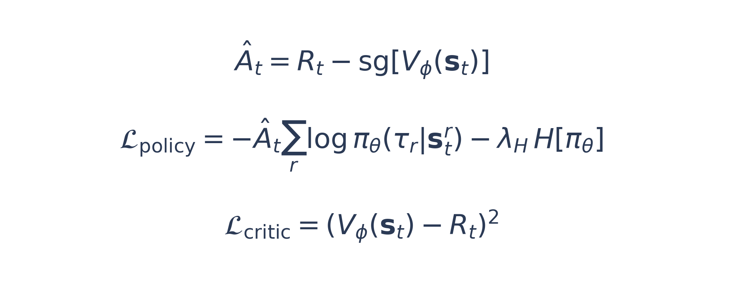
Actor–Critic Policy Optimisation
Training a policy network with a single noisy batch reward is unstable — the gradient variance is too high and the policy oscillates (we confirmed this empirically on YelpChi). Using a learned value function as a baseline solves this.
Problem: vanilla REINFORCE has high gradient variance → policy oscillates, YelpChi training diverges.
Solution: single-step actor–critic with a learned value baseline.
Training schedule (prevents policy from learning on a noisy, untrained backbone):
▸ Epochs 0–5 (GNN warmup): λπ = 0, only supervised loss runs.
▸ Epochs 5–10 (policy ramp): linearly anneal λπ from 0 to 0.3.
▸ Epochs 10–31: full policy training at λπ = 0.3.
RL Pillar | 12 / 27

Slide 13
LLM as Reasoning Engine, Not Text Encoder
Our first experiments tried the obvious thing — plug sentence-transformer embeddings into the policy state — and it failed. Our LLM pillar instead uses the LLM as a reasoning engine that emits compact, fraud-specific signals, not as a generic text encoder.
Why not sentence-transformer embeddings?
▸ Study A6 tried this on Amazon: 384-dim MiniLM embeddings projected into the policy state. Result: −0.19 pp AUC (FAILED).
▸ Root cause: lossy round-trip converts precise numerics (degree = 23) into text and back, destroying the signal.
Our approach: use Claude Haiku 4.5 as a reasoning engine. Two complementary signal streams:
 | Part 1 (both datasets) | Part 2 (YelpChi only)
Input to LLM | 26 graph statistics per node | raw review text
Output | 6 structural risk scores | 6 text risk scores
Entry point | CAPN state vector | node features (via gate)
All LLM scores are precomputed once and loaded as tensors — no API calls inside the training loop (reproducibility + cost).
LLM Pillar | 13 / 27

Slide 14
Part 1: Structural Reasoning Scores
For every node we compute 26 graph statistics (degrees, overlaps, z-scores, ego-density, 2-hop reach …) and ask Claude to return six fraud-relevant risk assessments. These scores enter the CAPN state so the policy can condition on LLM-level reasoning about structure.
26 graph statistics per node → Claude Haiku 4.5 → 6 risk scores:
▸ structural_anomaly — unusual connectivity pattern
▸ relation_consistency — uniform behaviour across relations
▸ neighborhood_risk — suspicious neighbours (training-label stats)
▸ feature_anomaly — statistical feature outliers
▸ coordination_signal — likelihood of coordinated activity
▸ isolation_score — peripheral vs deeply embedded
Why LLM over a linear formula?
The LLM reasons about interactions: 'high ego-density combined with high label disagreement in a single relation' signals a fraud ring — a linear formula misses that conjunction. Study A7 confirms this beats the template-formula baseline.
Integration: 6-score vector → linear projector → 16-dim eᵥ concatenated into CAPN state. State grows D+5 → D+21.
LLM Pillar | 14 / 27

Slide 15
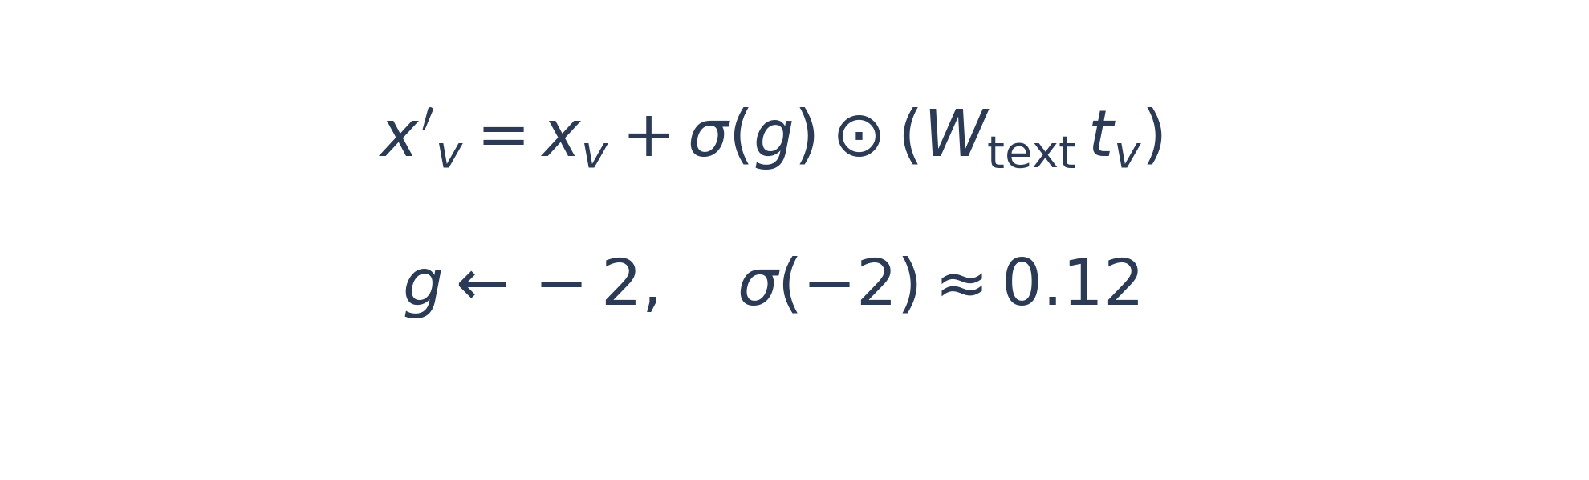
Part 2: Text-Risk Scoring and Gated Injection
On YelpChi each review has a body of text. We score each review for fraud-specific linguistic signals — but concatenating those scores to node features hurts performance (Study A8). A learnable gated residual lets the network admit as much text signal as training finds useful.
YelpChi only (Amazon ships no review text). Six fraud-specific text scores per review:
▸ generic_language • sentiment_mismatch • promotional_tone
▸ copy_paste_signal • detail_authenticity • behavioral_anomaly
How not to inject: Study A8 concatenated scores to features → −0.59 pp AUC (wider weight matrix absorbs noise).
TextFeatureGate (ours): residual with learnable per-dim sigmoid gate.
▸ Preserves original feature dimension ℝ³² → ℝ³² (downstream code unchanged).
▸ Gate starts near zero: initial behaviour ≈ CARE-GNN — safe initialisation.
▸ Training can unlearn harmful dimensions by pushing g → −∞.
LLM Pillar | 15 / 27

Slide 16
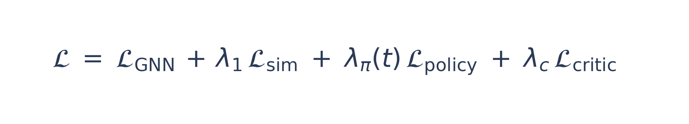
Joint Training Objective
All three pillars are trained end-to-end under a single loss function that combines supervised classification, label-agreement supervision, policy gradient, and critic regression. Two independent Adam optimisers keep the different time-scales separated.
Single end-to-end loss combining all four signals:
Dual-optimiser setup:
▸ Backbone optimiser: Adam, LR 10⁻², clip max-norm 1.0.
▸ Policy / critic optimiser: Adam, policy LR 3·10⁻³, critic LR 10⁻³, clip max-norm 5.0.
Why two optimisers?
The actor–critic and the backbone converge on different timescales — a single learning rate destabilises training.
Unified Training | 16 / 27

Slide 17
Experimental Protocol
All experiments follow the same protocol — stratified splits, fixed 31-epoch budget, best-validation checkpointing, and multiple seeds on YelpChi. The goal is a statistically honest comparison between pillar configurations, not best-of-single-run cherry-picking.
▸ Splits: stratified 25 % / 15 % / 60 % train / val / test.
▸ Epochs: 31; best-validation-AUC checkpoint per run.
▸ Seeds: three seeds {72, 73, 74} on YelpChi (mean ± std); single seed 72 for Amazon ablations.
▸ Metrics: AUC-ROC and Average Precision (primary); F1-macro, Precision, Recall (secondary).
Thesis claim tested
The three-pillar combination (GNN + RL + LLM) significantly outperforms CARE-GNN on YelpChi.
Results | 17 / 27

Slide 18
Headline Result — YelpChi
AUC
AP
F1-macro
0.7856 ± 0.0022
0.4108 ± 0.0052
0.6099 ± 0.0565
+1.99 pp AUC over our CARE-GNN reproduction
+2.86 pp AUC over Dou et al. (2020) published CARE-GNN
Welch's t-test: p < 0.001 across three seeds.
Results | 18 / 27

Slide 19
Main Table — Three-Pillar Ablation on YelpChi
Four rows, each turning exactly one pillar on or off. The transitions Row 1 → 2, 1 → 3, and 3 → 4 each attribute a specific design decision to a measurable AUC delta.
Configuration | AUC | AP | F1-macro
Row 1: GNN only (CARE-GNN) | 0.7657 ± 0.0007 | 0.3766 ± 0.0038 | 0.5948 ± 0.0263
Row 2: GNN + RL | 0.7681 ± 0.0005 | 0.3837 ± 0.0007 | 0.5968 ± 0.0109
Row 3: GNN + LLM | 0.7797 ± 0.0038 | 0.3983 ± 0.0146 | 0.5927 ± 0.0578
Row 4: GNN + RL + LLM | 0.7856 ± 0.0022 | 0.4108 ± 0.0052 | 0.6099 ± 0.0565
Component contributions (mean AUC):
▸ +0.24 pp Row 1 → Row 2: RL pillar alone.
▸ +1.40 pp Row 1 → Row 3: LLM pillar alone (dominant contributor).
▸ +0.59 pp Row 3 → Row 4: RL on top of LLM (stabilises and lifts).
Worst seed of Row 4 (0.7828) already beats best seed of Row 1 (0.7663) by +1.65 pp — the improvement is robust, not a lucky seed.
Results | 19 / 27

Slide 20
Statistical Significance
With only three seeds the mean differences must be stress-tested. Welch's t-test shows the Full-vs-CARE-GNN improvement is far beyond noise; the incremental RL-on-top-of-LLM contribution is at the border of conventional significance — as expected with three seeds.
Two-sided Welch's t-test (three seeds):
Comparison | ΔAUC | t | p
Row 4 vs Row 1 (Full vs CARE-GNN) | +1.99 pp | ≈ 12.4 | < 0.001
Row 4 vs Row 2 (Full vs RL only) | +1.75 pp | ≈ 11.7 | < 0.001
Row 4 vs Row 3 (Full vs LLM only) | +0.59 pp | ≈ 2.7 | ≈ 0.05
▸ The full framework is significantly better than CARE-GNN AND than the RL-only variant.
▸ RL-on-top-of-LLM is at the border of conventional significance — would be strengthened by expanding the seed pool.
Results | 20 / 27

Slide 21
Comparison with the CARE-GNN Paper (YelpChi)
Our full framework also improves over the original CARE-GNN paper's reported AUC by +2.86 pp — larger than the gain over our own Row 1, because our reproduction is already a stronger CARE-GNN baseline than the published one.
Model | AUC | Recall
GCN * | 0.5247 | 0.5081
GAT * | 0.5624 | 0.5452
GraphSAGE * | 0.5400 | 0.5286
GraphConsis * | 0.6207 | 0.6208
CARE-GNN * | 0.7570 | 0.7192
Our Row 1 (CARE-GNN reproduction) | 0.7657 ± 0.0007 | 0.6987
Our Row 2 (GNN + RL) | 0.7681 ± 0.0005 | 0.6967
Our Row 3 (GNN + LLM) | 0.7797 ± 0.0038 | 0.6774
Our Row 4 (GNN + RL + LLM) | 0.7856 ± 0.0022 | 0.6923
* paper-reported values, Dou et al. (2020) Table 3, 40 % training data
Our full framework improves AUC by +2.86 pp over the paper-reported CARE-GNN.
Results | 21 / 27

Slide 22
Amazon Component Ablations (A1–A9) Takeaways
Nine Amazon ablations attribute a single design decision per study. Two of them (A6, A8) are FAILED configurations — they were just as important, because their negative results drove the specific design choices that produced the final framework.
A1
CAPN vs bandit
A2
Label predictor
+0.47 pp AUC over CARE-GNN; Label AUC +5.20 pp.
MLP alone hurts AUC (−0.77 pp); needs policy to realise the gain.
A3
Reward shaping
A4
LLM priors
Any continuous reward beats binary; specific decomposition barely matters.
Best single configuration; +0.81 pp Precision.
A5
λπ sensitivity
A6
Sentence-transformer (v1)
Robust: AUC varies by 0.0004 across a 50× range.
FAILED (−0.19 pp). Lossy text round-trip destroyed signal.
A7
Reasoning scores (v2)
A8
Feature-level concat
+0.05 pp AUC, +0.27 pp AP.
FAILED (−0.59 pp) — motivates the gated residual on YelpChi.
A9
Combined
No negative interactions — prerequisite for the YelpChi result.
Results | 22 / 27

Slide 23
Contributions
Five concrete contributions, ordered from architectural to empirical. Together they constitute the first unified graph-fraud framework that integrates a learned RL policy with LLM-derived reasoning and validates each decision through controlled ablations.
1
Unified GNN + RL + LLM framework architected around a three-pillar, additive design.
2
CAPN: an actor–critic replacement for CARE-GNN's heuristic bandit with per-node thresholds, shaped reward, and LLM-enriched state.
3
Structural LLM reasoning scores (Part 1): six fraud-specific risk scores from Claude Haiku 4.5 over 26 per-node graph statistics.
4
TextFeatureGate (Part 2): gated residual injection of text-risk scores that preserves feature dimension and is reversible.
5
Empirical validation: +1.99 pp AUC on YelpChi with p < 0.001; nine Amazon ablations attribute each design decision.
Conclusion | 23 / 27

Slide 24
Limitations and Future Work
Honest scope of the thesis, and where the framework would most benefit from follow-on work. Limitations are about what was NOT done; future work is about the highest-value extensions.
Limitations
Future Work
▸ Three seeds on YelpChi give tight CIs but limited power for border-line effects (Row 3 vs Row 4).
▸ RL pillar tested only on this benchmark family; no "in the wild" evaluation with concept drift.
▸ LLM reasoning prompts are not tuned — the template is frozen.
▸ Scale to five seeds and additional benchmarks (T-Finance, DGraph-Fin).
▸ End-to-end LLM prompt optimisation (DSPy, reward-model tuning).
▸ Temporal fraud detection: extend CAPN state with time-aware features.
▸ Compare against newer fraud-GNN baselines (GAGA, BWGNN, FLAG).
Conclusion | 24 / 27

Slide 25
Thank you
Questions?
Q&A | 25 / 27

Slide 26
Appendix: Dataset Relational Statistics
Recomputed from adjacency-list release used in this thesis
Relation | |E| (undir.) | Avg. Deg. | % Fraud Nbrs (fraud) | % Fraud Nbrs (benign)
Amazon — UPU | 175,608 | 29.4 | 10.0 | 4.8
Amazon — USU | 3,566,479 | 597.2 | 10.3 | 3.6
Amazon — UVU | 1,036,737 | 173.6 | 18.3 | 3.0
YelpChi — RUR | 49,315 | 2.15 | 92.5 | 0.4
YelpChi — RTR | 573,616 | 24.96 | 18.0 | 14.0
YelpChi — RSR | 3,402,743 | 148.09 | 20.5 | 13.5
RUR's near-perfect label homophily (92.5 % fraud nbrs for fraud nodes) is the dominant structural signal on YelpChi.
Appendix | 26 / 27

Slide 27
Appendix: Unified Training Hyperparameters
Hyperparameter | Value
Policy-weight target λπ* | 0.3
Similarity loss weight λ₁ | 2
Critic loss weight λ_c | 0.1
Entropy coefficient λ_H | 0.01
GNN warmup epochs E_warm | 5
Policy ramp epochs E_ramp | 5
Backbone LR | 1 × 10⁻²
Policy LR | 3 × 10⁻³
Critic LR | 1 × 10⁻³
Backbone gradient clip (max-norm) | 1.0
Policy / critic gradient clip (max-norm) | 5.0
Optimiser | Adam (two instances)
Batch size (YelpChi / Amazon) | 1,024 / 256
Epochs | 31
TextFeatureGate init g | −2 (sigmoid ≈ 0.12)

