Slide 1

CXS BRIDGE Encryption & Data Management System
Program: Digital Design Internship, Si-Vision
Supervised by: En. Menna Samir
Presented by Mariam Gomaa & Fady Samy

Slide 2
CONTENT
The problem & big picture
Operating phases & spec contract
Clocking, CDC & reset
Encryption & parity rules
One spec, two readings
Part A — [Teammate name]'s implementation
Part B — [Your name]'s implementation
Side-by-side comparison
Roadmap & conclusion

Slide 3
The Problem: Why a CXS Bridge?
SPEC
CXS Bridge
Logic block 1
Host software
configures the bridge and sends data
CXS link
Configure
Encrypt + parity
Logic block 2
FLITs + credits
Translate address
Store in CDM
Logic block N
each block owns a CDM address region
What the spec requires
1
2
3
4
5
Configurable encryption (bit expansion)
Parity for data integrity
Per-device memory regions
Status & error reporting
Independent CXS and system clocks

Slide 4
Big Picture: One Packet, End to End
SPEC
CLK_CXS
CDC
CLK_SYS
1
2
3
4
5
6
7
CXS RX
CDC
Control
Encrypt
Parity
Translate
Store (CDM)
Receive FLIT, grant credit
Cross into the system clock
Decode TLP for the current phase
Bit-expand the payload
Append the parity bit
Logical → physical address
Write into the device region
Return path: error / status → back across the CDC → response FLIT on CXS TX
Configuration packets stop at step 3 and are written directly to the CDM (no encryption)

Slide 5
Operating Phases
SPEC
1 Configuration
2 Link-Up
3 Data Transmission
Software sends
Configuration TLP: header + DEV_COUNT device entries
Bridge does
Stores the register file (encryption, parity, address mode) and each device's address region
Software sends
Link-Up header packet
Bridge does
Validates the header, identifies the target logic and returns STATUS = VALID
Software sends
Transfer TLPs: header + payload words (ADDR, DATA)
Bridge does
Encrypts, appends parity, translates the address, stores in the CDM and notifies the destination
Errors, any phase invalid header · unsupported encryption mode · parity mismatch · invalid state transition → reported through status

Slide 6
Spec Contract: TLP Words & Register File
SPEC
Header
word 0
BASE_ADDR
DEV_COUNT
ENC_MODE
ADDR_MODE
PARITY
SYS_STATE
[31:16]
[15:8]
[7:4]
[3]
[2]
[1:0]
Device entry
config words 1…N
END_ADDR
START_ADDR
[31:16]
[15:0]
Payload
transfer words 1…N
ADDR
DATA
[31:16]
[15:0]
Bit layout per the detailed architecture spec (§6)
TLP framing
Register file @ 0x0000
Word 0 is the header, followed by N words
Configuration: N = DEV_COUNT device entries
Transfer: N payload words (address + data)
ENC_MODE: 0000 even · 0001 odd expansion
PARITY_MODE: even / odd
SYS_STATE: Idle · Config · Link-Up · Transfer
ADDR_MODE: address range or region mode

Slide 7
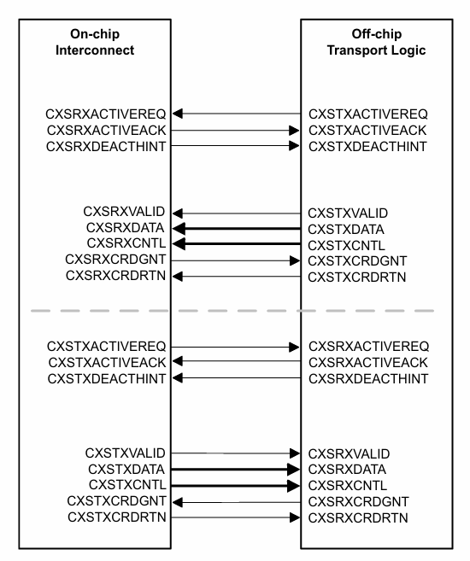
CXS Protocol
Streaming, Point-to-Point : Packetized data sent directly between two link partners — no addressing/routing layer, just protocol packets riding on flits
Full-Duplex : Independent TX and RX signal paths operate simultaneously and independently of each other
Flit-Based Transfer : Data moves one flit (flow-control unit) per clock cycle; a flit can carry multiple packets, or one packet can span several flits
Credit-Based Flow Control : Non-blocking: the transmitter only sends when it holds a credit from the receiver, preventing buffer overflow without handshake stalls
Control Field (CXSCNTL):Encodes START/END/ERROR boundary info per flit so the receiver can reconstruct packet boundaries from the raw flit stream

Slide 8
Clocking, CDC & Reset Rules
SPEC
CLK_CXS domain
CDC boundary
CLK_SYS domain
CXS Interface (RX / TX)
Link flow control
Packet parsing
Async FIFO
packet data
Control Unit & register file
Encryption & parity
Central Data Memory
2-FF synchronizers
control bits
CDC rules (§10)
Reset strategy (§11)
Gray-coded pointers, dual-FF pointer synchronizers
Single-bit control → 2-stage synchronizer
Multi-bit buses → async FIFO or handshake
No logic between stages; no fan-out from FF1
Static CDC analysis; formally verified FIFOs
RST_N_CXS and RST_N_SYS, active low
Asynchronous assertion: FSM to Idle, FIFOs flushed
Synchronous deassertion via a 2-FF reset synchronizer
Power-up: reset → clocks stable → release per domain → Configuration

Slide 9
Encryption & Parity Rules
SPEC
Balanced, or both counts even?
yes → 0 → 01 · 1 → 10
1 · Count the 0s and 1s
2 · Append parity (even / odd)
no → mode expansion
Spec rules
Worked example (spec)
Mode A (even): bits duplicated, e.g. 1011 → 11001111
Mode B (odd): expansion applies when the selected count is odd
Special case wins: counts equal or both even → 0 → 01, 1 → 10
Parity bit (even or odd) appended before CDM storage
Input 10 → one 1, one 0 → balanced
Special mapping → 1001
Even parity: two 1s → parity bit 0
Stored → 0 · 1001
The odd-mode mapping is left open; see 'One spec, two readings'.

Slide 10
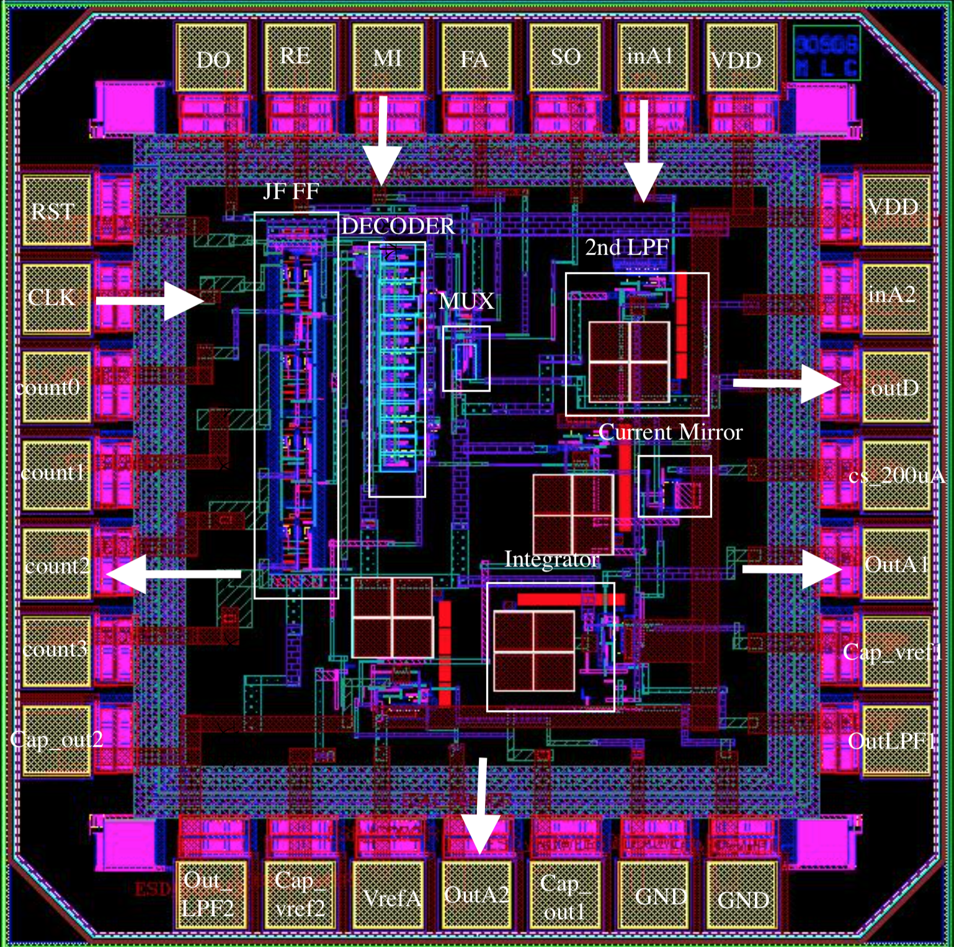
A
Part A
Mariam's implementation

Slide 11
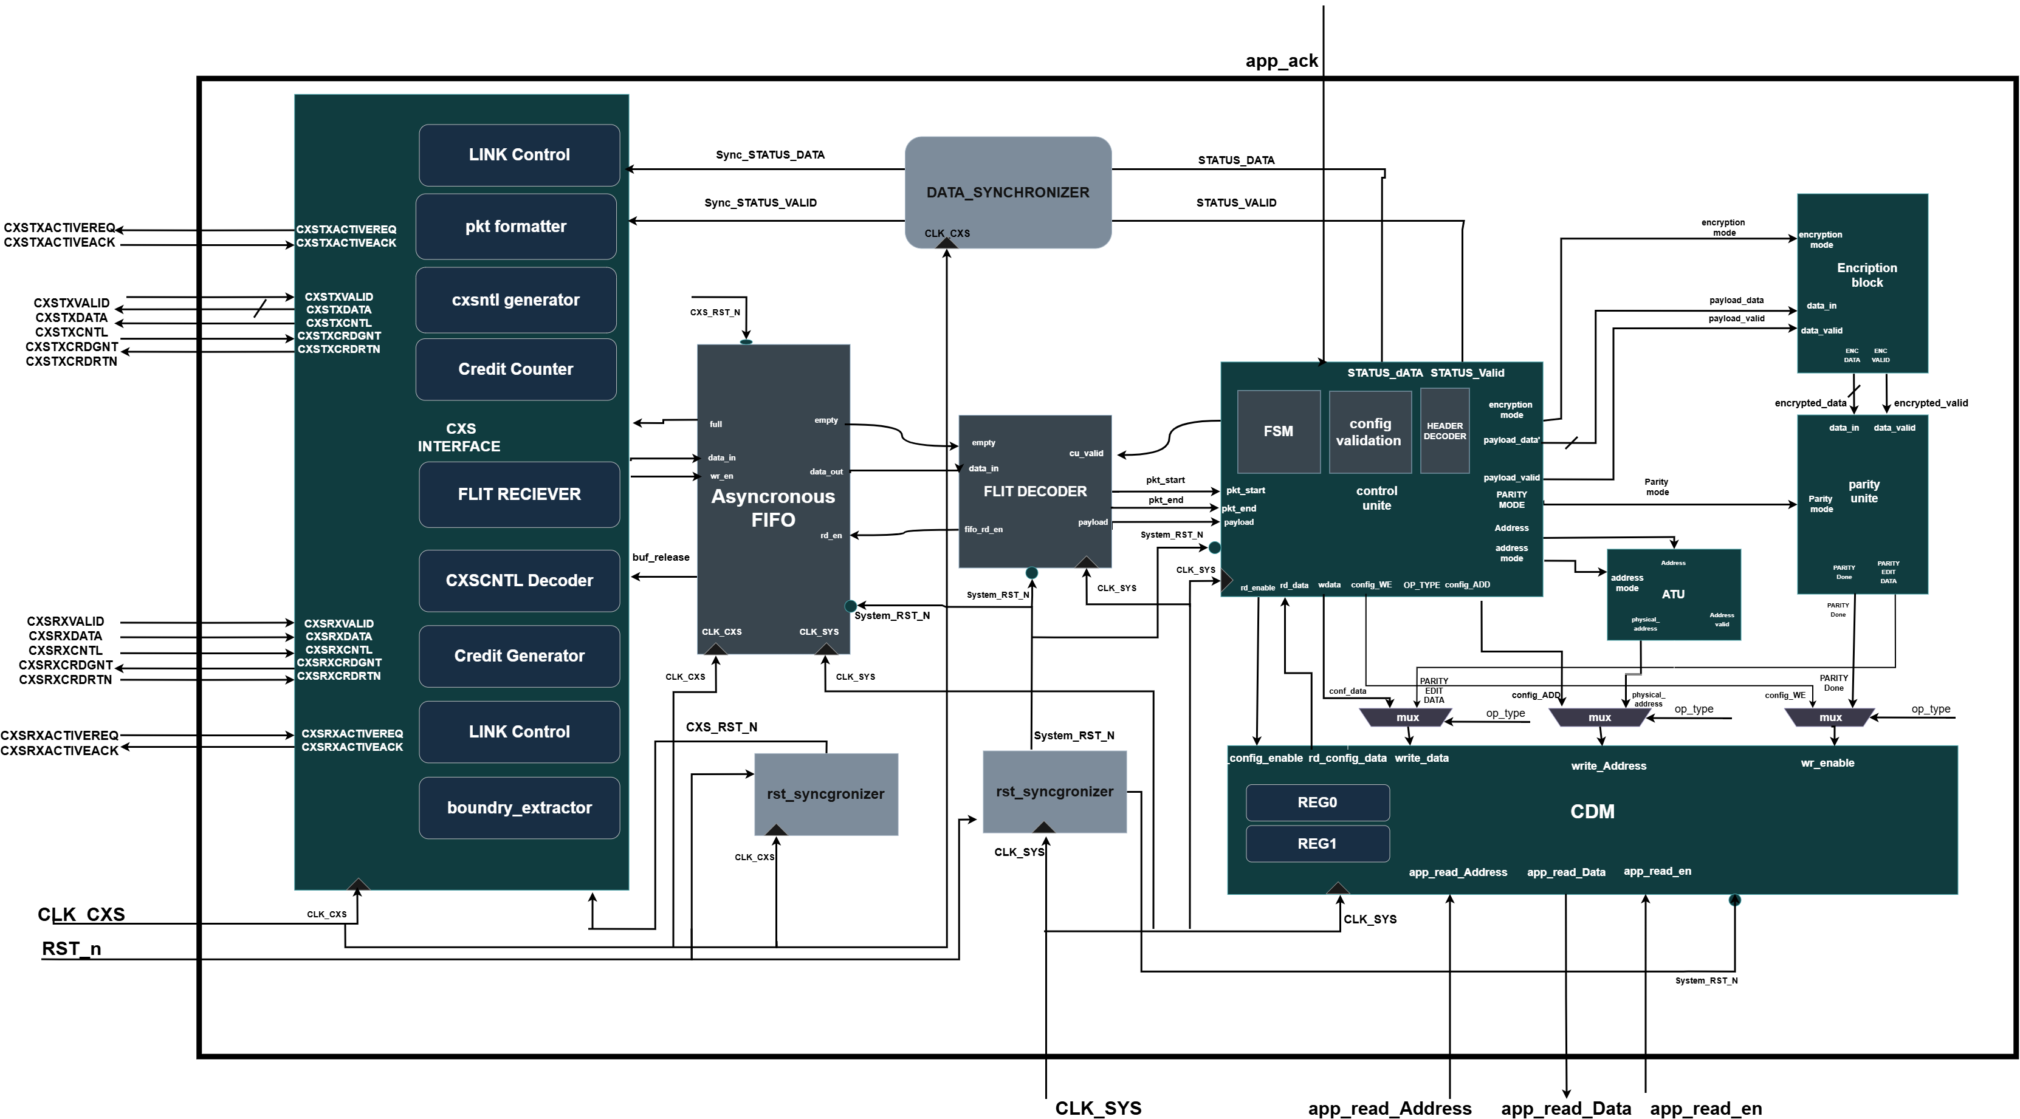
System Architecture
High-level block diagram of the CXS Bridge — CXS Interface, Control Unit, Encryption, Parity, ATU, and CDM working together.

Slide 12
High-Level Data Flow
Incoming CXS flits cross from the CXS clock domain into the system clock domain through the Asynchronous FIFO, where the Flit Decoder extracts payload and packet-boundary information for the Control Unit
Incoming Data
CXS Interface
Receives flit, credit-based flow control
Async FIFO
CDC buffer: CXS clk → System clk
Flit Decoder
Extracts payload, to 16bit internal bath start/end/error flags
Control Unit
ATU + Encryption + Parity
Translates address, encrypts payload, appends parity
CDM
Stores config (direct write) or processed payload (ATU address)
Data Sync + CXS TX
CDC buffer: System clk → CXS clk; sends status flit back

Slide 13
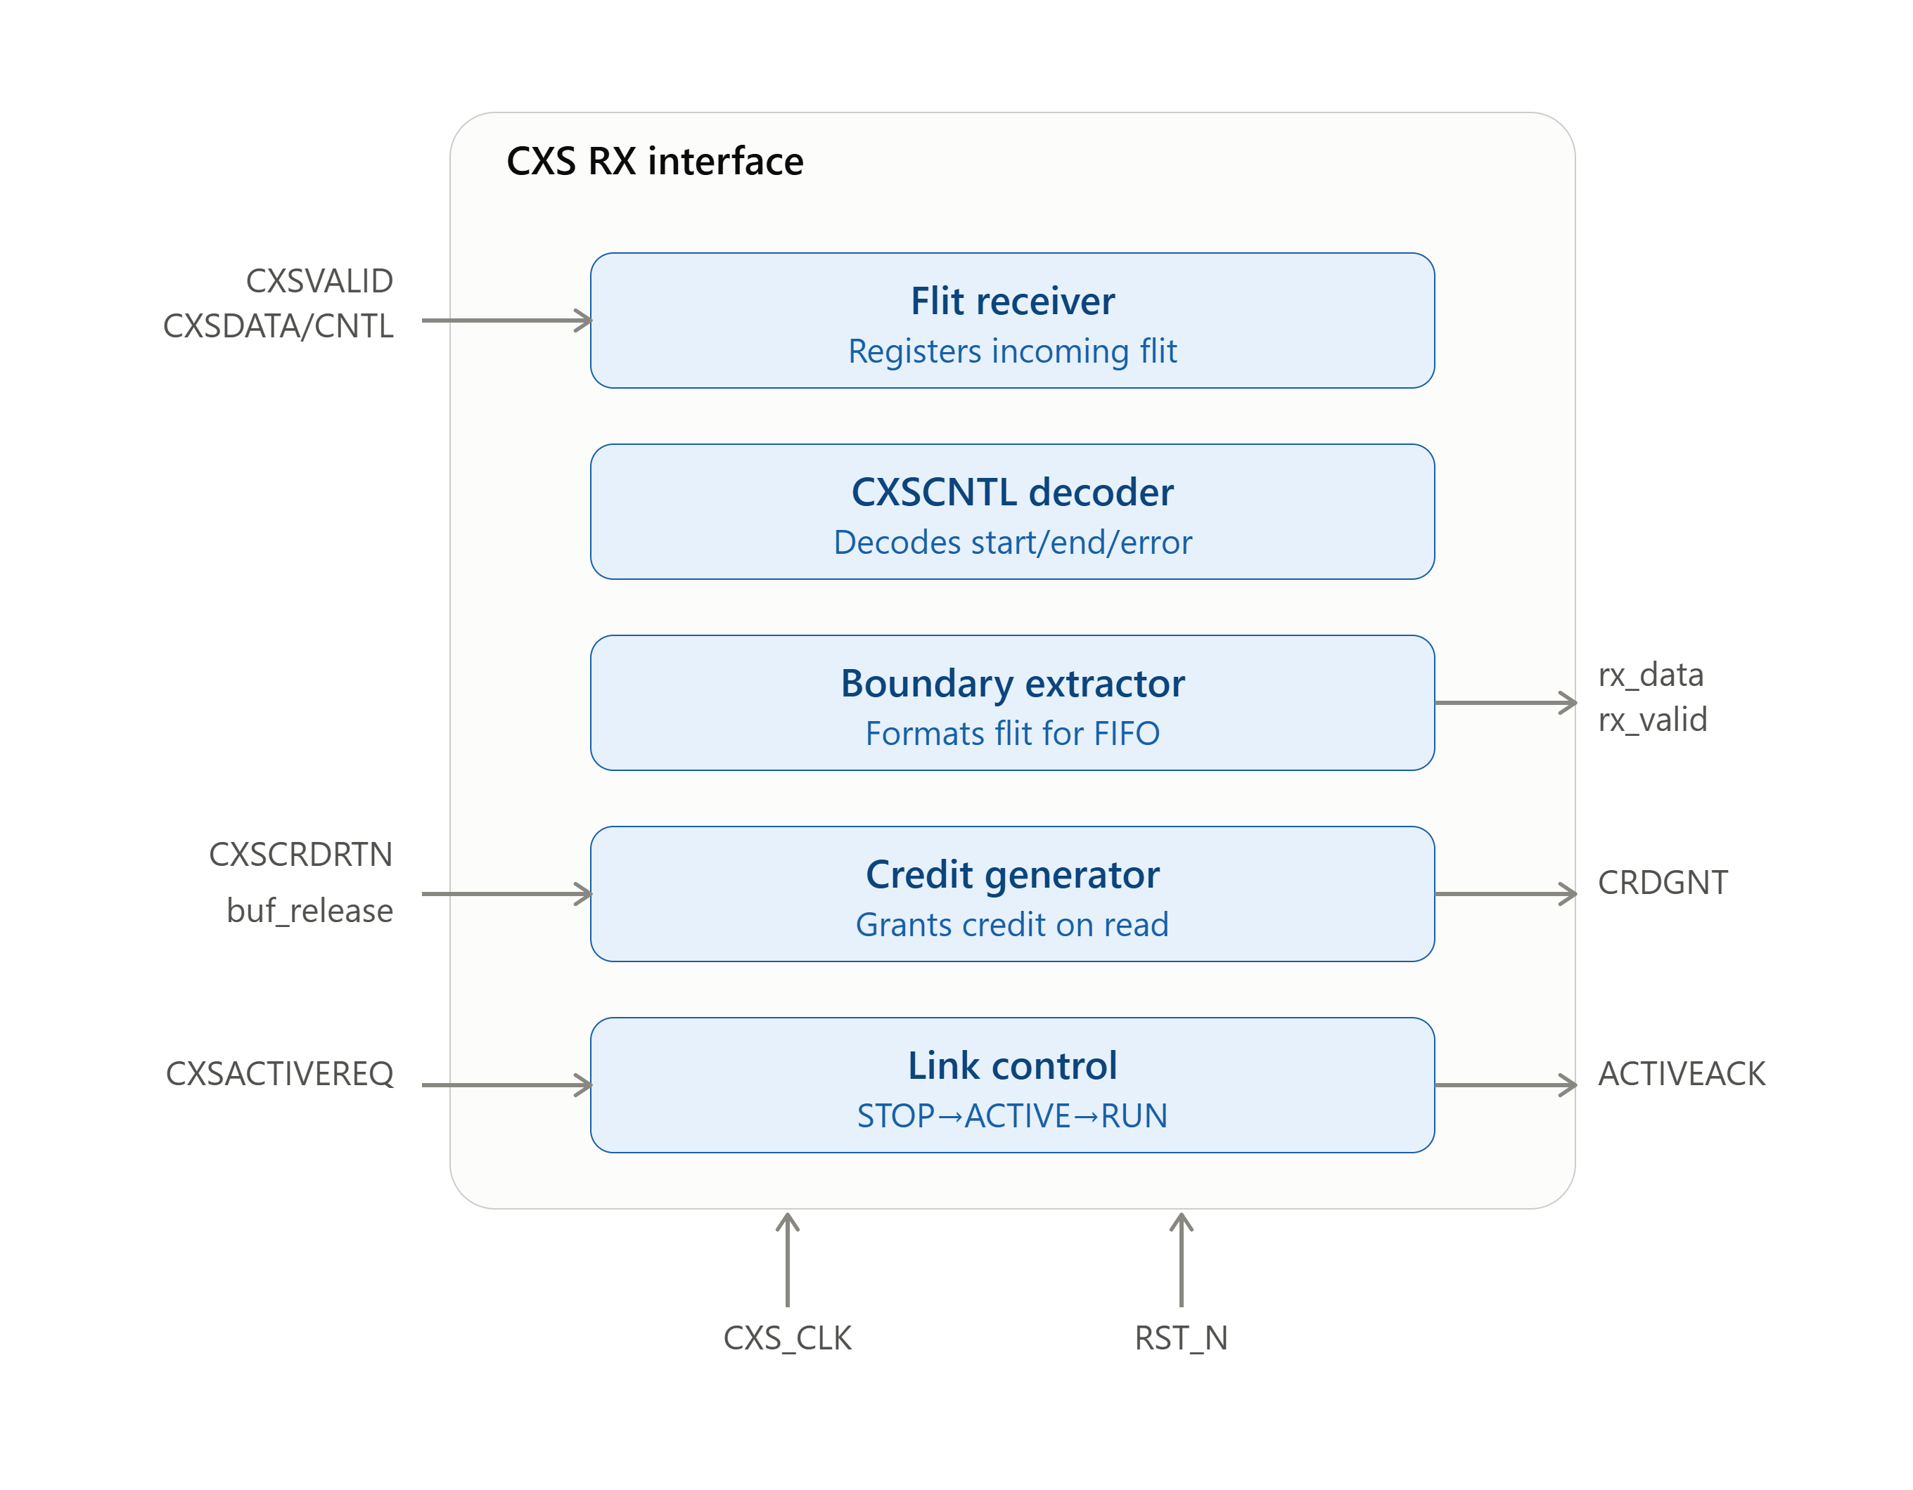

CXS Interface (RX)
Flit Receiver
Samples 32 bit CXSDATA/ 6 bit CXSCNTL on the CXS clock when CXSVALID is asserted; registers the flit
CXSCNTL Decoder
Decodes the control field to identify packet start, end, and error boundaries
Boundary Extractor
Formats the decoded flit + boundary info for storage into the Async FIFO
Credit Generator
Monitors FIFO space; asserts CXSRXCRDGNT when a read frees a buffer slot, deasserts when FIFO is full
Link Control (RX)
FSM managing link activation/deactivation handshake (CXSRXACTIVEREQ/ACK)

Slide 14

CXS Interface (TX)
CXS Packet Formatter
Converts status_valid/pkt_type/error_type into internal packet format with start/end markers
CXS TX Credit Counter
Tracks available transmission credits (CXSTXCRDGNT in, consumed on each flit sent, max 15)
CXS Flit Transmitter
Transmits the flit only when packet is available, link permits sending, and credit is available
CXS Control Encoder (cxscntl_encoder)
Encodes START/END/ENDERROR into the final CXSTXCNTL field
Link Control (TX)
Manages CXSTXACTIVEREQ/ACK handshake and gates transmission permission

Slide 15
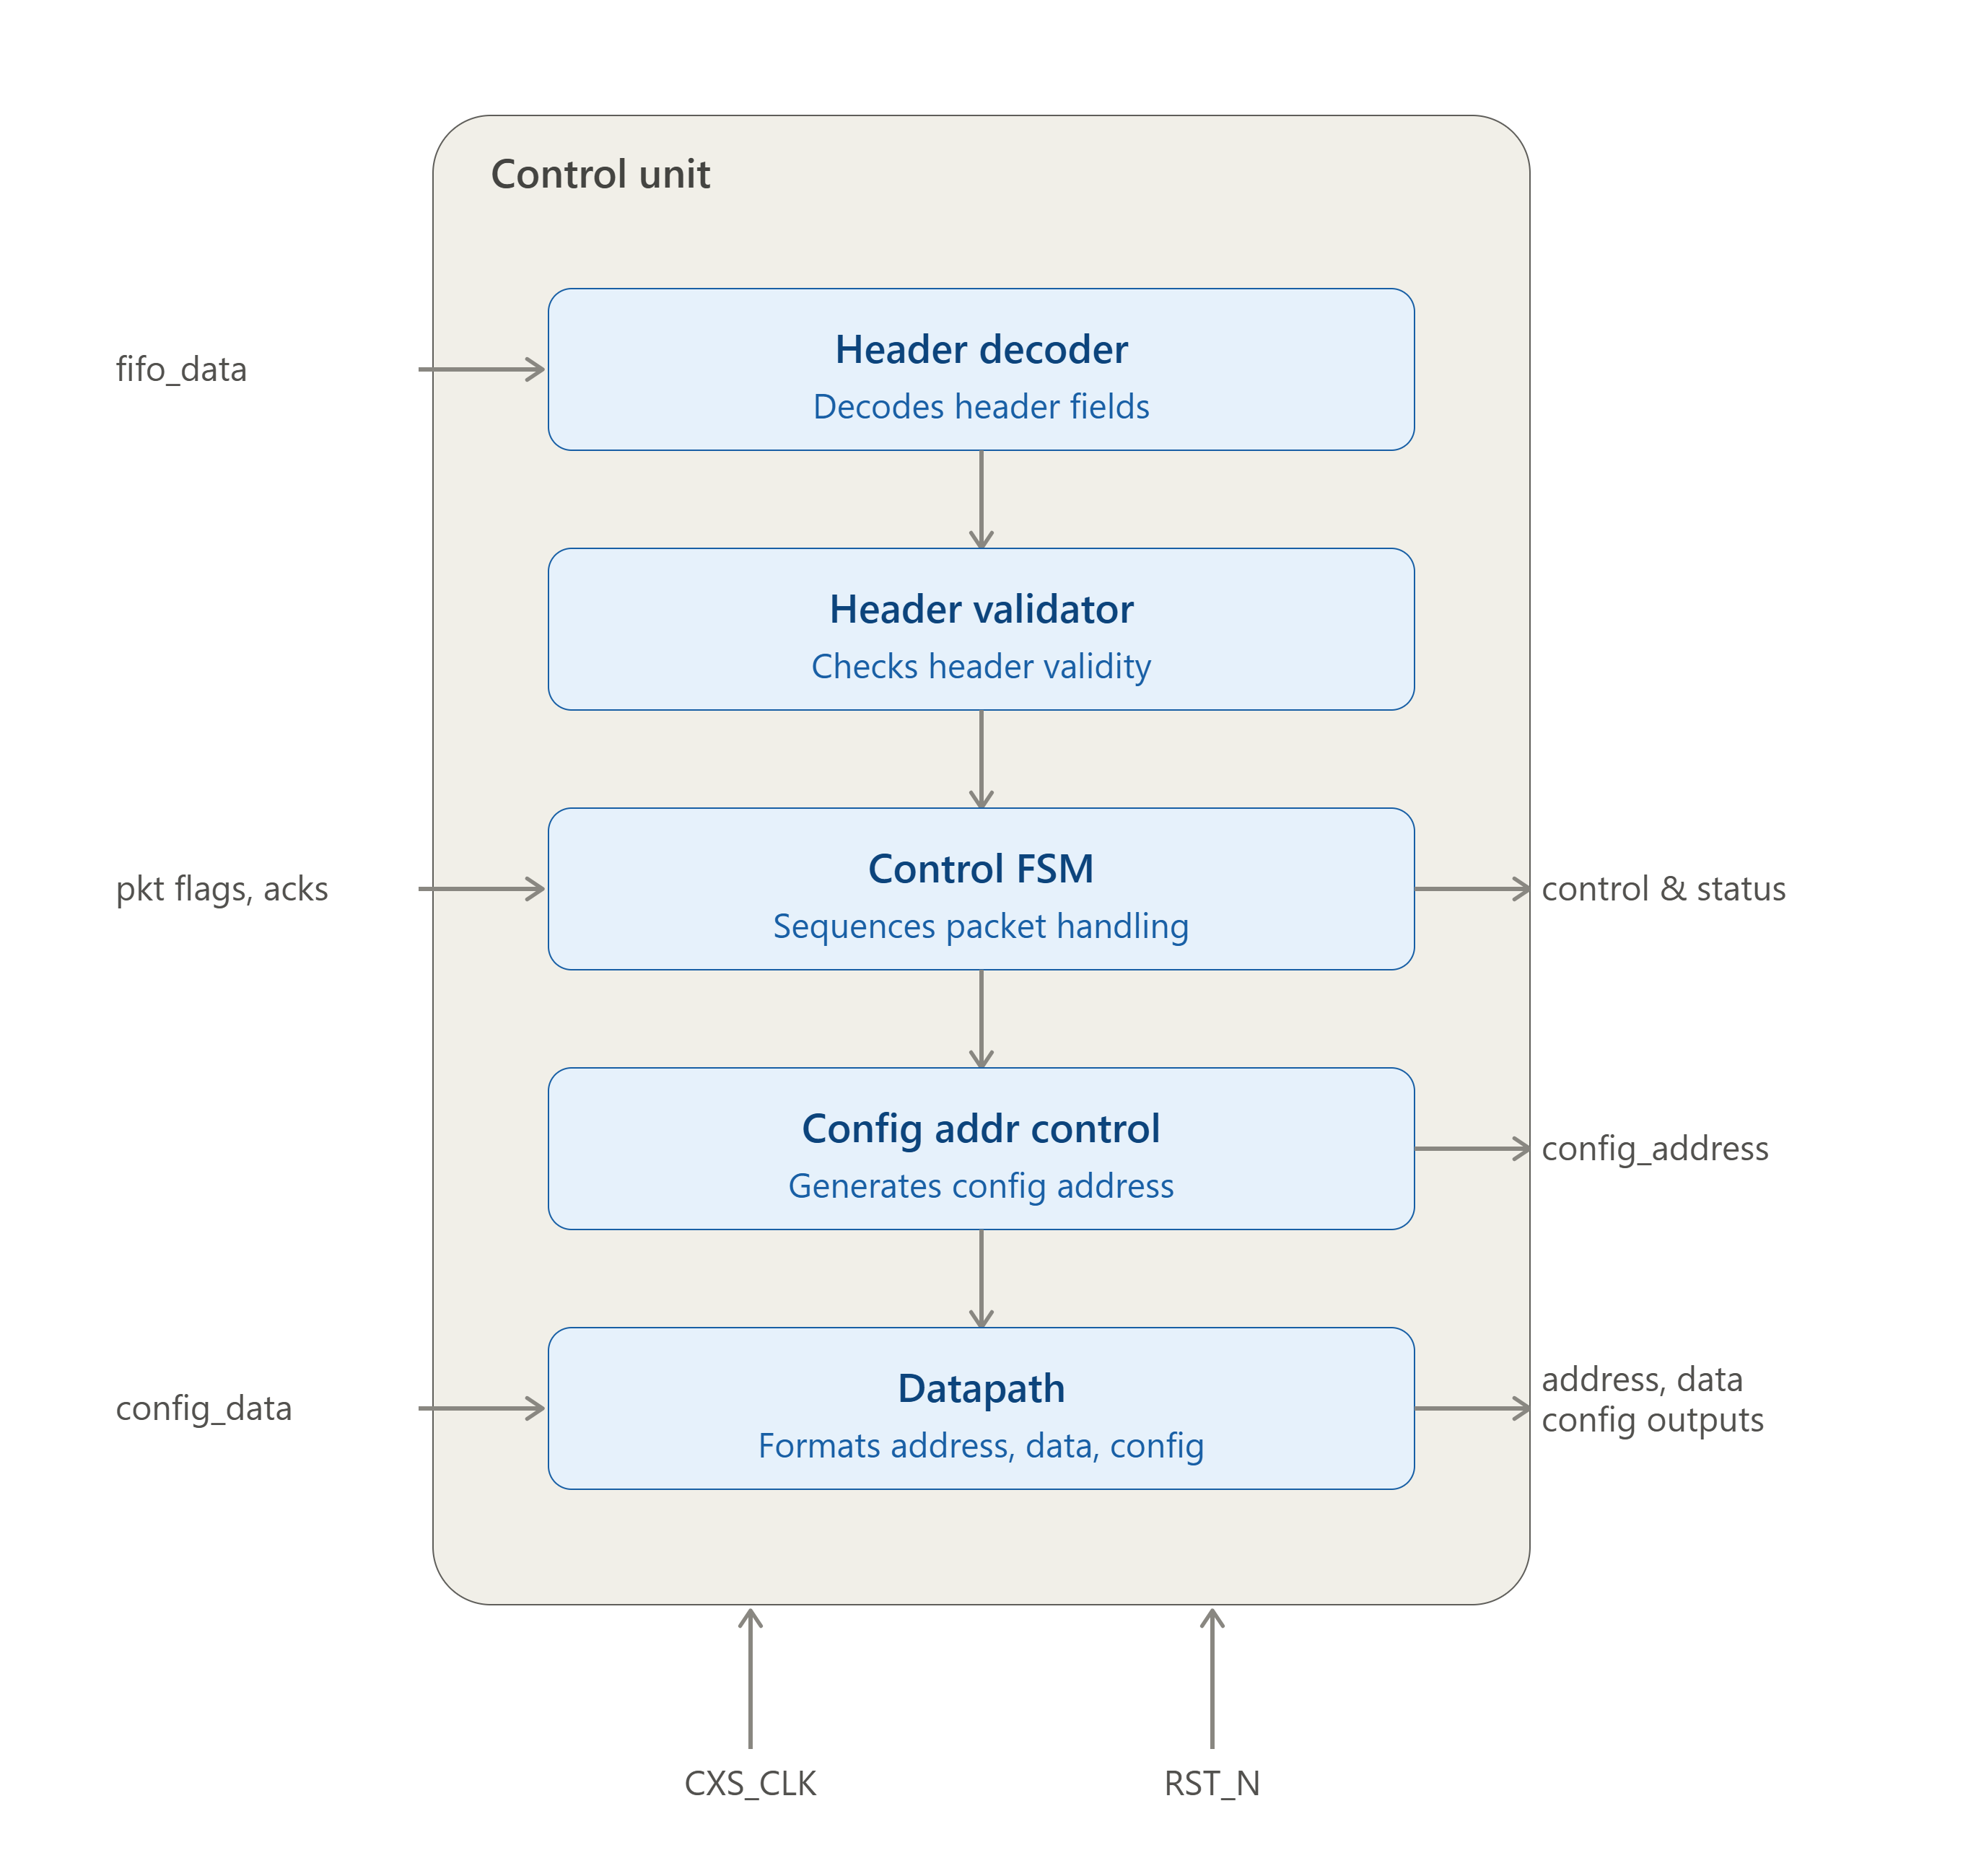
Control Unit
Central controller of the CXS Bridge — receives the formatted packet stream from the RX Interface and manages system operation according to the current protocol state
Packet boundary detection: Uses pkt_start / pkt_end signals to identify each packet; the first payload word (pkt_start = 1) is interpreted as the packet header
Header Decoder: Extracts packet type and control info from the header, letting the FSM determine the required operation
Per-packet-type behavior:
  Configuration Packets → validates content
  Link Packets → verifies header, transitions system to Link-Up state
  Data Packets → splits each 16-bit payload word into 8-bit address + 8-bit data
Error handling: Any validation error → Control Unit generates a status packet, sent back to the remote transmitter

Slide 16
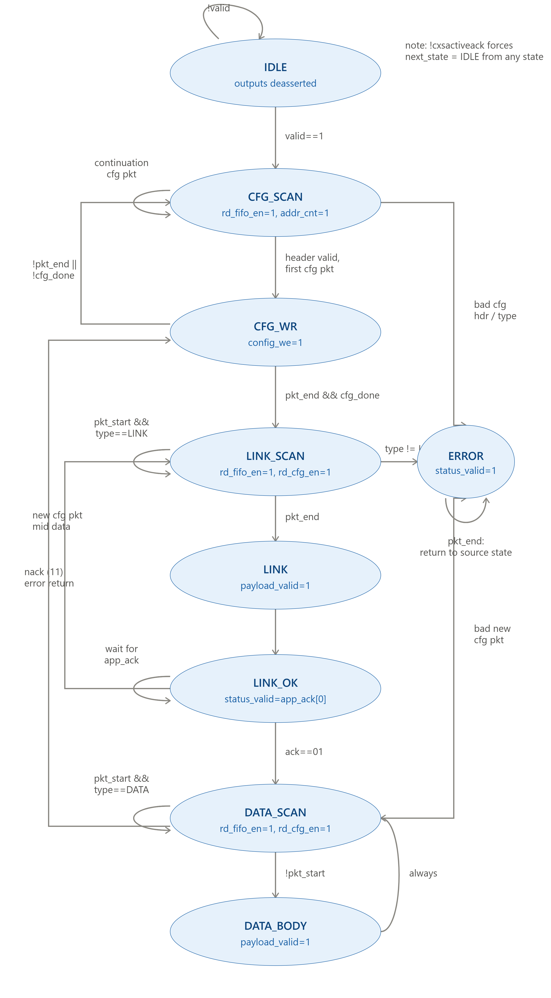
Control Unit FSM
IDLE
Default/reset state; waits while FIFO is empty
CFG
SCAN
Reads first flit, checks if it's a config header
rd_fifo_en=1, addr_counte=1
CFG_WR
Writes config payload into CDM
config_we=1
At system deactivation
LINK_SCAN
Verifies Link-Up packet after config is done
rd_fifo_en=1
LINK
Link validated; ready for data transfer
status_valid=1
DATA_SCAN
Detects start of payload packet
rd_fifo_en=1, rd_configen=1
DATA_BODY
Processes payload data until pkt_end
payload_valid=1, rd_config_en=1
ERROR
Entered on invalid header/type/protocol violation; holds until reset
status_valid=1, rd_fifo_en=1

Slide 17
ATU & Central Data Memory (CDM)
ATU
Central Data Memory (CDM)
Converts the logical address received from the data packet into a physical CDM address using the following formula :
Physical Address = Logical Address – Base Address + Start Address + 2
Supports configurable address translation mode with send the Base address with configuration packet.
The translated address is used to access the corresponding device memory region.
Configuration Region: Stores the configuration packet beginning at address 0x0000 ,0x0001, including the encryption mode, parity mode, number of devices, base address,and device memory-region information.
Payload Region: Stores payload data belonging to each configured device The physical address is generated by the ATU based on the logical address contained in the data packet.
Allow read operation for application devices
Allow read operation for control unit to access configuration data stored

Slide 18
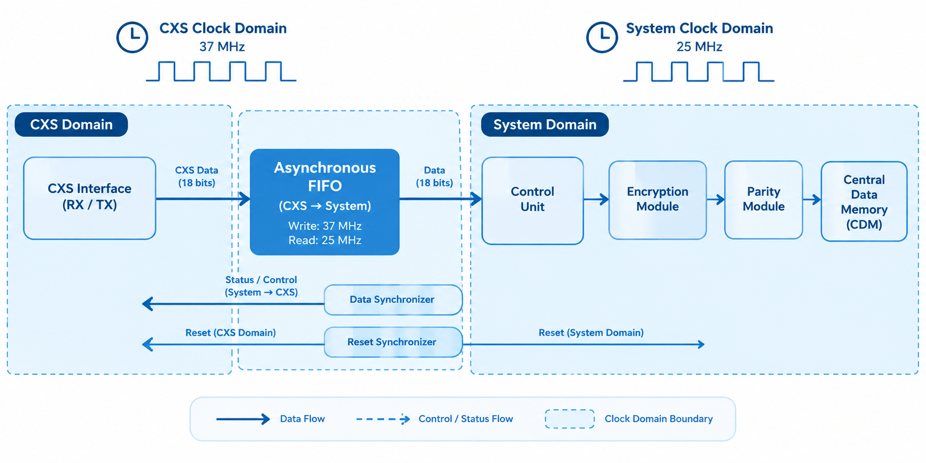
Clock Domain Crossing (CDC)
Objective
Direct transfer between asynchronous clock domains can cause:
Metastability
Data corruption
Incorrect pulse detection
1
Clock Domains
2
The design operates using two independent clock domains:
CXS Clock Domain: 37 MHz
System Clock Domain: 25 MHz
Solutions
Three CDC techniques are implemented:
Asynchronous FIFO – CXS → System domain
Data Synchronizer – System → CXS domain
Reset Synchronizer – Generates synchronized resets for both domains
3

Slide 19
CDC solutions
Asynchronous FIFO
Safe multi-bit data transfer between 37 MHz CXS domain → 25 MHz System domain.
Data Synchronizer
Transfers status information from System domain → CXS domain.
Reset Synchronizer
Separate reset synchronization for each clock domain.
Asynchronous reset assertion
Rate matching and buffering
Full/Empty status generation
Prevention of data loss between different clock rates
Uses a configurable multi-stage flip-flop synchronizer.
Synchronizes the enable/control signal.
Synchronous reset deassertion

Slide 20
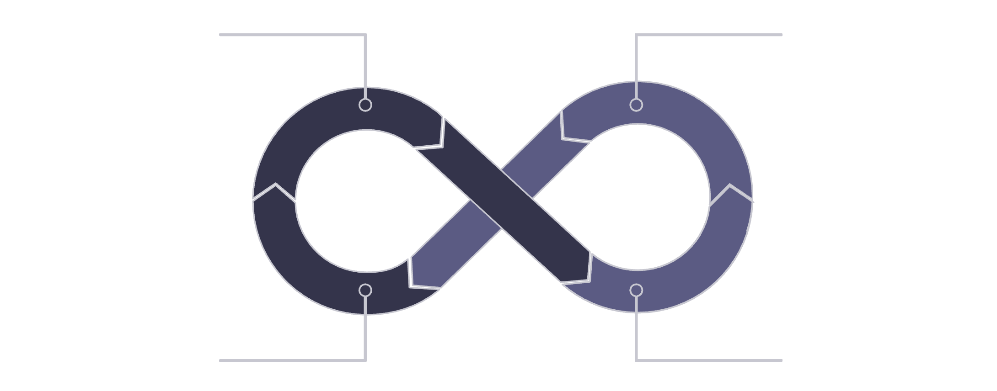
Verification Strategy
Two-Level Verification Approach
1. Unit-Level Verification
Each major CXS interface is verified independently.
Dedicated SystemVerilog self-checking testbenches are used.
Corner cases and protocol behavior are included.
2. End-to-End Verification
Verifies the complete CXS Bridge from RX to TX.
Functional behavior is checked using self-checking testbench tasks and assertions.
1
End to end verfication
Unit test for main blocks
Main Verification Goals
Self checking functions
Corner Case
Verfication
2
Correct CXS protocol operation
Correct packet processing
Correct credit-based flow control
Correct configuration and error handling
Correct encryption, parity, address translation, and CDM storage

Slide 21
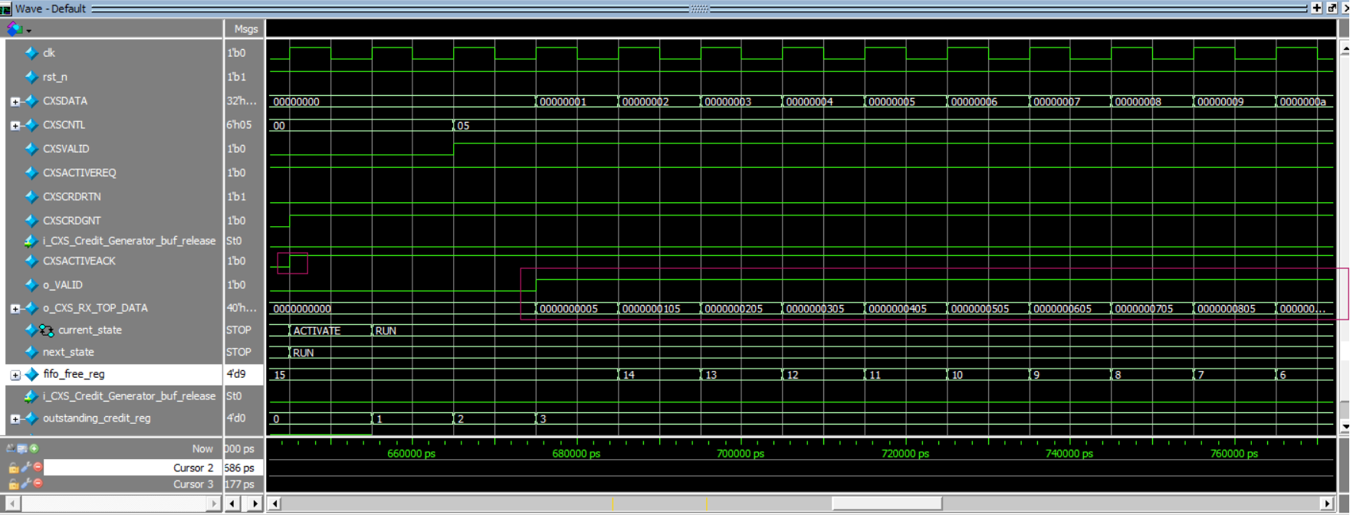
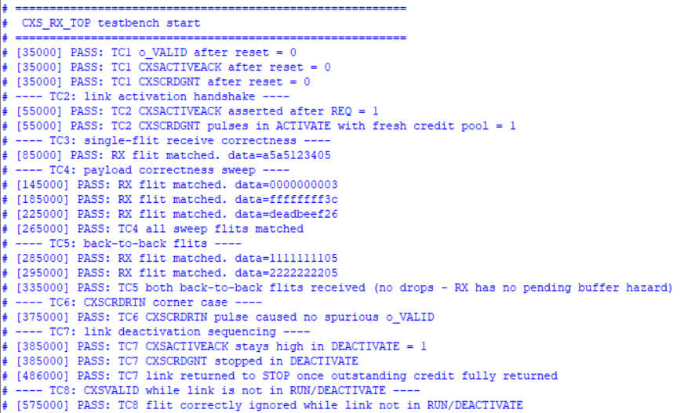
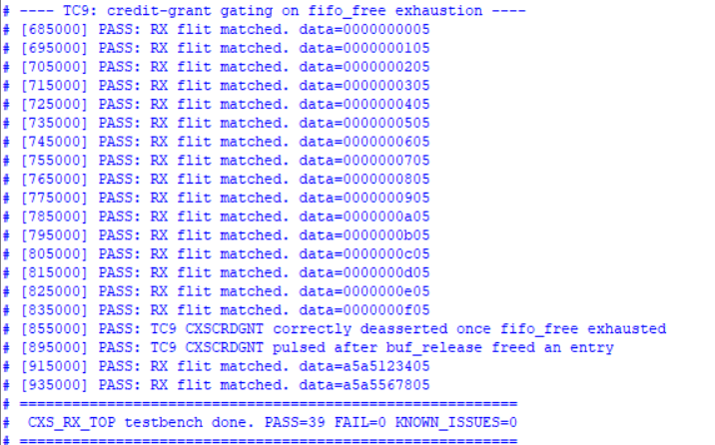
CXS RX Unit Verification
Main Scenarios
Reset verification
Link activation handshake
Single-flit reception
Payload/control combinations
Back-to-back flits
Credit return
Link deactivation
Invalid flit reception
Credit exhaustion and buffer release
Result
9/9 RX unit test cases PASS
Data path verified
Control decoding verified
Link control verified
Credit management verified
FIFO/buffer management verified
Corner cases verified
100% code coverage on questasim

Slide 22
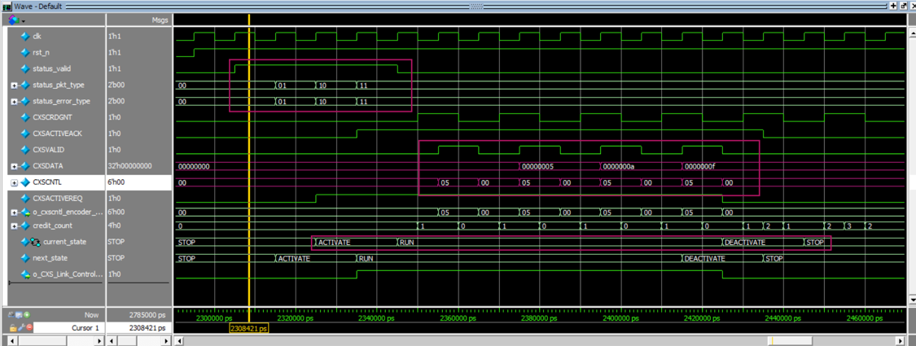
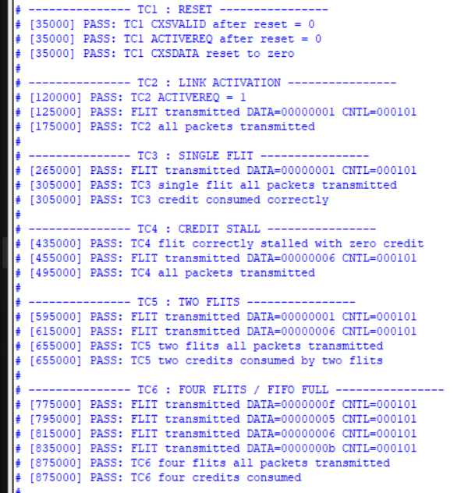
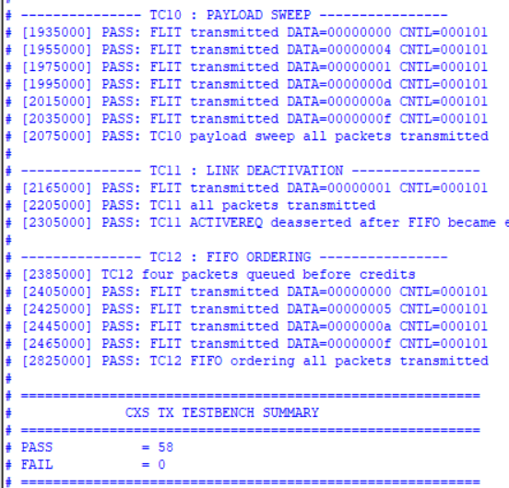
CXS TX Unit Verification
Main Scenarios
Reset verification
Link activation
Single-flit transmission
Transmission without credit
Multi-flit transmission
FIFO operation
Multiple queued packets
Credit accumulation/consumption
Credit exhaustion
Link deactivation
Result
10/10 TX unit test cases PASS
The TX unit was verified for packet formatting, buffering, transmission, and credit-based flow control.
Link control verified
Corner cases verified
100% code coverage on questasim

Slide 23
End-to-End Verification
Verification Includes
Reset and link initialization
Credit-based flow control
Configuration packets
Error detection and recovery
Link/Application handshake
Data packet processing
CDC/FIFO data transfer
Encryption and parity
Address translation
CDM write/read
Link deactivation
NACK/error response
CDC / Asynchronous FIFO
Control Unit
ATU
CXS RX Interface
Encryption + Parity
Central Data Memory
Application Interface
CXS TX Interface

Slide 24
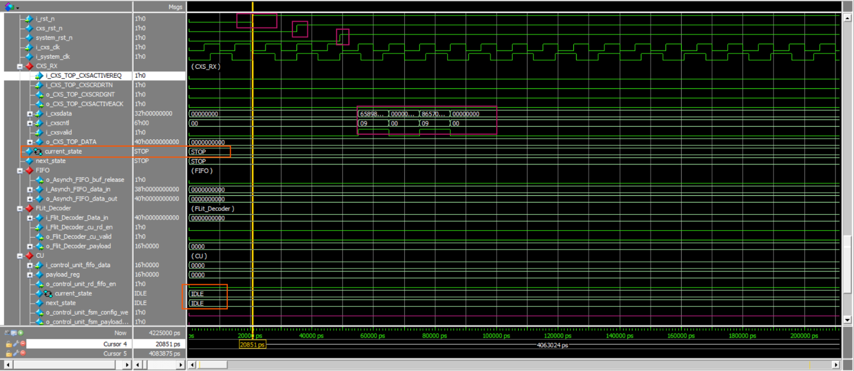
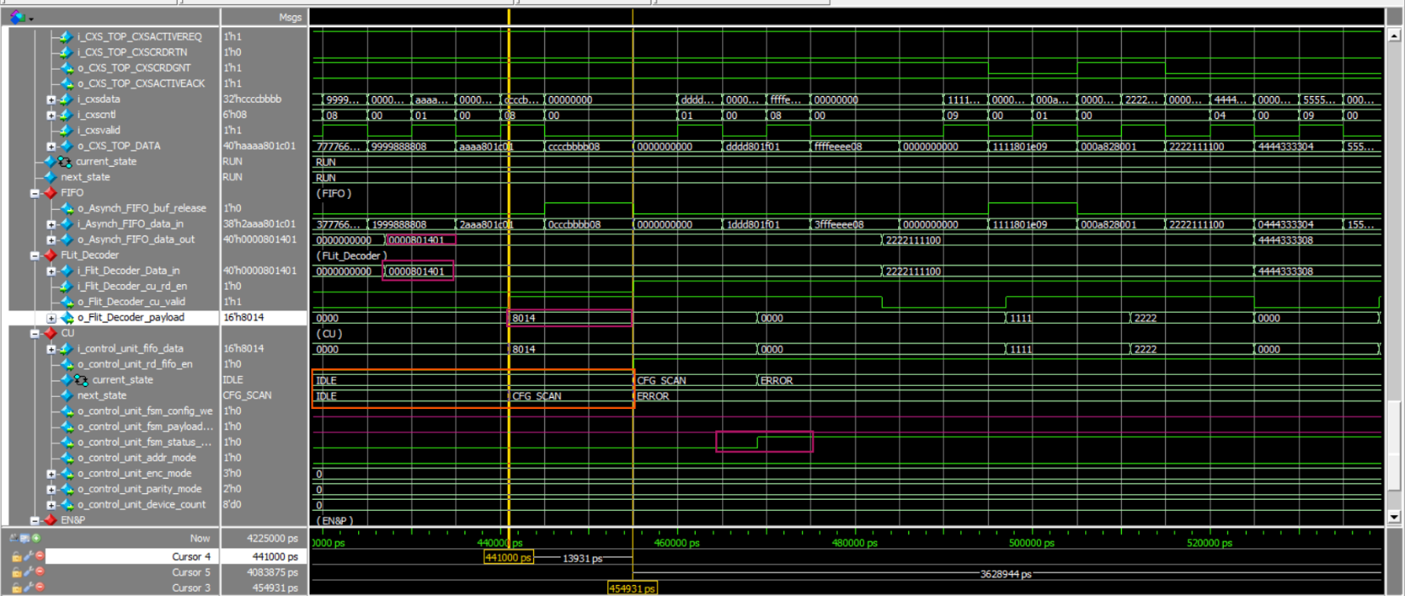
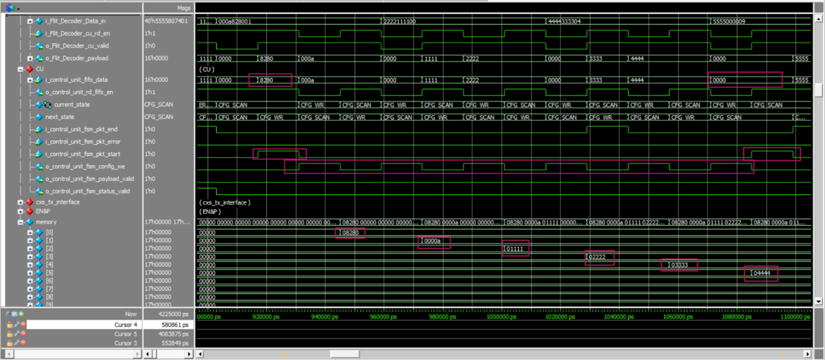
Initialization & Configuration
1. Reset & Pre-Activation
System is reset and enters the idle state.
Flits received before link activation are rejected.
No credits are granted.
No payload reaches the Control Unit.
2. Link Activation
CXSACTIVEREQ is asserted.
RX responds with CXSACTIVEACK.
Initial credits are granted.
RX enters the active state.
3. Configuration Validation
Tested invalid configuration cases:
Illegal device count
Illegal encryption mode
Illegal parity mode
Illegal packet type
Expected behavior:
Invalid configuration → ERROR state → Configuration write disabled.
4. Valid Configuration
Valid configuration packet is accepted.
Configuration data is stored correctly.
FSM progresses toward the operational state.

Slide 25
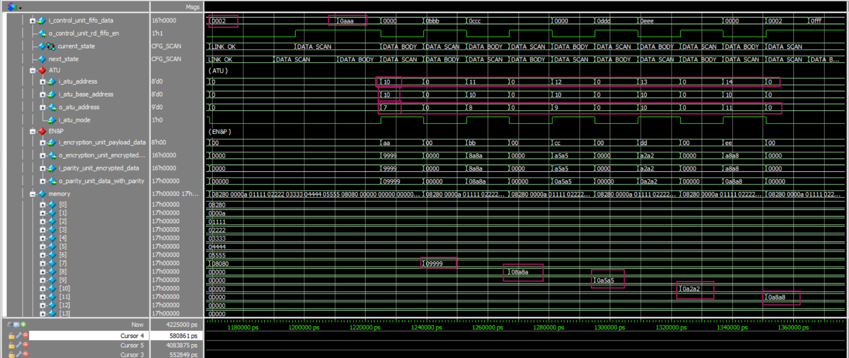
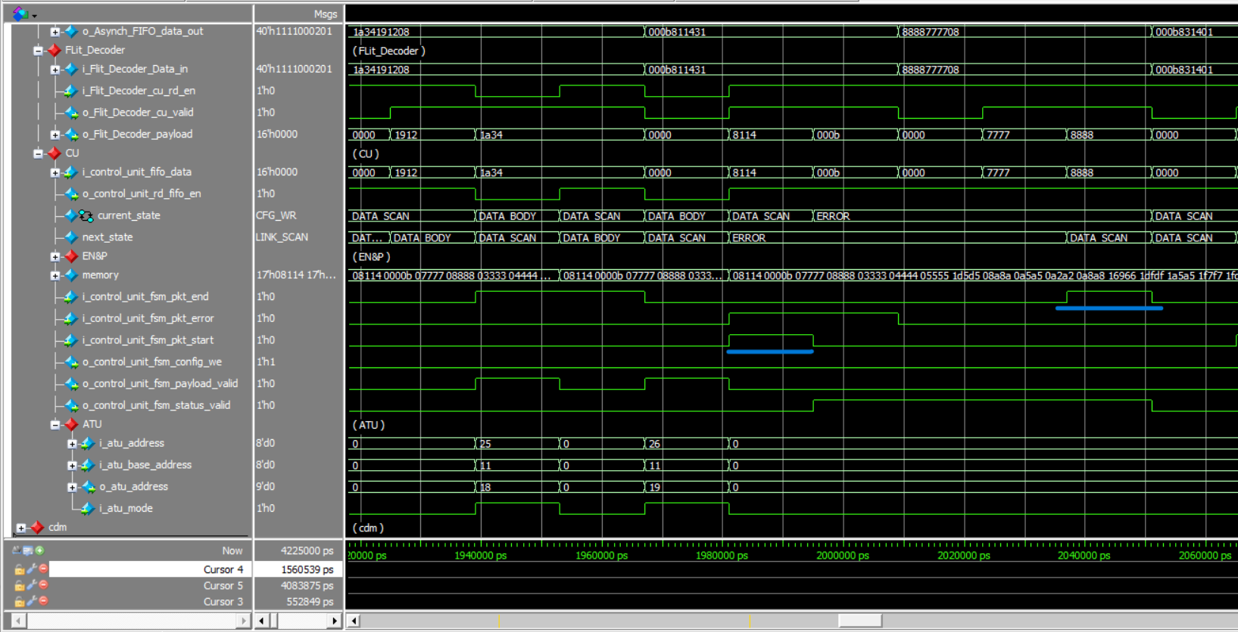
Data Processing
1. Data processing test cases
Correct packet decoding
Correct payload extraction
Correct FSM transitions
Correct logical-to-physical address translation
Correct encryption result
Correct parity generation
Correct CDM write address
Correct CDM stored data
No duplicated or skipped memory writes
2. Error handling in data packet
Expected behavior:
Invalid Data packet → ERROR state → Data write disabled and error packet discard and send status pkt error .
3. Valid Data
Valid Data packet is accepted.
Valid data is stored correctly.
FSM progresses toward the operational state.

Slide 26
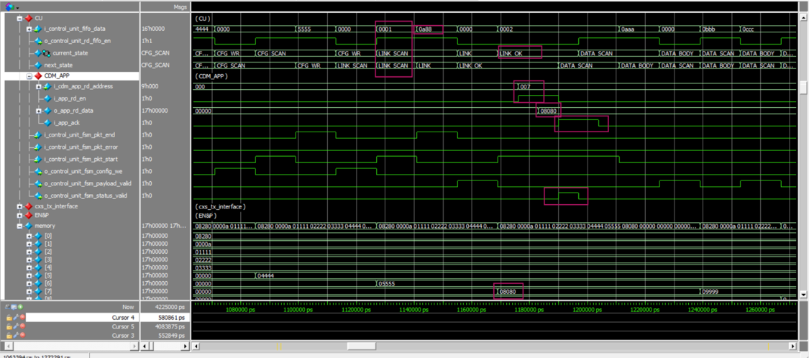
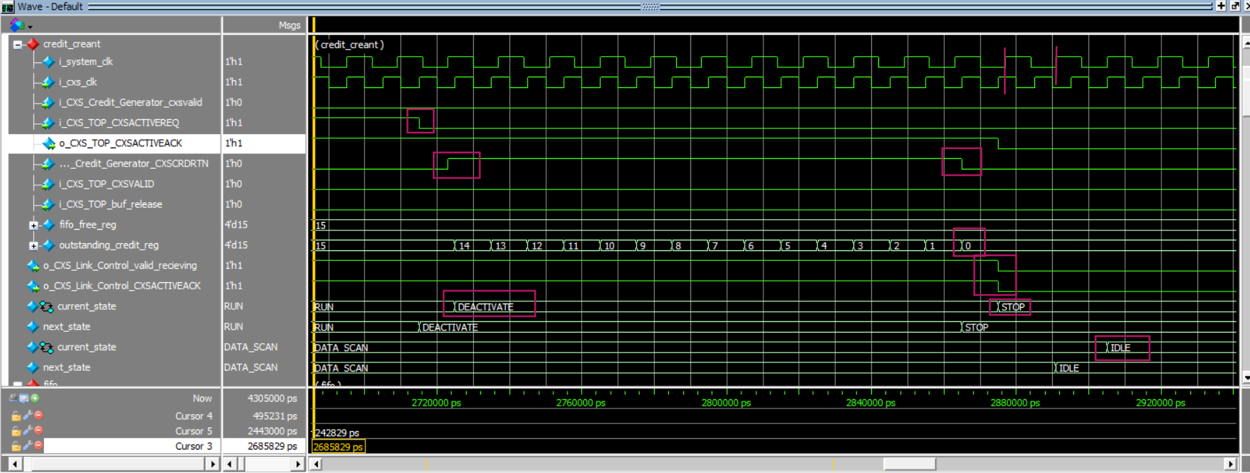
Link/Application & Deactivation
1.Application Handshake
Link packet is processed successfully.
Control Unit reaches LINK_OK.
Application reads the expected CDM location.
Returned data is compared with the expected value.
i_app_ack determines the next FSM transition.
Successful ACK allows transition to the data phase.
For application receiving unexpected data it return to link scan and sent invalid link pkt and receive another link packet
2.Link Deactivation
CXSACTIVEREQ is deasserted.
RX FSM transitions:
RUN → DEACTIVATE → STOP
Outstanding credits are returned.
Credit count drains to zero.
CXSACTIVEACK is deasserted.
Control Unit returns to IDLE.

Slide 27
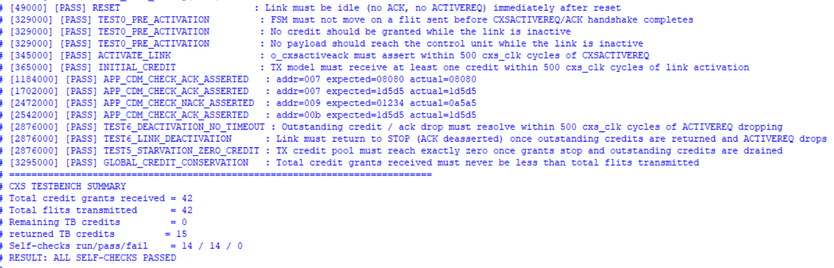
Verification Results
End-to-End Verification
Reset and initialization
Link activation and credit grant
Configuration validation
Error detection and recovery
CDC/FIFO data transfer
Application ACK handshake
Encryption + parity
ATU address translation
CDM storage/readback
Link deactivation
Credit conservation
NACK handling
PASS → The system pass all test cases

Slide 28
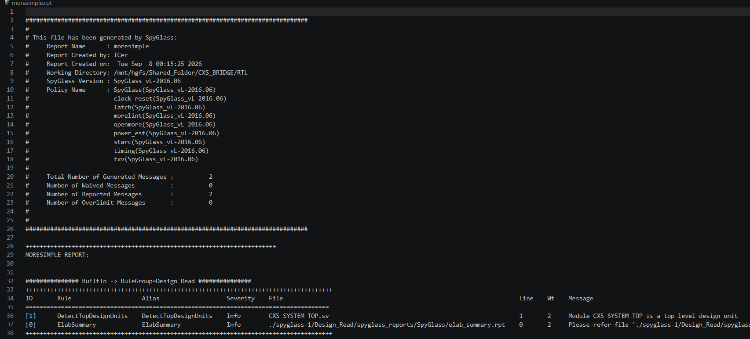
Linting Results
Linting
Result:
No Error-level violations
No unintended latches
No combinational loops
No CDC violations reported by the applied lint rules
No STARC coding violations
PASS — RTL is lint-clean under the applied SpyGlass rule set.

Slide 29
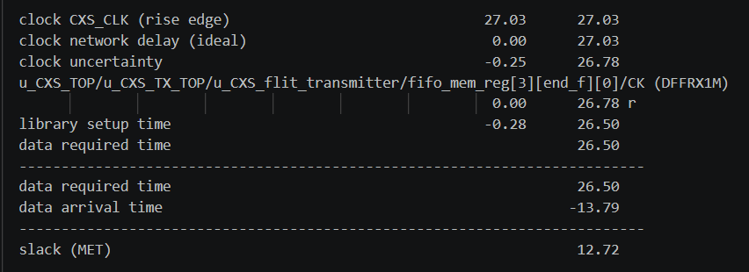
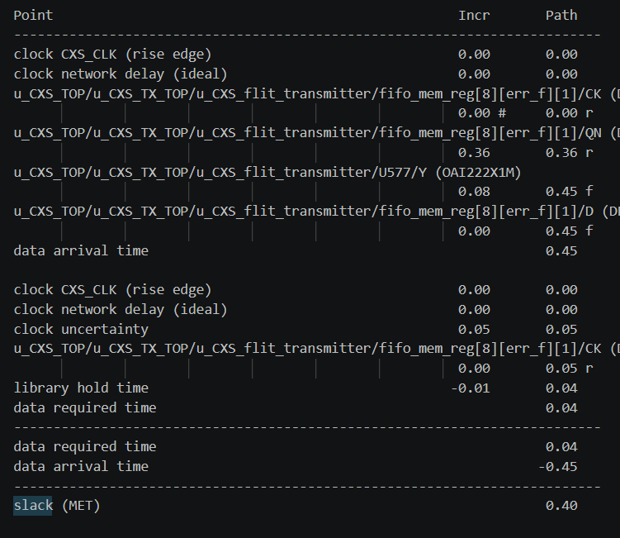
Synthesis Timing Results
Setup Timing Analysis
Checks whether data arrives before the capture clock edge.
The critical path was analyzed using the synthesized netlist.
No setup violations were reported.
Approximately 47% of the clock period remains as timing margin.
Hold Timing Analysis
Verifies the minimum-delay paths.
No hold violations were reported.
Overall Result
Setup ✓ | Hold ✓ | Timing MET

Slide 30
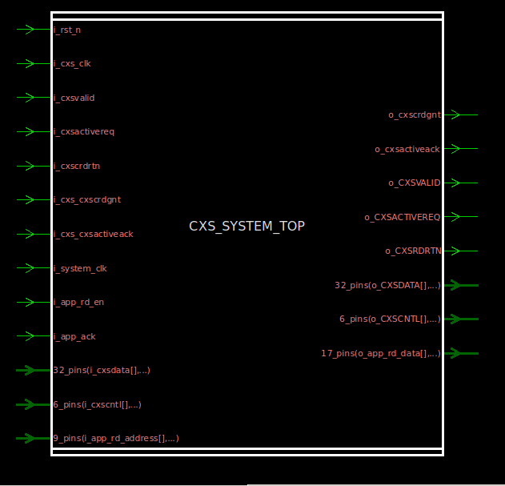
B
Part B
Fady's implementation

Slide 31
Architecture at a Glance
PART B

Slide 32
Key Design Decisions
PART B
1
Decode before the CDC
2
Wide link, 2 packets per FLIT
What: Packet Formatter extracts valid 32-bit TLP words in CLK_CXS.
Why: Only small, already-framed words cross the Async FIFO.
What: 256-bit data + 14-bit CXSCNTL, as in the detailed spec.
Why: START / END pointers let one FLIT carry two TLPs.
3
Toggle synchronizer for errors
4
5-state FSM, read-through FIFO
What: Error pulse → toggle flop → 2-FF → edge detect.
Why: A slower CXS clock cannot miss a one-cycle system pulse.
What: IDLE · CFG_HDR · LINK_UP · DATA_HDR · ERROR.
Why: Headers are peeked, so no extra "scan" states are needed.

Slide 33
CXS RX Path
PART B
combinational
16 × 270 bits
3-state FSM
32 bits × 8
RX Interface
FLIT FIFO
Packet Formatter
Async FIFO
Writes {CXSCNTL, CXSDATA} when CXSVALID = 1 and the FIFO is not full
Synchronous, CXS clock
Wrap-bit pointers → full / empty
Registered read
IDLE → CAPTURE → STREAM
Writes only words inside a packet
Stalls while the Async FIFO is full
Crosses into CLK_SYS
Gray pointers, 2-FF sync
Link partner (CXS TX side)
Credit Manager
counter starts at the FIFO depth: −1 per write, +1 per read -1 · CXSRXCRDGNT while credits remain

Slide 34
Packet Formatter: CXSCNTL Decoding
PART B
CXSCNTL
14 bits
END_PTR[1]
END_PTR[0]
END_ERROR
END
START_PTR
START
[13:11]
[10:8]
[7:6]
[5:4]
[3:2]
[1:0]
example value
110
010
00
11
10
11
FLIT
8 × 32-bit words
Packet 0: START_PTR 0 → END_PTR 2
Packet 1: START_PTR 1 (×4) → END_PTR 6
W0
W1
W2
W3
W4
W5
W6
W7
written
written
written
dropped
written
written
written
dropped
Word-valid rule
Limitations
Word i is written when START[j] and END[j] are set and START_PTR[j] × 4 ≤ i ≤ END_PTR[j]
STREAM walks W0 → W7, one word per cycle
Pauses while the Async FIFO is full
Packets spanning FLITs are not supported
END_ERROR is decoded but not yet used

Slide 35
CXS TX Path & Error Return
PART B
1 · Error detected
2 · Toggle + 2-FF
3 · Edge detect
4 · Packet Encoder
5 · Holding register
6 · Credit gate
one-cycle error_valid, 2-bit code held
pulse flips a toggle; two flops re-time it
XOR with a delayed copy → one CXS pulse
one-word FLIT: opcode 0xE0 + code, START0/END0
stores the FLIT; flit_ready = 0 while pending
sends when TX credit > 0 → CXSTXVALID / DATA / CNTL
CLK_SYS
CDC
CLK_CXS
Credit available (ERR_TX_FLIT)
No credit (TX_CREDIT_STALL)
Response FLIT is captured, then sent while TX credit > 0
TX credit counter −1 per sent FLIT
FLIT parked in the holding register, flit_ready = 0
CXSTXCRDGNT grants are counted up to 16
The first grant releases the FLIT

Slide 36
Control Unit & TLP Handling
PART B
Header
word 0
BASE_ADDR
unused
DEV_COUNT
ENC_MODE
ADDR_MODE
PARITY
SYS_STATE
[31:24]
[23:16]
[15:8]
[7:4]
[3]
[2]
[1:0]
Payload
transfer words
ADDR
DATA
[31:16]
[15:0]
Device entry
config words
END_ADDR
START_ADDR
[31:16]
[15:0]
SYS_STATE | Control Unit action | Error → code
01 Configuration | Header → CDM 0x00 (direct write); next DEV_COUNT words → 0x01, 0x02, … | ENC_MODE not 0000 / 0001 → 01
10 Link-Up | Consume the TLP; payload words written; enter the data phase | Header rejected → 00 (validation placeholder)
11 Transfer | ADDR → ATU · DATA → Encryption → Parity → CDM | Idle / Config header in data phase → 10
00 Idle | Words dropped while waiting for a Configuration header | —

Slide 37
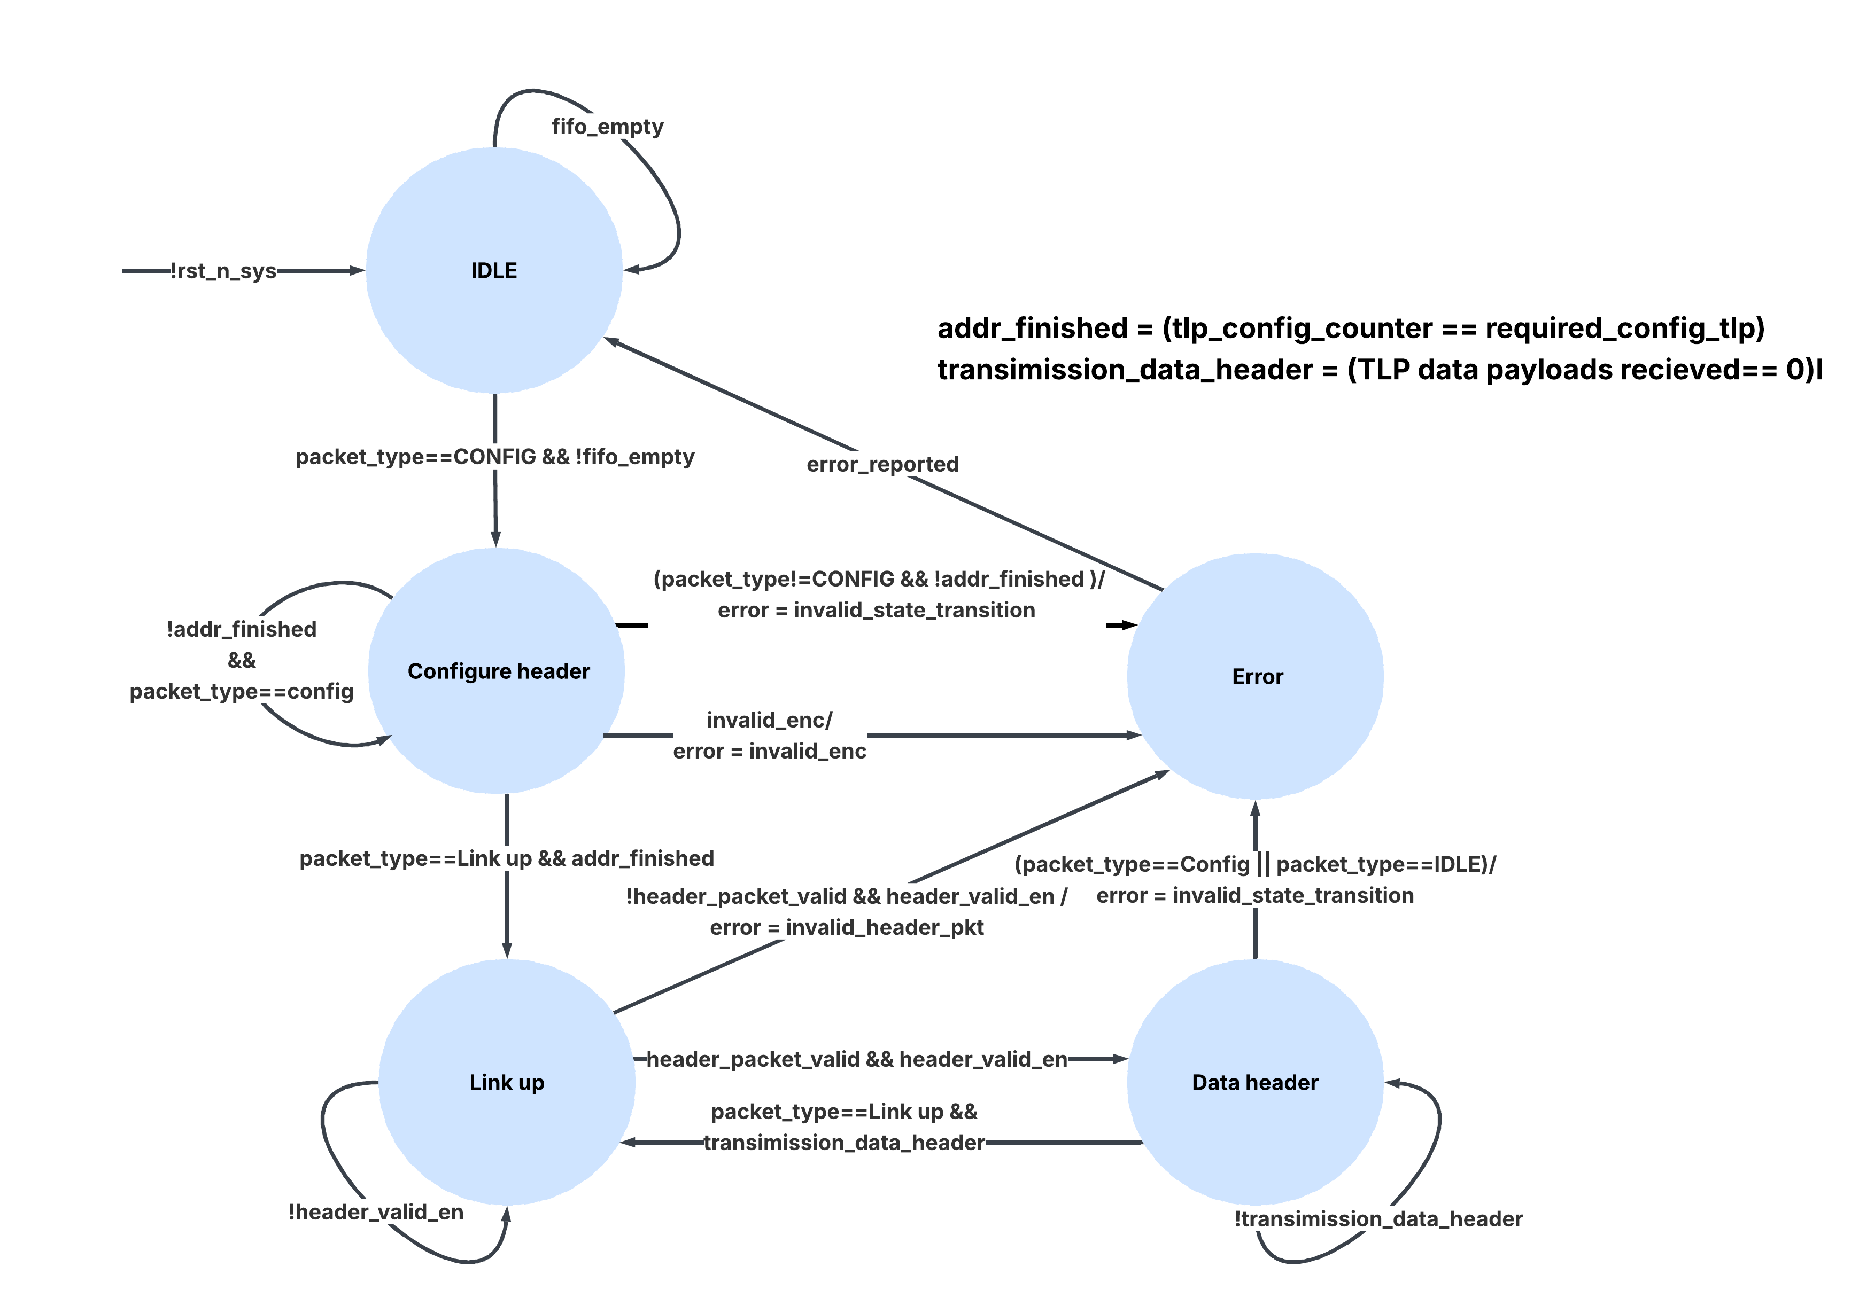
Control Unit FSM
PART B
Counters
word position in the 4-word TLP · device entries written

Slide 38
Data Path to Storage: One Payload Word
PART B
ATU
0x10 + 0x02 = 0x12
Payload word
0x0200_A5A5
ADDR 0x02 · DATA 0xA5A5
CDM[0x12]
0_9966_9966
33 bits
Encryption
8 ones / 8 zeros → balanced
0xA5A5 → 0x9966_9966
Parity (even)
16 ones → bit 0
Example setup: base address 0x10 from configuration · ENC_MODE 0000 · PARITY_MODE even
0x00
Global config register
CDM & ATU rules
256 × 33-bit memory, 8-bit address
Configuration words bypass encryption (direct write)
Reset clears only the configuration region
ATU captures the base address during configuration writes
Read port reserved for application access
0x01 +
Device table {END, START}
base + ADDR
Payload: encrypted + parity
Notes:
CHECK: the ATU captures the base address on every direct CDM write, including device entries.

Slide 39
CDC Implementation
PART B
Async FIFO · data, CXS → SYS
Toggle sync · error, SYS → CXS
Write side
CLK_CXS
binary → Gray
Memory
8 × 32 bits
Read side
CLK_SYS
binary → Gray
error_valid
T flop
FF1
FF2
XOR + dly
CLK_SYS
CLK_CXS
g_wptr
error_valid (SYS)
2-FF
toggle (SYS)
2-FF
g_rptr
toggle sync (CXS)
Full: next Gray write pointer vs synchronized read pointer
Empty: synchronized write pointer vs next read pointer
Depth 8, 32-bit TLP words
Read-through: the Control Unit peeks before popping
pulse (CXS)
Error code held stable until the next error, so the encoder samples it safely
A slow CXS clock cannot miss a one-cycle system pulse

Slide 40
Verification Plan
PART B
Block | Unit testbench | UVM scenario | Checking
Async FIFO | async_fifo_tb: random R/W, unrelated clocks | all scenarios | reference-queue compare
Packet Formatter | packet_formatter_tb: 5 directed tests | TWO_TLP_ONE_FLIT | directed stimulus
Control Unit | control_unit_tb: 13 directed tests | CFG_LINK_XFER, ERR_TX_FLIT | self-checking ($error)
Encryption Unit | encryption_unit_tb: 12 vectors | CFG_LINK_XFER | expected-value compare
Parity Unit | parity_unit_tb: 8 vectors | CFG_LINK_XFER | expected-value compare
CXS TX + credits | — | ERR_TX_FLIT, TX_CREDIT_STALL | waveform
ATU + CDM | — | CFG_LINK_XFER, TWO_TLP_ONE_FLIT | waveform
UVM environment: driver · monitor · agent · env · test · reset + directed sequences

Slide 41

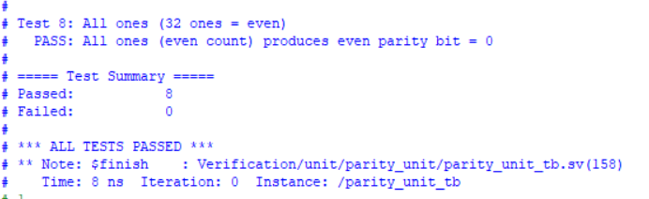
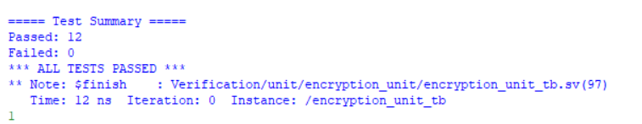
Unit Test Results
PART B
✓
5
13
12/12
8/8
Async FIFO
Packet Formatter
Control Unit
Encryption
Parity
all read words match
directed tests, 0 errors
directed tests, 0 errors
test vectors pass
test vectors pass
Async FIFO
Parity Unit
Encryption Unit
Notes:
TODO: Unit testbench transcripts: async_fifo, packet_formatter, control_unit, encryption, parity (Source: QuestaSim transcript)
Results measured before ADDR_WIDTH = 8 and the packet_formatter declaration-order fix; re-run before presenting.

Slide 42
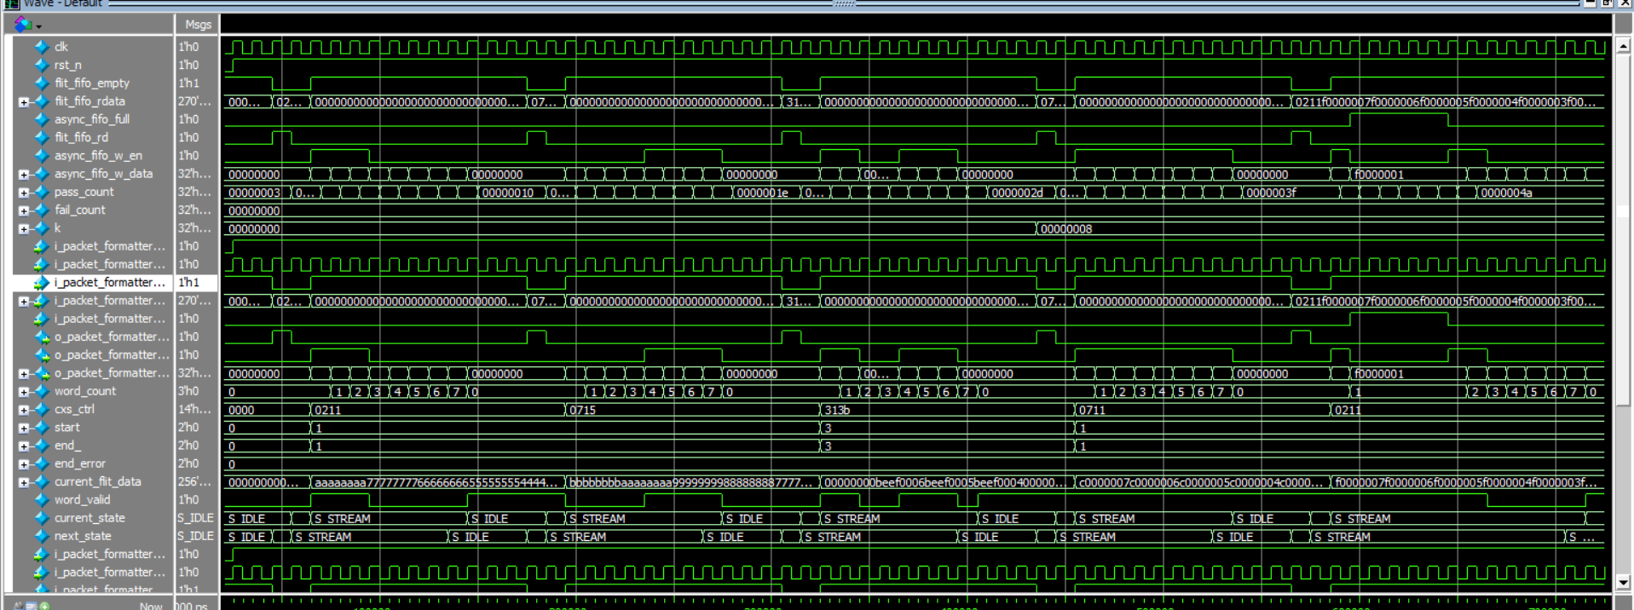
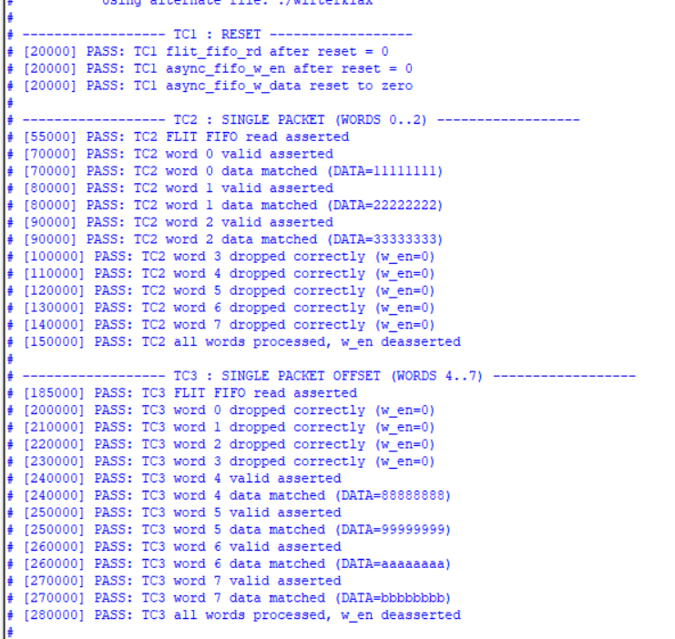
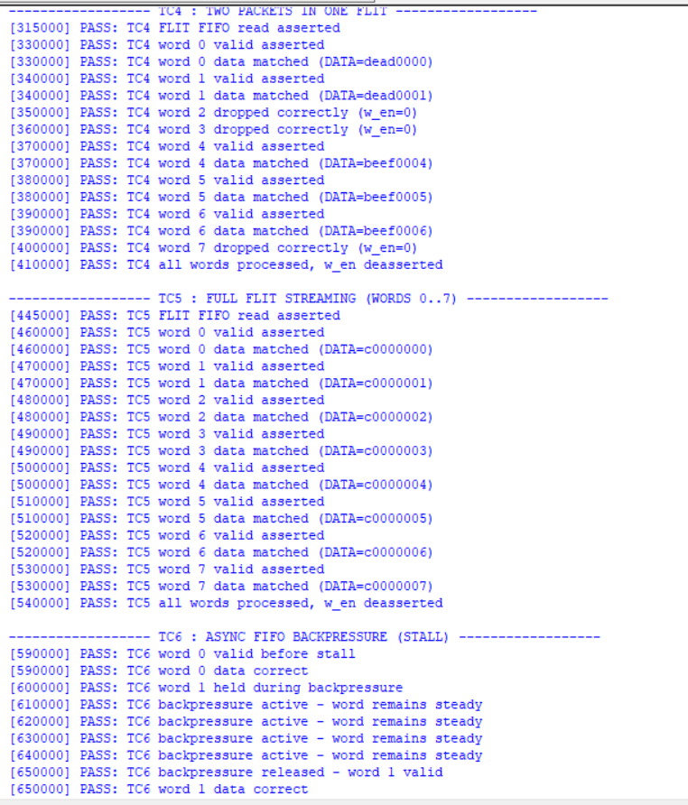
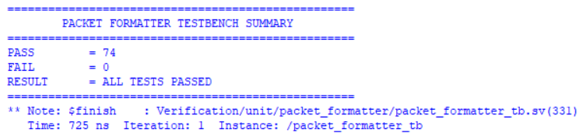
Packet Formatter Unit Verification
Main Scenarios
➤ Reset verification
➤ Single packet extraction (aligned words 0..2)
➤ Unaligned packet extraction (offset words 4..7)
➤ Multi-packet extraction (2 packets in 1 FLIT)
➤ Full FLIT continuous streaming (words 0..7)
➤ Invalid/unselected word dropping & masking
➤ Downstream FIFO backpressure & stall handling
➤ Streaming resumption after backpressure release
Result
✓ 6/6 Formatter test cases PASS (74/74 assertions)
✓ FLIT FIFO read handshake verified
✓ Start/End pointer decoding verified
✓ Word-by-word streaming order verified
✓ Non-packet word suppression verified
✓ Backpressure hold & freeze verified

Slide 43
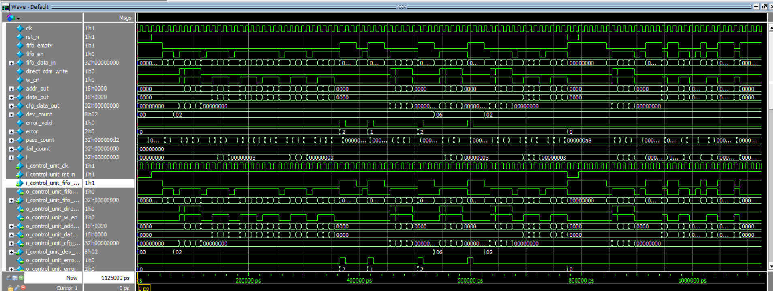
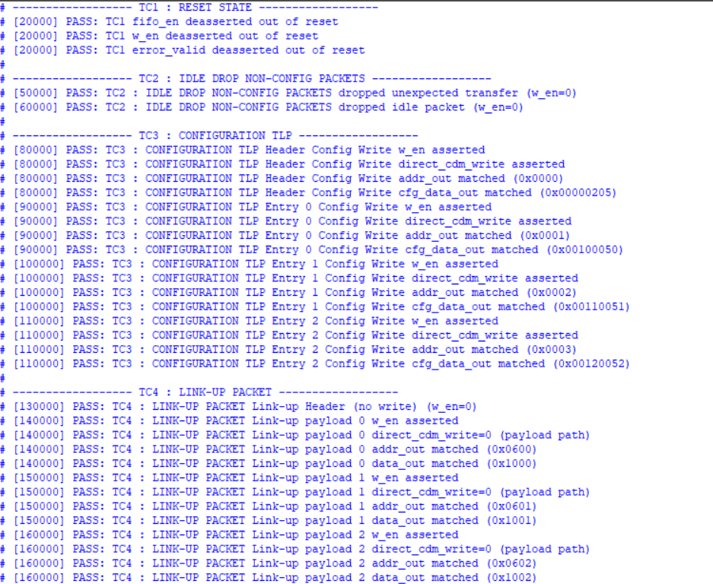
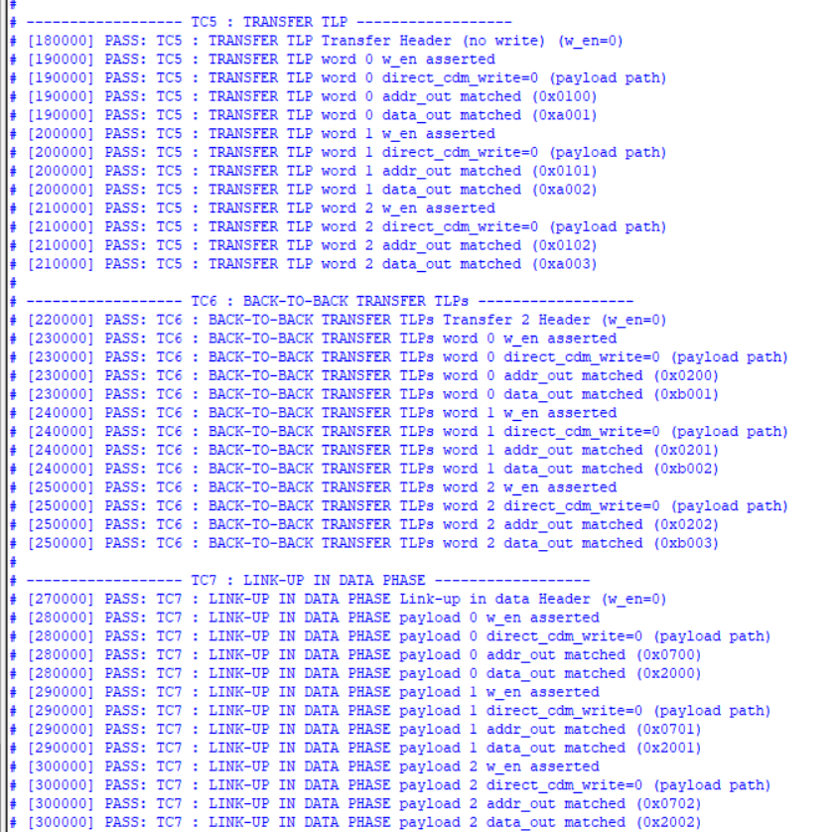
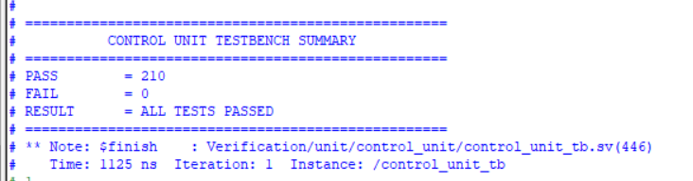
Control Unit Verification
Main Scenarios
➤ Reset state verification
➤ Out-of-order/non-config packet drop in Idle
➤ Configuration phase & direct CDM register write
➤ Link-up packet handling & state transition
➤ Transfer TLP parsing & encryption datapath routing
➤ Back-to-back Transfer TLPs & 4-word frame alignment
➤ In-flight Link-up packets during data phase
➤ Error injection: Config header in data phase
➤ Error injection: Unsupported encryption algorithm
➤ Error injection: Premature header before device limit
➤ Error recovery & FSM re-initialization
➤ Asynchronous FIFO starvation & random stall survival
Results
✓ 13/13 Control Unit test cases PASS (210/210 assertions)
✓ Configuration decoding verified
✓ Datapath multiplexing verified
✓ Protocol FSM transitions verified
✓ Comprehensive error reporting verified

Slide 44
System-Level UVM Scenarios
PART B
CFG_LINK_XFER
Stimulus: Config TLP → Link-Up TLP → Transfer TLP
Expected: CDM 0x00 / 0x01+ written; payloads at base + ADDR
TWO_TLP_ONE_FLIT
Stimulus: Two Transfer TLPs in words 0–3 and 4–7
Expected: six payload writes from one FLIT
ERR_TX_FLIT
Stimulus: Invalid ENC_MODE, TX credit available
Expected: error 01 → response FLIT (0xE0) on CXS TX
TX_CREDIT_STALL
Stimulus: Same error, no TX credit
Expected: FLIT held until one CXSTXCRDGNT
Result: 0 UVM_ERROR · 0 UVM_FATAL · behaviour checked on waveforms
Notes:
TODO: UVM waveforms for the four directed scenarios (Source: QuestaSim waveform (enc_sys_uvm))
Results measured before ADDR_WIDTH = 8 and the packet_formatter declaration-order fix; re-run before presenting.
CHECK: directed_seq still packs 16-bit addresses in [31:16]; with ADDR_WIDTH = 8 the RTL reads [31:24].

Slide 45
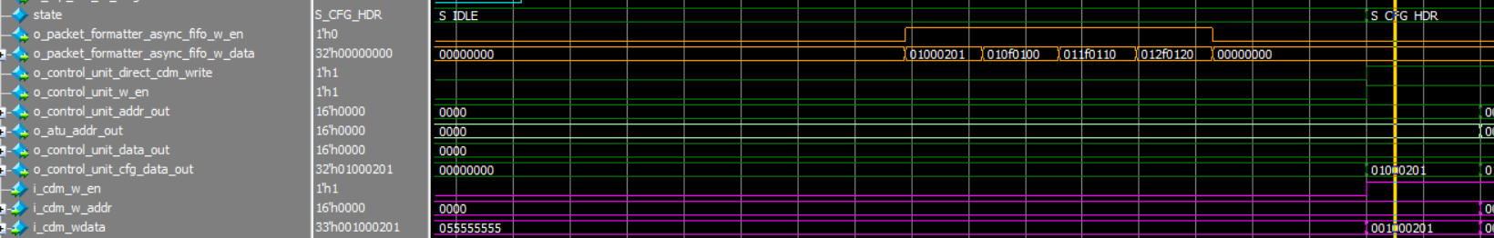
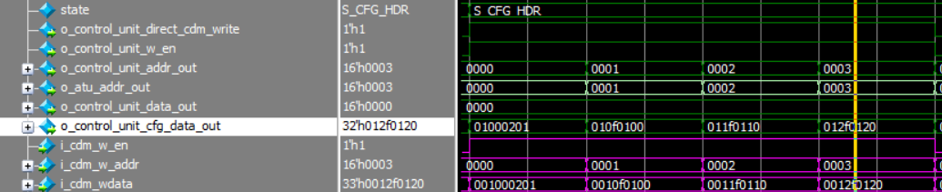
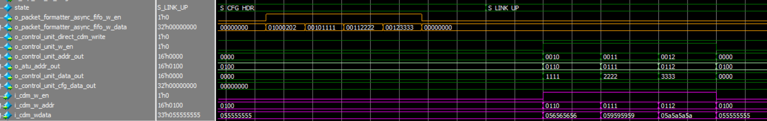
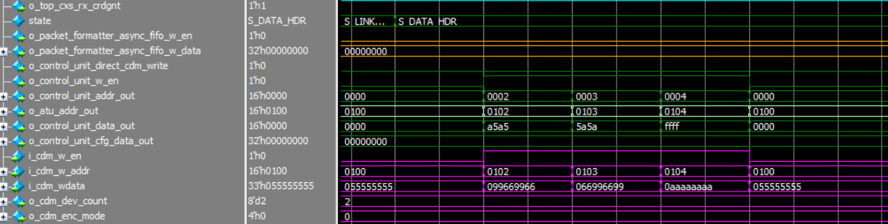

CFG_LINK_XFER
PART B
Stage | Stimulus / Input | FSM Progression
Configuration | Config FLIT: Base Addr = 0x0100Dev Count = 2ENC_MODE = 4'h0 (Even)Parity = Even | IDLE → CFG
Link-Up | Addrs: {0x0010, 0x0011, 0x0012}Data: {0x1111, 0x2222, 0x3333} | CFG → LINKUP
Data Transfer | Addrs: {0x0002, 0x0003, 0x0004}Payloads: {0xA5A5, 0x5A5A, 0xFFFF} | LINKUP → DATA
Overall Flow | Config → Link-Up → Transfer FLITs | IDLE → CFG → LINKUP → DATA
Notes:
TODO: SpyGlass lint summary report (Source: SpyGlass)
TODO: Design Compiler setup / hold timing reports (Source: Design Compiler report_timing)

Slide 46
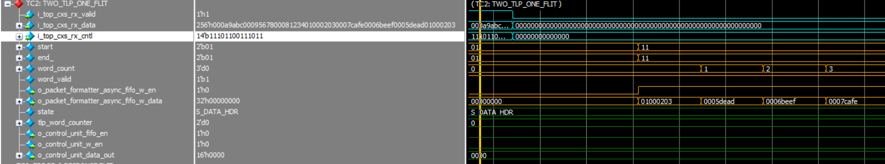
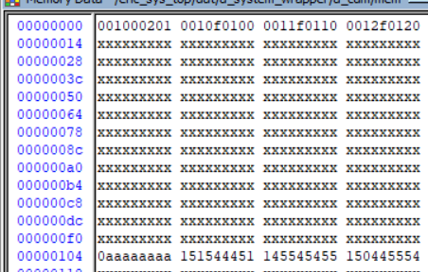
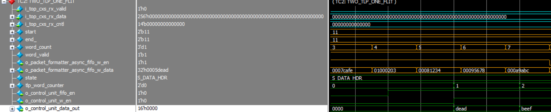
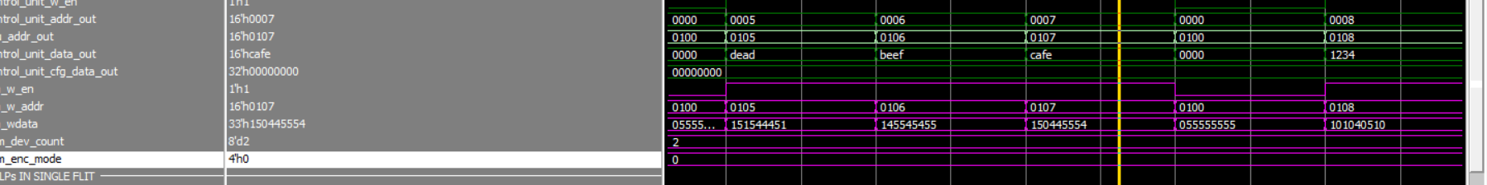
TWO_TLP_ONE_FLIT
PART B
Multi-Packet in Single FLIT (TWO_TLP_ONE_FLIT)
▪ Two Transfer TLPs packed into a single CXS FLIT.
▪ CXS Packet Formatter decodes Start0/End0 and Start1/End1 pointers.
▪ Both packets sequentially extracted and streamed across Async FIFO.
▪ Control Unit parses each frame without cross-packet corruption.
▪ Expected behavior: Multi-packet throughput with zero word loss.
Notes:
TODO: SpyGlass lint summary report (Source: SpyGlass)
TODO: Design Compiler setup / hold timing reports (Source: Design Compiler report_timing)

Slide 47
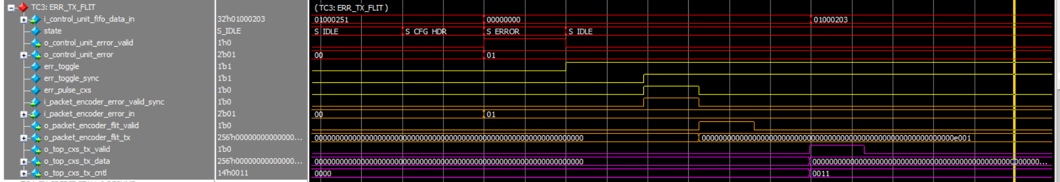
ERR_TX_FLIT
PART B
Error Injection & Response FLIT (ERR_TX_FLIT)
▪ Configuration header injected with unsupported ENC_MODE.
▪ Control Unit detects invalid mode and transitions to ERROR state.
▪ Error code synchronized across CDC boundary via toggle handshake.
▪ CXS TX interface encodes and transmits an Error Response FLIT.
▪ Expected behavior: Safe error trapping and protocol response.
Notes:
TODO: SpyGlass lint summary report (Source: SpyGlass)
TODO: Design Compiler setup / hold timing reports (Source: Design Compiler report_timing)

Slide 48
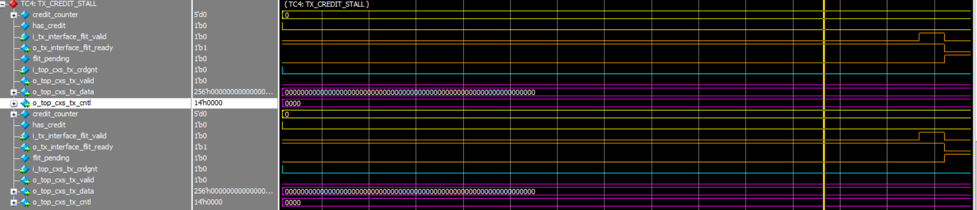
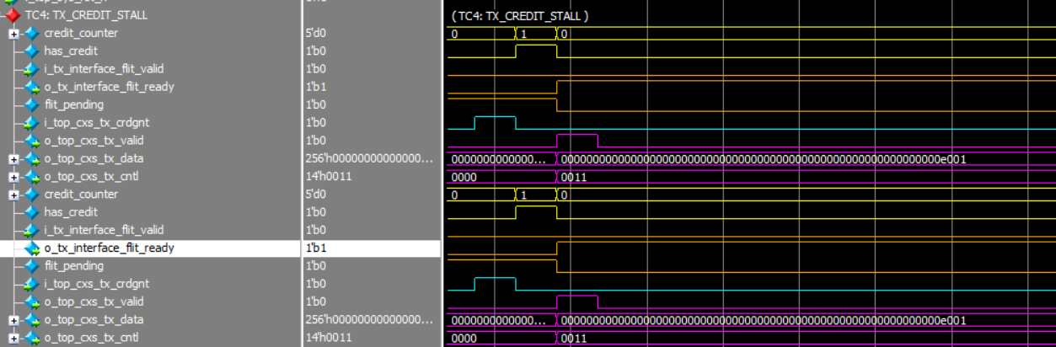
TX_CREDIT_STALL
PART B
TX Credit Flow Control & Stall (TX_CREDIT_STALL)
▪ Error Response FLIT ready for transmission while TX credit = 0.
▪ TX Interface stalls and buffers FLIT without dropping packets.
▪ External TX credit granted (i_top_cxs_tx_crdgnt asserted).
▪ Transmission resumes immediately; credit decremented correctly.
▪ Expected behavior: Full credit flow control compliance.
Notes:
TODO: SpyGlass lint summary report (Source: SpyGlass)
TODO: Design Compiler setup / hold timing reports (Source: Design Compiler report_timing)

Slide 49
Linting & Synthesis Setup
PART B
Implementation & Tool Setup
PDK & Technology Library:
  Synopsys SAED 90nm educational design kit
  Typical operating corner (saed90nm_typ.db, 1.2V, 25°C)
RTL Lint & CDC (SpyGlass):
  Checked coding standards, latches, and synthesizability
  Verified Clock Domain Crossing (CDC) between CXS (37 MHz) and System (25 MHz)
Logic Synthesis (Design Compiler):
  Constrained dual asynchronous clock domains (37 MHz / 25 MHz)
  Mapped RTL to standard cells and generated Timing, Area, and Power reports
Notes:
TODO: SpyGlass lint summary report (Source: SpyGlass)
TODO: Design Compiler setup / hold timing reports (Source: Design Compiler report_timing)

Slide 50
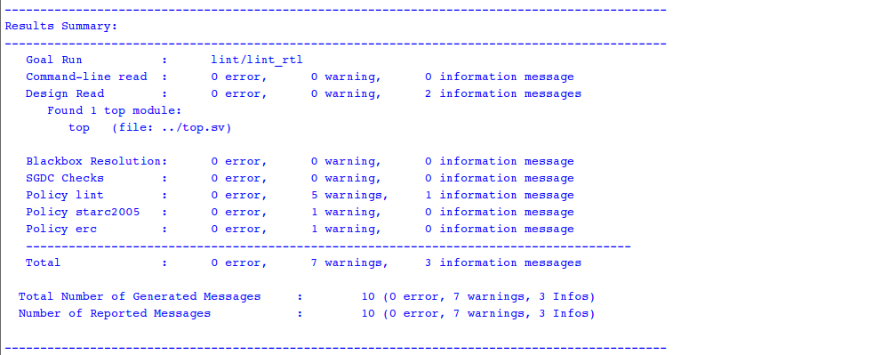
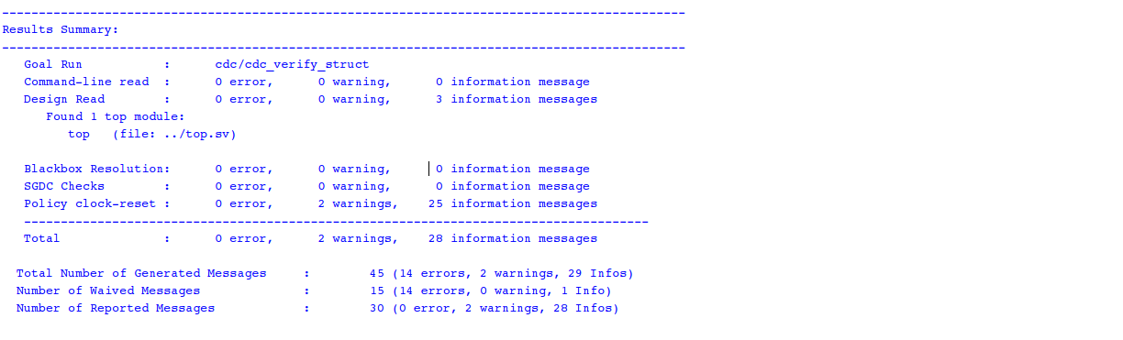
Lint
PART B
0
Errors
0
Latches
0
CDC
Notes:
TODO: SpyGlass lint summary report (Source: SpyGlass)
TODO: Design Compiler setup / hold timing reports (Source: Design Compiler report_timing)

Slide 51



Synthesis results
PART B
12.20 ns
Setup slack
0.23 ns
Hold slack
670,253.87 μm²
Area
Notes:
TODO: SpyGlass lint summary report (Source: SpyGlass)
TODO: Design Compiler setup / hold timing reports (Source: Design Compiler report_timing)

Slide 52
Side-by-Side Comparison
SUMMARY
Dimension | Part A — Mariam Gomaa | Part B — Fady Samy
CXS link | 32-bit data / 6-bit CNTL | 256-bit data / 14-bit CNTL
Link activation | CXSACTIVEREQ/ACK FSM (STOP → ACTIVE → RUN) | Not implemented
FLIT decoding | Flit Decoder in CLK_SYS (after the Async FIFO) | Packet Formatter in CLK_CXS (before the Async FIFO)
Control FSM | 9 states, LINK_OK application handshake | 5 states on a read-through FIFO
Payload word | 8-bit address + 8-bit data | ADDR[31:16] + DATA[15:0]
ATU | Logical − Base + Start + 2 | Base + Logical
CDC back-path | Data synchronizer + reset synchronizers | Data synchronizer + reset synchronizers
Verification | Unit TBs (RX 9/9, TX 10/10) + end-to-end; SpyGlass; DC | Unit TBs + UVM (4 scenarios); SpyGlass; DC

Slide 53
Roadmap
SUMMARY
AES encryption engine
ECC instead of parity
CRC packet check
DMA & variable-length TLPs

Slide 54
Conclusion
SUMMARY
The spec
Two implementations
Outcome
One contract: TLP formats, register file, three phases
Two clock domains with defined CDC and reset rules
The same packet journey
Different decode location, link width, FSM and CDC back-path
Part A & B: verified, lint-clean, timing met
One specification, two bridges: comparing them shows where the spec leaves room for design choices.

Slide 55


