Slide 1

CXS BRIDGE Encryption & Data Management System
Program: Digital Design Internship, Si-Vision
Supervised by: En. Menna Samir

Slide 2
CONTENT
Introduction & Objectives
System Overview
High-Level Architecture
CXS Interface (RX)
CXS Interface (TX)
Packet Formatter & CXSCNTL
Control Unit & FSM
Encryption & Parity
ATU & Central Data Memory (CDM)
Clock Domain Crossing (CDC)
Verification Strategy & Test Cases
Linting Results (SpyGlass)
Synthesis Timing Results
Conclusion

Slide 3
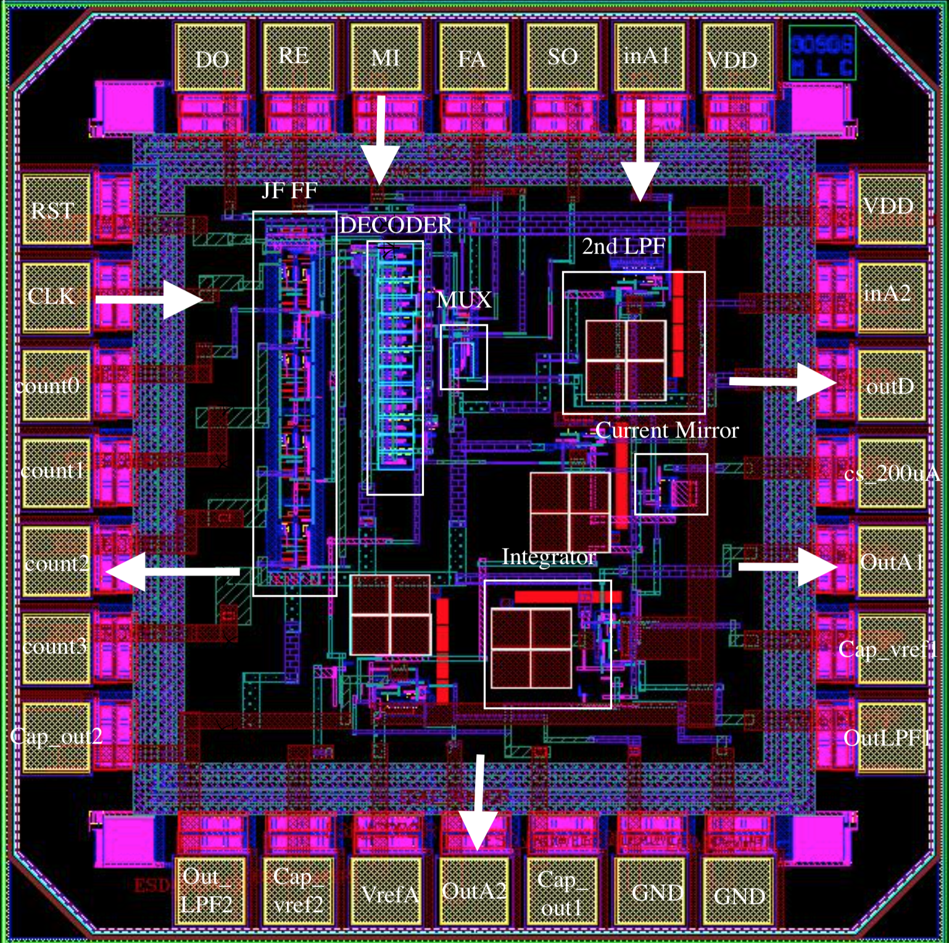
1
Introduction & Objectives

Slide 4
Design Objectives
Modular, scalable, parameterised SystemVerilog architecture
Reliable CXS RX/TX interface with credit-based flow control
CXSCNTL decoding (2 packets per FLIT) and safe CDC operation
Encryption, parity, address translation and CDM storage
Verifiable design: unit-level testbenches and a UVM system environment
Receiving
Encryption
Parity
Storing

Slide 5
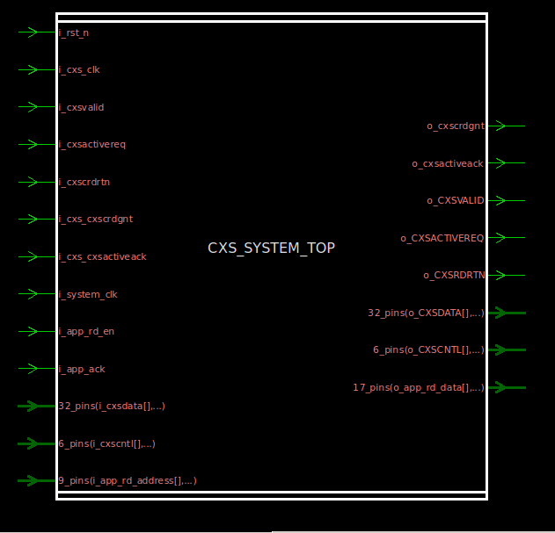
2
High-Level Architecture & System Overview

Slide 6
System Architecture
PLACEHOLDER
My top-level block diagram: cxs_if (CLK_CXS), asynchronous FIFO + error toggle synchronizer (CDC), system_wrapper (CLK_SYS)
Source: draw.io diagram
Top-level block diagram: CXS Interface (CLK_CXS), Asynchronous FIFO and error synchronizer (CDC), System Wrapper (CLK_SYS) with Control Unit, ATU, Encryption, Parity and CDM.
Notes:
TODO: My top-level block diagram: cxs_if (CLK_CXS), asynchronous FIFO + error toggle synchronizer (CDC), system_wrapper (CLK_SYS) (Source: draw.io diagram)

Slide 7
System Main Blocks
The proposed high-level architecture of the CXS Bridge Encryption and Data Management System consists of the following major blocks:
CXS Interface (RX/TX)
Control Unit
Data Protection Path
Address Translation (ATU)
Central Data Memory (CDM)
FLIT reception and error response transmission, credit-based flow control, CXSCNTL decoding and 32-bit word extraction
5-state FSM controller; TLP header decoding, config writes, Link-Up/Transfer handling, error reporting
Encryption Unit: 16 → 32-bit expansion with 2 modes and a balanced-word override + Parity Unit (odd / even) appended before storage
Converts logical addresses to physical CDM addresses by adding the base address captured from the configuration packet
Stores the configuration register, device table and encrypted payload data at ATU addresses
These modules cooperate to receive FLITs from the CXS link, extract and validate TLPs, encrypt and add parity, translate addresses, store the processed data in memory and report errors back over CXS TX.

Slide 8
High-Level Data Flow
Incoming CXS FLITs are buffered and decoded in the CXS clock domain; only valid 32-bit TLP words cross into the system clock domain through the Asynchronous FIFO to the Control Unit.
Incoming FLITs
CXS RX + FLIT FIFO
Buffers FLITs, credit-based flow control
Packet Formatter
CXSCNTL decode → valid 32-bit TLP words
Async FIFO
CDC buffer: CXS clk → System clk
Control Unit
ATU + Encryption + Parity
Translates address, encrypts payload, appends parity
CDM
Stores config (direct write) or encrypted payload (ATU address)
Error Return + CXS TX
Toggle sync System → CXS clk; response FLIT sent

Slide 9
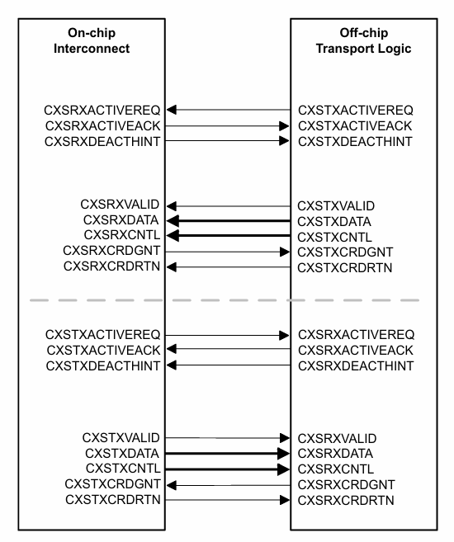
CXS Protocol
Streaming, Point-to-Point : Packetized data sent directly between two link partners — no addressing/routing layer, just protocol packets riding on flits
Full-Duplex : Independent TX and RX signal paths operate simultaneously and independently of each other
Flit-Based Transfer : Data moves one flit (flow-control unit) per clock cycle; a flit can carry multiple packets, or one packet can span several flits
Credit-Based Flow Control : Non-blocking: the transmitter only sends when it holds a credit from the receiver, preventing buffer overflow without handshake stalls
Control Field (CXSCNTL):Encodes START/END/ERROR boundary info per flit so the receiver can reconstruct packet boundaries from the raw flit stream

Slide 10

CXS Interface (RX)
PLACEHOLDER
CXS RX path: rx_interface → flit_fifo → packet_formatter → async FIFO, with credit_manager driving CXSRXCRDGNT
Source: draw.io diagram
RX Interface
Writes the 270-bit FLIT {CXSCNTL, CXSDATA} into the FLIT FIFO when CXSVALID is high and the FIFO is not full
FLIT FIFO
Synchronous 16-entry FIFO on the CXS clock; full/empty from wrap-bit pointers; registered read
Credit Manager
Counter starts at the FIFO depth: −1 per write, +1 per read; CXSRXCRDGNT asserted while credits remain
Packet Formatter
Decodes CXSCNTL START/END pointers and writes only valid 32-bit TLP words into the Async FIFO
Notes:
TODO: CXS RX path: rx_interface → flit_fifo → packet_formatter → async FIFO, with credit_manager driving CXSRXCRDGNT (Source: draw.io diagram)

Slide 11
CXS Interface (TX)
PLACEHOLDER
CXS TX path: error pulse → packet_encoder → tx_interface (holding register + TX credit counter) → CXSTX signals
Source: draw.io diagram
Packet Encoder
On a synchronized error pulse, builds a one-word response FLIT: opcode 0xE0 + 2-bit error code, START0/END0 set
TX Holding Register
Holds one pending FLIT; flit_ready stays low until it is transmitted
TX Credit Counter
Counts CXSTXCRDGNT grants up to 16; one credit consumed per transmitted FLIT
FLIT Transmitter
Drives registered CXSTXVALID / DATA / CNTL only when a FLIT is pending and a credit is available
Notes:
TODO: CXS TX path: error pulse → packet_encoder → tx_interface (holding register + TX credit counter) → CXSTX signals (Source: draw.io diagram)

Slide 12
Packet Formatter
PLACEHOLDER
packet_formatter: IDLE → CAPTURE → STREAM FSM and CXSCNTL field decode (START / START_PTR / END / END_ERROR / END_PTR)
Source: draw.io diagram
Role — converts each 270-bit FLIT into a stream of valid 32-bit TLP words for the Async FIFO, entirely in the CXS clock domain
FSM: IDLE (pop FLIT) → CAPTURE (register data + CXSCNTL) → STREAM (step through the 8 words, write the valid ones; stalls while the Async FIFO is full)
CXSCNTL layout (14 bits, 2 packets per FLIT):
  [1:0] / [5:4] START / END flag per packet
  [3:2] START_PTR per packet (units of 4 words)
  [7:6] / [13:8] END_ERROR flags / END_PTR (3 bits, in words)
Word valid: START[j] and END[j] set, and START_PTR[j] × 4 ≤ word index ≤ END_PTR[j]
Limitations: packets spanning FLITs are not supported; END_ERROR is decoded but not yet used
Notes:
TODO: packet_formatter: IDLE → CAPTURE → STREAM FSM and CXSCNTL field decode (START / START_PTR / END / END_ERROR / END_PTR) (Source: draw.io diagram)

Slide 13
Control Unit
PLACEHOLDER
Control unit internal view: header decode, word / config counters, FSM, CDM write outputs, error code register
Source: draw.io diagram
Central controller of the CXS Bridge — reads 32-bit TLP words (header + 3 payload words) from the read-through Async FIFO and sequences configuration, Link-Up and data transfer
Header Decoder: packet type [1:0] (00 Idle, 01 Config, 10 Link-Up, 11 Transfer) and encryption mode [7:4]
Per-packet-type behavior:
  Configuration Packets → global register written directly to CDM 0x00, device entries to 0x01+
  Link-Up Packets → payload words processed, FSM enters the data phase
  Transfer Packets → each payload word split into ADDR [31:24] + DATA [15:0]
Error handling: one-cycle error_valid pulse with a held 2-bit code (invalid header, invalid encryption mode, invalid sequence), returned as a response FLIT
Notes:
TODO: Control unit internal view: header decode, word / config counters, FSM, CDM write outputs, error code register (Source: draw.io diagram)

Slide 14
Control Unit FSM
PLACEHOLDER
Control unit FSM: S_IDLE, S_CFG_HDR, S_LINK_UP, S_DATA_HDR, S_ERROR with transition conditions
Source: draw.io state diagram
IDLE
Waits for a Configuration header; drops any other word
CFG HDR
Global register → CDM 0x00, then device entries → 0x01+
direct_cdm_write=1, w_en=1
LINK UP
Consumes the Link-Up TLP; payload words written like data
fifo_en=1, w_en=1 on payload words
fifo_en=1 on dropped words
DATA HDR
Transfer TLPs: payload → ATU / encryption / parity → CDM
w_en=1; Link-Up header → LINK UP
ERROR
Invalid ENC_MODE, header type or packet sequence
error_valid=1 for one cycle → IDLE
Notes:
TODO: Control unit FSM: S_IDLE, S_CFG_HDR, S_LINK_UP, S_DATA_HDR, S_ERROR with transition conditions (Source: draw.io state diagram)

Slide 15
Encryption & Parity
Encryption
Parity
The parity bit follows PARITY_MODE (CDM configuration register bit [2]): Even parity (XOR of the data) or Odd parity (inverted XOR).
The 32-bit encrypted word is extended to 33 bits by appending the parity bit as the MSB before it is written to the CDM.
Even Mode (0000): each of the 16 input bits expands to a 2-bit pair (32-bit output); mapping:
0 → 00 1 → 01
Odd Mode (0001): each input bit expands to a 2-bit pair; mapping:
0 → 10 1 → 11
Special Case: if the number of '0' bits equals the number of '1' bits, or both counts are even, the selected mode is overridden:
0 → 01 1 → 10

Slide 16
ATU & Central Data Memory (CDM)
ATU
Central Data Memory (CDM)
Converts the 8-bit logical address of each payload word into a physical CDM address:
Physical Address = Base Address + Logical Address
The base address is captured from bits [31:24] of the configuration words while they are written; addresses pass through unchanged during configuration.
ADDR_MODE (range / region) is decoded; both modes currently use the same translation.
Configuration Region: global register at 0x00 — DEV_COUNT [15:8], ENC_MODE [7:4], ADDR_MODE [3], PARITY_MODE [2]; device table {END_ADDR, START_ADDR} from 0x01.
Payload Region: encrypted data + parity bit (33 bits) written at the address generated by the ATU.
Configuration words bypass encryption (direct write); reset clears only the configuration region.
256 × 33-bit memory (8-bit address); a read port is provided for future application access.
Notes:
CHECK: the ATU captures the base address on every direct CDM write, including device entries, so the effective base comes from the last configuration word written.

Slide 17
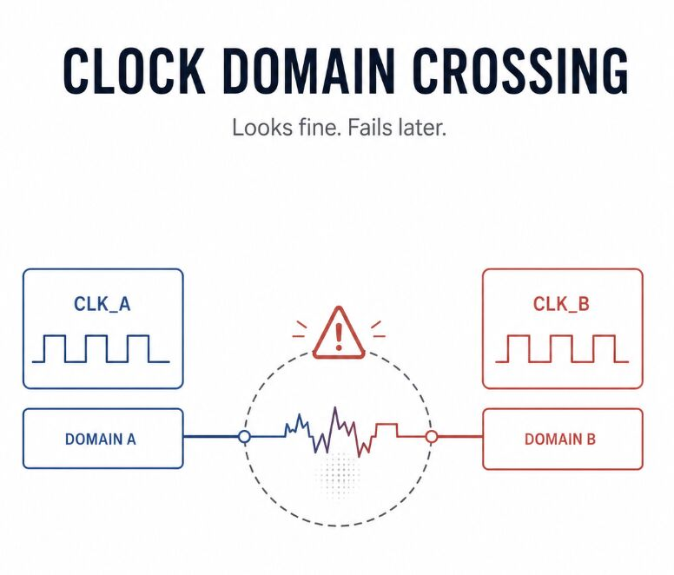
3
Clock Domain Crossing (CDC) Strategy

Slide 18
Clock Domain Crossing (CDC)
Objective
PLACEHOLDER
CDC diagram: 32-bit async FIFO (CXS → SYS) and error toggle + 2-FF synchronizer + edge detect (SYS → CXS)
Source: draw.io diagram
Direct transfer between asynchronous clock domains can cause:
Metastability
Data corruption
Incorrect pulse detection
1
Clock Domains
2
The design operates using two independent clock domains:
CXS Clock Domain: 37 MHz
System Clock Domain: 25 MHz
Solutions
Two CDC techniques are implemented:
Asynchronous FIFO – CXS → System domain (32-bit TLP words)
Toggle Synchronizer – System → CXS domain (error pulse)
3
Notes:
TODO: CDC diagram: 32-bit async FIFO (CXS → SYS) and error toggle + 2-FF synchronizer + edge detect (SYS → CXS) (Source: draw.io diagram)

Slide 19
CDC Solutions
Asynchronous FIFO
Safe transfer of 32-bit TLP words from the 37 MHz CXS domain → 25 MHz System domain.
Toggle Synchronizer
Carries the one-cycle error pulse from the System domain → CXS domain.
Depth 8, Gray-coded read/write pointers
2-FF pointer synchronizers; full/empty generated in their own domains
Prevents data loss between different clock rates
Pulse → toggle flop → 2-FF synchronizer → edge detect
Error code held stable, so the encoder samples it safely

Slide 20

4
Verification Strategy & Test cases

Slide 21
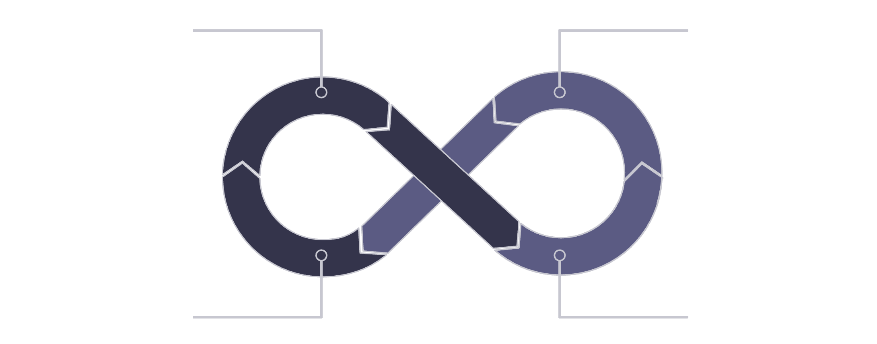
Verification Strategy
Two-Level Verification Approach
1. Unit-Level Verification
Key RTL blocks are verified independently.
Self-checking SystemVerilog testbenches for 5 key blocks.
Directed corner cases: back-pressure, stalls, bad headers.
2. System-Level (UVM) Verification
UVM environment drives the complete top from CXS RX to CXS TX.
Directed sequences; behavior checked on waveforms.
1
End-to-end verification
Unit test for main blocks
Main Verification Goals
Self-checking testbenches
Corner case
verification
2
Correct CXSCNTL decoding and word extraction
Correct credit-based flow control (RX and TX)
Correct CDC transfer of TLP words and error pulses
Correct configuration and error handling
Correct encryption, parity, address translation and CDM storage

Slide 22
CXS Path Unit Verification
Main Scenarios
Packet Formatter: one packet in words 0–2
One packet in words 4–7 (START_PTR = 1)
Two packets in one FLIT
One packet spanning words 0–7
Async FIFO back-pressure
Async FIFO: randomized writes / reads on unrelated clocks
Every read word compared with a reference queue
Result
Packet Formatter: 5 directed tests, 0 errors
Async FIFO: all read / write comparisons passed
CXSCNTL decoding and word extraction verified
Async FIFO back-pressure verified
Clock-domain crossing of TLP words verified
PLACEHOLDER
packet_formatter_tb waveform: FLIT capture, CXSCNTL decode, async FIFO writes
Source: QuestaSim waveform
PLACEHOLDER
packet_formatter_tb transcript
Source: QuestaSim transcript
PLACEHOLDER
async_fifo_tb transcript: read / write comparisons
Source: QuestaSim transcript
Notes:
TODO: packet_formatter_tb waveform: FLIT capture, CXSCNTL decode, async FIFO writes (Source: QuestaSim waveform)
TODO: packet_formatter_tb transcript (Source: QuestaSim transcript)
TODO: async_fifo_tb transcript: read / write comparisons (Source: QuestaSim transcript)
Re-run to confirm on the current RTL (ADDR_WIDTH = 8 and the latest packet_formatter) before presenting these results.

Slide 23
System Path Unit Verification
Main Scenarios
Control Unit: reset and idle-word drop
Configuration TLP and Link-Up
Transfer TLPs (two in a row)
Link-Up / config header in data phase
Invalid encryption mode
Bad or early header
Recovery after error
Random FIFO stalls
Encryption & parity mode vectors
Result
Control Unit: 13 directed tests, 0 errors
Encryption Unit: 12/12 test cases PASS
Parity Unit: 8/8 test cases PASS
Error detection and recovery verified
Configuration and data sequencing verified
PLACEHOLDER
control_unit_tb waveform: configuration, Link-Up and transfer writes
Source: QuestaSim waveform
PLACEHOLDER
control_unit_tb transcript (13 tests)
Source: QuestaSim transcript
PLACEHOLDER
encryption_unit_tb and parity_unit_tb summaries (12/12, 8/8)
Source: QuestaSim transcript
Notes:
TODO: control_unit_tb waveform: configuration, Link-Up and transfer writes (Source: QuestaSim waveform)
TODO: control_unit_tb transcript (13 tests) (Source: QuestaSim transcript)
TODO: encryption_unit_tb and parity_unit_tb summaries (12/12, 8/8) (Source: QuestaSim transcript)
Re-run to confirm on the current RTL (ADDR_WIDTH = 8 and the latest packet_formatter) before presenting these results.

Slide 24
End-to-End Verification (UVM)
Verification Includes
Driver, monitor, agent, env
Reset + directed sequences
CFG_LINK_XFER
TWO_TLP_ONE_FLIT
ERR_TX_FLIT
TX_CREDIT_STALL
Credit-based flow control
CDC / Async FIFO transfer
Encryption and parity
Address translation
CDM writes
Error response FLIT
Packet Formatter
CDC / Asynchronous FIFO
Encryption + Parity
CXS RX + FLIT FIFO
Control Unit
ATU
Central Data Memory
Packet Encoder + CXS TX
Notes:
Re-run to confirm on the current RTL (ADDR_WIDTH = 8 and the latest packet_formatter) before presenting these results.

Slide 25
Initialization & Configuration
1. Reset
Both clock domains reset; FSM starts in S_IDLE.
Words before a Configuration header are dropped.
RX credits start at the FLIT FIFO depth.
2. Configuration TLP
Global register written directly to CDM 0x00.
Device entries written to 0x01, 0x02, …
After DEV_COUNT entries only a Link-Up header is accepted.
3. Configuration Validation
Invalid ENC_MODE in the header.
Wrong header type during / after configuration.
Expected behavior: Invalid configuration → S_ERROR → error_valid pulse → response FLIT.
4. Link-Up
Link-Up TLP consumed; payload words written.
FSM enters the data phase (S_DATA_HDR).
PLACEHOLDER
UVM waveform: reset and configuration TLP reception
Source: QuestaSim waveform (enc_sys_uvm)
PLACEHOLDER
UVM waveform: CDM writes at 0x00 and 0x01+
Source: QuestaSim waveform (enc_sys_uvm)
PLACEHOLDER
UVM waveform: invalid ENC_MODE → S_ERROR, error_valid pulse
Source: QuestaSim waveform (enc_sys_uvm)
Notes:
TODO: UVM waveform: reset and configuration TLP reception (Source: QuestaSim waveform (enc_sys_uvm))
TODO: UVM waveform: CDM writes at 0x00 and 0x01+ (Source: QuestaSim waveform (enc_sys_uvm))
TODO: UVM waveform: invalid ENC_MODE → S_ERROR, error_valid pulse (Source: QuestaSim waveform (enc_sys_uvm))

Slide 26
Data Processing
1. Data processing test cases
Correct TLP header decoding
Correct payload split: ADDR [31:24], DATA [15:0]
Correct base + logical address translation
Correct encryption result
Correct parity generation
Correct CDM write address and stored data
Two TLPs in one FLIT (words 0–3 and 4–7)
2. Error handling in data phase
Expected behavior: Idle / Config header in the data phase → S_ERROR → error_valid pulse → response FLIT.
3. Valid Data
Transfer payloads written encrypted + parity.
A Link-Up header returns the FSM to S_LINK_UP.
PLACEHOLDER
UVM waveform: Transfer TLP → ATU address, encrypted + parity CDM write
Source: QuestaSim waveform (enc_sys_uvm)
PLACEHOLDER
UVM waveform: TWO_TLP_ONE_FLIT, words 0–3 and 4–7
Source: QuestaSim waveform (enc_sys_uvm)
Notes:
TODO: UVM waveform: Transfer TLP → ATU address, encrypted + parity CDM write (Source: QuestaSim waveform (enc_sys_uvm))
TODO: UVM waveform: TWO_TLP_ONE_FLIT, words 0–3 and 4–7 (Source: QuestaSim waveform (enc_sys_uvm))

Slide 27
Error Response & TX Credit Flow
1. Error Response (ERR_TX_FLIT)
Invalid ENC_MODE in the configuration header.
Control Unit pulses error_valid with code 01.
Pulse crosses System → CXS via the toggle synchronizer.
Packet Encoder builds a response FLIT (opcode 0xE0).
TX Interface sends it while TX credit is available.
2. TX Credit Stall (TX_CREDIT_STALL)
Same error with no TX credit granted.
Response FLIT held in the TX holding register.
flit_ready stays low; nothing is transmitted.
One CXSTXCRDGNT releases the FLIT.
PLACEHOLDER
UVM waveform: ERR_TX_FLIT — response FLIT (opcode 0xE0) on CXSTXDATA
Source: QuestaSim waveform (enc_sys_uvm)
PLACEHOLDER
UVM waveform: TX_CREDIT_STALL — FLIT held until CXSTXCRDGNT
Source: QuestaSim waveform (enc_sys_uvm)
Notes:
TODO: UVM waveform: ERR_TX_FLIT — response FLIT (opcode 0xE0) on CXSTXDATA (Source: QuestaSim waveform (enc_sys_uvm))
TODO: UVM waveform: TX_CREDIT_STALL — FLIT held until CXSTXCRDGNT (Source: QuestaSim waveform (enc_sys_uvm))

Slide 28
Verification Results
Verification Summary
Async FIFO unit test
Packet Formatter: 5 unit tests
Control Unit: 13 unit tests
Encryption Unit: 12/12
Parity Unit: 8/8
UVM: CFG_LINK_XFER
UVM: TWO_TLP_ONE_FLIT
UVM: ERR_TX_FLIT
UVM: TX_CREDIT_STALL
Next: scoreboard, coverage, SVA
PLACEHOLDER
Results summary: unit testbench transcripts and UVM report (0 UVM_ERROR / UVM_FATAL)
Source: QuestaSim transcript
PASS → Unit tests pass; UVM runs clean
Notes:
TODO: Results summary: unit testbench transcripts and UVM report (0 UVM_ERROR / UVM_FATAL) (Source: QuestaSim transcript)
Re-run to confirm on the current RTL (ADDR_WIDTH = 8 and the latest packet_formatter) before presenting these results.

Slide 29

5
Linting & Synthesis Timing Results

Slide 30
Linting Results
Linting
PLACEHOLDER
SpyGlass lint summary report
Source: SpyGlass
Result: [TBD]
Error-level violations: [TBD]
Unintended latches: [TBD]
Combinational loops: [TBD]
CDC violations: [TBD]
STARC coding violations: [TBD]
Status: [TBD] — SpyGlass run pending
Notes:
TODO: SpyGlass lint summary report (Source: SpyGlass)

Slide 31
Synthesis Timing Results
PLACEHOLDER
Design Compiler setup timing report (critical path)
Source: Design Compiler report_timing
Setup Timing Analysis
Checks whether data arrives before the capture clock edge.
The critical path is analyzed on the synthesized netlist.
Setup violations: [TBD]
Setup slack / timing margin: [TBD]
Hold Timing Analysis
Verifies the minimum-delay paths.
Hold violations: [TBD]
Overall Result
Setup [TBD] | Hold [TBD] | Timing [TBD]
PLACEHOLDER
Design Compiler hold timing report
Source: Design Compiler report_timing -delay_type min
Notes:
TODO: Design Compiler setup timing report (critical path) (Source: Design Compiler report_timing)
TODO: Design Compiler hold timing report (Source: Design Compiler report_timing -delay_type min)

Slide 32
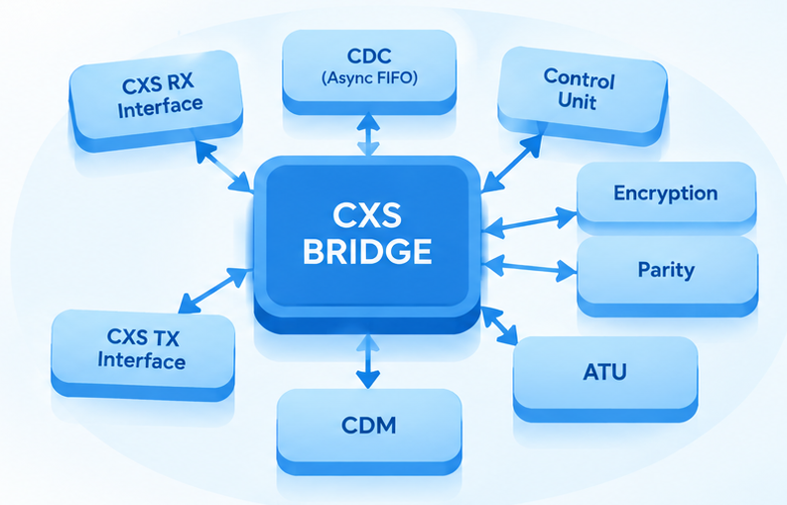
6
Conclusion

Slide 33
Conclusion
Designed a modular, parameterised CXS Bridge Encryption and Data Management System in SystemVerilog.
The CXS interface decodes CXSCNTL in the CXS clock domain and forwards only valid 32-bit TLP words across the CDC boundary.
Credit-based RX/TX flow control, an asynchronous FIFO, a toggle synchronizer, a 5-state control unit, encryption, parity, ATU and CDM form one end-to-end path.
All unit-level testbenches pass (async FIFO, packet formatter, control unit, encryption 12/12, parity 8/8).
The UVM environment runs the main system scenarios with 0 UVM errors.
Next steps: UVM scoreboard, coverage and assertions; cross-FLIT packets; lint and synthesis sign-off.
Final Outcome
RTL ✓ | Unit Verification ✓ | UVM Scenarios ✓ | Lint [TBD] | Synthesis [TBD]
Notes:
Re-run to confirm on the current RTL (ADDR_WIDTH = 8 and the latest packet_formatter) before presenting these results.

Slide 34


