Slide 1

CXS BRIDGE Encryption & Data Management System
Program: Digital Design Internship, Si-Vision
Supervised by: En. Menna Samir

Slide 2
CONTENT
Introduction & Objectives
System Overview
High-Level Architecture
CXS Interface (RX)
CXS Interface (TX)
Control Unit FSM
Encryption Module
Parity Module
ATU & Central Data Memory (CDM)
Clock Domain Crossing (CDC) Strategy
Verification Strategy & Test cases
Linting Results (SpyGlass)
Synthesis Timing Results
Conclusion

Slide 3
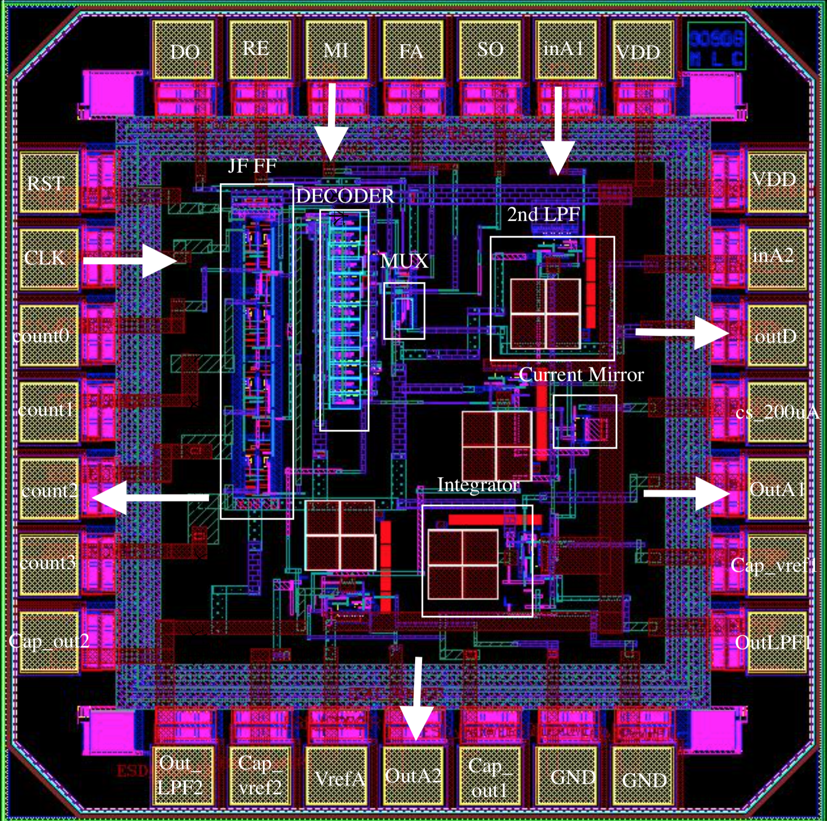
1
Introduction & Objectives

Slide 4
Design Objectives
Modular, scalable ,parametrized architecture
Reliable CXS interface with credit-based flow control
Packet extraction, encryption, parity, and storage
Address translation for mapping to CDM addresses
Protocol-compliant, verifiable, extendable design
Recieving
Encryption
Parity
Storing

Slide 5
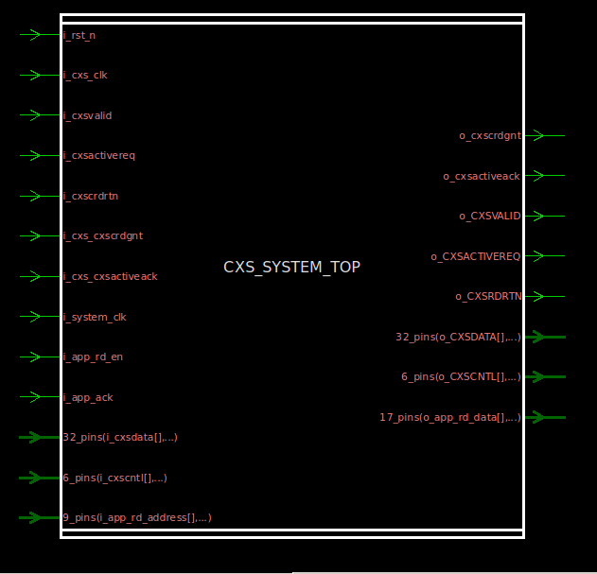
2
High-Level Architecture &System Overview

Slide 6
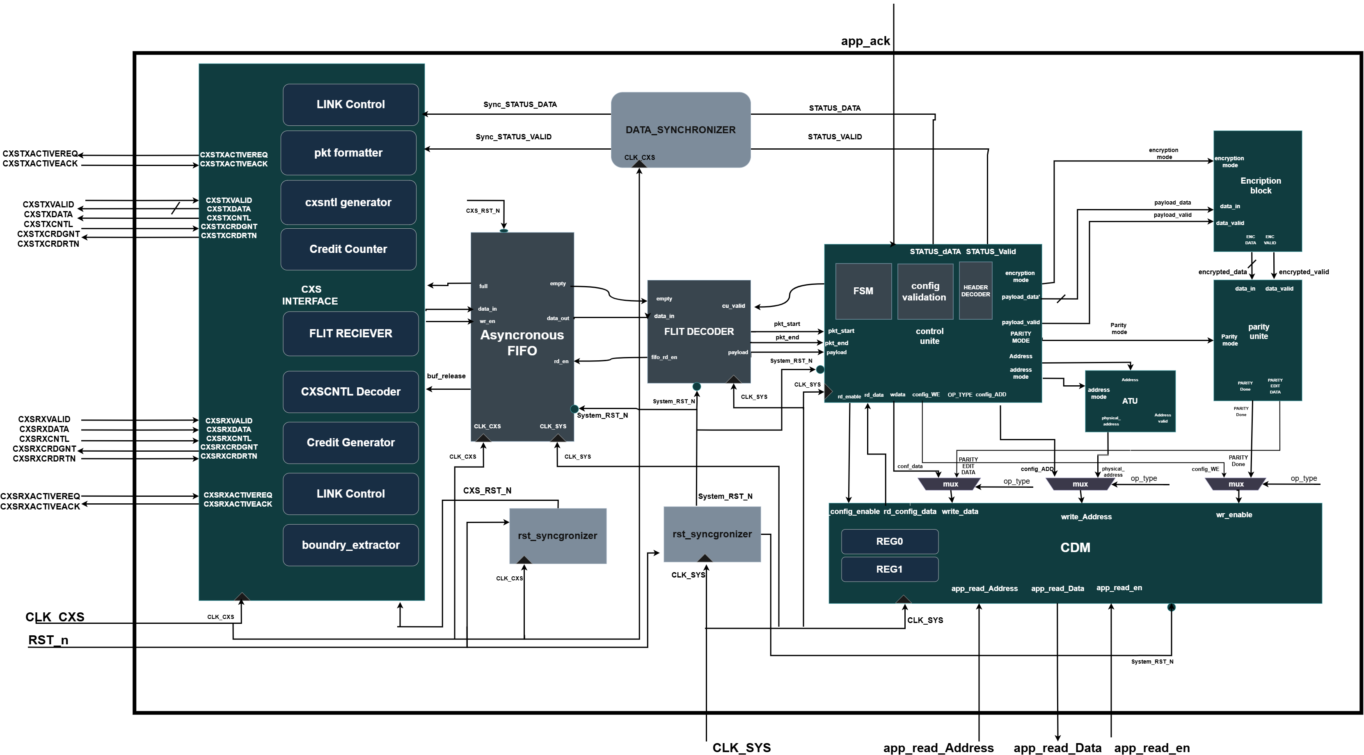
System Architecture
High-level block diagram of the CXS Bridge — CXS Interface, Control Unit, Encryption, Parity, ATU, and CDM working together.

Slide 7
System Main Blocks
The proposed high-level architecture of the CXS Bridge Encryption and Data Management System consists of the following major blocks:
CXS Interface (RX/TX)
Control Unit
Data Protection Path
Address Translation (ATU)
Central Data Memory (CDM)
Flit reception and error status packet
transmission, credit-based flow control, link activation, CXSCNTL decoding and packet formatting
FSM-based System controller; header decoding, config validation, payload extraction, error handling
Encryption Block with 2 mode of encryption and special encryption case + Parity Unit with 2 mode (odd / even) to secures payload before storage
Converts logical addresses to physical memory addresses using base address receiving in configuration packet and device count to define available region
Stores config + payload data; local controller validates writes to device regions
These modules cooperate to receive packets from the CXS interface, validate and process packet information, perform encryption and parity generation, translate addresses, and store the processed data in memory.

Slide 8
High-Level Data Flow
Incoming CXS flits cross from the CXS clock domain into the system clock domain through the Asynchronous FIFO, where the Flit Decoder extracts payload and packet-boundary information for the Control Unit
Incoming Data
CXS Interface
Receives flit, credit-based flow control
Async FIFO
CDC buffer: CXS clk → System clk
Flit Decoder
Extracts payload, to 16bit internal bath start/end/error flags
Control Unit
ATU + Encryption + Parity
Translates address, encrypts payload, appends parity
CDM
Stores config (direct write) or processed payload (ATU address)
Data Sync + CXS TX
CDC buffer: System clk → CXS clk; sends status flit back

Slide 9
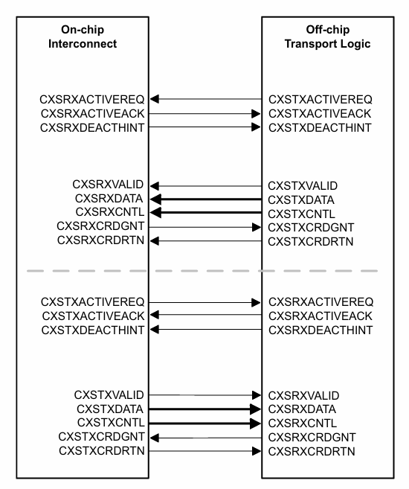
CXS Protocol
Streaming, Point-to-Point : Packetized data sent directly between two link partners — no addressing/routing layer, just protocol packets riding on flits
Full-Duplex : Independent TX and RX signal paths operate simultaneously and independently of each other
Flit-Based Transfer : Data moves one flit (flow-control unit) per clock cycle; a flit can carry multiple packets, or one packet can span several flits
Credit-Based Flow Control : Non-blocking: the transmitter only sends when it holds a credit from the receiver, preventing buffer overflow without handshake stalls
Control Field (CXSCNTL):Encodes START/END/ERROR boundary info per flit so the receiver can reconstruct packet boundaries from the raw flit stream

Slide 10
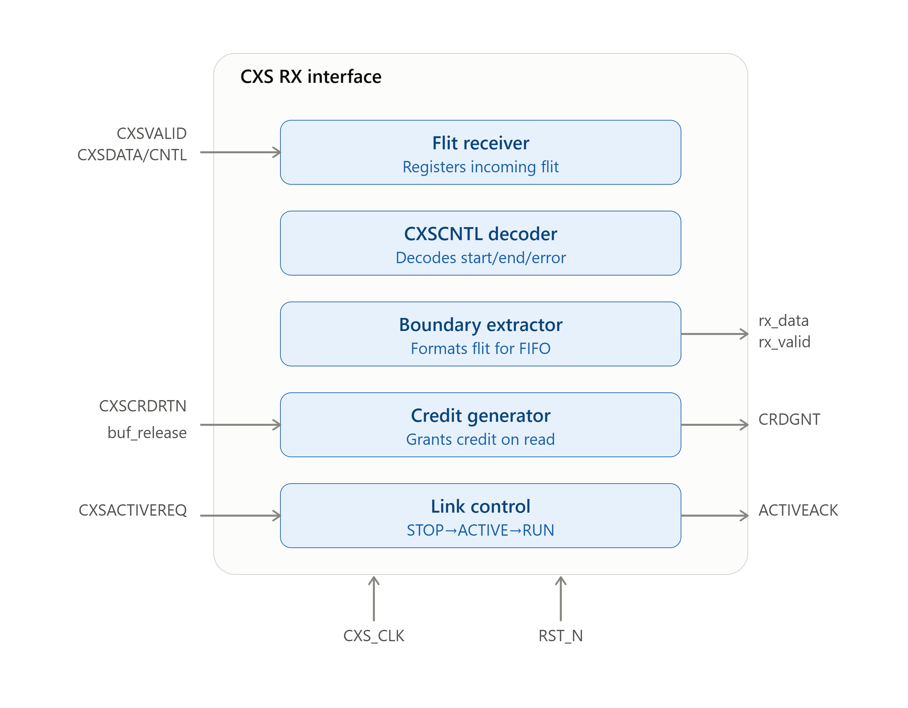

CXS Interface (RX)
Flit Receiver
Samples 32 bit CXSDATA/ 6 bit CXSCNTL on the CXS clock when CXSVALID is asserted; registers the flit
CXSCNTL Decoder
Decodes the control field to identify packet start, end, and error boundaries
Boundary Extractor
Formats the decoded flit + boundary info for storage into the Async FIFO
Credit Generator
Monitors FIFO space; asserts CXSRXCRDGNT when a read frees a buffer slot, deasserts when FIFO is full
Link Control (RX)
FSM managing link activation/deactivation handshake (CXSRXACTIVEREQ/ACK)

Slide 11

CXS Interface (TX)
CXS Packet Formatter
Converts status_valid/pkt_type/error_type into internal packet format with start/end markers
CXS TX Credit Counter
Tracks available transmission credits (CXSTXCRDGNT in, consumed on each flit sent, max 15)
CXS Flit Transmitter
Transmits the flit only when packet is available, link permits sending, and credit is available
CXS Control Encoder (cxscntl_encoder)
Encodes START/END/ENDERROR into the final CXSTXCNTL field
Link Control (TX)
Manages CXSTXACTIVEREQ/ACK handshake and gates transmission permission

Slide 12
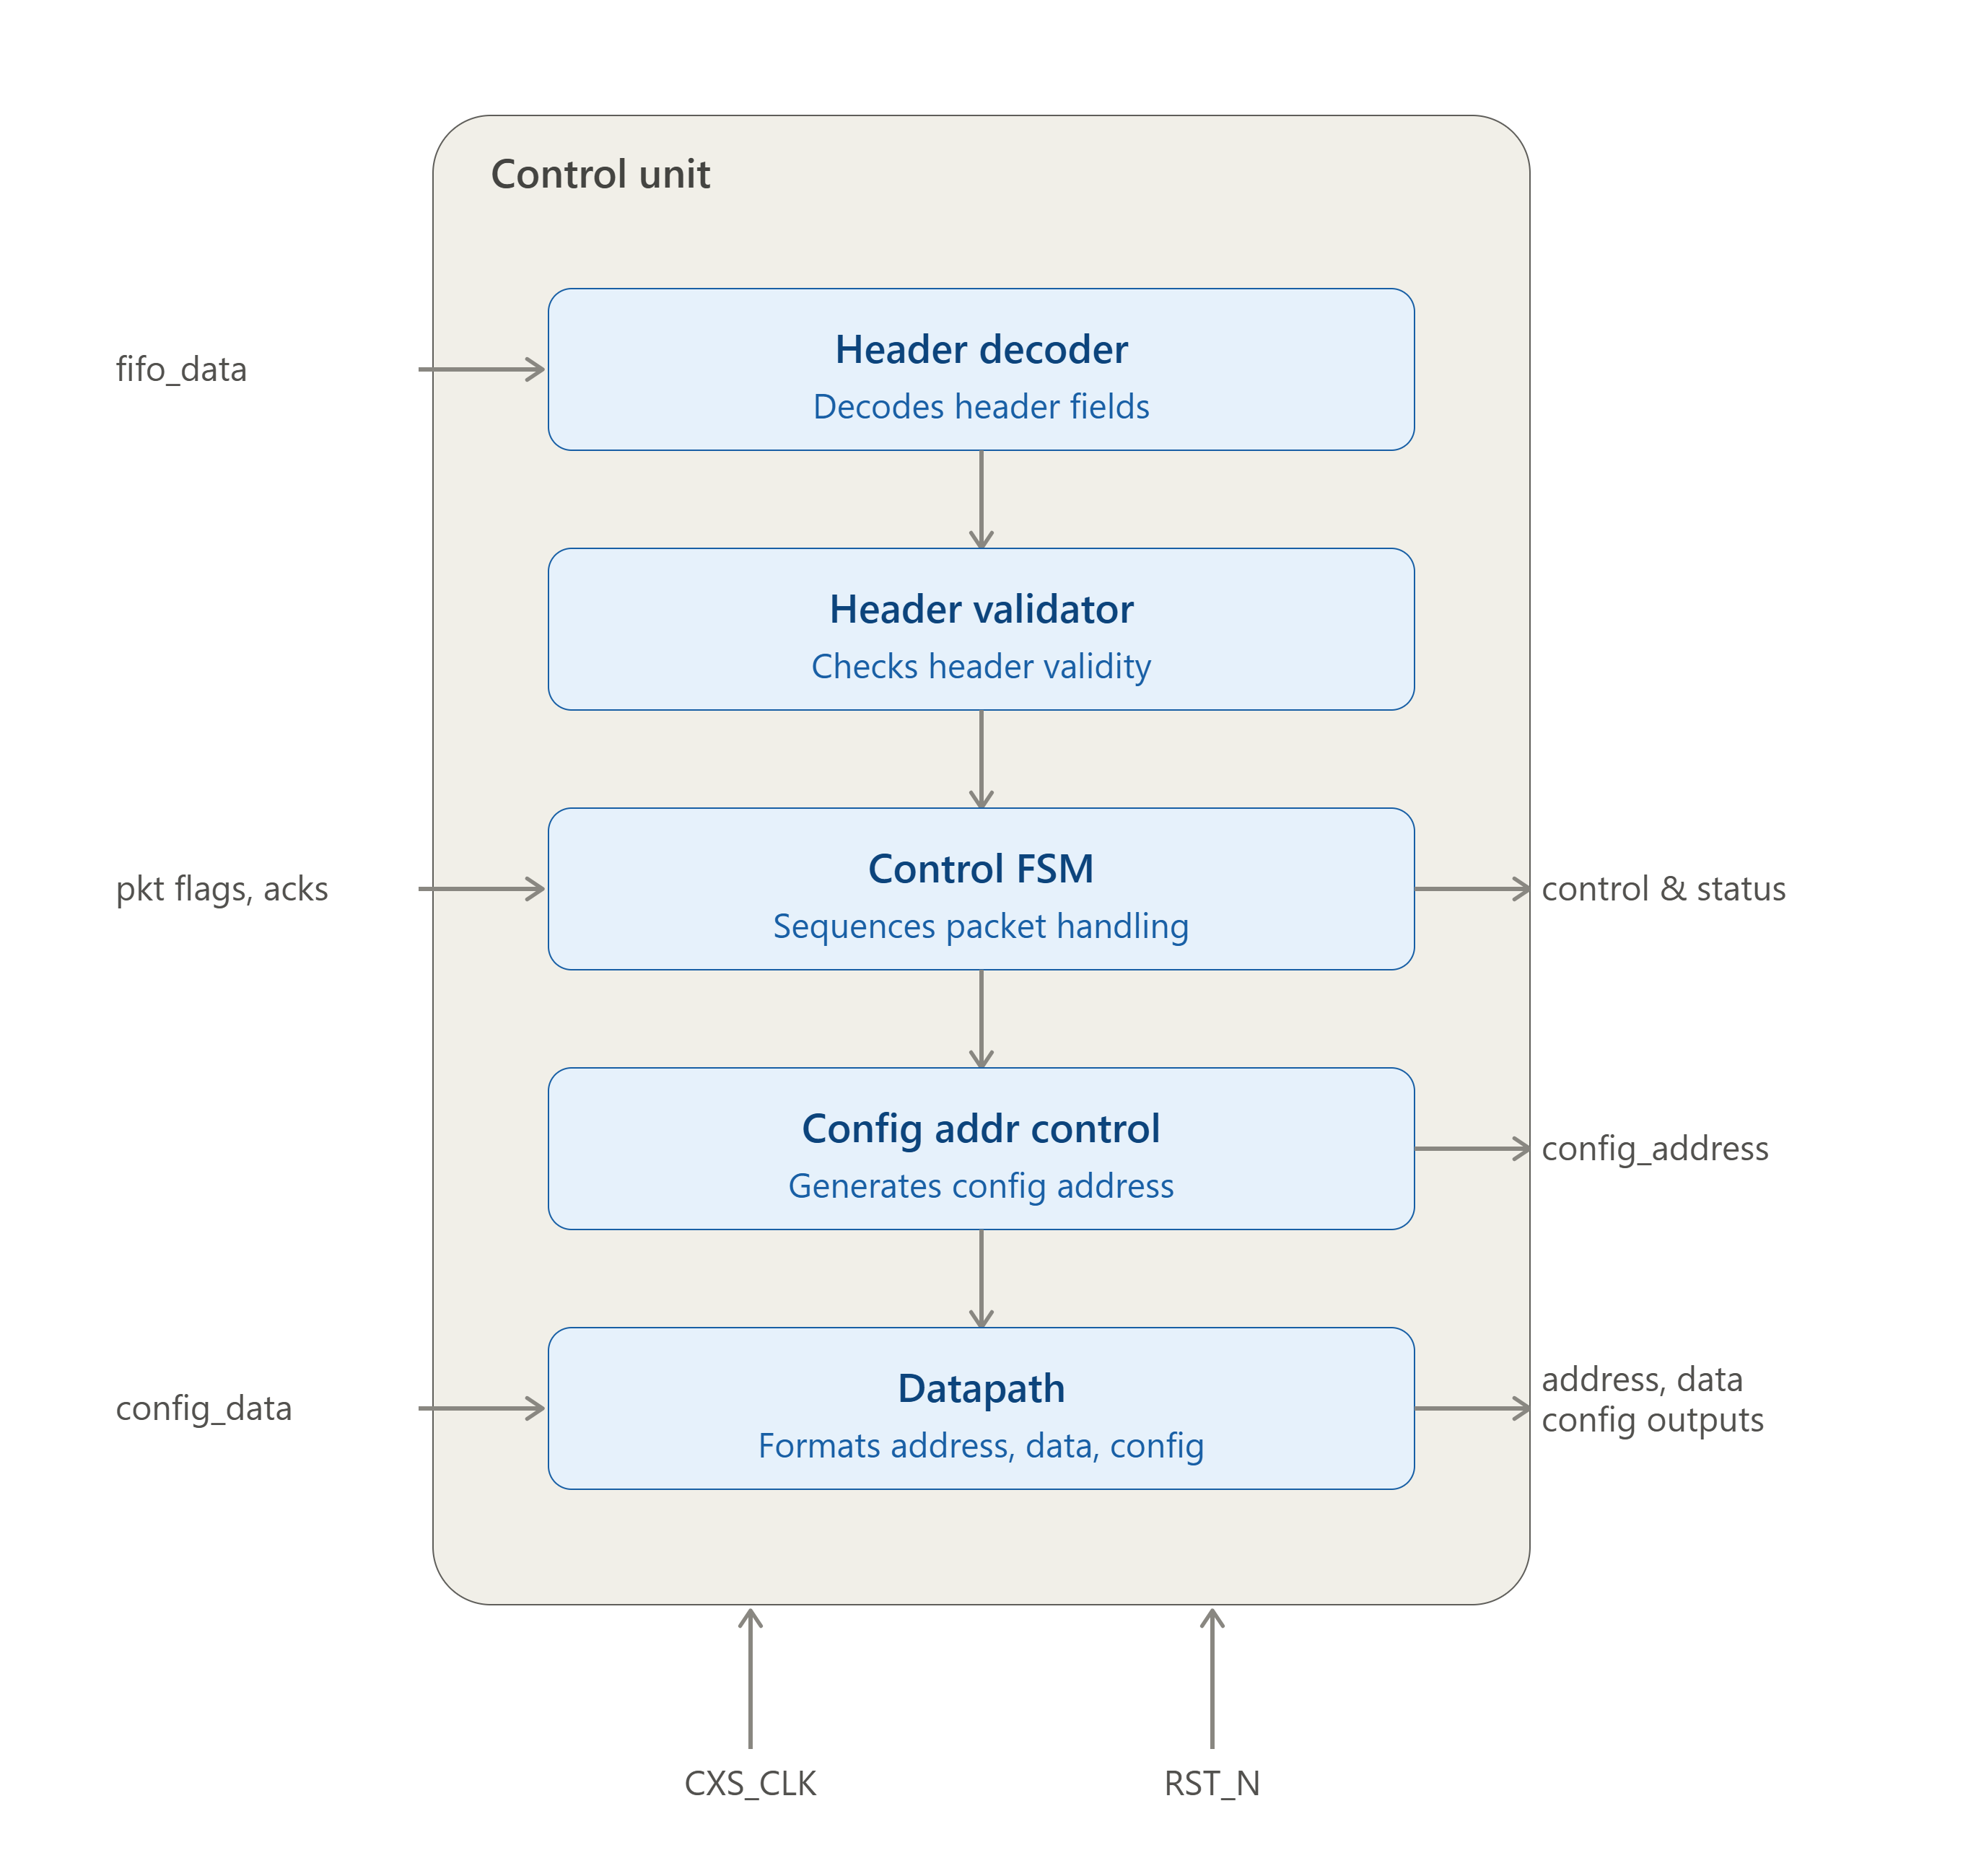
Control Unit
Central controller of the CXS Bridge — receives the formatted packet stream from the RX Interface and manages system operation according to the current protocol state
Packet boundary detection: Uses pkt_start / pkt_end signals to identify each packet; the first payload word (pkt_start = 1) is interpreted as the packet header
Header Decoder: Extracts packet type and control info from the header, letting the FSM determine the required operation
Per-packet-type behavior:
  Configuration Packets → validates content
  Link Packets → verifies header, transitions system to Link-Up state
  Data Packets → splits each 16-bit payload word into 8-bit address + 8-bit data
Error handling: Any validation error → Control Unit generates a status packet, sent back to the remote transmitter

Slide 13
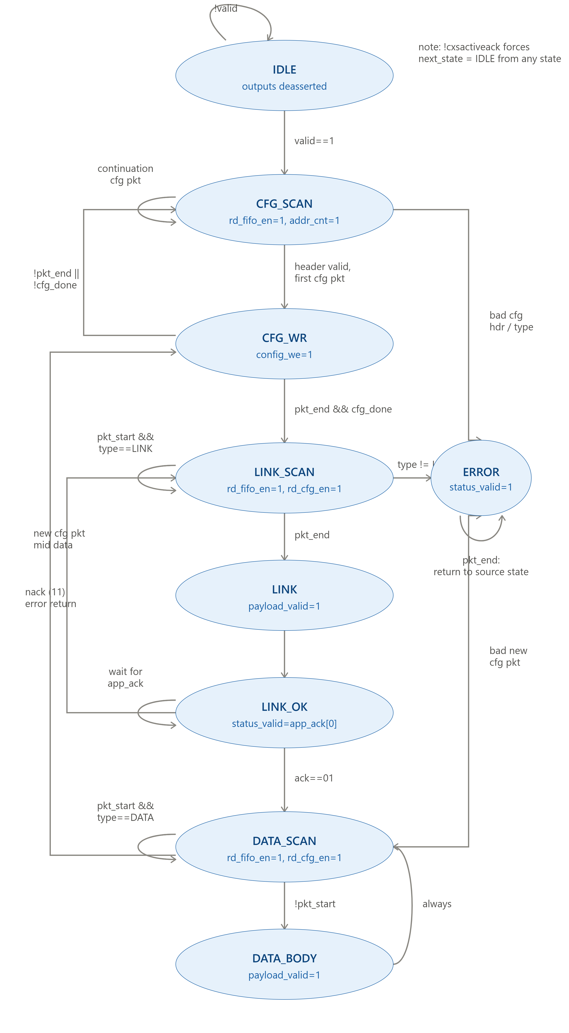
Control Unit FSM
IDLE
Default/reset state; waits while FIFO is empty
CFG
SCAN
Reads first flit, checks if it's a config header
rd_fifo_en=1, addr_counte=1
CFG_WR
Writes config payload into CDM
config_we=1
At system deactivation
LINK_SCAN
Verifies Link-Up packet after config is done
rd_fifo_en=1
LINK
Link validated; ready for data transfer
status_valid=1
DATA_SCAN
Detects start of payload packet
rd_fifo_en=1, rd_configen=1
DATA_BODY
Processes payload data until pkt_end
payload_valid=1, rd_config_en=1
ERROR
Entered on invalid header/type/protocol violation; holds until reset
status_valid=1, rd_fifo_en=1

Slide 14
Encryption & Parity
Encryption
Parity
The parity bit is generated according to the parity mode stored in the Register File, which specifies either Even Parity or Odd Parity.
When a valid encrypted payload is received, the block immediately computes the parity bit and appends it to the encrypted data
Even Mode Each input bit is expanded by appending 0 example for mapping:
0 → 00 1 → 10
Odd Mode Each input bit is expanded by appending 1 example for mapping:
0 → 01 1 → 11
Special Case If the number of logic '0' bits equals the number of logic '1' bits, or if both counts are even, the block overrides the selected mode and applies the special mapping:
0 → 01 1 → 10

Slide 15
ATU & Central Data Memory (CDM)
ATU
Central Data Memory (CDM)
Converts the logical address received from the data packet into a physical CDM address using the following formula :
Physical Address = Logical Address – Base Address + Start Address + 2
Supports configurable address translation mode with send the Base address with configuration packet.
The translated address is used to access the corresponding device memory region.
Configuration Region: Stores the configuration packet beginning at address 0x0000 ,0x0001, including the encryption mode, parity mode, number of devices, base address,and device memory-region information.
Payload Region: Stores payload data belonging to each configured device The physical address is generated by the ATU based on the logical address contained in the data packet.
Allow read operation for application devices
Allow read operation for control unit to access configuration data stored

Slide 16
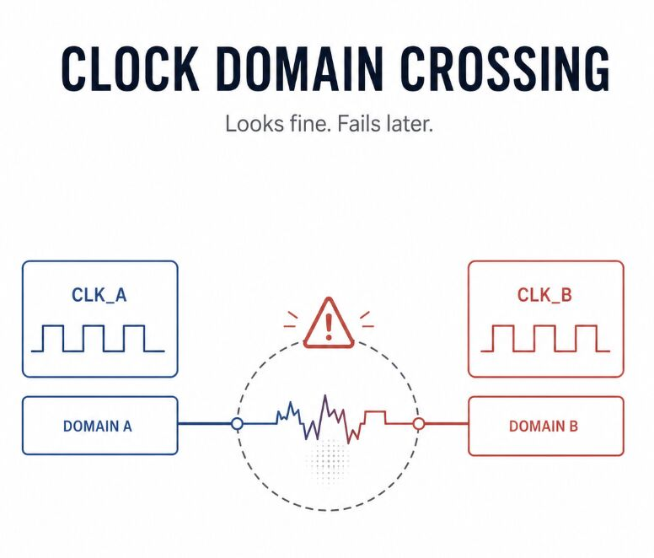
3
Clock Domain Crossing (CDC) Strategy

Slide 17
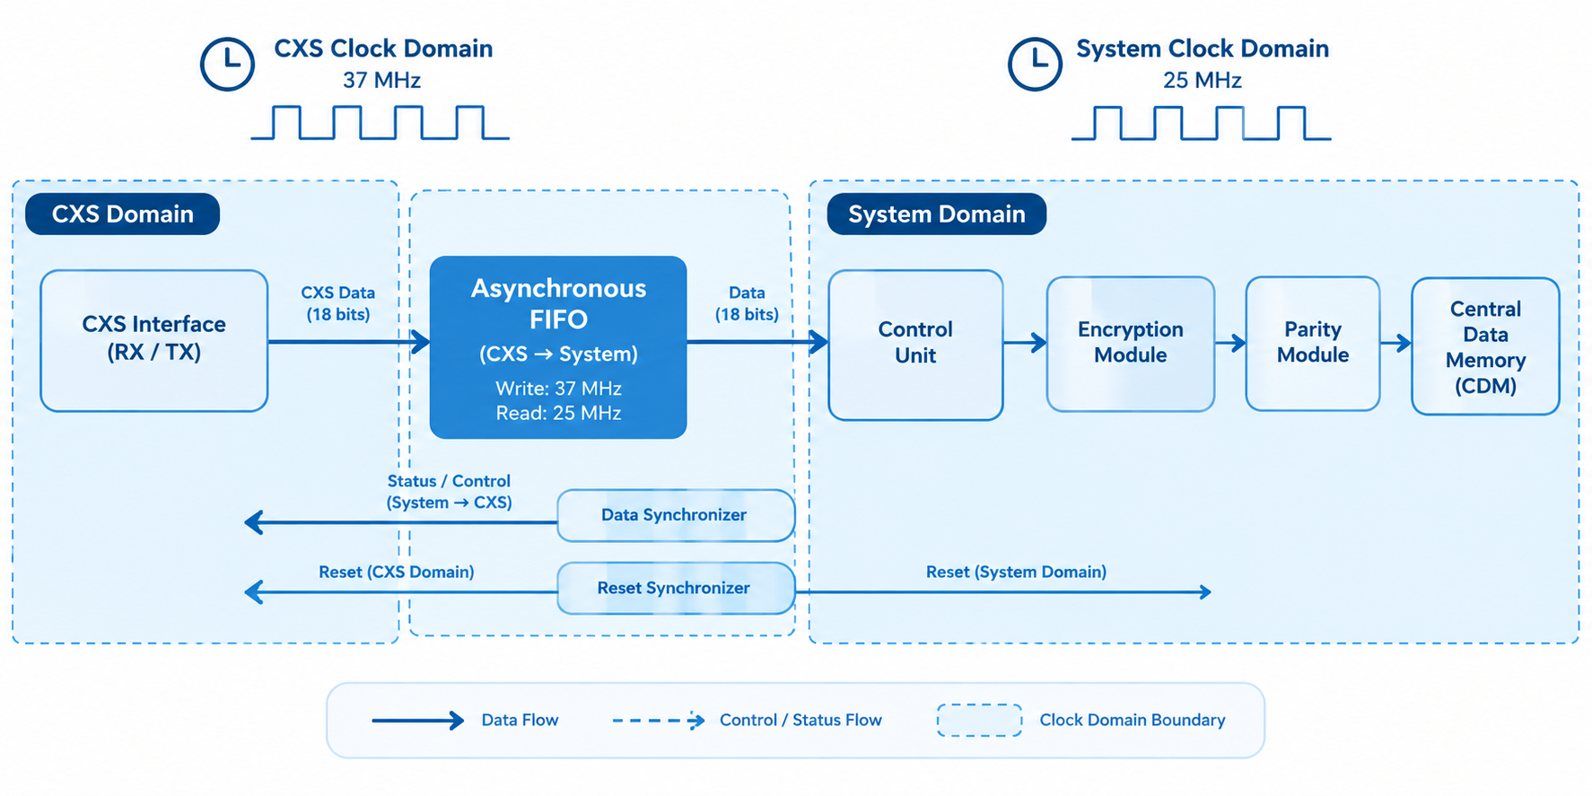
Clock Domain Crossing (CDC)
Objective
Direct transfer between asynchronous clock domains can cause:
Metastability
Data corruption
Incorrect pulse detection
1
Clock Domains
2
The design operates using two independent clock domains:
CXS Clock Domain: 37 MHz
System Clock Domain: 25 MHz
Solutions
Three CDC techniques are implemented:
Asynchronous FIFO – CXS → System domain
Data Synchronizer – System → CXS domain
Reset Synchronizer – Generates synchronized resets for both domains
3

Slide 18
CDC solutions
Asynchronous FIFO
Safe multi-bit data transfer between 37 MHz CXS domain → 25 MHz System domain.
Data Synchronizer
Transfers status information from System domain → CXS domain.
Reset Synchronizer
Separate reset synchronization for each clock domain.
Asynchronous reset assertion
Rate matching and buffering
Full/Empty status generation
Prevention of data loss between different clock rates
Uses a configurable multi-stage flip-flop synchronizer.
Synchronizes the enable/control signal.
Synchronous reset deassertion

Slide 19

4
Verification Strategy & Test cases

Slide 20
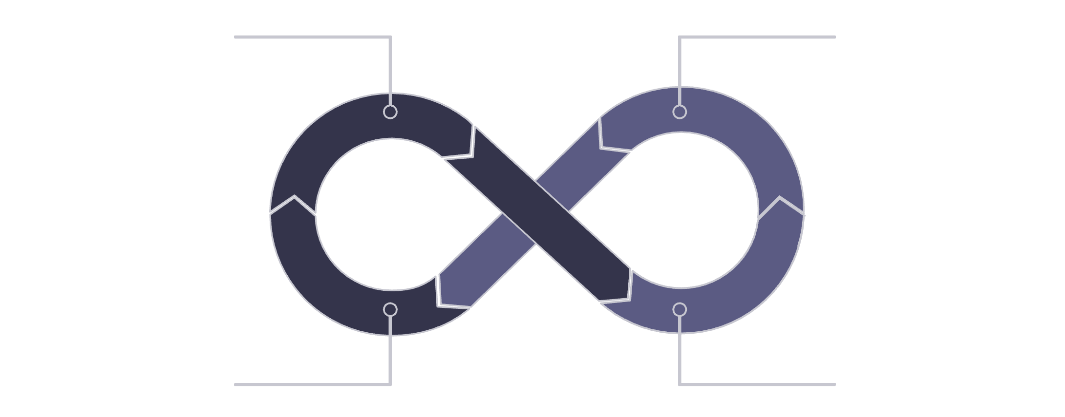
Verification Strategy
Two-Level Verification Approach
1. Unit-Level Verification
Each major CXS interface is verified independently.
Dedicated SystemVerilog self-checking testbenches are used.
Corner cases and protocol behavior are included.
2. End-to-End Verification
Verifies the complete CXS Bridge from RX to TX.
Functional behavior is checked using self-checking testbench tasks and assertions.
1
End to end verfication
Unit test for main blocks
Main Verification Goals
Self checking functions
Corner Case
Verfication
2
Correct CXS protocol operation
Correct packet processing
Correct credit-based flow control
Correct configuration and error handling
Correct encryption, parity, address translation, and CDM storage

Slide 21
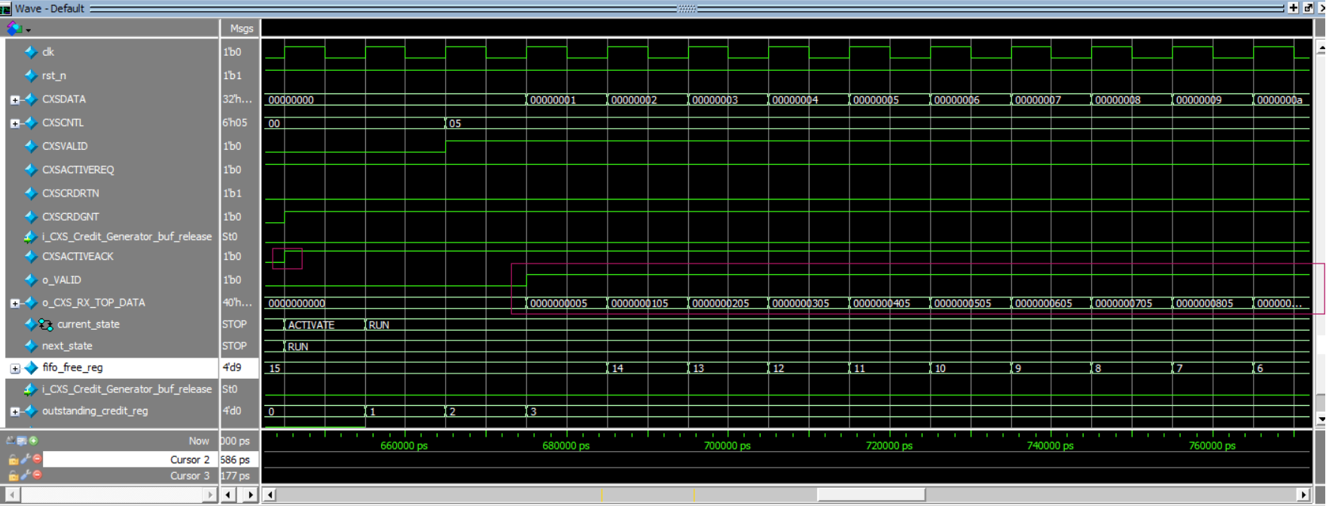
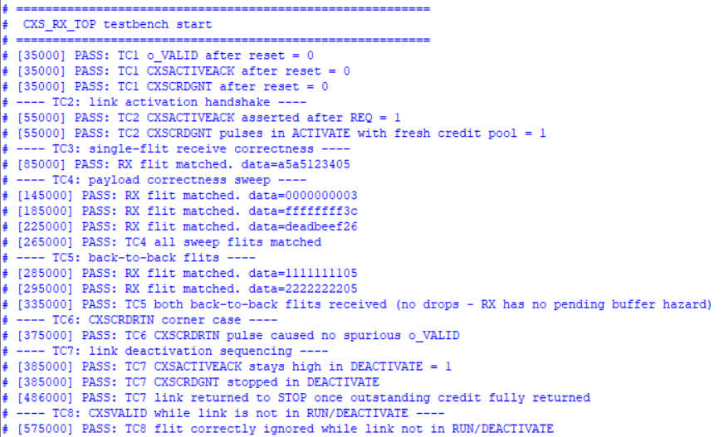
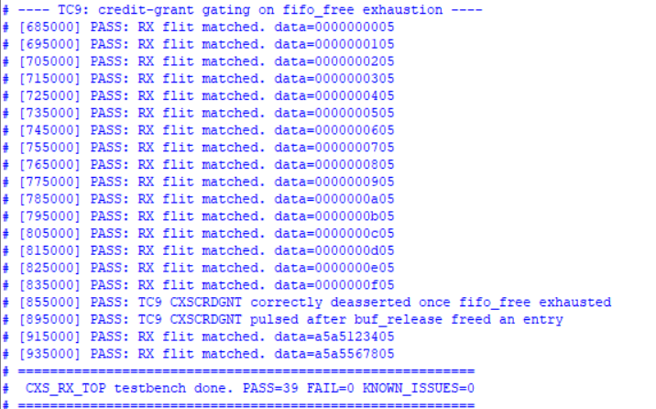
CXS RX Unit Verification
Main Scenarios
Reset verification
Link activation handshake
Single-flit reception
Payload/control combinations
Back-to-back flits
Credit return
Link deactivation
Invalid flit reception
Credit exhaustion and buffer release
Result
9/9 RX unit test cases PASS
Data path verified
Control decoding verified
Link control verified
Credit management verified
FIFO/buffer management verified
Corner cases verified
100% code coverage on questasim

Slide 22
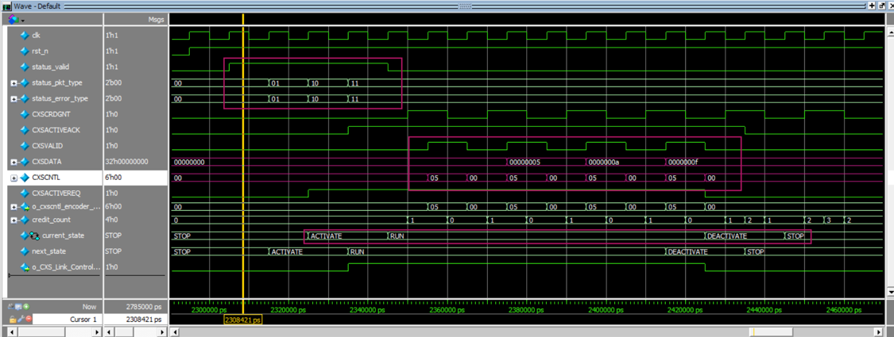
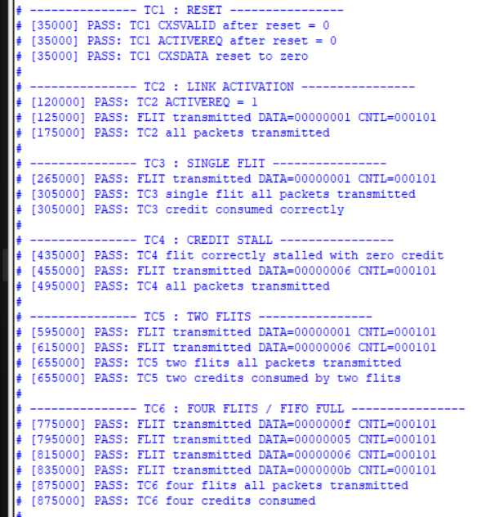
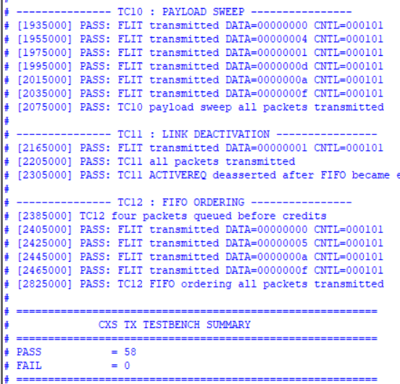
CXS TX Unit Verification
Main Scenarios
Reset verification
Link activation
Single-flit transmission
Transmission without credit
Multi-flit transmission
FIFO operation
Multiple queued packets
Credit accumulation/consumption
Credit exhaustion
Link deactivation
Result
10/10 TX unit test cases PASS
The TX unit was verified for packet formatting, buffering, transmission, and credit-based flow control.
Link control verified
Corner cases verified
100% code coverage on questasim

Slide 23
End-to-End Verification
Verification Includes
Reset and link initialization
Credit-based flow control
Configuration packets
Error detection and recovery
Link/Application handshake
Data packet processing
CDC/FIFO data transfer
Encryption and parity
Address translation
CDM write/read
Link deactivation
NACK/error response
CDC / Asynchronous FIFO
Control Unit
ATU
CXS RX Interface
Encryption + Parity
Central Data Memory
Application Interface
CXS TX Interface

Slide 24
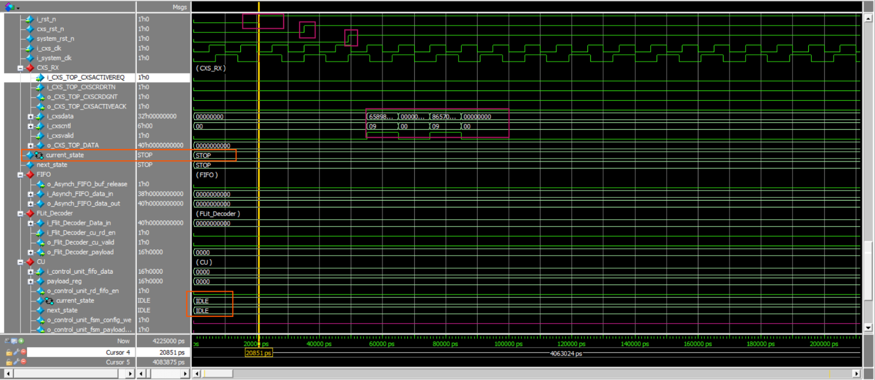
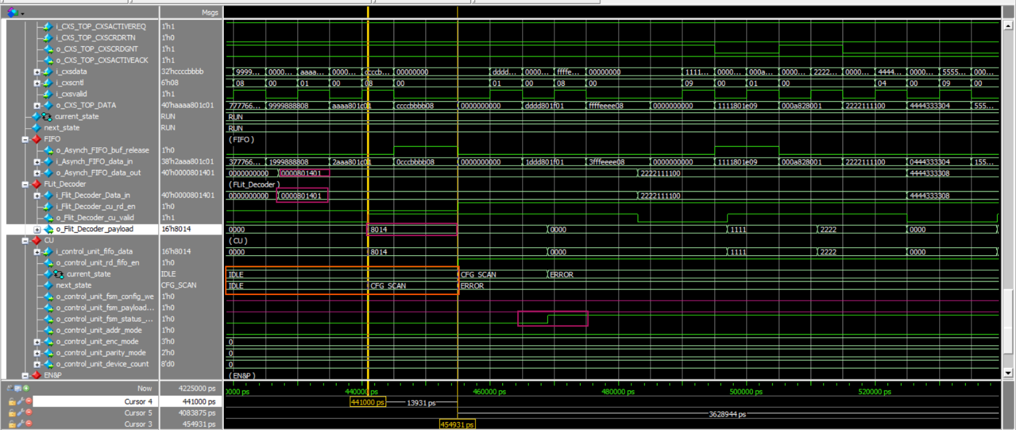
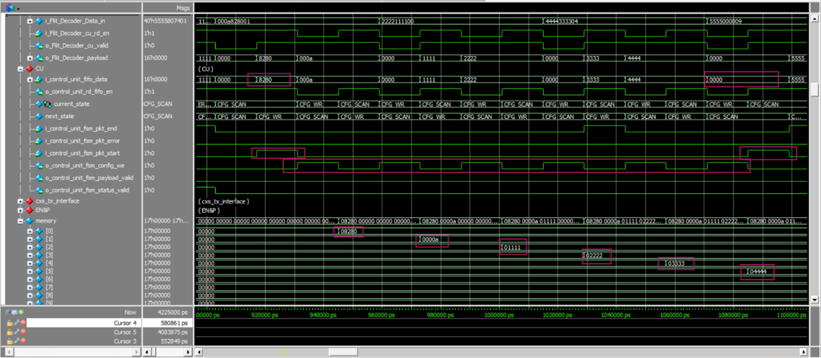
Initialization & Configuration
1. Reset & Pre-Activation
System is reset and enters the idle state.
Flits received before link activation are rejected.
No credits are granted.
No payload reaches the Control Unit.
2. Link Activation
CXSACTIVEREQ is asserted.
RX responds with CXSACTIVEACK.
Initial credits are granted.
RX enters the active state.
3. Configuration Validation
Tested invalid configuration cases:
Illegal device count
Illegal encryption mode
Illegal parity mode
Illegal packet type
Expected behavior:
Invalid configuration → ERROR state → Configuration write disabled.
4. Valid Configuration
Valid configuration packet is accepted.
Configuration data is stored correctly.
FSM progresses toward the operational state.

Slide 25
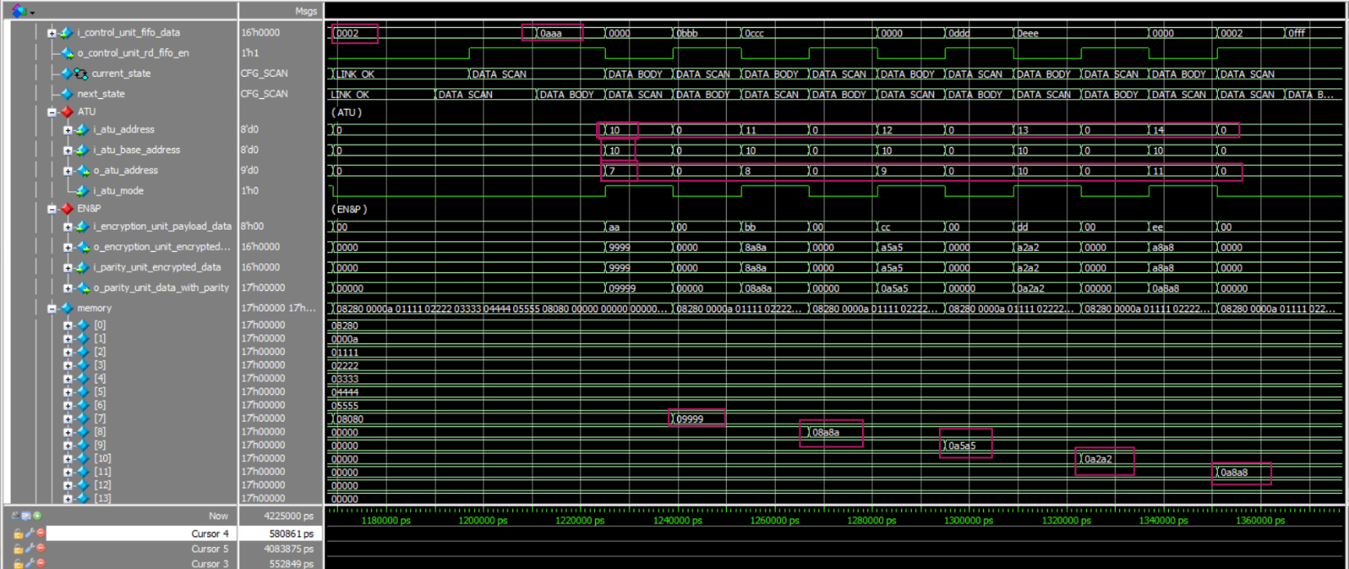
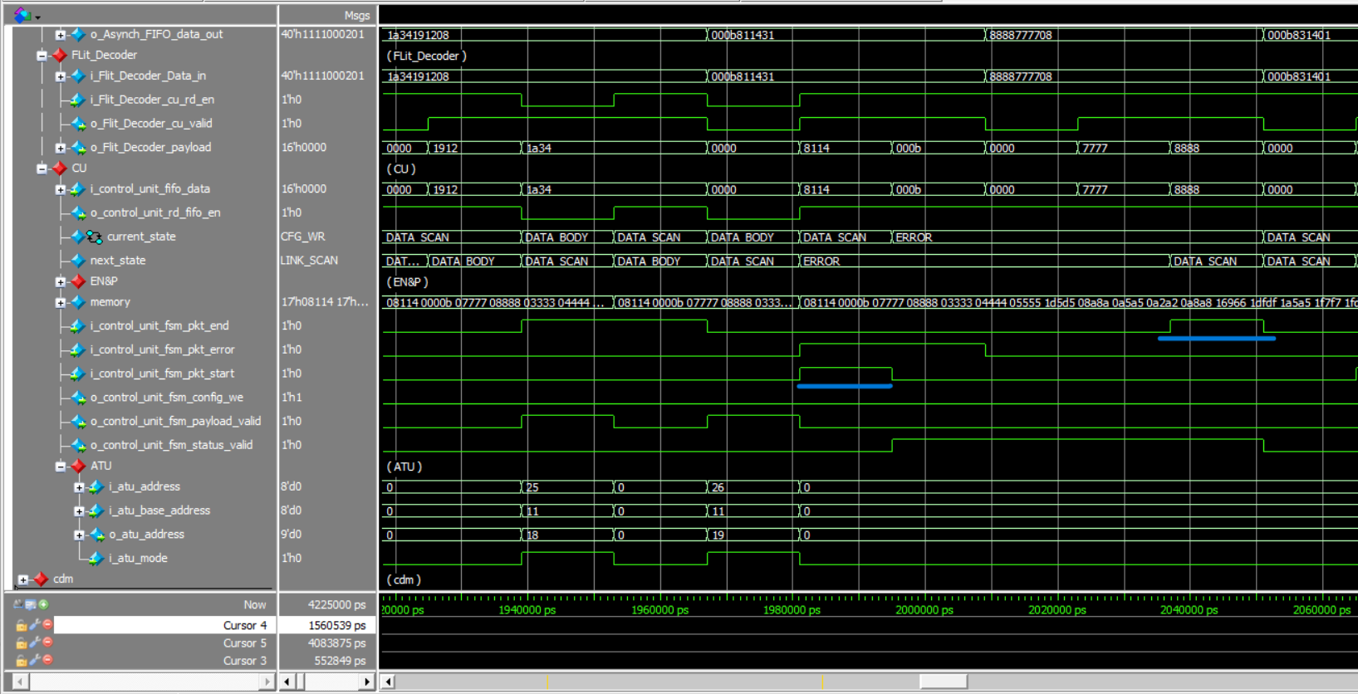
Data Processing
1. Data processing test cases
Correct packet decoding
Correct payload extraction
Correct FSM transitions
Correct logical-to-physical address translation
Correct encryption result
Correct parity generation
Correct CDM write address
Correct CDM stored data
No duplicated or skipped memory writes
2. Error handling in data packet
Expected behavior:
Invalid Data packet → ERROR state → Data write disabled and error packet discard and send status pkt error .
3. Valid Data
Valid Data packet is accepted.
Valid data is stored correctly.
FSM progresses toward the operational state.

Slide 26
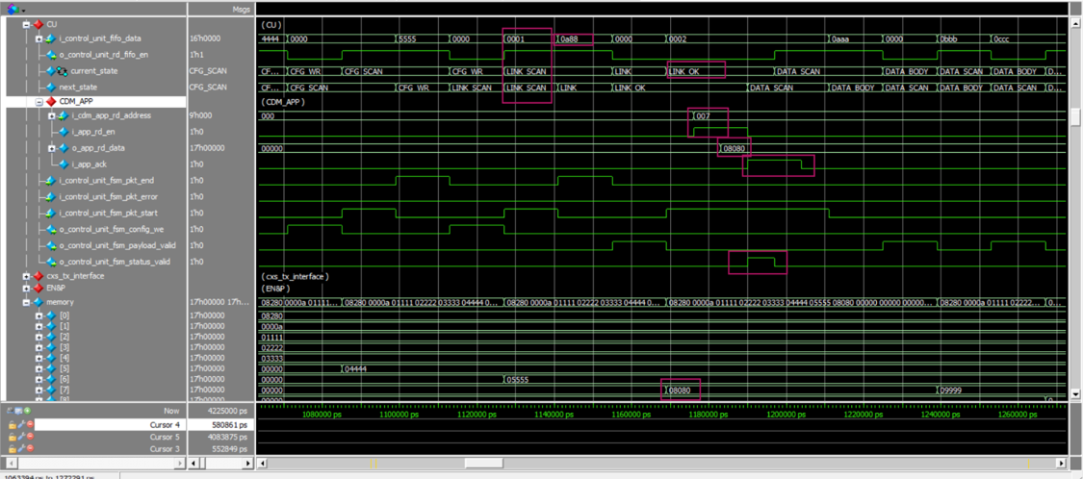
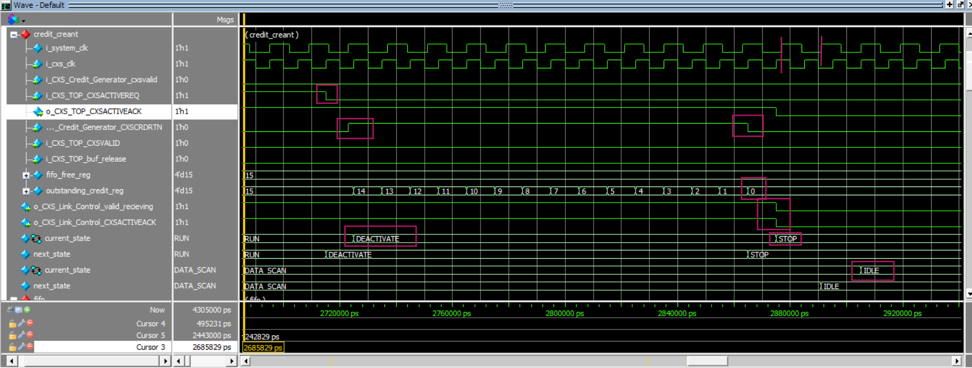
Link/Application & Deactivation
1.Application Handshake
Link packet is processed successfully.
Control Unit reaches LINK_OK.
Application reads the expected CDM location.
Returned data is compared with the expected value.
i_app_ack determines the next FSM transition.
Successful ACK allows transition to the data phase.
For application receiving unexpected data it return to link scan and sent invalid link pkt and receive another link packet
2.Link Deactivation
CXSACTIVEREQ is deasserted.
RX FSM transitions:
RUN → DEACTIVATE → STOP
Outstanding credits are returned.
Credit count drains to zero.
CXSACTIVEACK is deasserted.
Control Unit returns to IDLE.

Slide 27
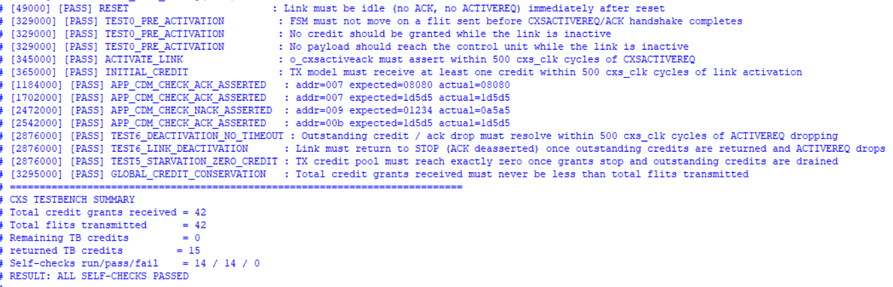
Verification Results
End-to-End Verification
Reset and initialization
Link activation and credit grant
Configuration validation
Error detection and recovery
CDC/FIFO data transfer
Application ACK handshake
Encryption + parity
ATU address translation
CDM storage/readback
Link deactivation
Credit conservation
NACK handling
PASS → The system pass all test cases

Slide 28

5
Linting & Synthesis Timing Results

Slide 29
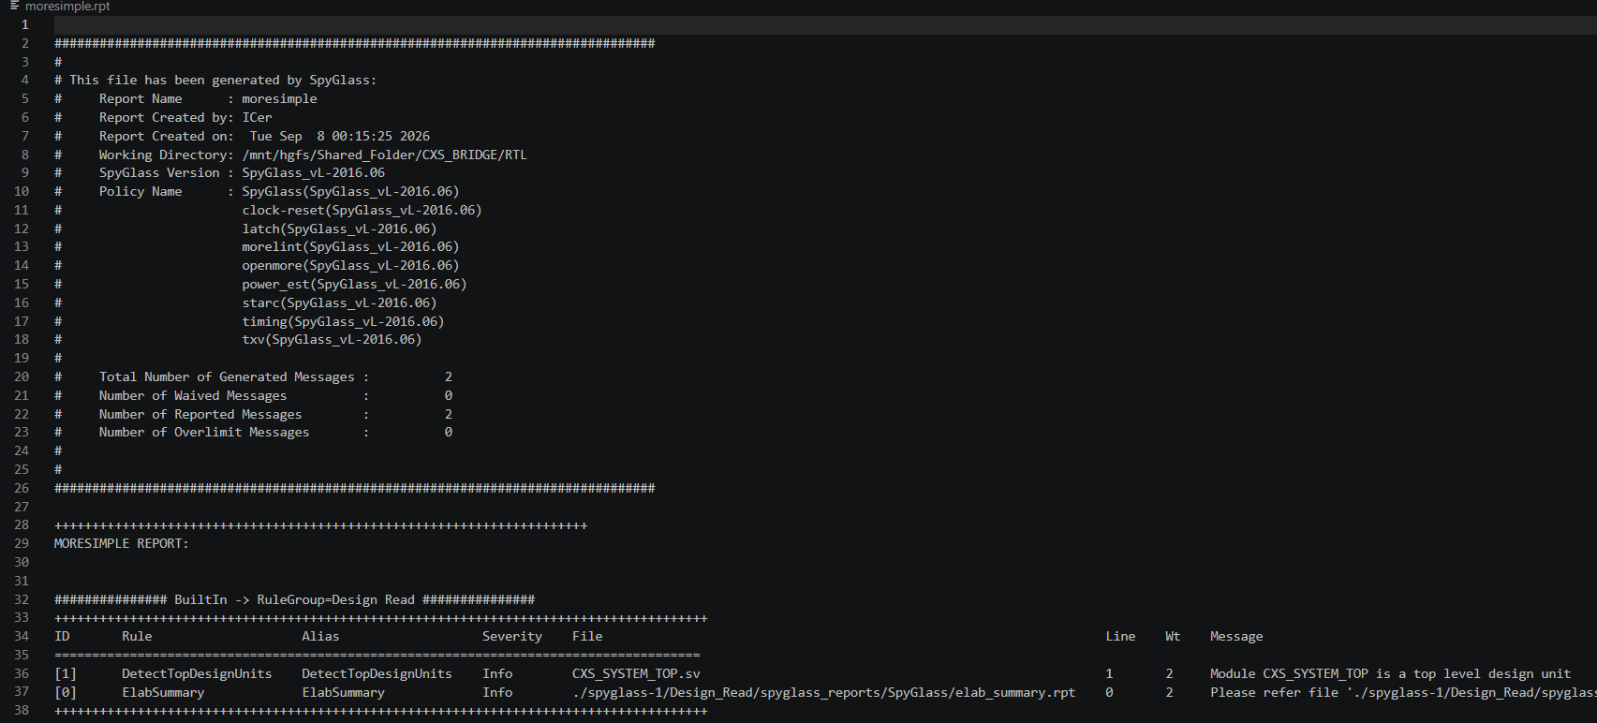
Linting Results
Linting
Result:
No Error-level violations
No unintended latches
No combinational loops
No CDC violations reported by the applied lint rules
No STARC coding violations
PASS — RTL is lint-clean under the applied SpyGlass rule set.

Slide 30
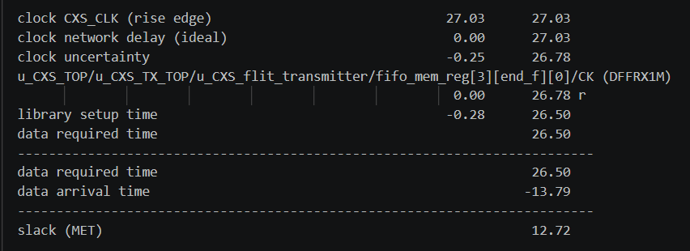
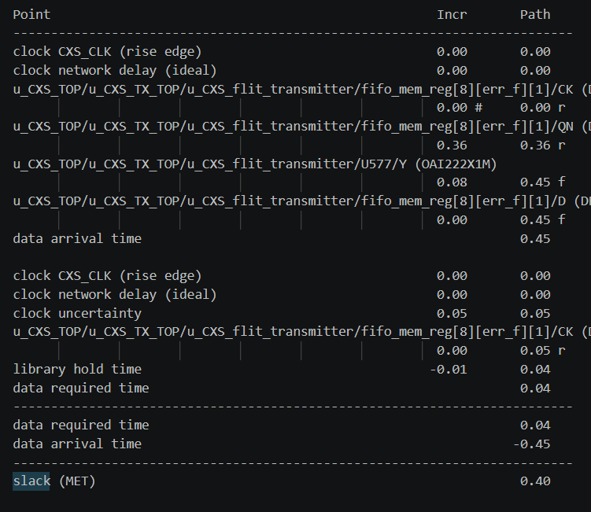
Synthesis Timing Results
Setup Timing Analysis
Checks whether data arrives before the capture clock edge.
The critical path was analyzed using the synthesized netlist.
No setup violations were reported.
Approximately 47% of the clock period remains as timing margin.
Hold Timing Analysis
Verifies the minimum-delay paths.
No hold violations were reported.
Overall Result
Setup ✓ | Hold ✓ | Timing MET

Slide 31
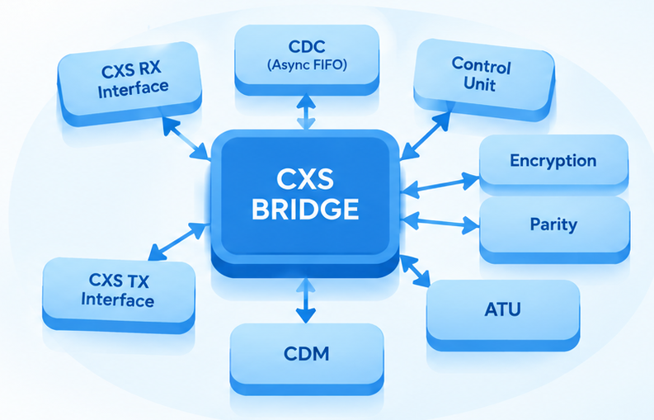
6
conclusion

Slide 32
Conclusion
Successfully designed and implemented a CXS Bridge Encryption and Data Management System using modular RTL architecture.
The design integrates CXS RX/TX interfaces, CDC handling, Control Unit, Encryption, Parity, ATU, and CDM into a complete end-to-end data path.
Unit-level verification validated the major CXS interface functions, including packet handling, link control, FIFO management, and credit-based flow control.
End-to-end verification confirmed correct system operation from packet reception through processing, address translation, encryption/parity, memory storage, application handshake, and status transmission.
SpyGlass linting reported no Warning- or Error-level violations under the applied rule set.
Synopsys Design Compiler timing analysis achieved setup and hold timing MET, with approximately 47% of the clock period available as setup margin.
Overall, the implemented design was functionally verified, lint-clean, and timing-compliant for the evaluated configuration.
Final Outcome
Functional Verification ✓ | CDC ✓ | Lint ✓ | Synthesis ✓ | Timing ✓

Slide 33


