Slide 1
HTML Tags
Tag | Syntax | Description
table | <table> <tr> <td></td> <td></td> <tr> </table> | tr - rows td - columns
img | <img src=””> | src = image link
iframe | <iframe src=””></iframe> | Src = youtube video link
input | <form><input type=””></form> | Text, number, color, radio, password, submit

Slide 2
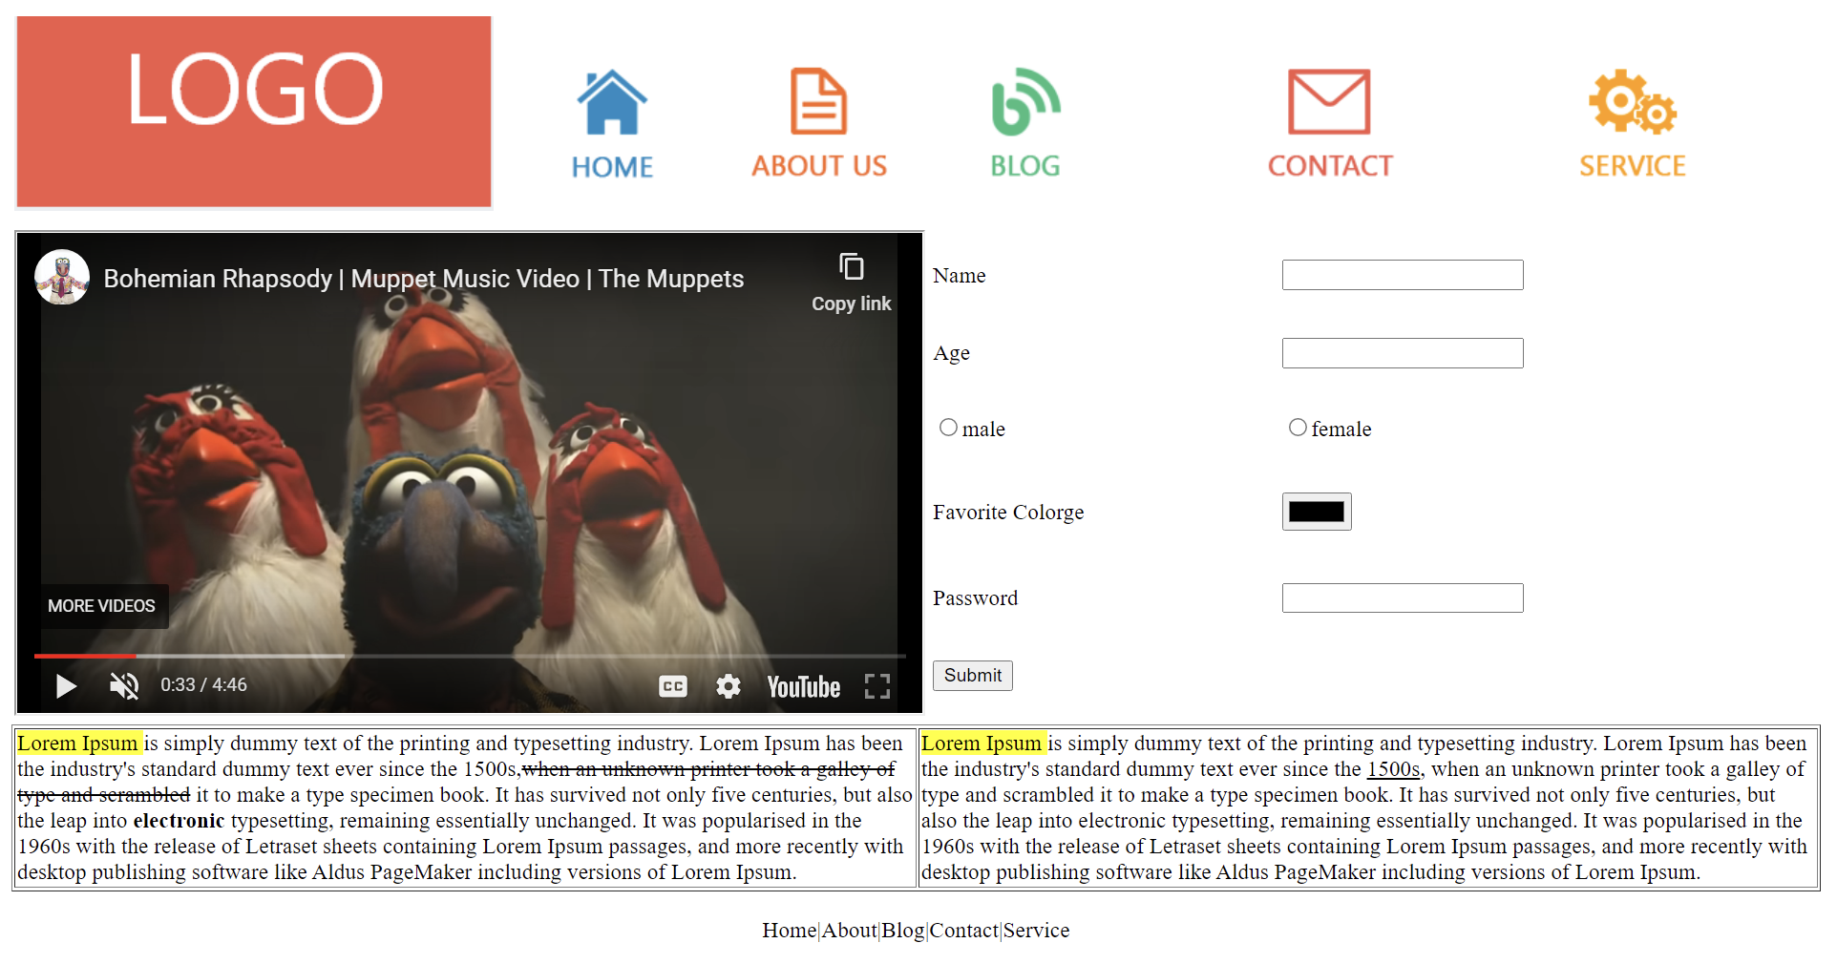
Task 1

Slide 3

Task 2

