Slide 1




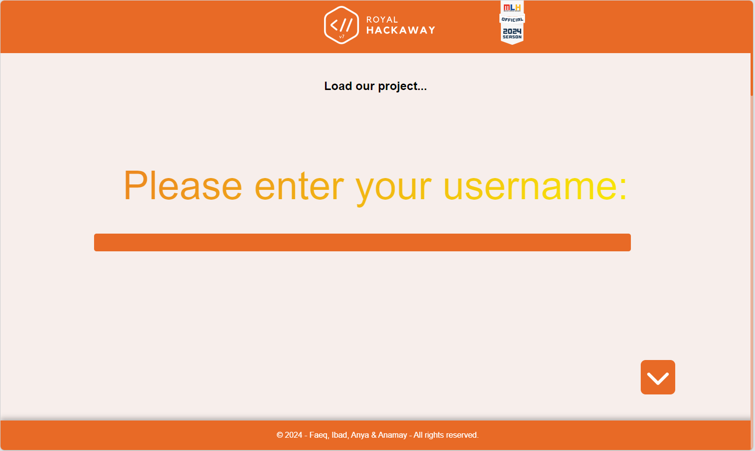


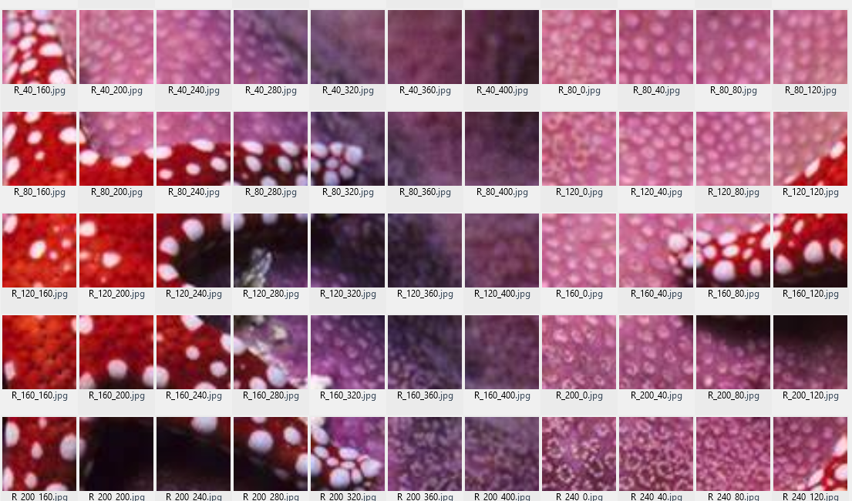

?
Self-driving car
Unintuitive UI for login to app
Coloring game

