Slide 1


A concurrency-based
game environment
Leveraging Gleam and the BEAM for Robust Multiplayer Game Systems
By Faeq

Slide 2

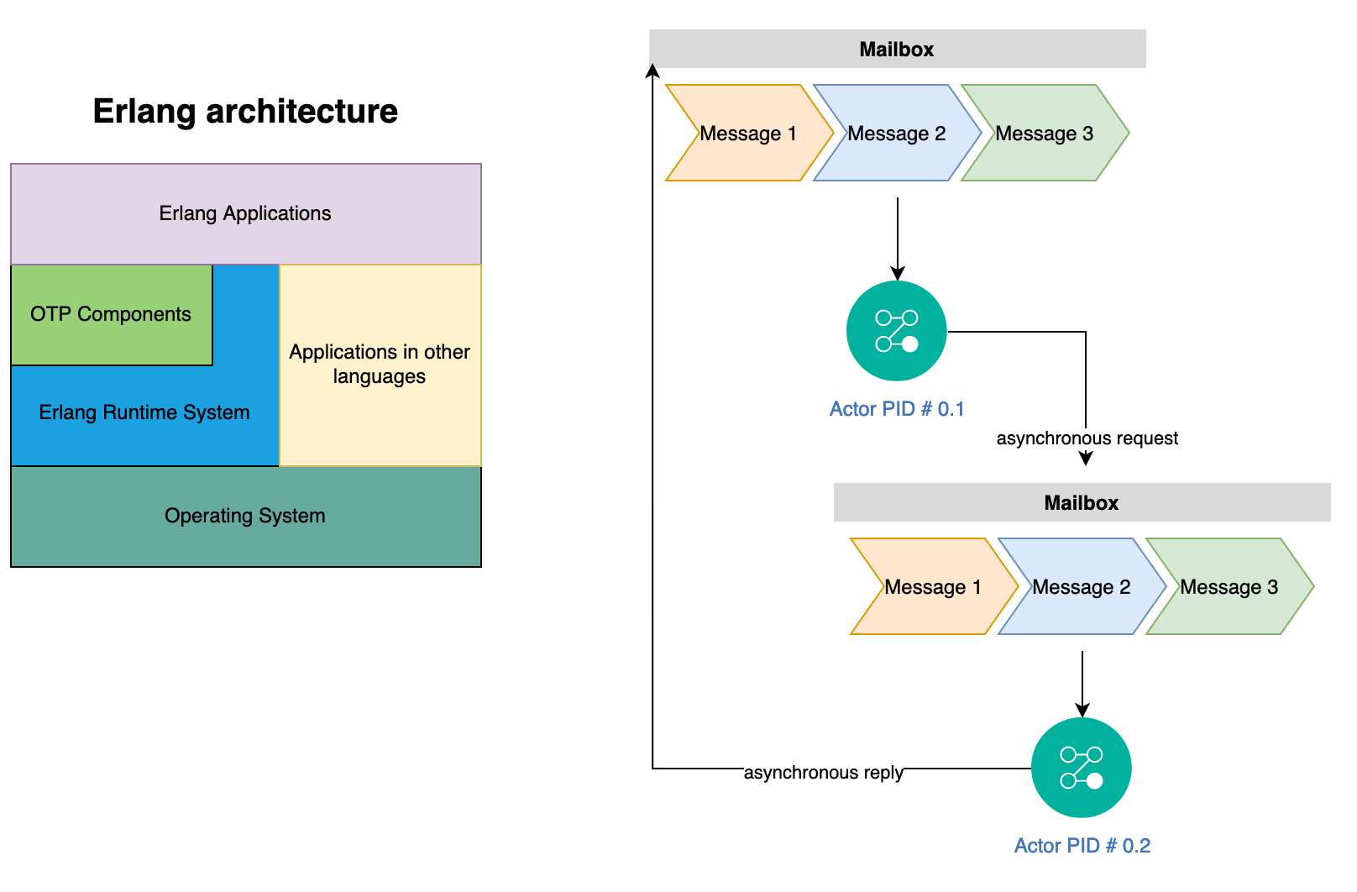
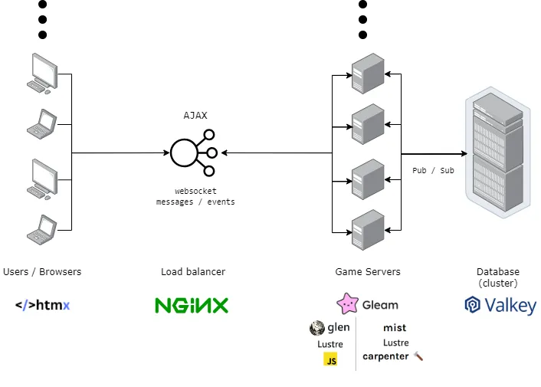
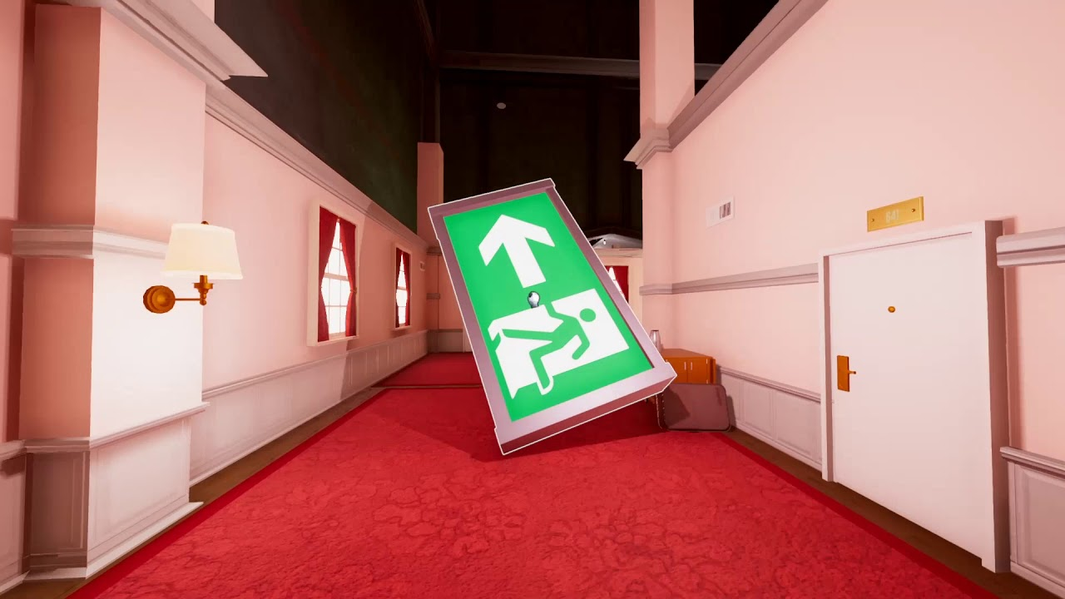


Introduction
1
Context
2
Concepts
3
Approach
4
Progress
5
Conclusion
6
Summary

Slide 3
Context
Games and Play
Entertainment, relaxation, stress relief
Critical thinking, problem-solving
Multiplayer Games
Social skills, emotional intelligence, building resilience
”fun experienced when interacting with others is more positive than solitary fun” [Reis et al., 2017]
Concurrency Mechanisms
Simultaneous actions, race conditions, system reliability
WebSockets, Actors, Threads, Goroutines, Coroutines, Pub / Sub

Slide 4
Main Concepts
JavaScript’s Concurrency Model
Non-blocking IO
External Systems
Single Thread
Promises, Await, .then()

Slide 5
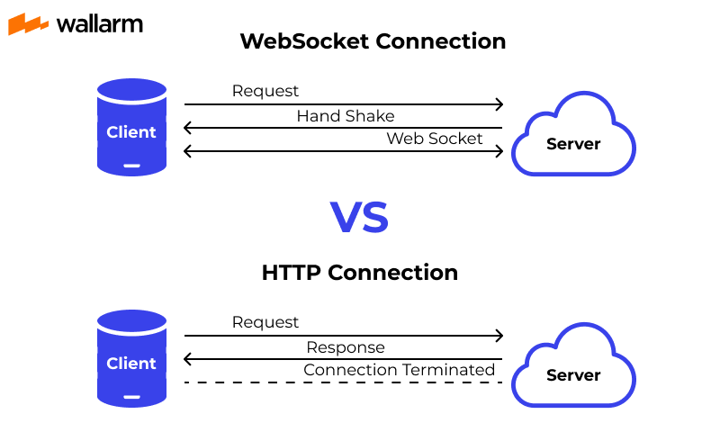
Main Concepts
Improvements
Realtime communication between systems
Multiple Threads
Actors, Goroutines, Coroutines

Slide 6
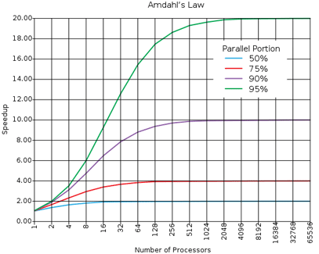
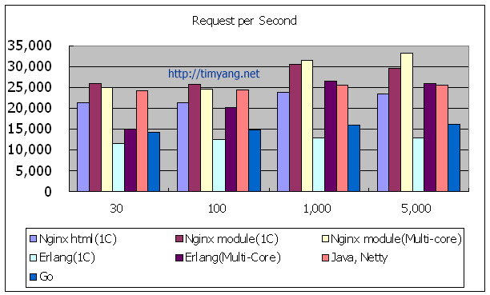
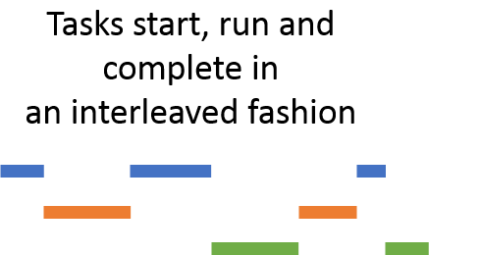
Main Concepts
Using Actors
Your parallel program only goes as fast as its slowest sequential part
Fault-tolerance & Memory Usage

Slide 7
My approach and my progress
Research
Viable technologies for creating concurrent environments
Learning
Technologies and design patterns to implement
JS PoCs
Implemented PoCs to show concrete understanding of the new technologies
Erl PoCs
Implemented the PoCs to understand the Erlang Concurrency Model
Testing
Incremental Interactive Unit Testing, and end-to-end testing
Document-ation
ALL types, functions and modules having documentation
Final Game
Began planning the final game. Started optimizing the features in the proof of concepts for reuse

Slide 9
Conclusion and my next steps
Final Game Development
Enhanced error handling
Scalability Optimizations
User Testing
• Automatic scaling
• Performance Telemetry
• Efficient inter-node . communication
• Controlled gameplay sessions
• Simulated high-load . environments
• Accessibility Evaluation
• Chat room
• Map
• Updates section
• Cause indications
• Automatic error categorization
• Real-time error recovery

Slide 10
Summary
Games, multiplayer games, and their benefits. The need for concurrency mechanisms.
Concurrency models, agents, technologies, and architectures.
My progress; proof of concepts, architecture, and chosen technologies.
My next steps; final game development, enhanced error handling, scalability optimizations, etc.

Slide 11

fyp_presentation folder
Thank You
© 2024 Louis Pilfold
Creator of the Gleam programming language.
The Gleam graphics used within this presentation are from gleam.run

