Slide 1




Automatic Test Amplification for Executable Models
Faezeh Khorram, Erwan Bousse, Jean-Marie Mottu, Gerson Sunyé
IMT Atlantique, Nantes Université
Nantes, France
Pablo Gómez-Abajo, Pablo C. Cañizares, Esther Guerra, Juan de Lara
Universidad Autónoma de Madrid
Madrid, Spain

Slide 2
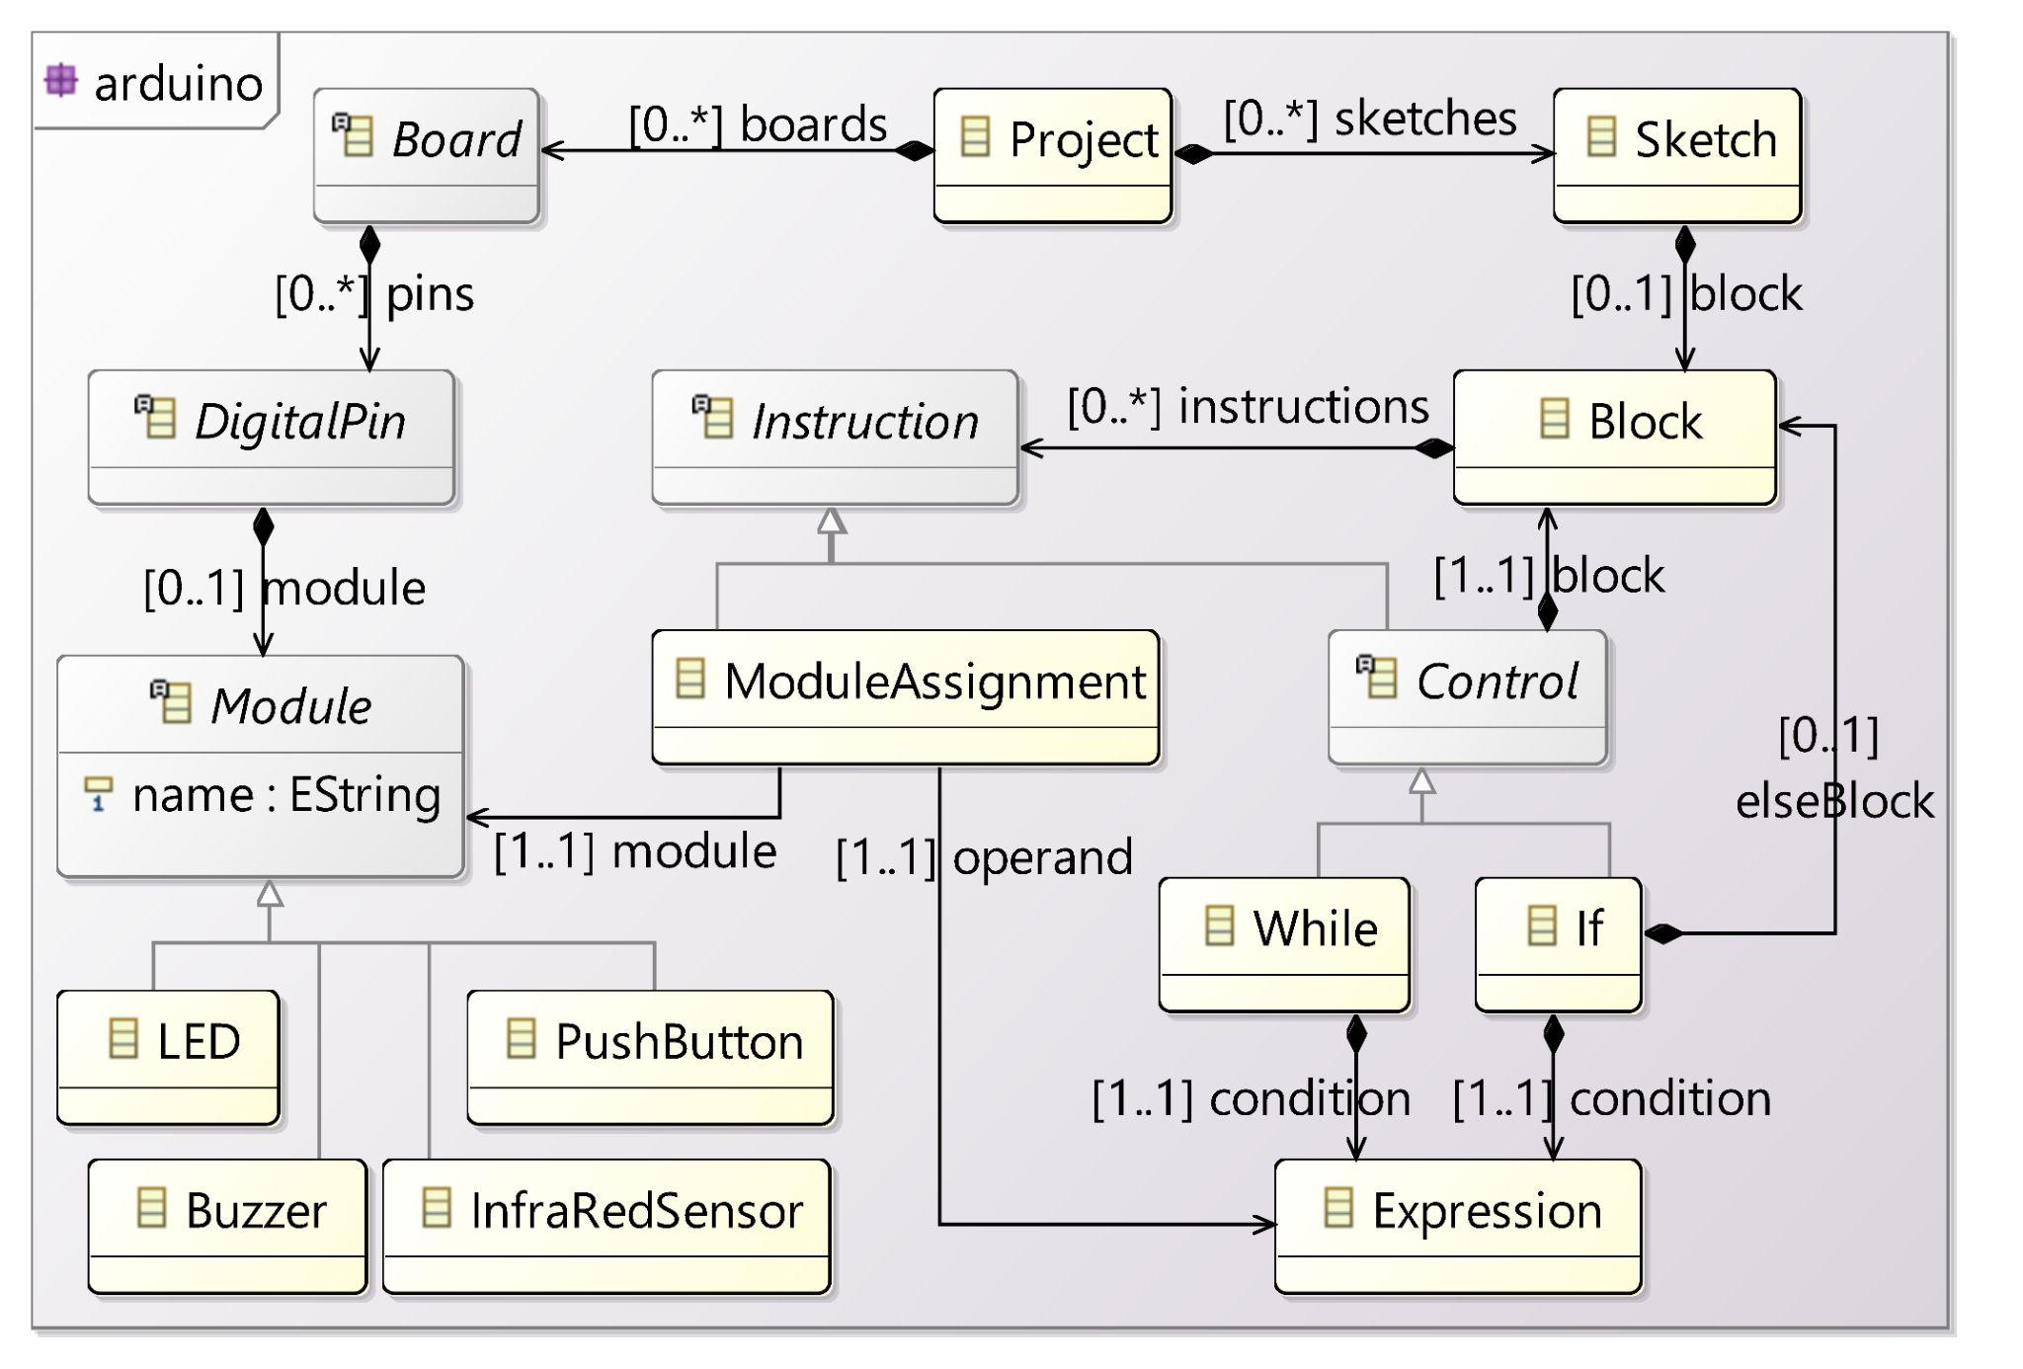
Executable Domain-Specific Language (xDSL)
Abstract Syntax
domain concepts defined in an Ecore metamodel
Running Example: an xDSL for modeling Arduino boards and their behaviors (xArduino)

Slide 3
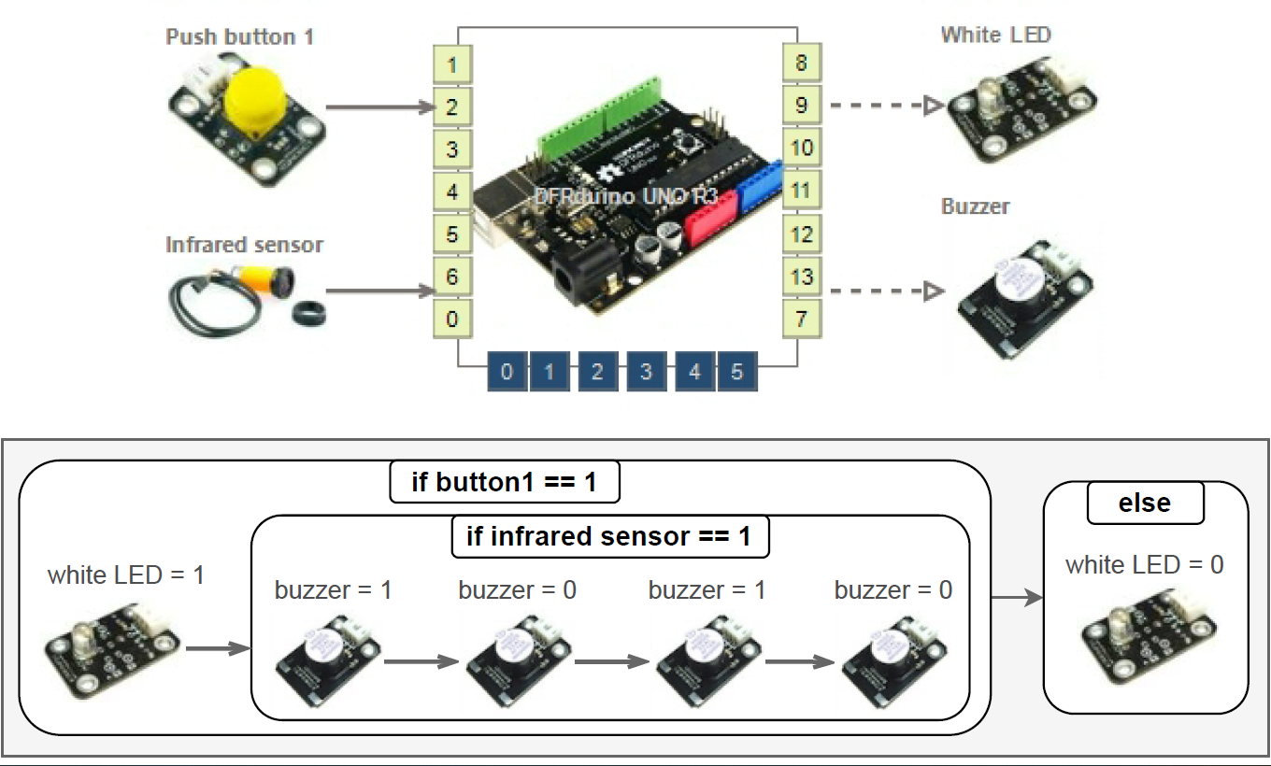
An Example Executable Arduino Model
Basic intrusion alarm system:

Slide 4
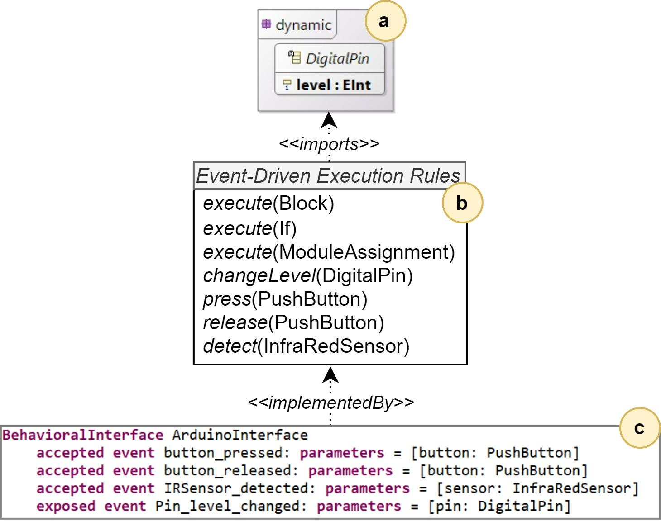
Executable Domain-Specific Language (xDSL)
Operational Semantics (Interpreter)
Definition of runtime state
Execution rules: changing runtime state to execute a model
Behavioral Interface
How to interact with a running model
a
b
c

Slide 5
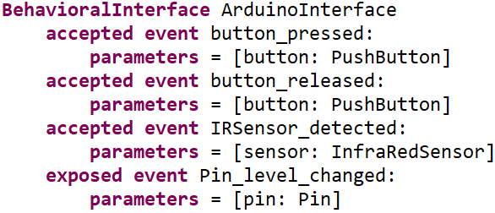
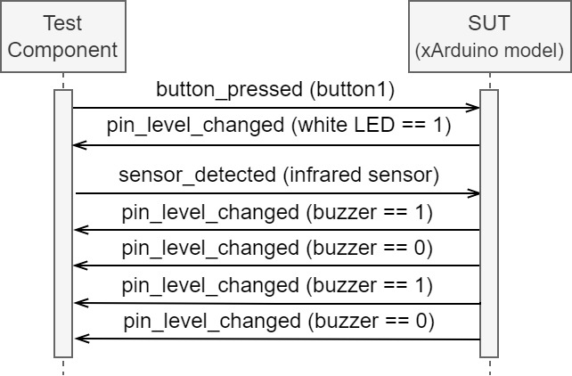
An Example Test Case for the xArduino model [1]
Using events of the behavioral interface to define test data
test input data and expected output are both a trace of events
Using the operational semantics to run the test case and get the verdict
[1] Faezeh Khorram, Erwan Bousse, Jean-Marie Mottu, Gerson Sunyé. Advanced Testing and Debugging Support for Reactive Executable DSLs. Software and Systems Modeling, 2022.

Slide 6
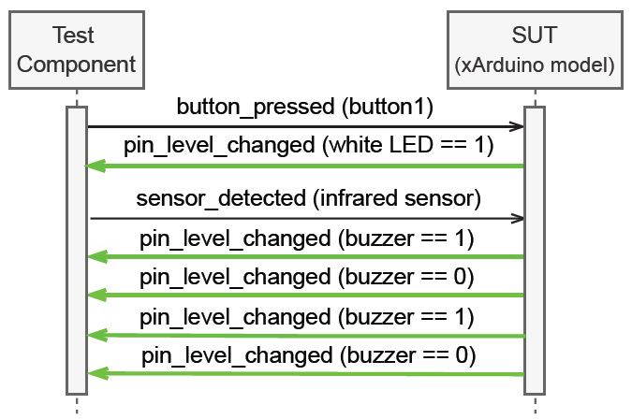
An Example Test Case for the xArduino model [1]
Using events of the behavioral interface to define test data
test input data and expected output are both a trace of events
Using the operational semantics to run the test case and get the verdict
[1] Faezeh Khorram, Erwan Bousse, Jean-Marie Mottu, Gerson Sunyé. Advanced Testing and Debugging Support for Reactive Executable DSLs. Software and Systems Modeling, 2022.

Slide 7
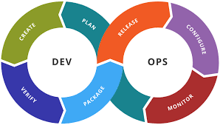
What about regression testing?
Notes:
Consider xDSL, we work on the different testing activities and testing step, such as Regression testing

Slide 8
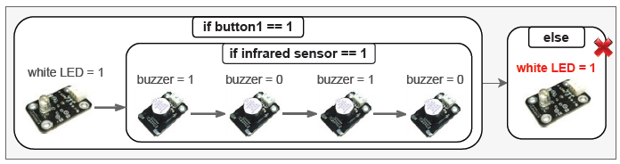
What about regression testing?
Limits of Manually Written Test Case Suite:
Legend: covered not-covered
Defect in the model
Legend: covered not-covered

Slide 9
Test Amplification
Leveraging the value of existing manually-written tests to achieve a specific engineering goal [2]
Amplification by Addition: adding new test cases by modifying existing test cases to improve them for regression testing
[2] Benjamin Danglot, Oscar Luis Vera-Pérez, Zhongxing Yu, Andy Zaidman, Martin Monperrus, Benoit Baudry.
A Snowballing Literature Study on Test Amplification. Journal of Systems and Software, Elsevier, 2019, 157, pp.1-16.

Slide 10
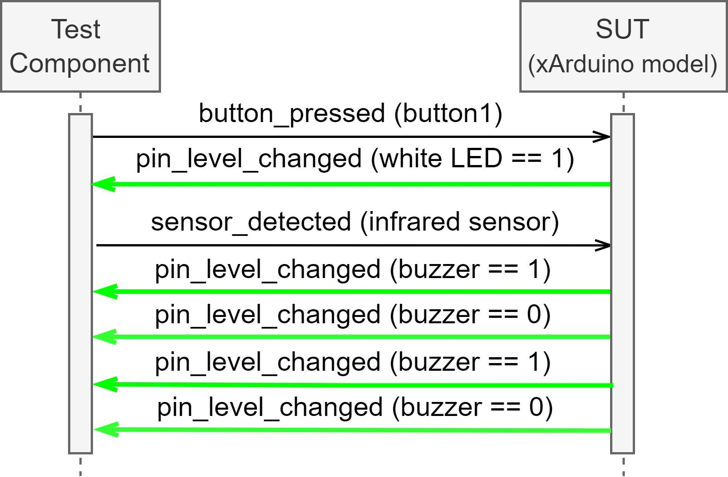
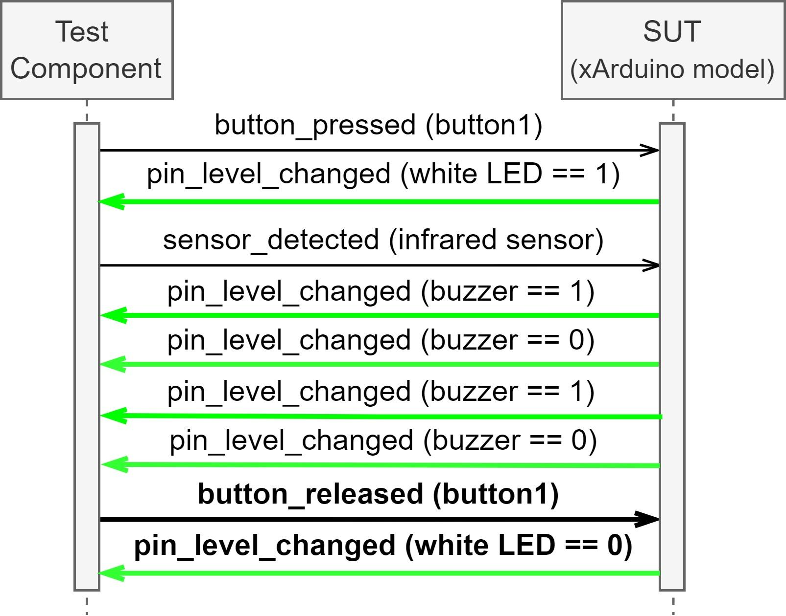
Objective: A generic approach for regression testing of executable Models (xModels) using test amplification
Test Amplification Example
A test case to be generated by amplification (output)
The manually written test case (input)
Amplification

Slide 11
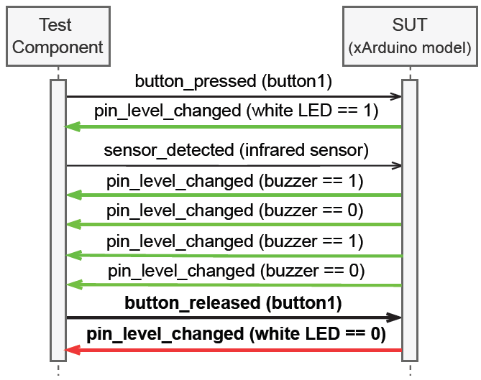
The Amplified Test Case & its trace on the faulty model
The last assertion fails, so the test case fails => detecting the regression fault

Slide 12


Approach:
Regression test suite
defines
xDSL
defines
Selected amplified test cases
Mutation Operators
Manually-Written Test Suite
imports
Abstract Syntax
uses
Test Case Selector
specific to
conforms to
imports
Model Under Test
Mutant Generator
Test Runner
reads
Operational Semantics
Implemented by
Test Case Modifier
Behavioral Interface
Test Case Modifier
reads
New test cases
(with assertions)
reads
reads
New test cases
(without assertions)
Test Runner
Execution traces
Assertion Generator
If mutation score <1
Legend
Generated artifact
Intermediate artifact
User-provided artifact
Existing Tool
Proposed Tool
Data flow
Dependency

Slide 13
First tool: Test Case Modifier
Step 1: Removing Assertions
Step 2: Test Input Data Modification Operators
Modification of Primitive Data:
A numeric value n is replaced.
A string value is modified.
A boolean value is negated.
Modification of Event Sequences:
Event duplication
Event deletion
Event permutation
Event creation
Event modification
Notes:
A numeric value n is replaced by either 1, −1, 0, n + 1, n−1, n×2, n÷2, or with another existing value of the same type.
A string value is modified by either adding a random character, removing one of its characters randomly, arbitrarily replacing one of its characters with a random character, or replacing the string with a random string of the same size.
A boolean value is negated.

Slide 14
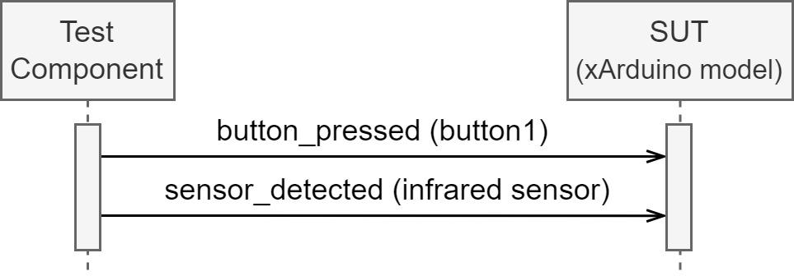
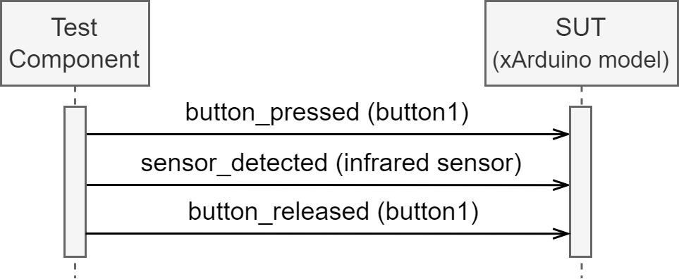
First tool: Test Case Modifier
Finding not-used events of the interface:
Test case modification
Finding values for the parameters of not-used events:
Instantiating events and
adding them to the test case:
Notes:
An example of test case modification using EventCreation modifier

Slide 15
Second Tool: Assertion generator
Executing the new test case on the original model, the trace provides the exposed events that can be transformed into the test case assertions
Assertion generation
Notes:
definition of both
the behavioral interface
and the abstract syntax of the xDSL

Slide 16
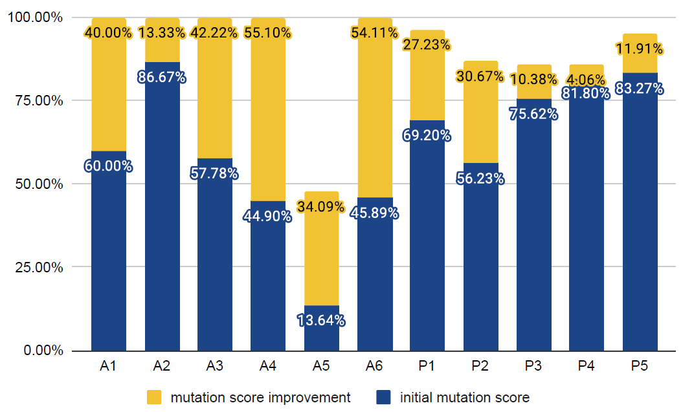
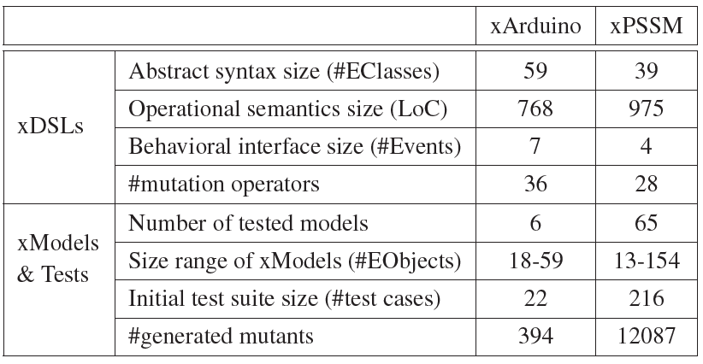
Evaluation Result
RQ1 How much genericity is provided by the framework in terms of the supported xDSLs?
RQ2 To what extent do the generated test cases increase the mutation score of the original, manually-written, test cases?
Mutation score improvement for 11 test suites of manually defined models:
6 xArduino models (A bars)
5 xPSSM models (P bars)
Notes:
65 pssm models = 60 standard + 5 large manually defined model

Slide 17
Evaluation Result
RQ3 To what extent do the size and the quality of the original test suites impact the amplification result?
Different datasets based on size and mutation score (threshold = 80%)
Two types of comparison:
same size, different qualities
different sizes, similar qualities
the original test cases with higher quality have more contribution to test amplification
by amplifying high-quality tests and/or more test cases, it is more probable to generate new effective test cases
Notes:
Small Size Medium Quality (SSMQ): one test case with mutation score < 80%
Small Size High Quality (SSHQ): one test case with mutation score ≥ 80%
Medium Size Medium Quality (MSMQ): more than one test case with mutation score < 80%
Medium Size High Quality (MSHQ): more than one test case with mutation score ≥ 80%

Slide 18


Automatic Test Amplification for Executable Models
This project has received funding from the European Union’s Horizon 2020 research and innovation programme under the Marie Skłodowska-Curie grant agreement n° 813884.
Faezeh Khorram, Erwan Bousse, Jean-Marie Mottu, Gerson Sunyé
IMT Atlantique, Nantes Université
Nantes, France
Pablo Gómez-Abajo, Pablo C. Cañizares, Esther Guerra, Juan de Lara
Universidad Autónoma de Madrid
Madrid, Spain
Link to the paper: https://hal.archives-ouvertes.fr/hal-03745034
Link to the tool: https://github.com/Faezeh-Kh/TestAmplification4Models

